Slide 1
Dead Argument Elimination pass
Faculty of Mathematics
Department of Computer Science
Dimitrije Jovanovic and Igor Kandic

Slide 2
Table of contents
1) LLVM
2) About DAE
3) Pass implementation
4) Examples
5) Citations

Slide 3

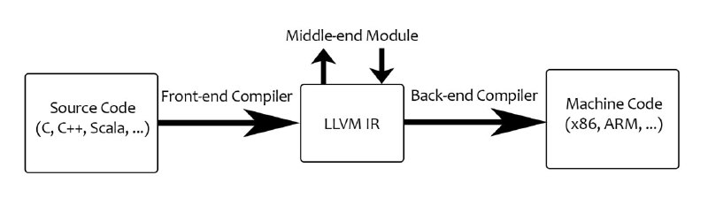
LLVM
LLVM is a set of compiler and toolchain technologies that can be used to develop a frontend for any programming language and a backend for any instruction set architecture.

Slide 4
LLVM
Front-end
  The frontend compiler takes a source code in a supported language as input (like C, C++, Objective C, Ada, Rust, Fortran) and produces an Itermediate Representation in LLVM IR syntax.
Middle-end
  This module transforms the IR, applying some analysis, optimizations and transformations.
Back-end
  The back-end takes the Itermediate Representation optimized by the middle-end, and generates the native code for a given machine, like ARM, MIPS, Intel, Sparc, etc., ready to be executed by the target machine.

Slide 5
LLVM
The intermediate representation LLVM (IR) is independent from both the language and the architecture; it is placed between the source code in a given programming language and the machine code for a specific architecture.
Optimizations are implemented as Passes that traverse some portion of a program to either collect information or transform the program.

Slide 6
About DAE
Dead Argument Elimination (DAE for short) removes arguments which are directly dead, as well as arguments only passed into function calls as dead arguments of other functions. This pass also deletes dead arguments in a similar way.
This pass is often useful as a cleanup pass to run after aggressive interprocedural passes, which add possibly-dead arguments.

Slide 7
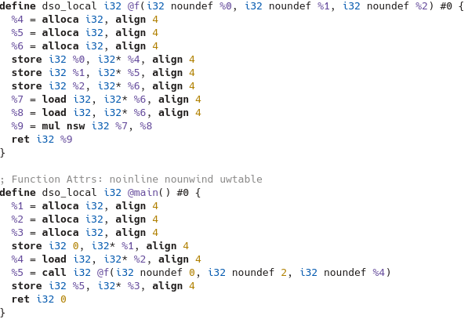
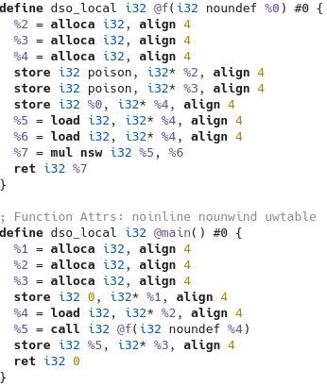
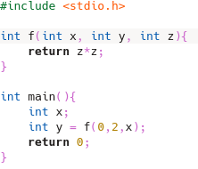

About DAE

Slide 8
Pass implementation
We will explain our DAE pass into two main parts:
  Checking the liveliness of each argument
  Transforming the IR so that it possesses no arguments which are dead

Slide 9
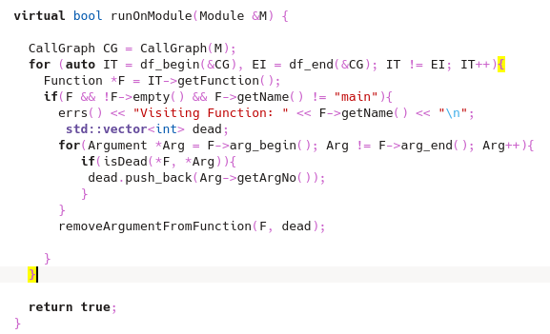
Pass implementation (liveliness)
runOnModule function
  We traverse the entire program
  in order to check the liveliness

Slide 10
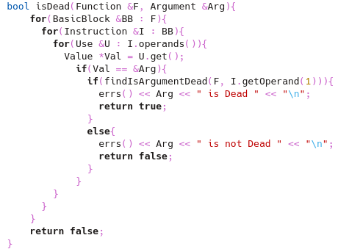
Pass implementation (liveliness)
isDead function
  For each function we check
  the liveliness of an argument
  by sending it to the
  findIsArgumentDead function

Slide 11
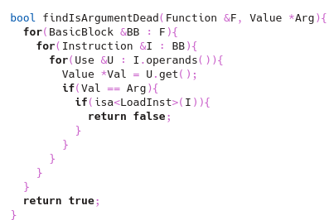
Pass implementation (liveliness)
findIsArgumentDead function
  This function proceeds to check
  whether our argument is ever
  loaded with the load instruction
  If it’s never loaded then we
  pronounce it as dead

Slide 12
Pass implementation (transformation)
After being done with the liveliness section our next objective is to implement a function that will transform our current IR into one devoid of dead arguments
This is done by deleting the function containing DA and replacing it with a new one

Slide 13
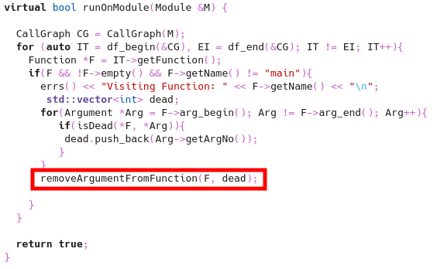
Pass implementation (transformation)
In runOnModule we had a function “removeArgumentFromFunction” which takes a function with a vector containing all of its arguments fit for elimination

Slide 14
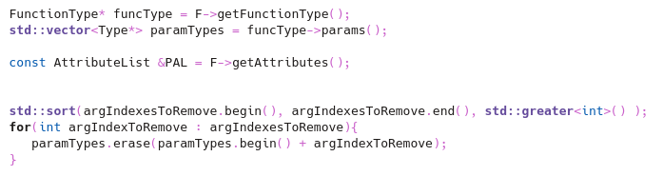
Pass implementation (transformation)
The first step is getting the function type, parameter types, and list of attributes of the original function
We also sort the vector with the arguments for deletion

Slide 15
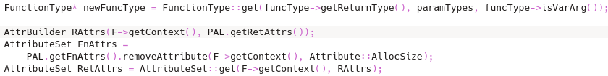
Pass implementation (transformation)
We then want to create our new function
RAttrs gets us return attributes of a function
After that we remove the attribute that specifies the allocation size of a function
The final line constructs a AttributeSet by combining the context and the return attributes stored in RAttrs

Slide 16
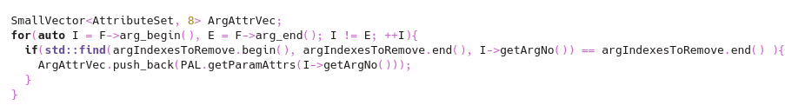
Pass implementation (transformation)
It’s time to filter the arguments!

Slide 17
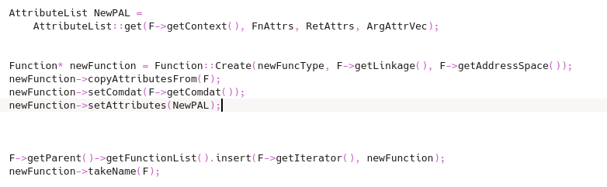
Pass implementation (transformation)
The following piece(s) of code is creating the essential parts of the new function

Slide 18
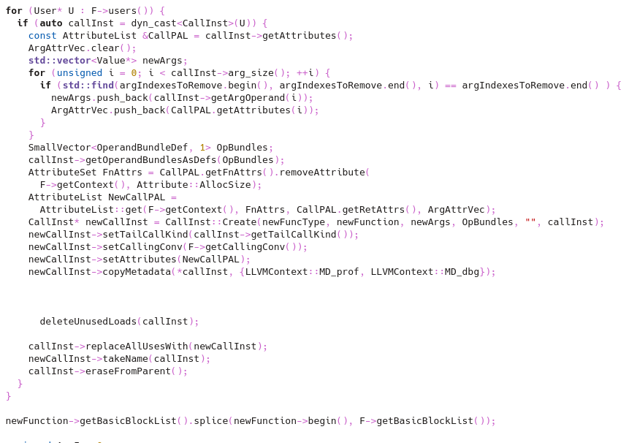
Pass implementation (transformation)

Slide 19
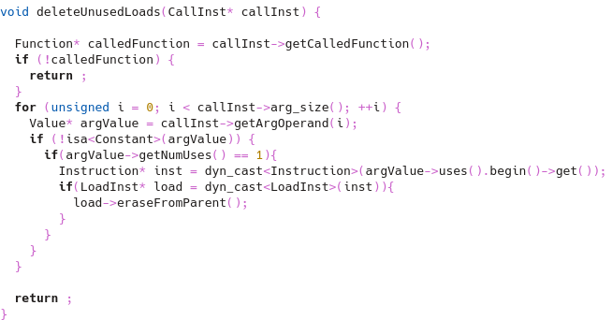
Pass implementation (transformation)
deleteUnusedLoads function deletes the load instruction that won’t be present in the new function

Slide 20
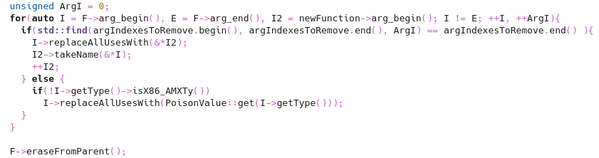
Pass implementation (transformation)
At last we take the instructions which survived and put them in our new function while deleting the old one

Slide 21
Examples
(This is the part where you run the pass on one of the examples)

Slide 22
Citations
https://www.skenz.it/compilers/llvm
https://en.wikipedia.org/wiki/LLVM
https://llvm.org/
ChatGPT

Slide 23
End

