Slide 1
Computers in Education
The History and Achievements

Slide 2
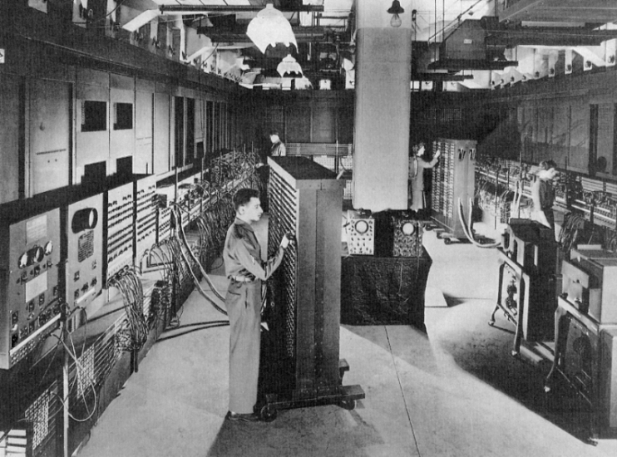
Early Computer History
The first computers were created in the 1940’s and were vacuum-tube models
They were first used in WWII and Cold War efforts.
  Technology for aircraft design
  Weapons manufacturing

Slide 3
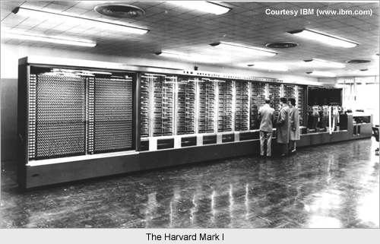
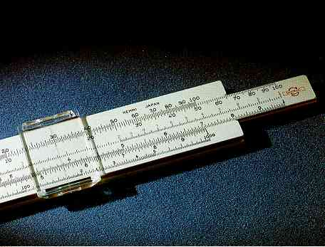
Computer History
The field of education was probably the most heavily influenced by the development of the computer.
It began at Harvard in 1944 with the MARK 1.
  This model was designed specifically for solving advanced mathematical problems and engineering.
  It outdated so-called archaic tools such as the slide rule.

Slide 4
Computers in Education
1957 began the golden-age in education.
Educational demands began to blossom, and computers were becoming a major tool.
Computers allowed for CAL, or computer-assisted learning.
  Computers were still mainly used only in the mathematic and science fields. The programs that were developed allowed for students to practice drills and receive quick and accurate feedback.

Slide 5
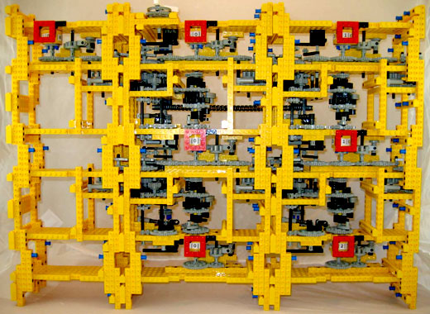
Computers in Education
In the 1970s, Seymour Papert developed the LOGO system.
  LOGO was a critical thinking application first designed again for mathematics, but the difference was real-life situations and the ability to be utilized in everyday situations and other subject, such as physics and music.
  LOGO was actually the gateway to creating the LEGO construction kits.

Slide 6
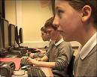
Computers in Education
The 1970s was the era in which computers in education really began to take flight
  In 1974, over two million students were using computers in their schools.
  Most of the computers were utilized primarily in higher education institutions and also secondary schools.
  By 1977, 23% of the computers in schools were being used for classroom instruction.

Slide 7
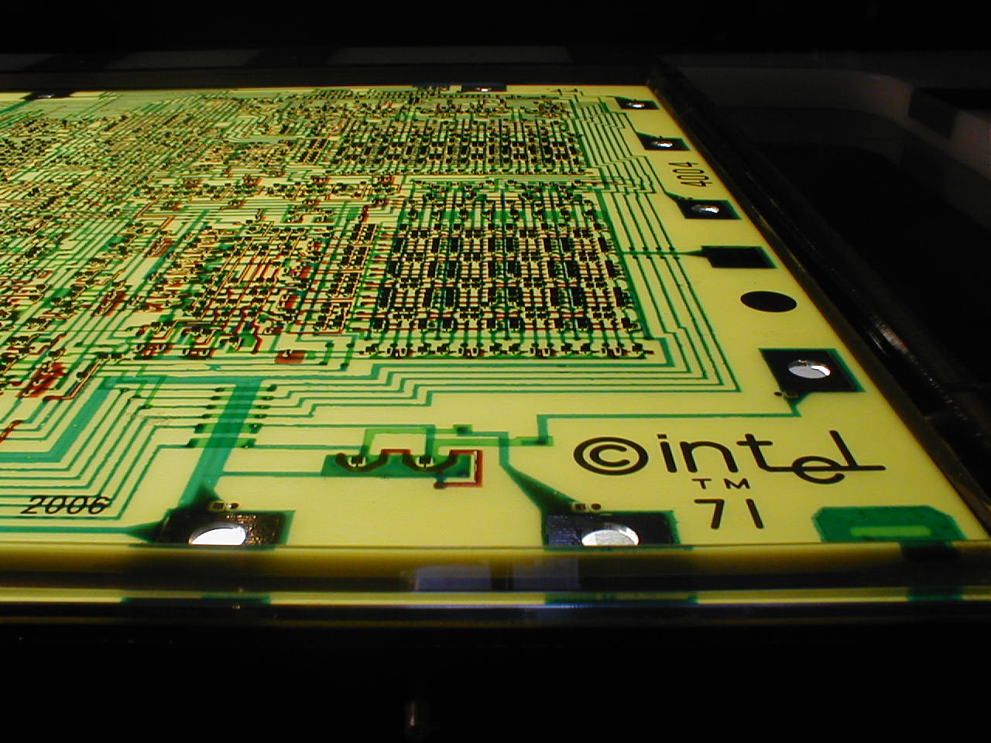
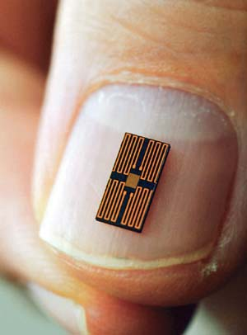
Computers in Education
The 1970s was especially influential because of the invention of the microprocessor. The microprocessor began the personal computer revolution.
Computers were no longer a luxury, but rather a necessity.
Computers were seen in offices, schools, homes, businesses, hospitals, and more.

Slide 8
Computer Applications
In 1979, WordStar was created. This was the first word-processing program.
Word processing can be defined as the manipulation of computer generated text data including creating, editing, storing, retrieving and printing a document
Word-processing allowed students to easily correct their work without having to use white-out or start projects over. This was a major advancement for the field of research.

Slide 9
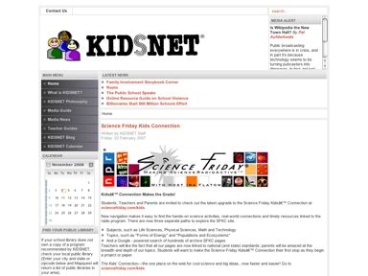
Computer Applications
As computers began to grow, so did the opportunities in the field of education.
More and more programs were being developed such as KidsNet which was a science program that allowed students to conduct field experiments on the water that was used in schools.
  Their discoveries using KidsNet began a reform of the drinking water in over 6,000 schools whose water supplies were found to be unsafe.

Slide 10
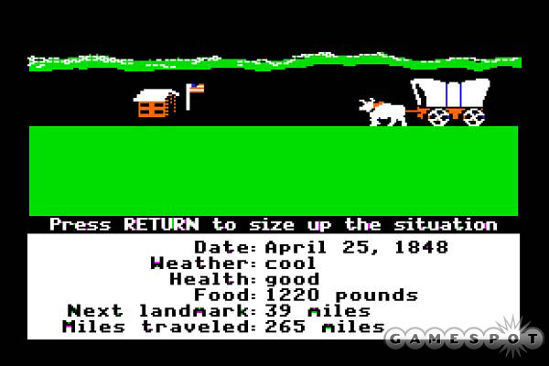
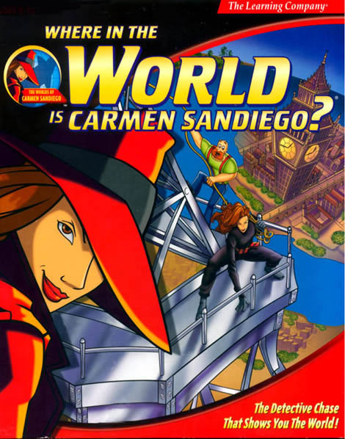
Computer Applications
By the late 1980s computers were being used everywhere including elementary schools.
This was to introduce children to computer literacy at an early age and provide fun and entertaining ways to learn.
Games such as Carmen San Diego and Oregon Trail were most popular in the primary school setting.

Slide 11
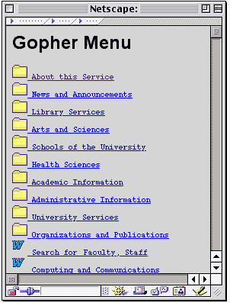
The Internet and Education
In 1992, students were introduced to Gopher, which was the first program to allow access to the World Wide Web.
The creation of the internet allowed students to be able to do research from their homes and classrooms very easily.

Slide 12
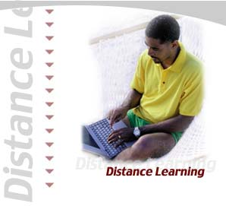
Distance Learning
Distance learning is one of the most modern advances in computers in education.
  People can actually earn an associates, bachelors, masters, or even doctorate degree all from the comfort of their own home at a fraction of the cost of attending a college campus.
  This is extremely helpful for single parents, financially strapped families, and other people in extenuating circumstances.

Slide 13
Benefits of Computers in Education
Computers enhanced the field of education in ways that were unimaginable just a few decades earlier.
Teachers were able to plan elaborate curriculums with ease.
Students were able to learn at quicker rates.
Standardized test scores vastly improved with the development of CAL programs.
Early computer fluency was developed.
Research and word processing became a breeze.
And many, many more…

Slide 14
References
Molnar, A. (2001). Computers in education: A brief history. The Journal. http://www.thejournal.com/articles/13739
The EasyDOS Tech Forum (2007). History, the history of computers, and the history of
computers in education. http://www.csulb.edu/~murdock/histofcs.html
Bellis, M. (2004). The history of computers. http://inventors.about.com/library/blcoindex.htm

