Slide 1
Li-ion battery modeling framework (current implemented version)
<number>
Notes:
<number>
5/9/17

Slide 2
Agenda
Li-ion model implementation:
governing equations
results
Li-ion multiparticle framework
3. “Odprta vprašanja”
<number>
Notes:
<number>
5/9/17

Slide 3
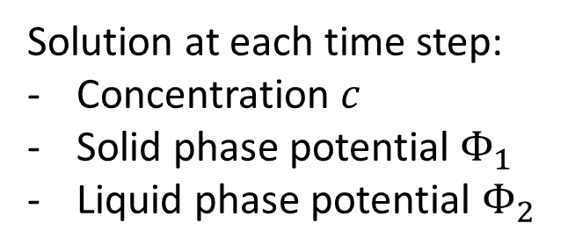
Governing equations
System of partial differential equations:
Electrochemical transport of Li+
through electrolyte:
Liquid phase current:
Solid phase current:
Solution at each time step:
Concentration
Solid phase potential
Liquid phase potential
<number>
Notes:
<number>
5/9/17

