Slide 1
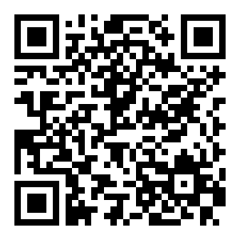
Lights Operations Center
Yes you can !
- Play with the lights:
- http://192.168.1.105:9999/
- Write your own lights code!
- Just ask!

