Slide 1

Project 5
Create Your First Java Web Application From Scratch!

Slide 2
Summary
Objective of the project
Project Requirements
URLs that application should serve
Update and manipulate SafetyNetAlert data
SureFire Report
Jacoco Coverage Report

Slide 3
Objectives of the project: ●The SafetyNet Alerts server starts. ●SafetyNet Alerts is developed with a Model-View-Controller architecture. ●All URL endpoints are functional as well as the actuators: health, info, trace, and metrics. ●All URL endpoints log their requests and their responses. Log successful responses with the info level, log errors or exceptions on the error level, and log informative calculations or steps on the debug level. ●A working Gradle or Maven build that executes unit tests and code coverage. ●All URL endpoints and any additional functionality have unit tests. ●The build generates a SureFire test report of the JUnit test results. ●The build includes a JaCoCo unit test coverage report and archives a code coverage of 80%.
The main goal of the project is to develop an application that manage the information about a population.

Slide 4
URLs that application should serve
1. http://localhost:8080/firestation?stationNumber=<station_number>
This URL should return a list of people serviced by the corresponding fire station. So if of children (anyone aged 18 or younger). station number = 1, it should return the people serviced by station number 1. The list of people should include these specific pieces of information: first name, last name, address, phone number. As well, it should provide a summary of the number of adults in the service area and the number of children (anyone aged 18 or younger).
2. http://localhost:8080/childAlert?address=<address>
This URL should return a list of children (anyone under the age of 18) at that address. The list should include the first and last name of each child, the child’s age, and a list of other persons living at that address.
3. http://localhost:8080/phoneAlert?firestation=<firestation_number>
This URL should return a list of phone numbers of each person within the fire station’s jurisdiction. This is will be used to send emergency text messages to specific households.
4. http://localhost:8080/fire?address=<address>
This URL should return the fire station number that services the provided address as well as a list of all of the people living at the address. This list should include each person’s name, phone number, age, medications with dosage, and allergies.
5. http://localhost:8080/flood/stations?stations=<a list of station_numbers>
This should return a list of all the households in each fire station’s jurisdiction. This list needs to group people by household address, include name, phone number, and age of each person, and any medications (with dosages) and allergies beside each person’s name.
6. http://localhost:8080/personInfo?firstName=<firstName>&lastName=<lastName>
This should return the person’s name, address, age, email, list of medications with dosages and allergies. If there is more than one person with the same name, this URL should return all of them.
7. http://localhost:8080/communityEmail?city=<city>
This will return the email addresses of all of the people in the city.

Slide 5
Update and manipulate SafetyNetAlert data
These endpoints provide the following via Http Post/Put/Delete methods
http://localhost:8080/person
This endpoint will provide the following via Http Post/Put/Delete: Add a new person. Update an existing person (at this time, assume that firstName and lastName do not change, but other fields can be modified). Delete a person. (Use a combination of firstName and lastName as a unique identifier)
http://localhost:8080/firestation
This endpoint will provide the following via Http Post/Put/Delete: Add a firestation/address mapping. Update an address’ firestation number. Delete a firestation/address mapping.
http://localhost:8080/medicalRecord
This endpoint will provide the following via Http Post/Put/Delete: Add a medical record. Update an existing medical record (as above, assume that firstName and lastName do not change). Delete a medical record. (Use a combination of firstName and lastName as a unique identifier)

Slide 6
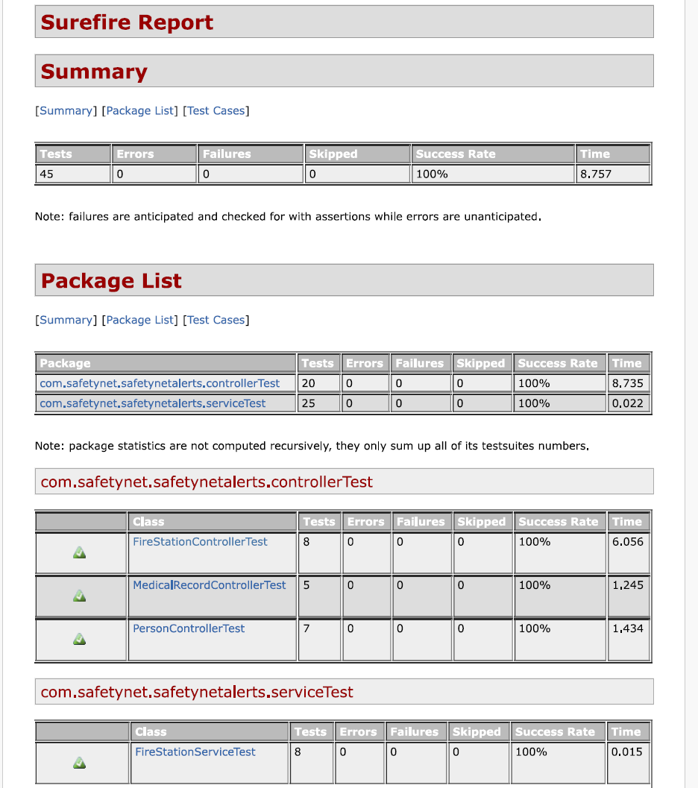
Surefire Report

Slide 7
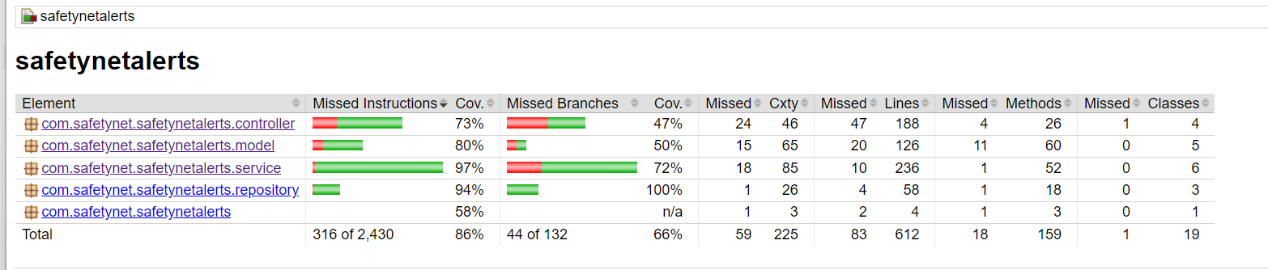
Jacoco Coverage Report

