Slide 1

Project 5
Create Your First Java Web Application From Scratch!

Slide 2
Summary
Objective of the project
Project Requirements
URLs that application should serve
Update and manipulate SafetyNetAlert data
SureFire Report
Jacoco Coverage Report

Slide 3
Objectives of the project: ●The SafetyNet Alerts server starts. ●All URL endpoints are functional as well as the actuators: health, info, trace, and metrics. ●All URL endpoints log their requests and their responses. Log successful responses with the info level, log errors or exceptions on the error level, and log informative calculations or steps on the debug level. ●A working Gradle or Maven build that executes unit tests and code coverage. ●All URL endpoints and any additional functionality have unit tests. ●The build generates a SureFire test report of the JUnit test results. ●The build includes a JaCoCo unit test coverage report and archives a code coverage of 80%. ●SafetyNet Alerts is developed with a Model-View-Controller architecture.
The main goal of the project is to develop an application that manage the information about a population.

Slide 4
URLs that application should serve
http://localhost:8080/firestation?stationNumber=<station_number>
http://localhost:8080/childAlert?address=<address>
http://localhost:8080/phoneAlert?firestation=<firestation_number>
http://localhost:8080/fire?address=<address>
http://localhost:8080/flood/stations?stations=<a list of station_numbers>
http://localhost:8080/personInfo?firstName=<firstName>&lastName=<lastName>
http://localhost:8080/communityEmail?city=<city>

Slide 5
Update and manipulate SafetyNetAlert data
These endpoints provide the following via Http Post/Put/Delete methods
http://localhost:8080/person
http://localhost:8080/firestation
http://localhost:8080/medicalRecord

Slide 6
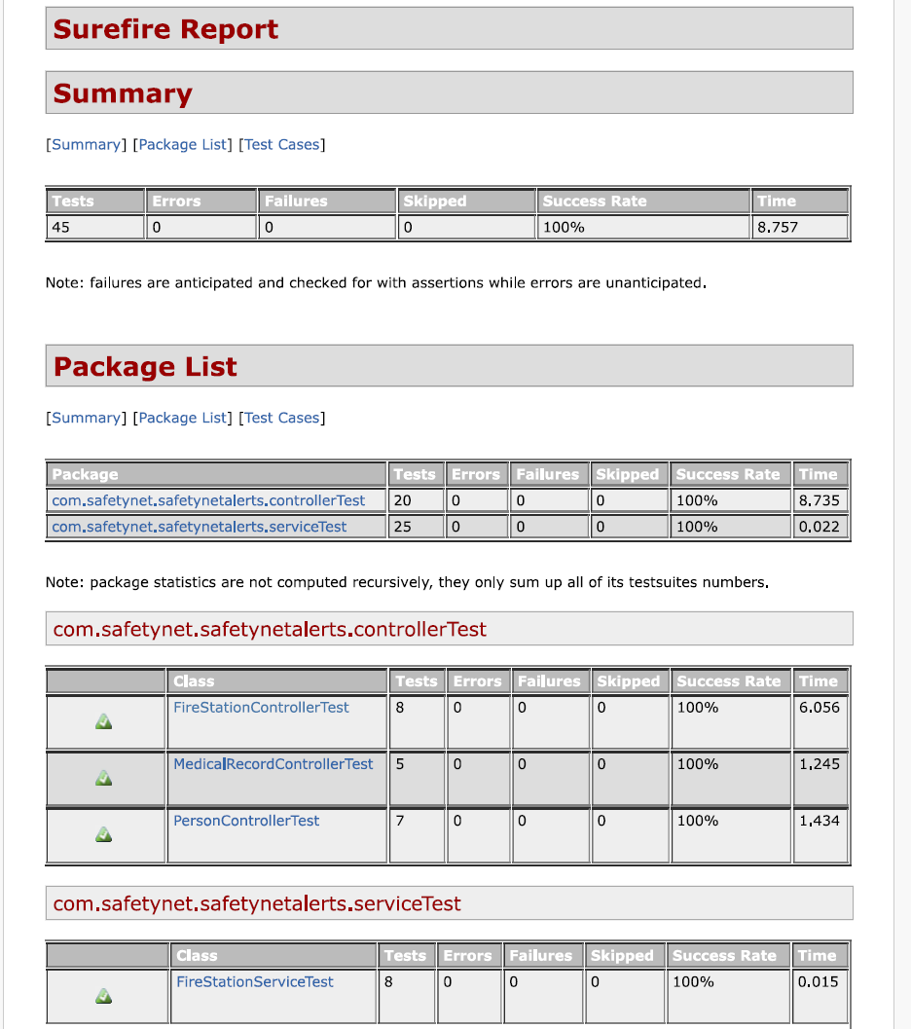
Surefire Report

Slide 7
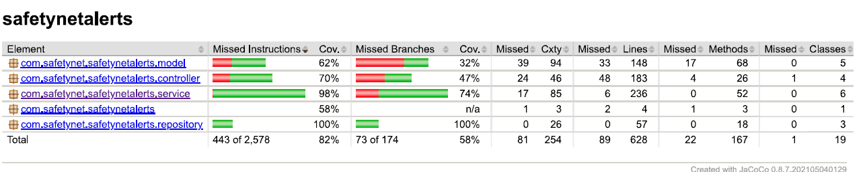
Jacoco Coverage Report

