Slide 1

Beginning Android
Copyright © 2015 SoftServe, Inc.

Slide 2
Agenda
Configure environment
Install java SDK
Install android SDK
Run and debug application
Real device debug enable
Support Libraries
Project structure
Manifest file
Java code
Resources (drawables, layouts, strings etc.)
Android components
Activities
Fragments
Services
Broadcast receivers
Content providers
Intent
Intent-filters
Database
Demo application
Resources

Slide 3

Configure environment: Java SDK
Java 7 is supported, not all features. Supported features are:
Diamond operator (<>)
String switch
Multiple-catch (catch (Exc1 | Exc2 e))
Underscore in number literals (1_234_567)
Binary literals (0b1110111)

Slide 4
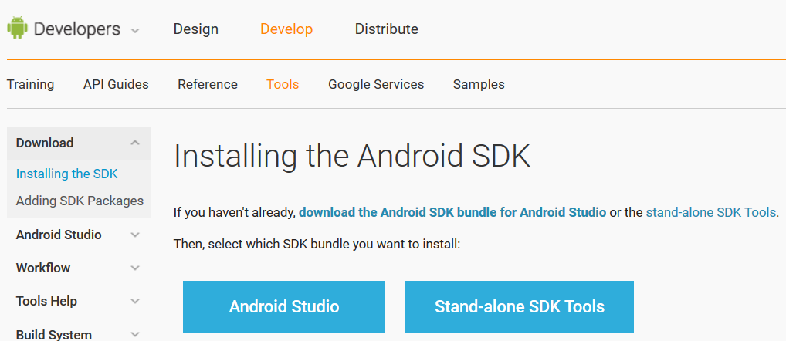
Configure environment: Install Android SDK
https://developer.android.com/sdk/installing/index.html

Slide 5
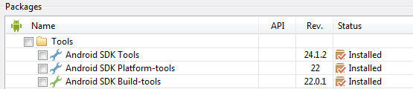
Configure environment: Adding SDK Packages
SDK Tools- Required
SDK Platform-tools- Required
SDK Build Tools- Required (at least last version)
SDK Platform- Required (last version)
Extras Android Support Repository- Recommended (to use Navigation drawer, compatible action bar, etc.)

Slide 6
Configure environment: Run and debug application
What to choose to run/debug application:
Standard emulator
+ Part of SDK
- Very slow
Genymotion (https://www.genymotion.com)
+ Faster than standard emulator
+ Free
- Need to register on home site, install emulator, install IDE plugin
Real device
+ Faster than standard emulator
+ Better for testing application usability
- For some devices you may not find driver
Note: For real devices need to enable debugging:

Slide 7
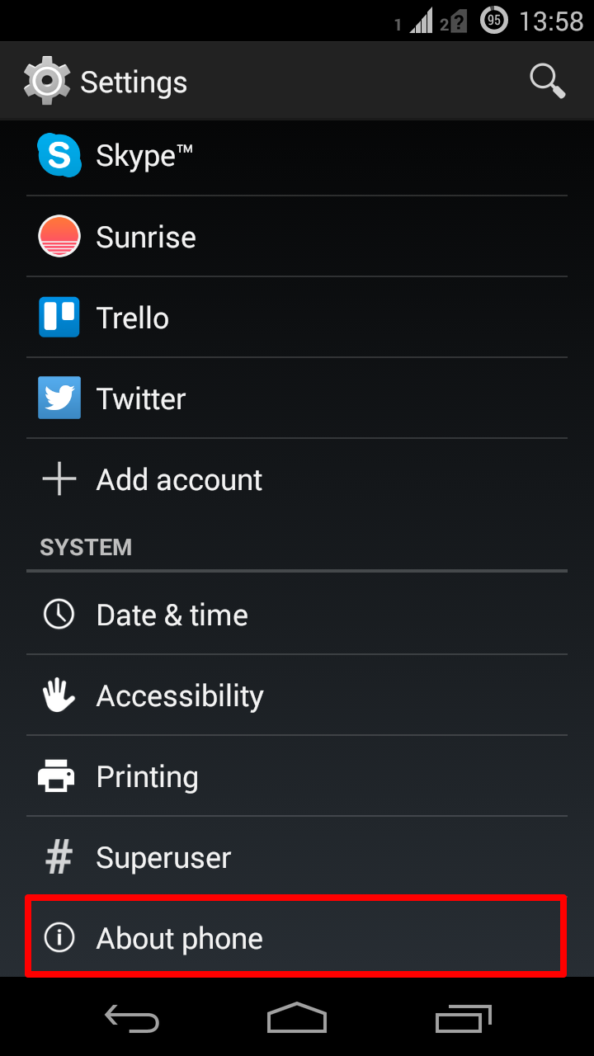
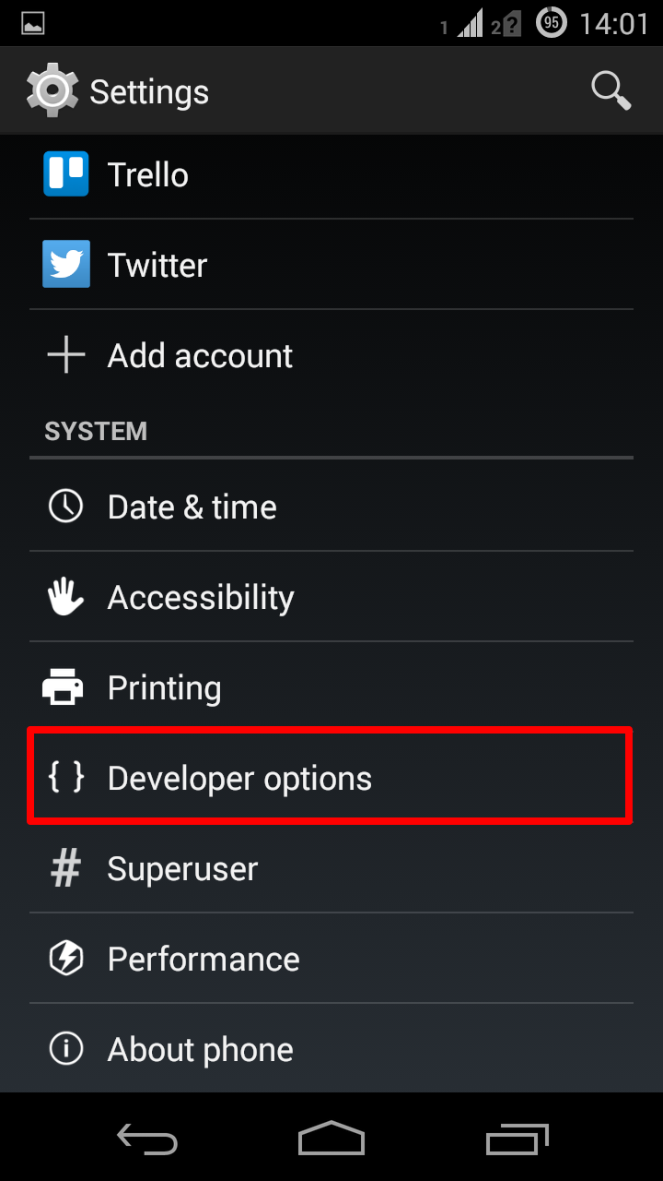
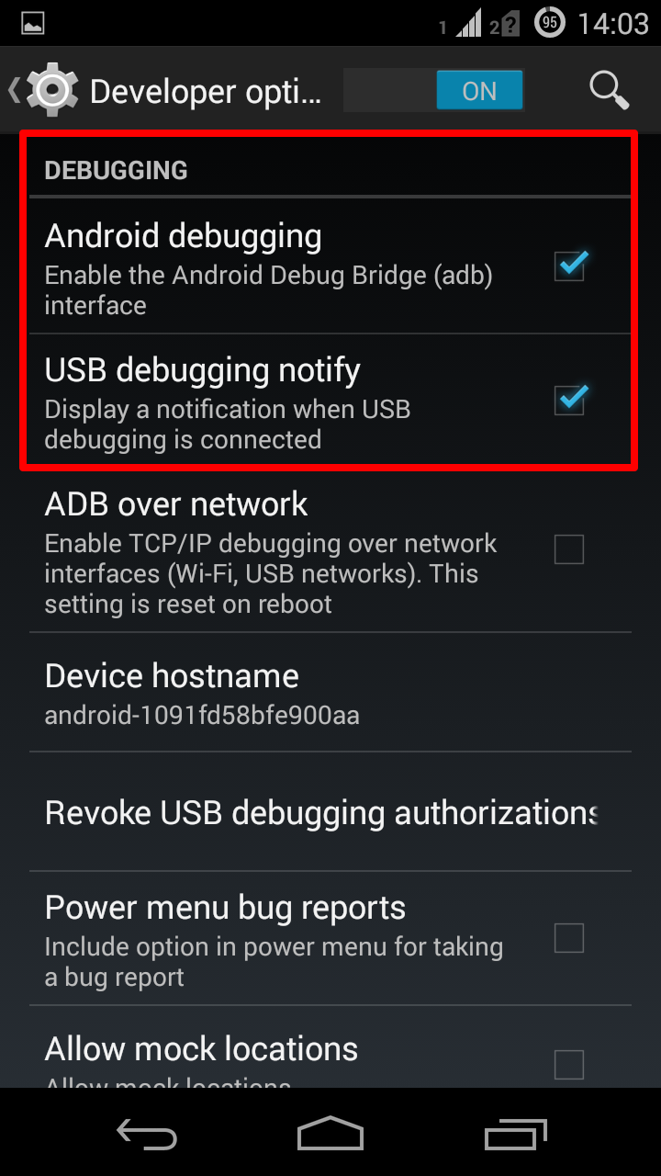

Configure environment: Real device debug enable
By default Developer options menu is hidden. To show menu do the following:
Go to: Settings > About phone (for Stock Android)
Click 7 times on “Build number” item
http://www.greenbot.com/article/2457986/how-to-enable-developer-options-on-your-android-phone-or-tablet.html

Slide 8
Support Libraries
What are Support Libraries ?
The Android Support Library package is a set of code libraries that provide backward-compatible APIs for older devices.
v4 Support Library - is designed to be used with Android 1.6
(API level 4). Add support important key classes Fragment, DrawerLayout etc.
v7 appcompat library - This library adds support for the Action Bar user interface design pattern. This library includes support for material design user interface implementations. (depends on the v4 Support Library)

Slide 9
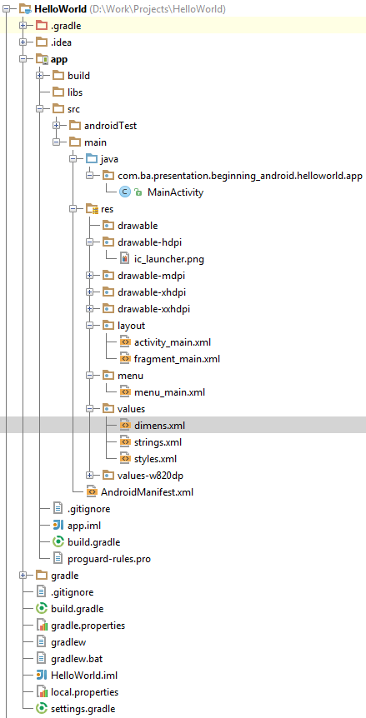
Project structure
AndroidManifest.xml – Every application must have it. It describes:
Components: activities, broadcast receivers, content providers and services.
Permissions: CALL_PHONE, INTERNET, VIBRATE, READ_CONTACTS, RECEIVE_BOOT_COMPLETED
Intent-filters
java – Activities, Fragments and other java classes
res/drawable – types .png, .jpg, .gif, .9.png, xml
res/menu – menu xml files
res/layout – layout xml files
res/values – xml files: strings, styles
Android studio uses gradle as build system

Slide 10
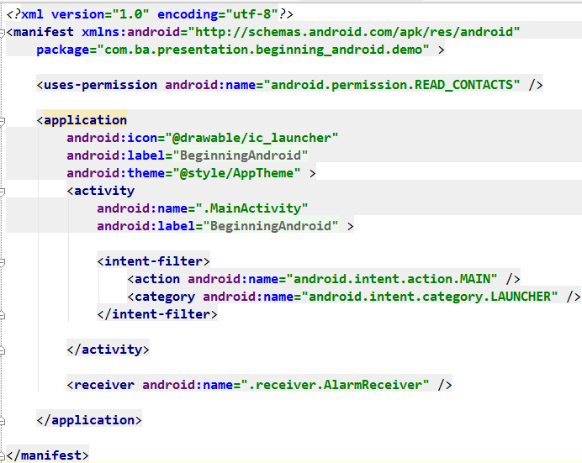
AndroidManifest.xml example

Slide 11
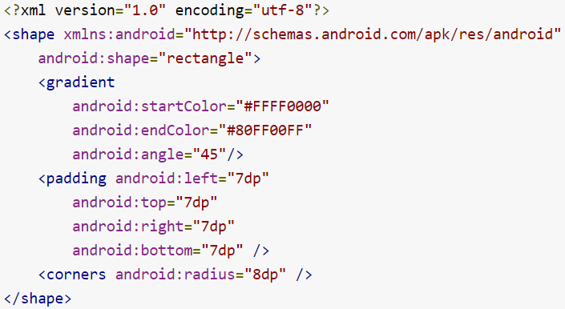
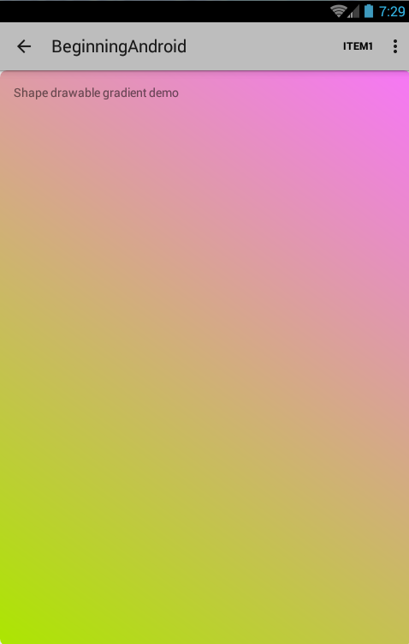
res/drawable
BitmapDrawable - .png, .jpg, .gif
NinePatchDrawable - A PNG file with stretchable regions to allow image resizing based on content (.9.png) [ tool: <Android_SDK>\tools\draw9patch.bat ]
ShapeDrawable - An XML file that defines a geometric shape, including colors and gradients. Example:

Slide 12
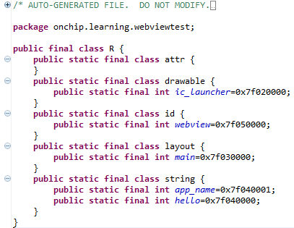
R.class
Auto-generated: you shouldn’t edit it
Contains IDs of the project resources
Use findViewById and Resources object to get access to the resources
Ex. Button b = (Button)findViewById(R.id.button1)
Ex. getResources().getString(R.string.hello));
\app\build\generated\source\r\debug\<package>\app\R.java

Slide 13
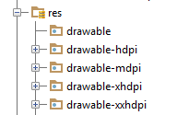
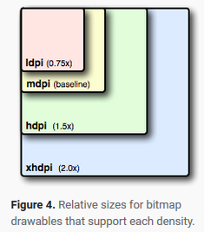
Supporting Multiple Screens
Density-independent pixel (dp) - A virtual pixel unit that you should use when defining UI layout, to express layout dimensions or position in a density-independent way.
MDPI (medium) ~160dpi (160px)
HDPI (high) ~240dpi
XHDPI (extra-high) ~320dpi
XXHDPI (extra-extra-high) ~480dpi
Icon size examples:
MDPI - 48x48px (baseline)
HDPI - 72x72px
XHDPI - 96x96px
XXHDPI -180x180px
http://developer.android.com/guide/practices/screens_support.html

Slide 14
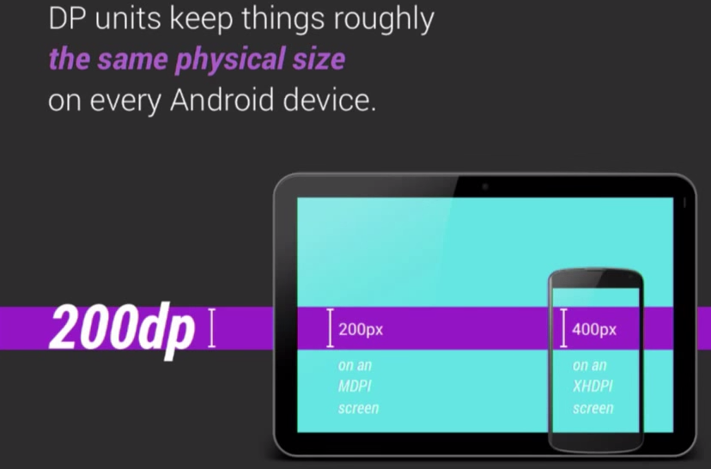
Supporting Multiple Screens

Slide 15
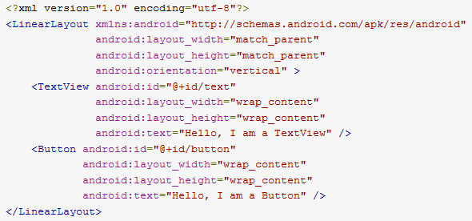
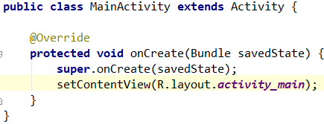
res/layout
Using Android's XML vocabulary, you can quickly design UI layouts and the screen elements they contain, in the same way you create web pages in HTML — with a series of nested elements.
Each layout file must contain exactly one root element, which must be a View or ViewGroup object
Use in activity example
Layout example

Slide 16
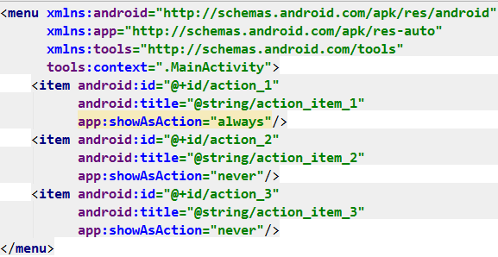
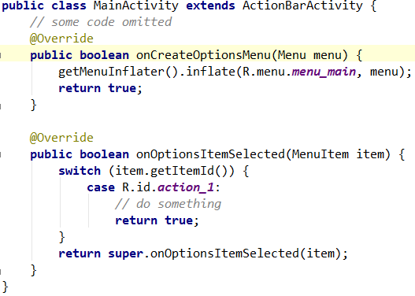
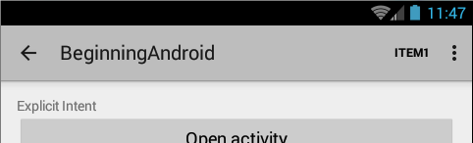
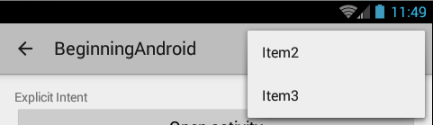
Menu example

Slide 17
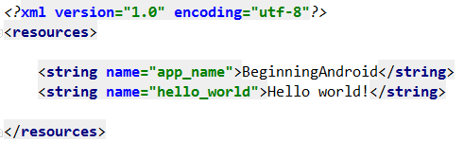
res/values
dimens.xml – define dimensions for views and layouts
styles.xml – app styles (theme)
strings.xml – defined all string of application

Slide 18
Android components
Activities – visual user interface focused on a single thing a user can do (window)
Services – no visual interface – they run in the background (but in UI thread)
Broadcast Receivers – receive and react to broadcast announcements
Content Providers – allow data exchange between applications

Slide 19
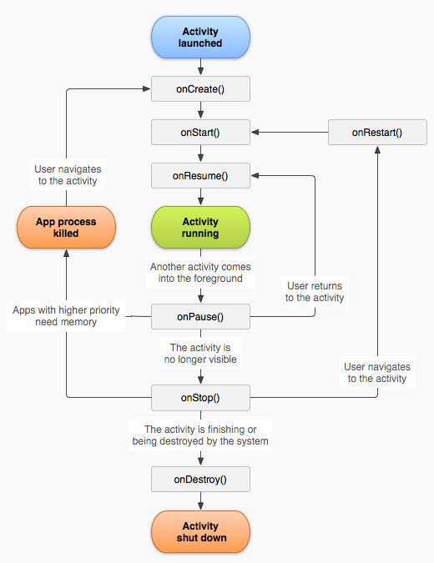
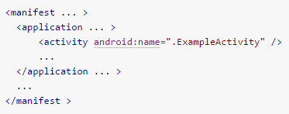
Activities
Life-cycle
Simple activity class
All activities must be defined in manifest file

Slide 20
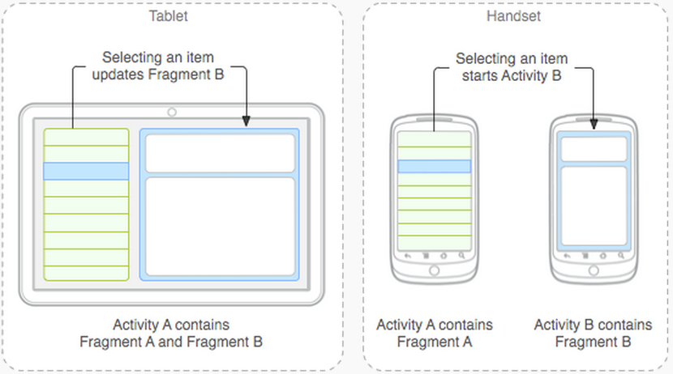
Fragments
Fragment - is modular section of an activity, which has its own lifecycle.

Slide 21
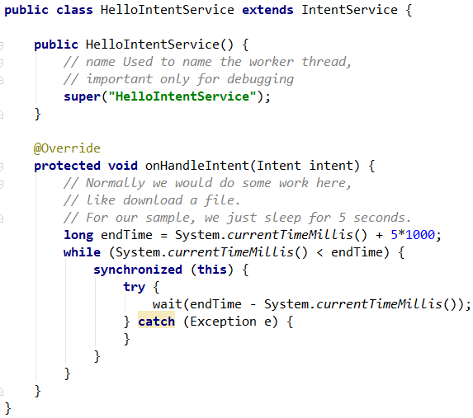
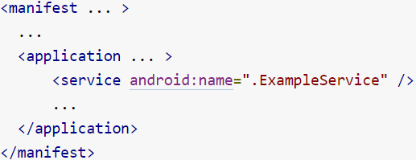
Services
Service - This is the base class for all services.
It uses your app main thread!
IntentService - best option if you don't require that your service handle multiple requests
All services should be added to manifest:

Slide 22
Broadcast Receivers
Broadcast receiver - is an Android component which allows you to register for system or application events. All registered receivers for an event are notified by the Android runtime once this event happens.

Slide 23
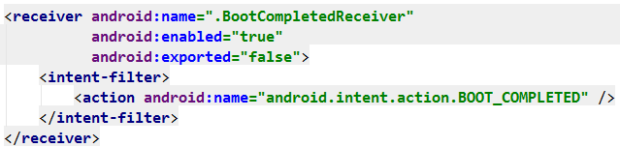
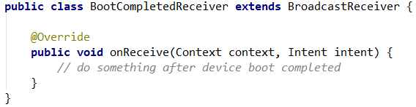
Broadcast Receivers
For example, applications can register for the ACTION_BOOT_COMPLETED system event which is fired once the Android system has completed the boot process.

Slide 24
Content Providers
Content Providers – used to shared data between applications.
You don't need to develop your own provider if you don't intend to share your data with other applications.
Android has 2 content provides:
Calendar Provider and Contacts Provider

Slide 25
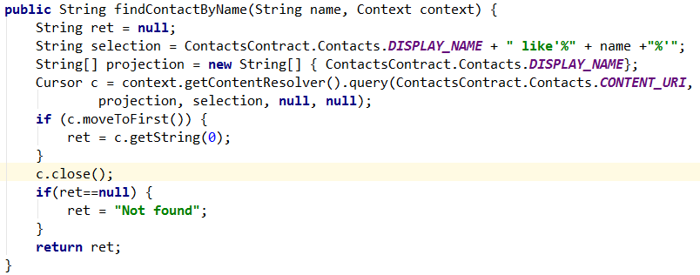
Content Providers
Find contact by name example

Slide 26
Intents
An Intent is a messaging object you can use to request an action from another app component.
Used to start activity, service, deliver a broadcast

Slide 27
Intents
Intent Types
Explicit intents specify the component to start by name. Allows start a component in your own app.
Explicit intents example:
Implicit intents do not name a specific component, but instead declare a general action to perform, which allows a component from another app to handle it

Slide 28
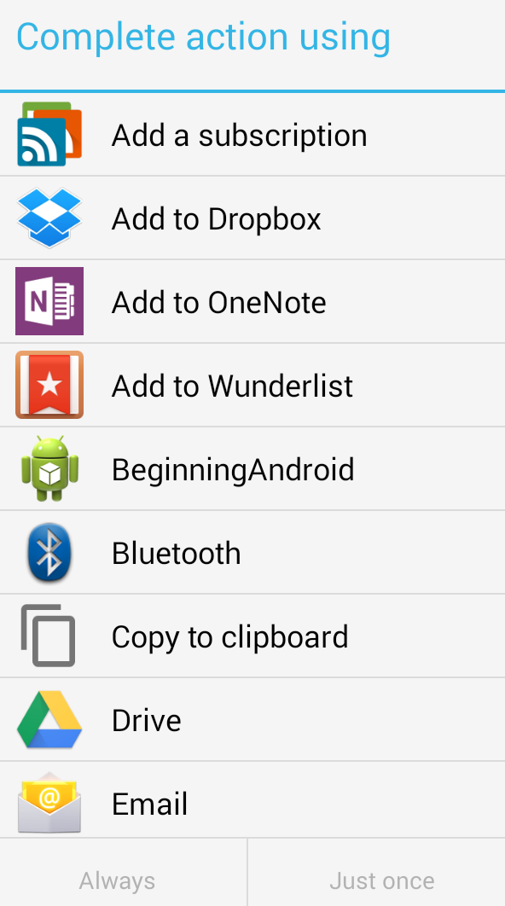

Intents
Implicit intents example. Share plain text
http://stackoverflow.com/questions/13065838/what-are-the-possible-intent-types-for-intent-settypetype

Slide 29
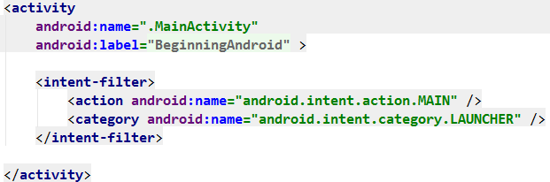
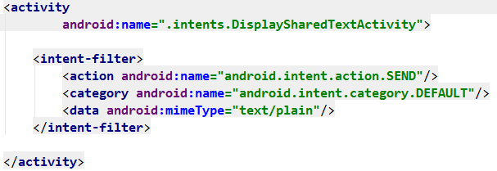
Intent-filters
To advertise which implicit intents your app can receive, declare one or more intent filters
Main activity filter example
Receive text filter example

Slide 30
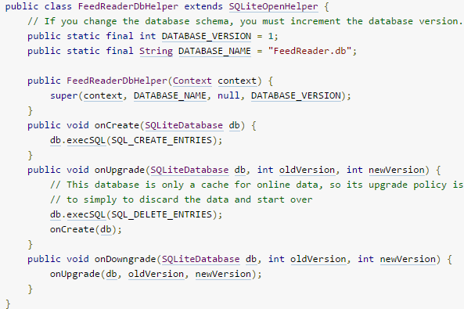
Database
A useful set of APIs is available in the SQLiteOpenHelper class.
To use SQLiteOpenHelper, create a subclass that overrides the onCreate(), onUpgrade() and onOpen() callback methods.
All you need to do is call getWritableDatabase() or getReadableDatabase().

Slide 31
Resources
Java 7 language features with Android
http://stackoverflow.com/questions/7153989/java-7-language-features-with-android
Android developers
https://developer.android.com/guide/index.html
When should the dimens.xml file be used in Android?
http://stackoverflow.com/questions/7508493/when-should-the-dimens-xml-file-be-used-in-android
Version of SQLite used in Android?
http://stackoverflow.com/questions/2421189/version-of-sqlite-used-in-android
Density-independent Pixels
https://www.youtube.com/watch?v=zhszwkcay2A&index=93&list=WL
Nine-patch (.9.png)
http://developer.android.com/guide/topics/graphics/2d-graphics.html#nine-patch

Slide 32


Slide 33


