Slide 1
support_tickets
File created on: 21.3.2026. 17:20:58

Slide 2
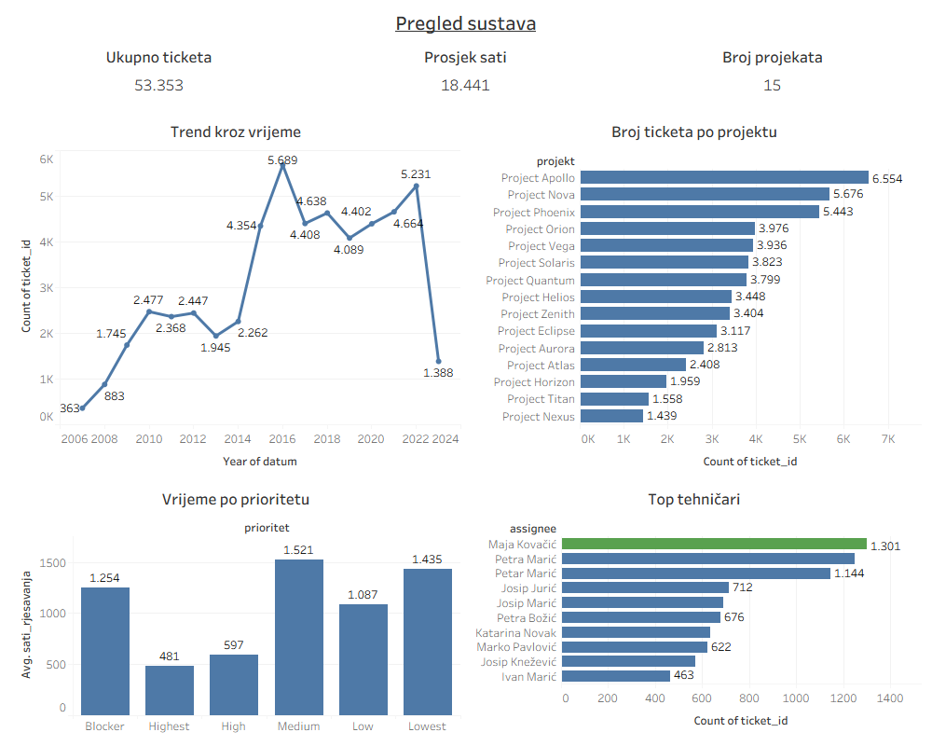

Slide 3
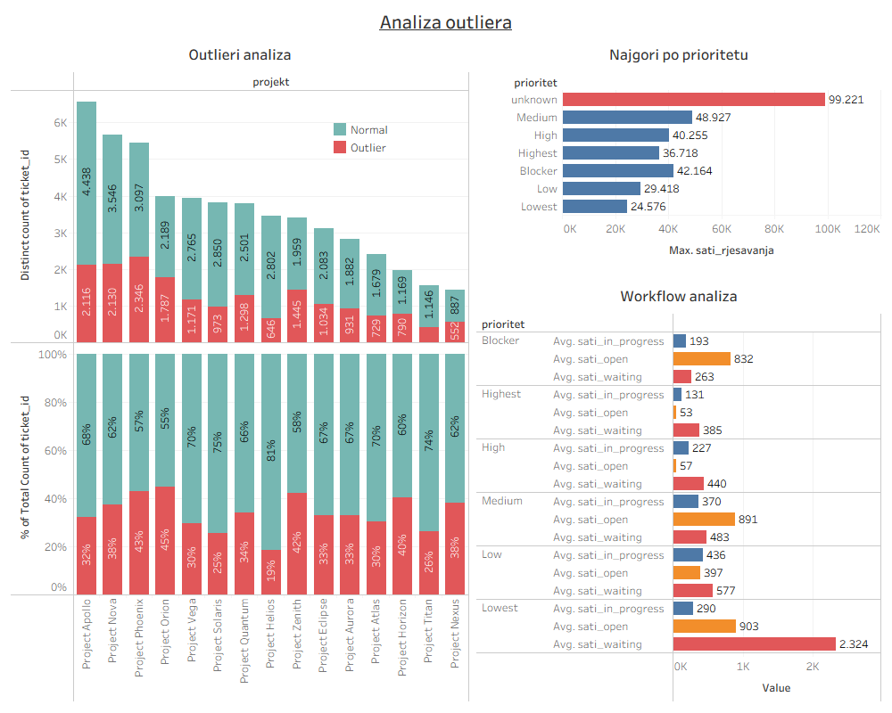

Slide 4
