Slide 1
nOmopoly
Avant-garde ZKML Compiler
without polynomial commitments

Slide 2

ZK and ZKML
 | SNARK | STARK | ZKML (ezkl) | nomopoly
Soundness
Completness
Speed

Slide 3
ZKML landscape today
ezkl
Halo2
Polyhedra Network
Bionetta (Rarimo)
Not open source

Slide 4
Goal
Learn the most efficient proof of inference system for a given model
01
Prove the token generation of a small language model
02
Build an LLM proving runtime usable in production
03

Slide 5


Elephant in the room
Can you really avoid polynomials?
TopLoc paper did it!
Strong soundness guarantees emerge the more you use the network

Slide 6
Neural Network Trifecta
Prover Net
Augment the original network with ”compressive memory” (Google’s Titan paper)
Each layer’s output is appended to this memory buffer of fixed size
Prover Net has 2 outputs: original output and the memory tensor
Verifier Net
Binary classification network learning to verify (in, out, proof) triplets correctly
Malicious Net
Given (in, out) pair tries to generate proof to fool the verifier

Slide 7
Intuition
Prover Net
Fully connects to each hidden layer – this captures the witness/trace
Proof tensor can be seen as embedding of the witness
Verifier Net
Binary classification network learning to verify (in, out, proof) triplets correctly
Malicious Net
Given (in, out) pair tries to generate proof to fool the verifier

Slide 8
Code snippets
…

Slide 9
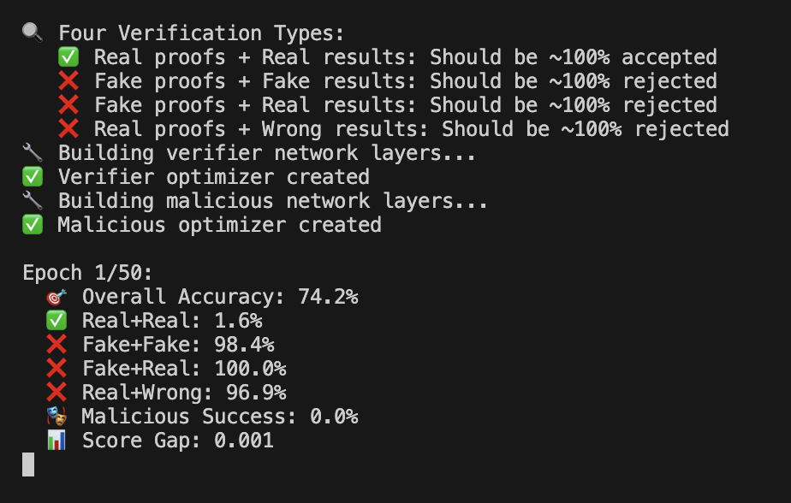
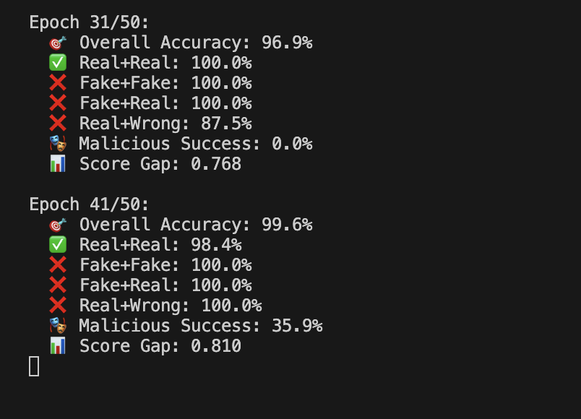
Training results
…
First epoch
Late training stages

Slide 10
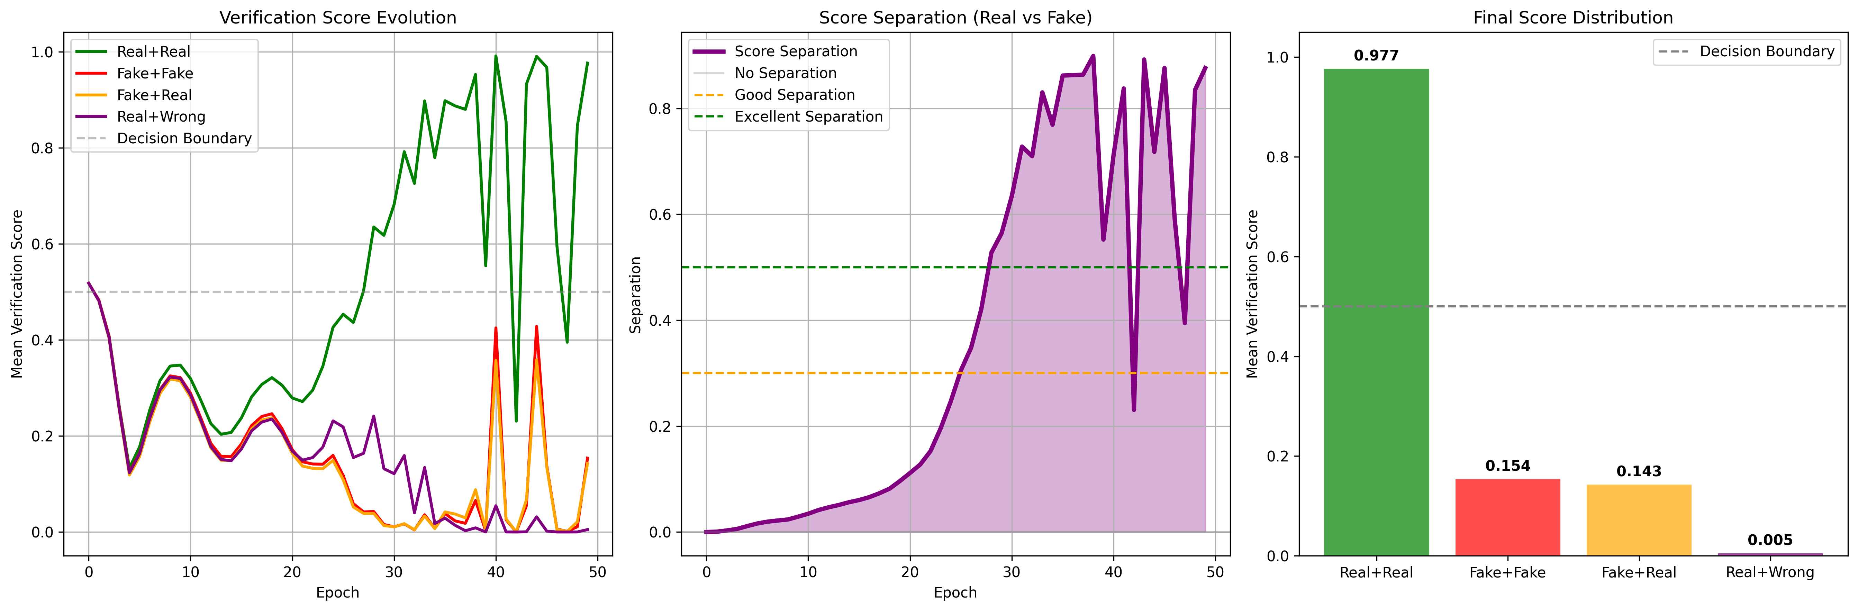
Training results
…

Slide 11
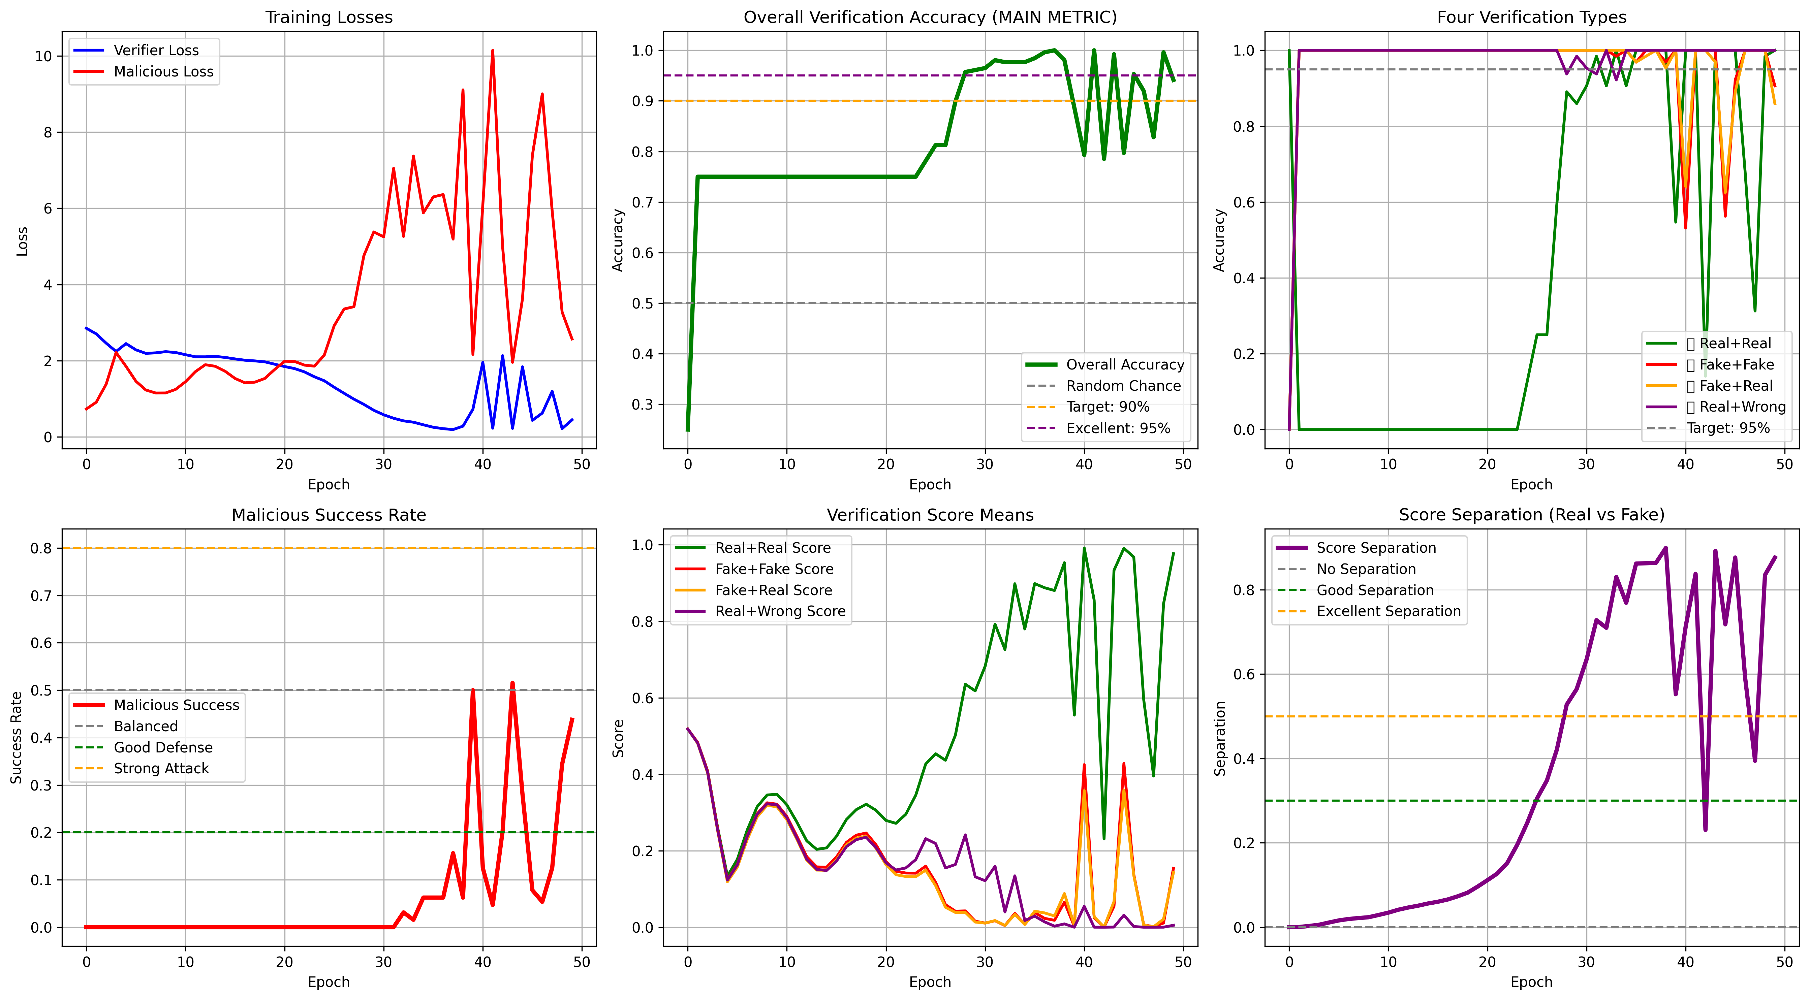
Training results
…

Slide 12
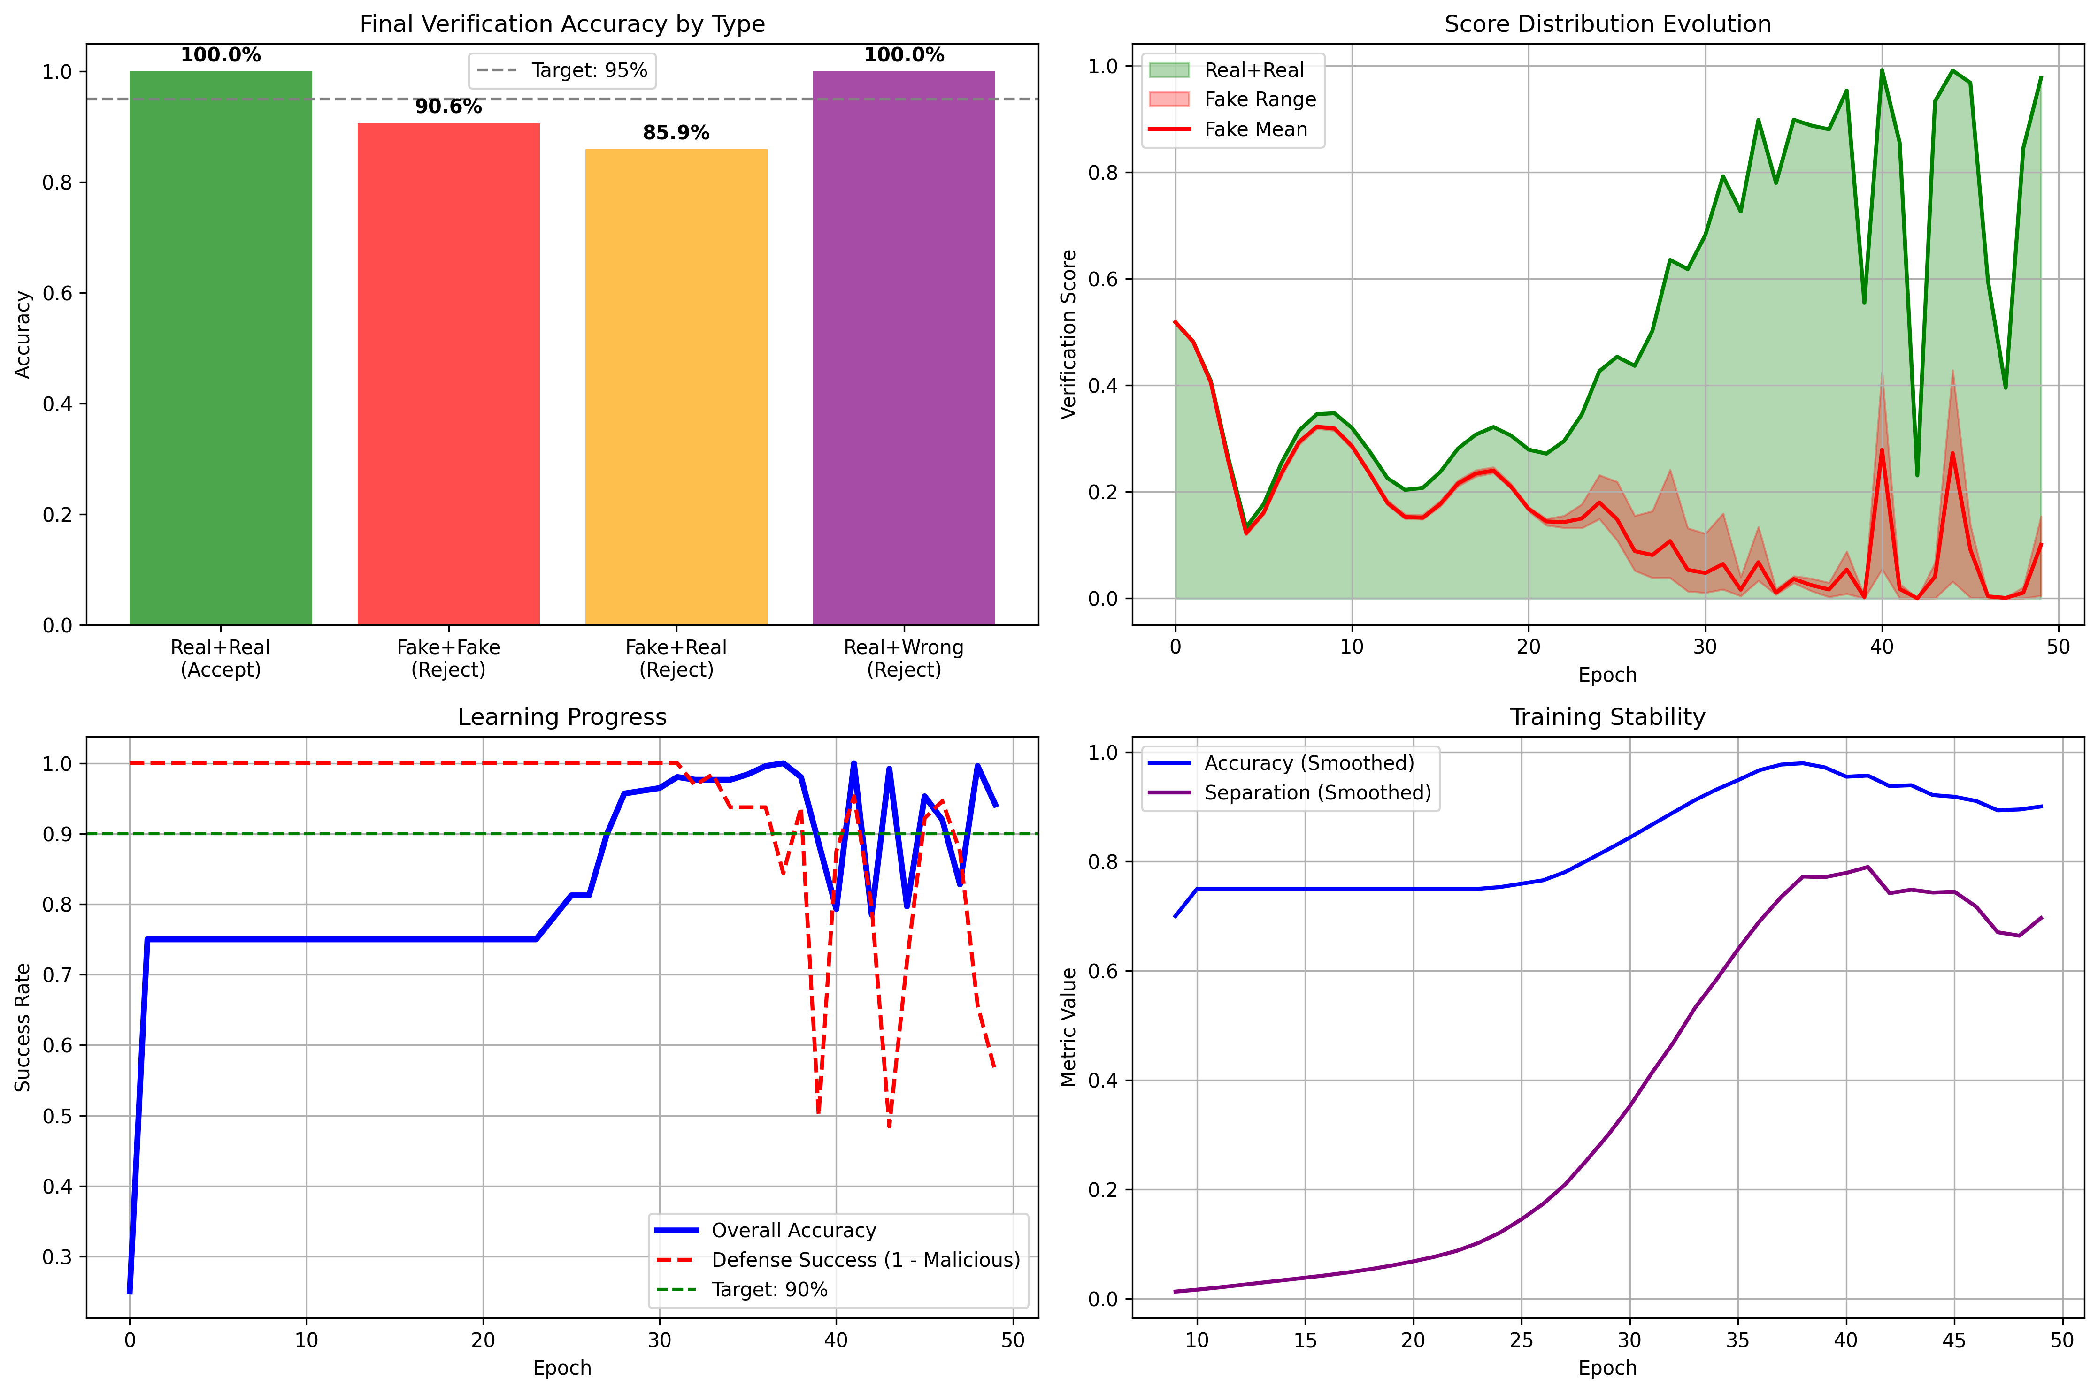
Training results
…

Slide 13
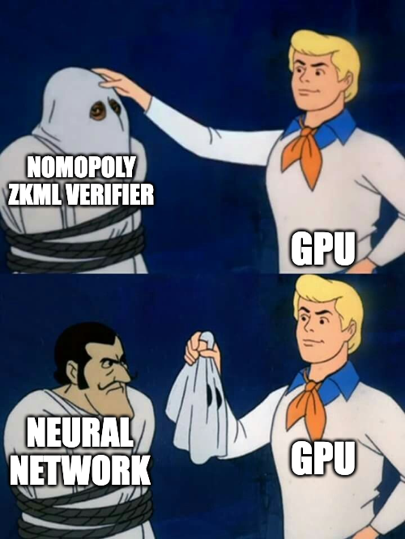
Benchmark
…

Slide 14
Alternative: pre-compile individual ops as ZK kernels once
Instead of learning ProverNet and VerifierNet each time end-to-end…
…we can learn each op (2DCONV, Linear, ReLU…)
Compiling becomes search and replace on the ONNX graph
Each OP’s proof must be verified (no folding)
it would still be efficient – verifier is a neural network, and it can accept batch of proofs as an input computing them in a single pass

Slide 15
Feedback is highly appreciated
There must be some sense working on this

