Slide 1
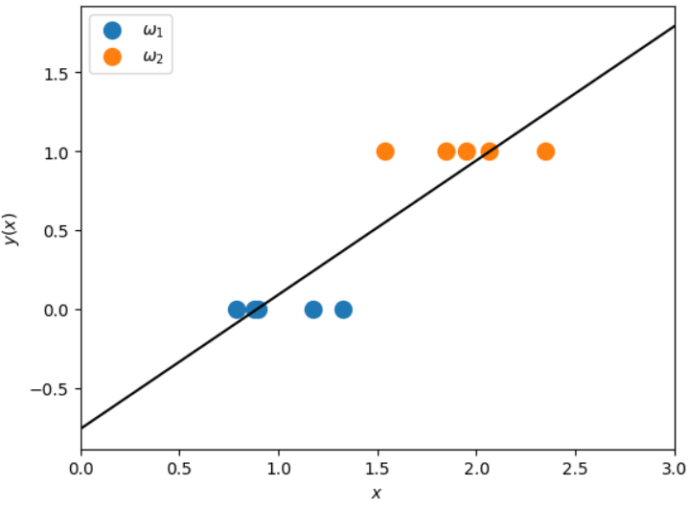
(2.34, 1.24)
(0.79, -0.09)

Slide 2
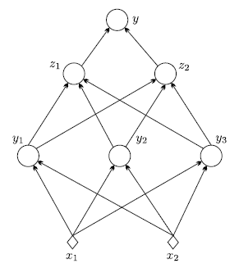
Output layer
Hidden layer 2
Hidden layer 1
Input layer

Slide 3





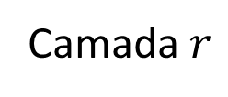


















Camada $r$
$$θ_{1}^{r}$$
Neurônio $$1$$
$$y_{1}^{r}$$
$$…$$
$$y_{1}^{r−1}$$
$$θ_{j}^{r}$$
$$…$$
$$y^{r−1}$$
$$y_{j}^{r}=f\left(z_{j}^{r}\right)=f\left({θ_{j}^{r}}^{T}y^{r−1}\right)$$
$$θ_{j_{1}}^{r}$$
$$y_{2}^{r−1}$$
$$θ_{j_{2}}^{r}$$
Neurônio $$j$$
$$y_{j}^{r}$$
$$…$$
$$y^{r}=\left[\begin{aligned}&1 \\ &f\left(z^{r}\right)\end{aligned}\right]=\left[\begin{aligned}&1 \\ &f\left(Θ^{r}y^{r−1}\right)\end{aligned}\right]$$
$$θ_{j_{k_{r−1}}}^{r}$$
$$y_{k_{r−1}}^{r−1}$$
$$…$$
$$θ_{k_{r}}^{r}$$
Neurônio $$k_{r}$$
$$y_{k_{r}}^{r}$$
$$…$$

Slide 4



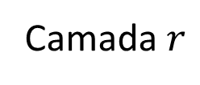










Camada $r$
$$y^{r−1}$$
$$y_{1}^{r−1}$$
$$θ_{j}^{r}$$
$$y_{j}^{r}=f\left(z_{j}^{r}\right)=f\left({θ_{j}^{r}}^{T}y^{r−1}\right)$$
$$θ_{j_{1}}^{r}$$
$$y_{2}^{r−1}$$
$$θ_{j_{2}}^{r}$$
Neurônio $$j$$
$$y_{j}^{r}$$
$$…$$
$$y^{r}=\left[\begin{aligned}&1 \\ &f\left(z^{r}\right)\end{aligned}\right]=\left[\begin{aligned}&1 \\ &f\left(Θ^{r}y^{r−1}\right)\end{aligned}\right]$$
$$θ_{j_{k_{r−1}}}^{r}$$
$$y_{k_{r−1}}^{r−1}$$

Slide 5
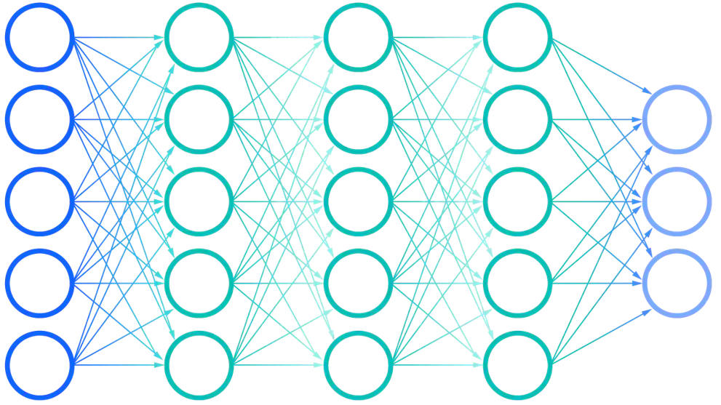






Input layer
Hidden layers
Output layer
Layer 1
Layer $r$
Layer $L−1$
Layer $L$
$$…$$
$$…$$
$L$ layers

Slide 6
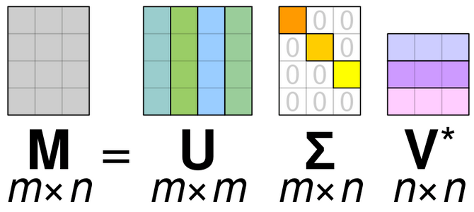
A
T

Slide 7
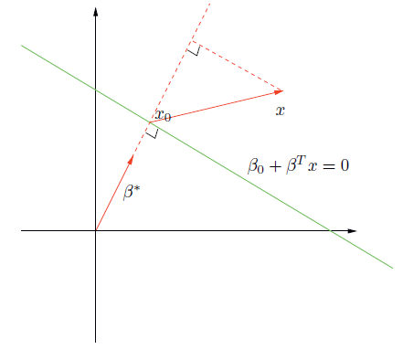






$$\frac{w}{\left\|w\right\|}$$
$$x$$
$$x−x_{0}$$
$$x_{0}$$
$$r$$
$$w_{0}+w^{T}x=0$$

Slide 8
Dado
Projeção do dado
Maior distância entre as projeções

Slide 9
Dado
Projeção

Slide 10
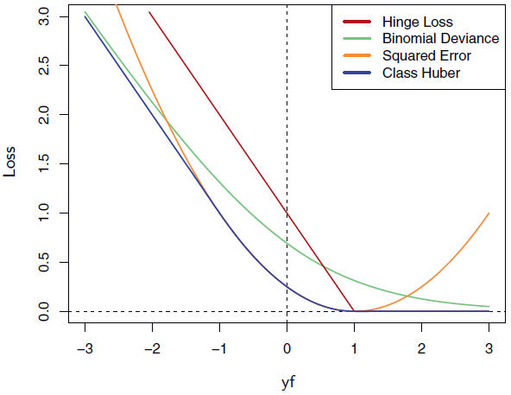
Erroneamente Classificados
Corret. class. e dentro da margem
Corret. class. e fora da margem

Slide 11
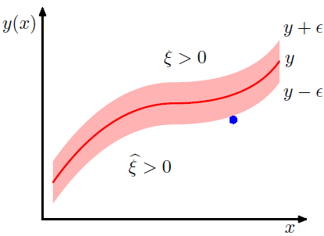







$$f\left(x\right)$$
$$f\left(x\right)+ε$$
$$f\left(x\right)$$
$$ξ_{2}$$
$$f\left(x\right)−ε$$
$${ξ′}_{6}$$
$${ξ′}_{1}=0 \\ ξ_{1}=0$$

Slide 12
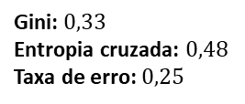
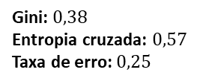
4|4
4|4
3|1
1|3
4|2
0|2
Gini: $0,38$ Entropia cruzada: $0,57$ Taxa de erro: $0,25$
Gini: $0,33$ Entropia cruzada: $0,48$ Taxa de erro: $0,25$

Slide 13
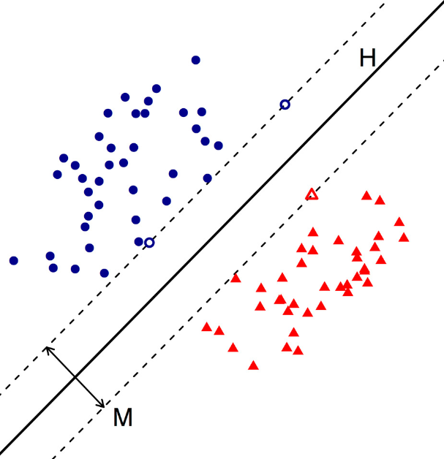


vetores de suporte

Slide 14
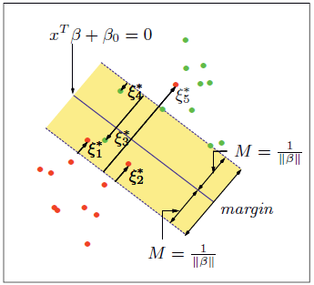


$$M$$
$$M$$
vetores de suporte

Slide 15
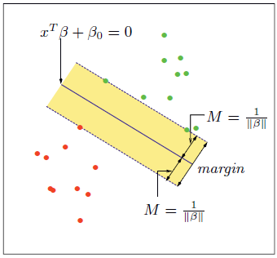



$$f\left(x\right)=0$$
$$M$$
$$M$$
vetores de suporte

