Slide 1
CMOS Delays
Igor Smirnov

Slide 2
Acknowledgements
Foils based on materials of
Chalmers University of Technology
The CMOS RC delay model
Inverter speed and propagation delay
POSTECH Embedded System Architecture Lab
Low Power SoC Design methods

Slide 3
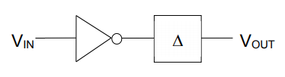
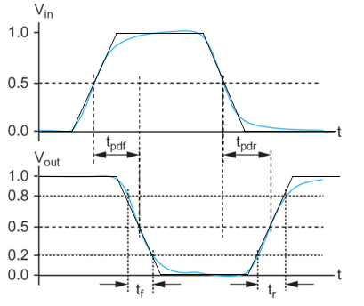
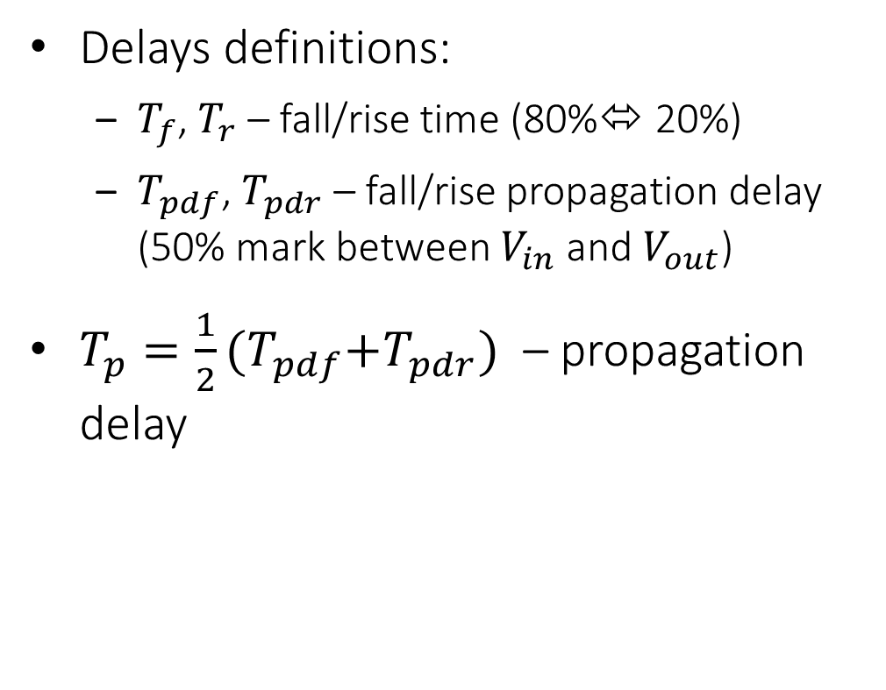
Propagation delay
Delays definitions:
$T_{f}$, $T_{r}$ – fall/rise time (80%⬄ 20%)
$T_{pdf}$, $T_{pdr}$ – fall/rise propagation delay (50% mark between $V_{in}$ and $V_{out}$)
$T_{p}=\frac{1}{2}(T_{pdf}\text{+}T_{pdr})$ – propagation delay
Fig. 1. An inverter with a delay model
Fig. 2. Propagation delay with input and output voltages approximated as ramps [From Weste & Harris]

Slide 4
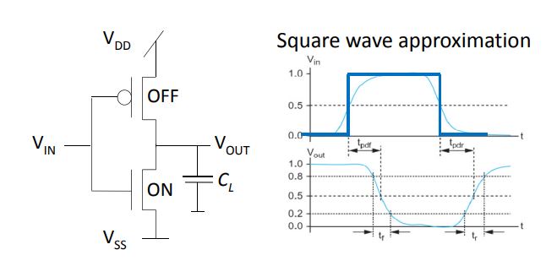
Step-respons model
First, let’s assume instant input voltage change (Vin)

Slide 5
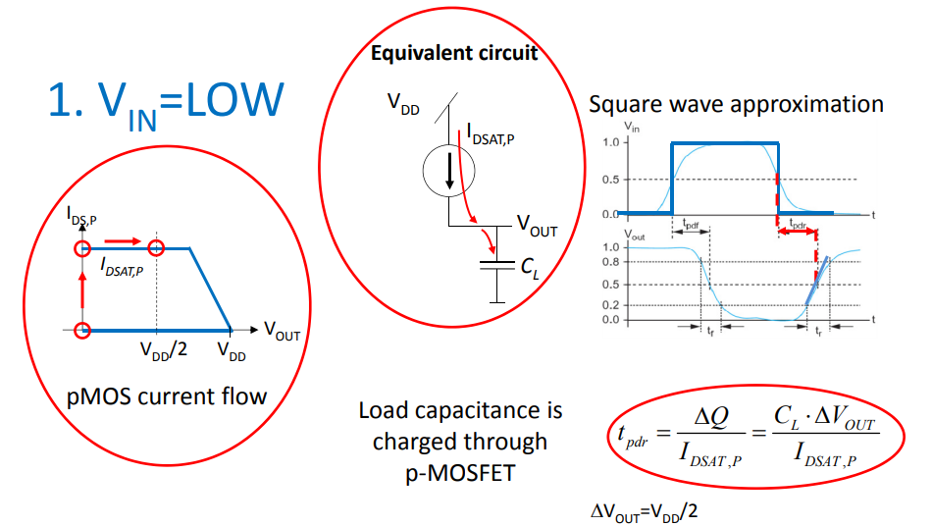
Step-respons rise-delay model

Slide 6
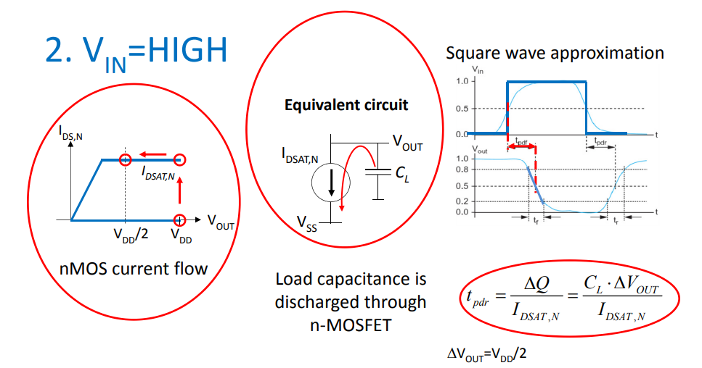
Step-respons fall-delay model

Slide 7
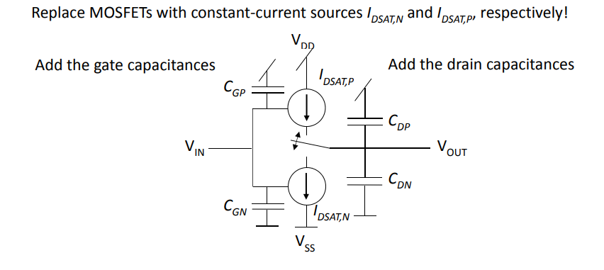
Electrical inverter model

Slide 8
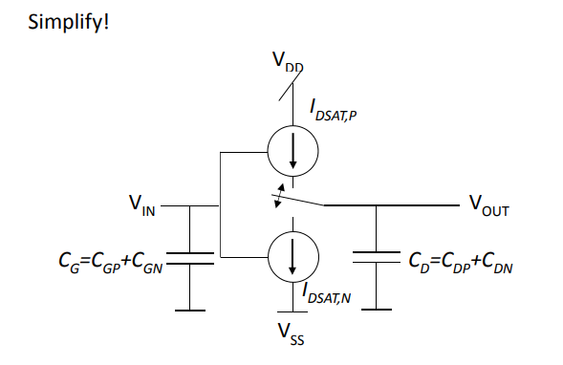
Electrical inverter model

Slide 9
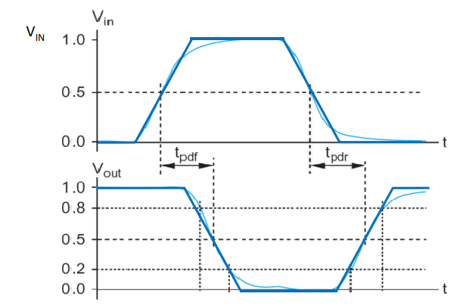
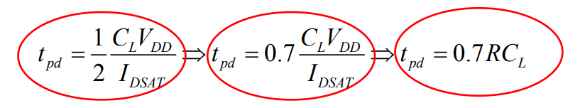
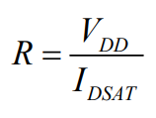

Back to ramp respons
$V_{out}\left(t\right)= V_{out}(0)e^{−t/RC}$
$V_{out}(0)$ = $V_{dd}$, $V_{out}{(t}_{pd})$ = ${\frac{1}{2}V}_{dd}$ ➔ 40% longer ramp response delay vs step model

Slide 10
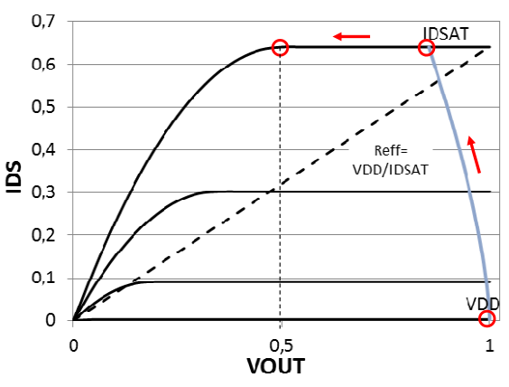
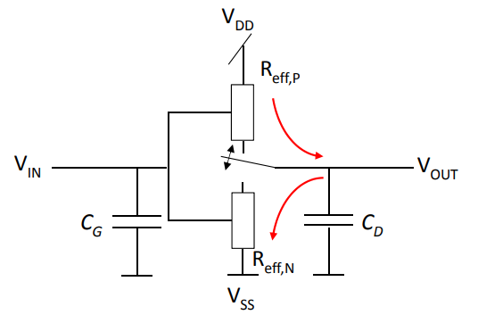
Discharge trace – ramp input
Replace current sources by resistors

Slide 11
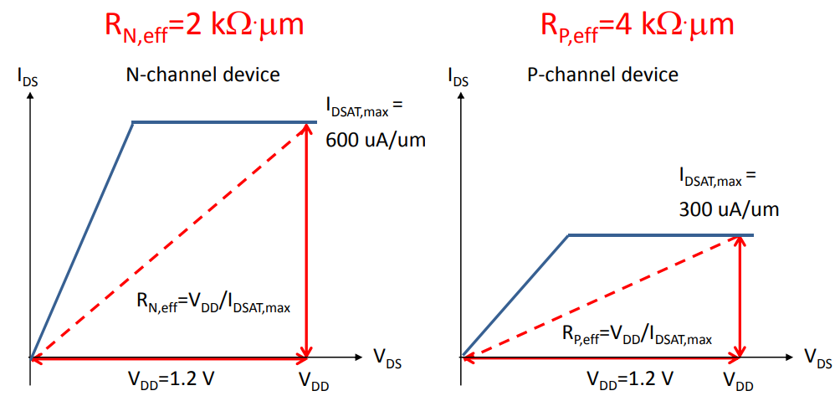



Effective resistances of 60 nm MOSFETs
$$R_{eff}\sim \frac{L}{WV_{DD}}$$
Saturation current:
$I_{D}=\frac{W}{2L}μC_{OX}{(V_{gs}^{}−V_{T}^{})}^{2}$ ➔
$$μ_{N}=\sim 2.7μ_{P}$$

Slide 12
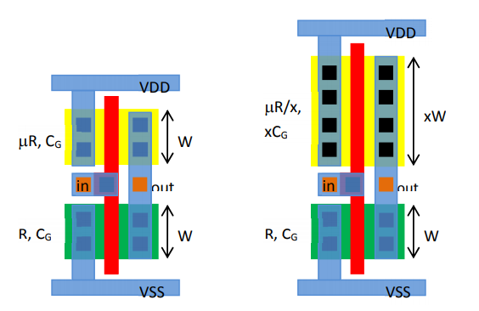
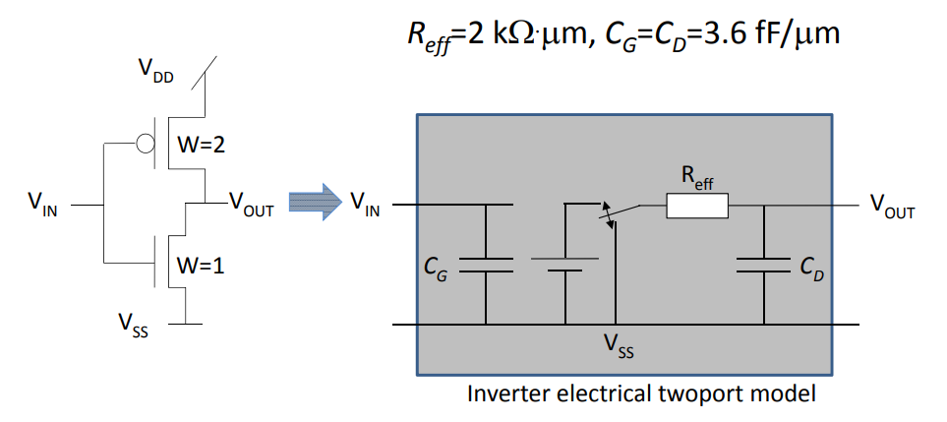
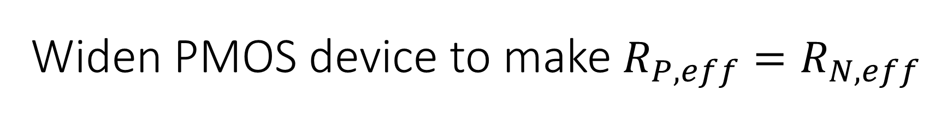
Widen PMOS device to make $R_{P,eff}=R_{N,eff}$

Slide 13
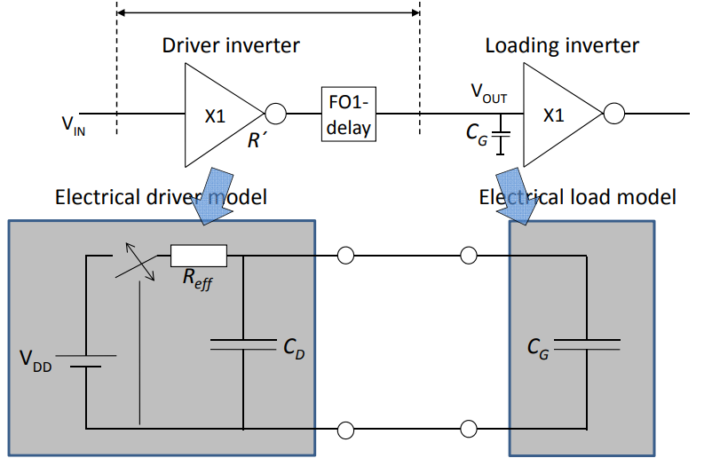
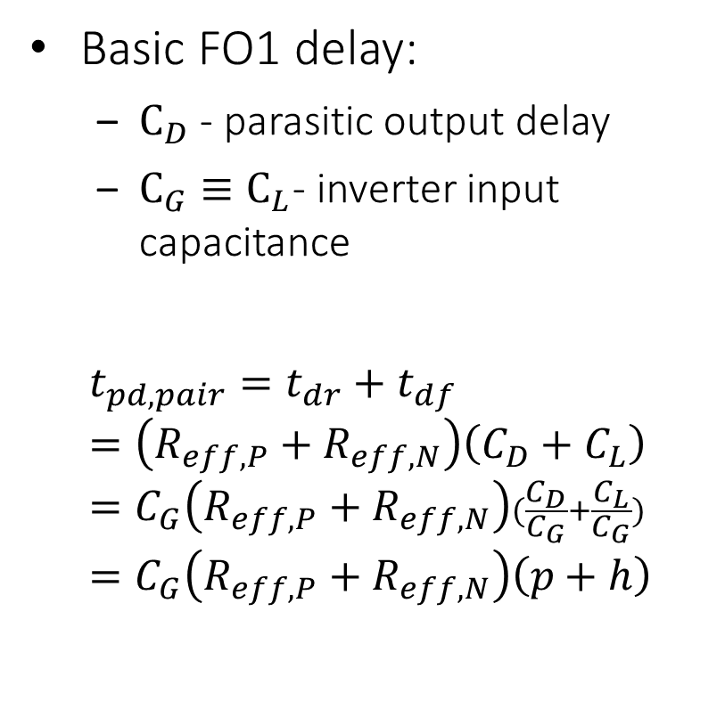

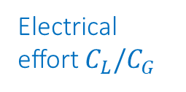
Inverter pair delay
Basic FO1 delay:
$С_{D}$ - parasitic output delay
$С_{G}≡С_{L}$- inverter input capacitance
$$t_{pd,pair}=t_{dr}+t_{df}=\left(R_{eff,P}+R_{eff, N}\right)\left(C_{D}+C_{L}\right)=C_{G}\left(R_{eff,P}+R_{eff, N}\right)(\frac{C_{D}}{C_{G}}+\frac{C_{L}}{C_{G}})=C_{G}\left(R_{eff,P}+R_{eff, N}\right)\left(p+h\right)$$
Parasitic delay $C_{D}/C_{G}$
Electrical effort $C_{L}/C_{G}$
Notes:
Нормализованную задержку логической схемы можно выразить в виде суммы двух компонент: нормализованной «паразитной задержки» p (которая равна задержке ненагруженного инвертора), и «трудозатрат логического элемента» f (которые зависит от нагрузки):
d=p+f.

Slide 14

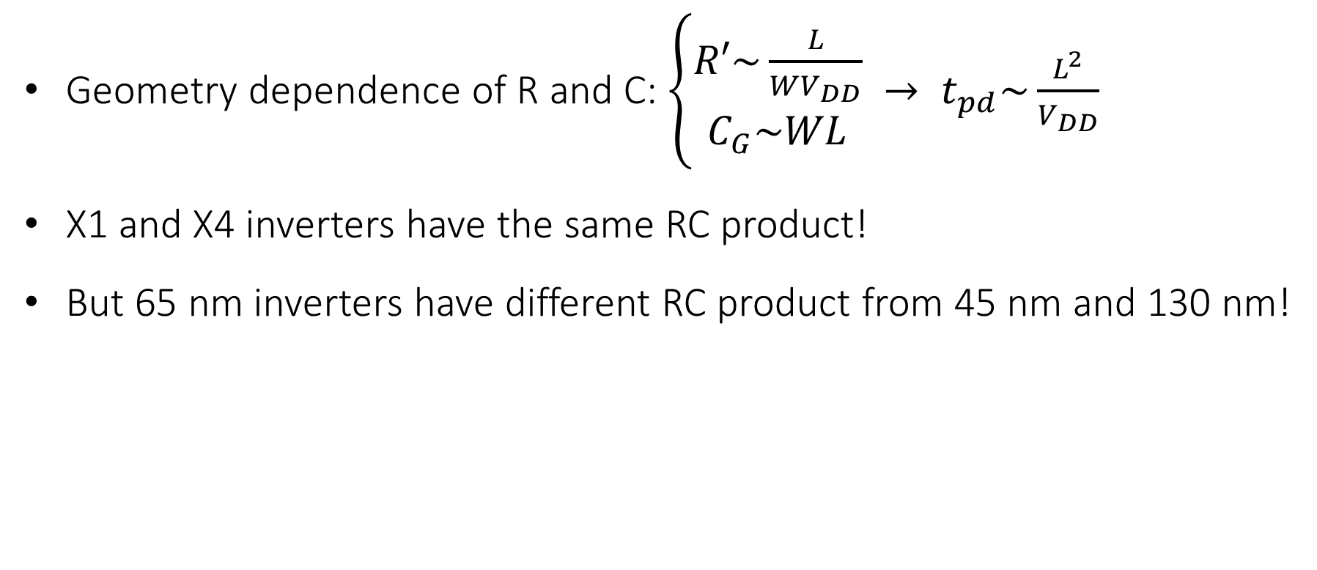
The RC product is width independent!
Geometry dependence of R and C: $\left\{\begin{aligned}R′\sim \frac{L}{WV_{DD}} \\ C_{G}\sim WL\end{aligned}\right. → t_{pd}\sim \frac{L^{2}}{V_{DD}}$
X1 and X4 inverters have the same RC product!
But 65 nm inverters have different RC product from 45 nm and 130 nm!
$$t_{pd,pair}={R′C}_{G}\left(\frac{C_{D}}{C_{G}}+\frac{C_{L}}{C_{G}}\right)={R′C}_{G}\left(p+h\right)$$

Slide 15
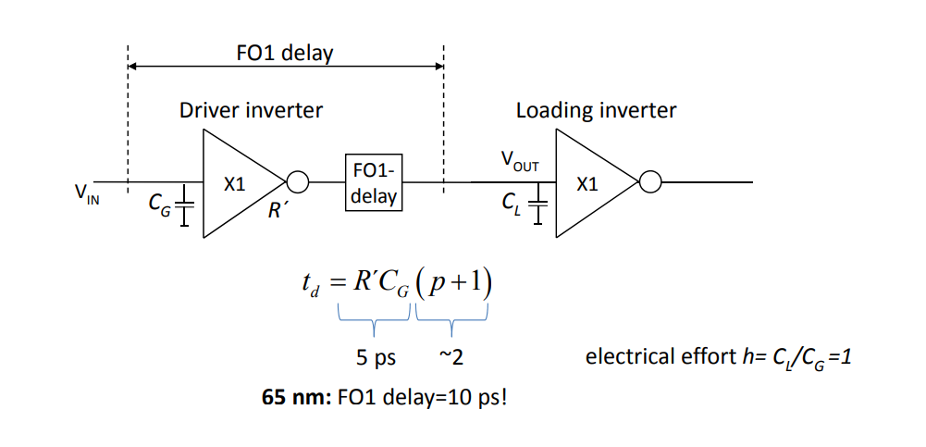
FO1 delay

Slide 16
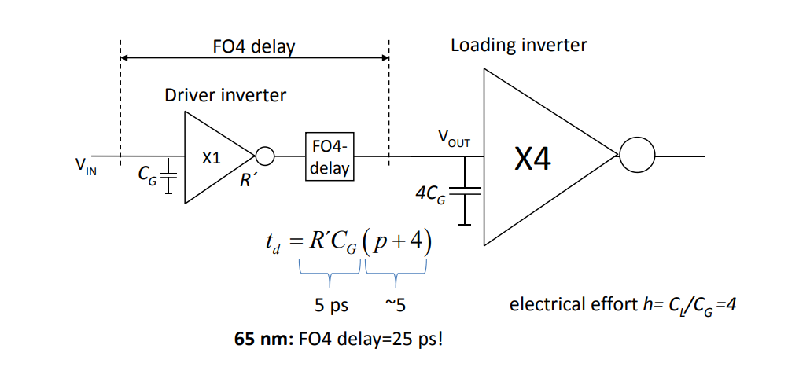
FO4 delay

Slide 17
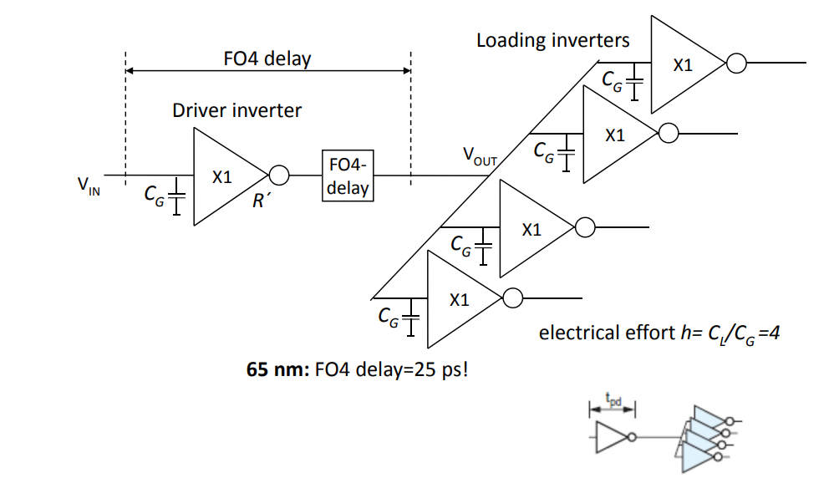
FO4 delay

Slide 18
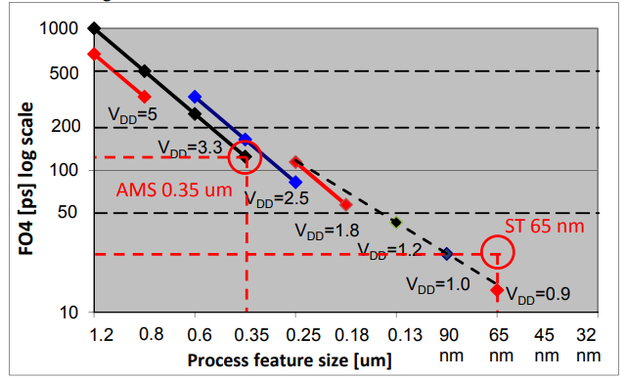
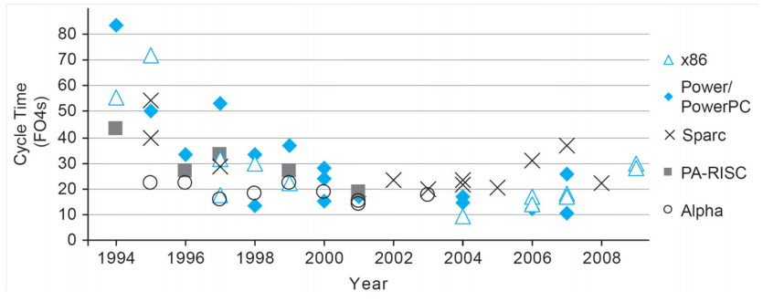
Conclusion
The RC‐delay model is based on an equivalent RC circuit
The two‐port model includes models for load and driver
Separated technology dependent time constant R’Cg from technology independent relative delay, d=p+h
Introduced parasitic delay p, and electrical effort h
FO4 delay
Relative: p+4 ~5
Absolute RC*(p+4) ~5RC

Slide 19
Power
Igor Smirnov

Slide 20
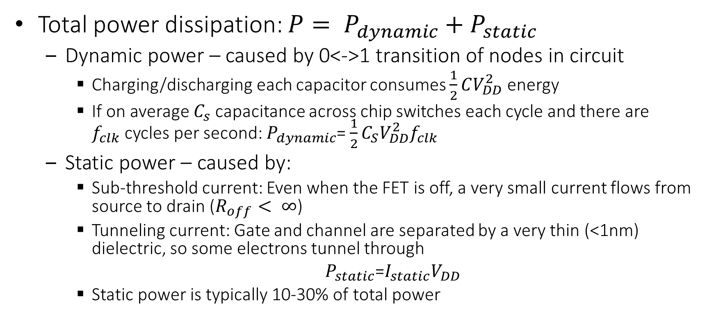
CMOS power dissipation
Total power dissipation: $P= P_{dynamic}+P_{static}$
Dynamic power – caused by 0<->1 transition of nodes in circuit
Charging/discharging each capacitor consumes $\frac{1}{2}CV_{DD}^{2}$ energy
If on average $C_{s}$ capacitance across chip switches each cycle and there are $f_{clk}$cycles per second: $P_{dynamic}$= $\frac{1}{2}C_{S}V_{DD}^{2}f_{clk}$
Static power – caused by:
Sub-threshold current: Even when the FET is off, a very small current flows from source to drain ($R_{off}< ∞$)
Tunneling current: Gate and channel are separated by a very thin (<1nm) dielectric, so some electrons tunnel through
$P_{static}$=$I_{static}V_{DD}$
Static power is typically 10-30% of total power

Slide 21
Low power design approaches
Switching power
Less switching (less work, less power consumption)
Removing redundant work
Clock gating → dynamic power management
Dynamic voltage scaling
Leakage power
Power gating → dynamic power management

Slide 22
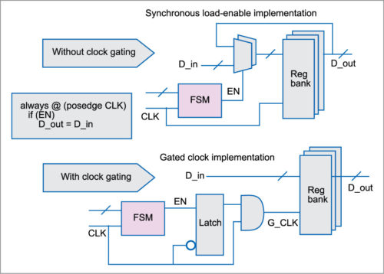
Clock gating (CG)
CG is a power saving technique removing “free-running” clock and associated logic toggling
Eliminates all switching activity in the block
One of the easiest ways to obtain low power states
Wakeup overhead is a few clock cycles
Addresses dynamic power
Leakage power not removed as Voltage still supplied

Slide 23
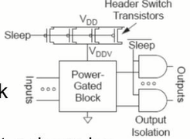

Power gating (PG)
Turn OFF power to blocks when they are idle to save leakage
Use virtual Vdd (Vddv)
Gate outputs to prevent invalid levels to next block
Voltage drop across sleep transistor degrades performance during normal operation
Size the transistor wide enough to minimize impact
Switching wide sleep transistor costs dynamic power
Only justified when circuit sleeps long enough

Slide 24

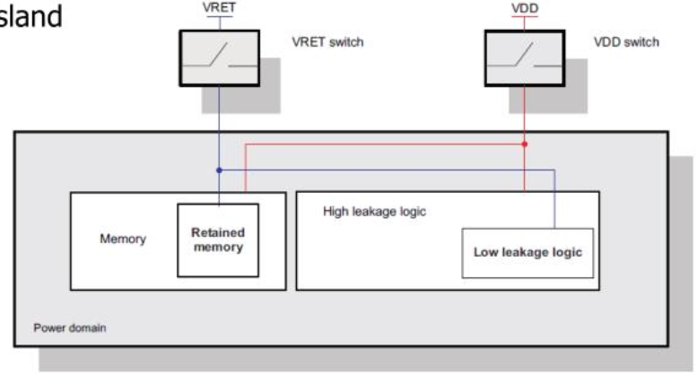
Power gating (PG)
PG targets leakage power consumed even after clock is gated
Power domain: unit of power gating, often called voltage island
Power on/off transition overhead is 100s/1000s cycles
Retention period
Power applied only to (some) memory
Vret (e.g. 0.6V) < Vdd (1.1V)
Reduces transition delay to (re)store states on power-on/off transitions
Notes:
Retention registers
When power gating is used, the system needs some form of state retention, such as scanning out data to a RAM, then scanning it back in when the system is reawakened. For critical applications, the memory states must be maintained within the cell, a condition that requires a retention flop to store bits in a table. That makes it possible to restore the bits very quickly during wakeup. Retention registers are special low leakage flip-flops used to hold the data of the main registers of the power gated block. Thus the internal state of the block during power down mode can be retained and loaded back to it when the block is reactivated. Retention registers are always powered up. The retention strategy is design dependent. A power gating controller controls the retention mechanism such as when to save the current contents of the power gating block and when to restore it back.

Slide 25
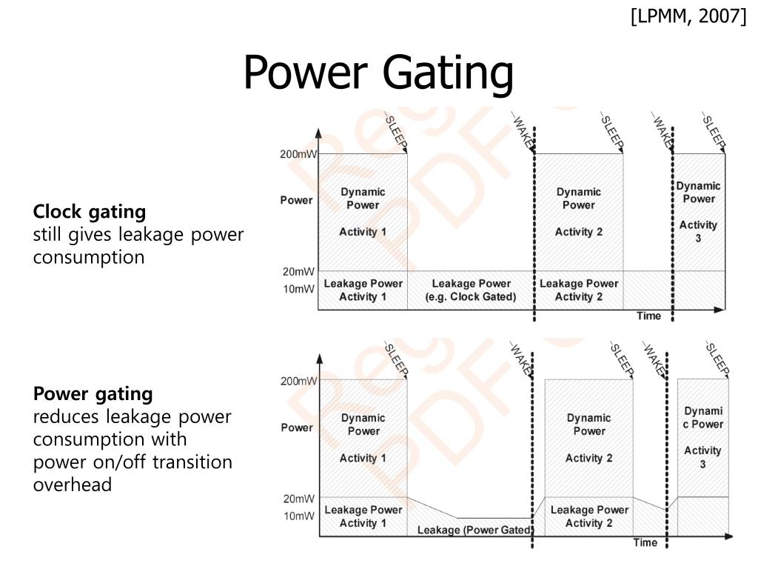

Slide 26
Back up
Slides below are taken from Computer Architecture course

Slide 27
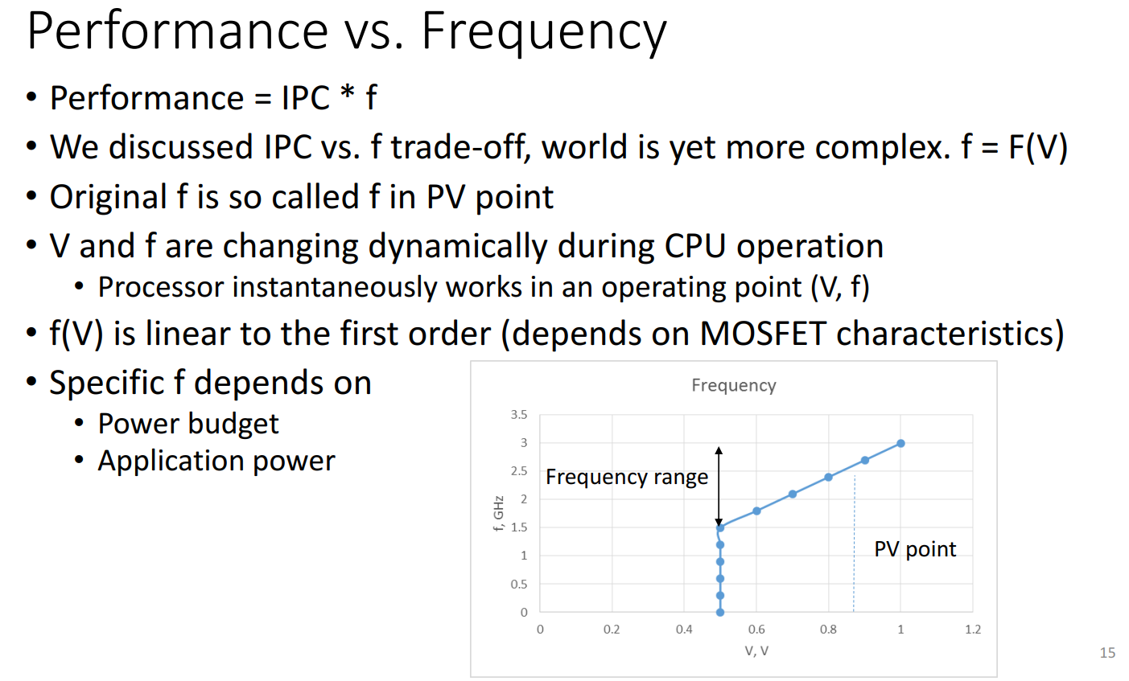

Slide 28
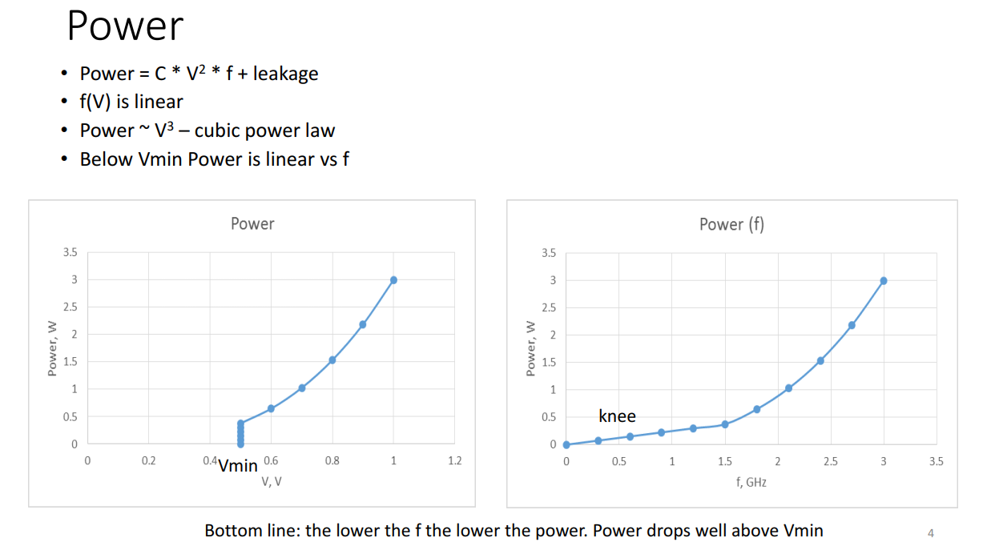

Slide 29
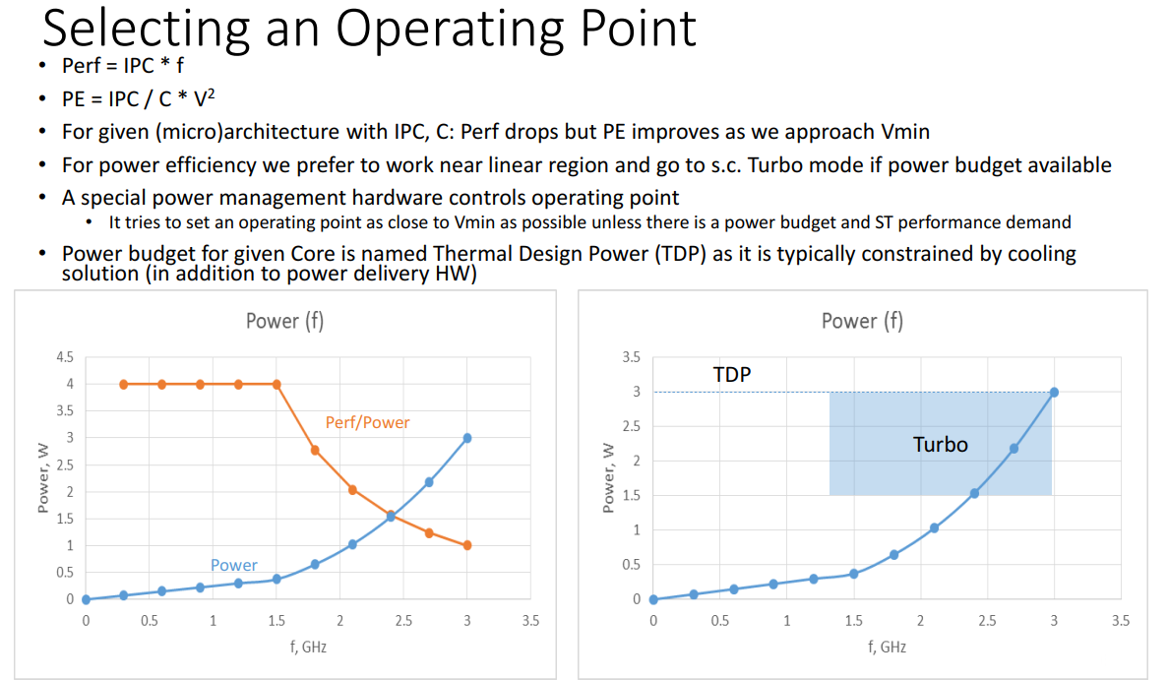

Slide 30
Questions?

Slide 31
Orgs
Nov 24 – final exam
Duration: 1h 20 min
1 Attempt
Exam on L1-L9
Dec 1 – exam/course results

