Slide 1
Impedance analysis of harmonic resonance in HVDC connected Wind Power Plants
Master Thesis Project
Igor Sowa
July 2016

Slide 2
Outline
Introduction
Motivation
Simulations description
Simulations results
Summary

Slide 3
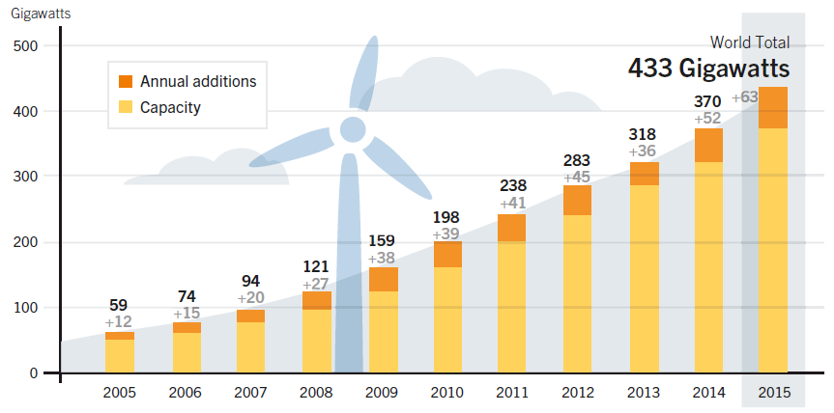
Introduction
Wind power capacity development
Figure 1: Wind Power Global Capacity and Annual Additions, 2005-2015.
Second RES
Wind power: 3.7% at the of 2015 global electricity production
In 2015 largest annual increase ever: 63.7 GW (~43% of all RES) – growth rate of 17.2% comparing to 2014
Record low prices for forthcoming RES in some countries due to policies and market frameworks

Slide 4
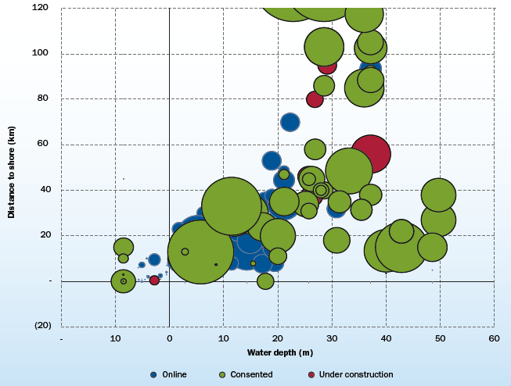
Introduction
Offshore WPP
Total of 12 GW
3.4 GW installed in 2015
3019 MW in Europe (more than twice than capacity added in 2014)
Trends in technology:
Power of turbines
Water depth
Distance from shore (average of 43.3 km in 2015 only)

Slide 5
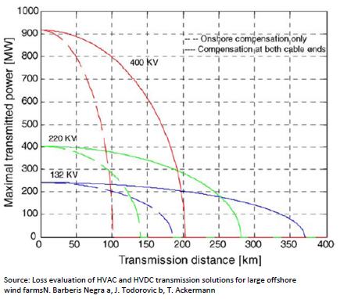
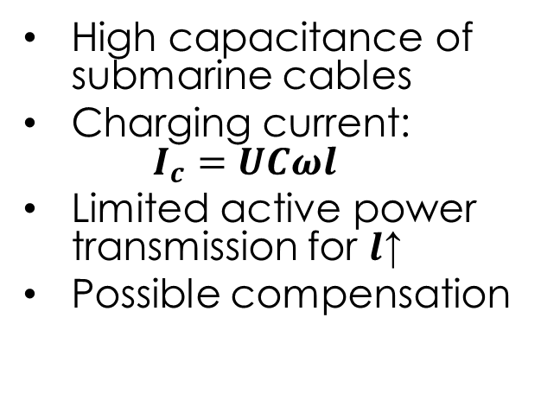
Introduction
Power transmission to shore
High capacitance of submarine cables
Charging current: $I_{c}=UCωl$
Limited active power transmission for $l$↑
Possible compensation

Slide 6
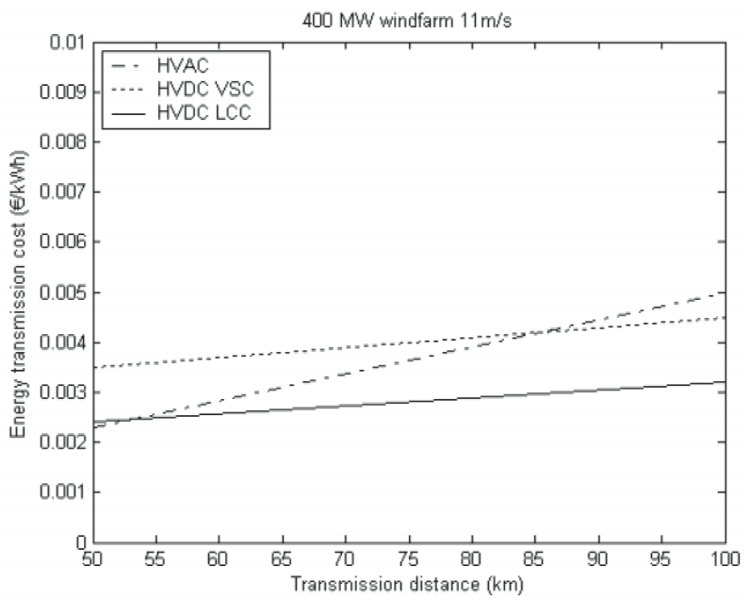
Introduction
HVDC transmission
No charging current – no compensation
Lower transmission losses
Cheaper cable
Higher losses and risk of failure of converter
Should be decided on the project per project basis

Slide 7
Motivation
Recent experience in operation of first HVDC connected offshore WPP (committed in 2013)
Phenomenon of harmonic resonance due to:
AC network with many cables bringing down the resonant frequencies
Power converter dominated grid with limited damping (weak grid, decoupled from main AC grid)
Necessity of harmonic resonance analysis for future project

Slide 8
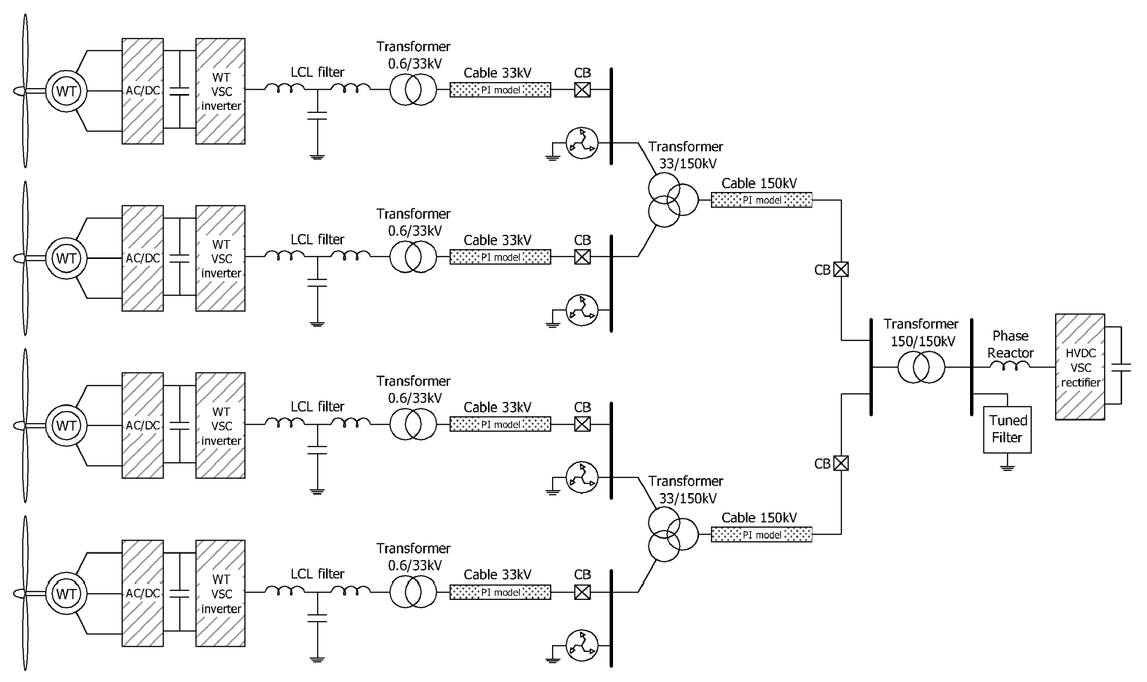
Simulations description
Test system topology cases

Slide 9
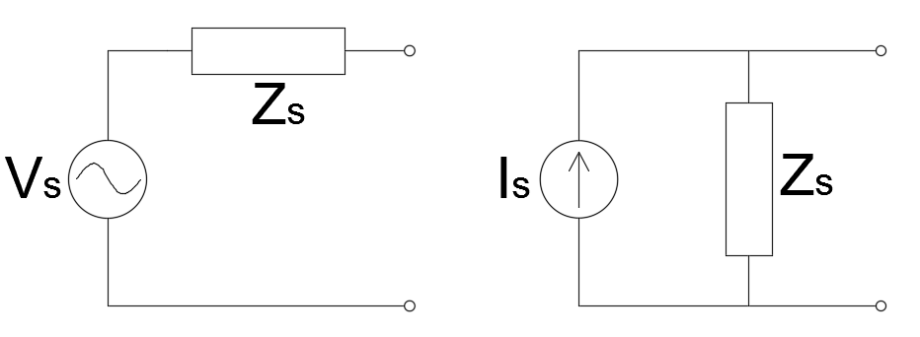
Simulations description
Converter models I
Importance of converter modelling
Difficulty in detail data obtainment
Model as either ideal voltage or ideal current source
Ideal VS becomes short-circuit in f domain
Ideal CS becomes open-circuit in f domain

Slide 10
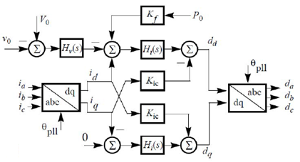
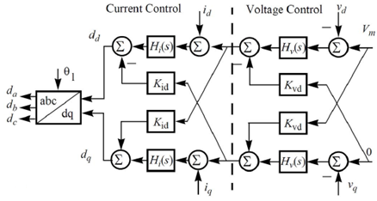
Simulations description
Converter models II
Nonlinear impedance models:
derived for WT inverter and HVDC-link rectifier
harmonic linearization method
positive- and negative-sequences
valid below and above fundamental frequency

Slide 11
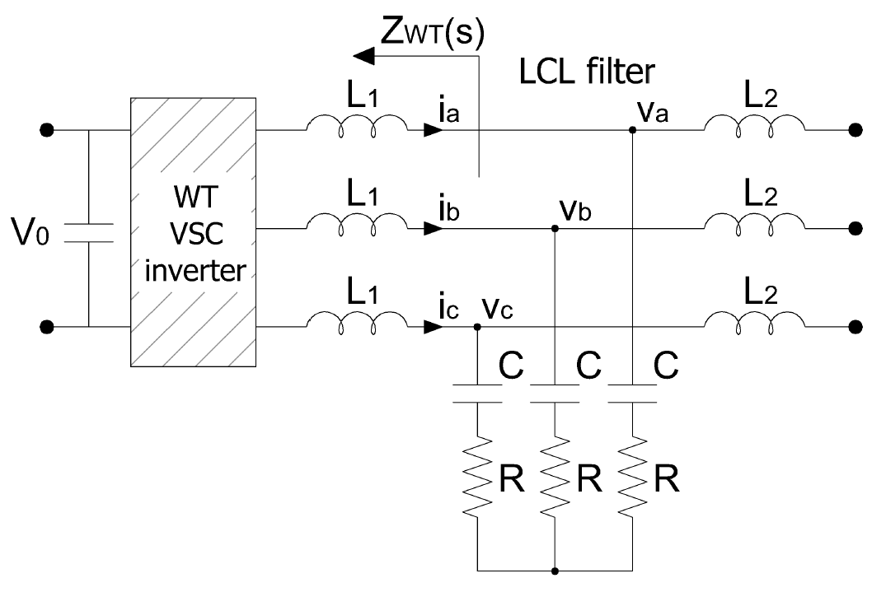
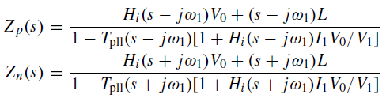

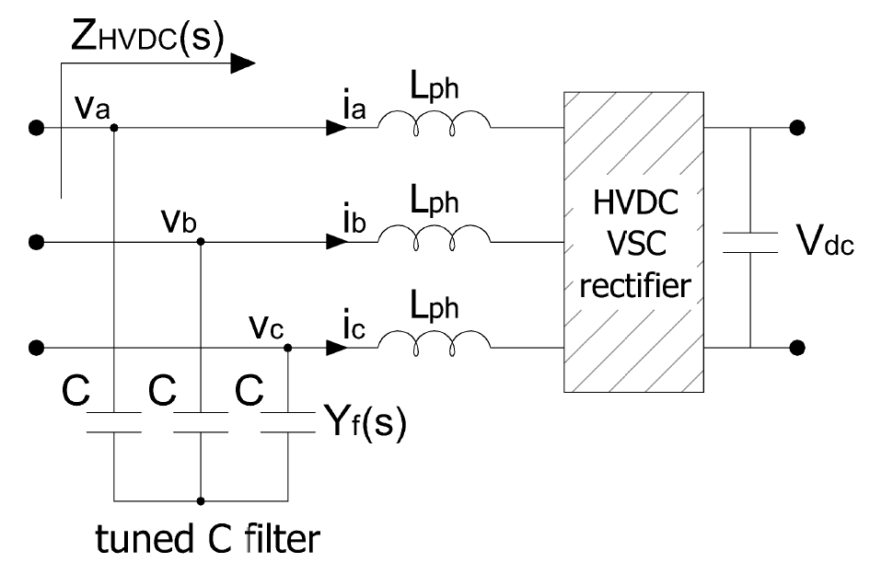
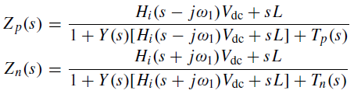

Simulations description
Converter models III
WT inverter
HVDC-link rectifier

Slide 12
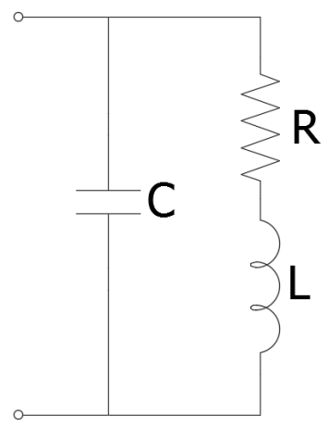
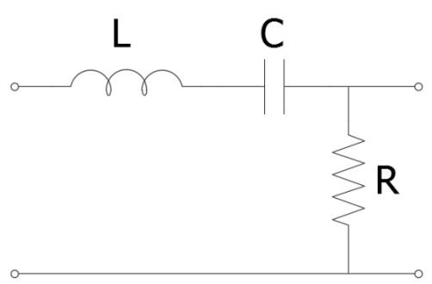
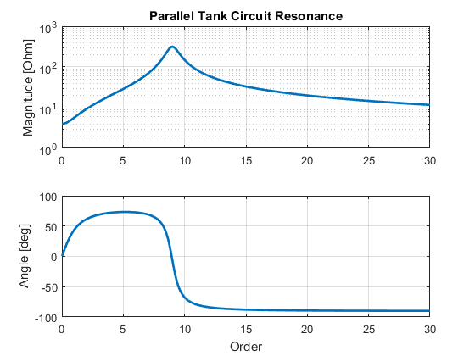
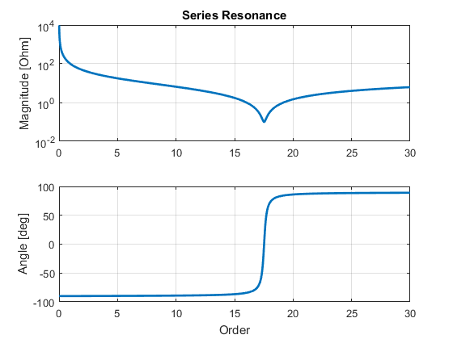
Simulations description
Frequency Sweep
Characterization of the system equivalent impedance at a bus in the system as a function of frequency

Slide 13
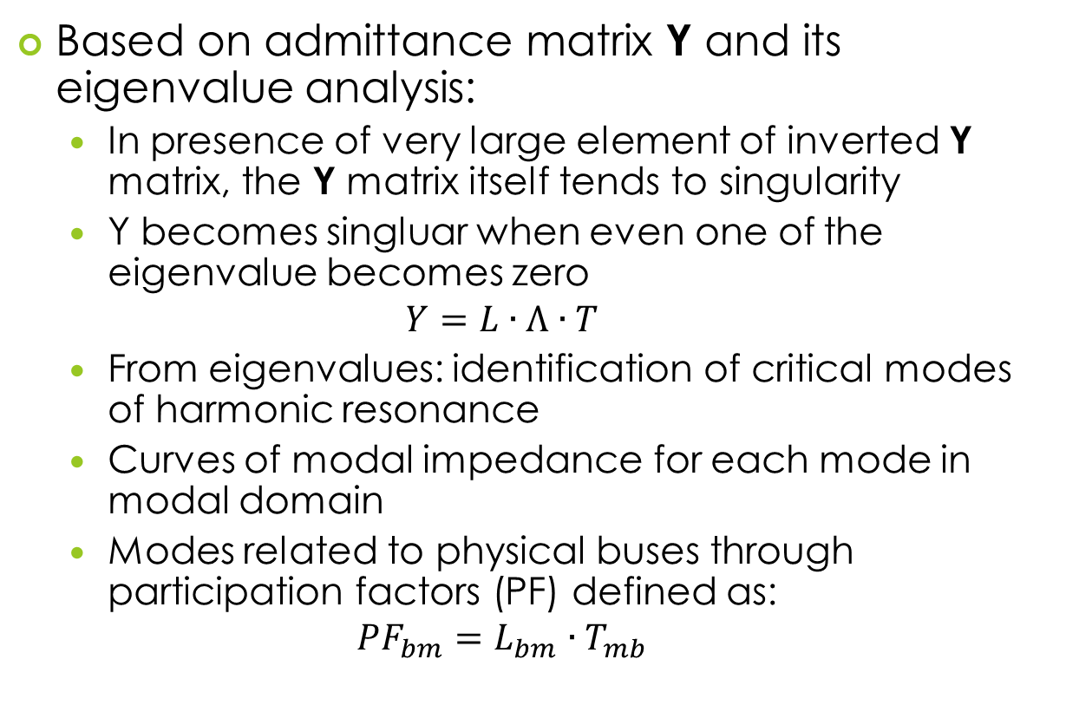
Simulations description
Harmonic Resonance Modal Analysis
Based on admittance matrix Y and its eigenvalue analysis:
In presence of very large element of inverted Y matrix, the Y matrix itself tends to singularity
Y becomes singluar when even one of the eigenvalue becomes zero
$$Y=L∙Λ∙T$$
From eigenvalues: identification of critical modes of harmonic resonance
Curves of modal impedance for each mode in modal domain
Modes related to physical buses through participation factors (PF) defined as:
$$PF_{bm}=L_{bm}∙T_{mb}$$

Slide 14
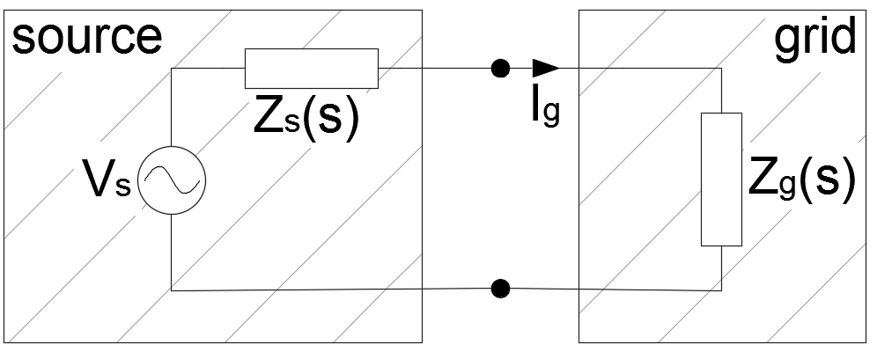

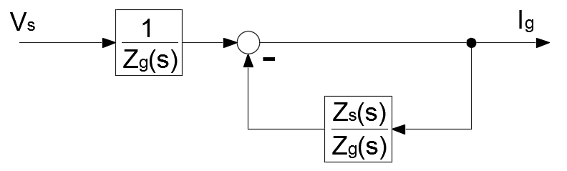
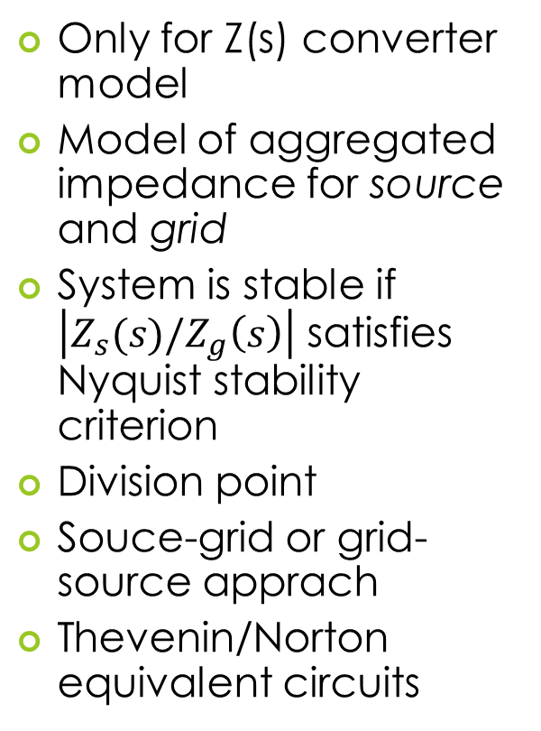
Simulations description
Stability analysis model
Only for Z(s) converter model
Model of aggregated impedance for source and grid
System is stable if $\left|Z_{s}(s)/Z_{g}\left(s\right)\right|$ satisfies Nyquist stability criterion
Division point
Souce-grid or grid-source apprach
Thevenin/Norton equivalent circuits

Slide 15
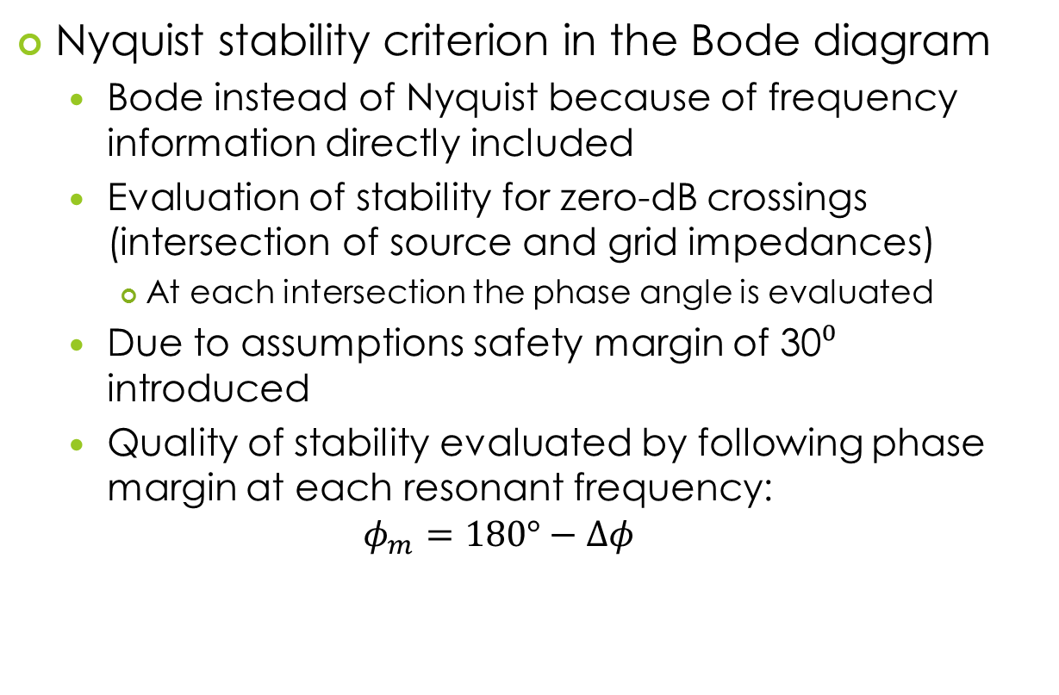
Simulations description
Stability assessment
Nyquist stability criterion in the Bode diagram
Bode instead of Nyquist because of frequency information directly included
Evaluation of stability for zero-dB crossings (intersection of source and grid impedances)
At each intersection the phase angle is evaluated
Due to assumptions safety margin of 30⁰ introduced
Quality of stability evaluated by following phase margin at each resonant frequency:
$$φ_{m}=180°−Δφ$$

Slide 16
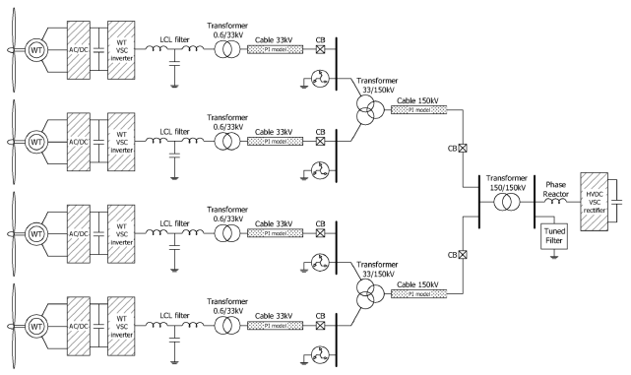
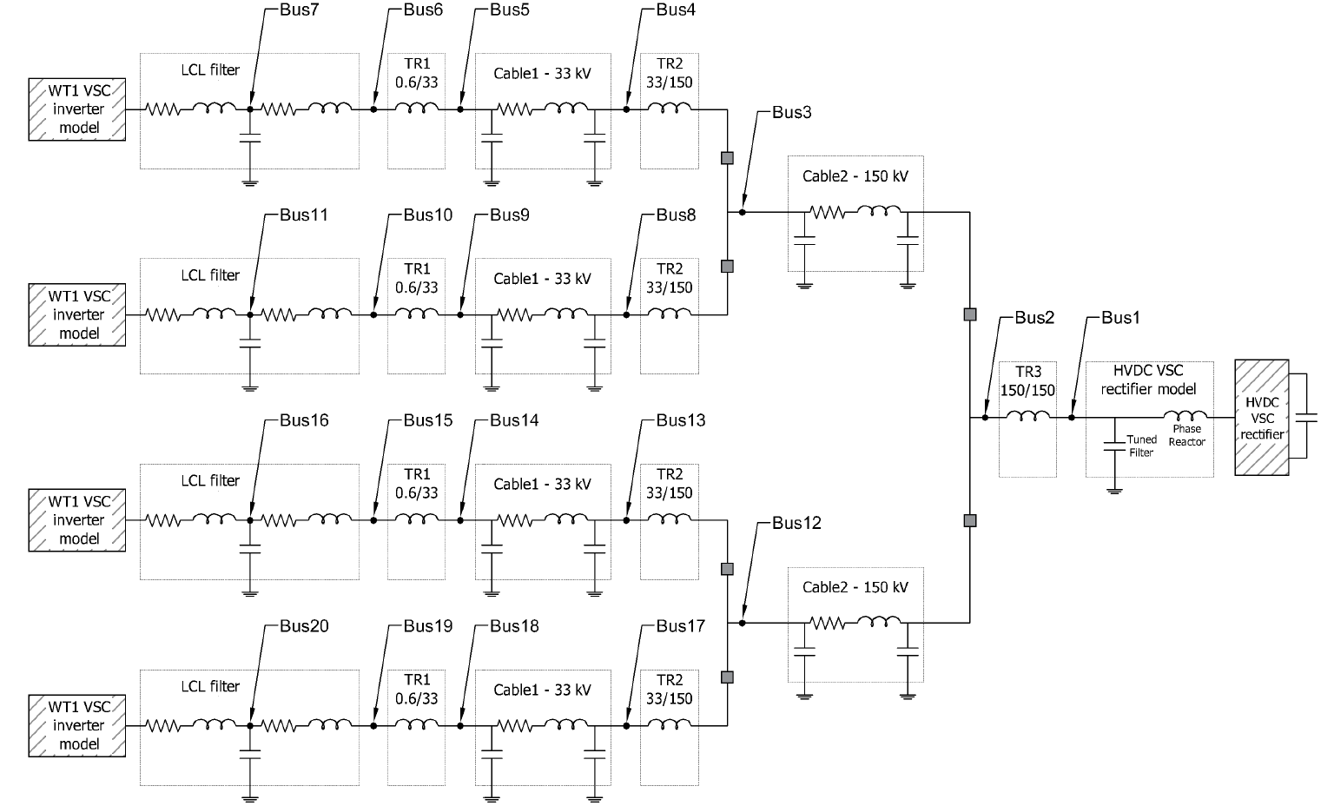
Simulations description
Impedance model
Case 1
Case 2
Case 3

Slide 17
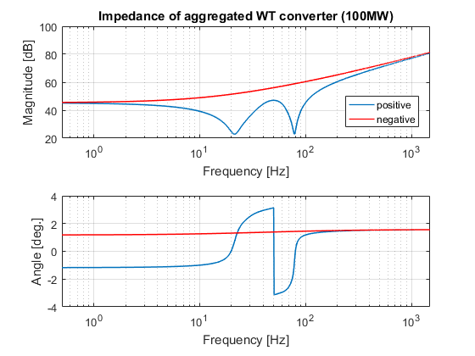
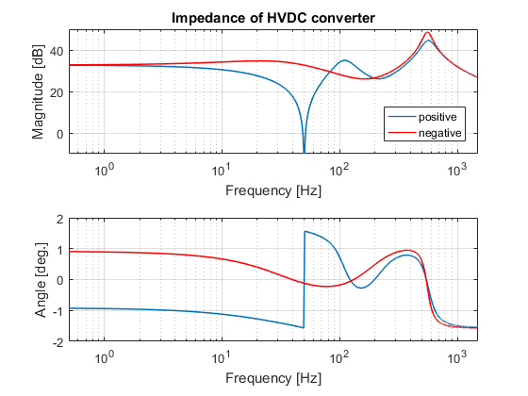
Simulations results
Nonlinear impedances of WT inverter and HVDC-link rectifier
WT inverter (100 MW)
HVDC rectifier (400 MW)

Slide 18
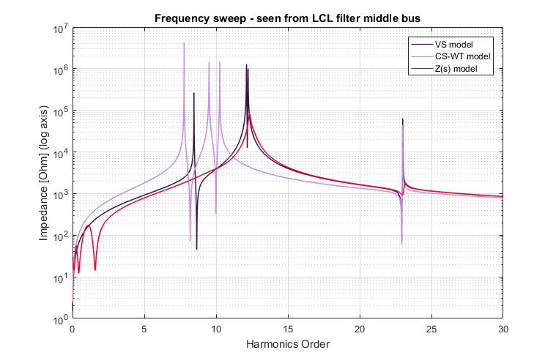
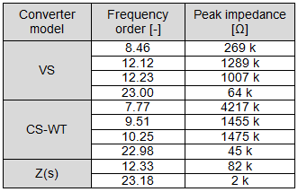
Simulations results
Case 2: Frequency sweep

Slide 19
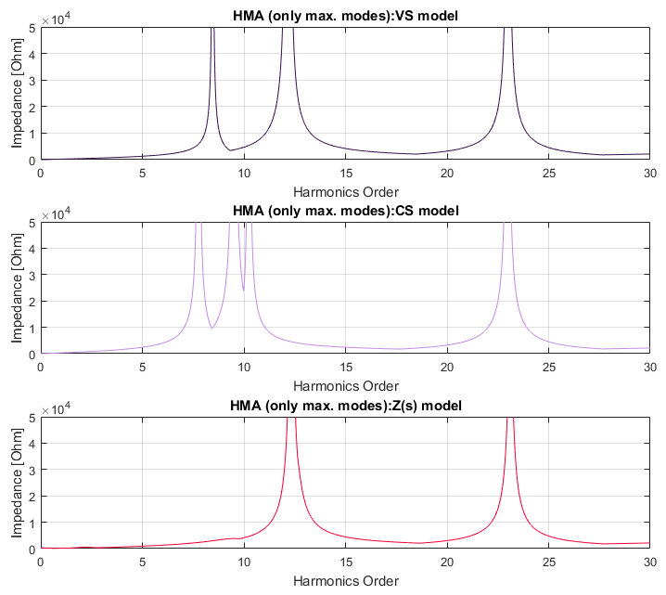
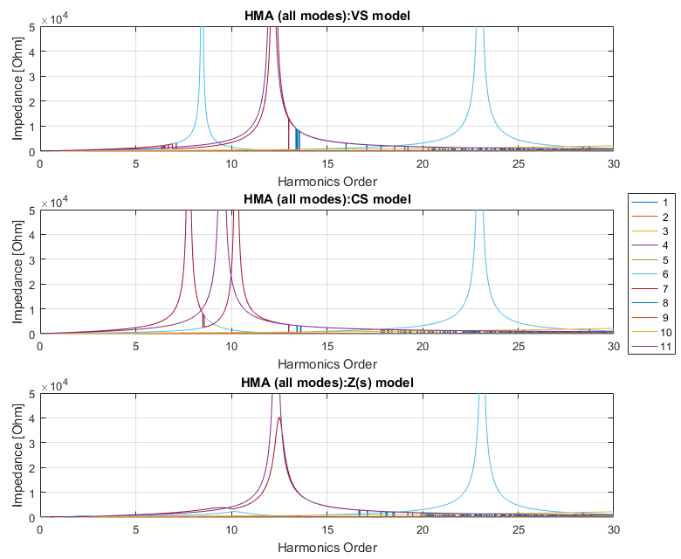
Simulations results
Case 2: Harmonic Resonance Modal Analysis – max. modes and all modes

Slide 20
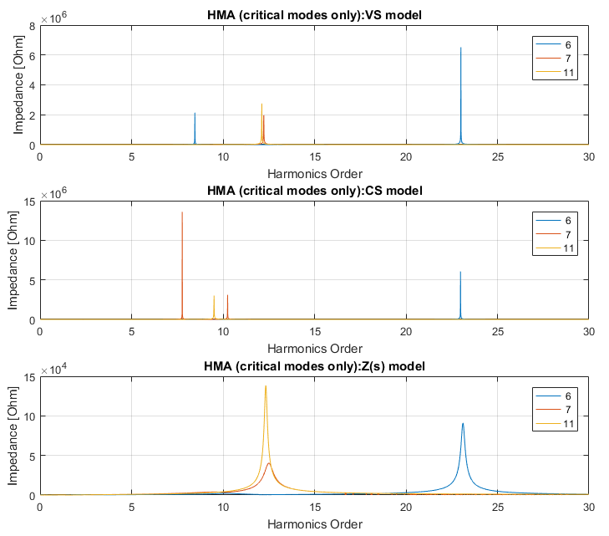
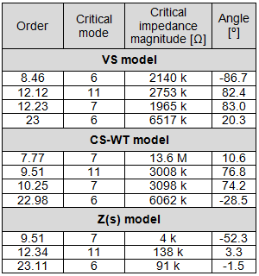
Simulations results
Case 2: Harmonic Resonance Modal Analysis – critical modes

Slide 21
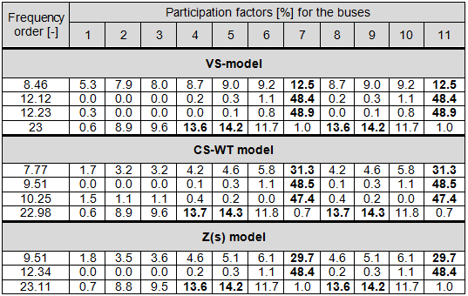
Simulations results
Case 2: Harmonic Resonance Modal Analysis – participation factors

Slide 22
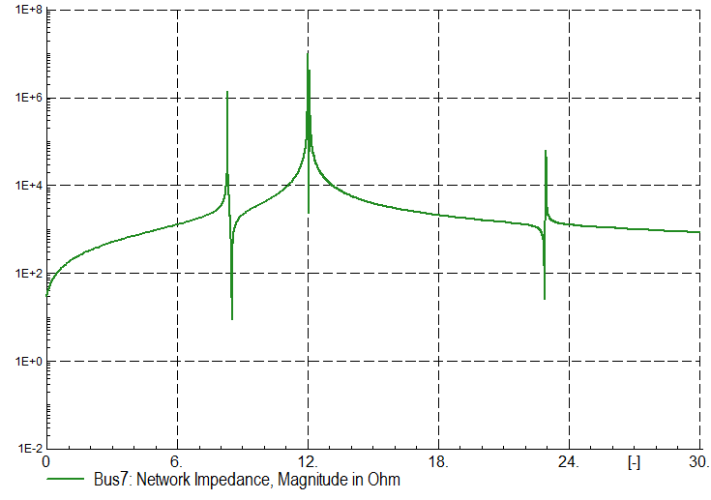
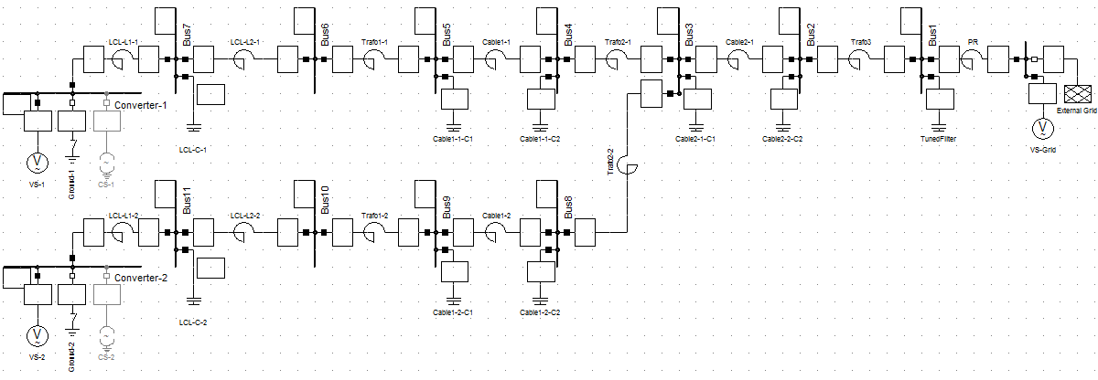
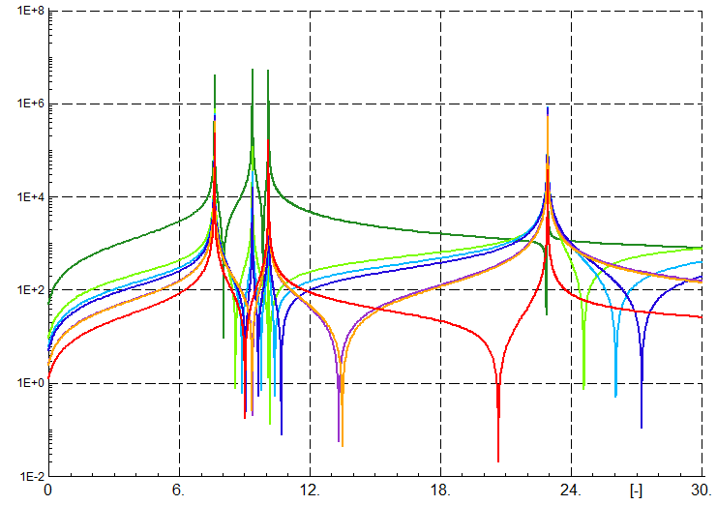
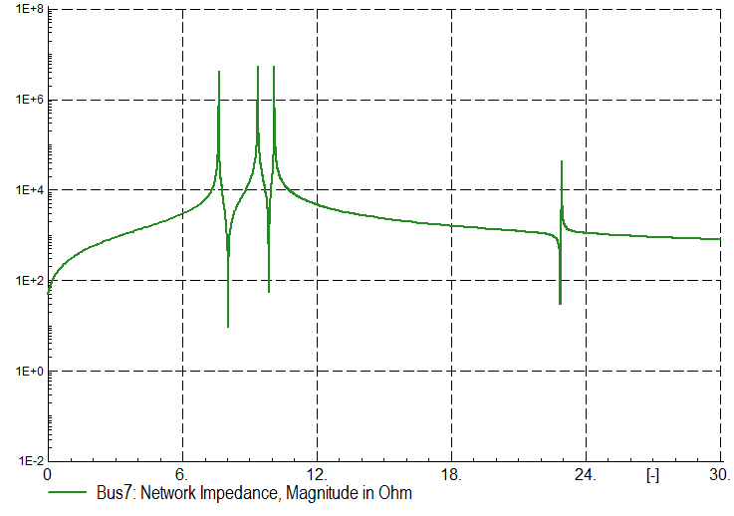
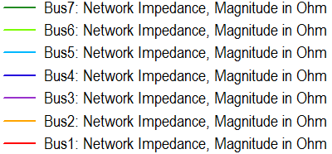
Simulations results
Case 2: Verification in Power Factory

Slide 23
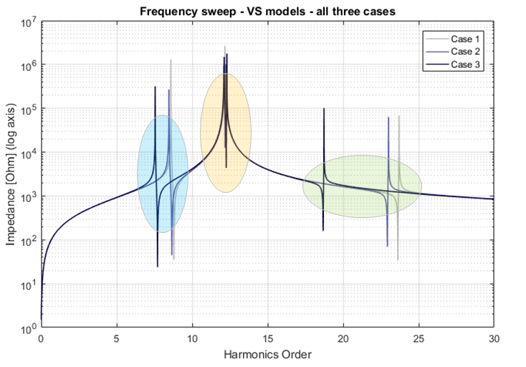
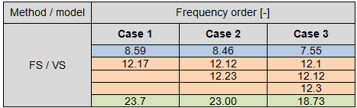
Simulations results
VS model
CS-WT model
Z(s) model
Comparison between topology cases: FS – VS model

Slide 24
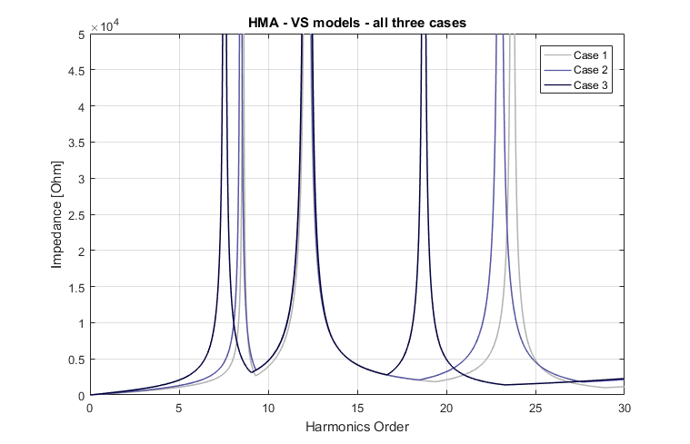
Simulations results
Comparison between topology cases: HRMA – VS model

Slide 25
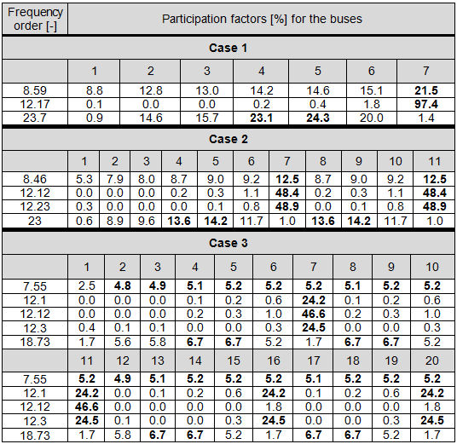
Simulations results
Comparison between topology cases: HRMA PF’s – VS model

Slide 26
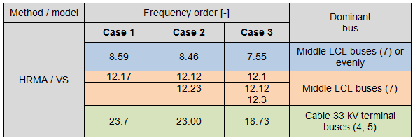
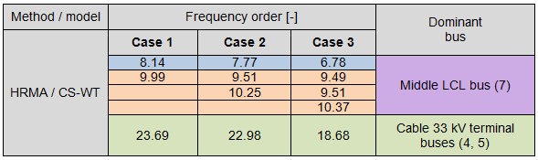
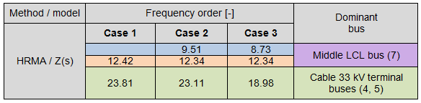
Simulations results
Comparison between topology cases: HRMA dominant buses – VS model

Slide 27

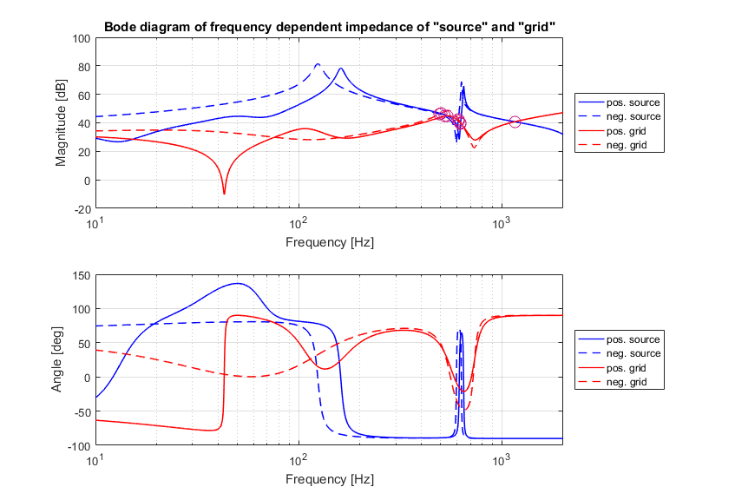
Simulations results
Case 2: Stability I

Slide 28
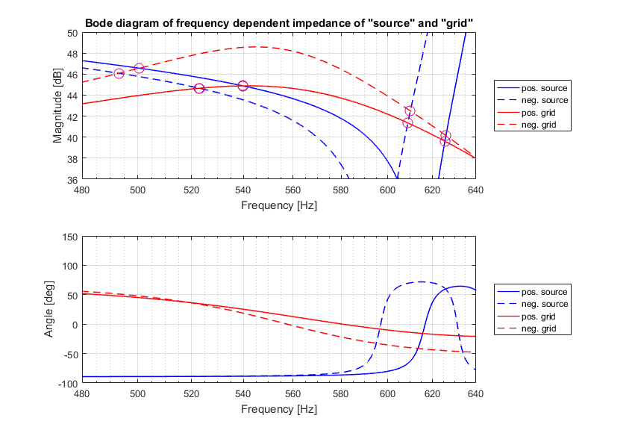
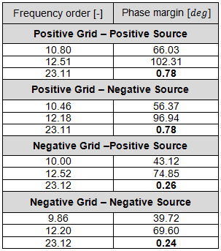

Simulations results
Case 2: Stability I
$$φ_{m}=180°−Δφ$$

Slide 29

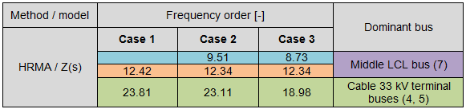
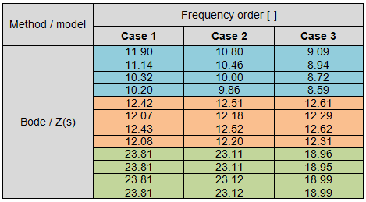
Simulations results
FS vs. HRMA vs. Bode for all topology cases
marginally stable
unstable

Slide 30
Summary
Output from the methods
FS: parallel & series resonance frequencies seen from particular point in the network
HRMA: parallel resonant frequencies & participation factors indicating source bus(es) of resonance
Nyquist/Bode: parallel resonant frequencies & phase margin indicating quality of stability

Slide 31

Summary
Observations from simulations
More resonant frequncies for cases with multiple branches
Downward shift of resonance for topology cases with more cables (more capacitance): $ω=\frac{1}{\sqrt{LC}}$
New resonant frequencies have expected values and expected source due to symmetry in the network
All three models consistent with respect to sources of resonance
The resonance sourced near WT inverter is the ”stiffest”: minor shifting, highest PF’s and highest stability phase margin
Resonant frequencies of highest group (around 23th order) marked as unstable (unstable operation in case of presence of waveforms around this order)
Progressively worse stability phase margin for the topologies with more branches

Slide 32
Summary
Conclusions
Recognition of resonant frequencies and their values and number in a network
Identification of origins of resonances indicating the best locations for filters implementation
Prediction of new resonances and their approximate origins after topology change
Labeling the resonances with respect to hazard for stability
Mitigation of resonance by adjusting of converter impedance (detailed control data necessary)

Slide 33
Thank you!

