Slide 1
CS599 - Open Source software development
GitHub
Dr. Igor Steinmacher
e-mail: Igor.Steinmacher@nau.edu
Twitter: @igorsteinmacher

Slide 2
Dealing with the Remote Repo

Slide 3
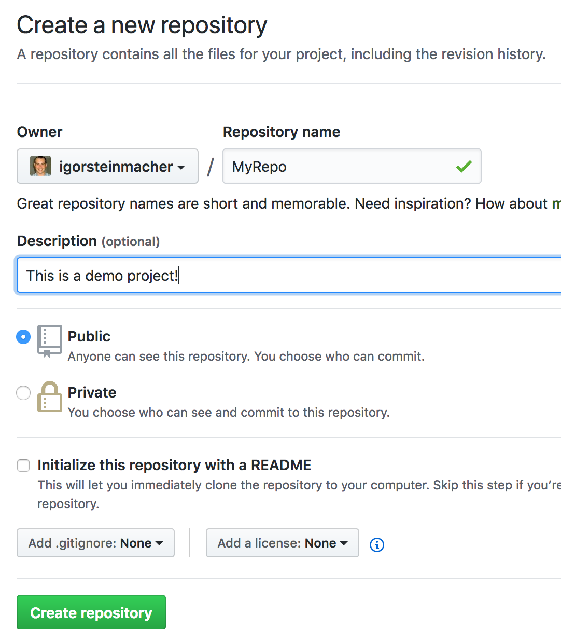
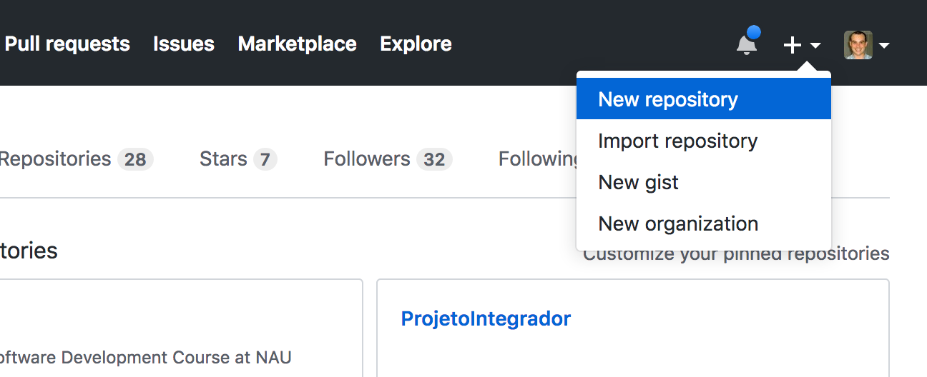
Create a Repo in GitHub

Slide 4
But… how to set my upstream repo?
git remote add origin git@github.com:<owner>/<repo>
git push -u <remote> <branch name>
git push –u origin main
Now we are linked to the GitHub repo...
Let’s try?

Slide 5
The opposite: Cloning to a Local Repo
That’s simple! Cloning means bringing all the history to a local repo
git clone …
Testing it out
git clone git@github.com:NAU-OSS/githandson.git
Cloning into 'githandson’
remote: Enumerating objects: 11, done.
remote: Counting objects: 100% (11/11), done.
remote: Compressing objects: 100% (8/8), done.
remote: Total 11 (delta 0), reused 8 (delta 0), pack-reused 0
Receiving objects: 100% (11/11), done.

Slide 6
Working In This Repo
Some different commands to deal with remote repo
git branch --r
git pull //pulls everything from the remote repo and updates the local repo
git fetch //pulls changes from remote repos, but it doesn't integrate any of this new data into your working files
git push
git push <remoteName> <branchName> //push your local changes to an online repository (git push origin main)
git push <remoteName> <localBranchName>:<remoteBranchName> // This pushes the LOCALBRANCHNAME to your REMOTENAME, but it is renamed to REMOTEBRANCHNAME.

Slide 7
Usual Workflow
git clone
branch out to add your changes locally
your adds/commits
pull changes to your local repo
merge your branch back (LOCALLY)
Resolve any conflict
push changes back to the remote repo
push –u origin <new_branch> (IF NEEDED)

Slide 8
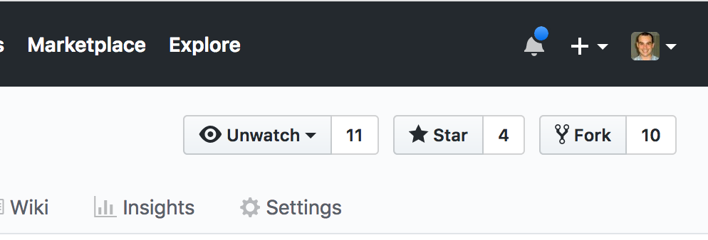
GitHub Workflow
Fork + pull-request
You usually creates a fork for your repo
“A fork is a copy of a repository. Forking a repository allows you to freely experiment with changes without affecting the original project”
Creating a fork
Then, you usually clone your fork… work, and send a pull request against the main repo

Slide 9
Example
Server
main
git pull
#updates local repo
Pull
origin/main
PC
main
main is a local branch
origin/main is a remote branch (a local copy of the branch named "master" on the remote named "origin")
origin is a remote

Slide 10
Example
Server
main
Someone changed
the remote
Pull
origin/main
PC
main

Slide 11
Example
Server
main
Updating the workspace and the local repo
Pull
Pull
origin/main
PC
main

Slide 12
Example
Server
main
Updating the local repo
but not the workspace
Pull
Fetch
origin/main
PC
main

Slide 13
A Pull Request Example
(GitHub) Fork
(CLI) Clone (the fork)
(CLI) Commits
(CLI) Push
(GitHub) Send Pull Request
Follow it
Revise it
Update it
Keep your fork up-to-date
https://help.github.com/articles/syncing-a-fork/

