Slide 1
Internet Protocol (IP)
- Presentation

Slide 2
What is IP……?
IP stands for Internet Protocol
IP specifies the format of packets, also called datagrams, and the addressing scheme. Most networks combine IP with a higher-level protocol called Transmission Control Protocol (TCP), which establishes a virtual connection between a destination and a source.

Slide 3
What is IP……? (cont.)
IP by itself is something like the postal system.
It allows you to address a package and drop it in the system, but there's no direct link between you and the recipient.
TCP/IP, on the other hand, establishes a connection between two hosts so that they can send messages back and forth for a period of time.

Slide 4
What is Protocol…
Rules and conventions explaining how something must be done
Used to describe how devices can communicate
Protocol also defines the format of Data i.e. : being exchanged.
If we both utilize the same protocol then you know how to format data so I will understand it and I know how to format data so you will understand it

Slide 5
Construction of Datagrams….
Each #datagram has two components
Header
Payload
Header
+
Data (Payload)
Packet

Slide 6
IP Service
Delivery service of IP is minimal.
IP provides an unreliable connectionless best effort service
Unreliable : IP doesn’t make an attempt to recover lost packets
Connectionless : Each packet is handled independently
Best Effort : IP doesn’t make guarantees on the service ( No through output , No delay guarantee…)

Slide 7
IP Service (Cont.…)
IP supports the following services
One-to-one (unicast)
One-to-all (broadcast)
One-to-several (multicast)
unicast
broadcast
multicast

Slide 8
OSI Reference Model
Open Systems Interconnection Reference Model
Splits communication system into seven layers
Each layer performs their task and passes the data to the next layer
Layer 7: Application
Layer 6: Presentation
Layer 5: Session
Layer 4: Transport
Layer 3: Network
Layer 2: Data Link
Layer 1: Physical

Slide 9
Orientation of Internet Protocol
IP is a Network Layer Protocol

Slide 10
What is TCP/IP..?
TCP/IP is a set of protocols developed to allow cooperating computers to share resources across a network.
TCP stands for Transmission Control Protocol
They are Transport Layer & Network Layer protocols in OSI model.
The most well known network that adopted TCP/IP is --> Internet. ( The Biggest WAN)

Slide 11
Why TCP/IP is so popular..?
TCP/IP was developed very Early!
Technologies were widely discussed in documents called “Request For Comments” (RFC) – free of charge
Supported by UNIX Operating System

Slide 12
TCP/IP Model
Because TCP/IP was developed earlier than the OSI 7 layer model, it doesn’t have 7 layers but only 4 layers.
Application Layer
Transport Layer
Internet Layer
Network Access Layer

Slide 13
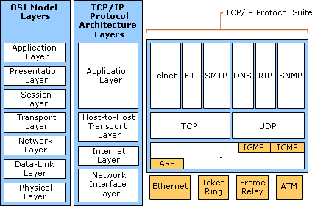

Slide 14
Application Layer…….
Application layer protocols defined the rules when implementing specific network applications.
Examples :
FTP – (File Transfer Protocol)
Telnet – ( Remote Terminal Protocol)
SMTP – (Simple Mail Transfer Protocol)
HTTP – (Hyper Text Transfer Protocol)

Slide 15
Transport Layer…
End to End data transfer……
Examples :
TCP (Transmission Control Protocol)
Connection oriented (connection established before data exchanged)
Reliable delivery of data
UDP (User Datagram Protocol)
Connectionless service
Delivery is not guaranteed (unreliable)

Slide 16
Internet Layer……
Internet layer protocols define the rules of how to find the routers for a packet to the destination.
It only gives best effort delivery. (packets can be delayed, corrupted, lost or out of order)
Examples :
IP – Internet Protocol (Provide packet delivery)
ARP – Address Resolution Protocol (Defined the procedure of network address / mac address translation)
ICMP – Internet Control Message Protocol (Defined the procedure of error message transfer)

Slide 17
Network Access Layer….
Also known as Network Interface Layer…
The Network Access Layer is the layer in the TCP/IP model at which data is transmitted and received across the physical network.
Mostly in hardware
A well known example is Ethernet
Examples :
Ethernet
Token Ring
Frame Relay
ATM (Asynchronous Transfer Mode)

Slide 18
IP Address
What is an IP address…?
An IP address is a unique global address for a network interface
- is a 32 bit long identifier
- encodes a network number (network prefix) and a host number
10000000
10001111
10001001
10010000
1st Byte
= 128
2nd Byte
= 143
3rd Byte
= 137
4th Byte
= 144
128.143.137.144

Slide 19
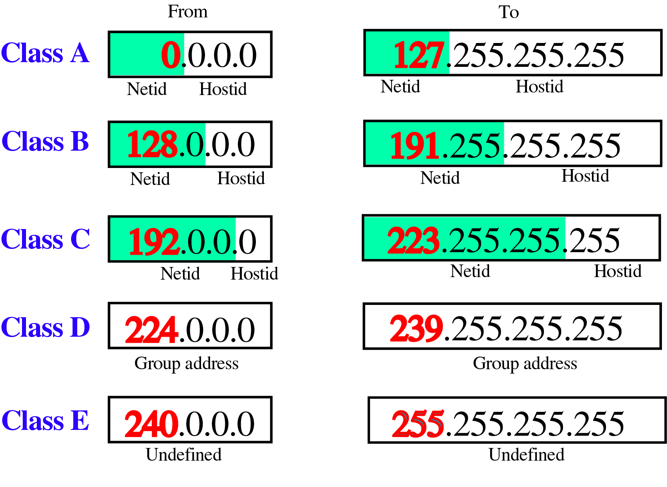
Class Ranges of Internet Addresses

Slide 20

Class A
Class A addresses are assigned to networks with a very large number of hosts
The high-order bit in a class A address is always set to zero.
The next seven bits (completing the first octet) complete the network ID.
The remaining 24 bits represent the host ID.

Slide 21

Class B
Class B addresses are assigned to medium-sized to large-sized networks.
The two high-order bits in a class B address are always set to binary 1 0.
The next 14 bits complete the network ID.
The remaining 16 bits represent the host ID.

Slide 22

Class C
Class C addresses are used for small networks.
The three high-order bits in a class C address are always set to binary 1 1 0.
The next 21 bits complete the network ID.
The remaining 8 bits represent the host ID.

Slide 23
Class D & E
Class D addresses are reserved for IP multicast addresses.
The four high-order bits in a class D address are always set to binary 1 1 1 0.
The remaining bits are for the address that interested hosts recognize.
Class E is an experimental address that is reserved for future use
The high-order bits in a class E address are set to 1111.

Slide 24
Class Ranges of Network IDs…
Address Class | First Network ID | Last Network ID
Class A | 1.0.0.0 | 126.0.0.0
Class B | 128.0.0.0 | 191.255.0.0
Class C | 192.0.0.0 | 223.255.255.0
The network ID cannot begin with the number 127. The number 127 in a class A address is reserved for internal loopback functions.
All bits within the network ID cannot be set to 1. All 1's in the network ID are reserved for use as an IP broadcast address.

Slide 25
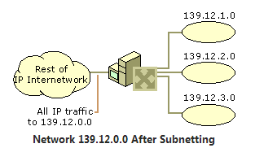
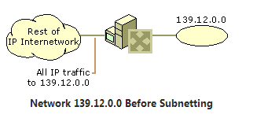
Subnetting….
Subnetting enables the network administrator to further divide the host part of the address into two or more subnets.
In this case, a part of the host address is reserved to identify the particular subnet.
This is easier to see if we show the IP address in binary format.

Slide 26
Subnet Mask….
Subnet masks are frequently expressed in dotted decimal notation.
Subnet mask is not an IP address.
Each host on a TCP/IP network requires a subnet mask even on a single segment network.
Address Class | Bits for Subnet Mask | Subnet Mask
Class A | 11111111 00000000 00000000 00000000 | 255.0.0.0
Class B | 11111111 11111111 00000000 00000000 | 255.255.0.0
Class C | 11111111 11111111 11111111 00000000 | 255.255.255.0

Slide 27
Journey to IP Versions…
IPV(1-3) : were not formally assigned.
IPV4 : TCP/IP , 32bit IP address currently used.
IPV5 : Internet Stream Protocol (SP)
Experimental Protocol
Never Introduced for public use.
IPV6 : Designed to replace IPV4 , 128bit IP address

Slide 28
Features of IPV4…
Connectionless protocol and best effort based.
Simplicity
It is simpler and easy to remember
Require less memory
Familiarity
Millions of devices are already knowing it
Existing infrastructure already support it

Slide 29
Benefits of IPV4….
Widely support
Shorter & Sweeter (header)
Support of all Operating Systems
All commonly used protocols are supported

Slide 30
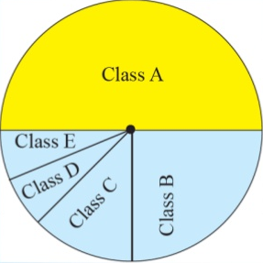
Shortcoming of IPV4….
IPV4 specification didn’t identify any security mechanism.
Millions of class A addresses are wasted.
Many class B addresses also wasted.
Not so many organizations are so small to have a class C block.
Class E addresses were reserved for future purposes.

