Slide 1
Chapter 11
User Datagram
Protocol
(UDP)

Slide 2
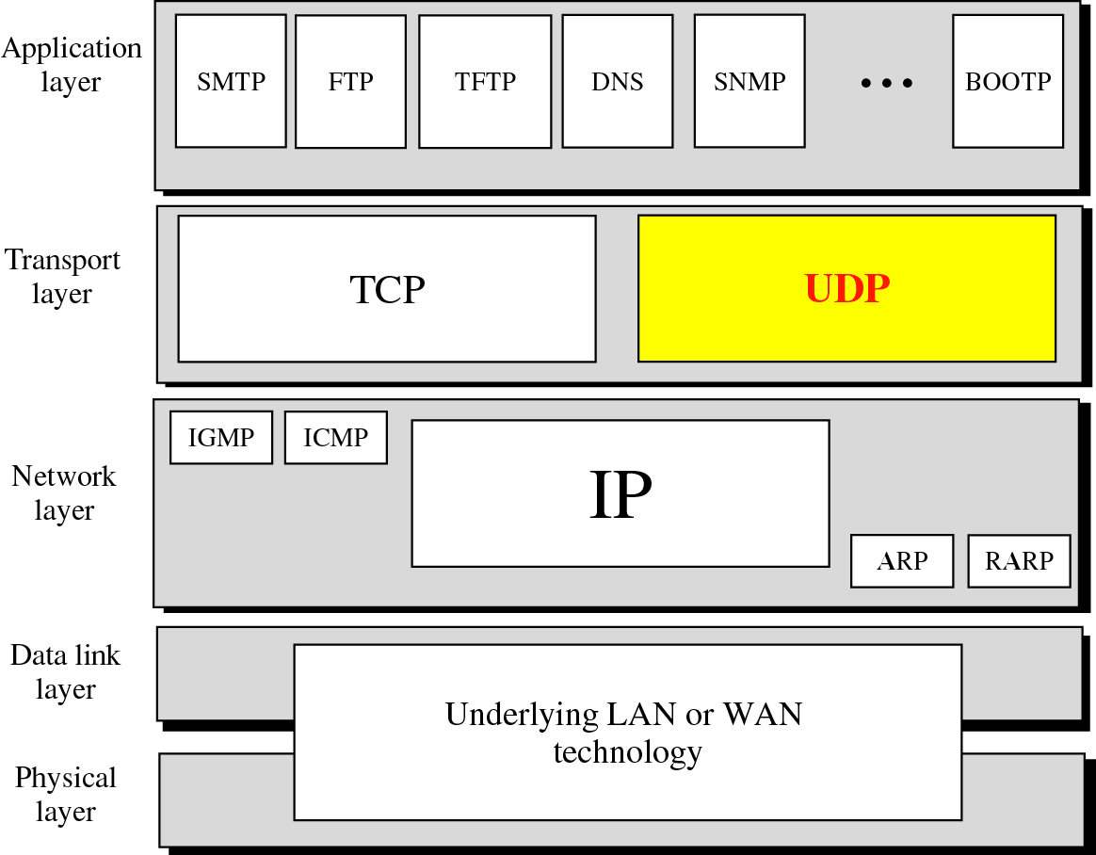
Figure 11-1
Position of UDP in the TCP/IP protocol suite

Slide 3
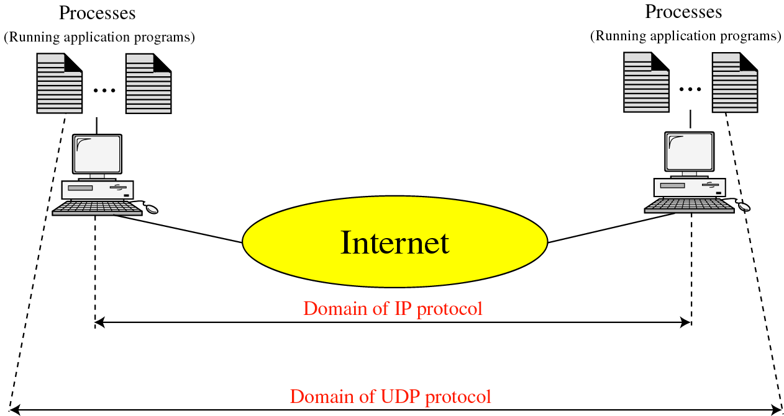
Figure 11-2
UDP versus IP

Slide 4
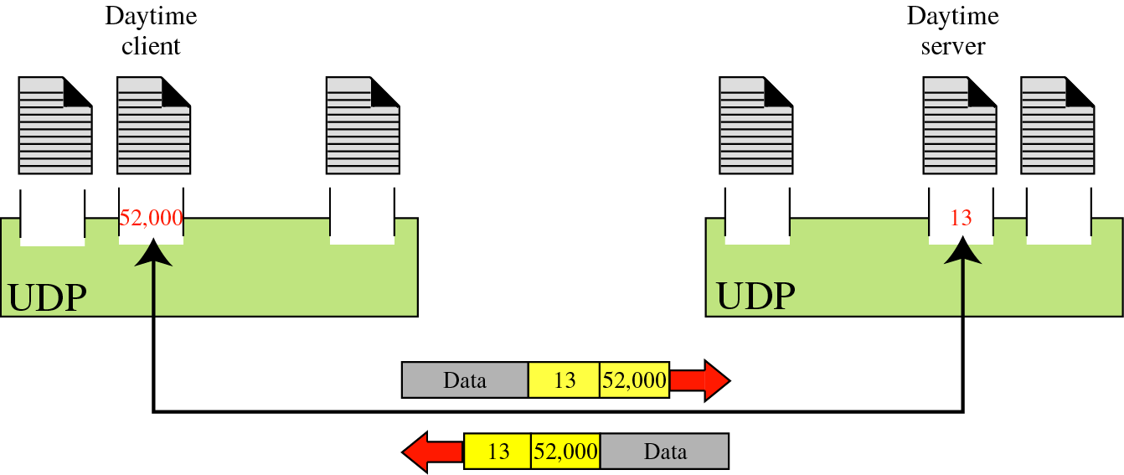
Figure 11-3
Port numbers

Slide 5
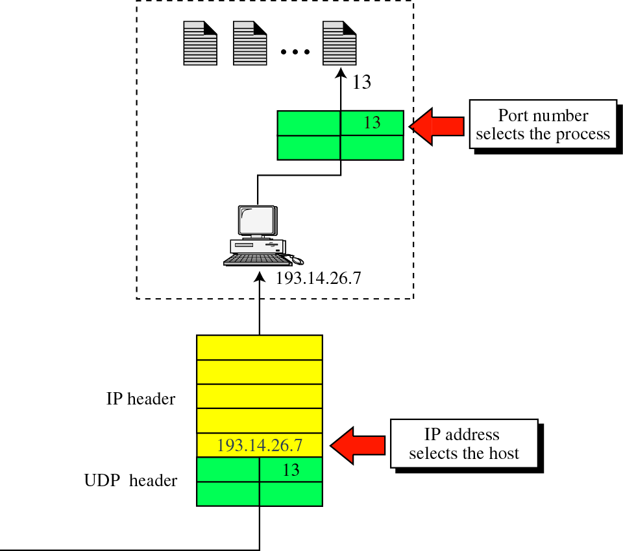
Figure 11-4
IP addresses versus port numbers

Slide 6
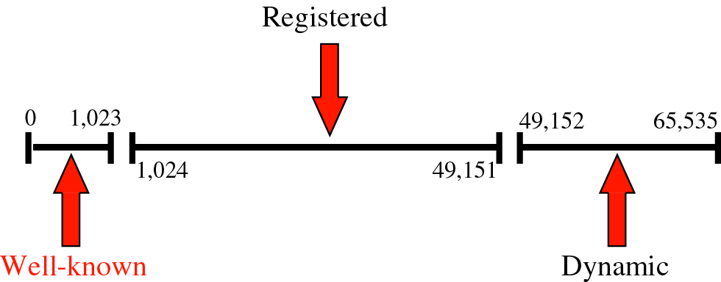
Figure 11-5
IANA ranges

Slide 7
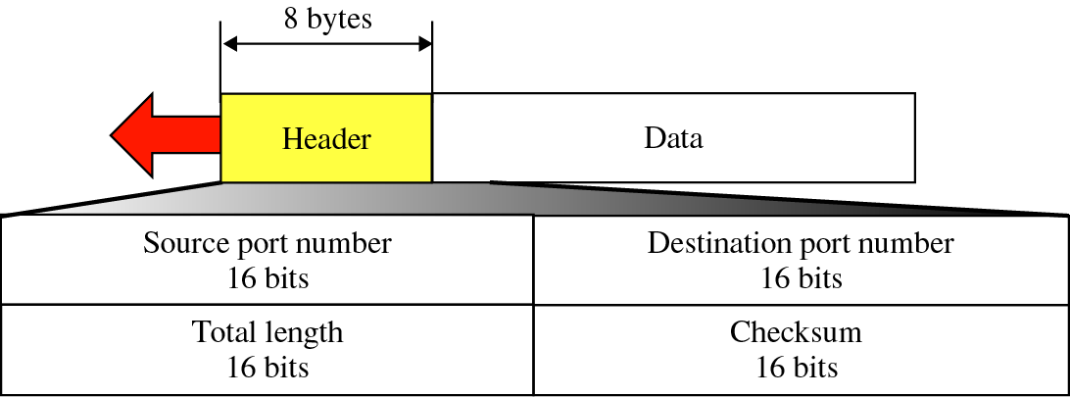
Figure 11-7
User datagram format

Slide 8

UDP length =
IP length − IP header’s length

Slide 9
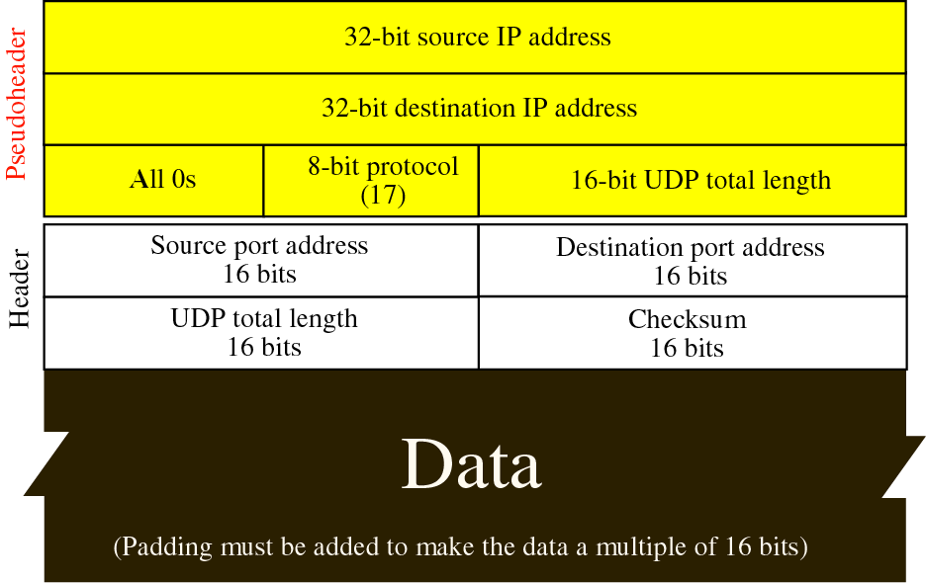
Figure 11-8
Pseudoheader added to the UDP datagram

Slide 10
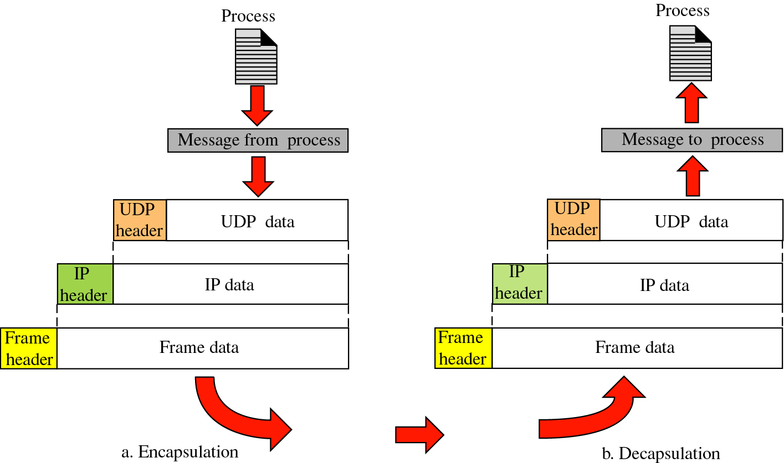
Figure 11-10
Encapsulation and decapsulation

Slide 11
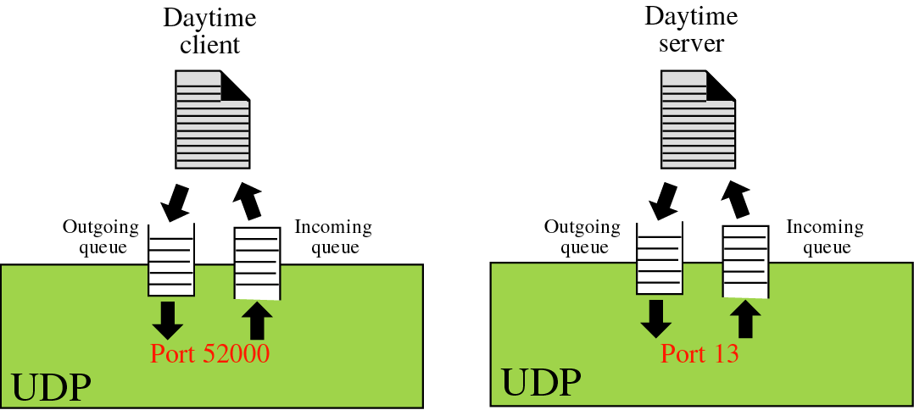
Figure 11-11
Queues in UDP

Slide 12
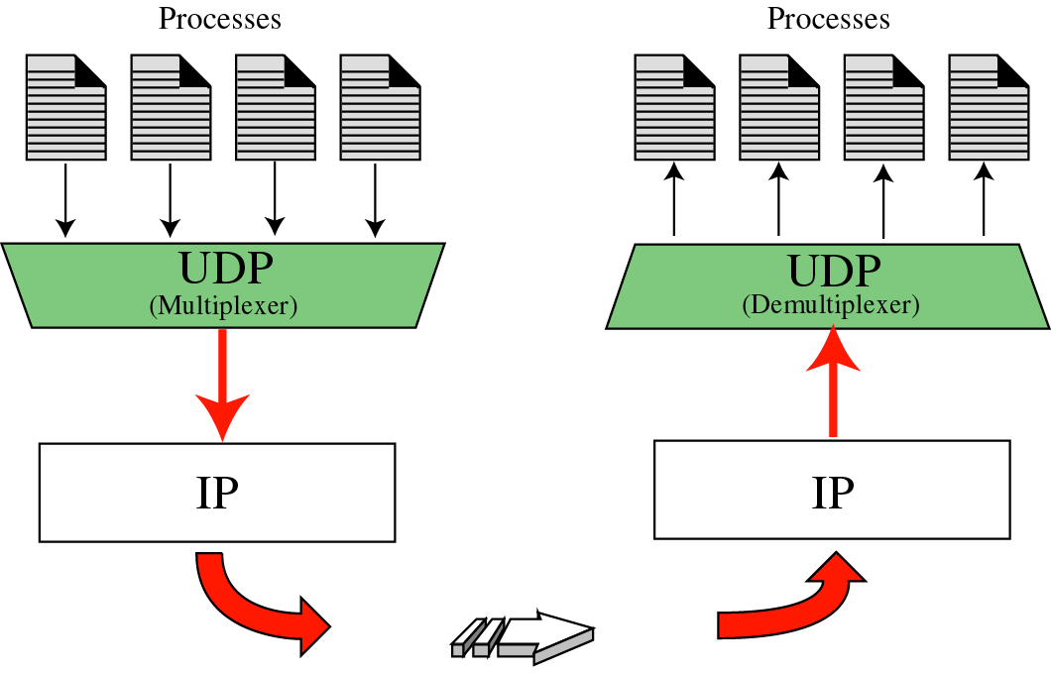
Figure 11-12
Multiplexing and demultiplexing

Slide 13
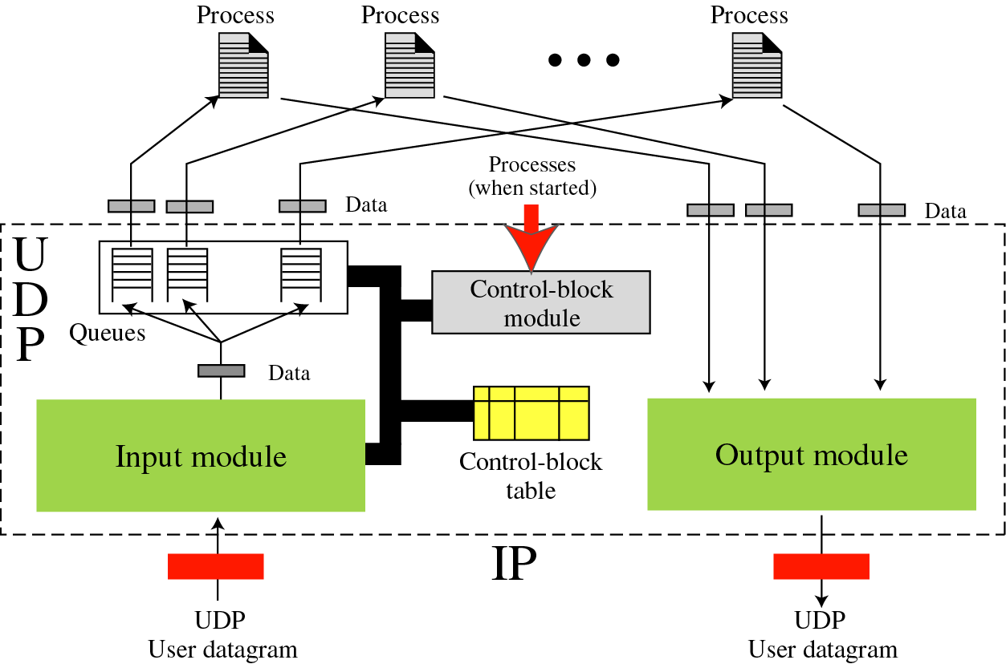
Figure 11-13
UDP package

