Slide 1
Risk Prediction and Diagnostics of Cardiovascular Diseases Igor Putrenko, Ph.D. Insight Heath Data Science Program San Francisco, CA September 2017

Slide 2
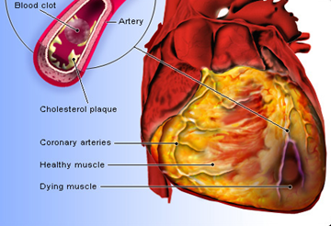
Problem / Motivation
By 2030, annual direct medical costs associated with CVD are projected to rise to 818 billion US$
There is an urgent need for tools used in risk assessment and early detection of CVD

Slide 3

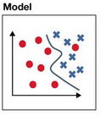
Goal: Prediction of CVD Types Based On Lab Tests
Patient
Physical assessment
ECG
Stress Test
Ultrasound
X-ray
MRI
Lab Tests
Angiography
Dx
Dx

Slide 4


Data Source
MIMIC-III, critical care database
38,597 patients
Median age is 65.8 years (52.8–77.8)
MIMIC-III
Recordings
Images
Lab Tests
Demographics
Notes and Reports
De-identification
Date shifting
Format conversion
Data Archive

Slide 5
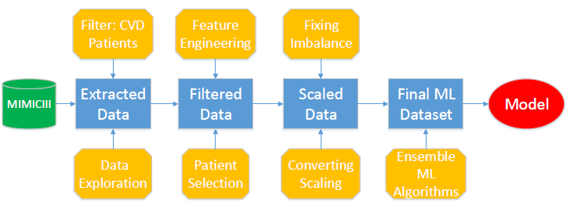
Workflow

Slide 6
Data Pipeline
~ 28 M records
~ 2.4 M CVD records

Slide 7
Data Pipeline
~ 28 M records
2455 patients
403 tests
~ 2.4 M CVD records

Slide 8
Data Pipeline
Threshold:
2155 patients/test
~ 28 M records
2455 patients
403 tests
1868 patients
30 tests
~ 2.4 M CVD records

Slide 9
Data Pipeline
Threshold:
2155 patients/test
Imbalance fix
Feature reduction
~ 28 M records
2455 patients
403 tests
1868 patients
30 tests
1603 patients
20 tests
~ 2.4 M CVD records

Slide 10
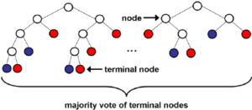
Random Forest Model
1603 patients
23 (20+3) features
6 CVD categories
Cross-validation
Grid search
Best Score: 44% (vs 16.7% chance)

Slide 11
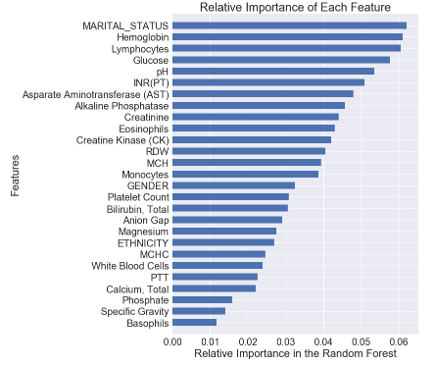
Feature Importance

Slide 12
Conclusion
The developed model can be used to create a tool for risk assessment and early detection of specific CVD
It will simplify, speed up and decrease the cost of clinical assessment

Slide 13

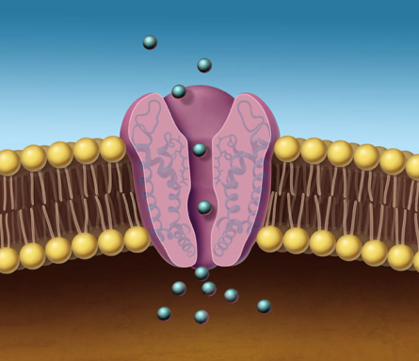
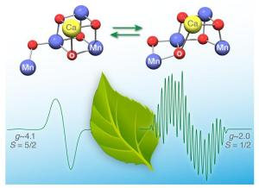


About Me
Photosynthesis, Electrophysiology (Ion Channels), Pain Drug Development

Slide 14
CVD categories
Patients selected with the following Diagnosis Related Groups (DRGCODES) used by the hospital for billing purposes
ACUTE ISCHEMIC STROKE
ACUTE MYOCARDIAL INFARCTION (AMI)
CARDIAC ARRHYTHMIA & CONDUCTION DISORDERS
HEART FAILURE
CIRCULATORY DISORDERS EXCEPT AMI
CIRCULATORY DISORDERS WITH AMI

Slide 15
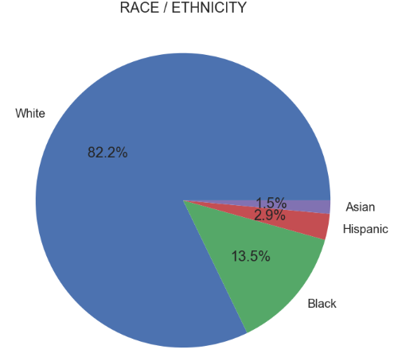
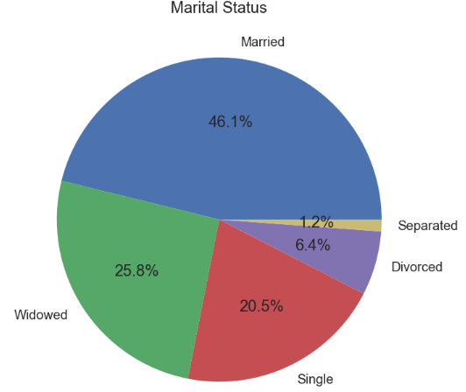
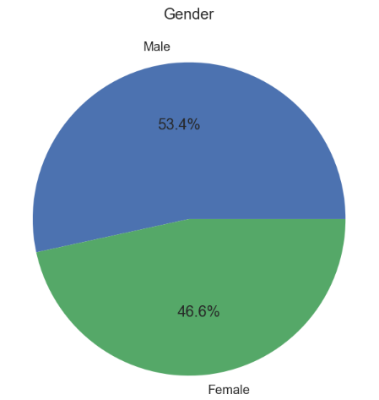
Demographic Data

Slide 16
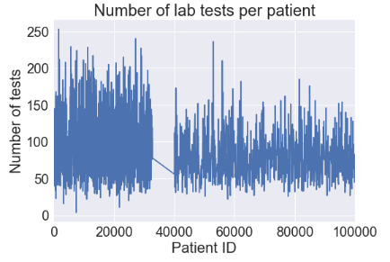
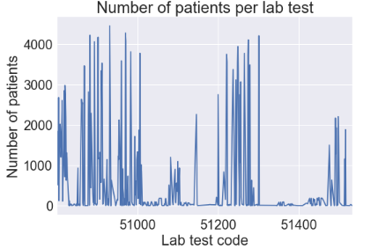
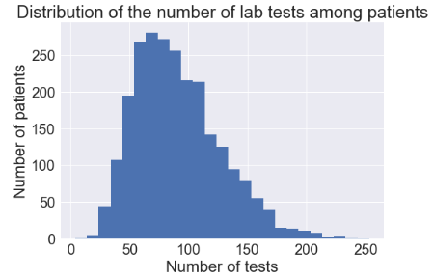
Feature Engineering – Selecting Patients
Total number of CVD patients | 2455
Feature selection threshold | 1955
Features passed the threshold | 35
Number of patients with the same features | 1544
Final number of selected patients | 1363

Slide 17
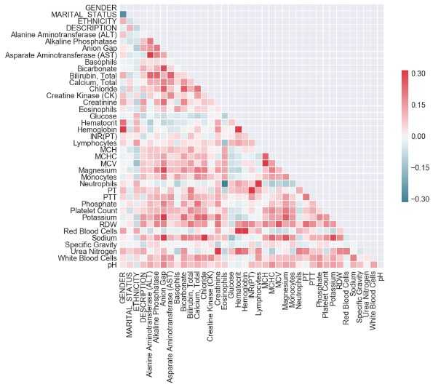
Feature Engineering - Selecting Features

Slide 18
ML Models
Model (with cross-validation) | Accuracy
Logistic Regression | 31.8 ± 1.8%
AdaBoost | 31.8 ± 1.8%
Gradient Boosting | 36.3 ± 3.5%
Artificial Neural Network (MLP) | 41.9 ± 2.5%
Random Forest | 41.1 ± 2.6%
Random Forest (Grid Search best score) | 44.2%
Random Chance (6 categories) | 16.7%

