Slide 1
Risk Prediction and Diagnostics of Cardiovascular Diseases Igor Putrenko Insight Health Data Science Program San Francisco, CA October 2017

Slide 2
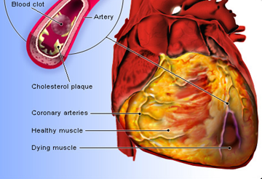
Cardiovascular Diseases (CVD)
Annual direct medical expenditures (by 2030) – $818 billion
One in three U.S. adults has one or more types of CVD
Optimized diagnostic process can substantially decrease the costs

Slide 3

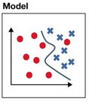
Can we predict CVD type based on lab tests?
Patient
Physical assessment
ECG
Stress Test
Ultrasound
X-ray
MRI
Lab Tests
Angiography
Dx
Dx

Slide 4


Data source
MIMIC-III, critical care database
38,597 patients
Median age is 65.8 years (52.8–77.8)
MIMIC-III
Recordings
Images
Lab Tests
Demographics
Notes and Reports
De-identification
Date shifting
Format conversion
Data Archive

Slide 5

Data pipeline
MIMIC-III
csv files
28 M records
SQL Server database
Dataset
1209 patients
20+3 features

Slide 6
Predictive modeling
6 CVD categories
Balanced classes
Cross-validation (5-fold)
Grid search
Gradient Boosting
Random Forest
Artificial Neural Network
Accuracy: 39% (vs 16.7% chance)

Slide 7
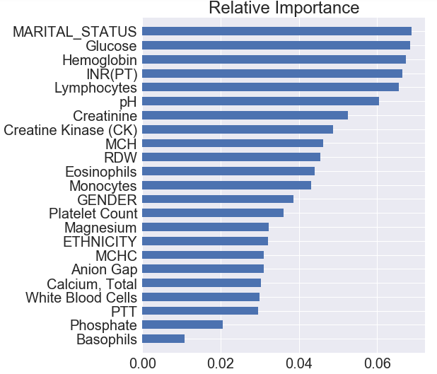
Feature Importance
Identified features are indicators of:
psychological well-being
status of immune system
chronic diseases (kidneys, liver, heart)
chronic infection
genetic factors

Slide 8

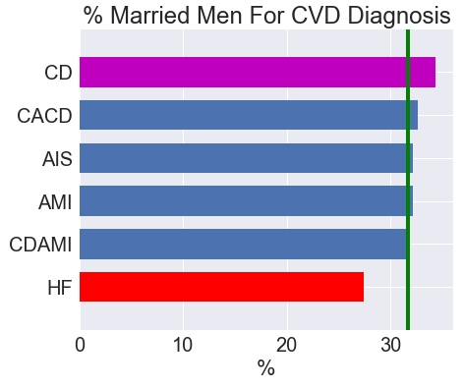
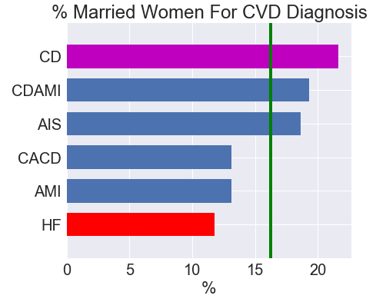
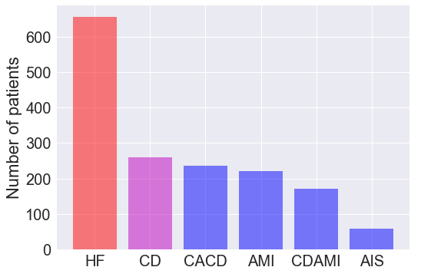
Should you get married?

Slide 9

Conclusion
The developed model can improve CVD diagnostic process:
Risk assessment
Early detection
Decision support
Cost reduction
Faster diagnostics
Clients: clinicians, health agencies, insurance companies

Slide 10










About me
Ph.D. in Biochemistry
Academia: ion channel electrophysiology, brain & pain research
Biotech industry: pain drug discovery
IT: business / systems analysis, infrastructure, network administration
Concentrate on Data Science

Slide 11
Backup Slides

Slide 12
CVD Categories
Patients selected with the following Diagnosis Related Groups (DRGCODES) used by the hospital for billing purposes
ACUTE ISCHEMIC STROKE
ACUTE MYOCARDIAL INFARCTION (AMI)
CARDIAC ARRHYTHMIA & CONDUCTION DISORDERS
HEART FAILURE
CIRCULATORY DISORDERS EXCEPT AMI
CIRCULATORY DISORDERS WITH AMI

Slide 13
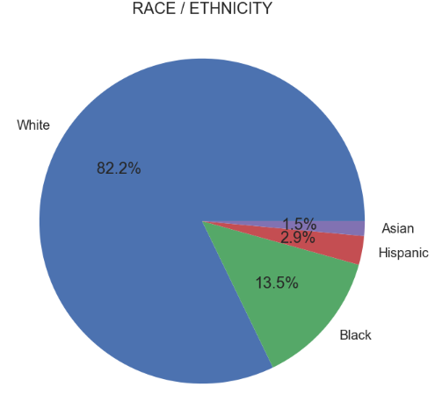
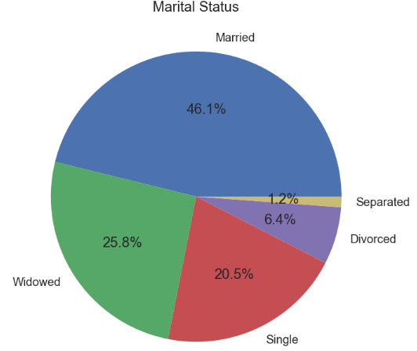
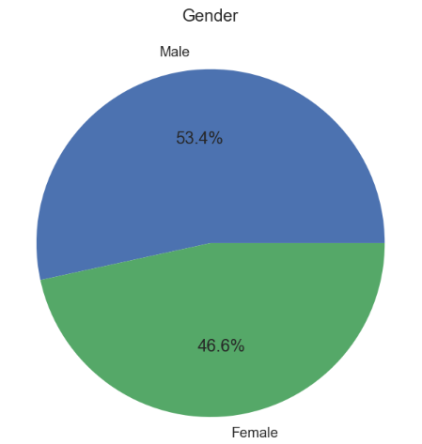
Demographic Data

Slide 14
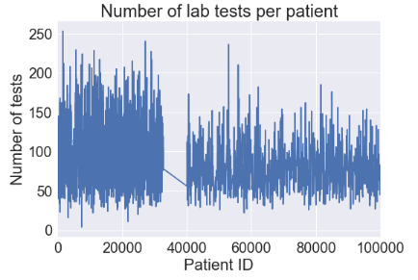
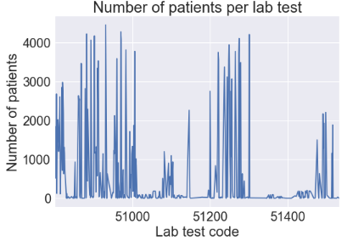
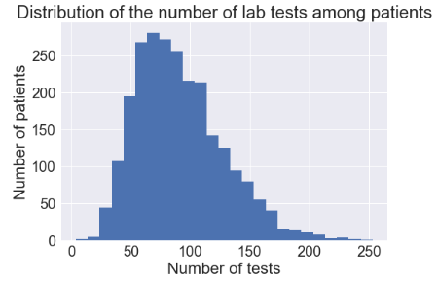
Dimension Reduction – Selecting Lab Tests
Total number of CVD patients | 2455
Total number of lab tests | 403
Feature selection – missing values threshold (patients/test) | 2155
Lab tests (features) passed | 35
Final number of selected patients | 1209

Slide 15
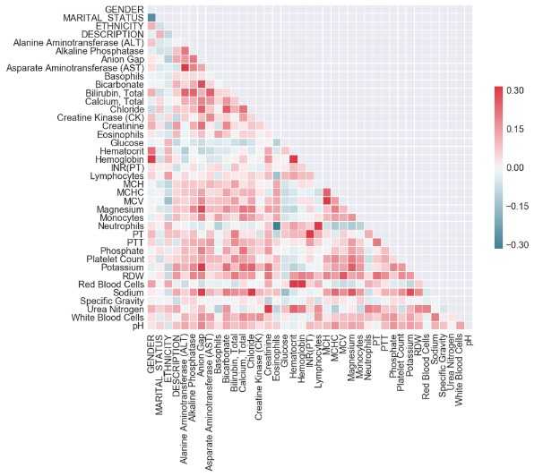
Identifying Multicollinearity

Slide 16
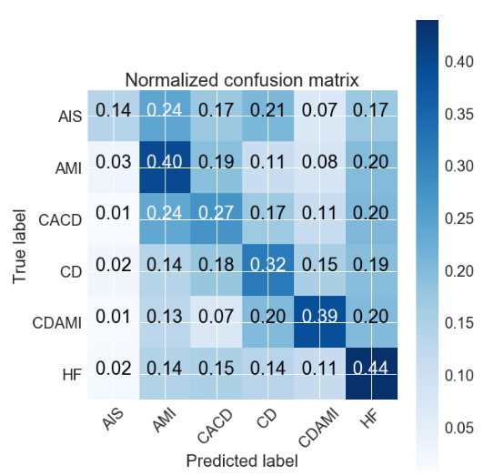
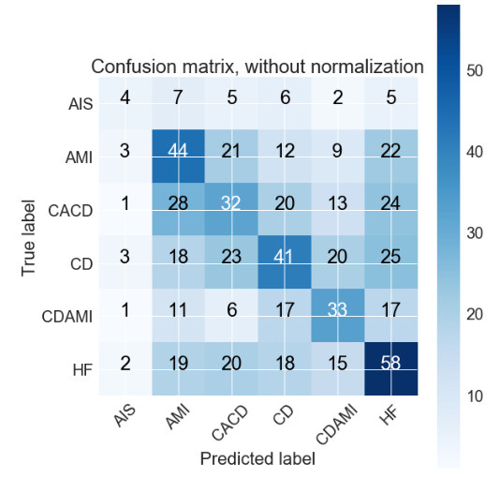
Confusion Matrix

Slide 17
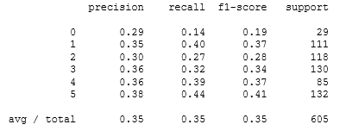
Precision, Recall, and F1-score

