Slide 1

RELEASE 0.2.46
B2B Client Profile
& My Space Calendar
amoCRM-style client cards · calendar with lead & personal tasks · Google Calendar sync · platform staff pickers
Yango · Sales Operations · Appli Taxi Oz
Notes:
Release overview for Yango leadership.

Slide 2
AGENDA
What shipped in 0.2.46
Five product surfaces managers will feel immediately
01
B2B Overview → profile
Search + click opens (or creates) a CRM client profile
02
Client profile workspace
Deal fields, managers, activity feed, Task/Note/Mail/Meeting
03
My Space Calendar
Sidebar subsection with meetings + assigned lead tasks
04
Event side drawers
Edit, reschedule, complete, append timestamped notes
05
Staff pickers cleaned
Only approved platform users (@appli.taxi) in assignee/owner filters
Yango · Sales Operations · Release 0.2.46 · Confidential
2 / 12

Slide 3
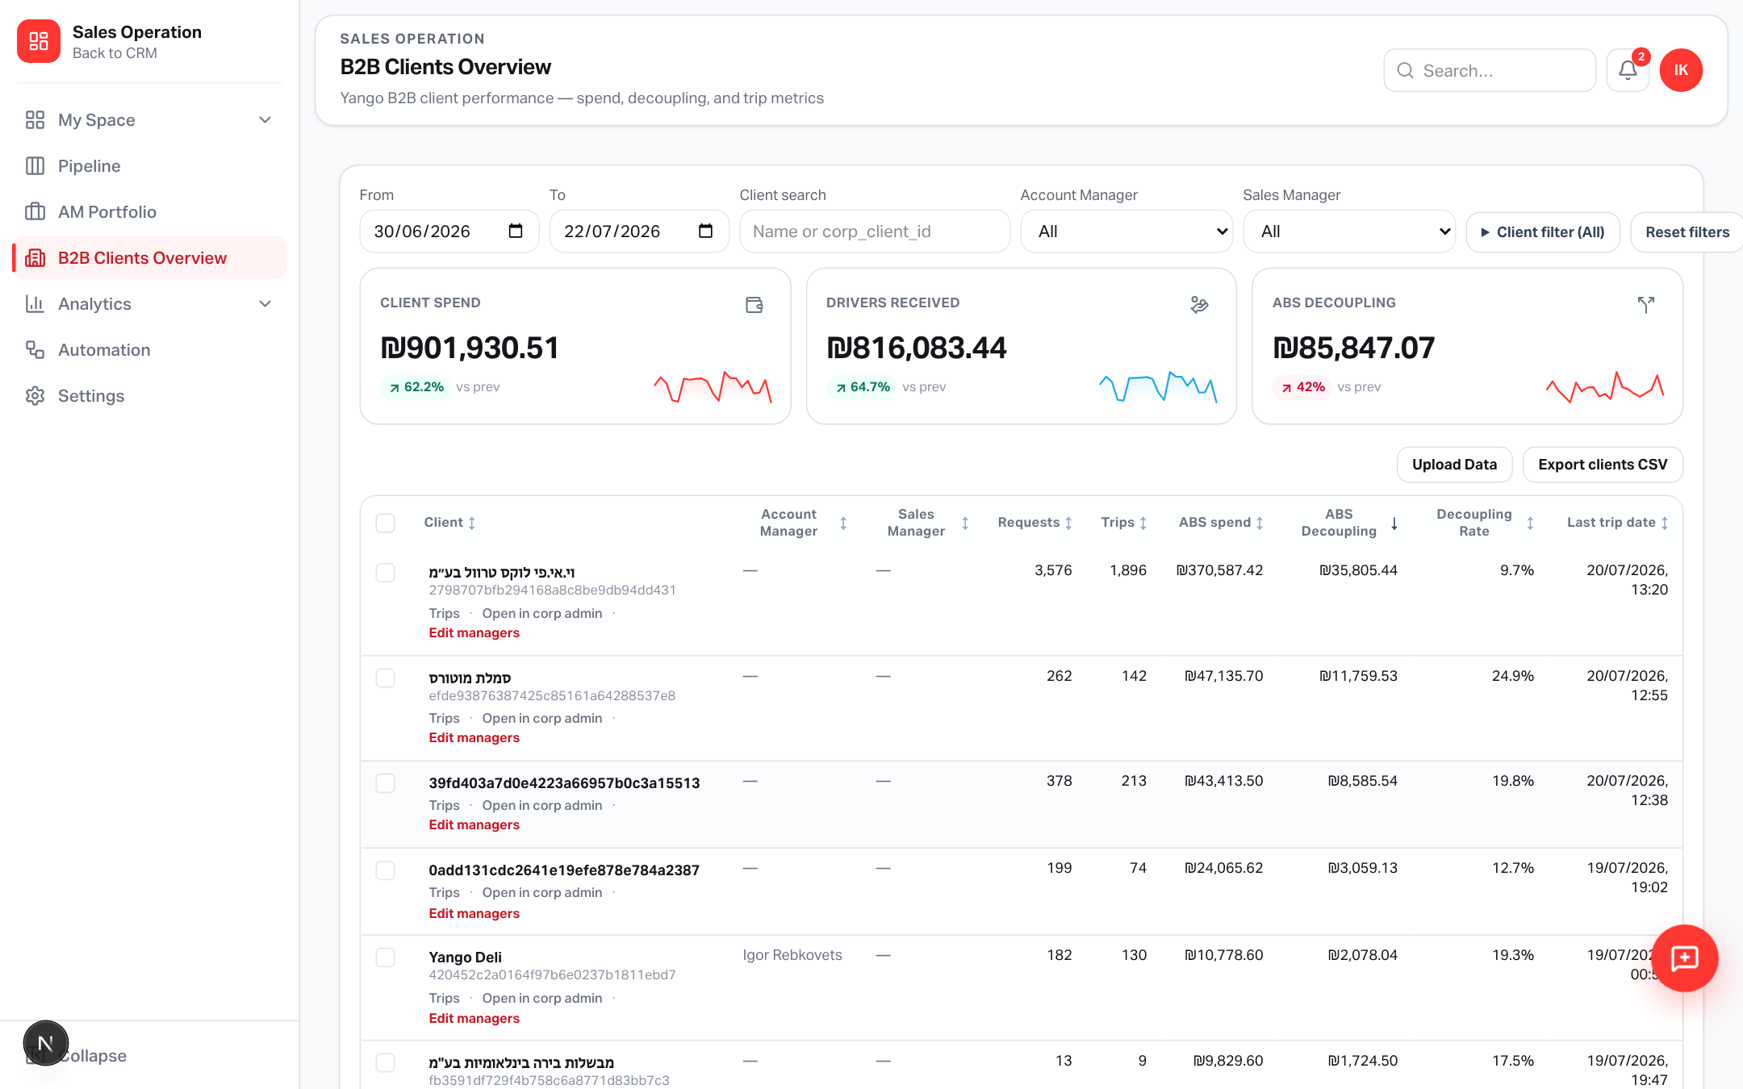
B2B OVERVIEW
Search and open any client into CRM
No more dead-end metrics-only click
How it works
• Filter table by name or corp_client_id
• Click → ensure CRM client
• Missing profile? creates signed lead + sales_clients
• Lands on amoCRM-style profile
• Trips remain a secondary link
Yango · Sales Operations · Release 0.2.46 · Confidential
3 / 12

Slide 4
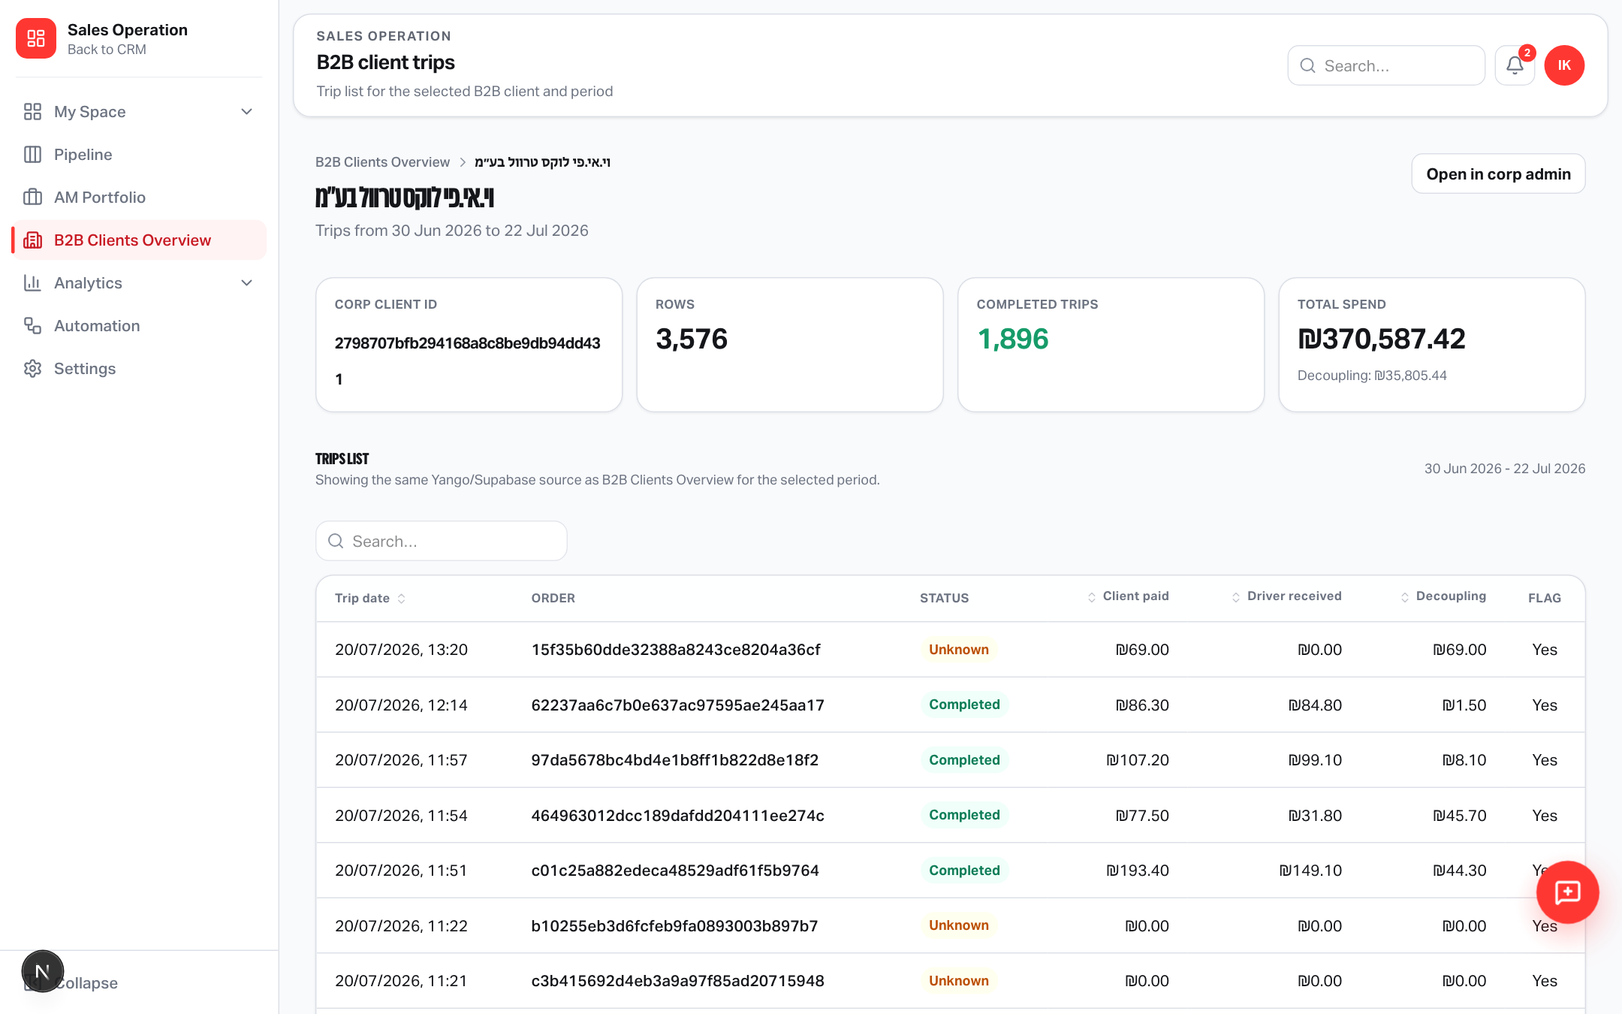
CLIENT PROFILE
Left: data · Right: activity
One place for post-signed client work
Left panel
• Contact fields
• Account / Sales managers
• Deal fields from linked lead
(segment, potential, pricing,
contract, address, notes…)
• B2B KPI tiles + date range
Yango · Sales Operations · Release 0.2.46 · Confidential
4 / 12

Slide 5
CLIENT PROFILE
Composer bubbles on the activity feed
Task · Note · Mail · Meeting — without leaving the card
Sync rules
• Task → My Space + Calendar
• Note → My Space notes
• Meeting → Calendar
(+ Google if connected)
• Mail → lead email thread
• Feed shows chronological history
Yango · Sales Operations · Release 0.2.46 · Confidential
5 / 12

Slide 6
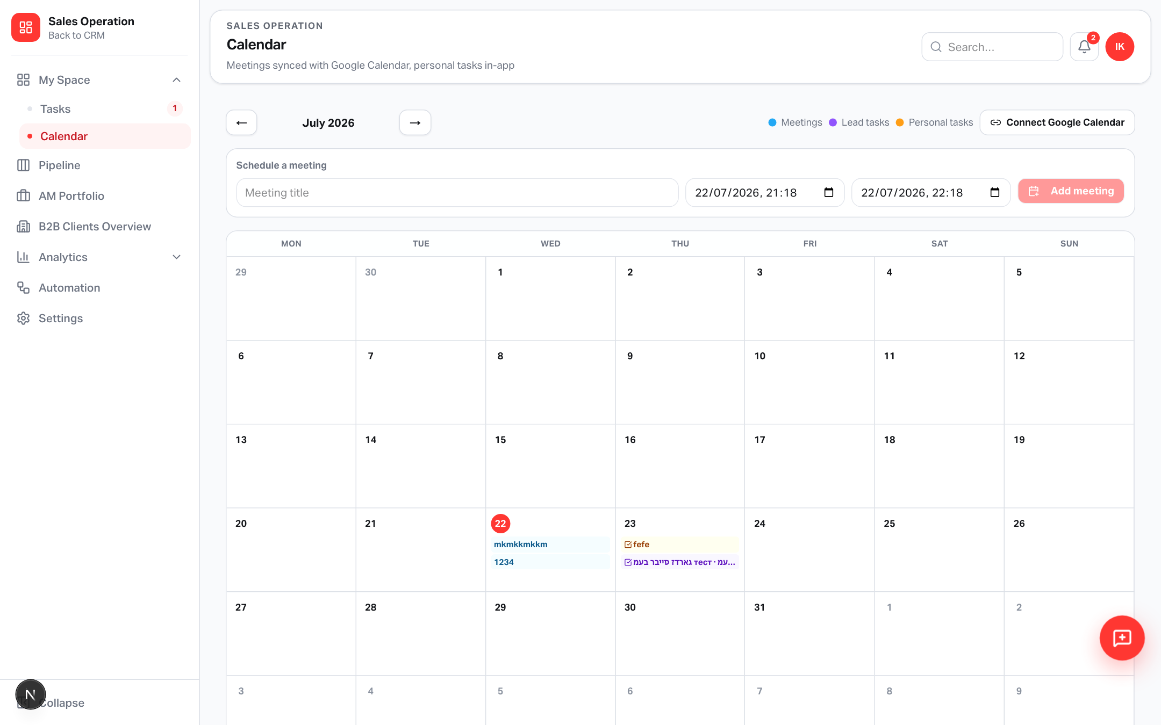
CALENDAR
My Space → Calendar in the sidebar
Meetings, lead tasks, personal tasks — one grid
Color legend
• Sky — Meetings
• Violet — Lead tasks
(assigned to you)
• Amber — Personal tasks
Optional: Connect Google
Calendar to sync meetings
Yango · Sales Operations · Release 0.2.46 · Confidential
6 / 12

Slide 7
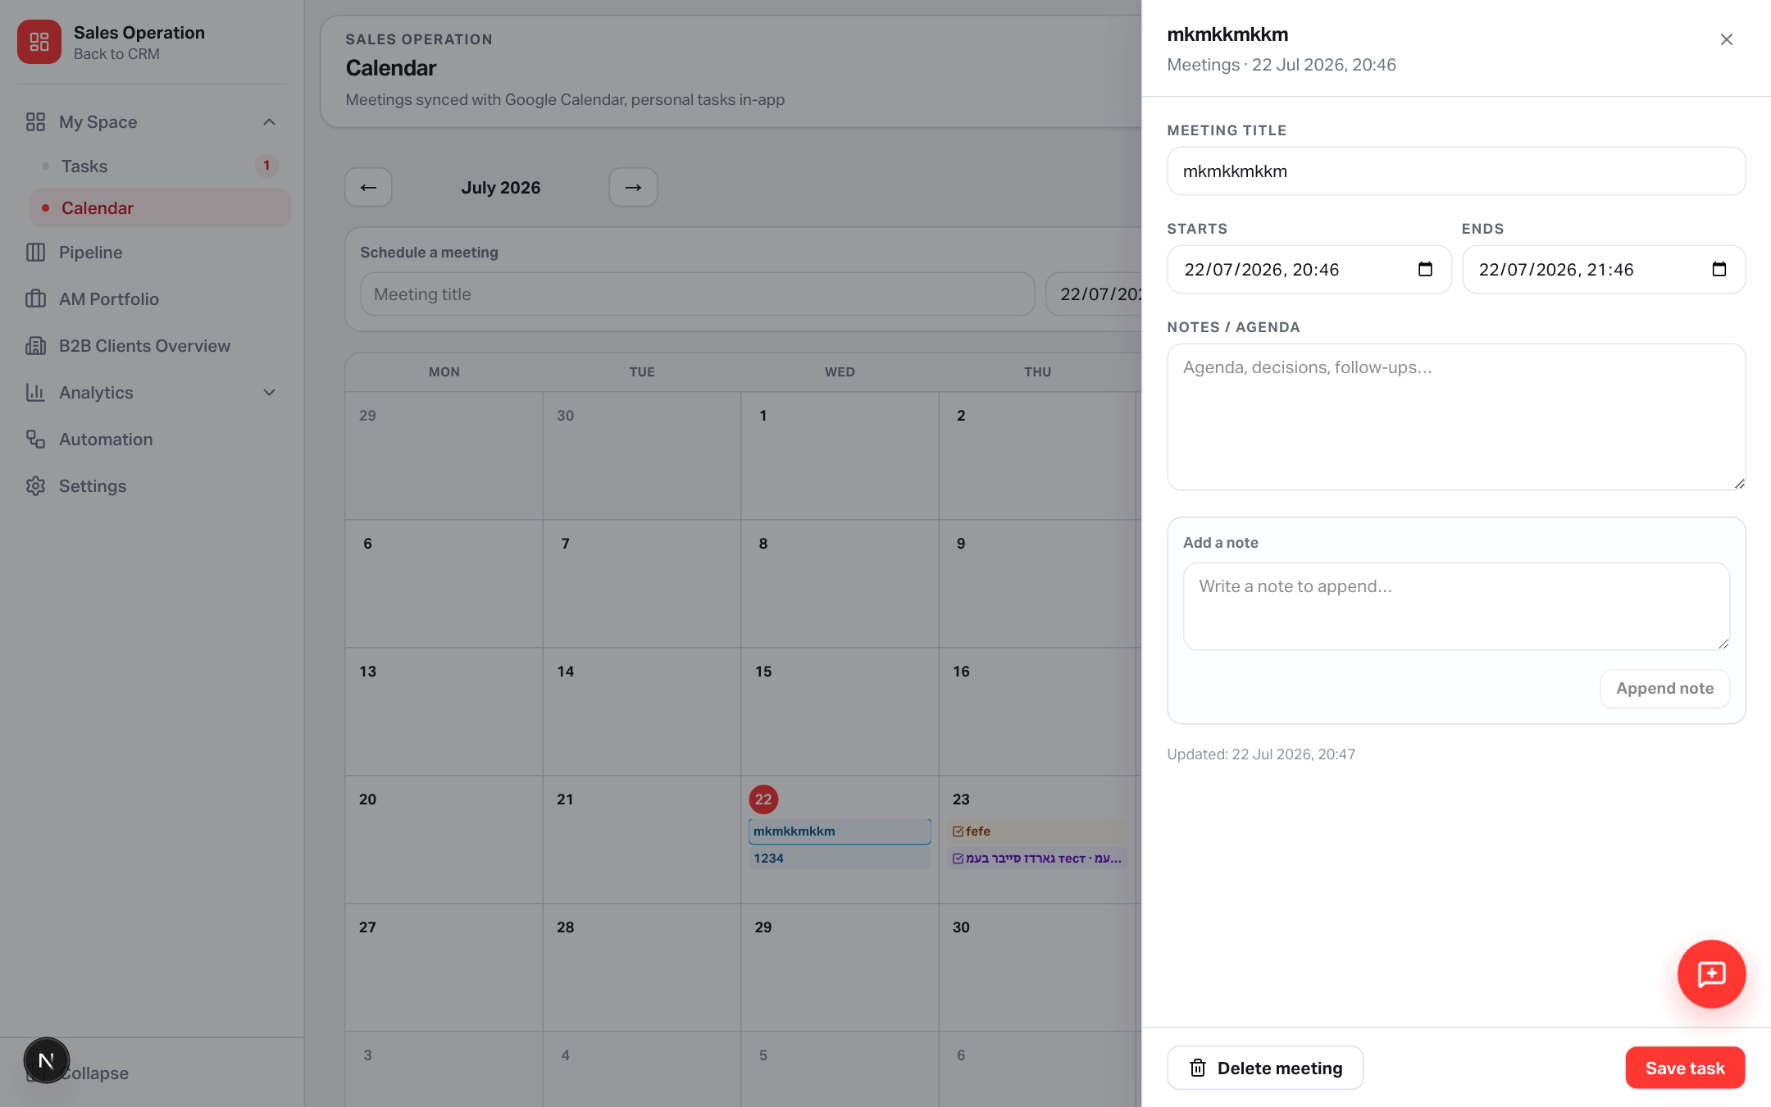
CALENDAR
Click any event → side card
Edit fields, append notes, complete or delete
Actions
• Meetings: title, window,
notes/agenda, delete
• Tasks: status, priority, due,
description, mark done
• Append timestamped notes
• Open linked client when set
Yango · Sales Operations · Release 0.2.46 · Confidential
7 / 12

Slide 8
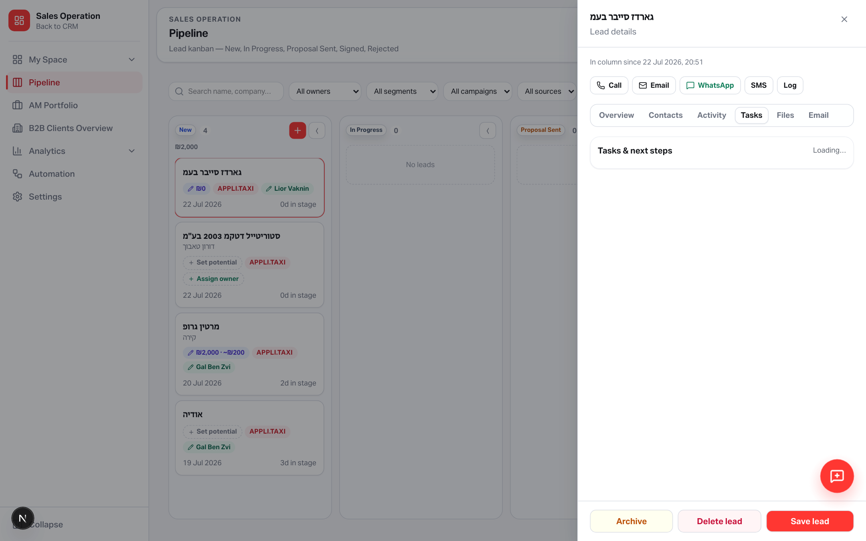
PIPELINE → CALENDAR
Tasks from the lead card reach the assignee
Create with an assignee + due date → appears on their calendar
Defaults that help
• Assignee defaults to you
• Due defaults to ~+2 hours
• Only open tasks with due
dates show on the grid
• Violet chip shows lead name
Yango · Sales Operations · Release 0.2.46 · Confidential
8 / 12

Slide 9
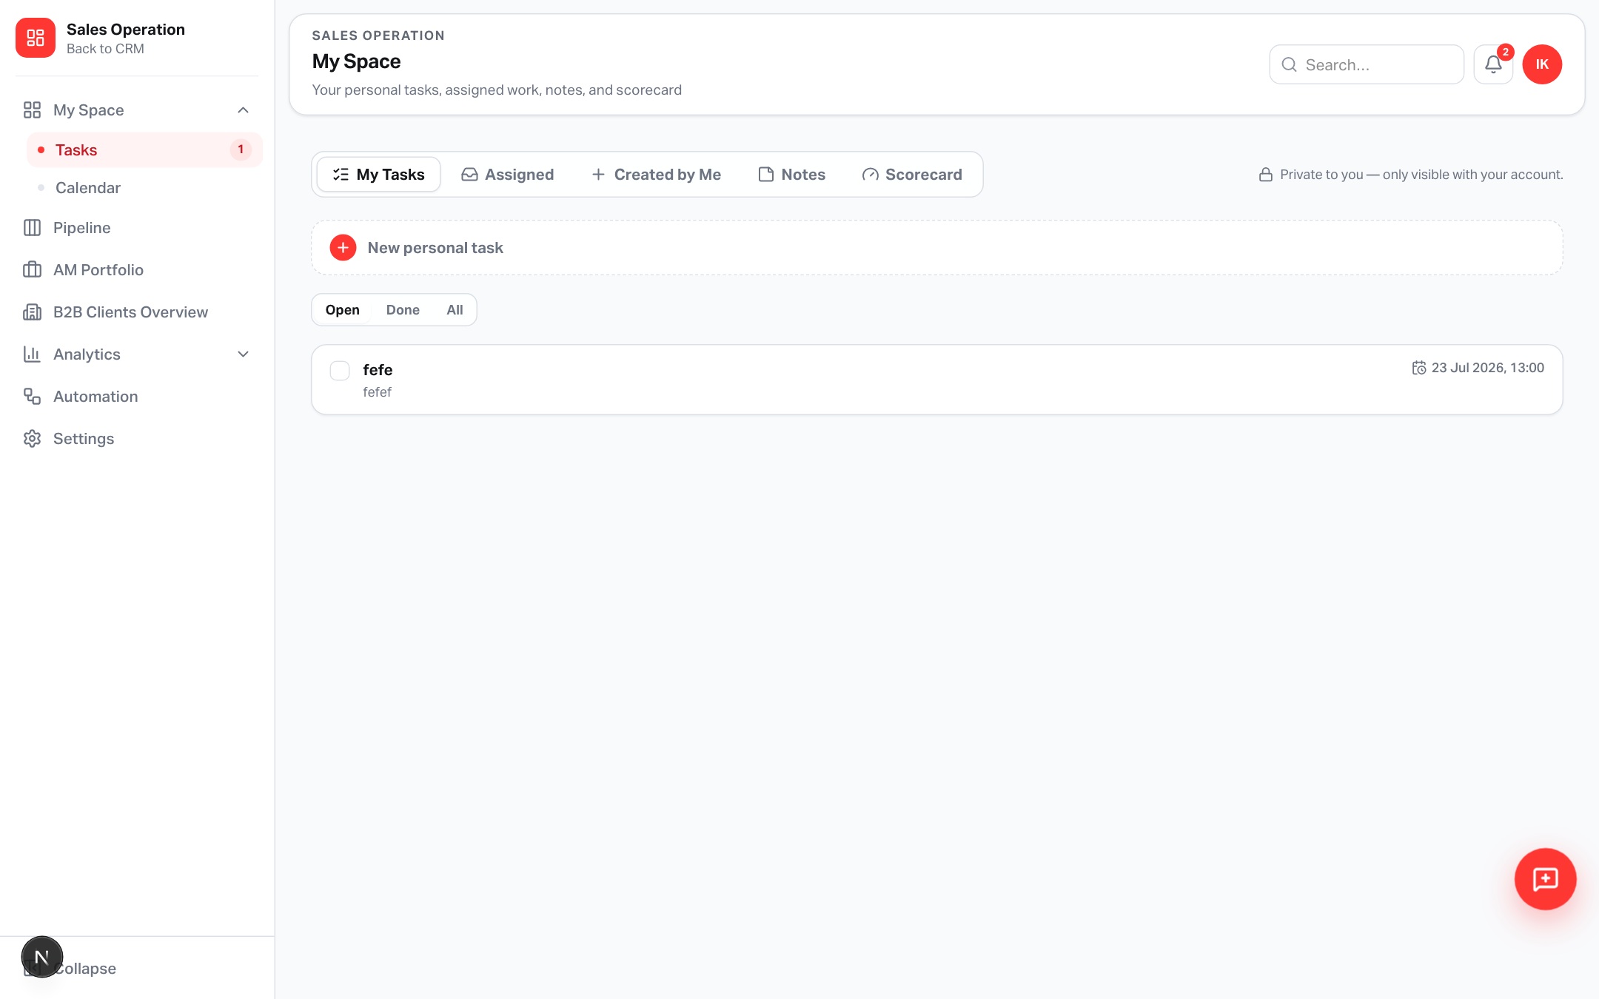
MY SPACE
Tasks stay in My Space — Calendar is next door
Sidebar group: Tasks + Calendar
Navigation
• My Space ▾
Tasks
Calendar
• Old ?tab=calendar redirects
• Badge still shows open work
Yango · Sales Operations · Release 0.2.46 · Confidential
9 / 12

Slide 10
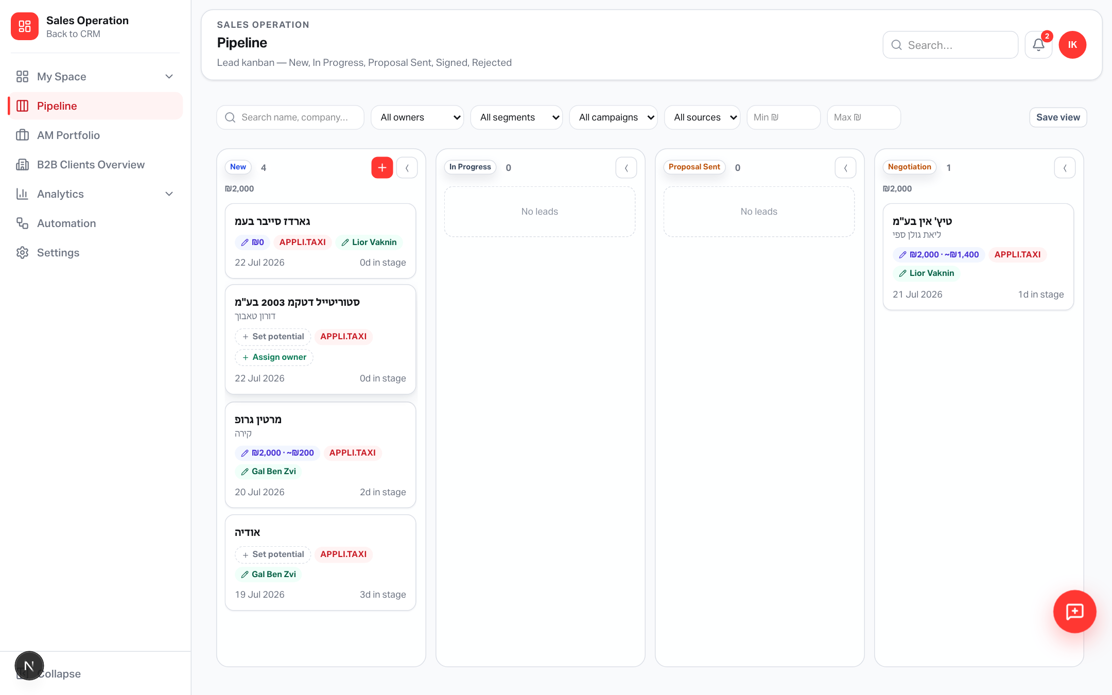
ACCESS HYGIENE
Assignees & owners = platform staff only
Approved internal users — no pending, rejected, or client-portal accounts
Where it applies
• Lead owner selects
• Pipeline owner filter
• Task assignee
• Reassign / follow-up
• Stage-gate follow-up
• AM/SM role pickers unchanged
Yango · Sales Operations · Release 0.2.46 · Confidential
10 / 12

Slide 11
OPS CHECKLIST
What to configure after deploy
SQL already applied; Google redirect may need a Cloud console update
Database
supabase_sales_client_activity.sql applied (meetings + GCal tokens + personal FKs)
Google Calendar
Add redirect https://applitaxi.space/api/google/calendar/callback
Env
GOOGLE_OAUTH_CLIENT_ID / SECRET (same Workspace OAuth client as SSO is fine)
Staff list
Only @appli.taxi approved users remain as internal platform staff
Yango · Sales Operations · Release 0.2.46 · Confidential
11 / 12

Slide 12
Ready for managers
From B2B Overview into a living client profile — and from every assigned task into the calendar.
applitaxi.space · Sales Operations · 0.2.46

