Slide 1

RELEASE 0.2.53
Yango client registration
on every lead card
Signed requires Corp Client ID · assign SM / AM from pipeline · hydrate from B2B Overview
Yango · Sales Operations · Appli Taxi Oz

Slide 2
AGENDA
What shipped in 0.2.53
Register earlier · sign with a real Corp Client ID · assign managers without leaving the pipeline
01
Yango form on the lead card
Available in any status — expand in-place or open a new window
02
Signed gate
Corp Client ID is required. Contract number alone is not enough
03
Assign SM + AM
Search B2B clients and save managers from Client details
04
Pending SM → map
When Corp Client ID is linked, pending sales manager writes to gp_corp_client_map
05
New leads from Overview
Create-lead hydrates name + SM from B2B Client Overview
Yango · Sales Operations · Release 0.2.53 · Confidential
2 / 11

Slide 3
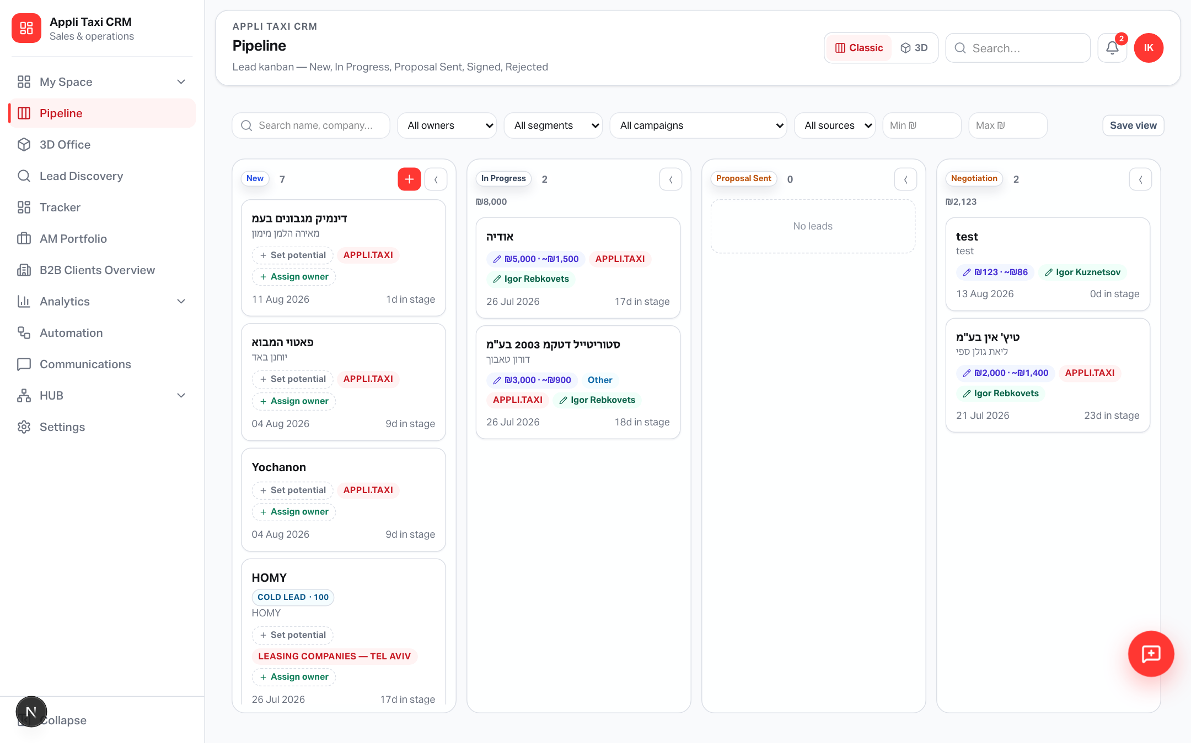
PIPELINE
Work the deal from the board
Open any lead — registration and managers live on the card, not only at Signed
Why it matters
• Register the B2B client
before the last stage
• Same card for SM / AM
• Signed still needs a
Corp Client ID
Yango · Sales Operations · Release 0.2.53 · Confidential
3 / 11

Slide 4
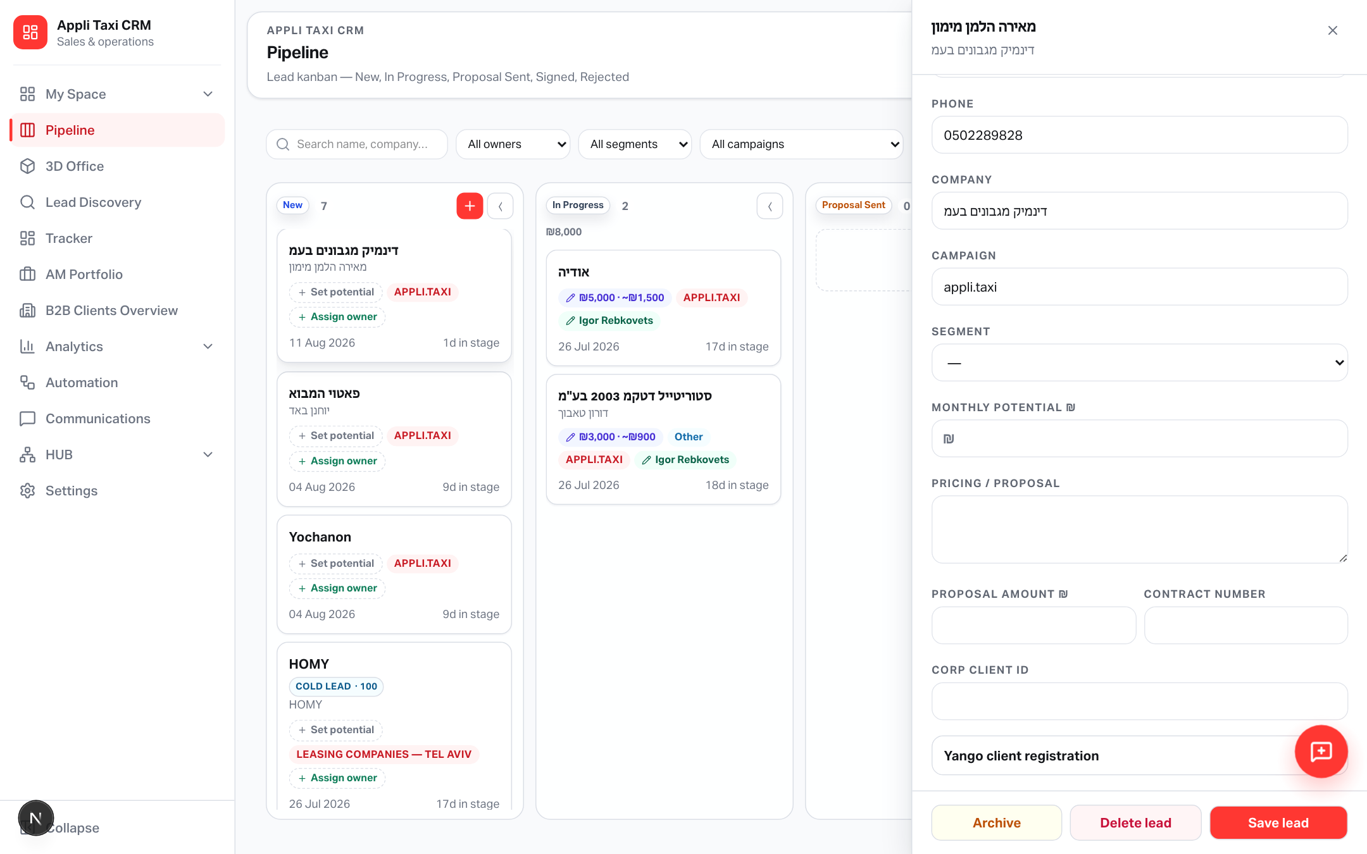
LEAD CARD
Yango client registration accordion
Any status · Overview tab · no fake “completed” pill
On the card
• Collapsed by default
• Next to Corp Client ID
• Removed from the
Signed stage-gate modal
Yango · Sales Operations · Release 0.2.53 · Confidential
4 / 11

Slide 5

LEAD CARD
Fill the offer form without leaving CRM
Embedded iframe + Open in new window
Isolated widget
• Yango CSS stays inside
the iframe
• Full page available at
/sales-operation/
corp-register
• No feedback FAB there
Yango · Sales Operations · Release 0.2.53 · Confidential
5 / 11

Slide 6
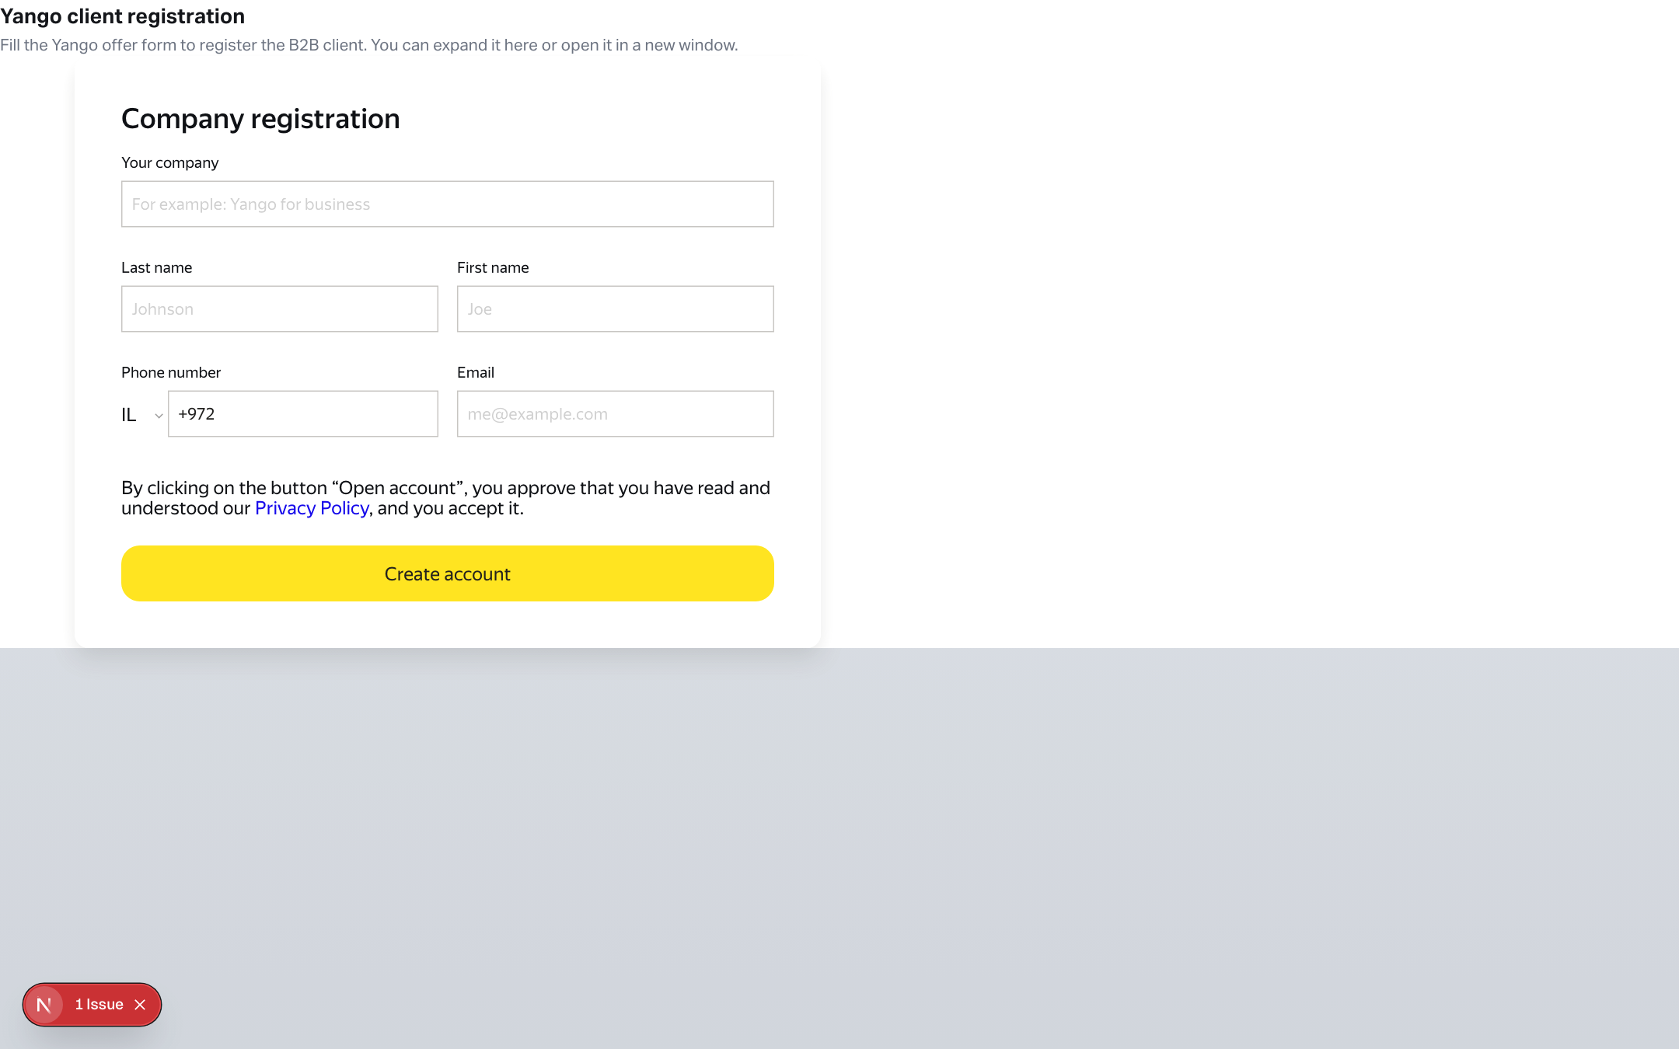
STANDALONE PAGE
Clean Yango registration window
/sales-operation/corp-register — compact chrome, no feedback icon
Use when
• Form needs more space
• Sharing a focused tab
• Embedding from the
lead accordion
Yango · Sales Operations · Release 0.2.53 · Confidential
6 / 11

Slide 7
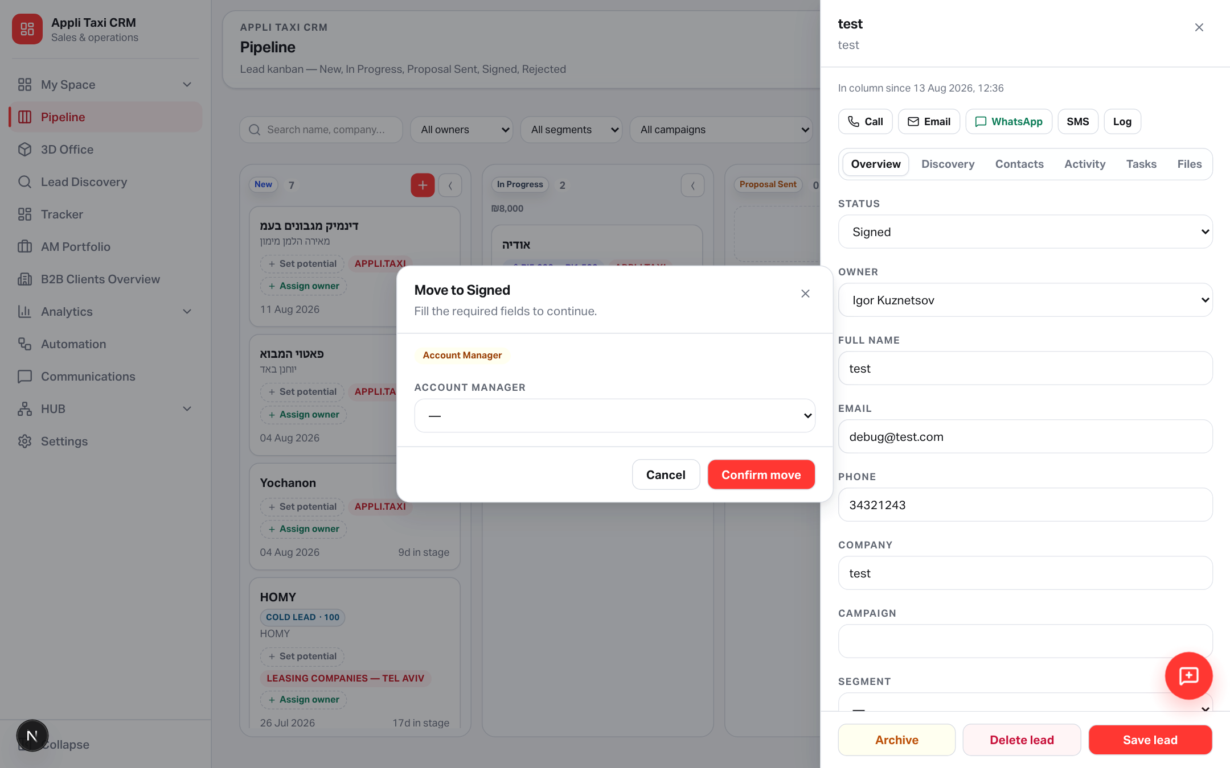
SIGNED GATE
No Corp Client ID → no Signed
Contract number is optional. Account Manager still required.
Server-enforced
• Stage Gate + API
• IDs match case-
insensitively
• Pending SM is applied
to gp_corp_client_map
when ID is linked
Yango · Sales Operations · Release 0.2.53 · Confidential
7 / 11

Slide 8
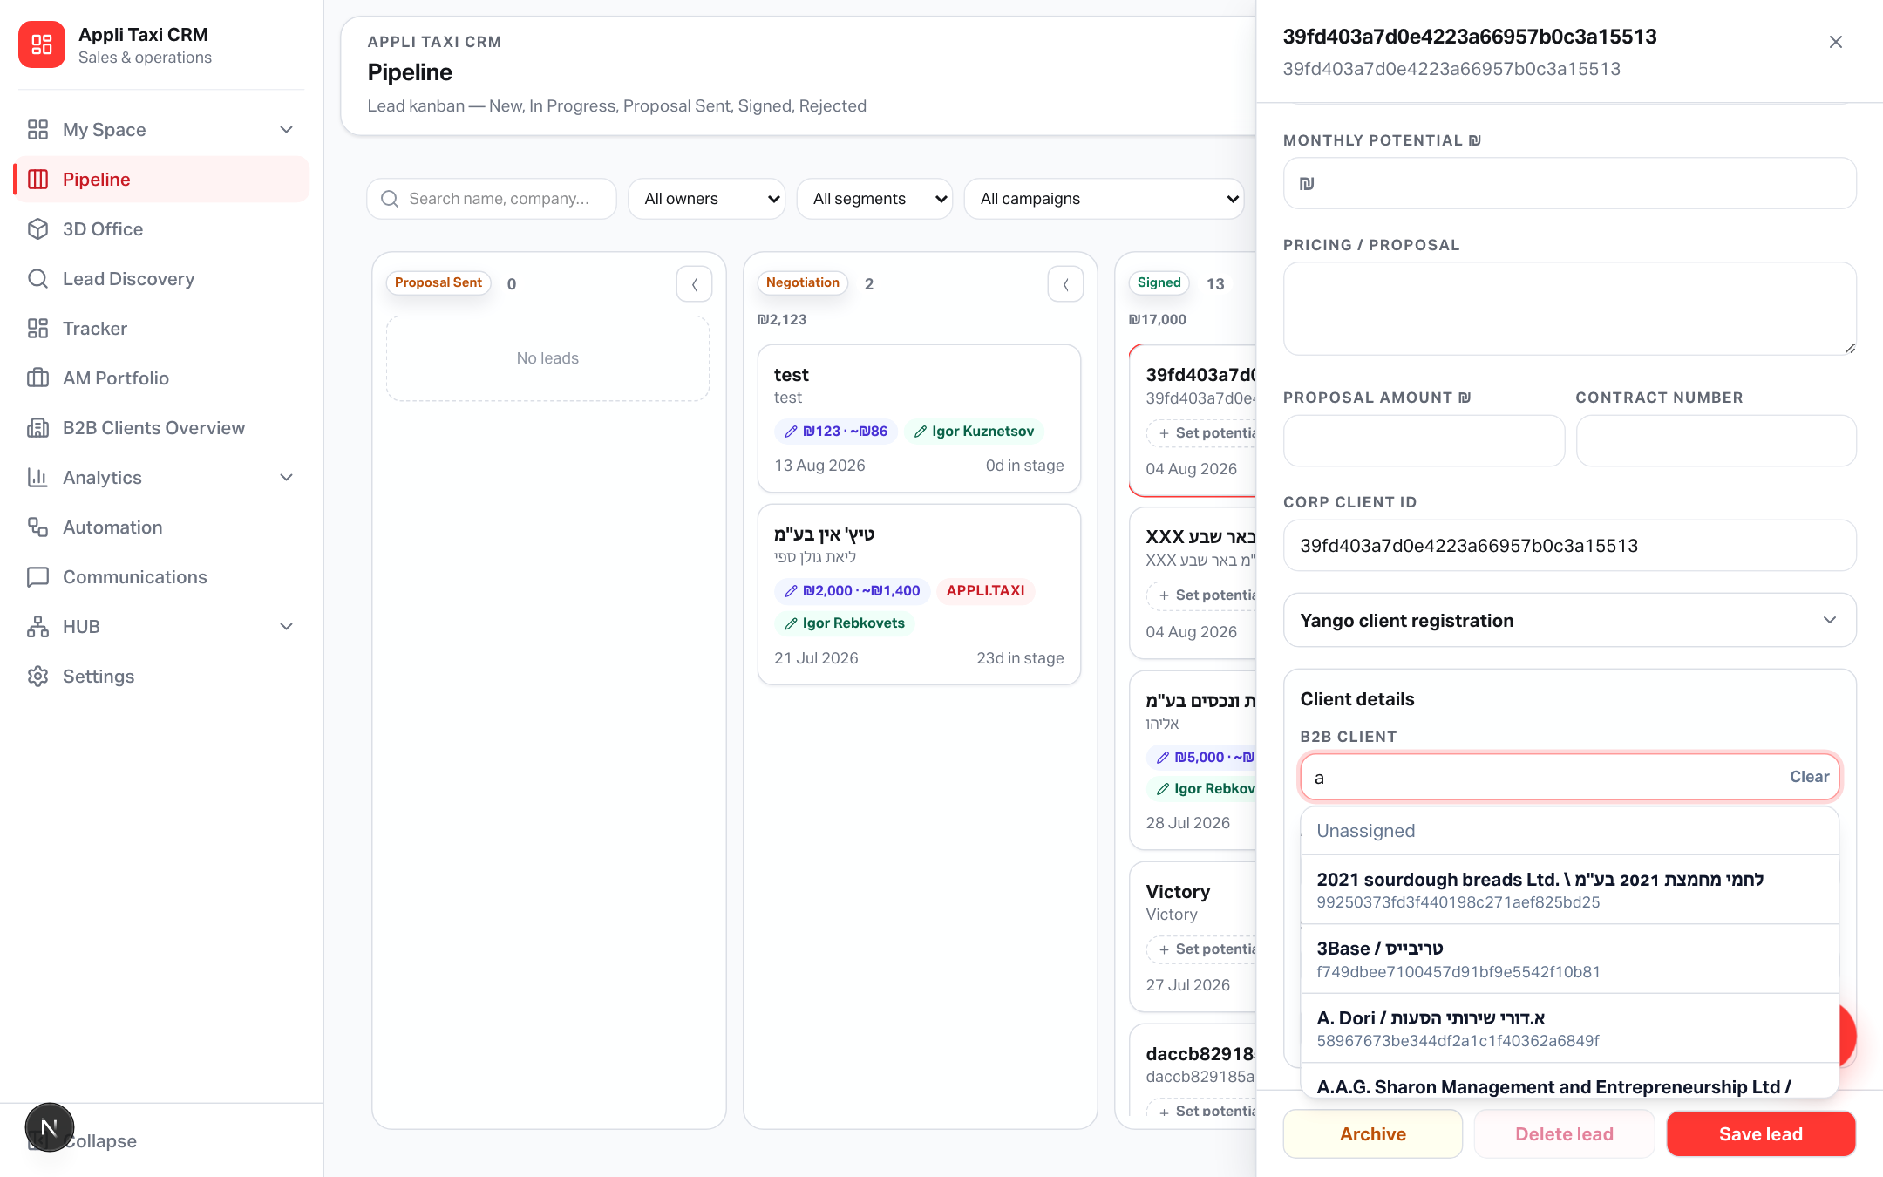
CLIENT DETAILS
Assign Sales + Account managers
Search B2B by name or corp_client_id · selects stay enabled
Rules
• SM can save on the lead
even without Corp ID
• AM needs a linked
B2B client
• All platform staff
appear in the lists
Yango · Sales Operations · Release 0.2.53 · Confidential
8 / 11

Slide 9
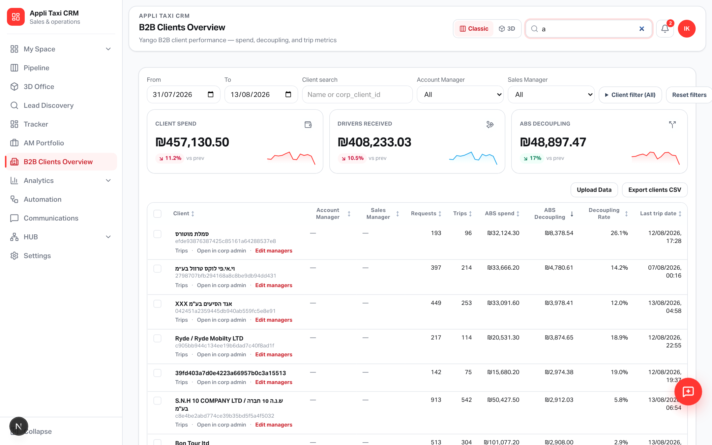
B2B OVERVIEW
New leads pick up existing clients
Create-lead + Overview search use gp_corp_client_map (case-insensitive)
Hydration
• Name + sales manager
from Overview row
• Canonical Corp ID
casing is preserved
• Explicit SM is not
overwritten
Yango · Sales Operations · Release 0.2.53 · Confidential
9 / 11

Slide 10
HOW TO USE
Recommended flow
Register early · link Corp ID · assign managers · then Sign
1. Any stage
Open the lead → expand Yango client registration → submit the offer form
2. Link ID
Paste Corp Client ID on Overview, or pick the B2B client in Client details
3. Assign people
Sales Manager on the lead; Account Manager after B2B is linked
4. Move to Signed
Gate asks only for Corp Client ID + AM — form is already on the card
Yango · Sales Operations · Release 0.2.53 · Confidential
10 / 11

Slide 11
Register first. Sign with a real ID.
Yango offer form on every lead · Corp Client ID gate · SM / AM from pipeline · Overview hydration.
applitaxi.space · Sales Operations · 0.2.53

