Slide 1
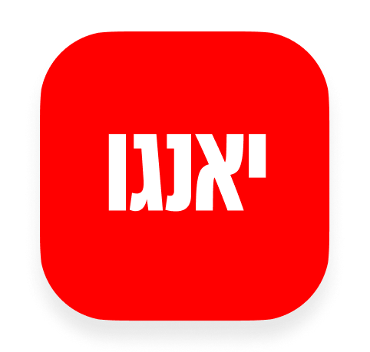
RELEASE 0.2.66
Token registry durable hotfix
Upstash KV quota exhausted → registry moved to Supabase Storage; never wipe KV with empty
Yango · Sales Operations · Release 0.2.66 · Confidential
1 / 2

Slide 2
What we fixed
Cause: Upstash KV max requests (500k) — registry-only cabinets vanished from Token diagnostics
Durable store: sales-attachments/system/yango-token-registry-v1.json (+ optional SQL table)
Safety: never write an empty registry over KV; memory cache 60s; KV mirror best-effort
Env cabinets re-synced into durable storage. CLIENT_* cabinets: re-add via onboarding if still missing after Upstash restore
Yango · Sales Operations · Release 0.2.66 · Confidential
2 / 2

