Slide 1

RELEASE 0.2.50
Appli Taxi CRM
+ interactive 3D Office
One shell for day-to-day sales · walking team agents · live CRM workbench
Yango · Sales Operations · Appli Taxi Oz

Slide 2
AGENDA
What shipped in 0.2.50
Unified product shell + a spatial way to work the CRM
01
Appli Taxi CRM branding
Sales Operation becomes the product name the team sees every day
02
Tools inside the shell
Communications, Price Calculator, Access — no more bouncing to Main CRM
03
Staff landing
Login / OAuth open Sales Operation; Main CRM nav stays empty for staff
04
3D Office
Rooms, Pipeline Wall, Classic ↔ 3D toggle
05
Team agents + workbench
Igor K, Lior, Igor R, Itay, Egor, Ido, Adam, Gal — real CRM actions
Yango · Sales Operations · Release 0.2.50 · Confidential
2 / 11

Slide 3
WHY
One CRM surface for the sales floor
Stop context-switching between Main CRM and Sales Operation
Before
After 0.2.50
Plus 3D Office
Day-to-day work lived in Sales Operation,
but Communications / Price Calculator /
Access still sat under Main CRM.
Staff saw two products and two navs.
Onboarding friction for new managers.
Appli Taxi CRM = Sales Operation shell.
Communications, Price Calculator,
Access under Settings — same chrome.
Old URLs redirect.
Login lands on Sales Operation.
Optional spatial view of the same CRM.
Agents walk the floor with live badges.
Click → workbench with leads / tasks /
analytics / discovery — no OpenClaw.
Classic UI always one click away.
Yango · Sales Operations · Release 0.2.50 · Confidential
3 / 11

Slide 4
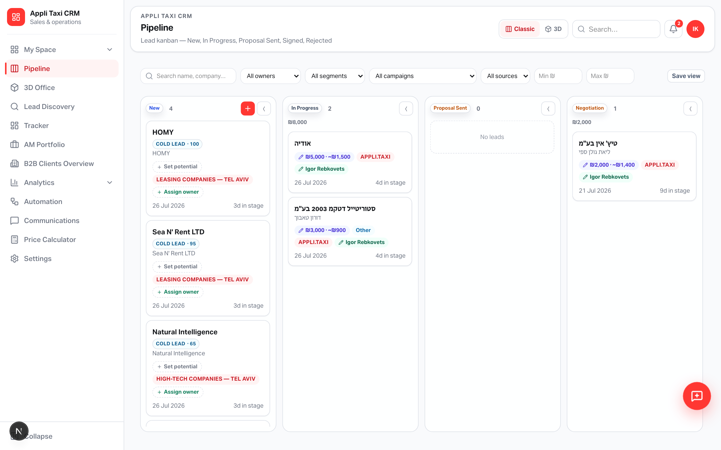
SHELL
Pipeline inside Appli Taxi CRM
Same board you know — now under a single product brand
Yango · Sales Operations · Release 0.2.50 · Confidential
4 / 11
Notes:
Point at the Appli Taxi CRM header/sidebar. Note Classic / 3D toggle if visible in header.

Slide 5
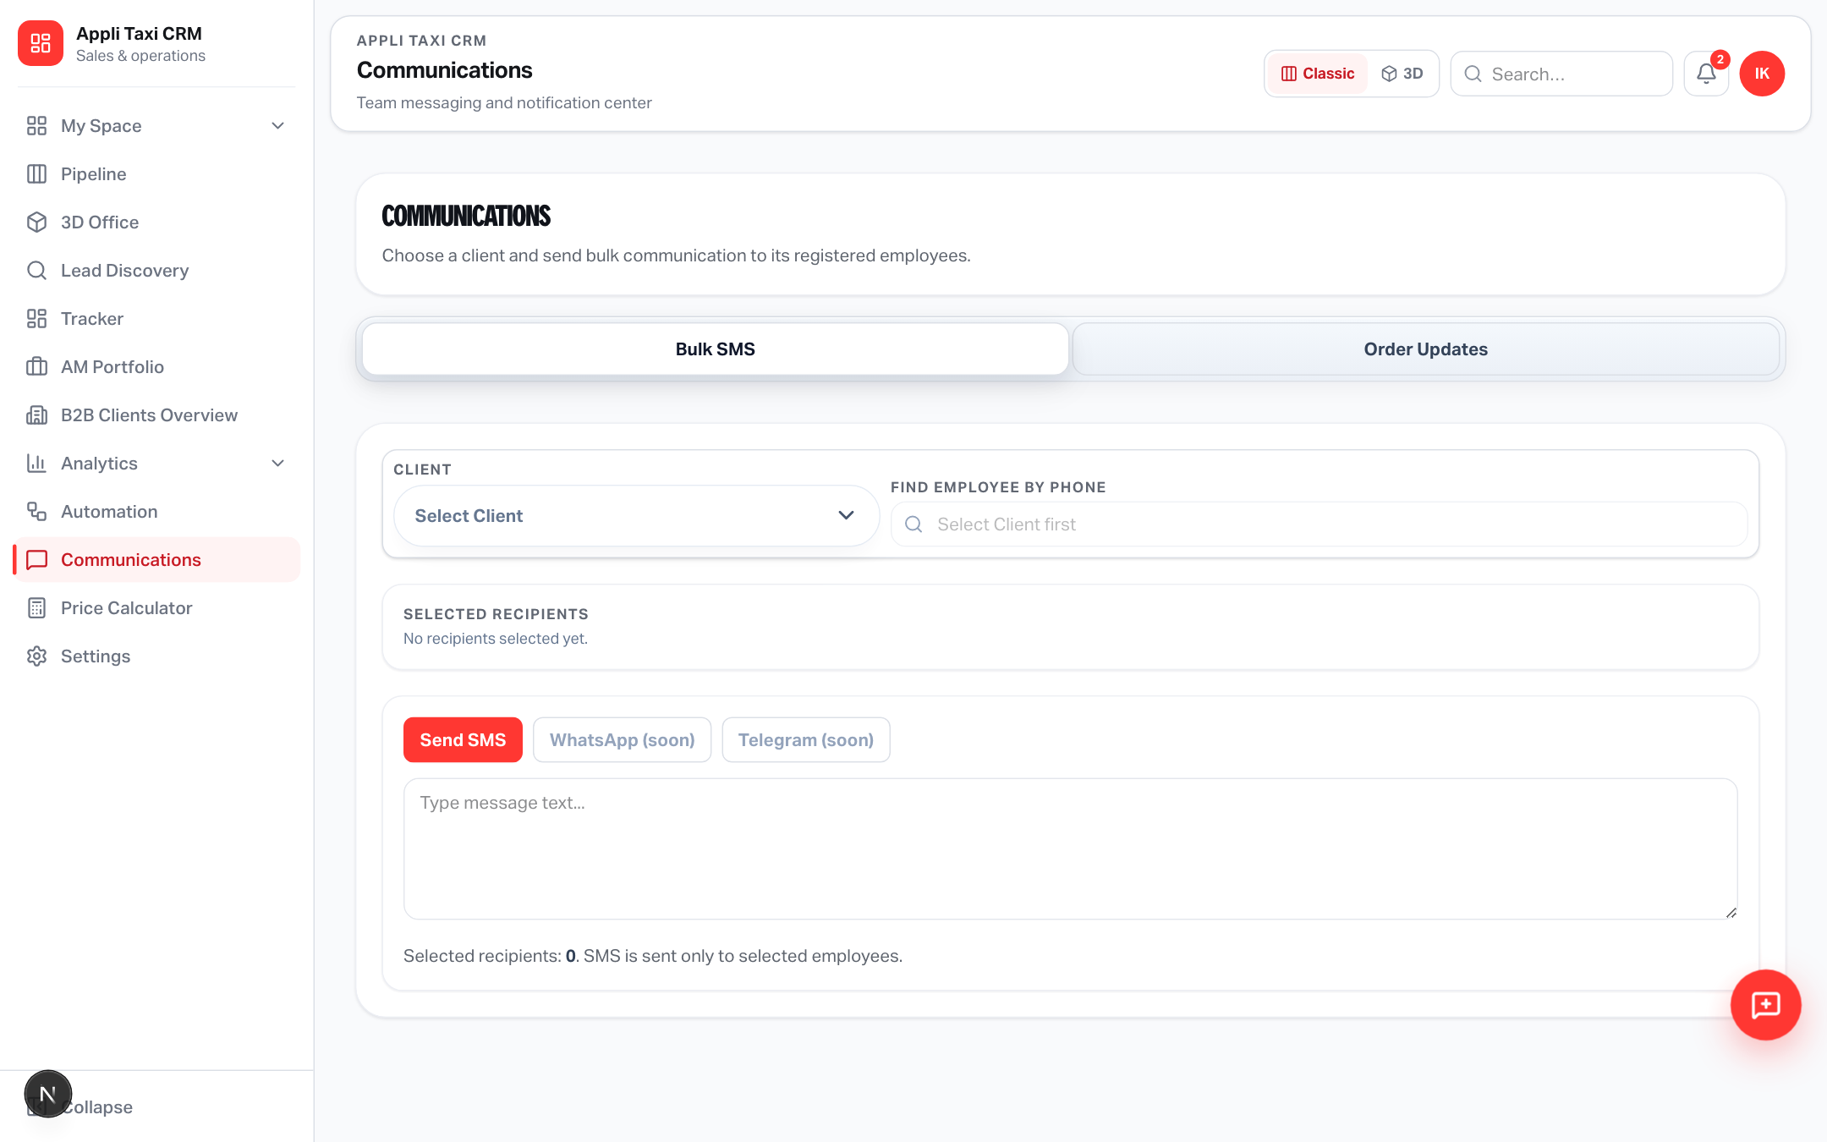
TOOLS
Communications in the CRM shell
/sales-operation/communications · old /communications redirects here
What to show the team
Sidebar item under Appli Taxi CRM.
Same permissions as before.
No new messaging backend —
only navigation + shell unify.
Use this when explaining
“everything lives in one app”.
Yango · Sales Operations · Release 0.2.50 · Confidential
5 / 11

Slide 6
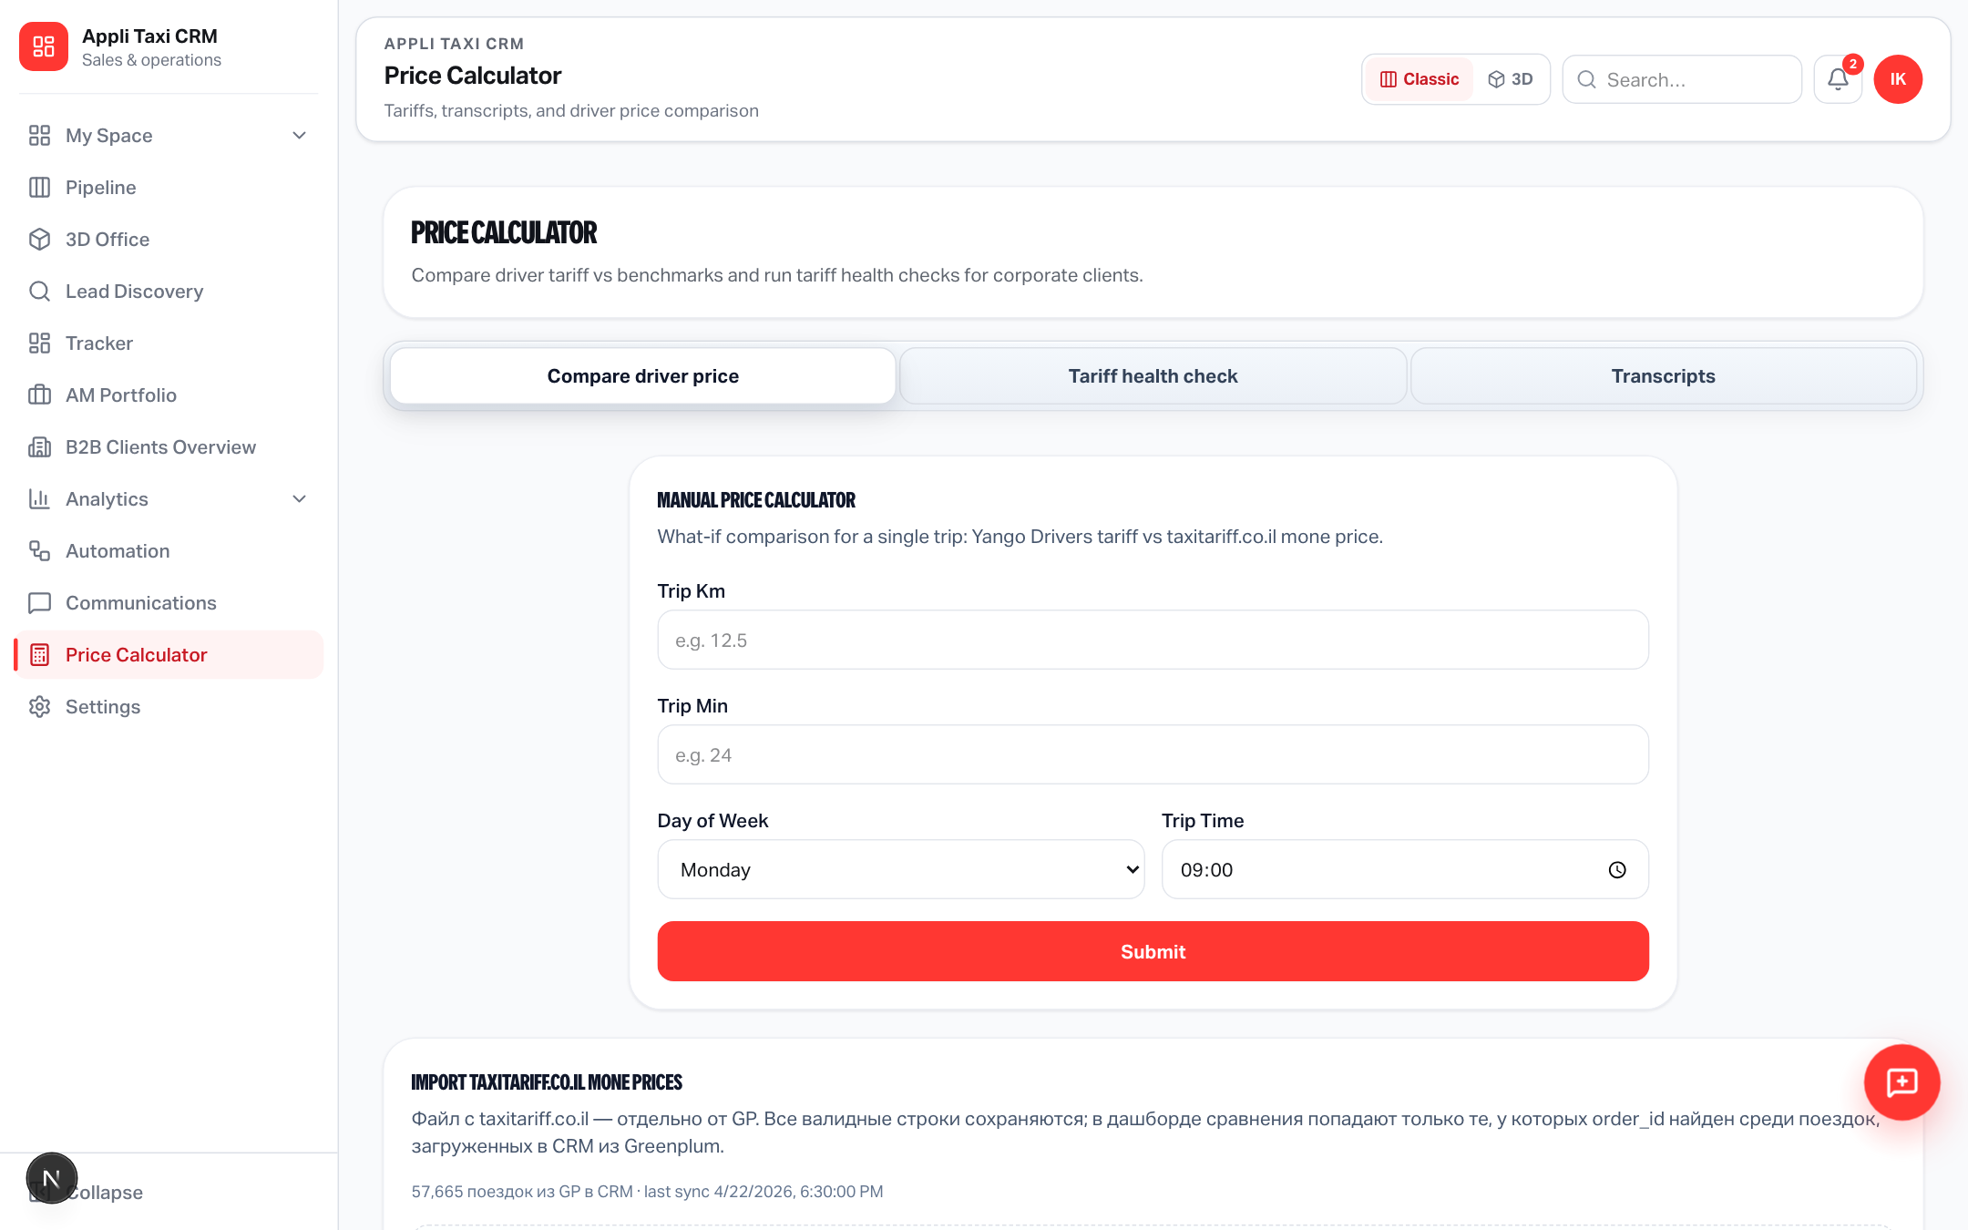
TOOLS
Price Calculator in the CRM shell
/sales-operation/price-calculator · tariffs & quotes without leaving SO
Sales floor use
Managers quote while staying
in the pipeline context.
Shared PriceCalculatorView
component (no logic rewrite).
Legacy /price-calculator
still redirects.
Yango · Sales Operations · Release 0.2.50 · Confidential
6 / 11

Slide 7
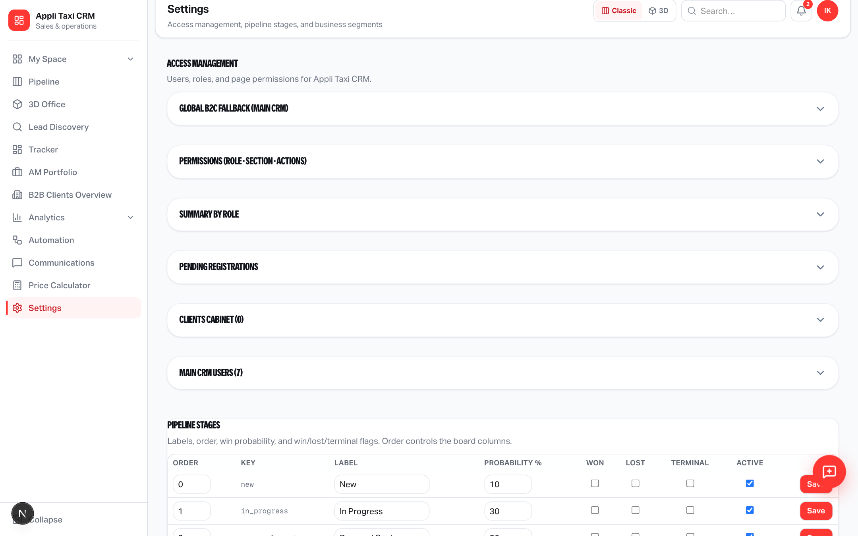
ADMIN
Access management in Settings
Settings → Access · roles & page permissions for Appli Taxi CRM
For admins
Users, roles, SO page keys.
Extracted AccessManagementView
embedded in Sales Settings.
Gate: salesSettings || accesses.
Old /accesses redirects into
Settings with section=access.
Yango · Sales Operations · Release 0.2.50 · Confidential
7 / 11

Slide 8
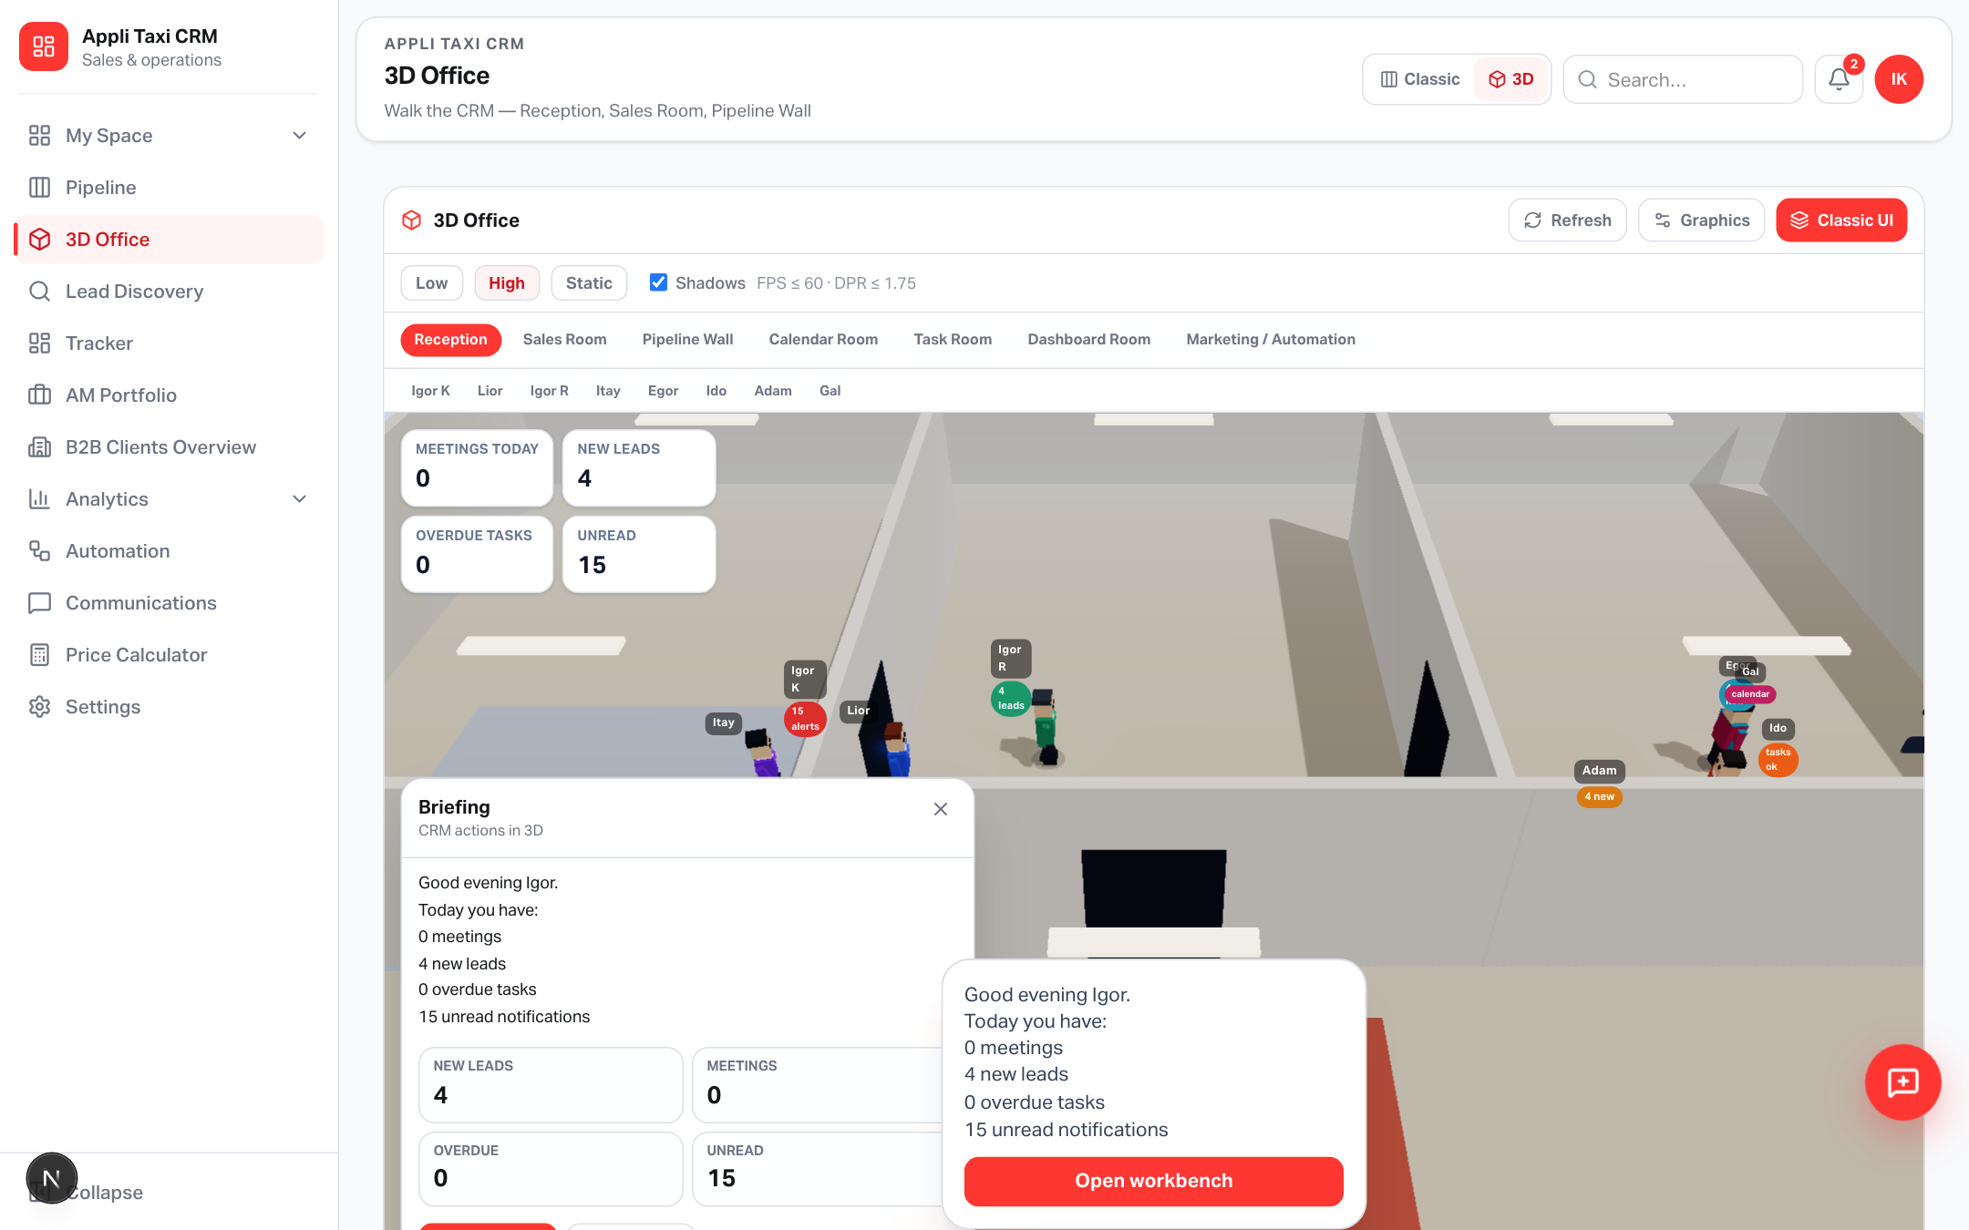
3D OFFICE
Walk the CRM
/sales-operation/office · rooms · live stats · Classic/3D toggle
Yango · Sales Operations · Release 0.2.50 · Confidential
8 / 11
Notes:
Highlight walking agents, room chips, reception HUD stats, Graphics preset.

Slide 9
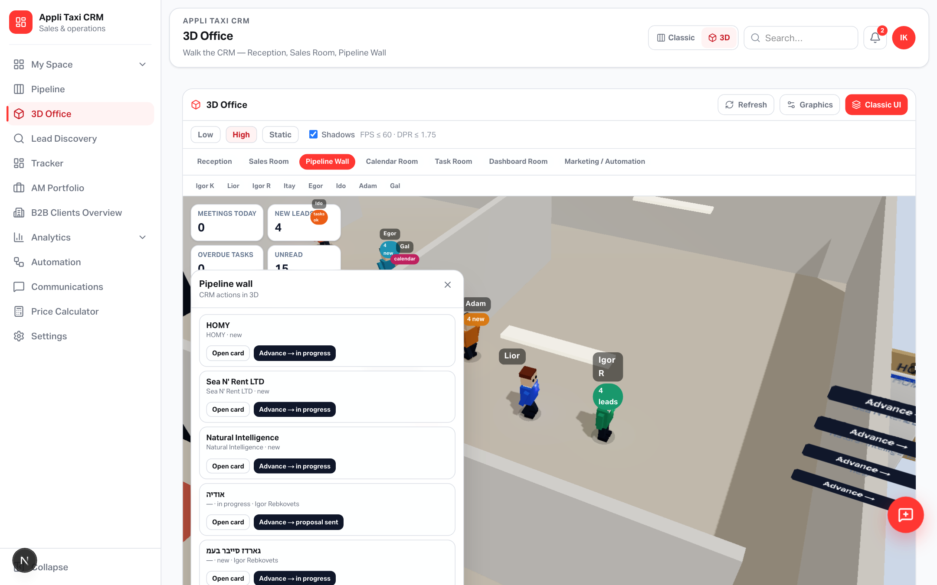
3D OFFICE
Pipeline Wall
Click sticker → lead drawer · Advance → next stage via existing transition API
Rooms & filters
Reception · Sales · Pipeline
Calendar · Tasks · Dashboard
Automation / Discovery
Room chips focus the camera
(zoom stays free after snap).
Agent quick-filters can pin
new / stuck / owner leads.
Yango · Sales Operations · Release 0.2.50 · Confidential
9 / 11
Notes:
Show stickers by stage and Advance on a card — stage move without leaving 3D.

Slide 10
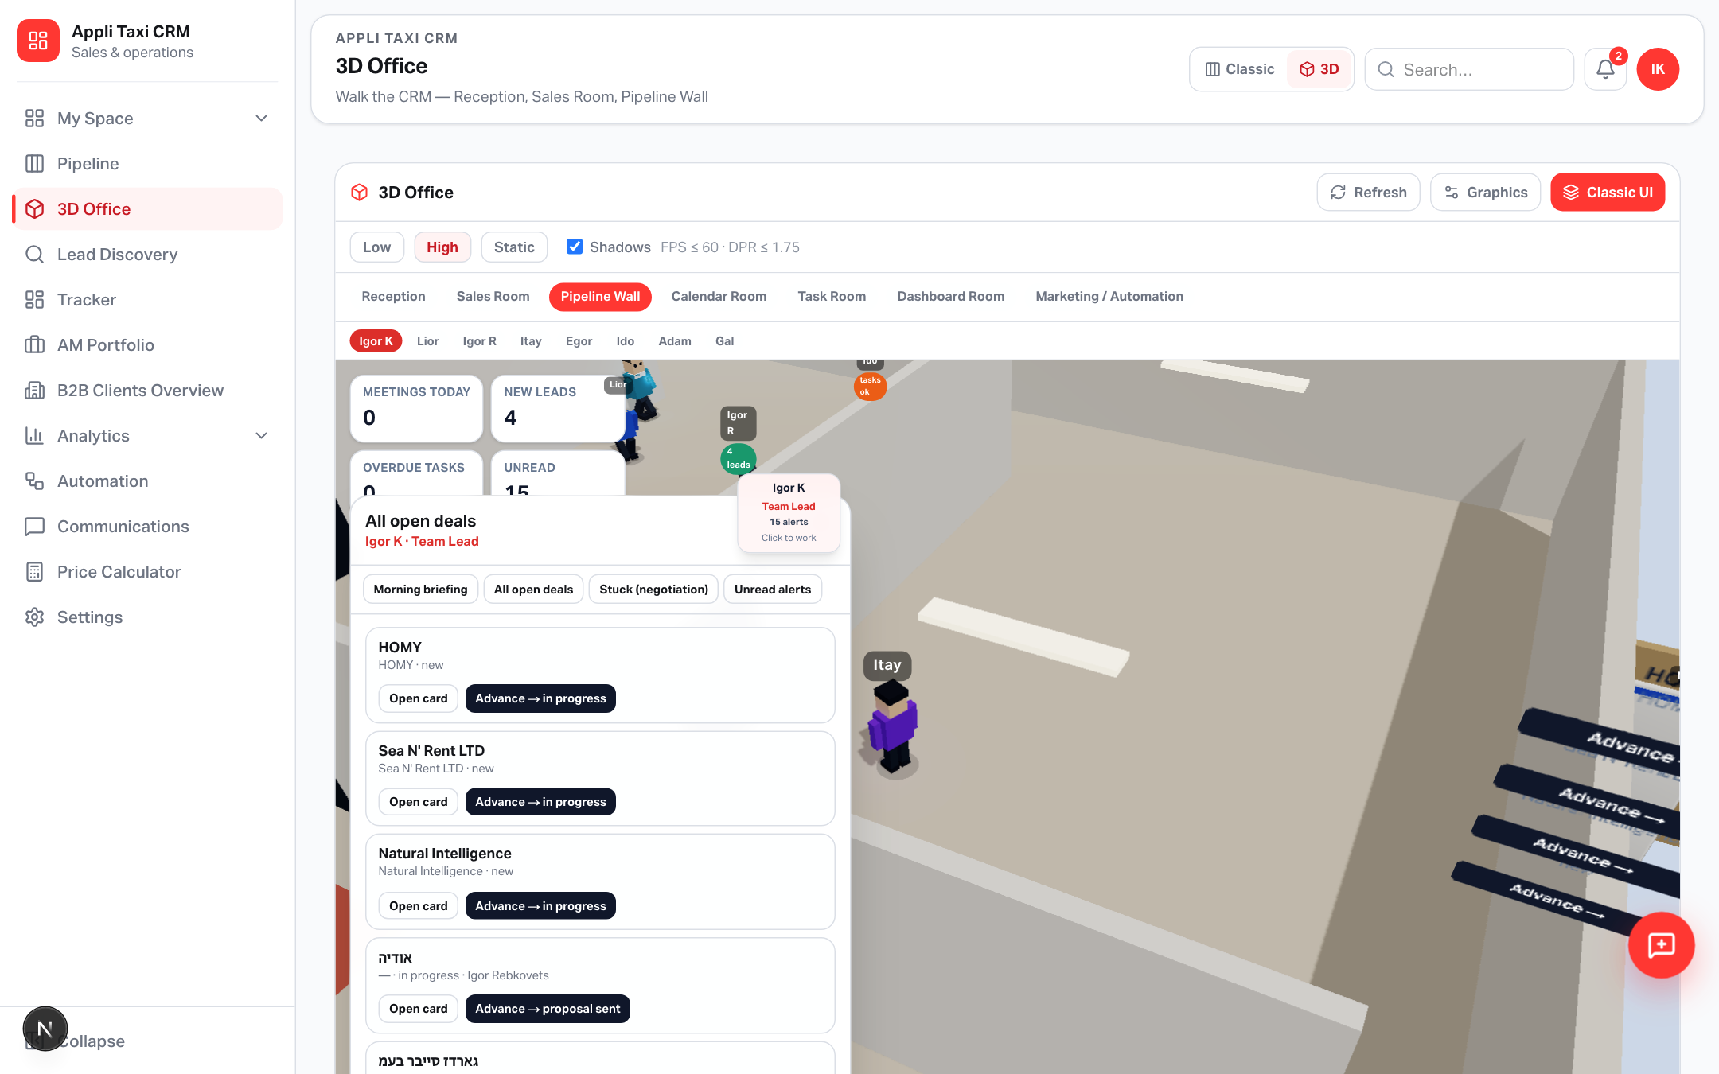
AGENTS
Team on the floor — with real CRM power
Hover · click · workbench panel · live badges from API data
Who does what
Igor K — briefing, stuck deals
Lior / Igor R / Itay — own leads
Egor — live funnel stats
Ido — tasks · mark Done
Adam — Lead Discovery
Gal — meetings · portfolio
Data from existing CRM APIs —
no separate agent database.
Yango · Sales Operations · Release 0.2.50 · Confidential
10 / 11
Notes:
Name the eight agents. Show workbench bottom-left with real actions (Open card, Advance, Done).

Slide 11
Open in production
https://applitaxi.space/sales-operation/office
Also: /sales-operation/pipeline · communications · price-calculator · settings?section=access
Header → Classic / 3D · Graphics Low / High / Static
Release 0.2.50 · Appli Taxi CRM + 3D Office · Appli Taxi Oz

