Slide 1

RELEASE 0.2.54
Linear-primary Sales Operation
redesign
Inset canvas · Appli mark · Yango fonts · presentation only — flows unchanged
Yango · Sales Operations · Appli Taxi Oz

Slide 2
AGENDA
What shipped in 0.2.54
Visual system only. APIs, RBAC, validations and integrations stay as they were.
01
Inset canvas shell
Grey workspace, white rounded canvas, 2px Yango active nav rail
02
Appli mark + Yango type
Sidebar logo from brand file; Text 400/500/700 + Headline 900
03
Flat cards everywhere
No glass, no hover-lift on Orders, Calculator, Comms, Pre-orders, Access
04
⌘K + density
Command palette wraps existing search; comfortable / compact toggle
05
Quiet motion
160ms ease-out drawers, button active 0.97 — no daily-action animation
Yango · Sales Operations · Release 0.2.54 · Confidential
2 / 10

Slide 3
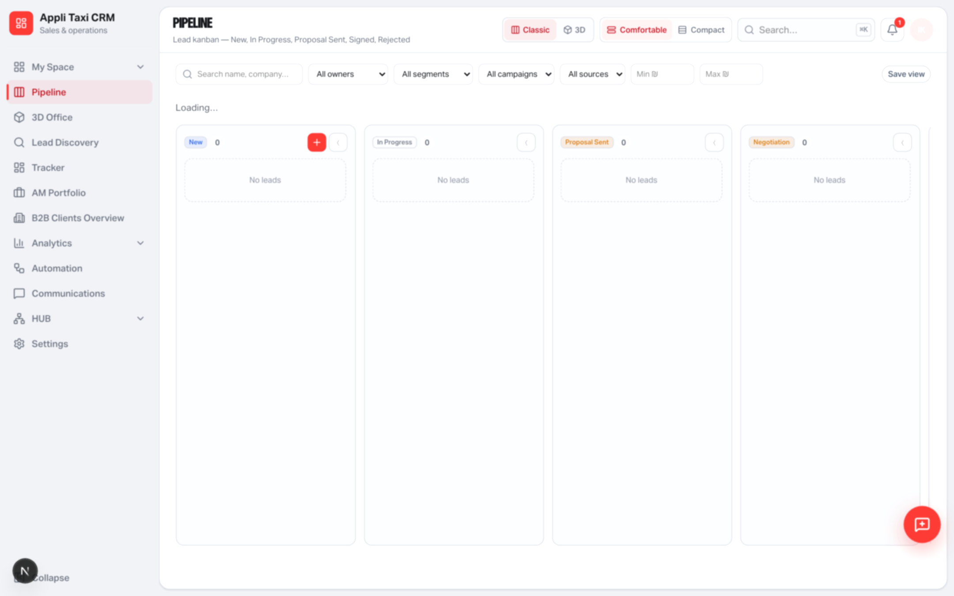
SHELL
Inset canvas + Appli mark
Sales Operation sits on #eceef2. The product lives in a white 16px canvas.
Signature
Appli squircle in the sidebar (same 36px slot)
Headline 900 for page H1 only
2px red rail on the active nav item
Density: comfortable or compact
Legacy Main CRM UI is unchanged
Yango · Sales Operations · Release 0.2.54 · Confidential
3 / 10

Slide 4
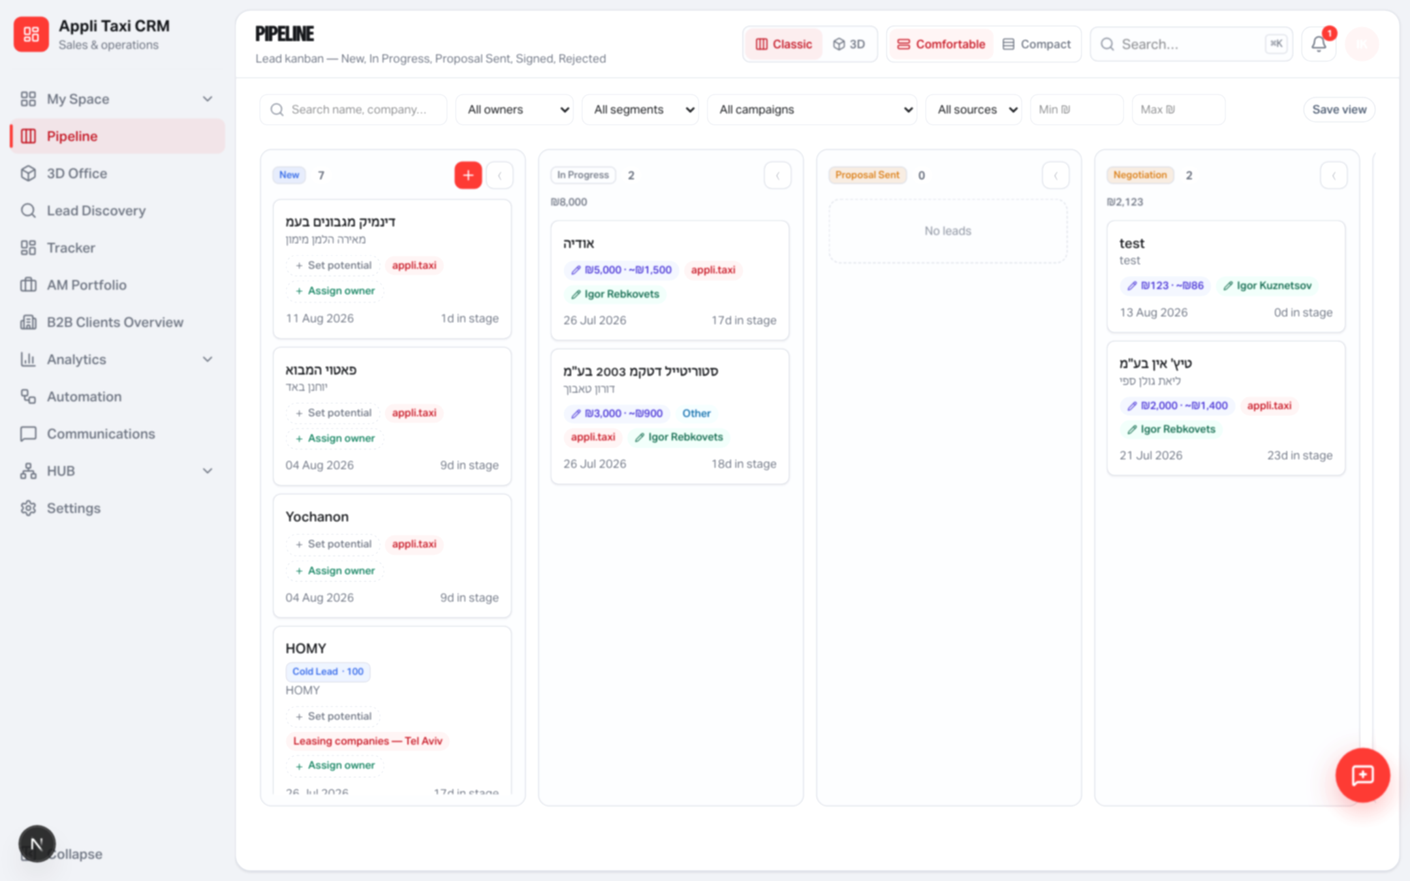
PIPELINE
Board chrome, not a new board
HTML5 drag-and-drop, stage gates and lead cards keep the same logic.
Yango · Sales Operations · Release 0.2.54 · Confidential
4 / 10

Slide 5
NAVIGATION
⌘K command palette + density
Same /api/sales-operation/search. Faster jump between pages, leads and clients.
Command palette
Density toggle
⌘K / Ctrl+K from anywhere in SO
Pages, recent search, jump to lead/client
Sentence-case group headings
No open/close animation (Emil rule)
Respects existing RBAC page keys
Header control: Comfortable / Compact
Persists in localStorage (so-ui-density)
data-density on the SO shell
Tighter rows and paddings in compact
Default stays comfortable
Yango · Sales Operations · Release 0.2.54 · Confidential
5 / 10

Slide 6
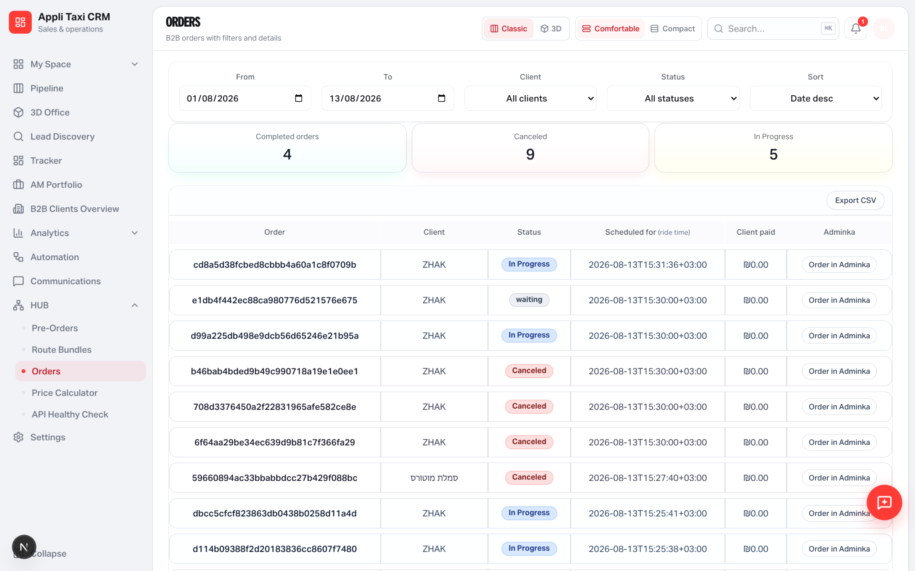
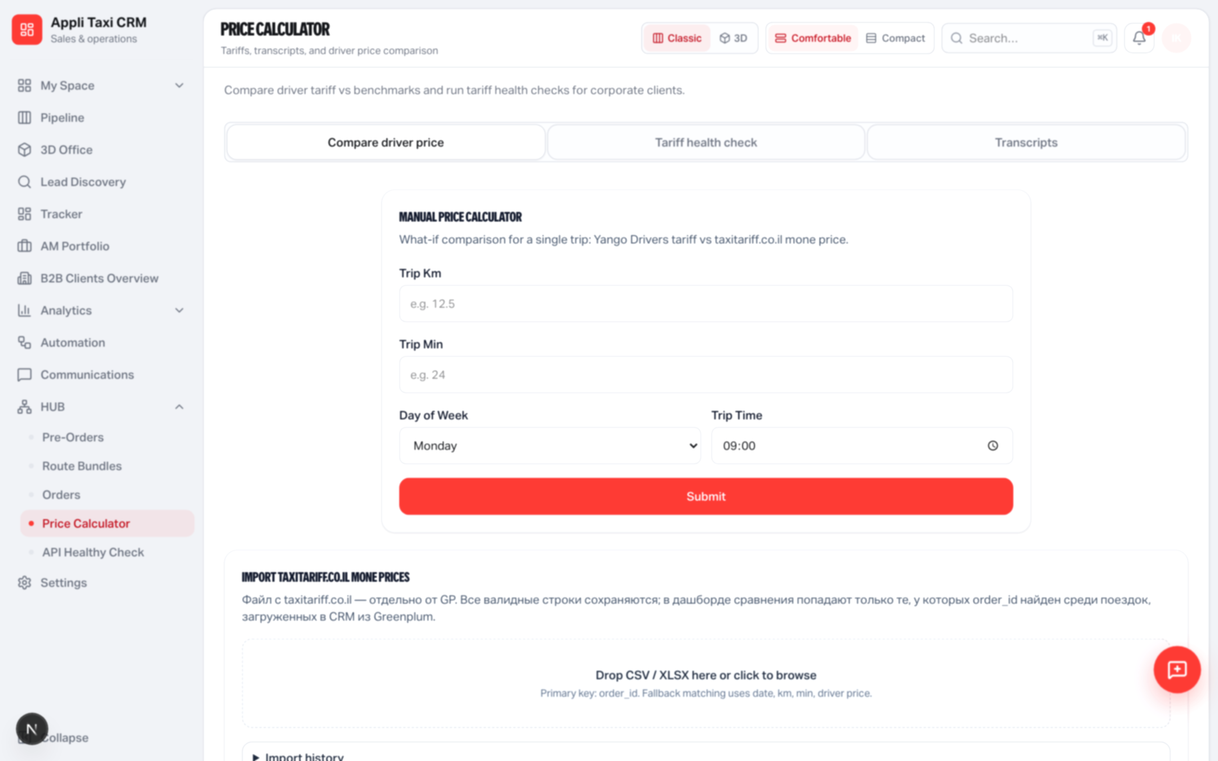
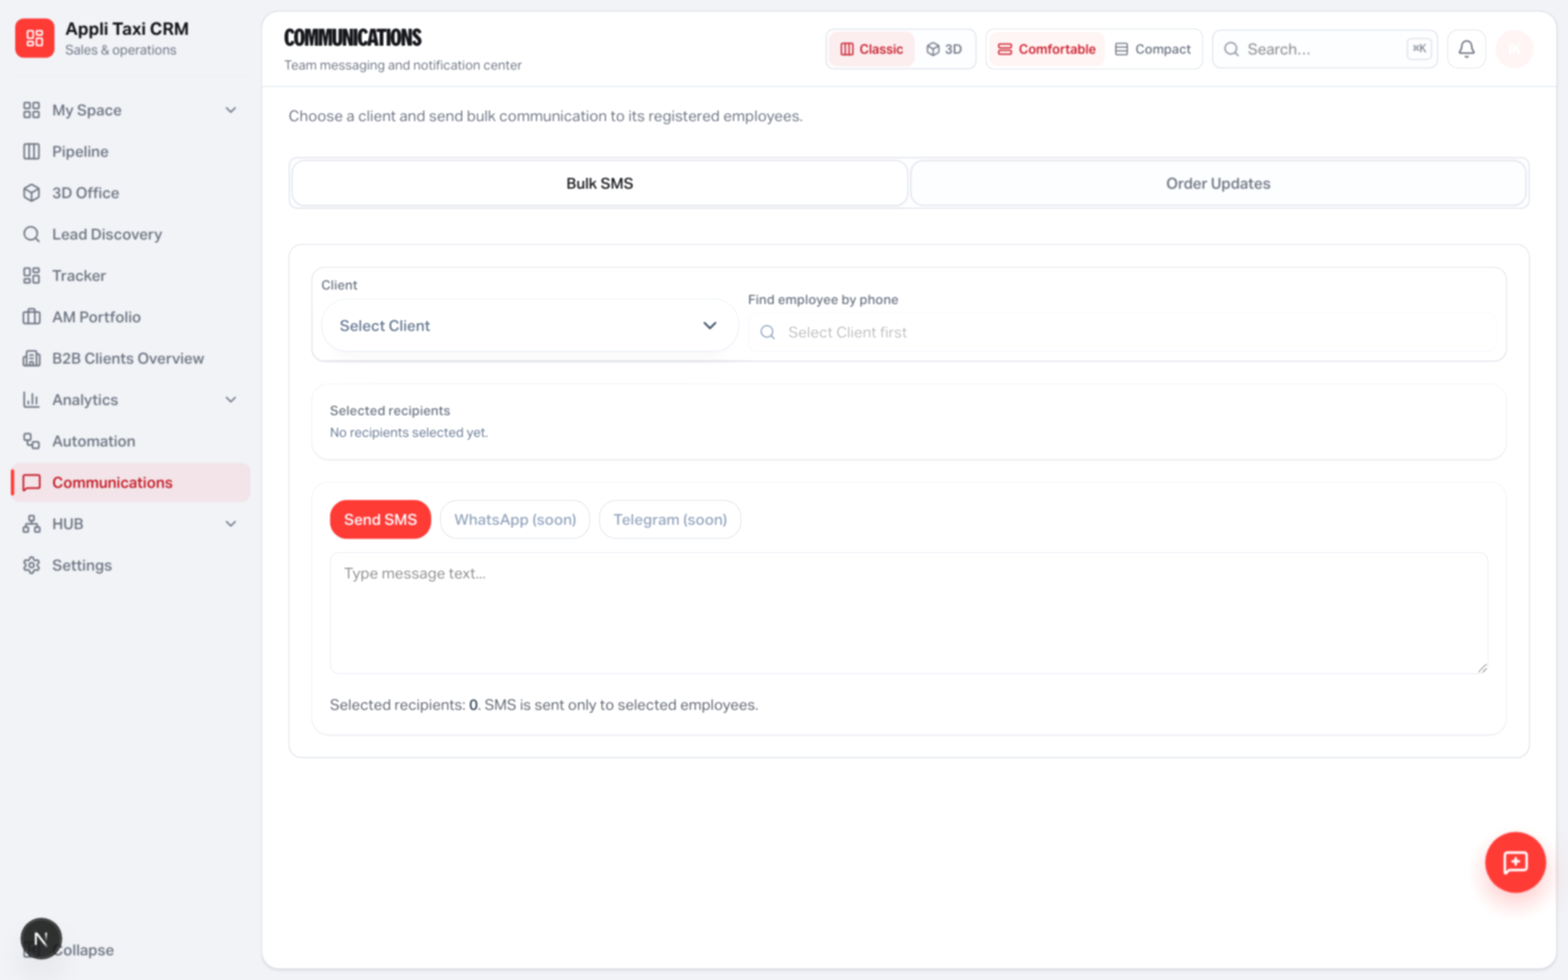
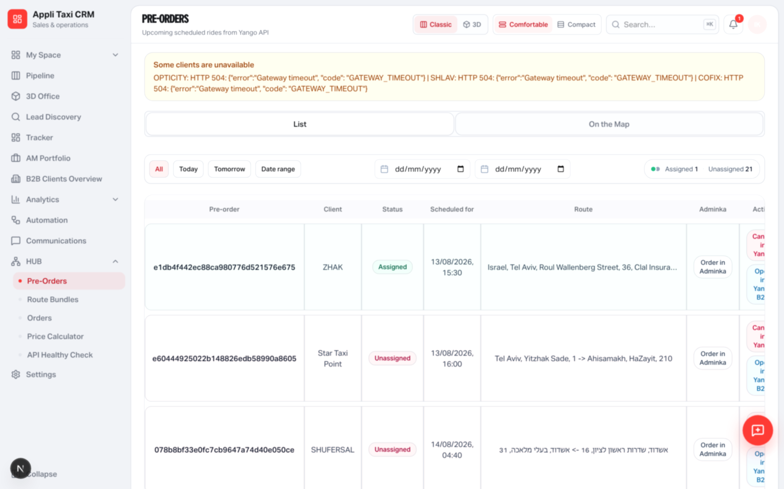
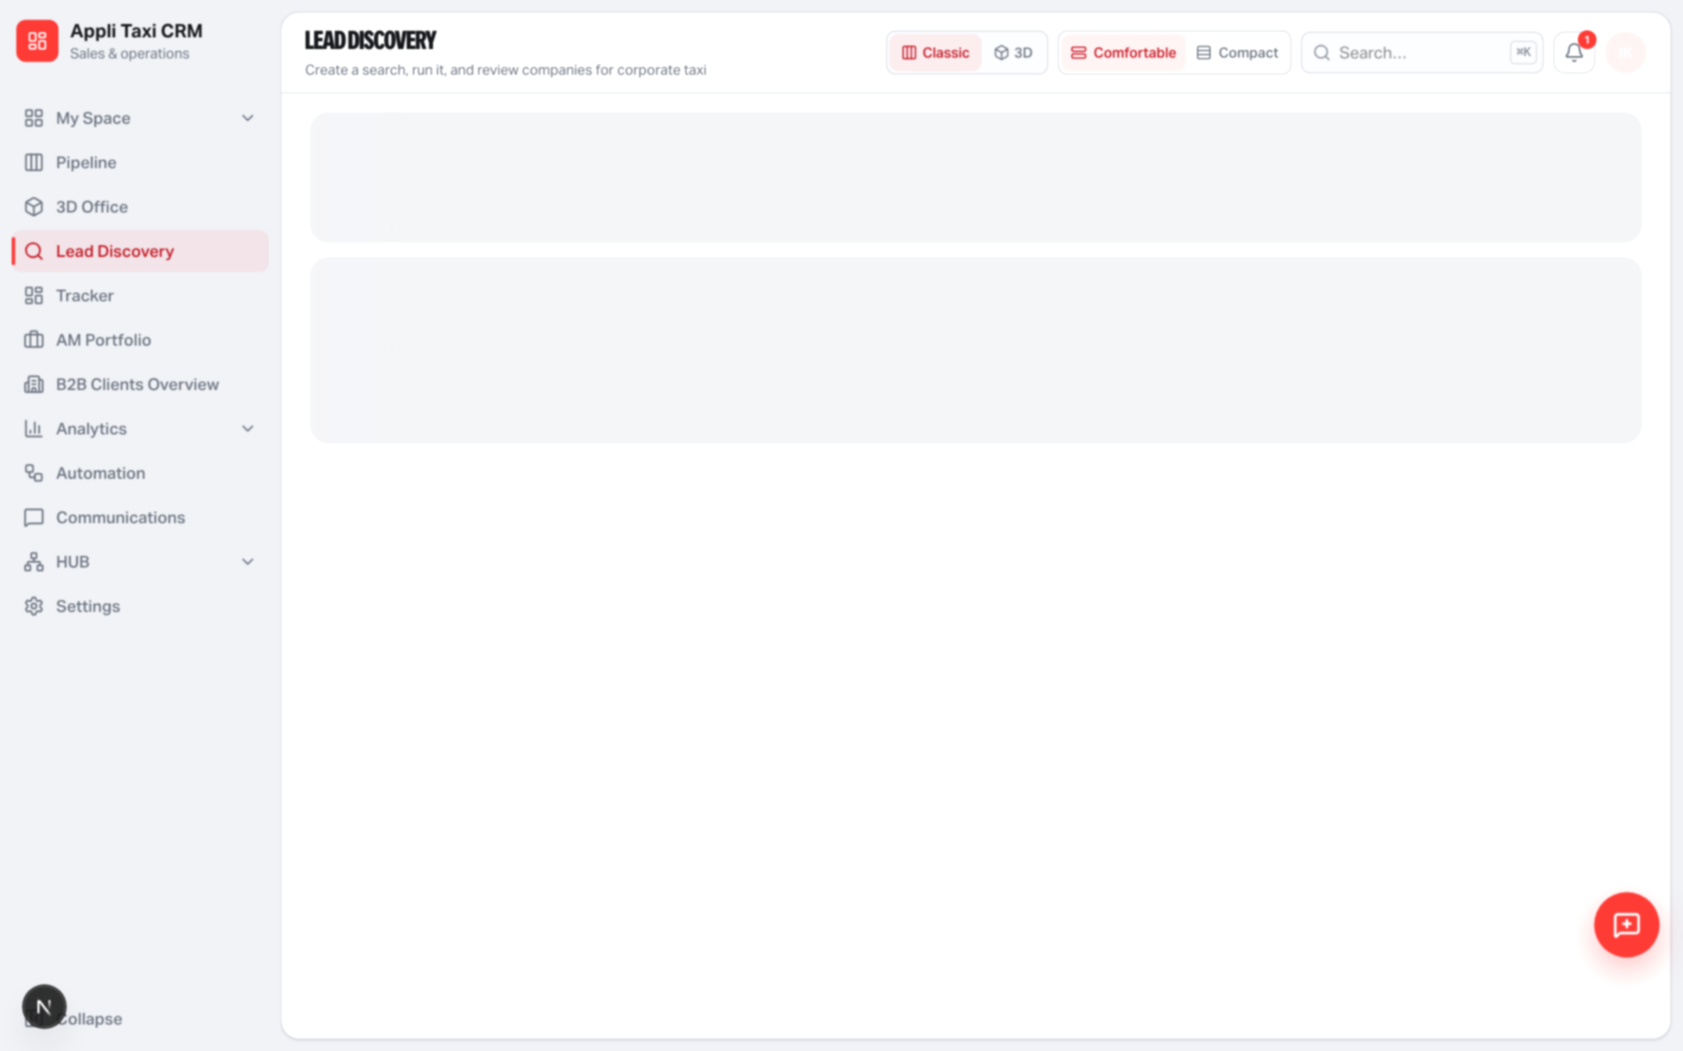
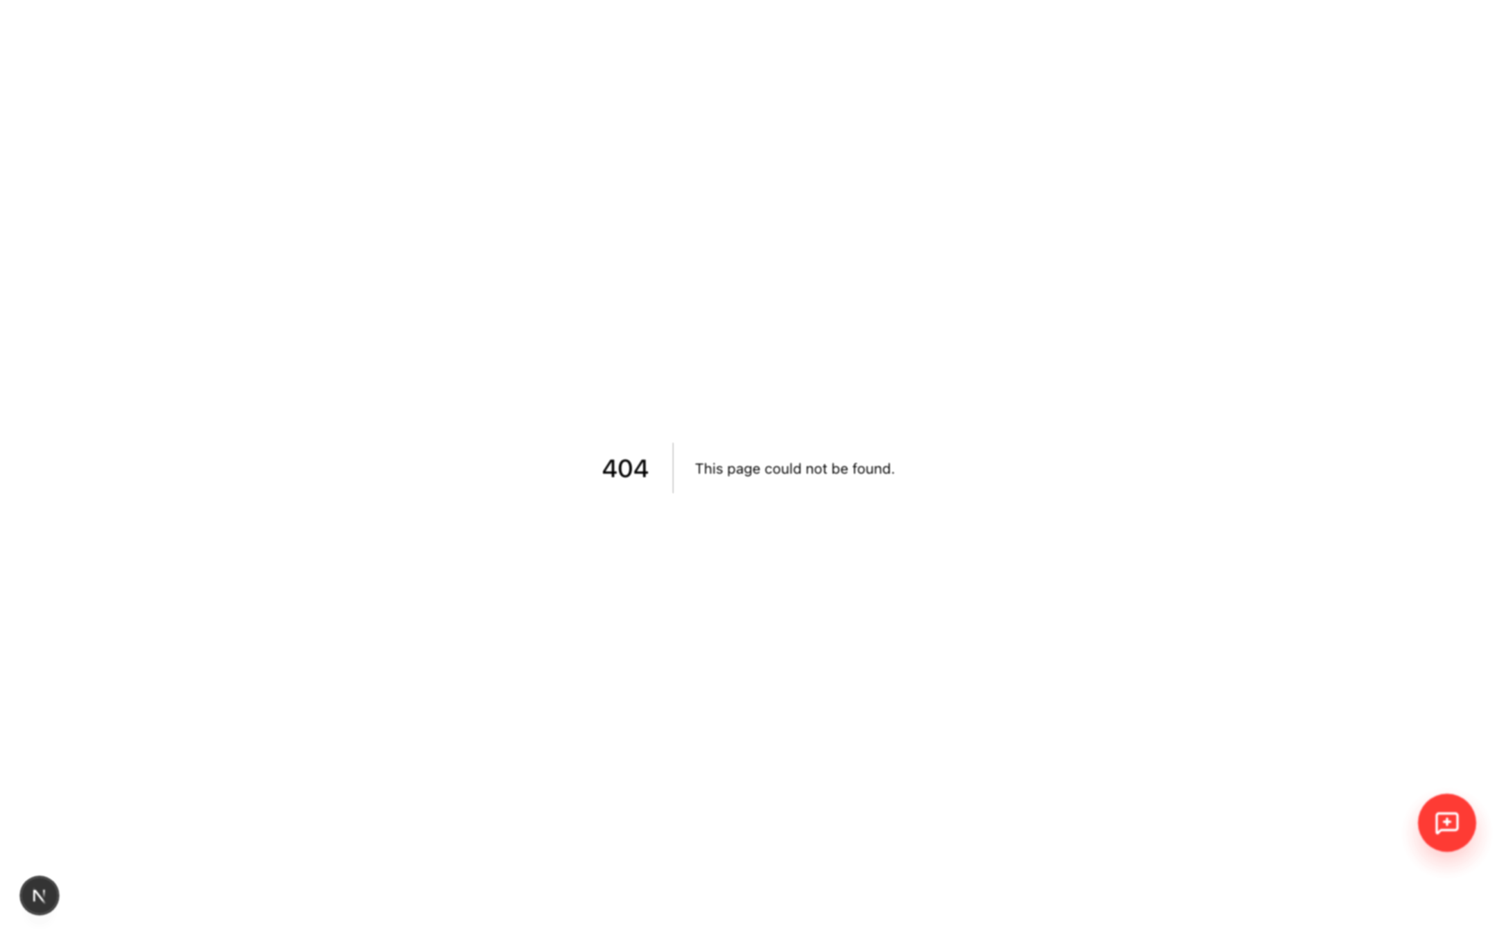
SURFACES
Glass and hover-lift are gone
P0 modules now use the same flat so-card language as Pipeline.
Yango · Sales Operations · Release 0.2.54 · Confidential
6 / 10

Slide 7
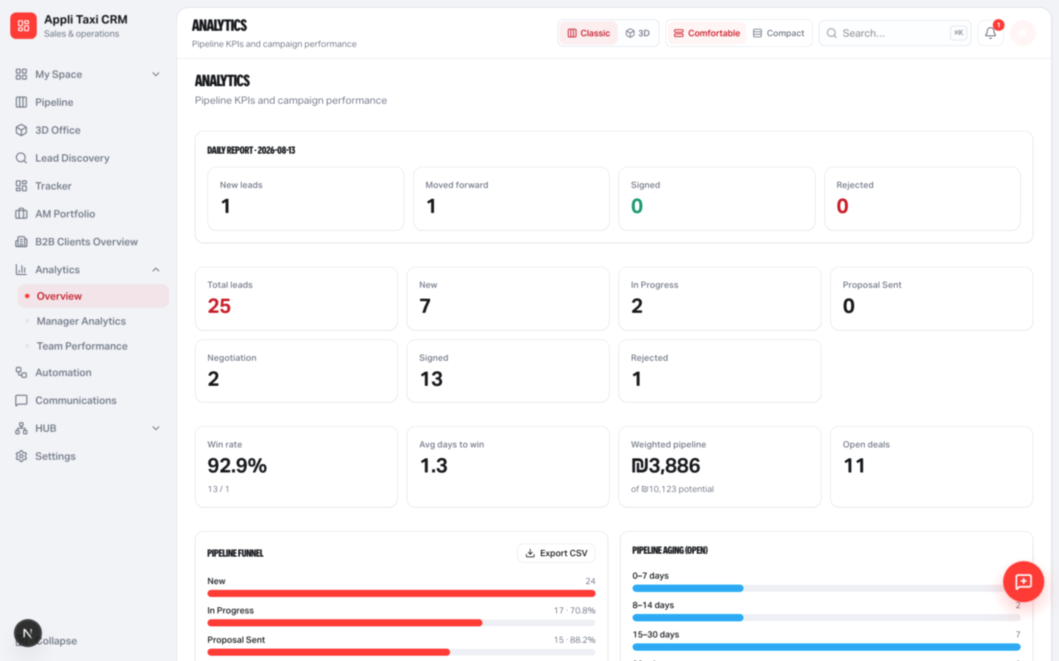
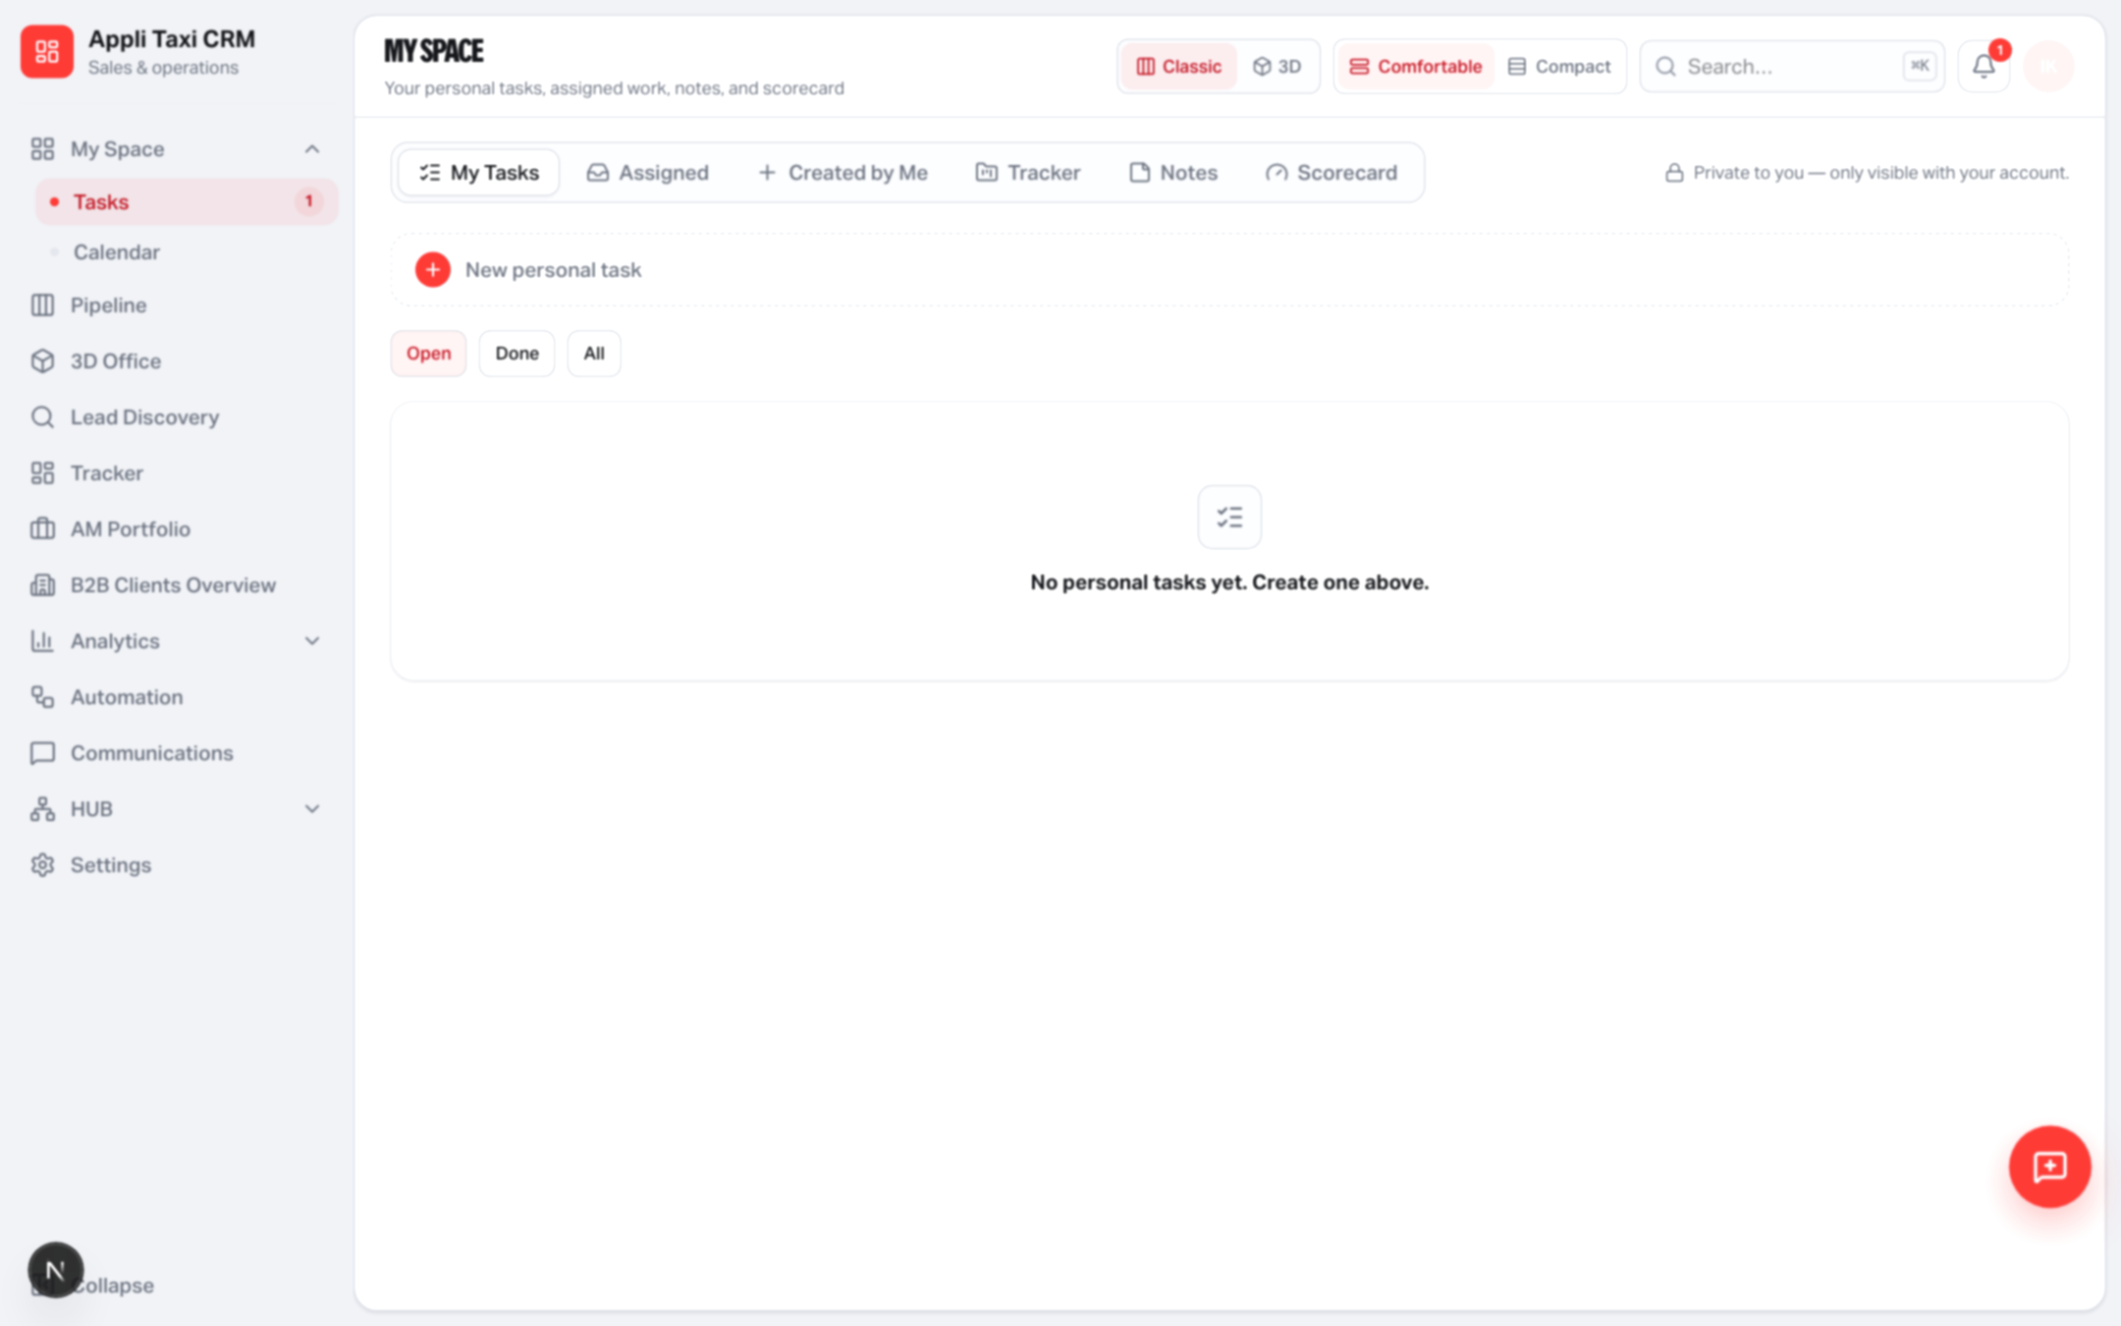
WORKSPACES
Analytics, My Space, Settings
Same reports and settings. Quieter chrome, sentence-case labels.
Yango · Sales Operations · Release 0.2.54 · Confidential
7 / 10

Slide 8
CRAFT
Type, color, motion
Yango only. No Inter, Geist or Google Fonts. No dark mode.
Typography
Color
Motion
Yango Text 400 / 500 / 700
Yango Headline 900 for H1
Sentence case labels (no ALL CAPS)
Section titles stay Text, not Headline
Accent #FF2D2D only
Workspace #eceef2
Surface #f7f8fa / white canvas
Monday-style status colors only
Drawers / modals 160–200ms ease-out
Button :active scale 0.97
No lift on cards or KPI tiles
No animation on daily actions
Yango · Sales Operations · Release 0.2.54 · Confidential
8 / 10

Slide 9
GUARDRAILS
What did not change
This release is presentation-only. Do not retrain the team on flows.
Pipeline DnD
Still HTML5 drag-and-drop — not dnd-kit
Tracker
Still @dnd-kit. Same columns, tickets, mentions
Automation
Still React Flow. Node logic unchanged
3D Office
Internals untouched; chrome only
APIs / RBAC
Same routes, permissions and validations
Legacy CRM
app/(crm) left as-is on the backend / old UI
Yango · Sales Operations · Release 0.2.54 · Confidential
9 / 10

Slide 10
Same CRM. Calmer product.
Inset canvas · Appli mark · flat cards · ⌘K · density · quiet motion.
applitaxi.space · Sales Operations · 0.2.54

