Slide 1

RELEASE 0.2.59
Documentation wiki
A shared Word-style workspace for Sales Operation — documents, tables, and file import, saved in Supabase.
applitaxi.space/sales-operation/documentation
Notes:
Title

Slide 2
WHY THIS RELEASE
Stop scattering process in chats and files
One shared wiki the team can edit together.
Vertical tabs
Word-style editor
Each document is a tab in a 240px rail: create, rename, drag reorder, delete.
Fonts, size, color, highlight, headings, lists, alignment — not markdown.
Tables + import
Saved on the server
CSV / XLSX become editable tables. DOCX body text, lists and tables flatten in.
TipTap JSON in documentation_documents. Autosave ~800ms, last-write-wins.
Yango · Sales Operations · Release 0.2.59 · Confidential
2 / 7
Notes:
Why

Slide 3
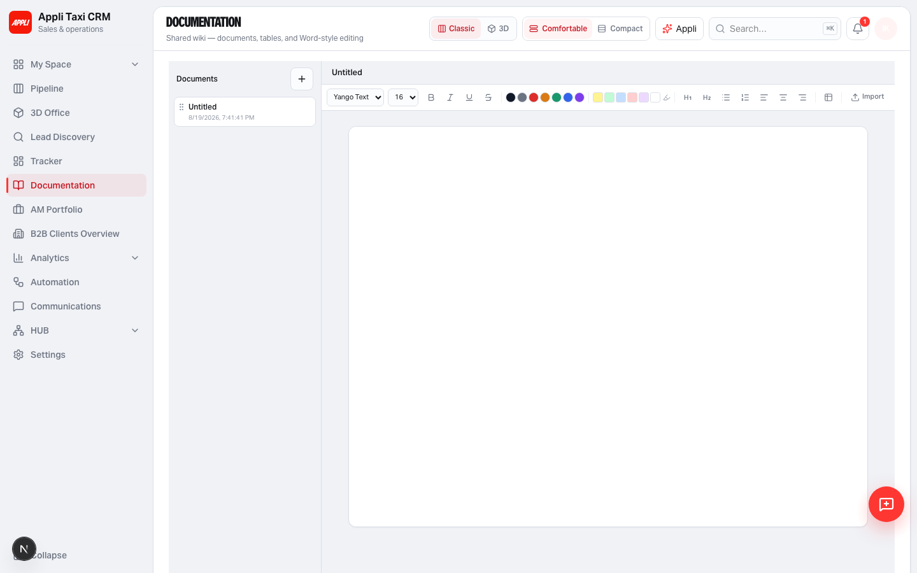
WORKSPACE
Documents on the left, page on the right
Hairline Linear-primary shell. Empty state until the first document.
Yango · Sales Operations · Release 0.2.59 · Confidential
3 / 7
Notes:
Workspace

Slide 4
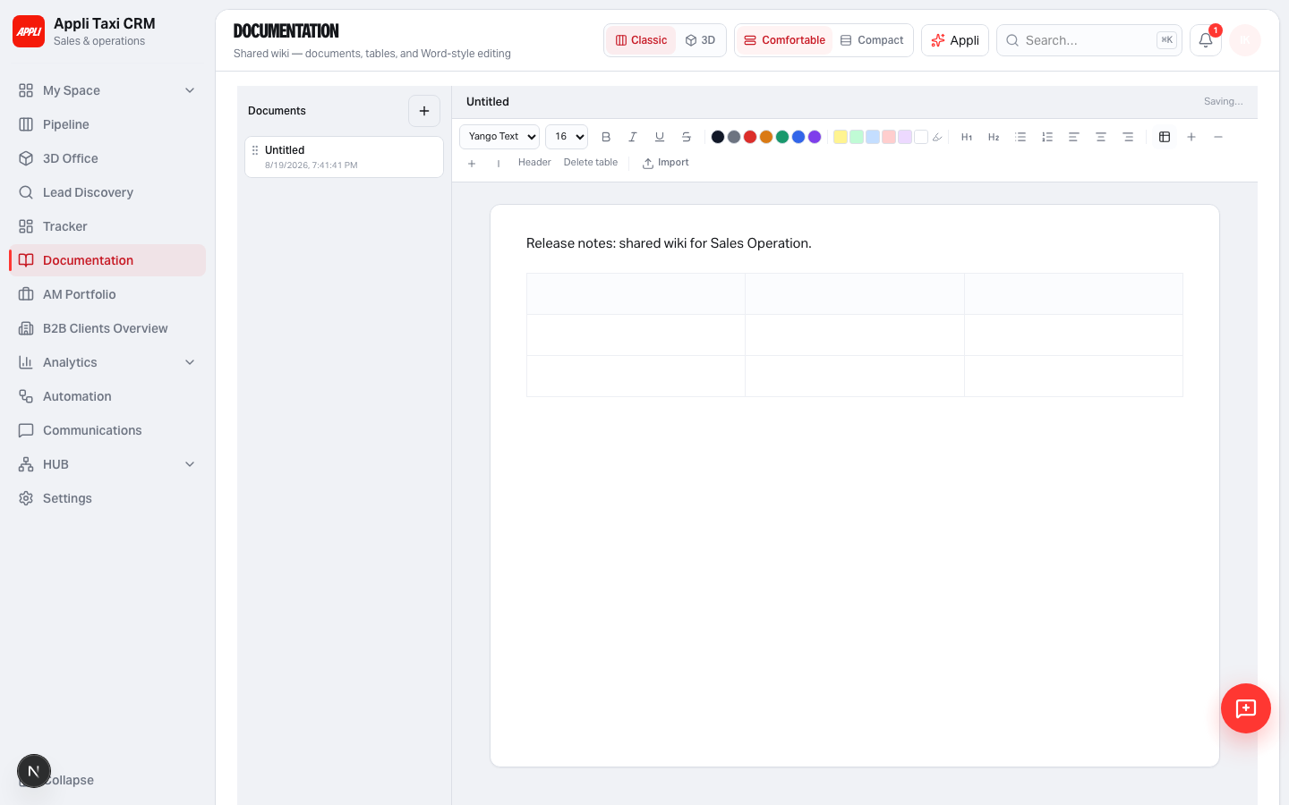
EDITOR
Sticky toolbar and an A4-ish canvas
Insert table, then add or remove rows and columns in place.
Yango · Sales Operations · Release 0.2.59 · Confidential
4 / 7
Notes:
Editor

Slide 5
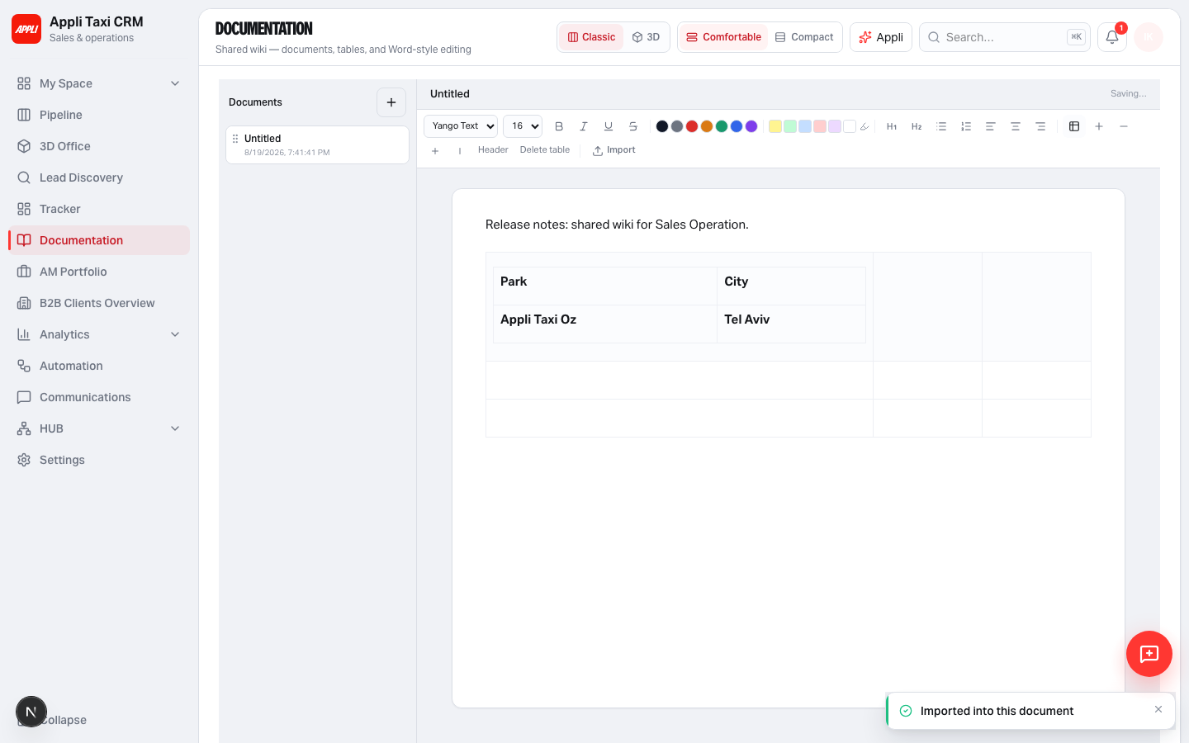
IMPORT
CSV, spreadsheet or Word into the current page
First sheet only for workbooks. Original files are not stored — content is the source of truth.
Yango · Sales Operations · Release 0.2.59 · Confidential
5 / 7
Notes:
Import

Slide 6
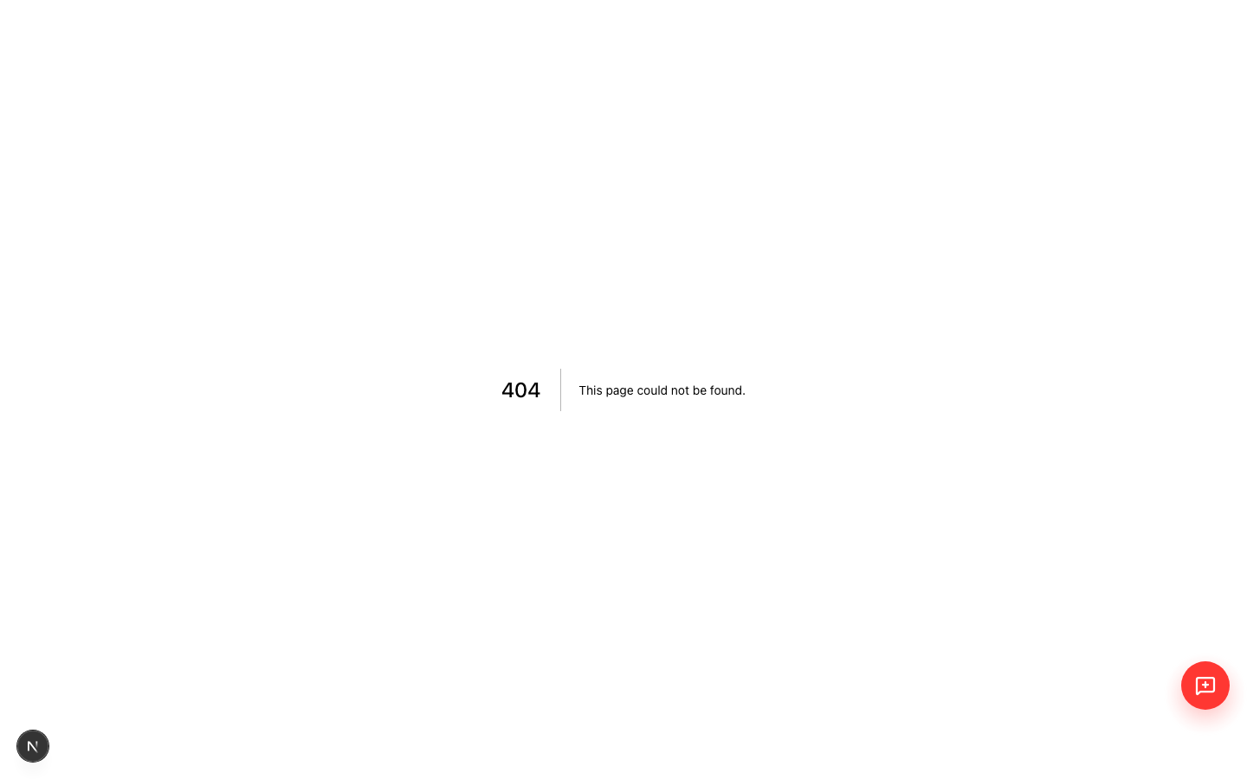
ACCESS
New page key: salesDocumentation
On for Admin, Account Manager and Sales Manager. Off for User and Team Lead. Permissions v15.
Yango · Sales Operations · Release 0.2.59 · Confidential
6 / 7
Notes:
Access

Slide 7
HOW TO USE
Open Documentation, write, import, it autosaves
SQL already registered in db:apply:sales-operation.
Open
Sidebar after Tracker, or ⌘K → Documentation.
Edit
Format like Word. Tables are first-class, not a separate grid.
Import
Toolbar → Import. CSV / XLSX / DOCX, max 5 MB.
Schema
scripts/sql/supabase_sales_documentation.sql
Yango · Sales Operations · Release 0.2.59 · Confidential
7 / 7
Notes:
Ship

