Slide 1

RELEASE 0.2.52
Route Bundles for
pre-order chaining
Suggest exclusive driver routes · map with road polylines · Operations HUB under Sales Operation
Yango · Sales Operations · Appli Taxi Oz

Slide 2
AGENDA
What shipped in 0.2.52
Ops tools moved into SO HUB + smart route suggestions
01
Operations HUB
Pre-Orders, Orders, Route Bundles, Price Calculator, API Health Check
02
Route Bundles engine
Beam search + exclusive packing — more short routes, no shared orders
03
Map workspace
Road polylines, multicolor legs, client name in popups
04
Workflow
Suggested → call driver → accept · recalculate · opportunities
05
Settings & RBAC
Buffers, empty-drive km, candidate caps · preOrders permission
Yango · Sales Operations · Release 0.2.52 · Confidential
2 / 11

Slide 3
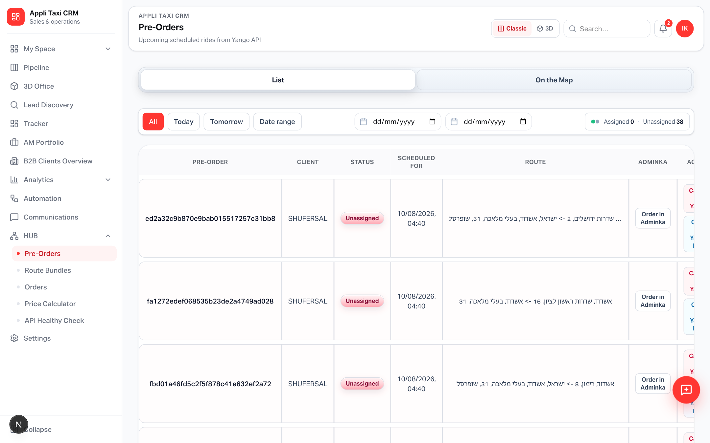
OPERATIONS HUB
Pre-Orders live under Sales Operation
Legacy /pre-orders and /orders redirect into the SO shell
Yango · Sales Operations · Release 0.2.52 · Confidential
3 / 11

Slide 4
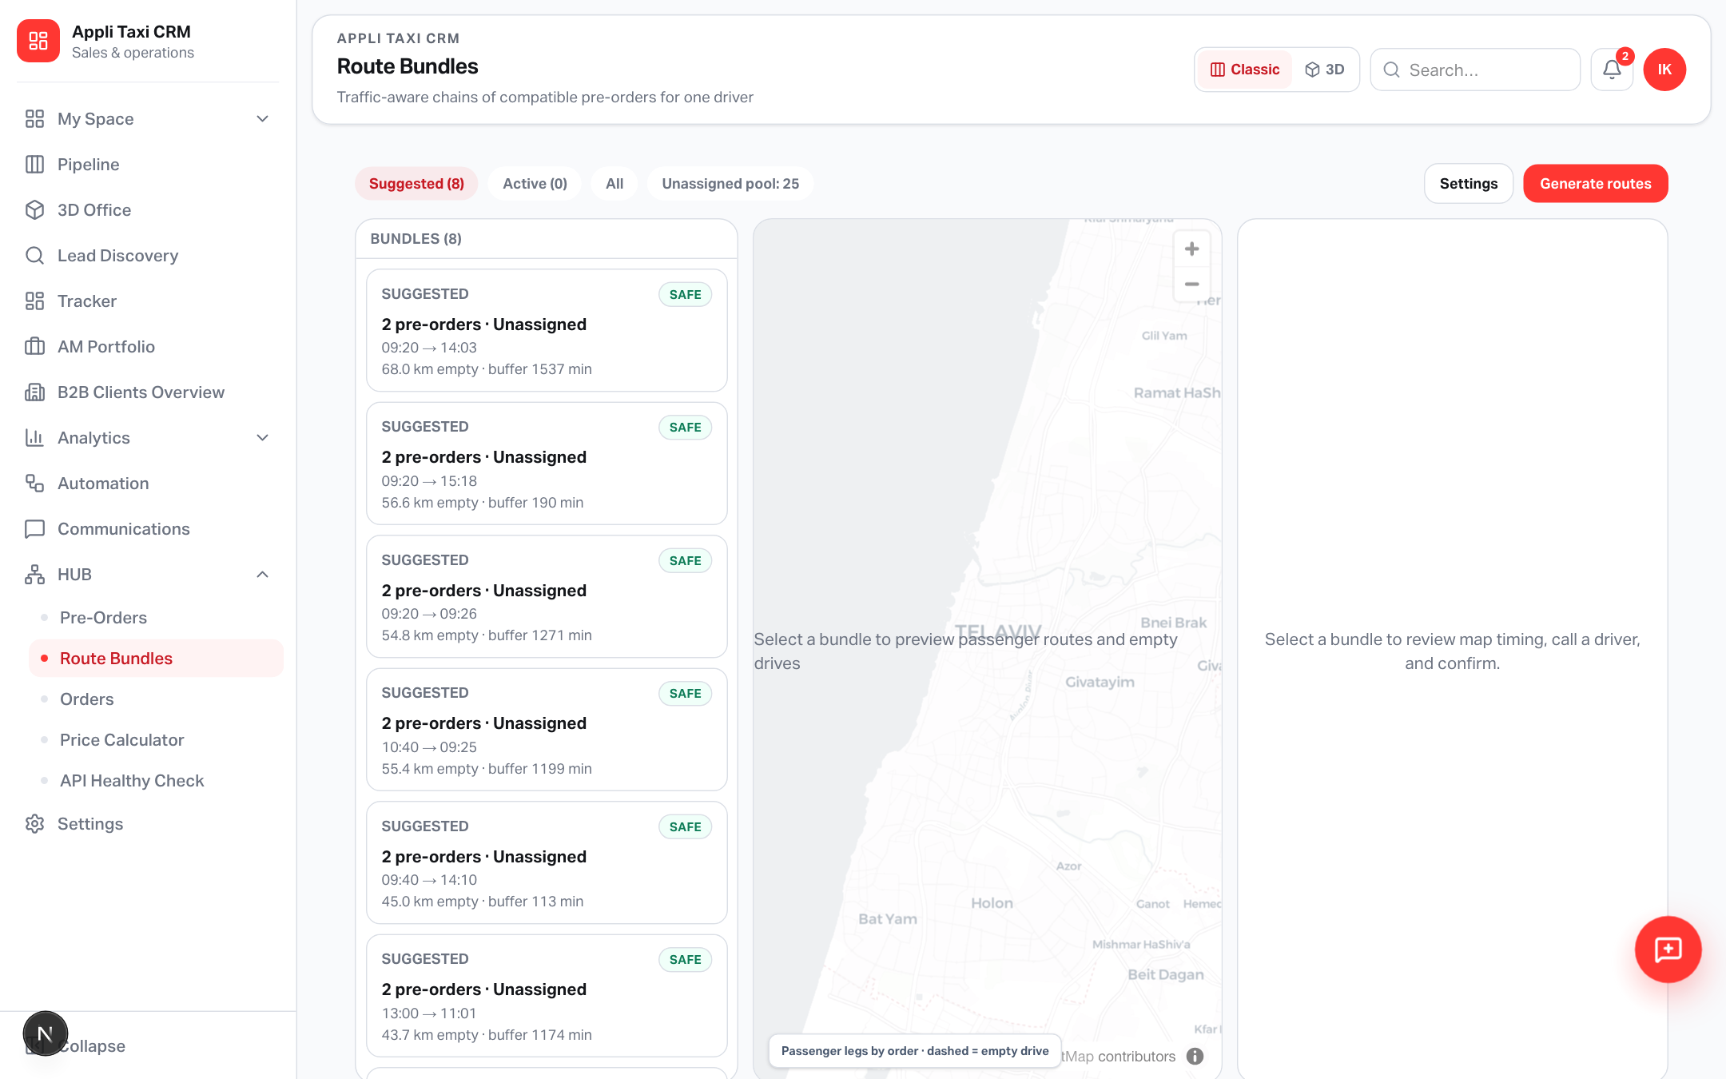
ROUTE BUNDLES
Suggested exclusive chains from the open pool
Generate rebuilds suggestions · statuses for call / accept / active
Yango · Sales Operations · Release 0.2.52 · Confidential
4 / 11

Slide 5
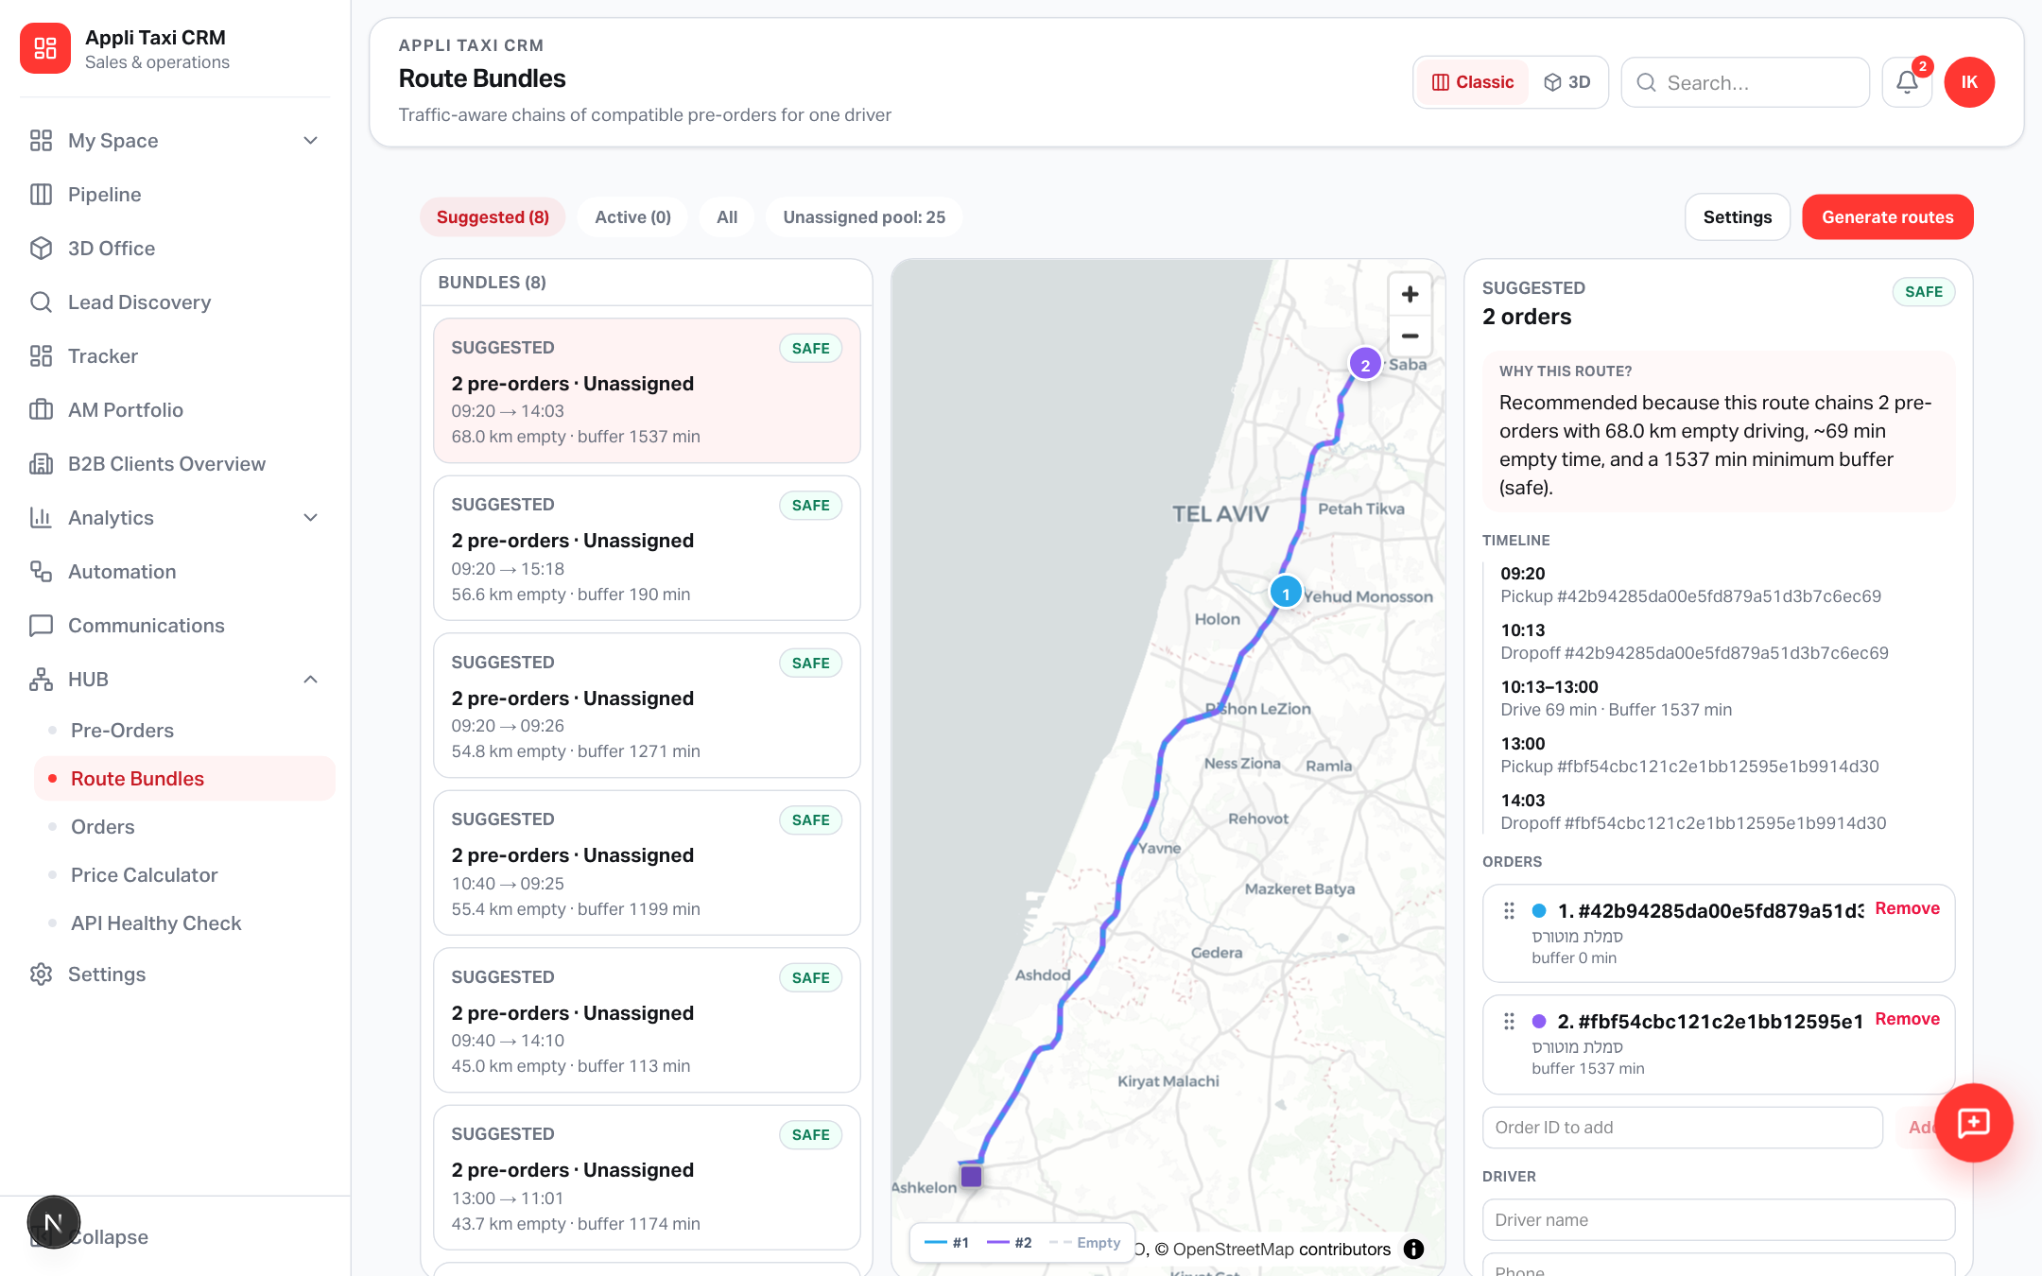
MAP
Real Google road geometry — not straight lines
Each order leg has its own color · dashed empty drives · client in marker popups
Yango · Sales Operations · Release 0.2.52 · Confidential
5 / 11

Slide 6
ENGINE
How suggestions are built
Same token · time buffers · empty-drive limits · Google Routes + Matrix
Enrich
Search
Pull open pre-orders, resolve pickup/dropoff coords (API → geocode)
Beam-search compatible chains (2…N) with traffic-aware travel times
Pack
Preview
Exclusive packing prefers more short routes over one long chain
Persist snapshot geojson; on open, upgrade stubs to road polylines
Yango · Sales Operations · Release 0.2.52 · Confidential
6 / 11

Slide 7
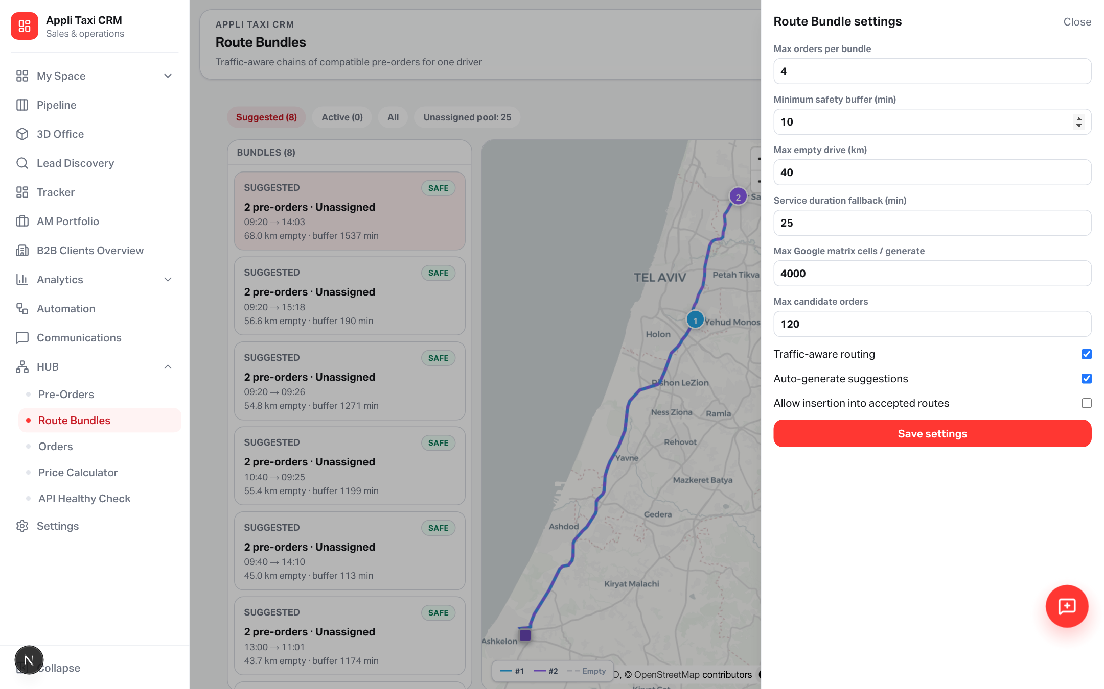
SETTINGS
Tune buffers, empty drive, and pool size
Write access: Admin / salesSettings · link from Sales Settings
Yango · Sales Operations · Release 0.2.52 · Confidential
7 / 11

Slide 8
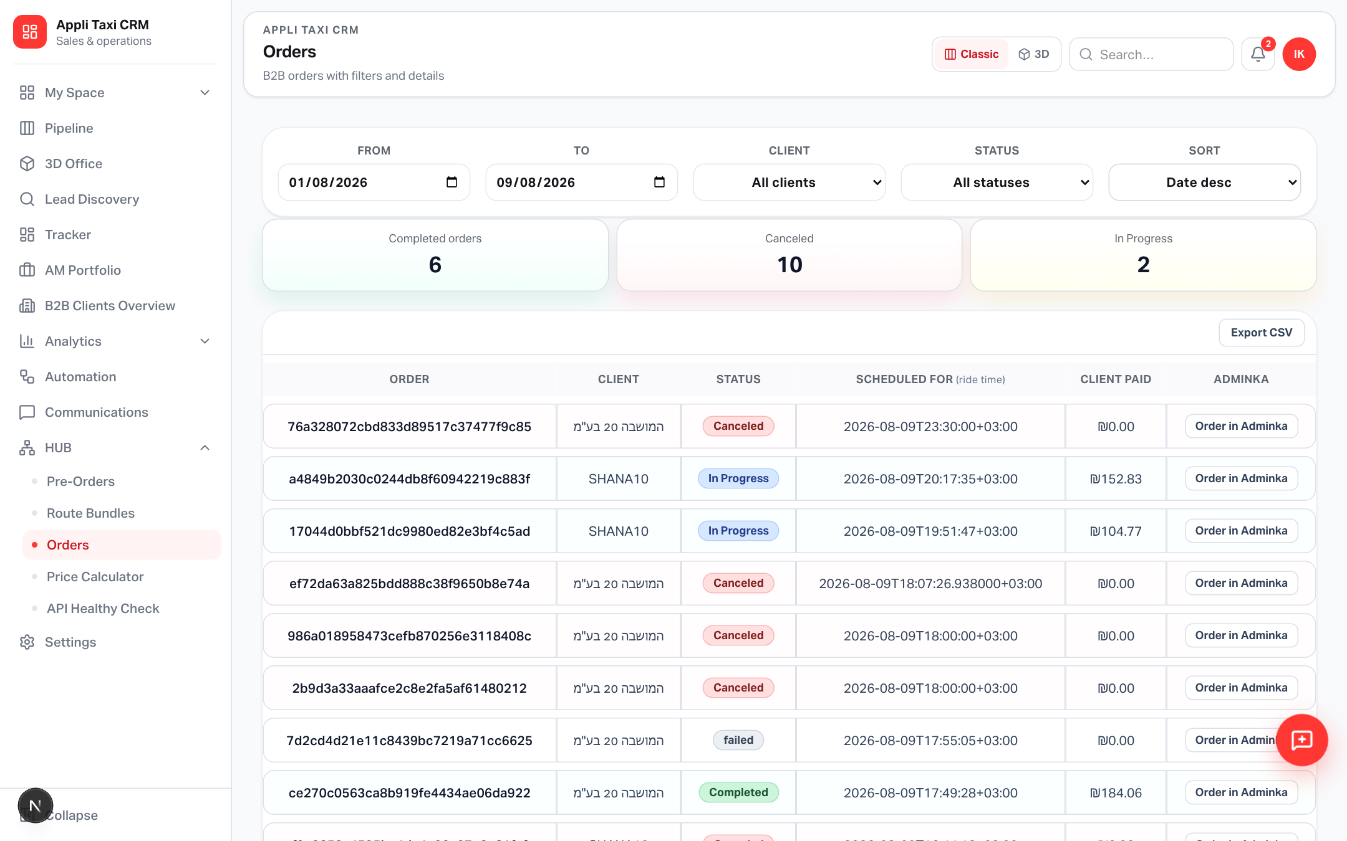
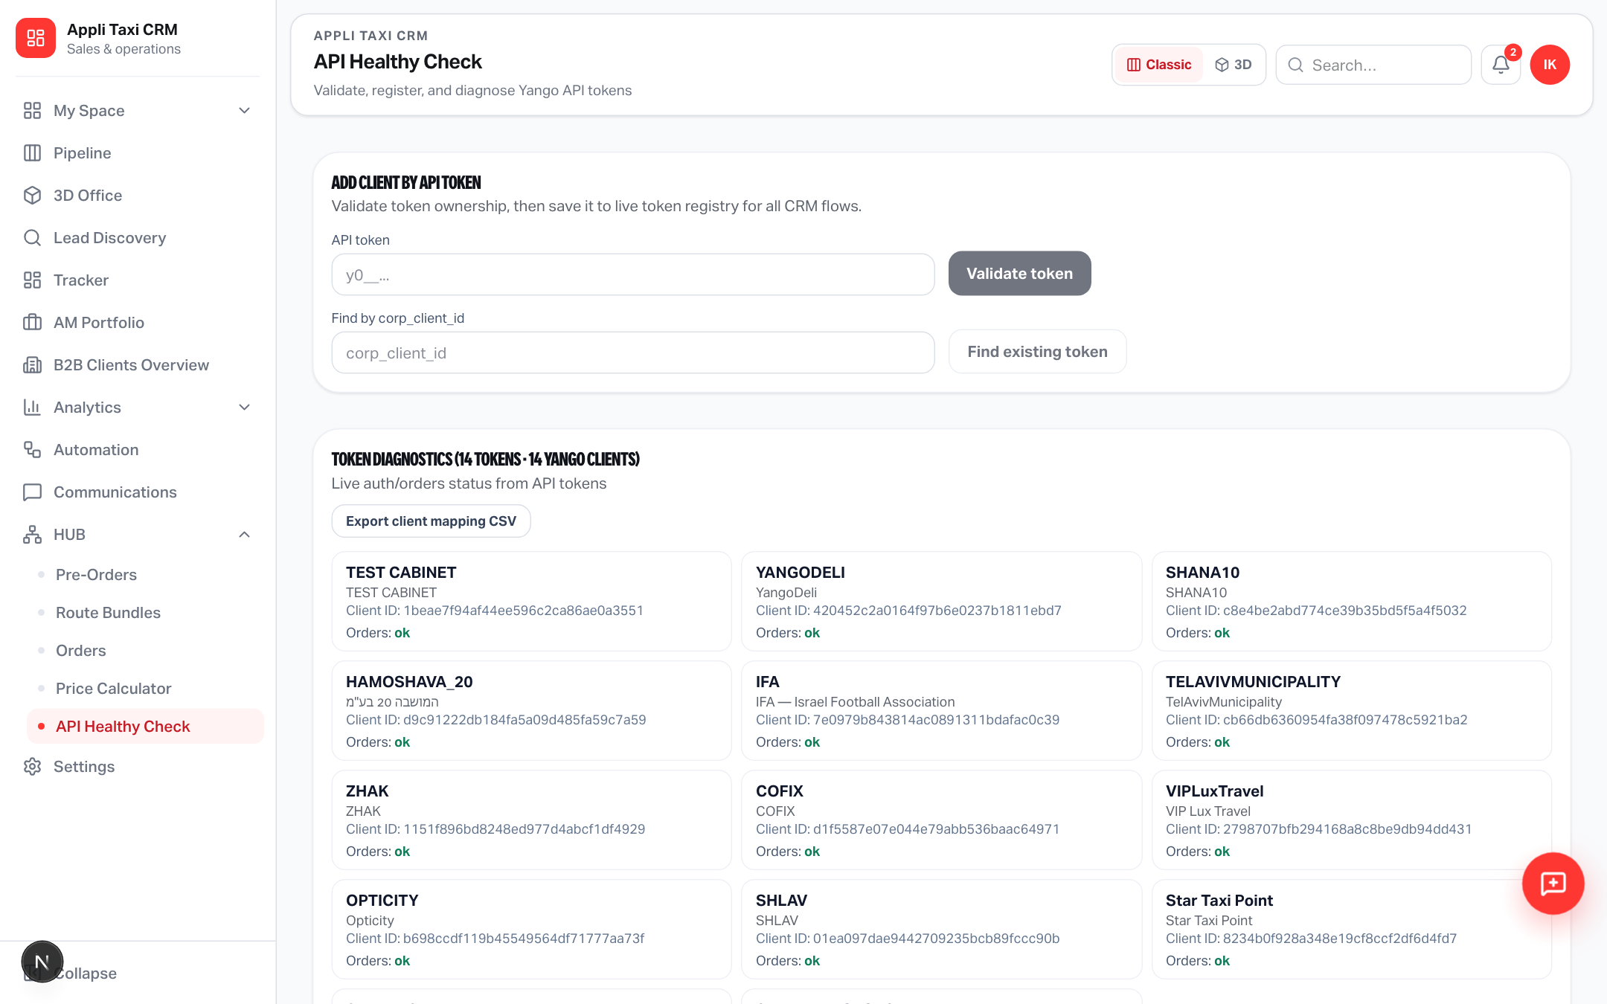
HUB NEIGHBORS
Orders + API Health Check in the same shell
Token health moved out of Notes into dedicated API Health Check
Yango · Sales Operations · Release 0.2.52 · Confidential
8 / 11

Slide 9
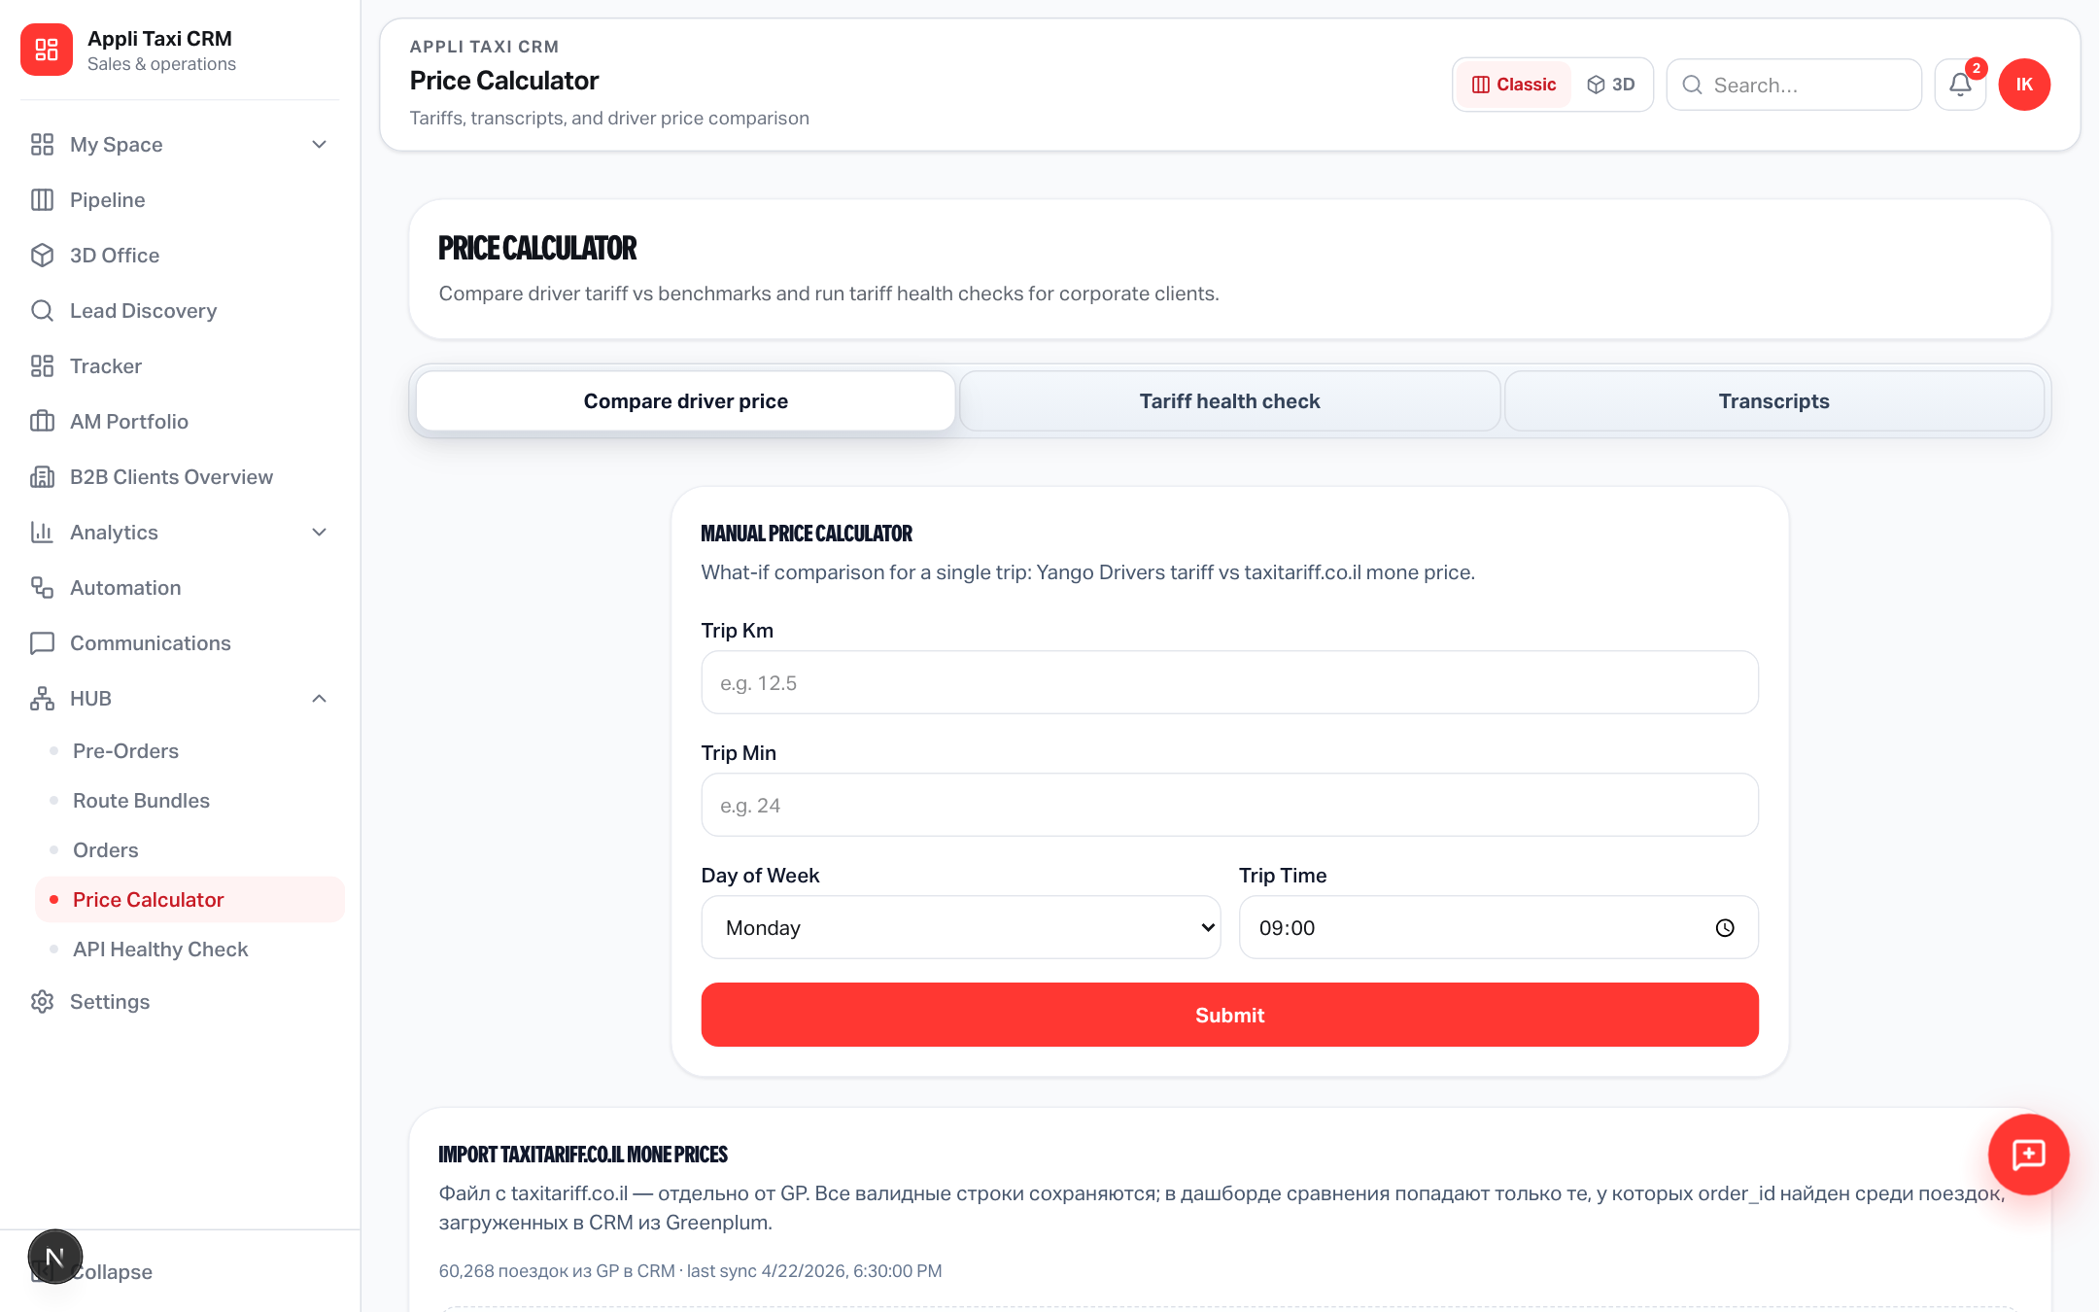
HUB
Price Calculator stays next to ops tools
One place for pre-order ops, pricing, and route planning
Yango · Sales Operations · Release 0.2.52 · Confidential
9 / 11

Slide 10
FEATURES
Release checklist
Everything operators need for day-one Route Bundles
• Generate exclusive suggested routes from mappable pre-orders
• Driver assignment after call · status workflow
• List tabs: Suggested / Active / All · health badges & explain text
• Insertion opportunities banner (accept / dismiss)
• MapLibre map: passenger + empty-drive legs, multicolor per order
• Settings: max orders, safety buffer, empty km, matrix budget, candidates
• Marker popups: client name + pickup/dropoff route text
• SQL tables applied · GOOGLE_MAPS_API_KEY required on Vercel
• Edit sequence (DnD), add/remove order, recalculate with Google
• EN + HE copy · RBAC via preOrders / notes / salesSettings
Yango · Sales Operations · Release 0.2.52 · Confidential
10 / 11

Slide 11
Try it on prod
https://applitaxi.space/sales-operation/route-bundles
Generate → open a suggestion → review map & buffers → contact driver → Accept
Yango · Sales Operations · Release 0.2.52

