Slide 1

RELEASE 0.2.49
Lead Discovery
for Israel B2B
Segment campaigns · Google Places · Groq qualification · Approve before pipeline
Yango · Sales Operations · Appli Taxi Oz

Slide 2
AGENDA
Find, score, and approve B2B leads automatically
New module at /sales-operation/lead-discovery
01
Describe a segment
Natural language → Groq interprets categories, cities, size, rules
02
Run Find leads
Google Places search + scoring; one campaign at a time
03
Approve candidates
Review pending leads before they enter the pipeline
04
Automations
Triggers for discovered / qualified / daily target / email reply
05
Ops & cron
Daily target in Advanced; discovery tick every 2 hours
Yango · Sales Operations · Release 0.2.49 · Confidential
2 / 9

Slide 3
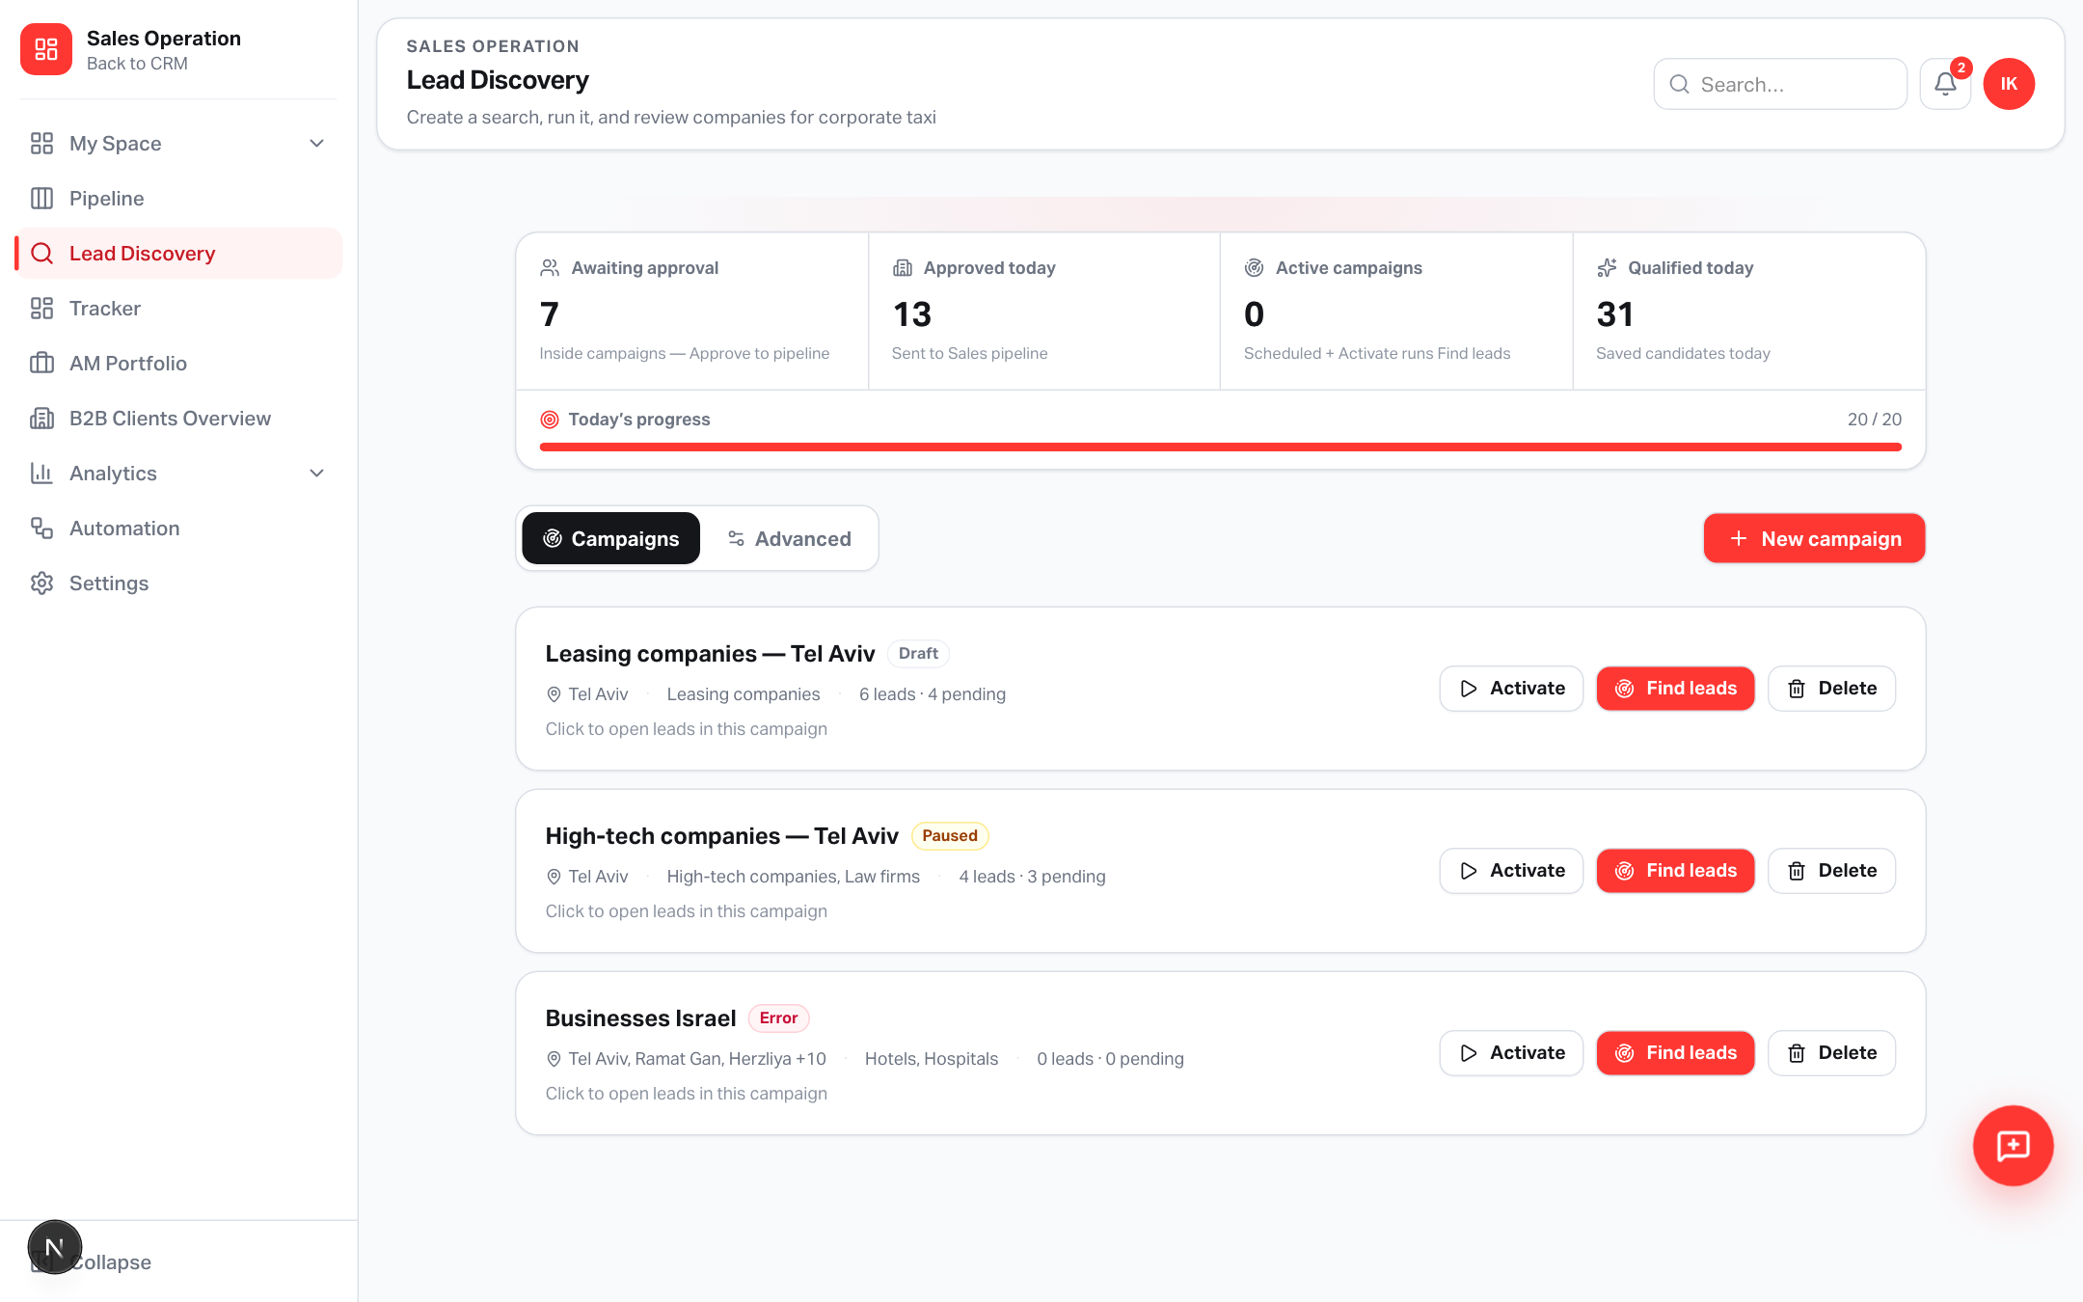
PRODUCT
Campaign dashboard
KPI tiles · active / paused · Find leads · Stop
Yango · Sales Operations · Release 0.2.49 · Confidential
3 / 9

Slide 4
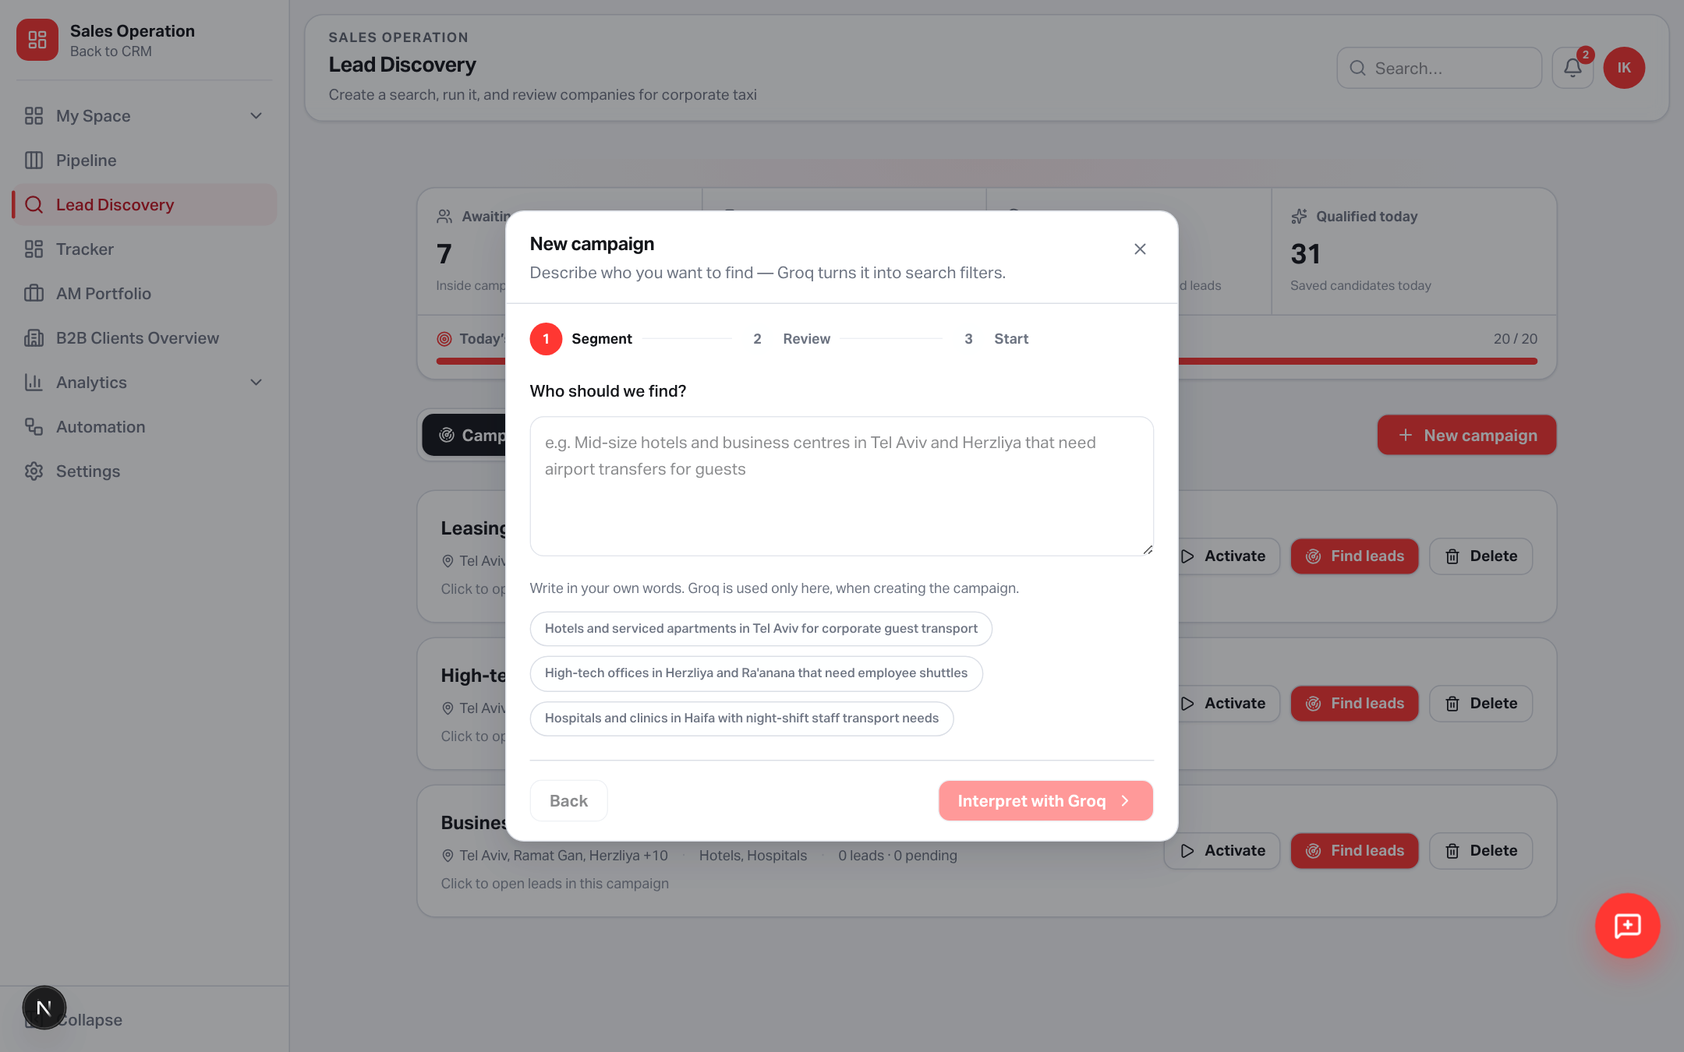
CREATE
Segment wizard powered by Groq
Describe once → review categories, cities, qualification rules → create
Yango · Sales Operations · Release 0.2.49 · Confidential
4 / 9

Slide 5
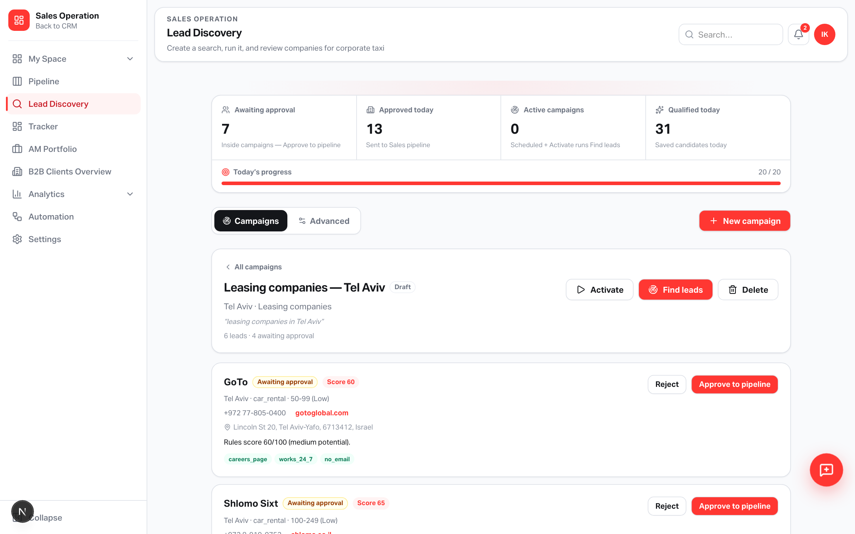
REVIEW
Approve before pipeline
Candidates stay pending until a manager accepts them into Sales Pipeline
Yango · Sales Operations · Release 0.2.49 · Confidential
5 / 9

Slide 6
FLOW
From segment text to pipeline lead
Deterministic scoring with optional LLM nudge
1 · Interpret
2 · Discover
3 · Approve
Groq turns free text into business types,
cities, size filter, and qualification rules.
Heuristic fallback if rate-limited (429).
Catalog synonyms (e.g. лизинг → leasing).
Google Places search per city × type.
Score with rule weights; closed places out.
One running campaign at a time.
Stop works mid-run; progress after save.
Pending approval queue.
Approve → create pipeline lead.
Cron tick every 2h for active campaigns.
Daily target editable in Advanced.
Yango · Sales Operations · Release 0.2.49 · Confidential
6 / 9

Slide 7
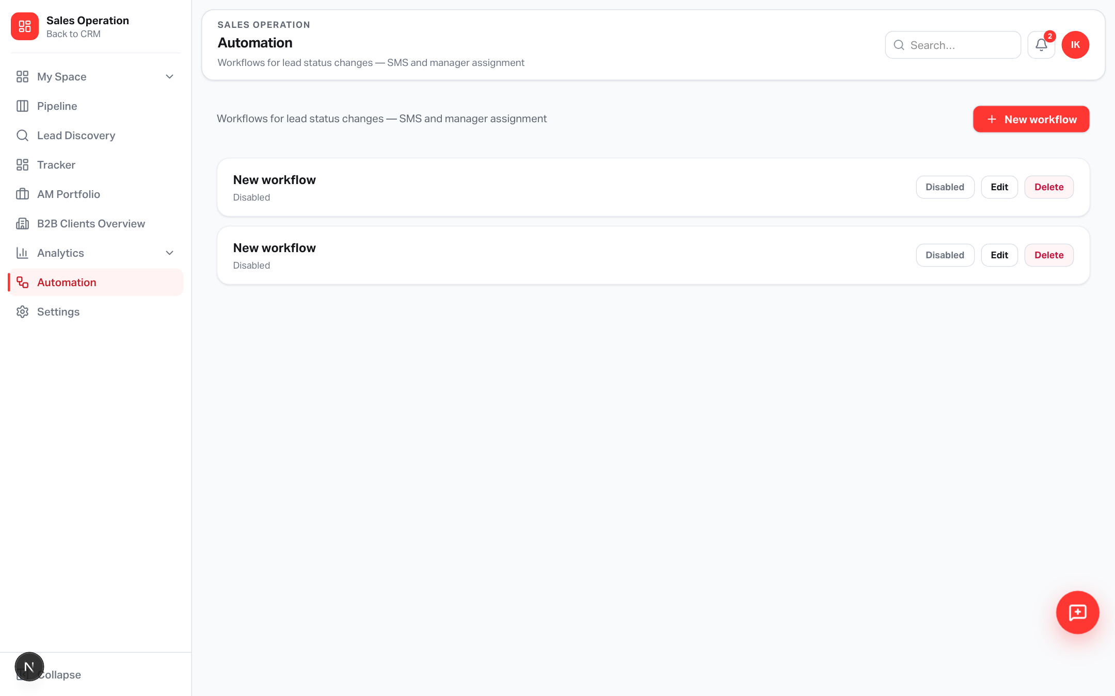
AUTOMATION
New discovery-aware nodes
Wire Lead Discovery into SMS, tasks, stickers, email sequences
New triggers & actions
Lead discovered (min score)
Qualification completed
Daily target not reached
Email replied
Condition gate
Actions: notify, sticker,
start email sequence
Yango · Sales Operations · Release 0.2.49 · Confidential
7 / 9

Slide 8
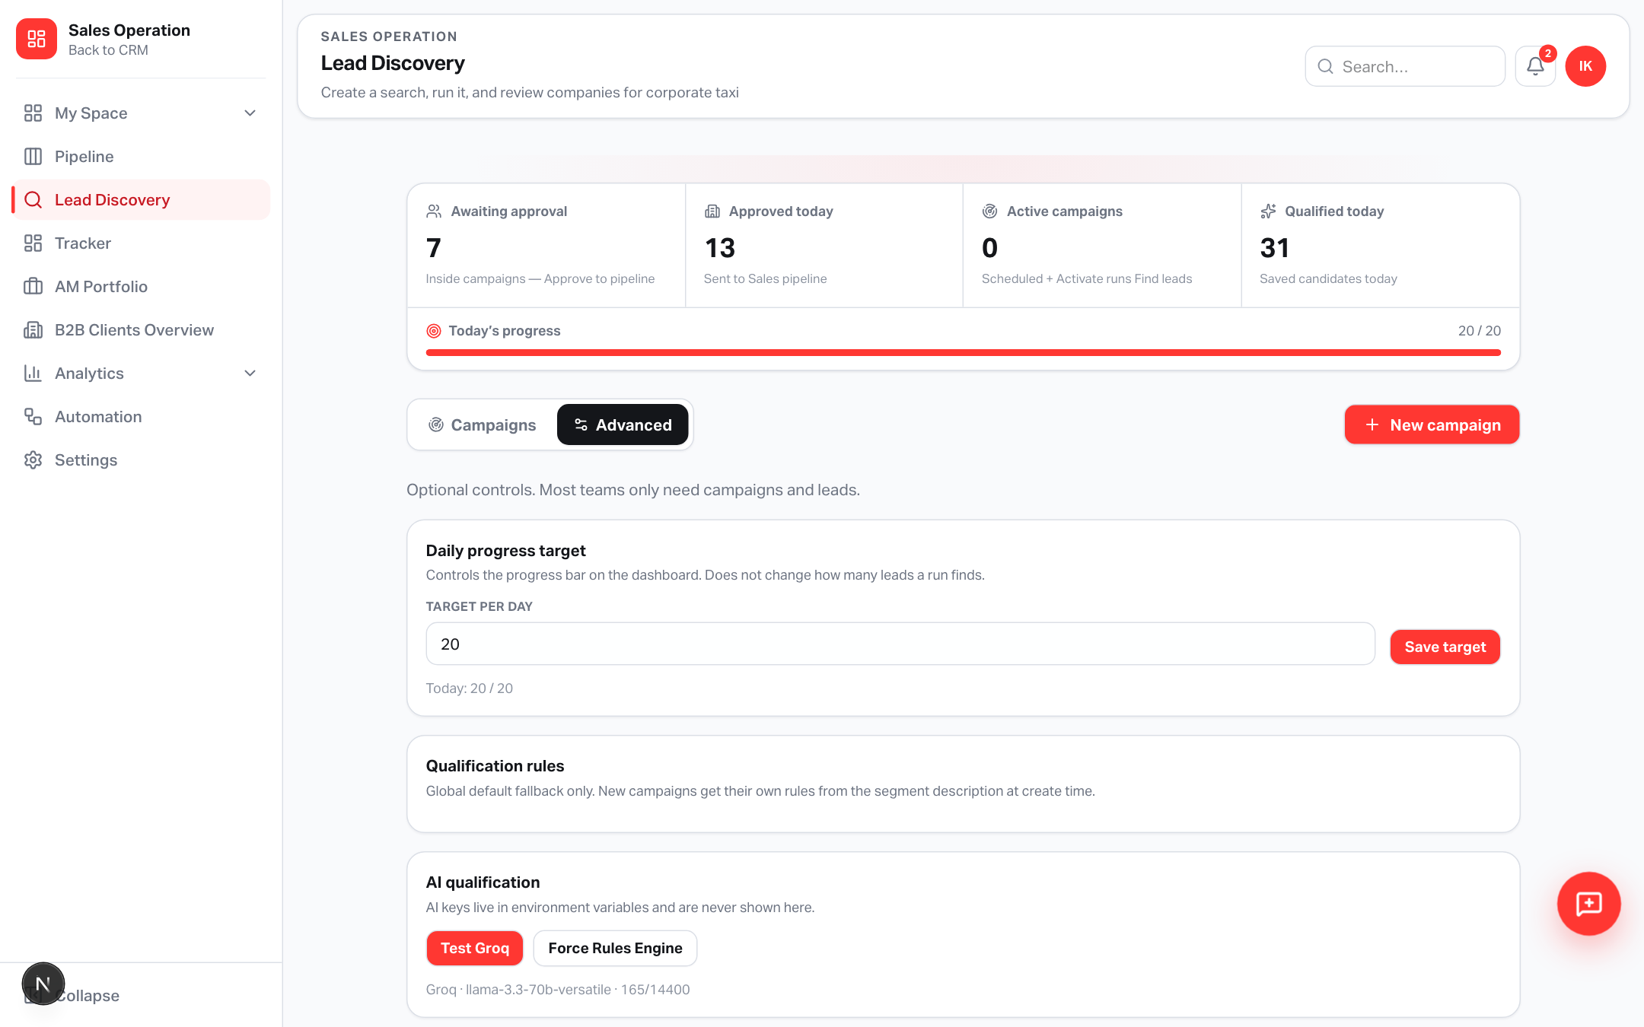
OPS
Advanced settings & schema
Apply SQL in Supabase before first production use
Ship checklist
SQL: supabase_sales_lead_discovery.sql
SQL: …_pending_approval.sql
Env: LEAD_DISCOVERY_ENABLED=1
GOOGLE_PLACES_API_KEY (or Maps)
GROQ_API_KEY + model
CRON_SECRET for discovery-tick
Permission: salesLeadDiscovery (v13)
Yango · Sales Operations · Release 0.2.49 · Confidential
8 / 9

Slide 9
Open in production
https://applitaxi.space/sales-operation/lead-discovery
Release 0.2.49 · Lead Discovery · Appli Taxi Oz

