Slide 1

RELEASE 0.2.48
Signed B2B
handover automation
Default Account Manager · Onboarding + First Touch · Calendar · Tracker launch checklist
Yango · Sales Operations · Appli Taxi Oz

Slide 2
AGENDA
What happens when a deal becomes Signed
One transition → AM + task + meeting + Tracker ticket
01
Default Account Manager
Stage Gate prefills AM from Settings (fallback igorrebkovets@appli.taxi)
02
Onboarding + First Touch
Single high-priority task assigned to the Account Manager
03
Calendar meeting
45-minute slot on the next business day for the AM
04
Tracker launch prep
Ticket with fixed checklist in the configured project
05
Settings
Change default AM and Tracker project anytime
Yango · Sales Operations · Release 0.2.48 · Confidential
2 / 9

Slide 3
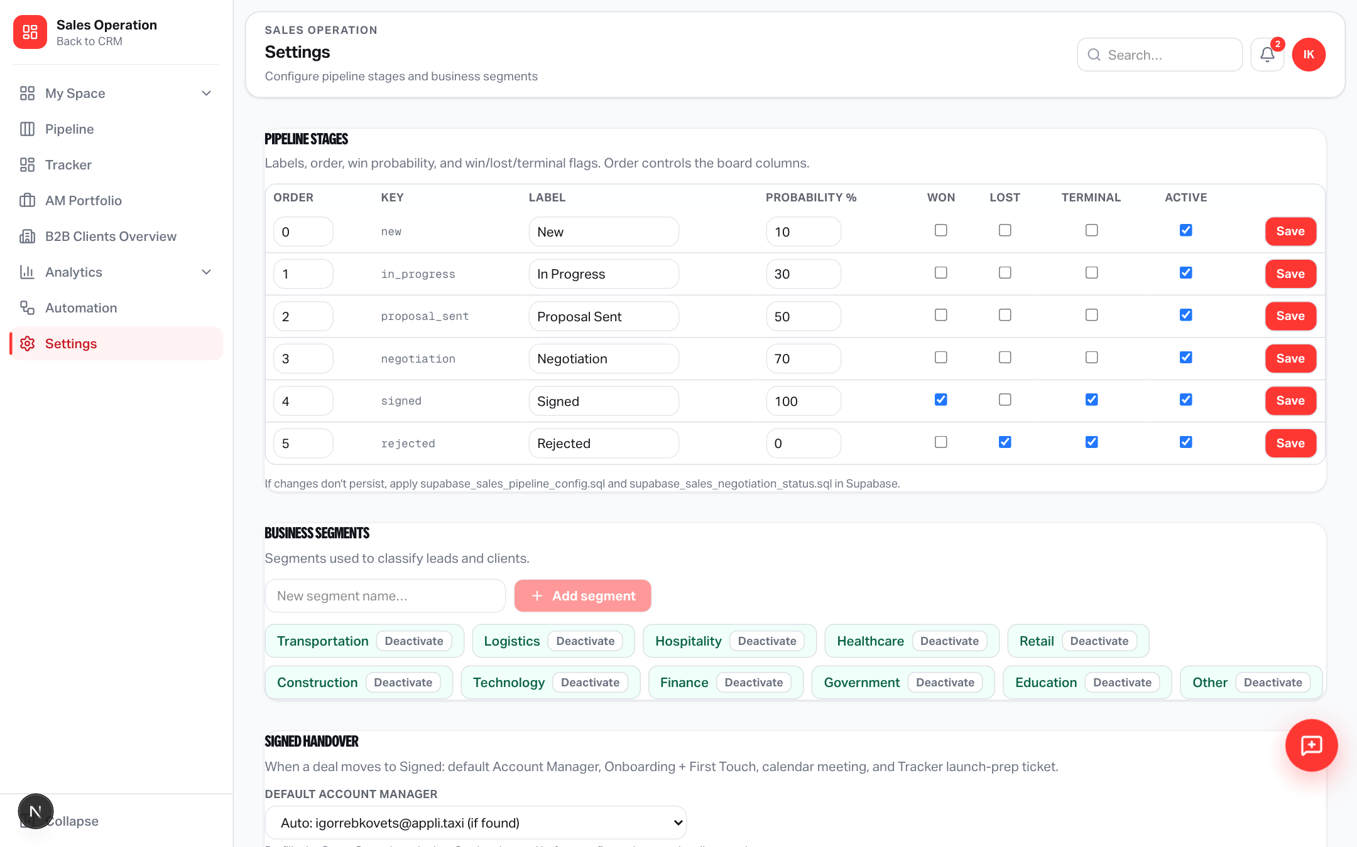
SETTINGS
Configure once — reuse on every Signed deal
Sales Operation → Settings → Signed handover
Configure
• Default Account Manager
• Tracker project for
launch-prep tickets
• Change anytime — Gate
still allows override
SQL required once:
supabase_sales_signed_
handover_settings.sql
Yango · Sales Operations · Release 0.2.48 · Confidential
3 / 9

Slide 4
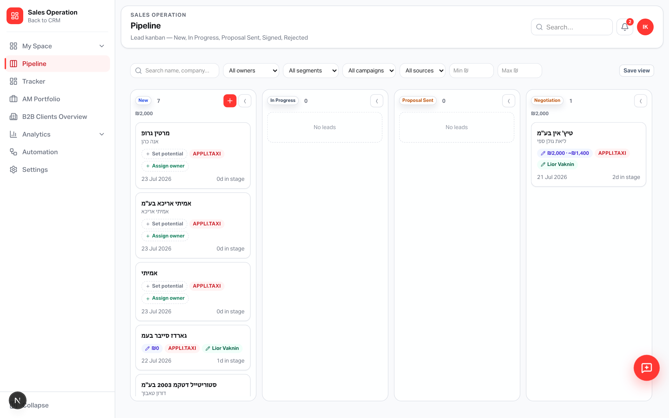
PIPELINE
Move the lead to Signed
Stage Gate prefills Account Manager — change before confirm if needed
On confirm
• AM saved on B2B client
• Client conversion runs
• Handover automation
starts for that AM
Yango · Sales Operations · Release 0.2.48 · Confidential
4 / 9

Slide 5
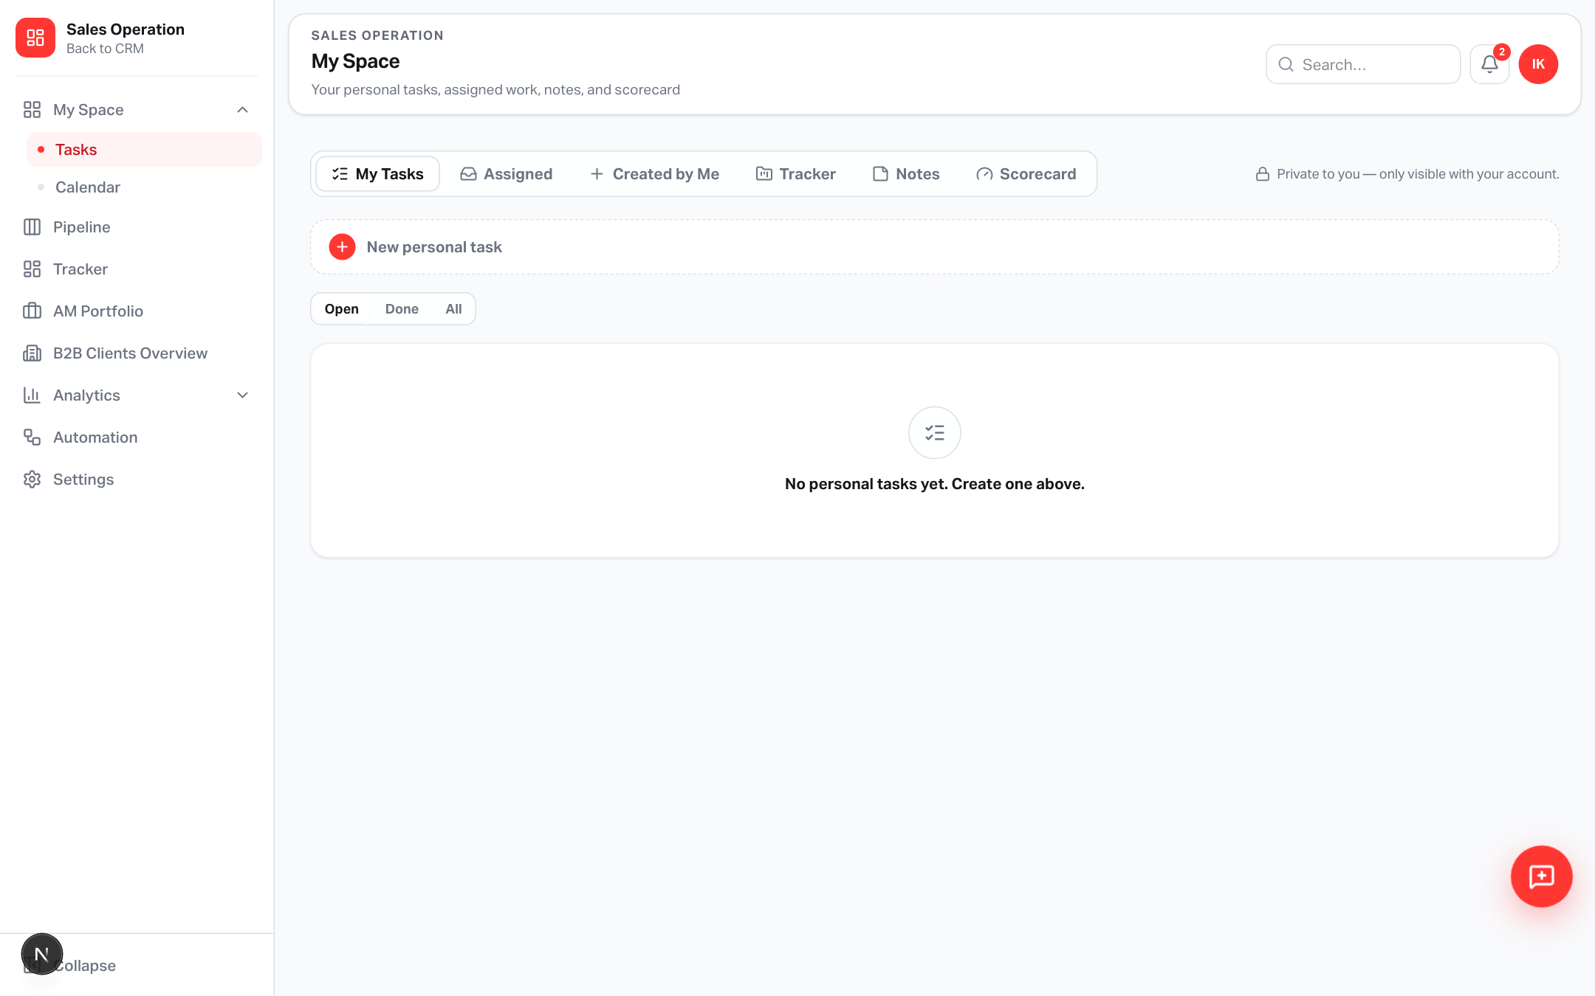
MY SPACE
Onboarding + First Touch task
Assigned to the Account Manager · high priority · due in 2 days
Replaces
• Old: Onboard Client (SM)
• Old: First Client Call
• New: one combined task
for the Account Manager
Yango · Sales Operations · Release 0.2.48 · Confidential
5 / 9

Slide 6
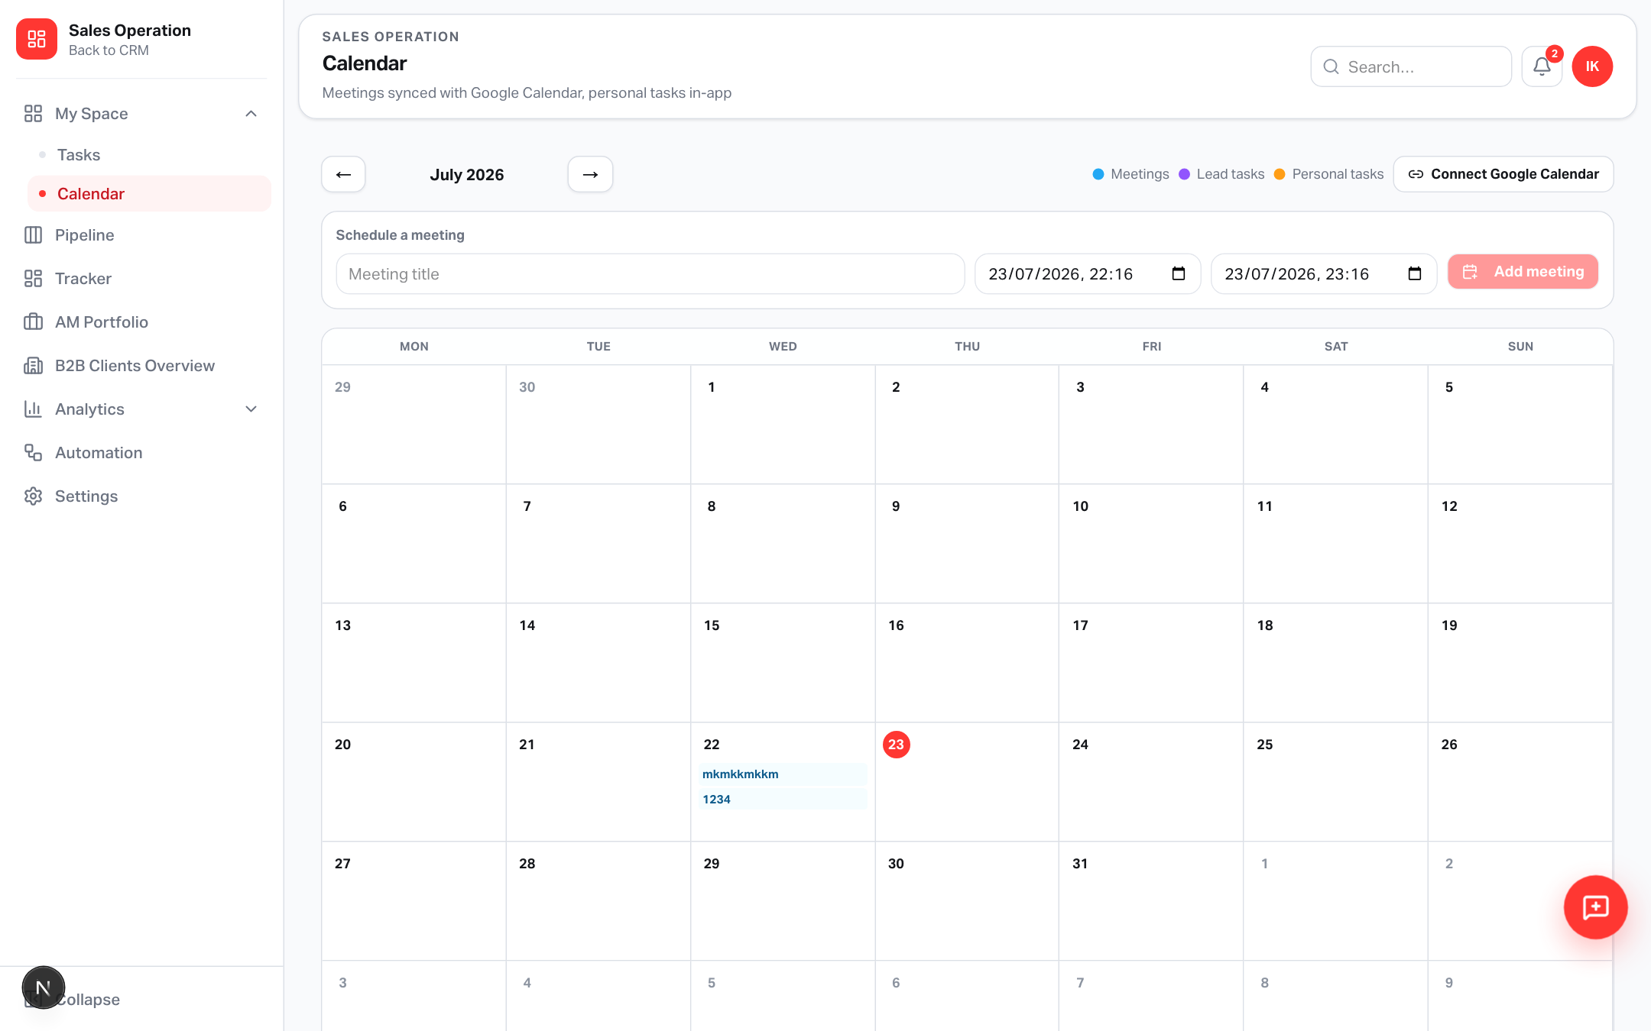
CALENDAR
Meeting auto-created for the AM
Next business day · 10:00 · 45 minutes · linked to client when available
Notes
• Lives on AM calendar
• Best-effort Google sync
if connected
• Never blocks Signed
Yango · Sales Operations · Release 0.2.48 · Confidential
6 / 9

Slide 7
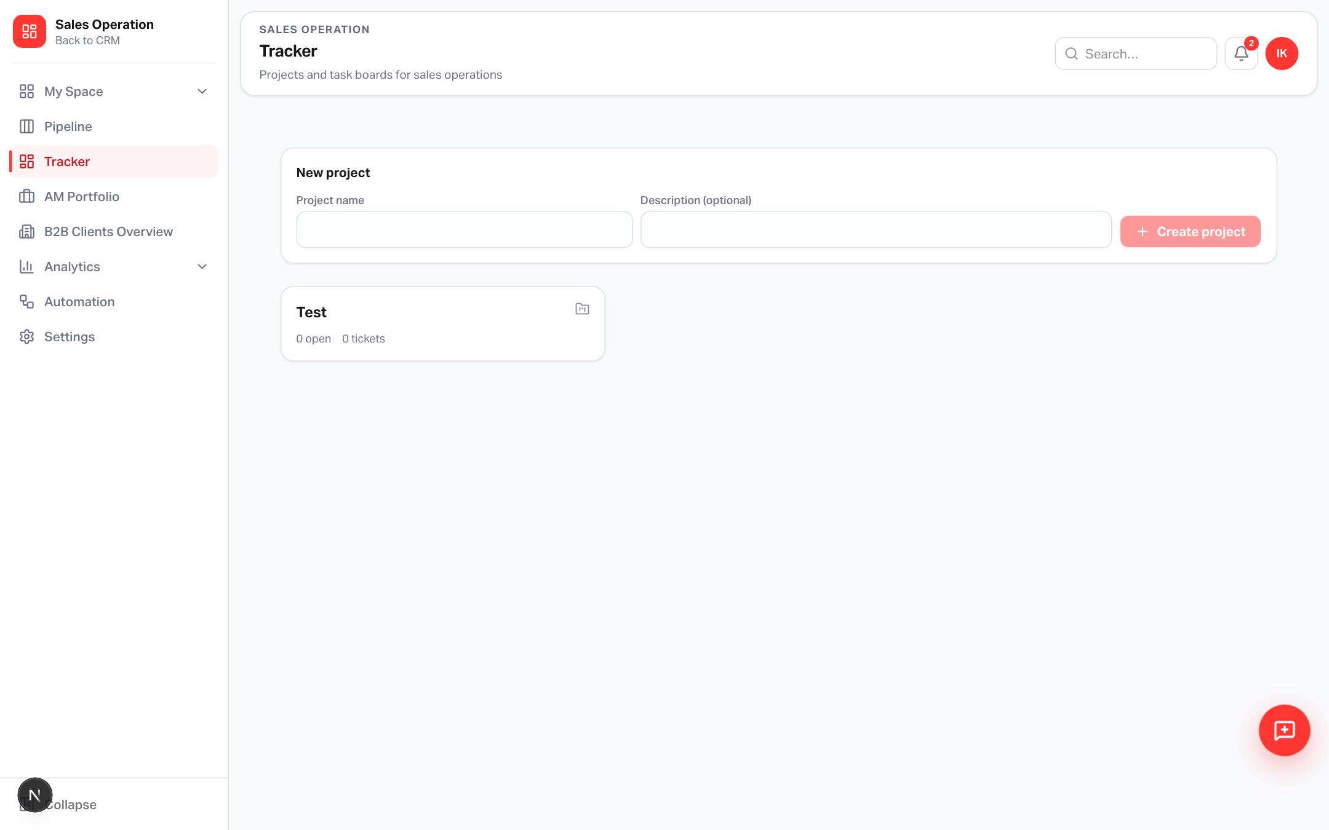
TRACKER
Launch prep ticket + checklist
Created in the project from Settings · assigned to AM
Checklist
1. Tariff setup
2. Credit limit setup
3. Special conditions
4. Credit card connect
5. Contract / terms review
Title: Launch prep — {client}
Yango · Sales Operations · Release 0.2.48 · Confidential
7 / 9

Slide 8
OPS CHECKLIST
After deploy
Code is live — schema + settings complete the loop
Database
Apply supabase_sales_signed_handover_settings.sql in Supabase
Settings
Pick default AM + Tracker project under Signed handover
Smoke test
Move a test lead to Signed → check task, meeting, Tracker ticket
Version
App 0.2.48 · Signed B2B handover automation
Yango · Sales Operations · Release 0.2.48 · Confidential
8 / 9

Slide 9
From Signed to launch-ready
Account Manager, first touch, calendar, and Tracker checklist — triggered by one stage move.
applitaxi.space · Sales Operations · 0.2.48

