Slide 1

YANGO
Sales Operations Platform
Executive onboarding — what it is, why it exists, how every section works,
and what depends on what.
Appli Taxi Oz · Internal CRM module · English walkthrough
Notes:
Welcome the Yango owner. Position this as the operating system for B2B sales from lead to live client performance.

Slide 2
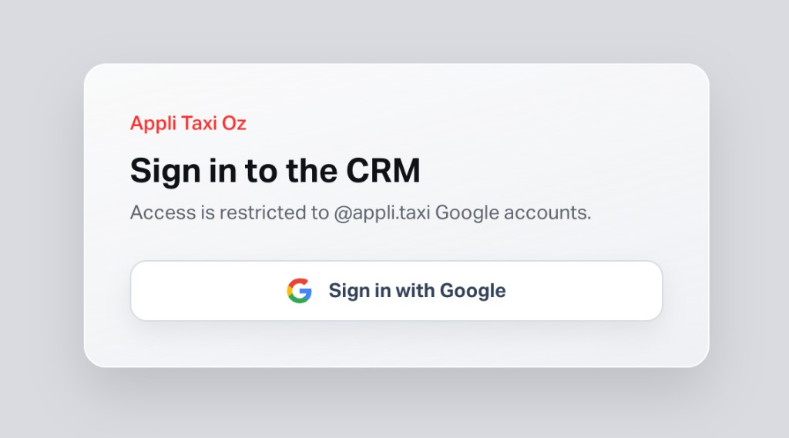
ACCESS PREREQUISITE
Access is restricted to @appli.taxi accounts
Sign-in is available only through Google Workspace.
The Google account must use the corporate @appli.taxi email domain.
Personal Gmail and external company accounts are rejected.
After sign-in, the user must also be approved and have the required Sales Operations role permissions.
This protects internal lead, client, trip, revenue and manager-performance data.
Required identity: name@appli.taxi
Yango · Sales Operations Onboarding · Confidential
2 / 26
Notes:
Start with the access prerequisite: this is an internal platform, not a public signup product.

Slide 3
WHY THIS EXISTS
From scattered sales work to one operating system
The problem
The platform
The outcome
Leads arrive from forms and manual entry.
Managers chase follow-ups in chat.
Signed clients must be linked to Yango corp IDs.
Performance (GMV, trips, decoupling) lives outside the CRM.
Targets and accountability are hard to see.
One Sales Operations module for:
• Pipeline execution
• Personal work (My Space)
• Signed-client portfolio
• B2B performance from Yango data
• Analytics, KPIs & targets
• Automations & notifications
• Configurable stages & segments
Owner visibility: who is selling, where deals sit, which clients perform, and whether managers hit targets — without leaving the CRM.
Yango · Sales Operations Onboarding · Confidential
3 / 26
Notes:
Explain the pain: leads, signed clients, B2B ride data and manager accountability lived in different places. SO unifies them.

Slide 4
PLATFORM MAP
How the sections connect
My Space
Pipeline
AM Portfolio
B2B Overview
Analytics
→
→
→
→
Tasks · Notes · Scorecard
Leads → Signed
Signed clients
Yango trips · GMV
Funnel · Forecast
Performance
Automation
Settings
Integrations
KPI targets vs actuals
Status → SMS / assign / task
Stages · Segments · Templates
WPForms · Email · SMS · Cron
Settings is the control plane: stage labels, probabilities and segments feed Pipeline, Analytics, Automation and forecast weighting.
Signed in Pipeline creates a client → Portfolio / Client profile → B2B link unlocks Yango GMV & trip metrics used in KPIs.
Yango · Sales Operations Onboarding · Confidential
4 / 26
Notes:
Walk the map left-to-right: execute → convert → measure → govern.

Slide 5
ACCESS & ROLES
Who can use which parts
Role | Typical access | Notes
Admin | All SO pages including Settings & Team Performance | Can set KPI targets
Account Manager | Pipeline, Portfolio, B2B, Analytics, Automation, My Space | No Settings by default
Sales Manager | Same operational set as AM | No Settings by default
User / Team Lead | No Sales Operations by default | Can be granted via Accesses
Two-level gate: module permission (salesOperation) + page permission (pipeline, B2B, analytics, settings…).
Access Management can override defaults per role.
Clients of the CRM are redirected away from this module.
Yango · Sales Operations Onboarding · Confidential
5 / 26
Notes:
Clarify who sees what. Admin owns Settings & Team Performance.

Slide 6
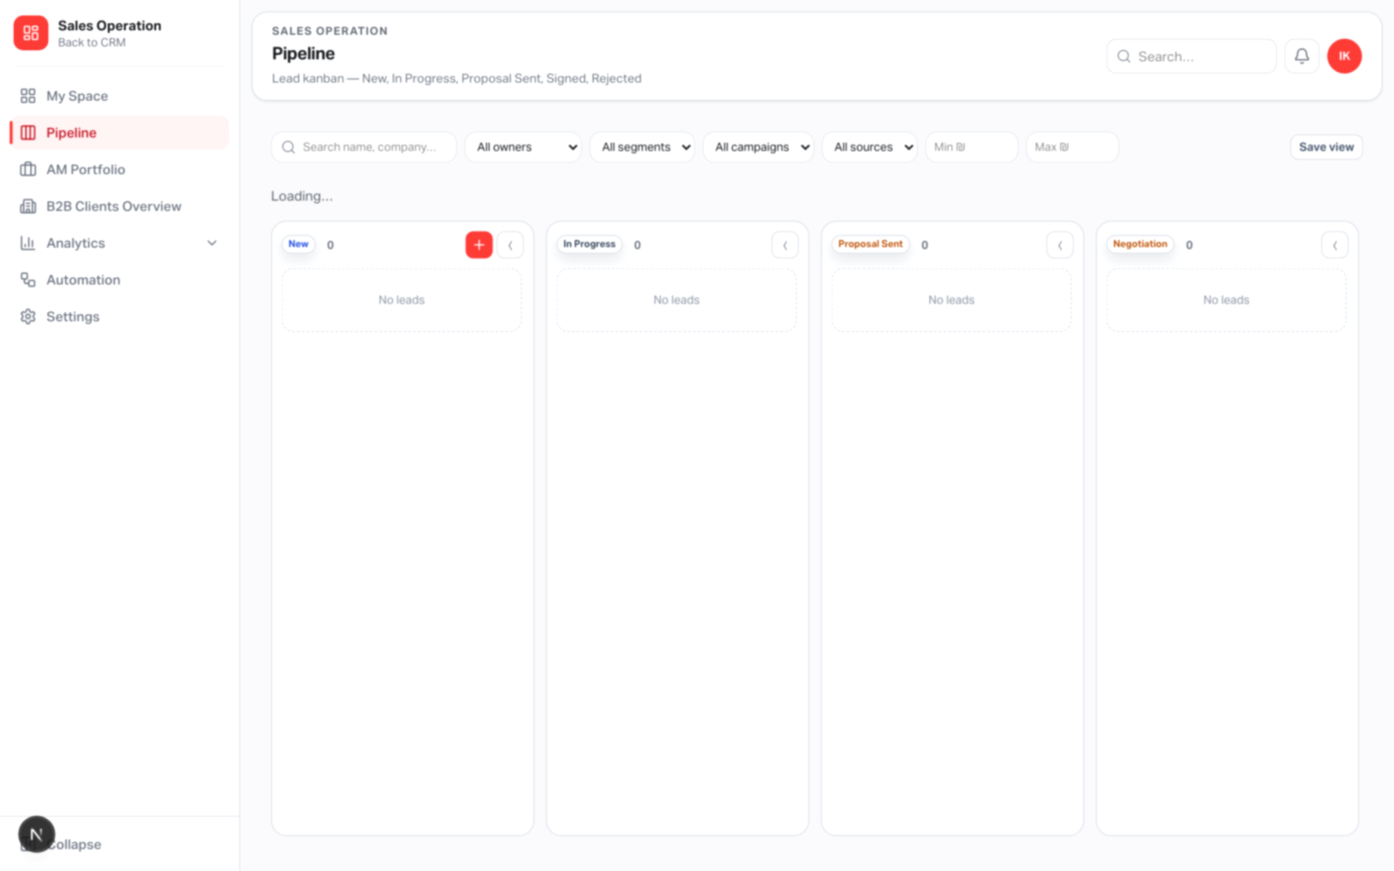
SHELL
Shared Sales Operations shell
Left sidebar: My Space, Pipeline, AM Portfolio, B2B, Analytics (nested), Automation, Settings.
Header: global search across leads, clients and contacts.
Notification bell (polls ~60s): assignments, mentions, task due, automation.
EN / HE language switch for the whole CRM UI.
Back to CRM returns to the main Appli Taxi product shell.
Yango · Sales Operations Onboarding · Confidential
6 / 26
Notes:
Point at sidebar, search, notifications on the screenshot.

Slide 7
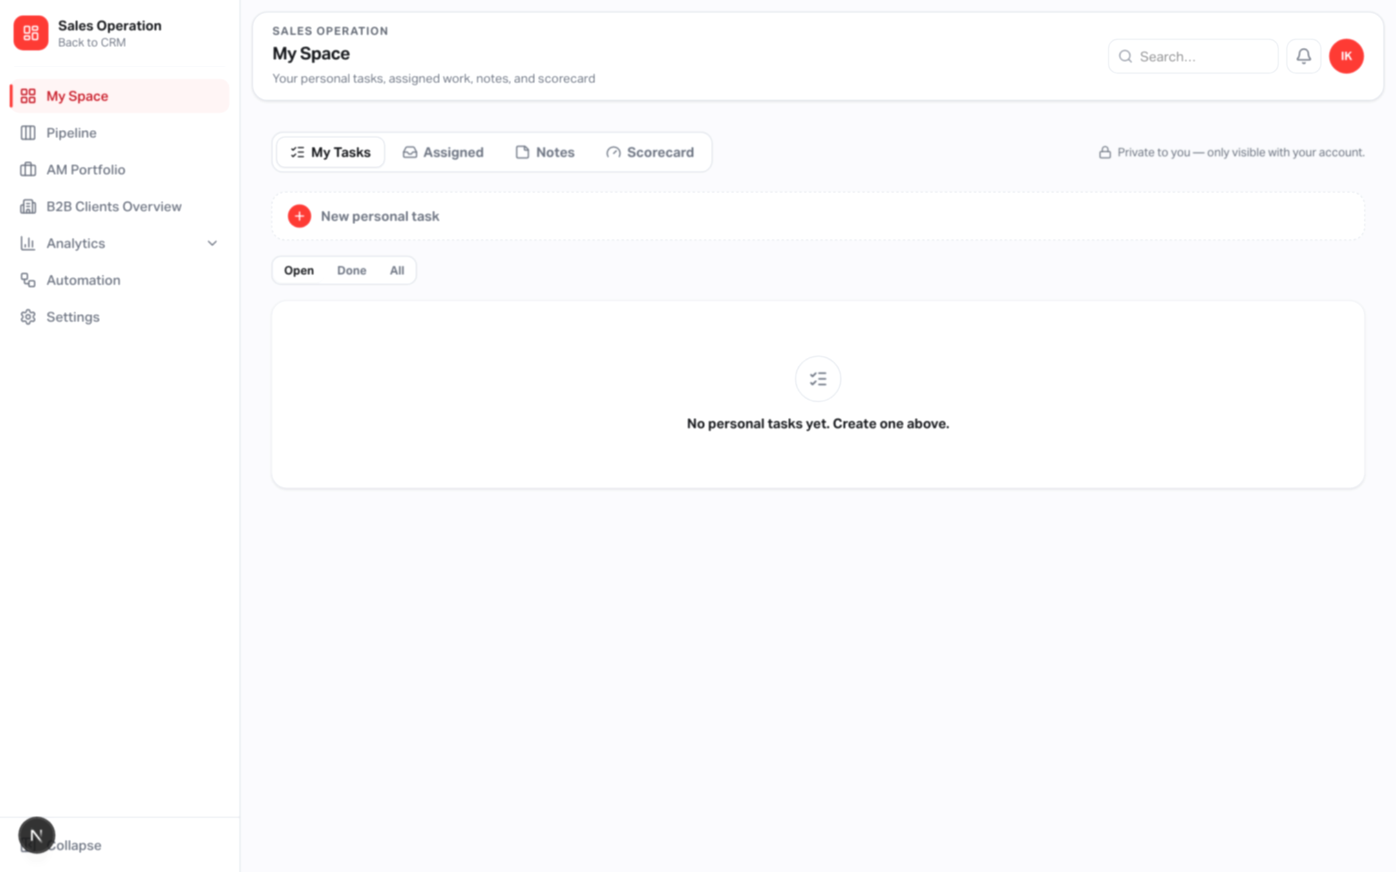
MY SPACE
Personal execution hub
Route: /sales-operation/tasks
My Tasks — private standalone tasks (priority, due, status).
Assigned — lead-linked tasks assigned to you (overdue / today / upcoming).
Notes — private, pinnable personal notes (not on the lead).
Scorecard — your KPI actuals vs admin-set targets.
Depends on: salesPipeline permission; Scorecard also needs manager-analytics APIs.
Privacy: personal tasks/notes filtered by authenticated user_id on every request.
Yango · Sales Operations Onboarding · Confidential
7 / 26
Notes:
Emphasize private vs assigned: personal tasks/notes are user-scoped.

Slide 8
PIPELINE
Lead kanban — the core workflow
Route: /sales-operation/pipeline
Configurable columns from Settings (order, labels, active flags).
Create lead: name + email or phone; live duplicate check.
Filters: owner, segment, campaign, source, search, potential range.
Saved views & collapsed columns remembered per user (browser).
Drag leads between stages; edit monthly potential inline on the card.
Depends on: pipeline stages & segments config; lead APIs.
Yango · Sales Operations Onboarding · Confidential
8 / 26
Notes:
Show the kanban. Mention create lead, filters, saved views.

Slide 9
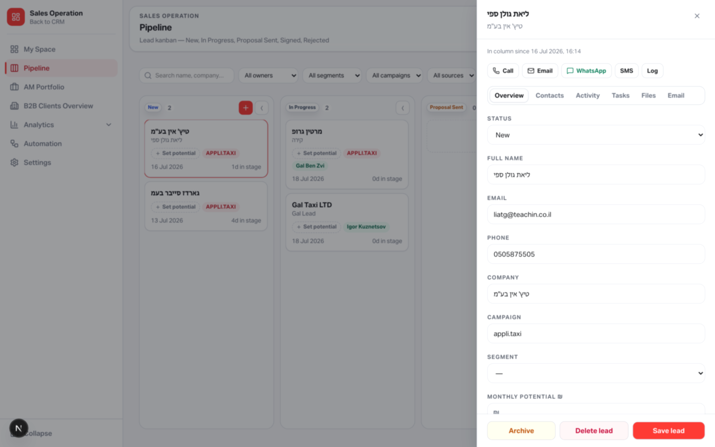
LEAD WORKSPACE
Lead drawer — everything about one deal
Overview — status, contact fields, segment, monthly potential ₪.
Contacts — multiple contacts, primary / decision-maker flags.
Activity — timeline of status changes, notes, tasks, emails, logs.
Tasks — lead tasks with assignees and due dates.
Files — attachments via Supabase Storage (signed download URLs).
Email — compose from templates; thread of sent/received messages.
Quick actions: Call, Email, WhatsApp, SMS, Log call/meeting/WhatsApp.
Yango · Sales Operations Onboarding · Confidential
9 / 26
Notes:
Open a lead mentally: tabs are the day-to-day workspace.

Slide 10
PIPELINE RULES
How leads are allowed to move
Movement rules
What happens on Signed
• Leads move freely across active stages (including Negotiation & Proposal Sent).
• New cannot jump directly to Signed or Rejected.
• Signed is terminal — cannot move again or be hard-deleted.
• First status move auto-assigns an unowned lead to the acting user.
• Archive soft-hides a lead without destroying history.
• Monthly potential is recommended for forecast quality, but does not block stage moves.
1. Create/update sales_clients record
2. Copy lead notes → client notes
3. Keep lead linked (history preserved)
4. Audit + activity events
5. Notify owning manager if someone else signed
6. Run enabled status-change automations
Then: managers link corp_client_id for B2B metrics.
Yango · Sales Operations Onboarding · Confidential
10 / 26
Notes:
Critical business rules — no bounce on Negotiation.

Slide 11
FORECAST INPUTS
Monthly potential & weighted pipeline
Estimated monthly potential (₪) editable on the card and in Overview.
Optimistic save with toast feedback and rollback on error.
Weighted value = potential × (lead probability override OR stage probability from Settings).
Default stage probabilities: New 10% → In Progress 30% → Proposal 50% → Negotiation 70% → Signed 100% → Rejected 0%.
Used in Analytics forecast and Team Performance “weighted forecast” KPI.
Depends on: Settings stage probabilities; lead field estimatedMonthlyPotential.
Yango · Sales Operations Onboarding · Confidential
11 / 26
Notes:
Potential drives weighted pipeline = potential × stage probability.

Slide 12
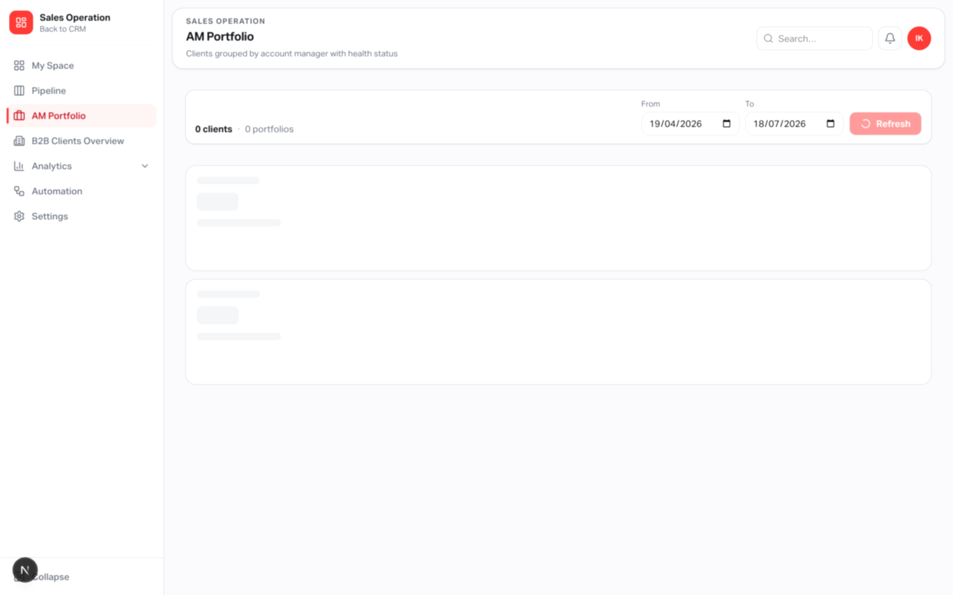
AM PORTFOLIO
Signed clients grouped by Account Manager
Route: /sales-operation/portfolio
Groups clients by AM; shows GMV, trips, health mix, last-trip recency.
Default ~90-day range (adjustable).
Surfaces unassigned clients that still need an AM.
Depends on: Signed conversion from Pipeline; B2B corp link for ride metrics; salesSignedClients permission.
Yango · Sales Operations Onboarding · Confidential
12 / 26
Notes:
Portfolio is the post-sale AM view.

Slide 13
CLIENT PROFILE
Signed client detail
Route: /sales-operation/b2b-clients/[id]
Company/contact/campaign snapshot from the signed lead.
Assign Account Manager & Sales Manager.
Link to Yango corp_client_id via B2B registry search.
Health score + reasons (recency, volume, decoupling).
Requests, completed trips, GMV, decoupling, recent trips.
Depends on: salesSignedClients; gp_corp_client_map + order facts for metrics.
Yango · Sales Operations Onboarding · Confidential
13 / 26
Notes:
Client profile is the bridge between CRM and Yango corp client.

Slide 14
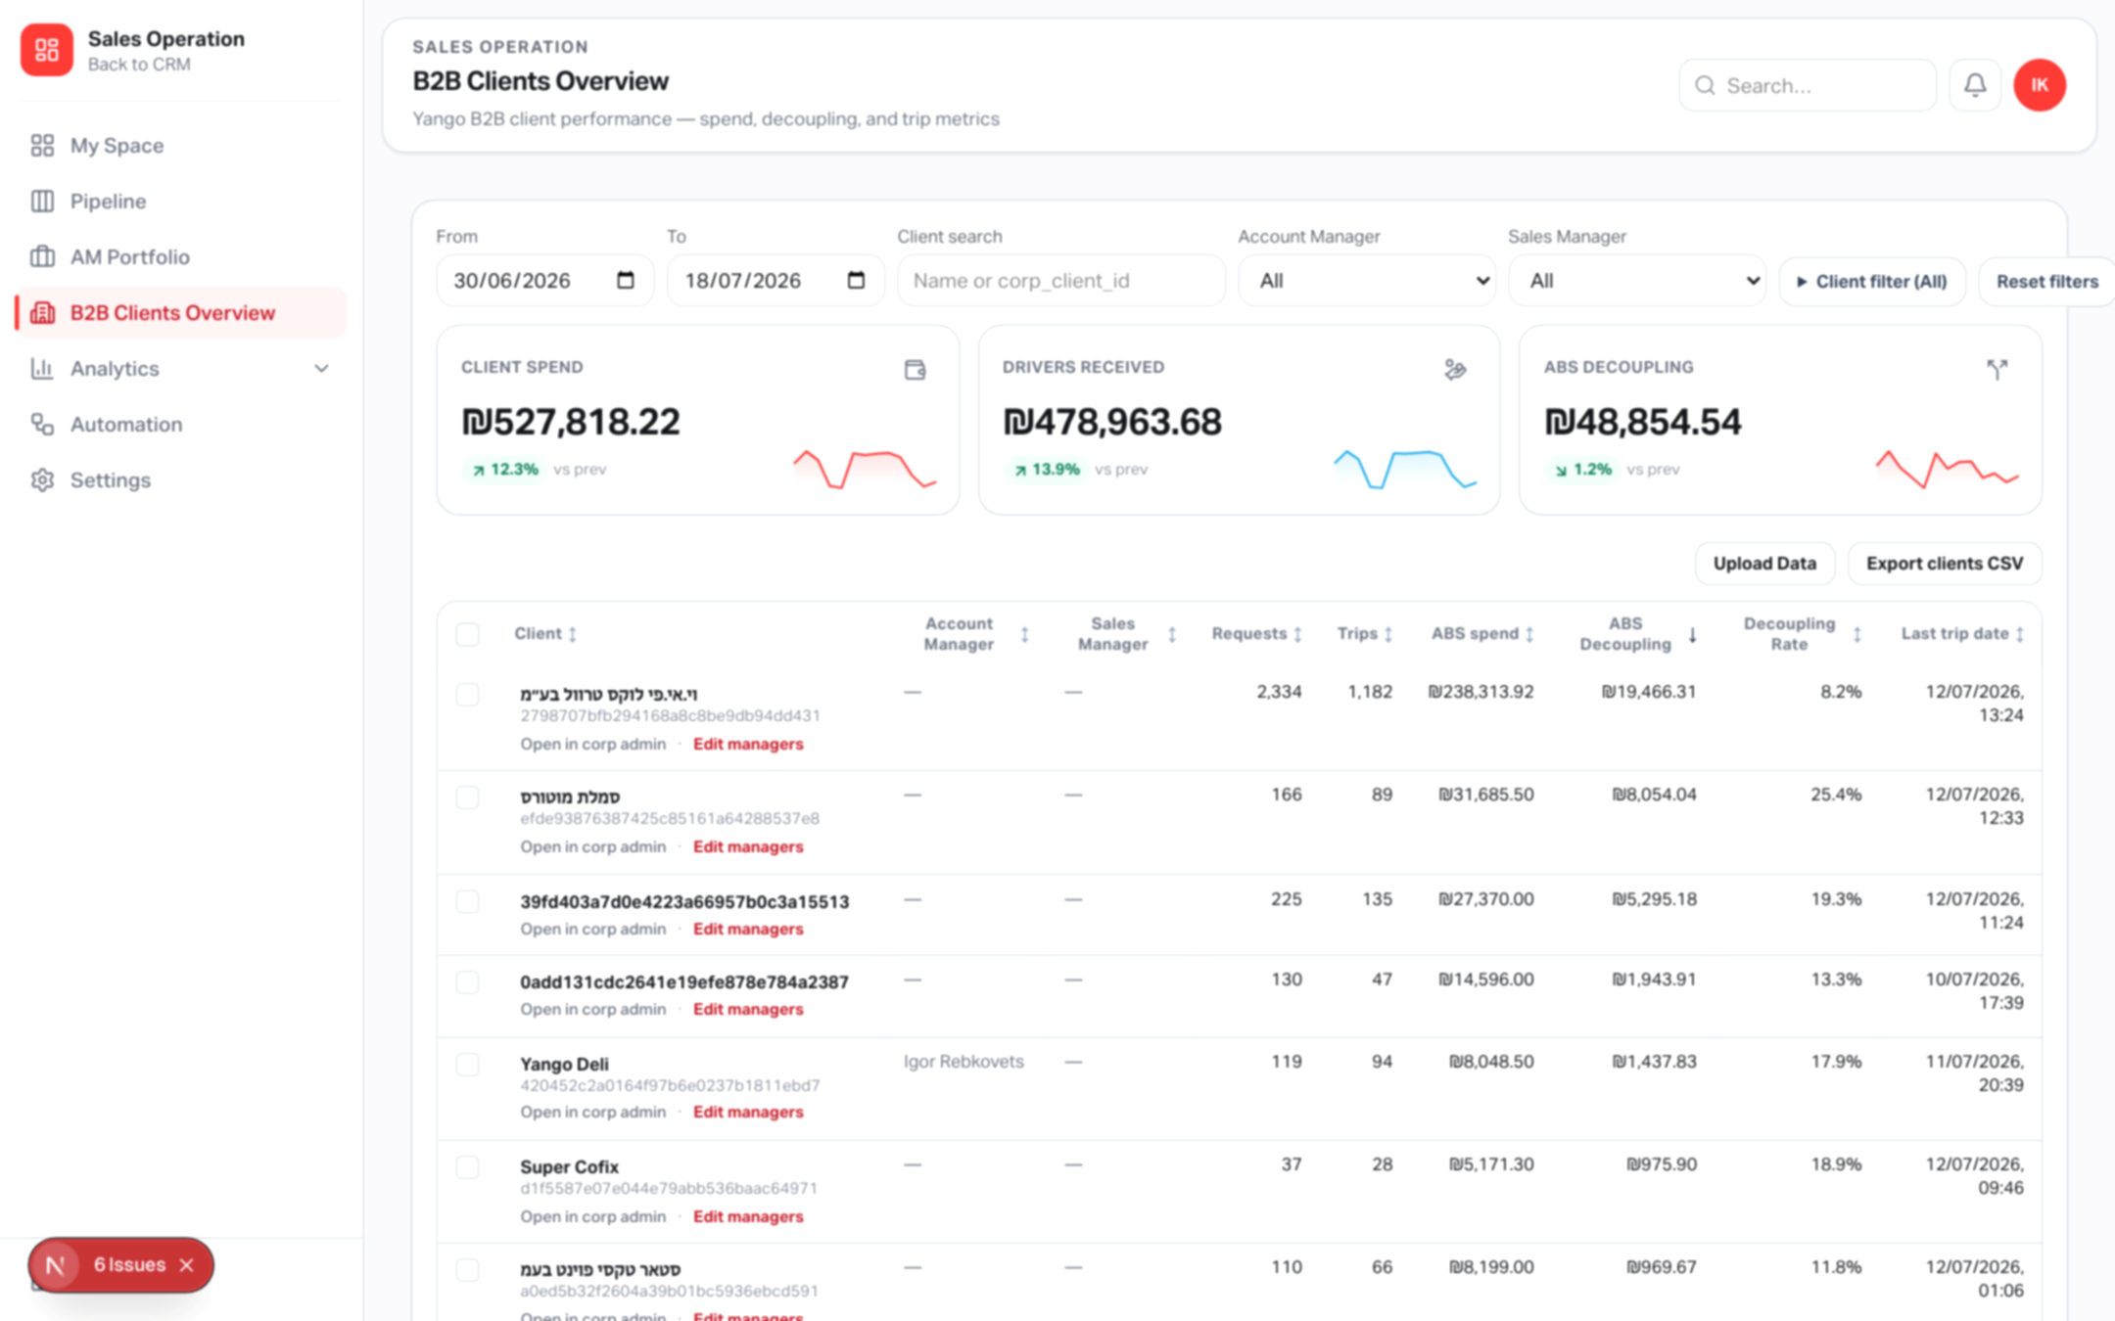
B2B CLIENTS
B2B Clients Overview — live performance
Route: /sales-operation/b2b-clients
Joins Yango order metrics with corp-client map and CRM managers.
KPI tiles with previous-period deltas and sparklines.
Virtualized table, selection, bulk CSV export.
Edit managers in a drawer; open Yango corp admin when linked.
Shows signed CRM clients still awaiting a B2B corp link.
Depends on: Greenplum/Yango order facts + manager registry.
Yango · Sales Operations Onboarding · Confidential
14 / 26
Notes:
B2B Overview is where Yango operational data meets CRM ownership.

Slide 15
TRIP DRILL-DOWN
Per-client trips & decoupling
Route: /sales-operation/b2b-clients/trips?corpClientId&from&to
Summary: rows, completed trips, client spend, total decoupling.
Premium table: date, order, status, client paid, driver received, flag.
Links out to Yango order / corp admin for operational follow-up.
Depends on: valid corpClientId + date range; Yango order data.
Yango · Sales Operations Onboarding · Confidential
15 / 26
Notes:
Trip drill-down is the audit trail for a single corp client.

Slide 16
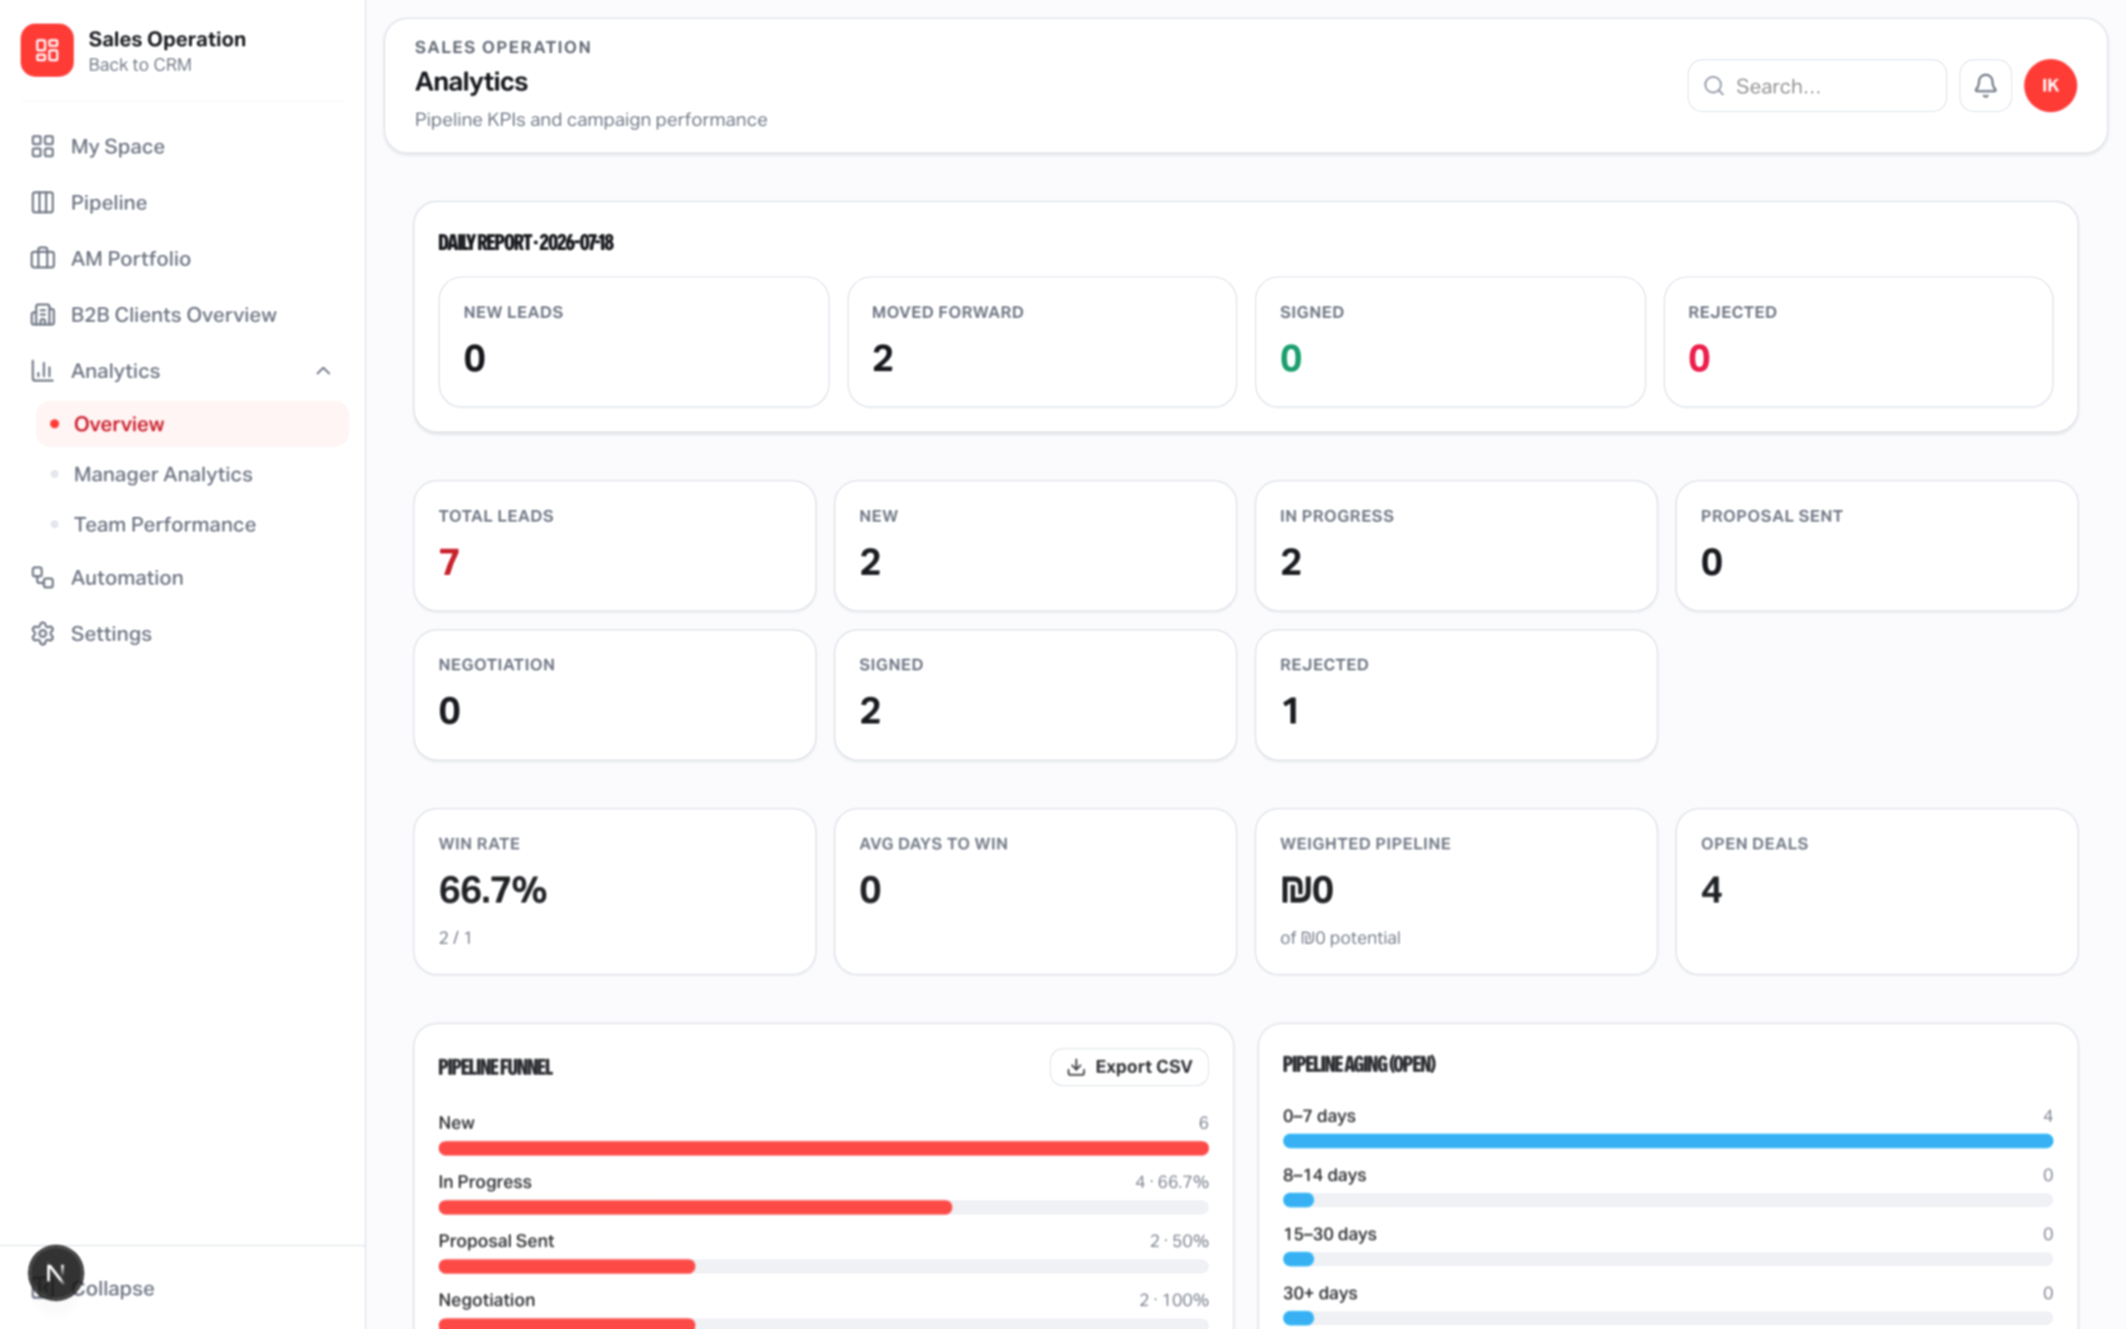
ANALYTICS
Funnel, aging, win/loss & forecast
Route: /sales-operation/analytics
Daily snapshot: new, moved forward, signed, rejected.
Funnel by configured stage labels + conversion between stages.
Aging buckets and average days in stage.
Win rate, avg days to win; source & segment tables; CSV export.
Weighted forecast by expected close month.
Depends on: Settings stages/segments; lead potentials & probabilities.
Yango · Sales Operations Onboarding · Confidential
16 / 26
Notes:
Analytics is the executive dashboard for the pipeline.

Slide 17
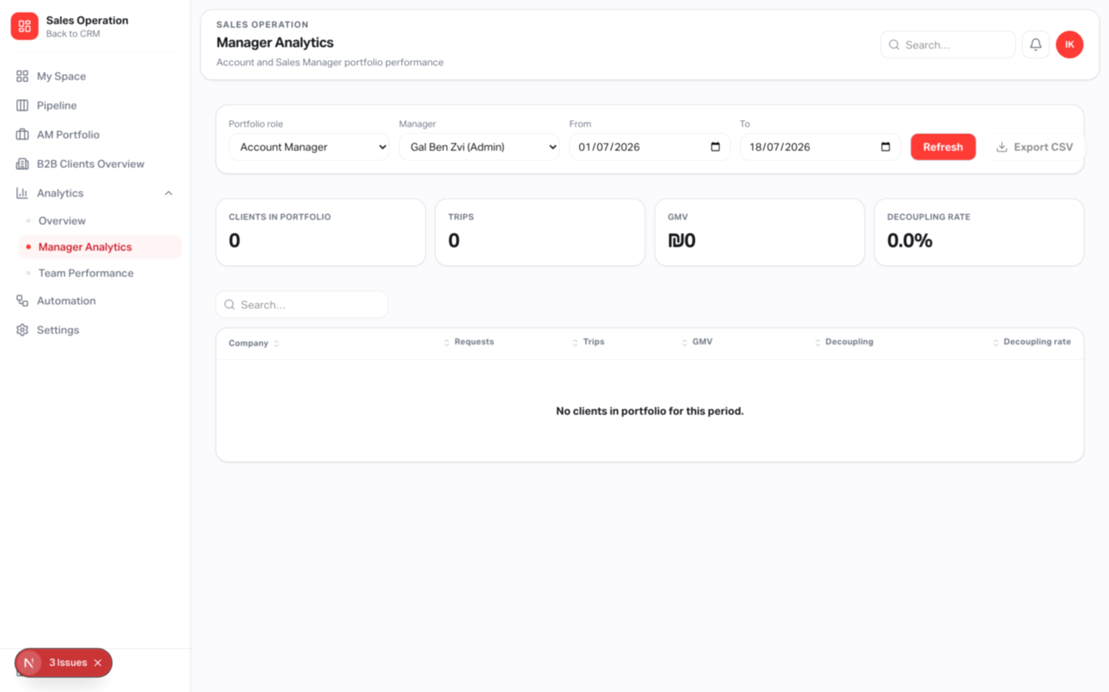
MANAGER ANALYTICS
Performance by Account or Sales Manager
Route: /sales-operation/manager-analytics
Filter by role (AM / SM), manager, and date range.
Clients, requests, trips, GMV, decoupling — with CSV export.
Attribution follows the B2B corp-client manager registry.
Depends on: salesManagerAnalytics permission + linked corp clients.
Yango · Sales Operations Onboarding · Confidential
17 / 26
Notes:
Manager analytics is operational, not the target-setting screen.

Slide 18
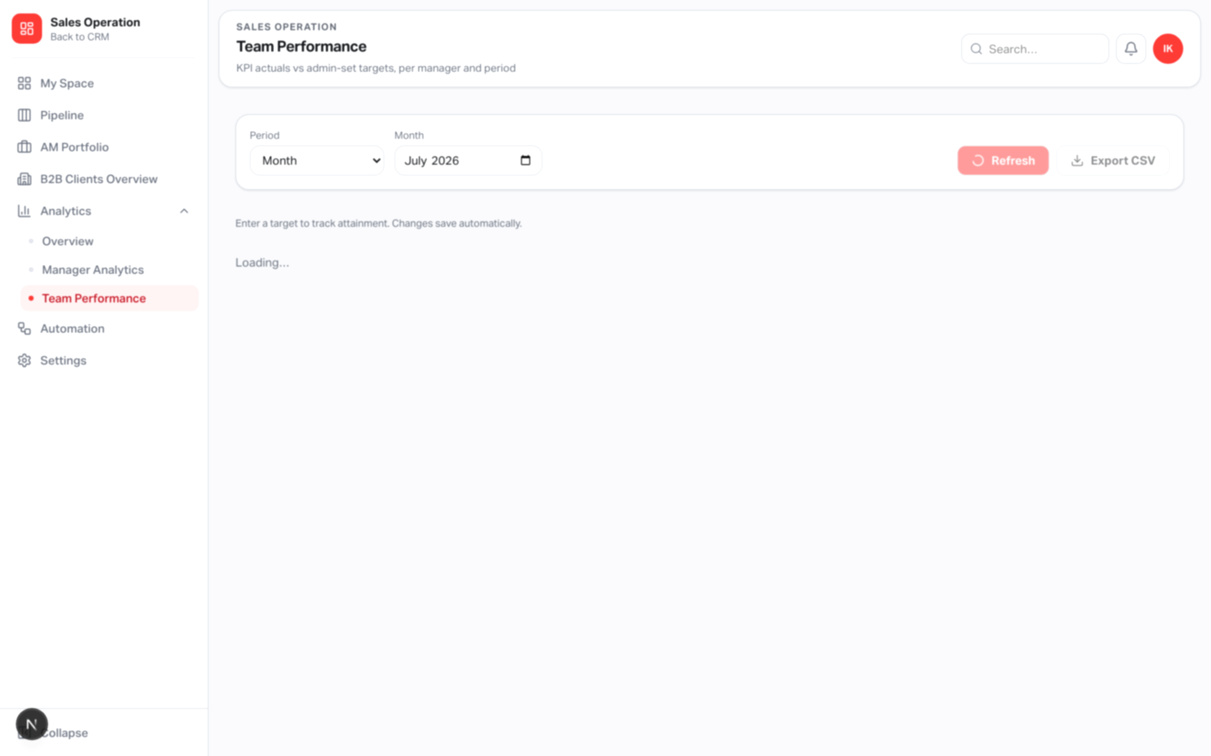
TEAM PERFORMANCE
KPI targets vs actuals
Route: /sales-operation/performance (admin / Settings access).
Ten metrics: signed, conversion %, leads worked, activities, tasks completed, avg cycle days, avg response hours, weighted forecast, GMV, trips.
Period: month or quarter; unique target per manager × metric × period.
Attainment colors: green ≥100%, yellow ≥70%, red <70% (invert for time metrics).
My Scorecard inside My Space shows the same math for the signed-in user.
Depends on: sales_kpi_targets table + pipeline/B2B activity data.
Yango · Sales Operations Onboarding · Confidential
18 / 26
Notes:
Team Performance is the Monday-style scoreboard for owners.

Slide 19
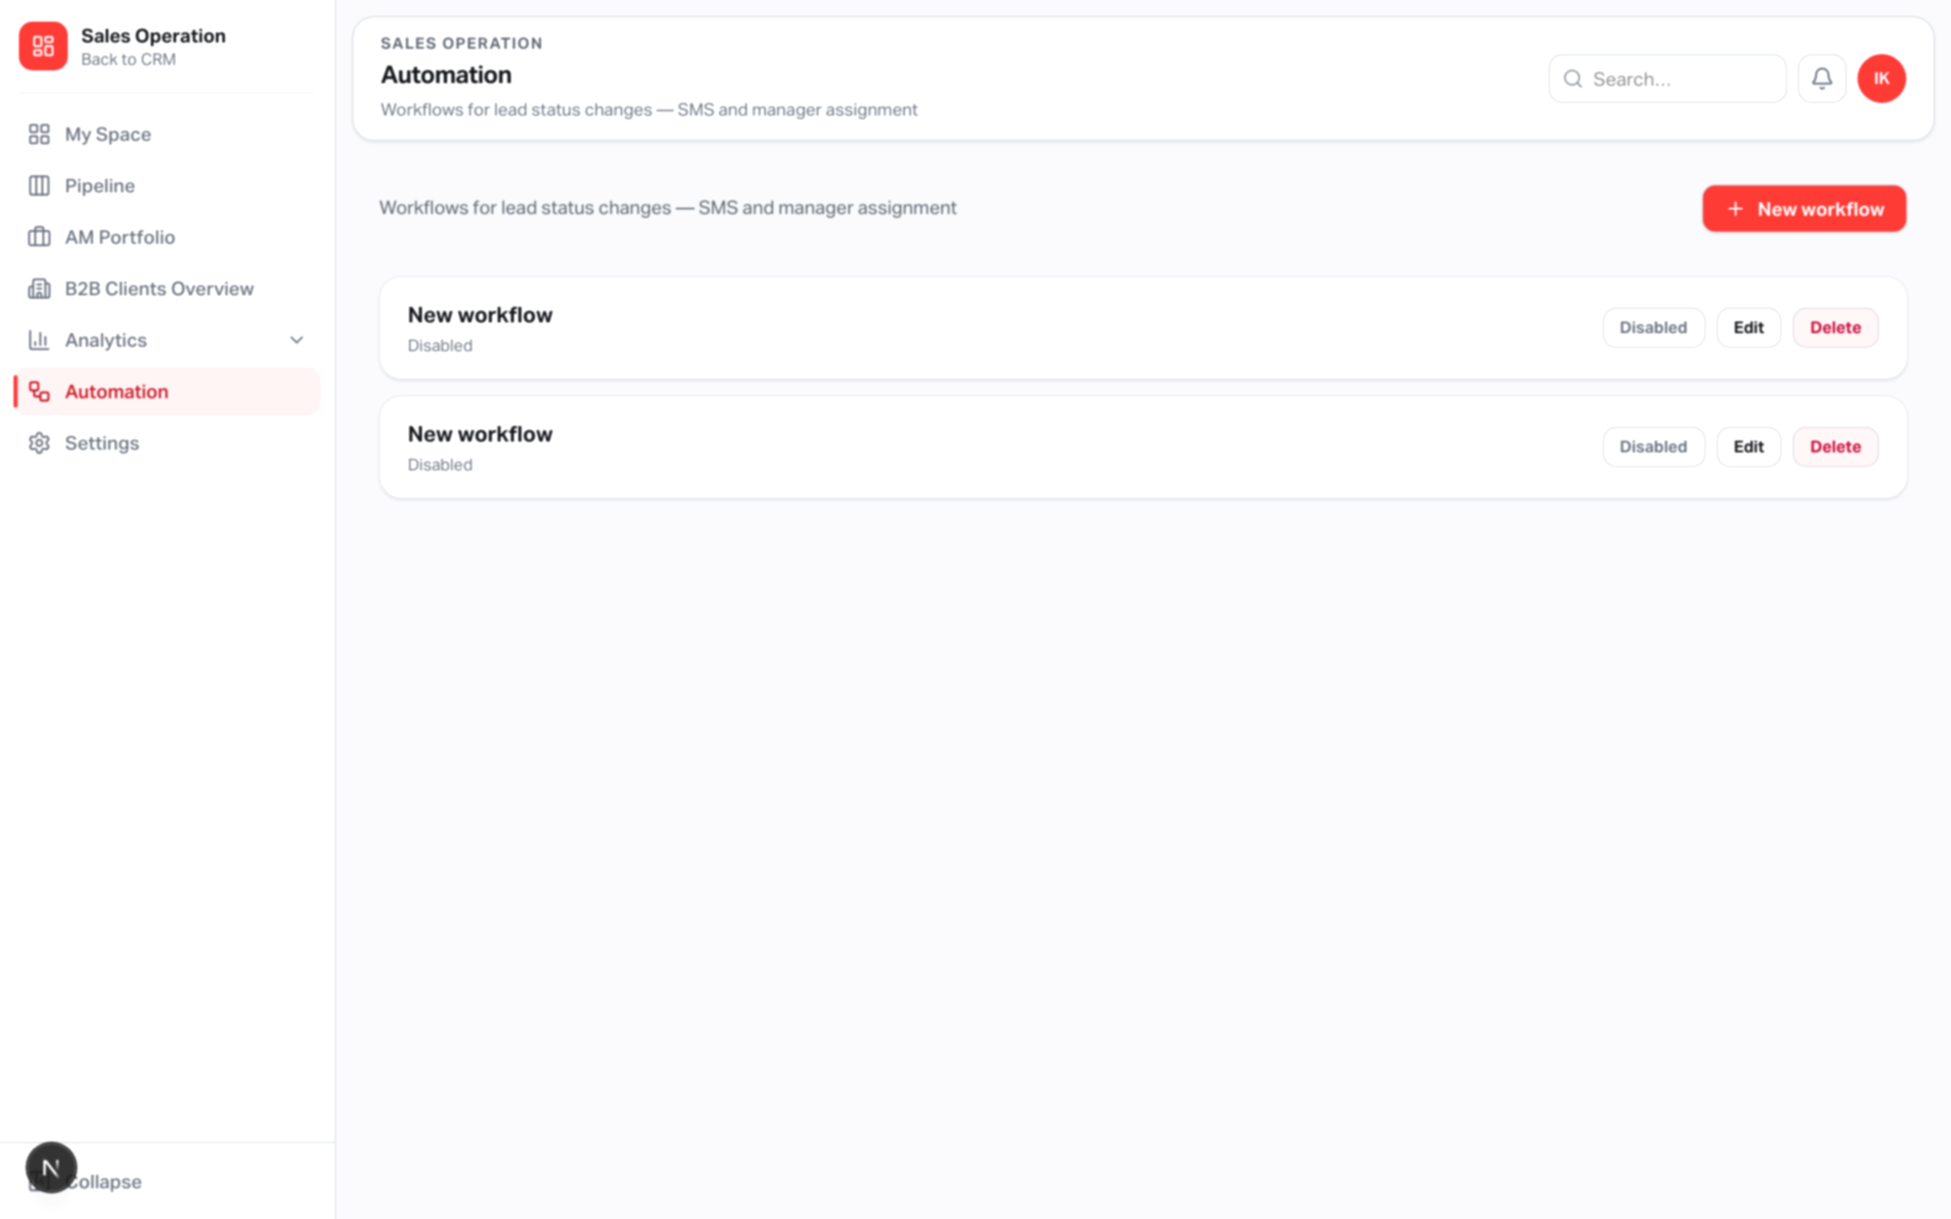
AUTOMATION
Status-triggered workflows
Routes: /sales-operation/automation and /automation/[id]
Visual graph: Trigger (from → to status, including Any) then actions.
Actions: SMS (InfoRU), Assign manager (fixed or round-robin), Create task.
Only enabled workflows run; each run stores per-node ok/partial/error.
Failures do not roll back the lead’s new stage.
Depends on: configured stage keys/labels; SMS/email env when used.
Yango · Sales Operations Onboarding · Confidential
19 / 26
Notes:
Automations run after a successful stage change — best effort.

Slide 20
NOTIFICATIONS
In-app alerts, mentions & reminders
Bell in the SO header: unread badge, mark one / mark all read.
Events: lead assignment, task assignment, task due, @mentions, automation, system.
@Full Name or @FirstName in lead notes creates a mention notification.
Cron /api/sales-operation/cron/task-reminders: overdue or due-in-24h tasks (needs CRON_SECRET in production).
Depends on: notifications table; authenticated user identity.
Yango · Sales Operations Onboarding · Confidential
20 / 26
Notes:
Notifications close the loop so managers do not miss work.

Slide 21
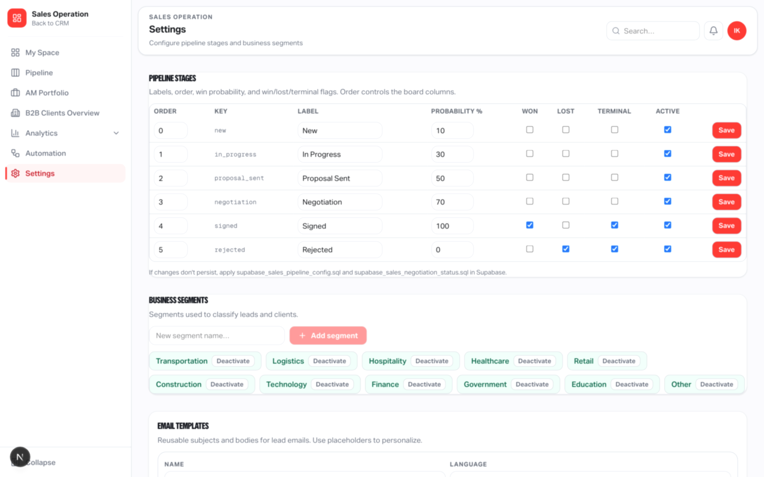
SETTINGS
Control plane — stages, segments, email templates
Route: /sales-operation/settings (Settings permission).
Pipeline stages: order, label, probability, won/lost/terminal/active.
Business segments: active list used on create/edit/filter/analytics.
Email templates: EN/HE subjects & bodies with placeholders.
Renames propagate to board, lead detail, activity, analytics, automation.
Inactive segments cannot be assigned to new leads; occupied inactive stages stay visible.
Yango · Sales Operations Onboarding · Confidential
21 / 26
Notes:
Settings is not cosmetic — it drives the whole module.

Slide 22
DEPENDENCIES
What drives what
If you change… | It affects…
Stage labels / order / active | Kanban columns, funnel, automation status pickers, activity labels
Stage probabilities | Weighted forecast & Performance weighted KPI
Won / Lost / Terminal flags | Win-loss analytics, open pipeline, signing semantics
Segments | Lead forms, filters, segment analytics
Signed transition | Client record, Portfolio, client profile, handover path
Corp client link + managers | B2B Overview, trips, GMV/trips KPIs, Manager Analytics
KPI targets (admin) | Team Performance matrix & My Scorecard
Enabled automations | Side effects after status changes (SMS / assign / tasks)
Yango · Sales Operations Onboarding · Confidential
22 / 26
Notes:
This is the ‘what depends on what’ slide — spend time here.

Slide 23
INTEGRATIONS
External inputs & delivery channels
Inbound
Outbound
Scheduled
• WPForms webhook → new leads
(SALES_OPERATION_WPFORMS_WEBHOOK_SECRET)
• Inbound email → lead thread
(SALES_EMAIL_INBOUND_SECRET)
• Yango / Greenplum facts
(orders, corp map)
• Google SSO (@appli.taxi)
• SMTP email from lead Email tab
(SALES_SMTP_*)
• InfoRU SMS (lead + automation)
(INFORU_*; automation needs enable flag)
• Notifications inside the app
• Task-due reminder cron
GET …/cron/task-reminders
Protect with CRON_SECRET in prod
• Dedupes reminders ~20h
• Does not mutate pipeline stages
Yango · Sales Operations Onboarding · Confidential
23 / 26
Notes:
List env dependencies without dumping secrets.

Slide 24
DATA & PRIVACY
What is private vs shared
Personal tasks & notes (My Space): scoped to the signed-in user_id — not visible to others via those APIs.
Pipeline leads, lead notes, tasks, files, email: shared CRM records visible to users with pipeline access.
Authorization is enforced in the application layer (approved user + permissions), not via Postgres RLS on SO tables.
B2B metrics come from operational Yango datasets; manager attribution can credit both AM and SM for the same client.
Screenshots in this deck are privacy-softened; treat live data as confidential.
Yango · Sales Operations Onboarding · Confidential
24 / 26
Notes:
Be honest about shared pipeline data vs private My Space.

Slide 25
OPERATING CHECKLIST
To run this well in production
Apply SQL migrations (including sales_kpi_targets & sales_personal_space) via db:apply:sales-operation or Supabase SQL Editor.
Configure Accesses so AMs/SMs have the right page permissions; keep Settings for admins.
Set stage probabilities & segments to match how you sell.
Link signed clients to corp_client_id so GMV/trips feed Portfolio, B2B and KPIs.
Set monthly/quarterly KPI targets on Team Performance.
Enable SMTP / SMS / WPForms secrets only when those channels are ready.
Protect the task-reminders cron with CRON_SECRET.
Train managers: Pipeline daily, My Space for personal work, Portfolio for post-sale care.
Yango · Sales Operations Onboarding · Confidential
25 / 26
Notes:
Leave the owner with a concrete operating checklist.

Slide 26
SUMMARY
What Yango gets with Sales Operations
Execute
Pipeline + My Space keep every deal and every follow-up moving.
Convert
Signed handover creates a client ready for AM ownership and B2B linking.
Measure
Analytics, Manager views and Team Performance connect CRM work to Yango GMV.
Govern
Settings, roles, automations and notifications keep the system consistent.
Yango · Sales Operations Onboarding · Confidential
26 / 26
Notes:
Close with the one-liner: lead → signed → live B2B performance → accountable managers.

