Slide 1
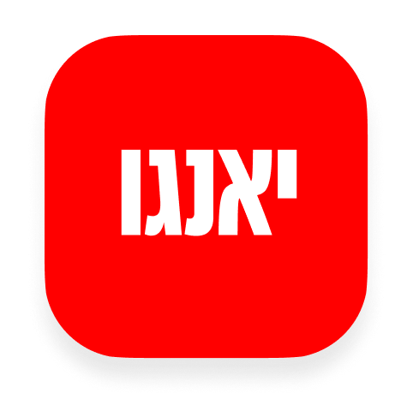
YANGO · SALES OPERATIONS
My Space Task Hub
+ Pipeline Stage Gates
Onboarding walkthrough — what was implemented from feedback,
how every flow works, and what happens behind the scenes.
RELEASE 0.2.43
PRODUCTION
Appli Taxi Oz · Internal onboarding · July 2026
Notes:
Position this as a focused onboarding for release 0.2.43: task execution and controlled pipeline progression.

Slide 2
FEEDBACK → DELIVERY
Every requested capability is now connected
Nine implementation areas — one operating flow from task execution to signed-client handover.
1
Task schema
2
Task API
3
Task Drawer
Summary, parent task, append-only events
Detail, scope=created, auth, events, reassign
One editor in My Space and Lead Tasks
4
Created by Me
5
Lead fields
6
Stage service
Creator-centric workload visibility
Pricing, amount, contract, Corp Client ID
Server preflight + structured 422
7
Gate modal
8
Signed handover
9
EN / HE + tests
Only missing fields are requested
Onboard Client + First Client Call
Localized UI, gate tests, production build
Yango · Sales Operations Onboarding · Release 0.2.43 · Confidential
2 / 17
Notes:
Use this as the feedback-to-delivery checklist. Every item is live in production.

Slide 3
ARCHITECTURE
Two workflows, one source of truth
My Space manages execution. Pipeline gates protect data quality and handover readiness.
MY SPACE · TASK EXECUTION
PIPELINE · CONTROLLED PROGRESSION
Tabs
Move requested
My Tasks · Assigned · Created by Me
Drag/drop or status change in lead drawer
Task list
Server preflight
Due buckets, status, owner, lead
Load lead + contacts · evaluate gate matrix
Task Drawer
Missing?
Edit · Summary · Timeline
Structured 422 → Stage Gate modal
Actions
Confirm
Reassign · Create follow-up
Patch fields + status + stage side effects
Yango · Sales Operations Onboarding · Release 0.2.43 · Confidential
3 / 17
Notes:
Explain the two related but separate flows: task execution and pipeline control.

Slide 4
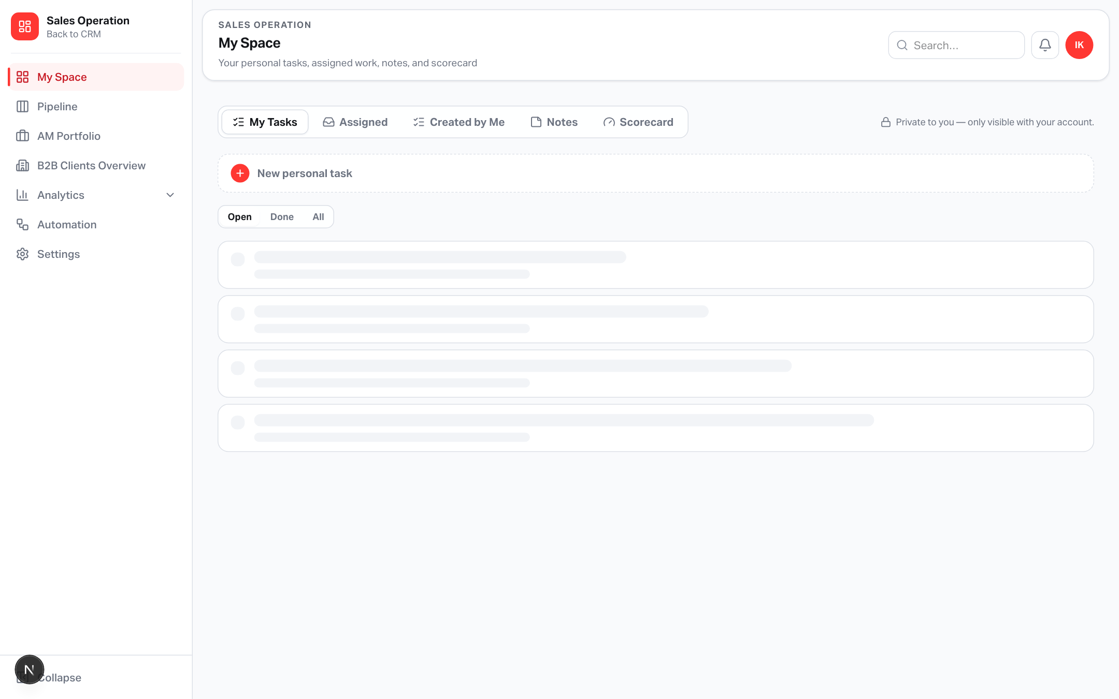
MY SPACE
A single daily workspace for every kind of work
Personal work stays private. Lead-linked work is collaborative and auditable.
My Tasks — private standalone tasks for the signed-in user.
Assigned — lead tasks currently assigned to you.
Created by Me — lead tasks you created, even when owned by somebody else.
Notes — private personal notes; the privacy hint only appears on personal tabs.
Scorecard — your KPI actuals versus targets.
My Space · all five work contexts in one tab set
PRIVACY RULE
“Private to you” applies only to personal tasks and notes — not lead-linked Assigned / Created by Me work.
Yango · Sales Operations Onboarding · Release 0.2.43 · Confidential
4 / 17
Notes:
Show where the new task hub lives and explain personal vs shared task visibility.

Slide 5
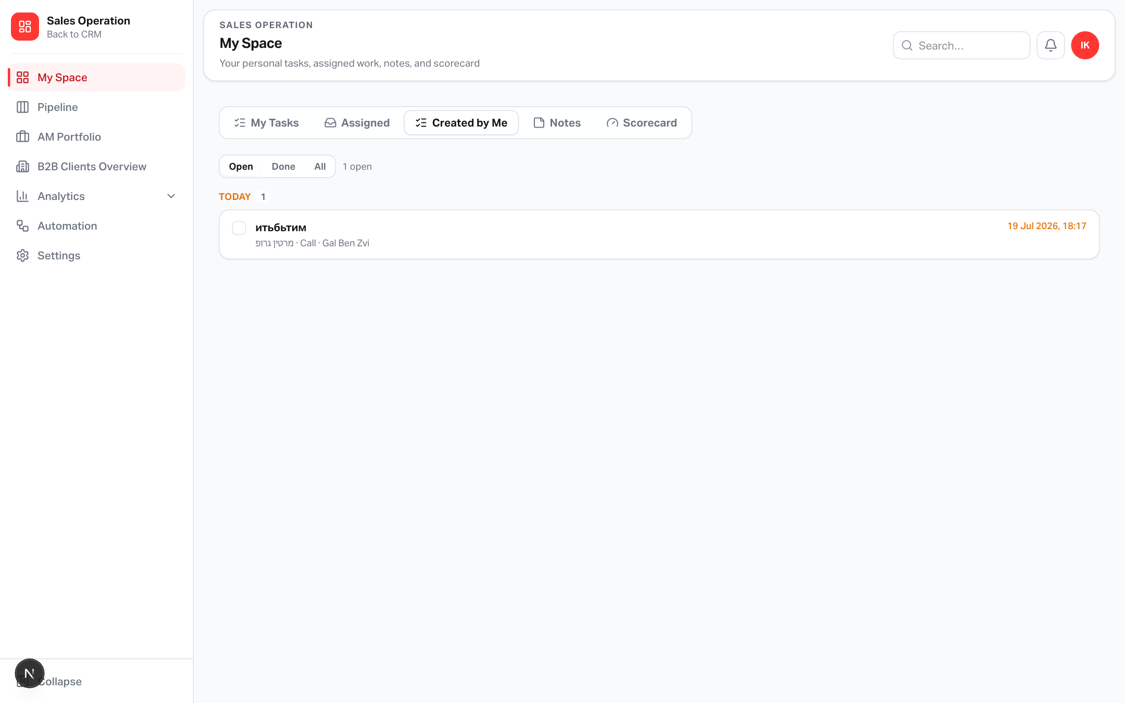
CREATED BY ME
Delegate work without losing visibility
The creator can reopen, review, reassign and follow up from the same list.
1
Create
A lead task stores both creator and assignee.
2
Delegate
The task moves to the assignee’s Assigned tab.
3
Track
The creator still sees it in Created by Me.
4
Act
Open the Drawer to update, reassign or create follow-up.
Creator scope is driven by sales_tasks.created_by_user_id
Yango · Sales Operations Onboarding · Release 0.2.43 · Confidential
5 / 17
Notes:
Created by Me gives task creators ownership visibility after delegation.

Slide 6
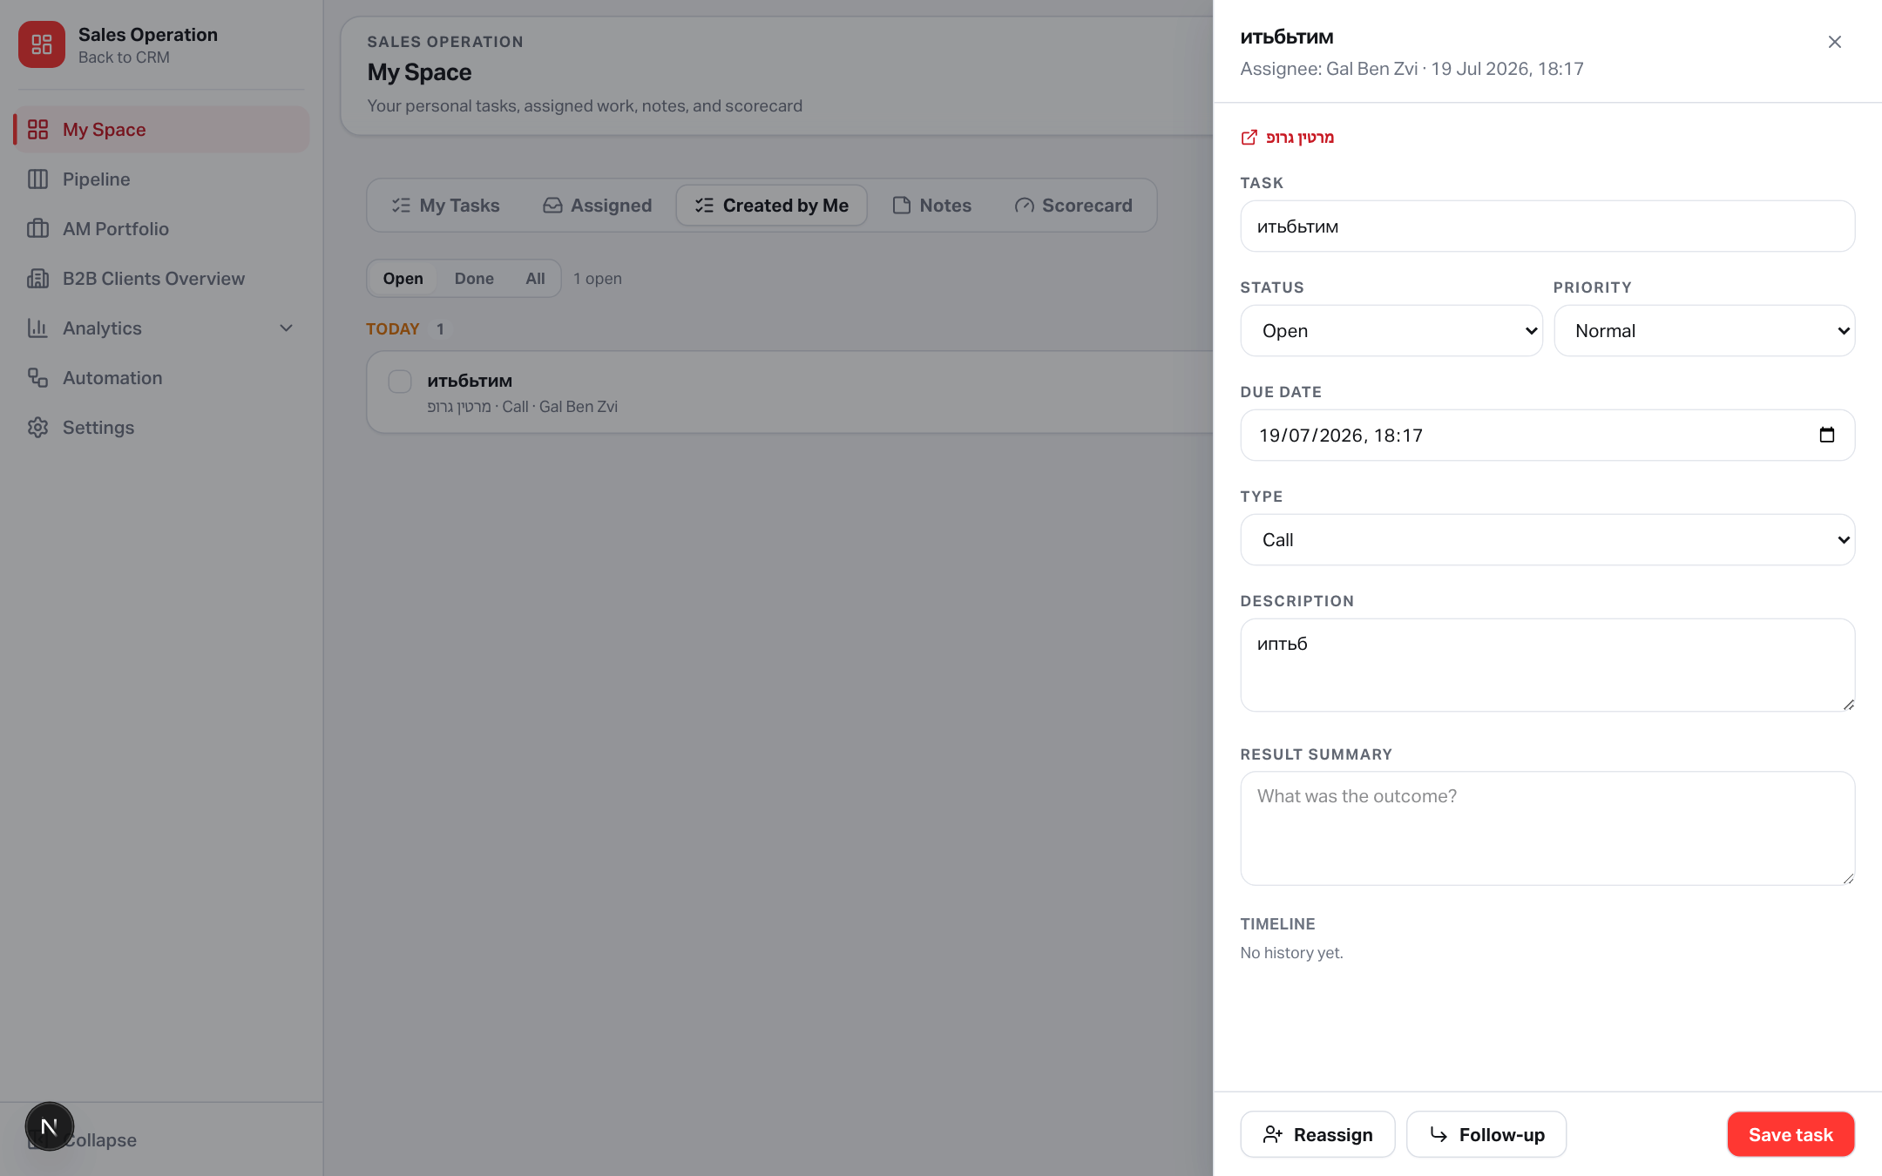
TASK DRAWER
One task editor everywhere
Opening a task keeps the user in context — no separate page and no duplicate editor.
Editable: title, status, priority, due date, type and description.
Result Summary records the outcome, not just task completion.
Timeline is append-only: created, status, reassignment, due, summary and follow-up events.
Deep link opens the linked lead in Pipeline.
Personal tasks use the same Drawer pattern, without collaboration actions.
Lead task Drawer · result summary and timeline are part of the task record
Yango · Sales Operations Onboarding · Release 0.2.43 · Confidential
6 / 17
Notes:
This is the central task editor reused in both My Space and Lead Tasks.

Slide 7
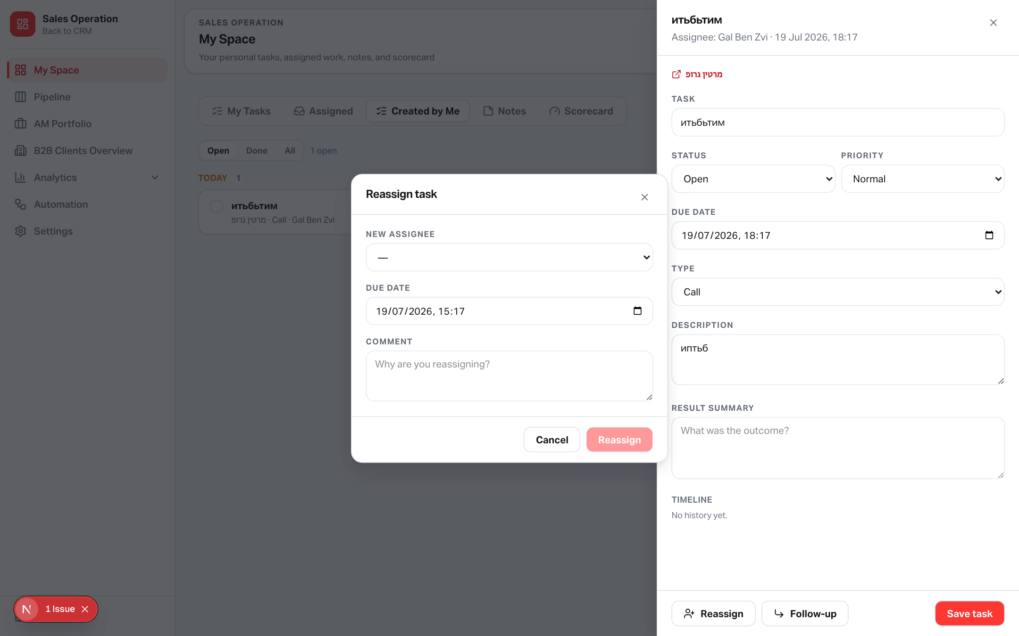
REASSIGN
A controlled handoff with context
Assignee, due date and handoff comment are captured in one action.
Select the new assignee.
Adjust the due date when responsibility changes.
Add a handoff comment so the new owner knows why.
A reassigned event is appended to sales_task_events.
The new owner receives an in-app task_assigned notification.
Object-level authorization allows assignee, creator, lead owner or Admin.
Reassign modal appears over the task Drawer
Yango · Sales Operations Onboarding · Release 0.2.43 · Confidential
7 / 17
Notes:
Reassignment is an auditable handoff, not a silent owner field update.

Slide 8
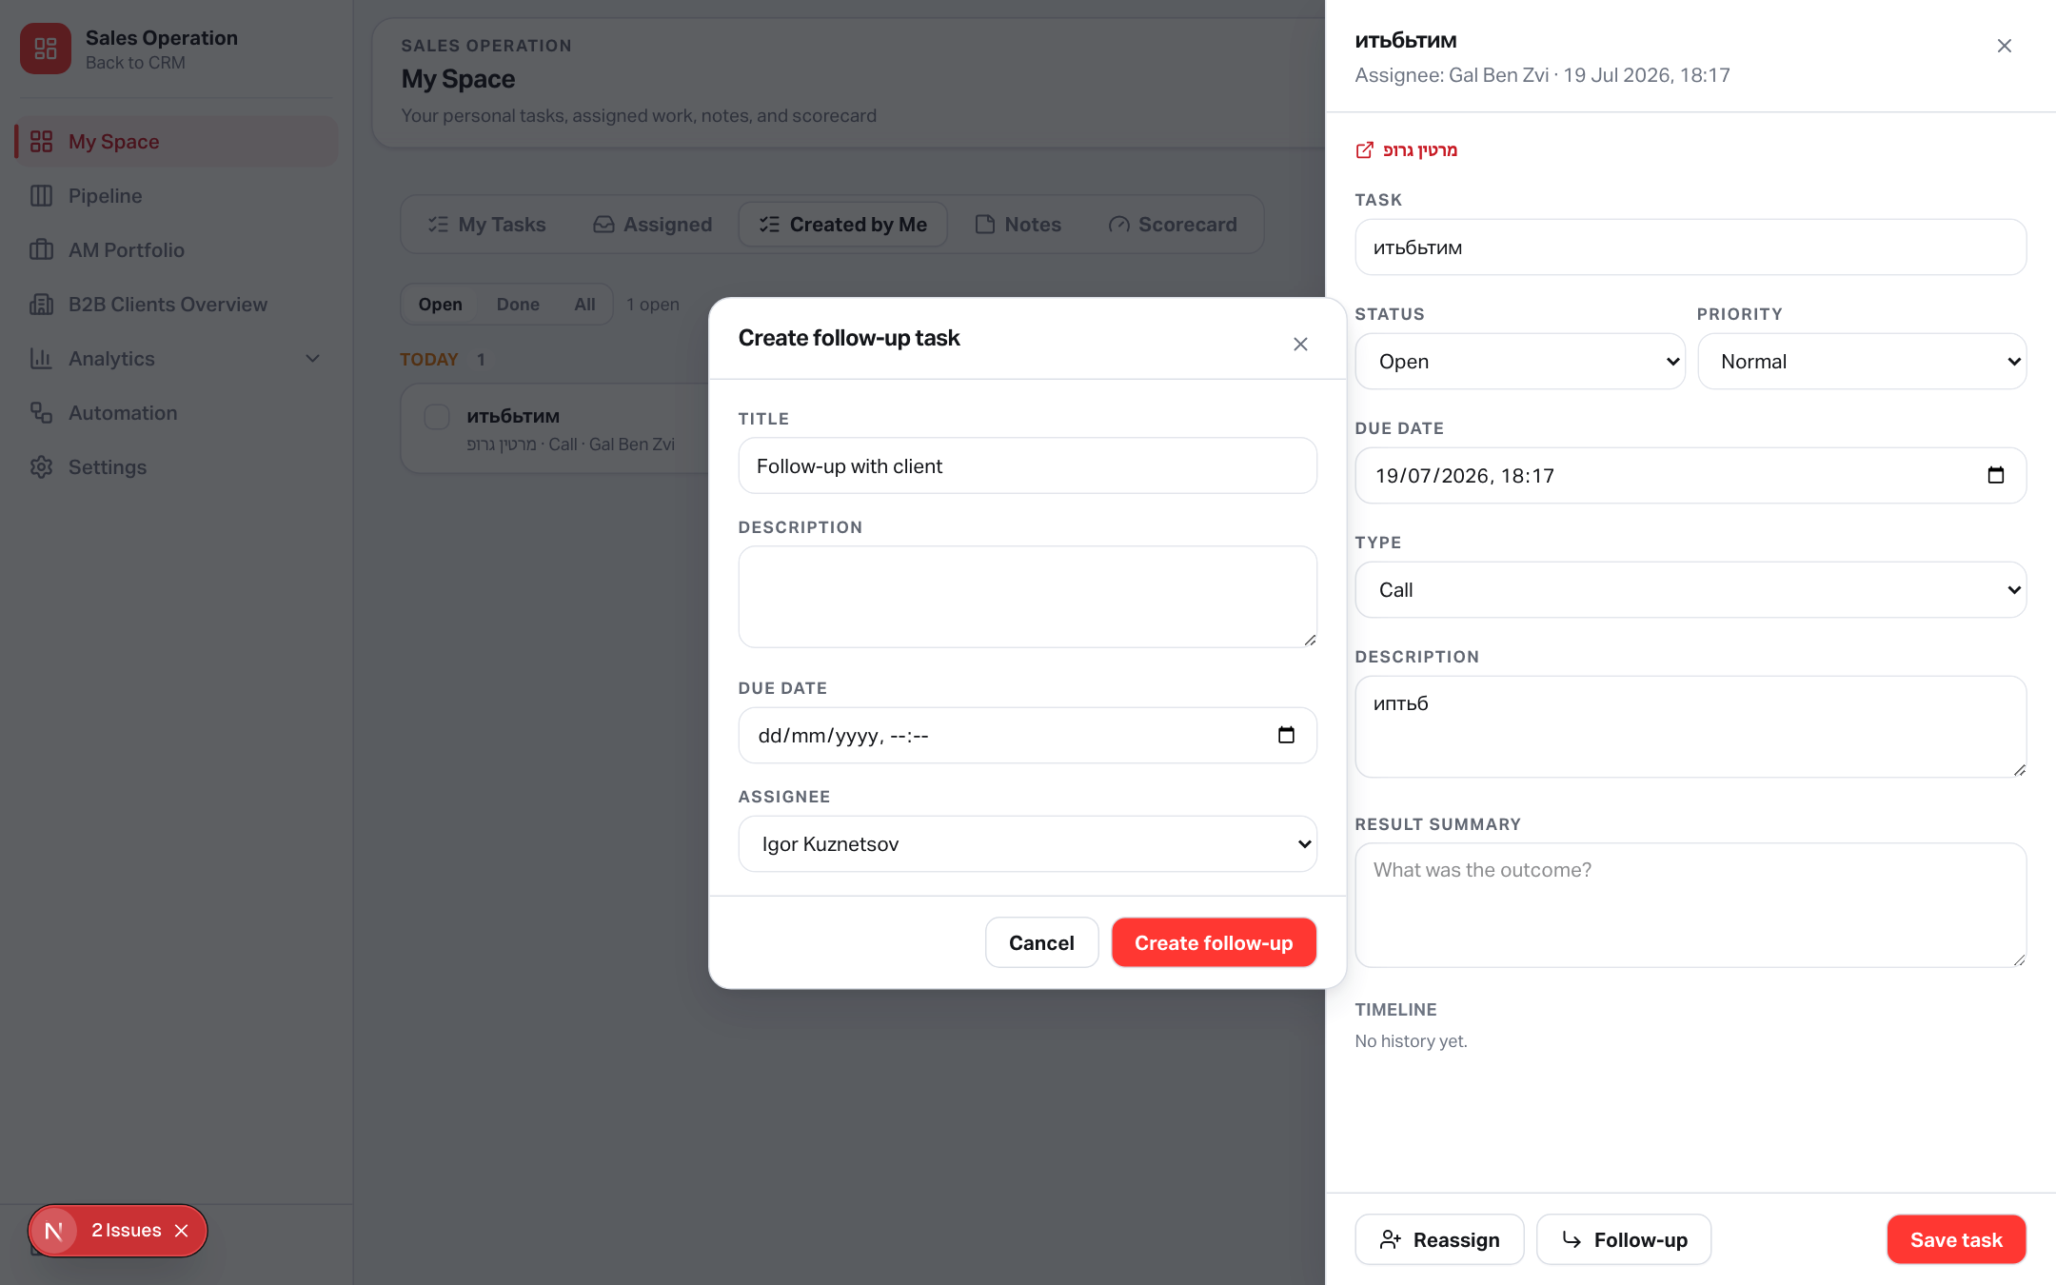
FOLLOW-UP
Turn every outcome into the next action
A follow-up task remains connected to its parent through parent_task_id.
Default title: “Follow-up with client”.
Set description, due date and assignee.
The new task is created on the same lead.
The parent receives a follow_up_created timeline event.
The Drawer can show the complete follow-up chain.
The assignee receives the standard task assignment notification.
Follow-up is created without leaving the current task context
Yango · Sales Operations Onboarding · Release 0.2.43 · Confidential
8 / 17
Notes:
Follow-up creates a linked task chain instead of losing context in a new standalone task.

Slide 9
TASK DATA MODEL
Durable outcomes, history and task chains
The original sales_tasks model was extended without breaking existing task APIs.
sales_tasks
sales_task_events
Indexes
Existing task record
+ result_summary
+ parent_task_id → sales_tasks.id
Existing fields retained:
lead_id · status · priority · due_at · assignee · creator
Append-only event stream
created
status_changed
reassigned
due_changed
summary_updated
follow_up_created
comment
Each event stores actor, body, changes and timestamp.
created_by_user_id
+ status + due_at
parent_task_id
Fast creator views and follow-up-chain lookups.
events
query
Yango · Sales Operations Onboarding · Release 0.2.43 · Confidential
9 / 17
Notes:
Explain why the task hub has durable history and traceable follow-up chains.

Slide 10
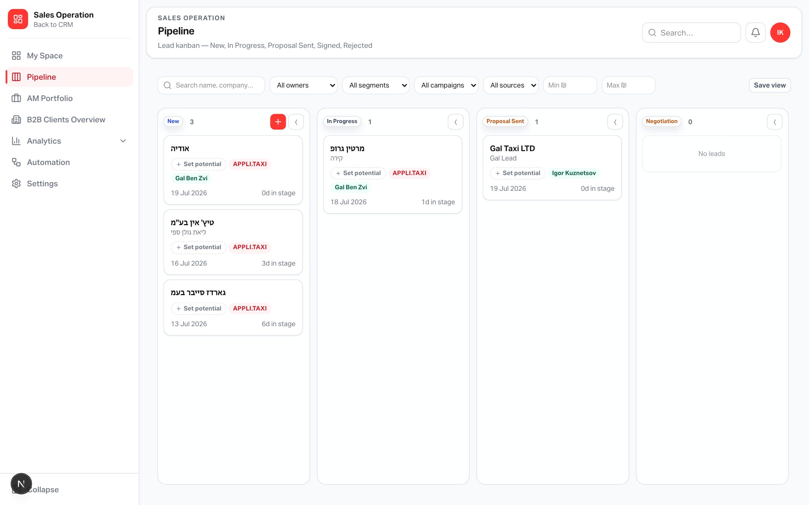
PIPELINE
No optimistic move — the server decides
The card stays in its current column until validation and persistence succeed.
1
User requests a move
Drag/drop or lead Drawer status change.
2
Preflight
POST /leads/[id]/transition with preflightOnly.
3
Decision
Success → move. Missing → structured requirements.
4
Confirm
Modal submits fields + transition in one operation.
Pipeline remains stable while the server evaluates the target stage
Yango · Sales Operations Onboarding · Release 0.2.43 · Confidential
10 / 17
Notes:
The key UX change is that the board does not pretend a move succeeded before the server validates it.

Slide 11
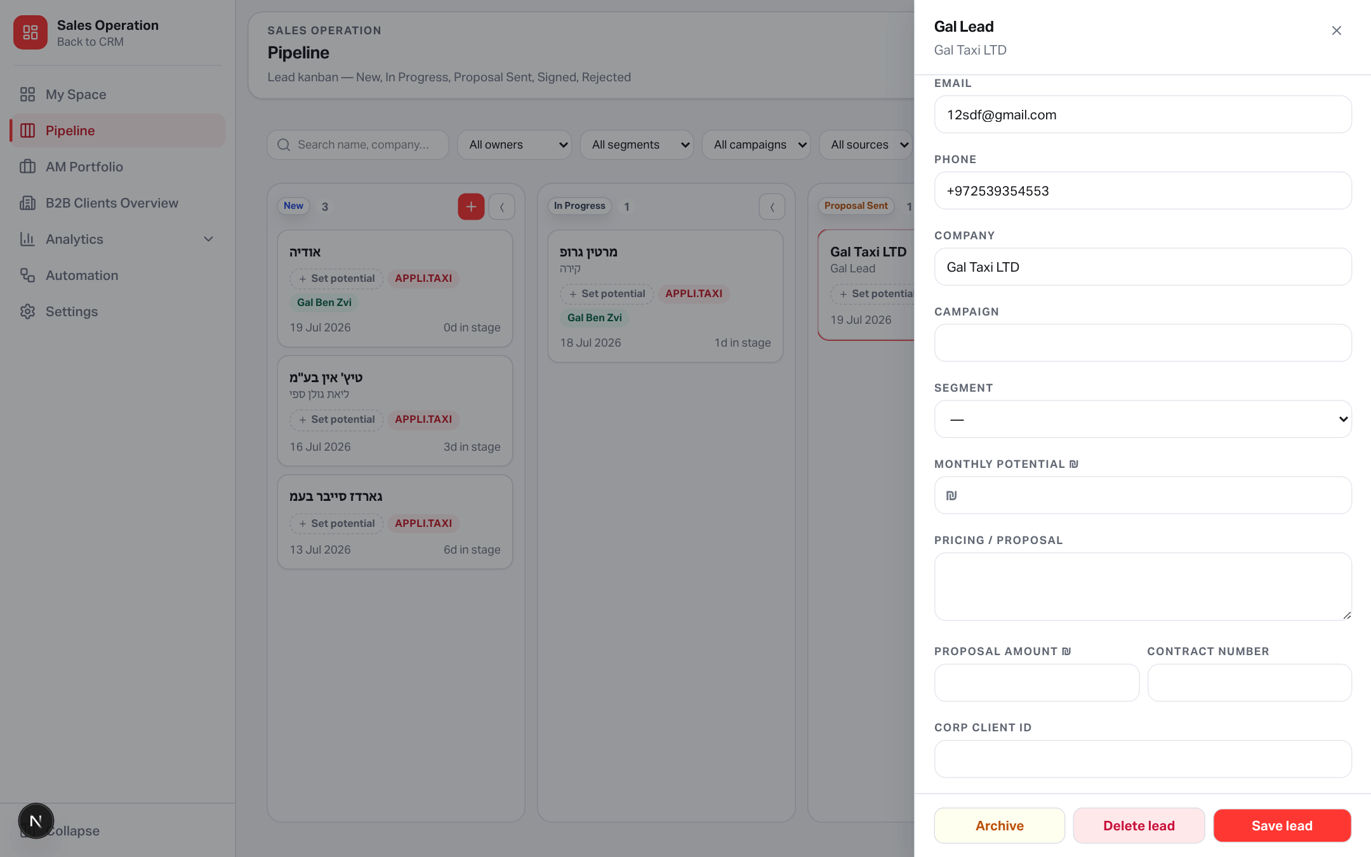
LEAD WORKSPACE
Commercial data now lives on the lead
The fields are staged before conversion and copied into the signed-client flow where relevant.
Pricing / proposal — text sent to the client; required for Proposal Sent.
Proposal amount — optional numeric value for future analytics.
Contract number — one of the accepted signing identifiers.
Corp Client ID — alternative signing identifier and B2B linkage seed.
Monthly potential remains the forecast input and is required for forward progression.
Lead Overview · commercial fields are editable before the transition
Yango · Sales Operations Onboarding · Release 0.2.43 · Confidential
11 / 17
Notes:
These fields can be entered in the lead Overview or requested by a stage gate.

Slide 12
GATE MATRIX
Requirements by forward transition
Backward moves and Rejected do not use commercial gates. Signed remains terminal.
Transition | Required before move | Why
New → In Progress | Active contact: name + email or phone Monthly potential > 0 | A workable lead with forecast value
In Progress → Proposal Sent | Non-empty Pricing / proposal | Proof that the commercial offer exists
Proposal Sent → Negotiation | Open follow-up task created in the transition | Negotiation always has a scheduled next step
Negotiation → Signed | Contract number OR Corp Client ID + selected Account Manager | A signed deal is ready for handover
FORWARD SKIPS ACCUMULATE REQUIREMENTS
BACKWARD / REJECTED: NO COMMERCIAL GATES
SIGNED: TERMINAL
Yango · Sales Operations Onboarding · Release 0.2.43 · Confidential
12 / 17
Notes:
Walk the matrix top to bottom. Gates accumulate on forward skips.

Slide 13
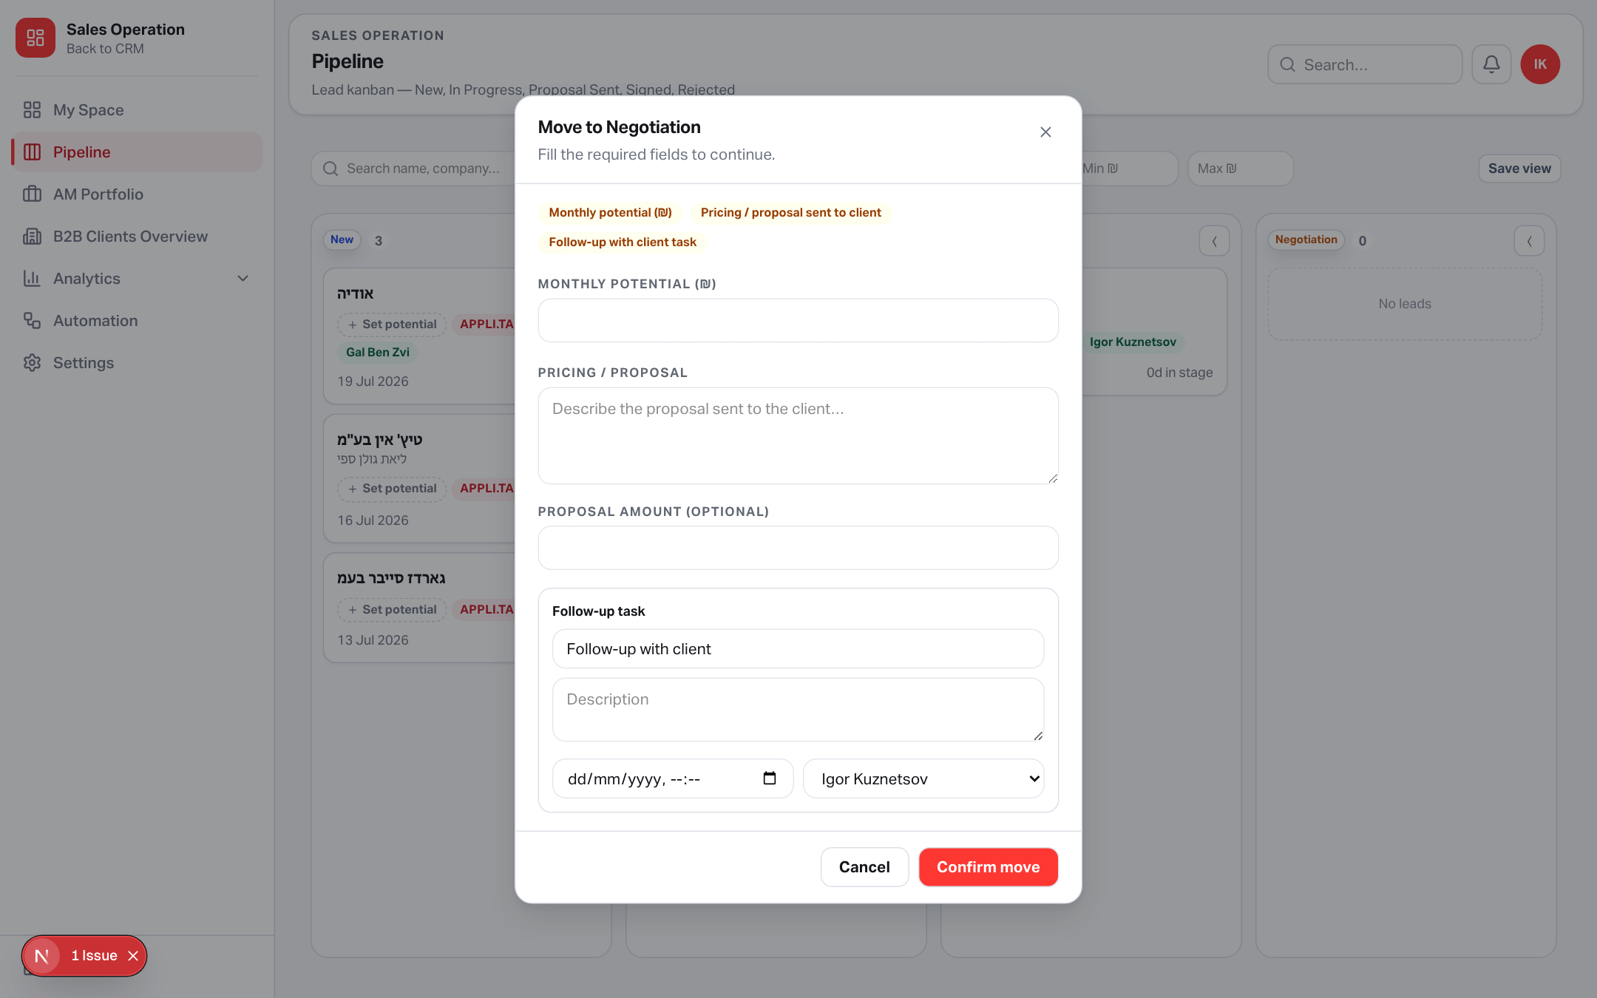
STAGE GATE MODAL
Ask only for what is missing
The response is structured — each missing requirement becomes a chip and an inline field.
Missing chips make the reason for blocking explicit.
Inline fields are rendered only for missing requirements.
Negotiation embeds follow-up title, due date, description and assignee.
Signed embeds contract / Corp Client ID plus Account Manager.
Confirm sends fields and stage payload to the transition service.
Cancel leaves the lead untouched in its original column.
Example: Negotiation requires potential, proposal and a follow-up task
Yango · Sales Operations Onboarding · Release 0.2.43 · Confidential
13 / 17
Notes:
This screenshot shows a Proposal Sent → Negotiation gate with accumulated missing fields.

Slide 14
SIGNED HANDOVER
From negotiation to an owned client relationship
The transition finalizes CRM conversion and creates the first two post-sale responsibilities.
1
Gate input
2
Signed
3
Client conversion
4
Onboard Client
5
First Client Call
Contract # OR Corp Client ID
+ Account Manager
Lead status persisted
Audit + activity
Create / update client
Copy Corp Client ID
High-priority task
Sales owner / signer
Assigned to selected AM
Due in ~2 days
NO DUPLICATE ONBOARDING TASKS
The previous generic onboarding task was aligned to “Onboard Client”; conversion creates it once, while the transition service adds only “First Client Call” for the selected Account Manager.
Yango · Sales Operations Onboarding · Release 0.2.43 · Confidential
14 / 17
Notes:
Signing is not just a status update — it is a cross-team handover workflow.

Slide 15
BACKEND CONTRACTS
APIs designed around explicit operations
The server owns validation, authorization, history and side effects.
GET /tasks?scope=created
Task object authorization
Tasks created by the signed-in user
Allowed when the user is:
• task assignee
• task creator
• linked lead owner
• Admin
Page-level salesPipeline access is still required first.
GET /tasks/[id]
Detail + events + follow-up chain
PATCH /tasks/[id]
Edit, summary, status or reassign
Structured gate error
POST /tasks/[id]/follow-up
HTTP 422 · code: "STAGE_REQUIREMENTS"
missing: [
{ key: "pricingProposal",
label: "Pricing / proposal sent to client" }
]
The client renders the modal from this response.
Create linked follow-up task
POST /leads/[id]/transition
Preflight or execute a stage transition
Yango · Sales Operations Onboarding · Release 0.2.43 · Confidential
15 / 17
Notes:
Summarize the backend contracts and object-level task authorization.

Slide 16
OPERATING PLAYBOOK
How the team should use the new flow
A short checklist for Sales Managers, Account Managers and Admins.
Sales / Account Manager
Task creator / delegator
Admin / owner
1. Start the day in My Space.
2. Review Assigned and overdue work.
3. Use Result Summary when closing a task.
4. Create a follow-up instead of an unlinked reminder.
5. Complete gate fields when moving deals forward.
1. Open Created by Me.
2. Check ownership and due dates.
3. Reassign with a clear comment.
4. Review the timeline before escalation.
5. Open the linked lead for deal context.
1. Keep users and roles accurate.
2. Monitor stage data quality.
3. Verify signed clients have an AM.
4. Ensure notifications are reviewed.
5. Use analytics after commercial fields are consistently populated.
Yango · Sales Operations Onboarding · Release 0.2.43 · Confidential
16 / 17
Notes:
End the walkthrough with the practical day-to-day behavior expected from managers.

Slide 17
THE RESULT
Every deal has a next action.
Every stage has proof.
Execution
Accountability
Data quality
Handover
My Space centralizes personal, assigned and delegated work.
Task events, summaries and follow-up chains preserve context.
Stage gates require the information needed for the next phase.
Signing creates an owned client and the first AM action.
Live in production · https://applitaxi.space
Notes:
Close on the operational outcome: fewer lost follow-ups and cleaner stage progression.

