Slide 1

RELEASE 0.2.47
Sales Operation
Tracker
Multi-project kanban · ticket drawer · @mentions · My Space sync · notifications
Yango · Sales Operations · Appli Taxi Oz
Notes:
Release overview for Yango leadership.

Slide 2
AGENDA
What shipped in 0.2.47
Tracker is the new shared work surface next to Pipeline
01
Projects list
Create boards for team workstreams under /sales-operation/tracker
02
Kanban board
Configurable columns, WIP limits, drag-and-drop tickets
03
Ticket drawer
Description, assignees, labels, checklist, links, activity
04
@Mentions
Autocomplete CRM users → My Space badge + notifications bell
05
My Space + Calendar
Assigned tickets in Tracker tab; emerald due dates on calendar
Yango · Sales Operations · Release 0.2.47 · Confidential
2 / 11

Slide 3
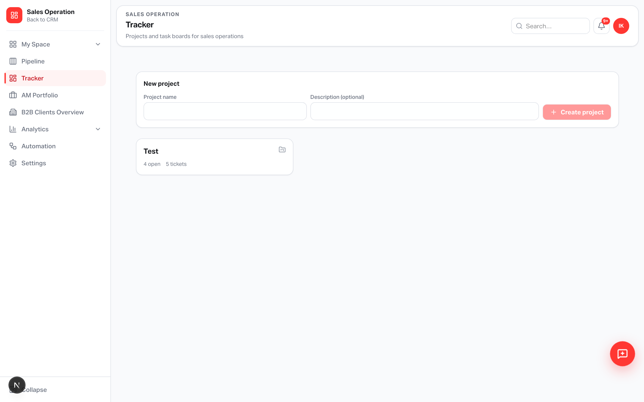
TRACKER
Start from projects — one board per workstream
Sidebar: Tracker sits with Pipeline and My Space
Managers do
• Open Tracker in the sidebar
• Create a project (e.g. Launch,
Partner ops, Hiring)
• Open the board
• Permission: salesTracker
Yango · Sales Operations · Release 0.2.47 · Confidential
3 / 11

Slide 4
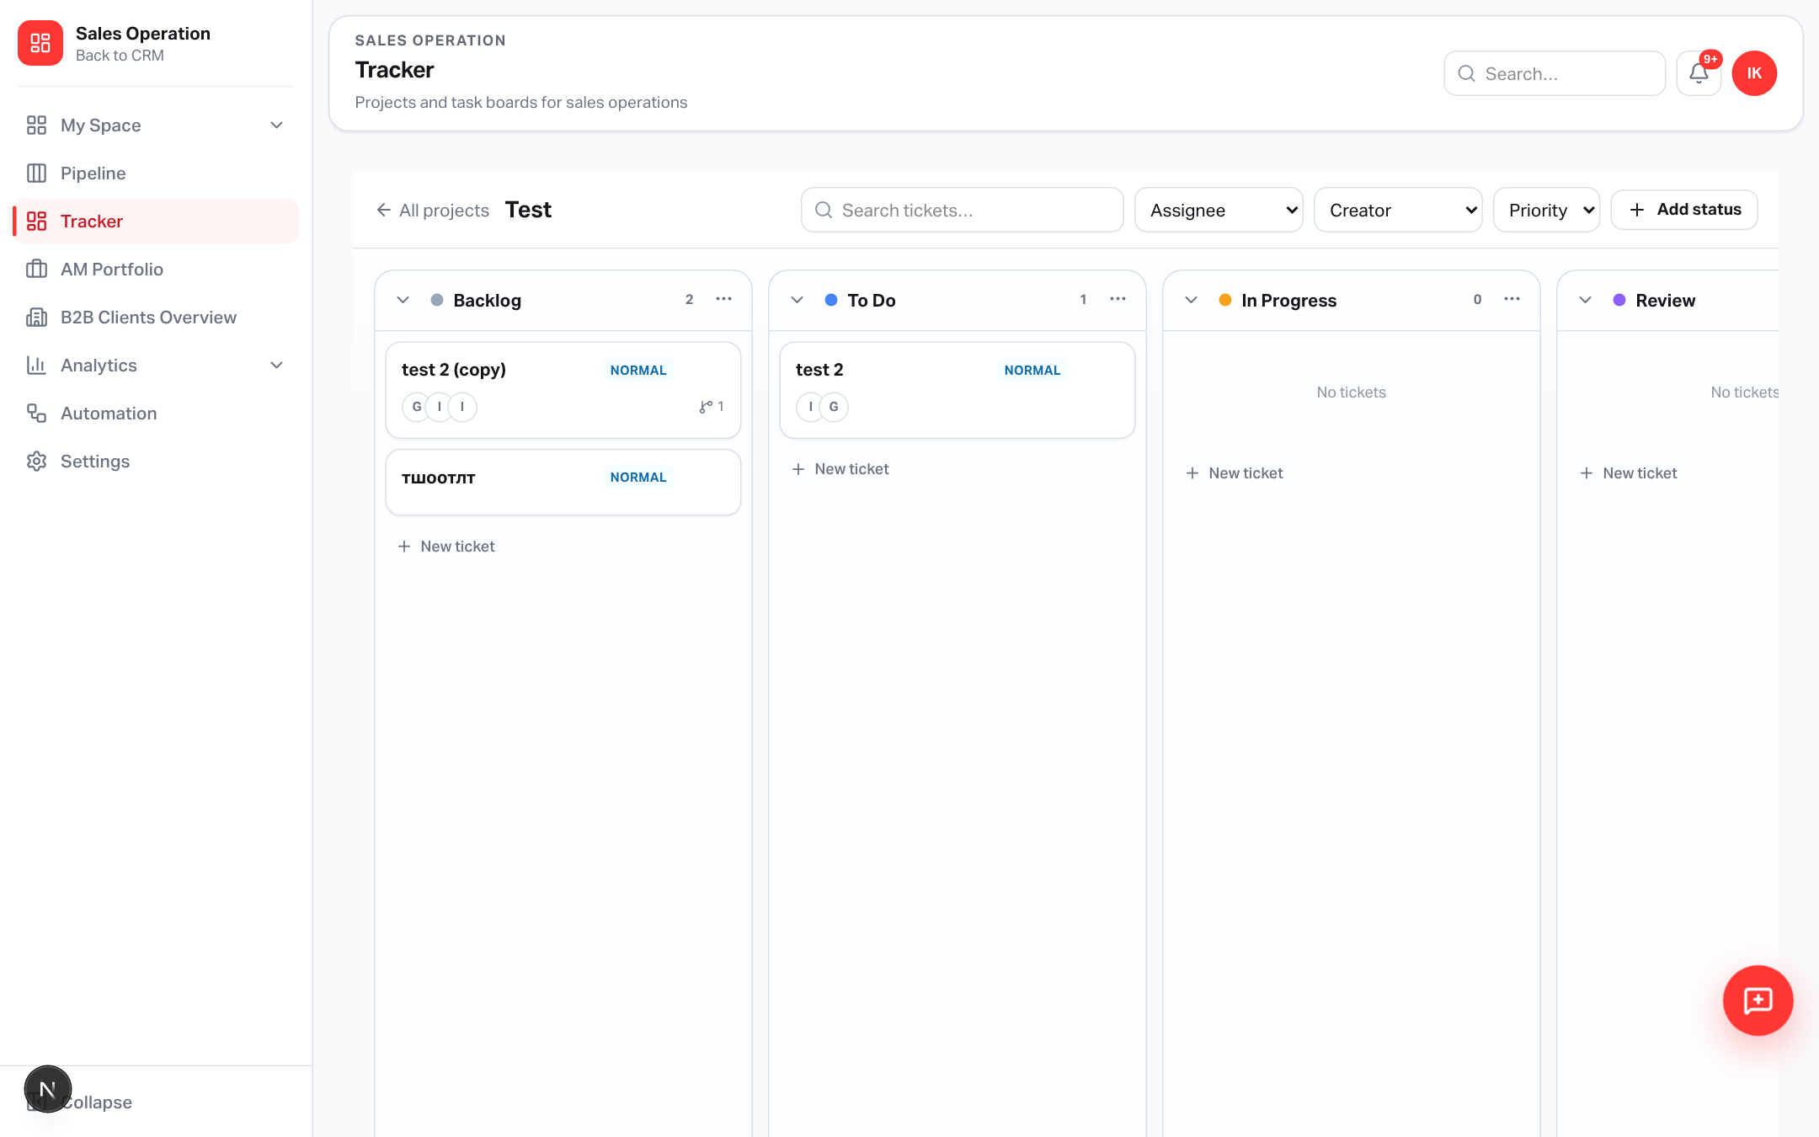
BOARD
Columns you control — tickets you drag
Rename, recolor, WIP, reorder, delete columns
Board tools
• Inline create ticket
• Filters + search
• Drag between columns
• Column ⋮ menu
• Copy ticket URL
Yango · Sales Operations · Release 0.2.47 · Confidential
4 / 11

Slide 5
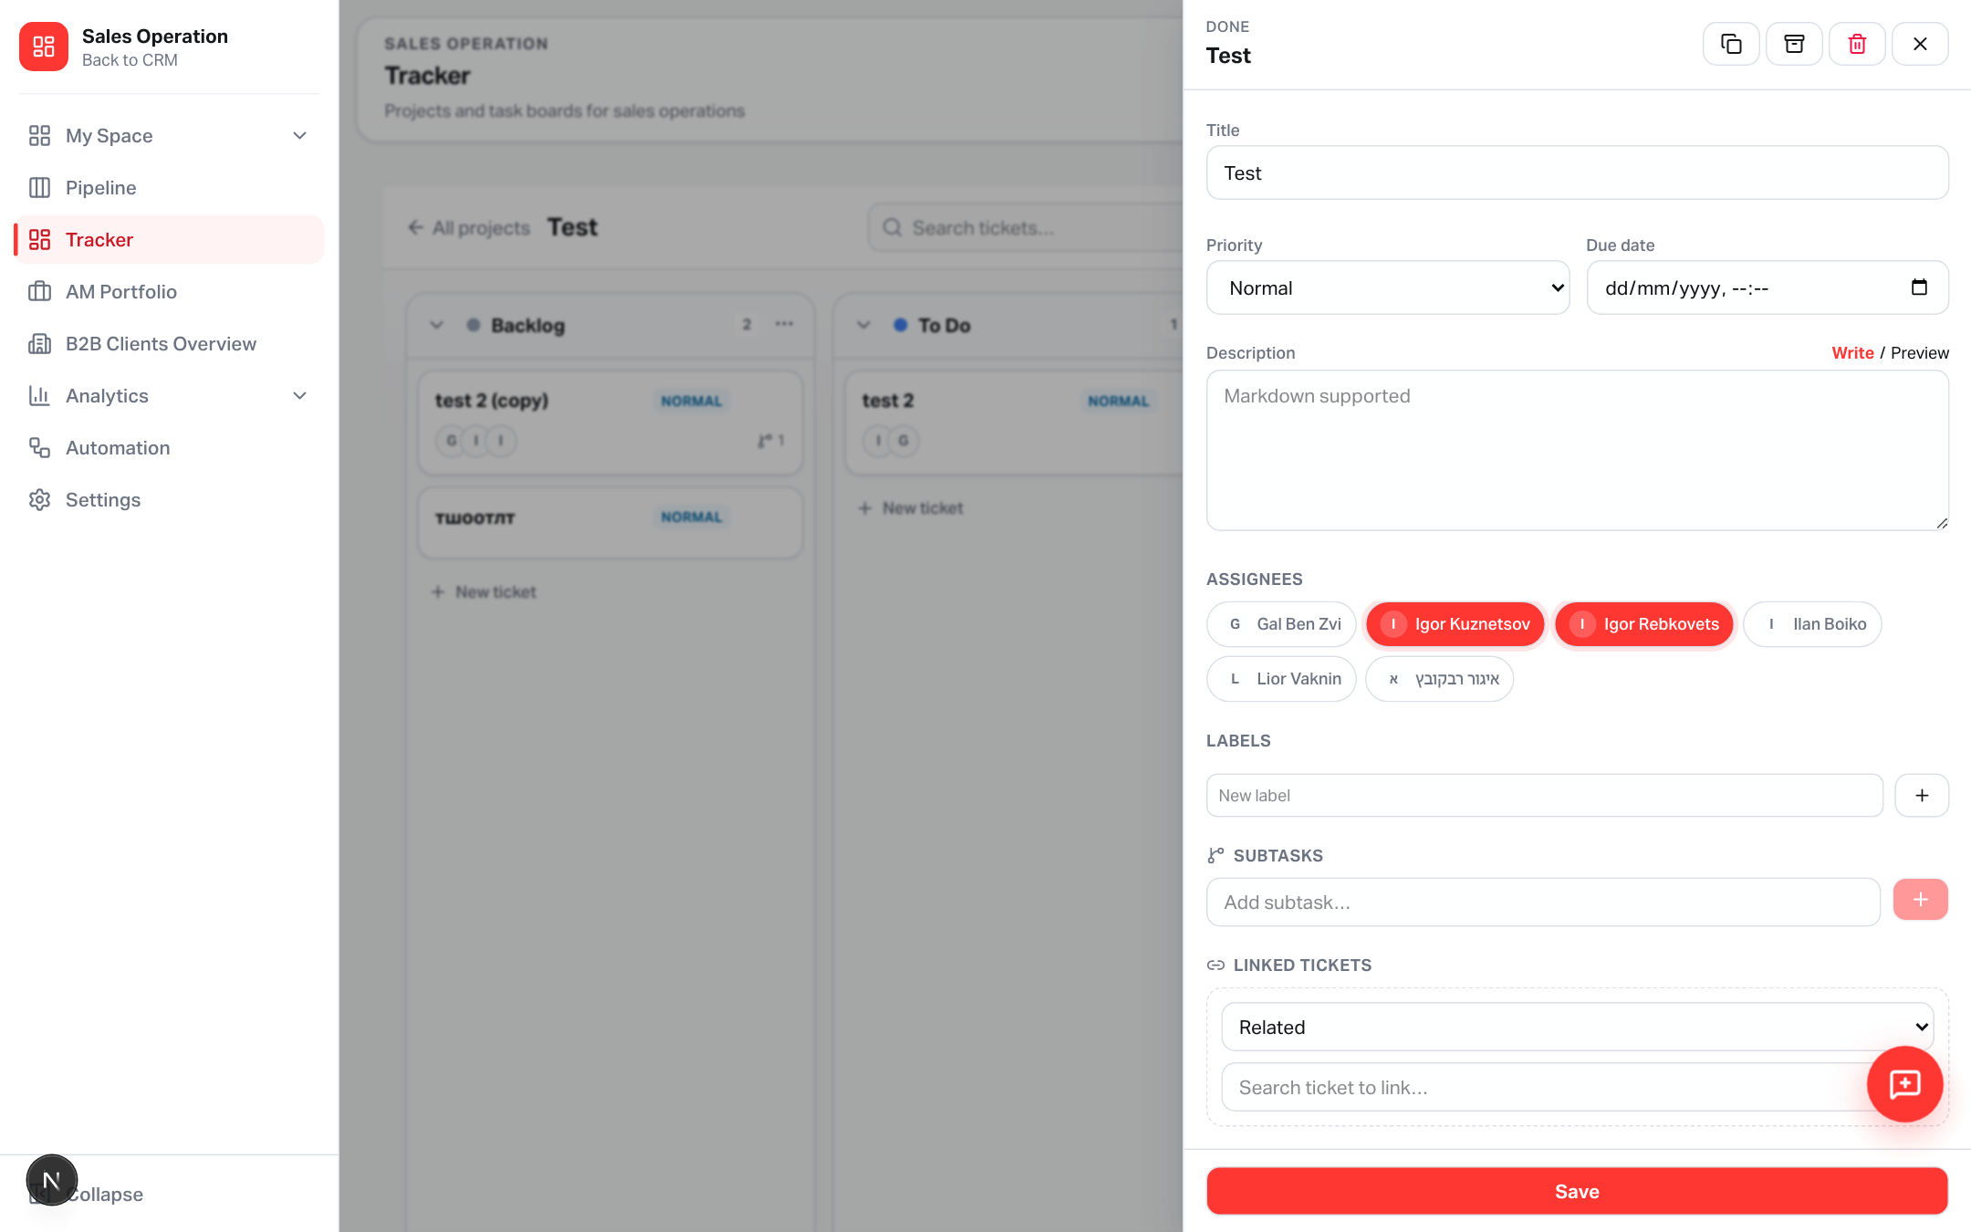
TICKET
Side drawer = full work context
Stay on the board — detail opens without a page jump
Inside a ticket
• Markdown description
• Multi-assignees
• Labels + priority + due
• Checklist / subtasks
• Linked tickets
• Activity + archive
Yango · Sales Operations · Release 0.2.47 · Confidential
5 / 11

Slide 6
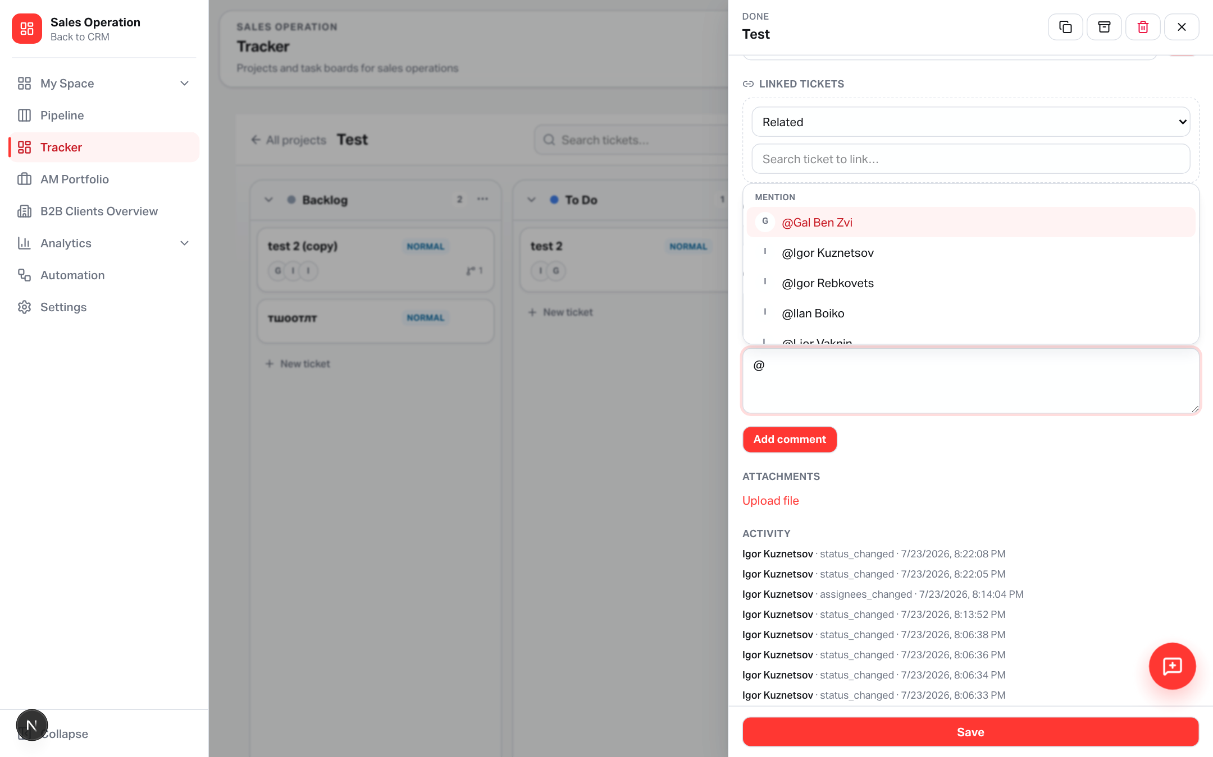
@MENTIONS
Tag CRM users in comments
Autocomplete → highlight → My Space + bell
What the assignee sees
• Red badge on My Space
Tracker tab
• @mention in notifications
• Highlighted comment text
• Deep link to the ticket
Yango · Sales Operations · Release 0.2.47 · Confidential
6 / 11

Slide 7
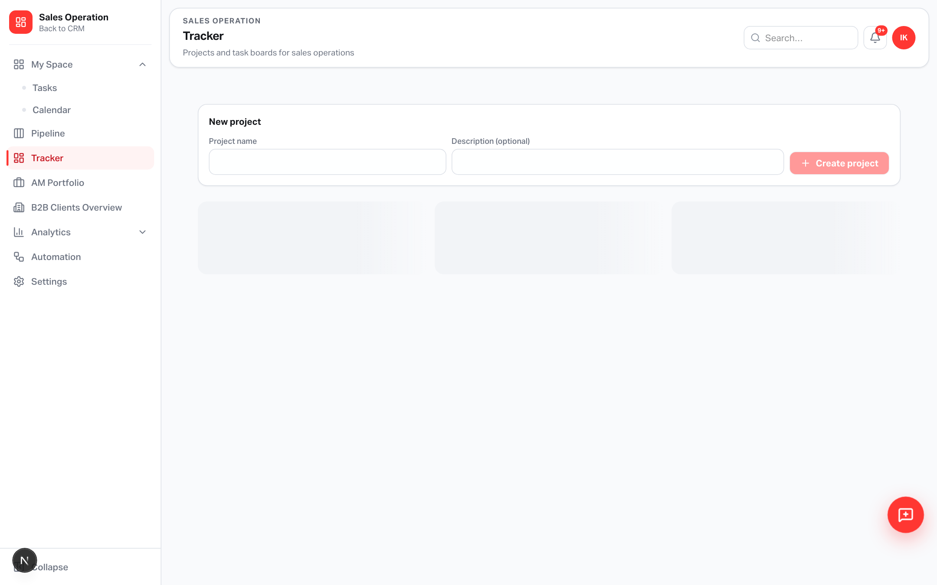
MY SPACE
Assigned Tracker tickets live next to Tasks
Personal inbox for board work assigned to you
Sync rules
• Assignees → My Space Tracker
• Mentions → red tab badge
• Click opens the board ticket
• Separate from sales_tasks
Yango · Sales Operations · Release 0.2.47 · Confidential
7 / 11

Slide 8
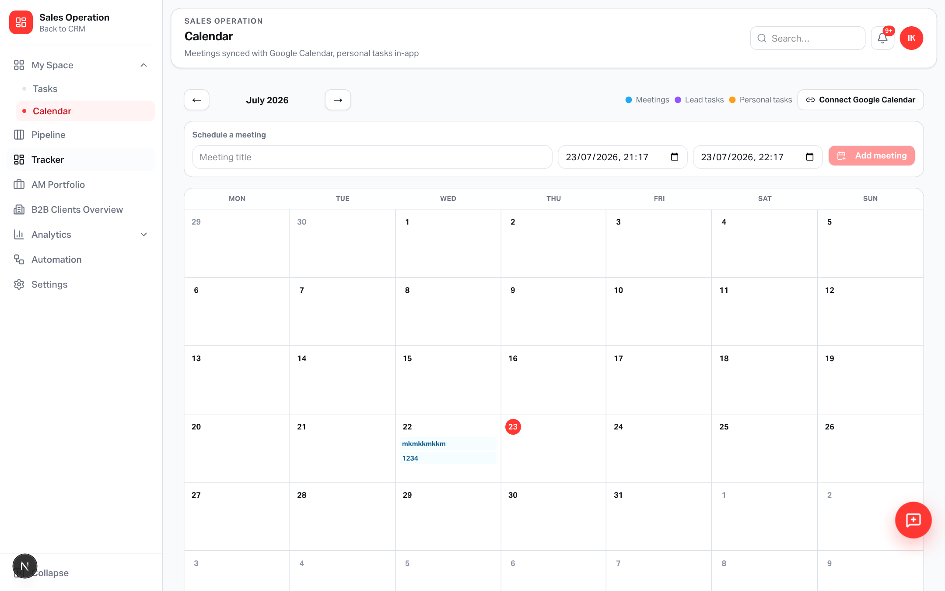
CALENDAR
Tracker due dates on the grid
Emerald chips = Tracker tickets with a due date
Color reminder
• Sky — Meetings
• Violet — Lead tasks
• Amber — Personal tasks
• Emerald — Tracker tickets
Yango · Sales Operations · Release 0.2.47 · Confidential
8 / 11

Slide 9
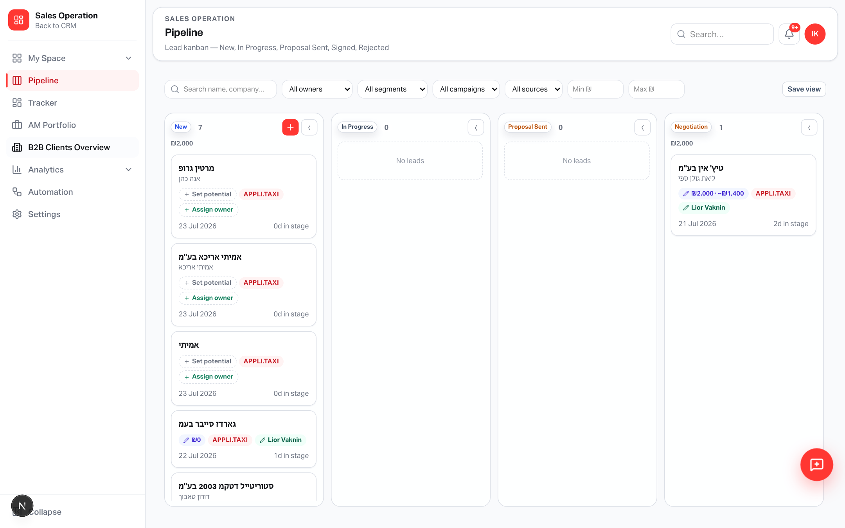
NAVIGATION
Tracker in the Sales Operation sidebar
Same shell as Pipeline — new page key salesTracker
Access
• Permissions version 12
• Grant salesTracker in Accesses
• Admins / managers first
• AI automation = later
Yango · Sales Operations · Release 0.2.47 · Confidential
9 / 11

Slide 10
OPS CHECKLIST
Required before first use on prod
Code is live on applitaxi.space — schema must be applied
Database
Run scripts/sql/supabase_sales_tracker.sql in Supabase (or npm run db:apply:sales-operation with DB URL)
Permissions
Confirm salesTracker page key for roles that should see Tracker
Smoke test
Create project → ticket → assign → @mention → check My Space + bell
Version
App 0.2.47 · commit d43c4d89 · release notes in CRM
Yango · Sales Operations · Release 0.2.47 · Confidential
10 / 11

Slide 11
Shared work, finally on a board
From Tracker columns into My Space and the calendar — with @mentions that actually reach people.
applitaxi.space · Sales Operations · 0.2.47

