Slide 1

RELEASE 0.2.68
Appli Jarvis presence
Visible agency in Sales Operation: header chip, card-first dock, token honesty, gated actions.
Yango · Sales Operations · Release 0.2.68 · Confidential
1 / 3

Slide 2
What's new
Header Appli chip — logo 16px + soft #FF2D2D presence
Right dock ~380px — token strip, propose cards first, chat secondary
First-open welcome once + New chat without deleting history
Enter sends · Shift+Enter newline · Supabase history hydrate
R1 soft-confirm always · Yango read/propose · create stays R2 + idempotent Approve
Dead tokens fail closed — no unsupervised money/history writes
Yango · Sales Operations · Release 0.2.68 · Confidential
2 / 3

Slide 3
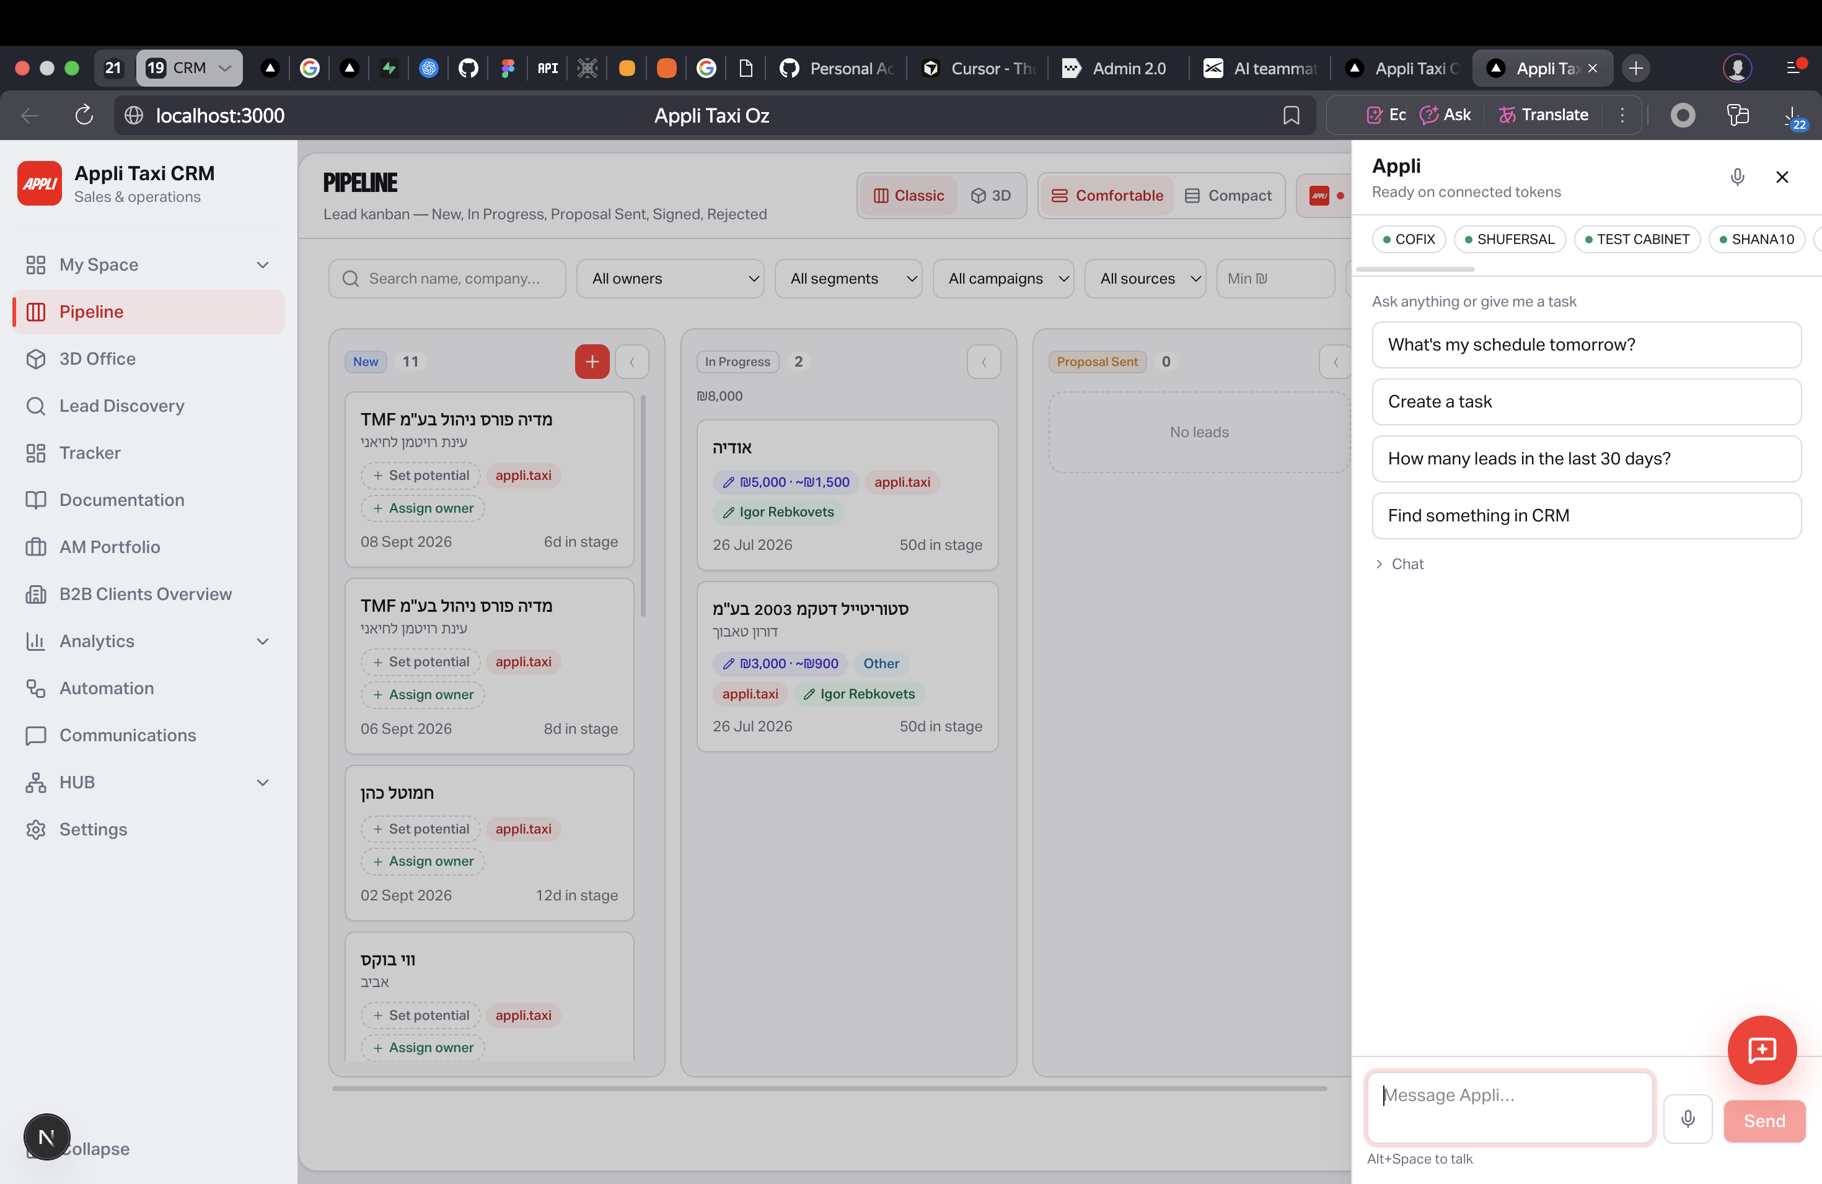
On the screen
Yango · Sales Operations · Release 0.2.68 · Confidential
3 / 3

