Slide 1

RELEASE 0.2.51
3D Office that
actually helps sales
Attention queue · My Desk · Team floor · stage-gate Advance — live CRM, not decoration
Yango · Sales Operations · Appli Taxi Oz

Slide 2
AGENDA
What shipped in 0.2.51
From decorative 3D scene → command center + personal desk
01
Attention dock
Overdue tasks, unassigned new, stuck deals, unread, meetings next 2h
02
My Desk
Leads & tasks filtered by current userId — Advance / Done / Open
03
Team floor
Real CRM managers with severity cues — click → their deals
04
Pipeline Wall
Age badges + Advance with the same stage-gate as classic
05
Ask Ops
Short commands open dock / classic pages (no OpenClaw)
Yango · Sales Operations · Release 0.2.51 · Confidential
2 / 10

Slide 3
PRODUCT
CRM state → spatial cues → fast act
Same pattern as Claw3D — our system of record stays Sales Operation APIs
Live state
Spatial cues
Snapshot: leads, tasks, meetings, notifications, managers roster
Red/amber pulse on managers · stickers with days-in-stage
Fast act
Deep link
Complete · Assign me · Advance (+ stage gate) · Open lead drawer
Calendar, Analytics, Discovery, full Pipeline when you need depth
Yango · Sales Operations · Release 0.2.51 · Confidential
3 / 10

Slide 4
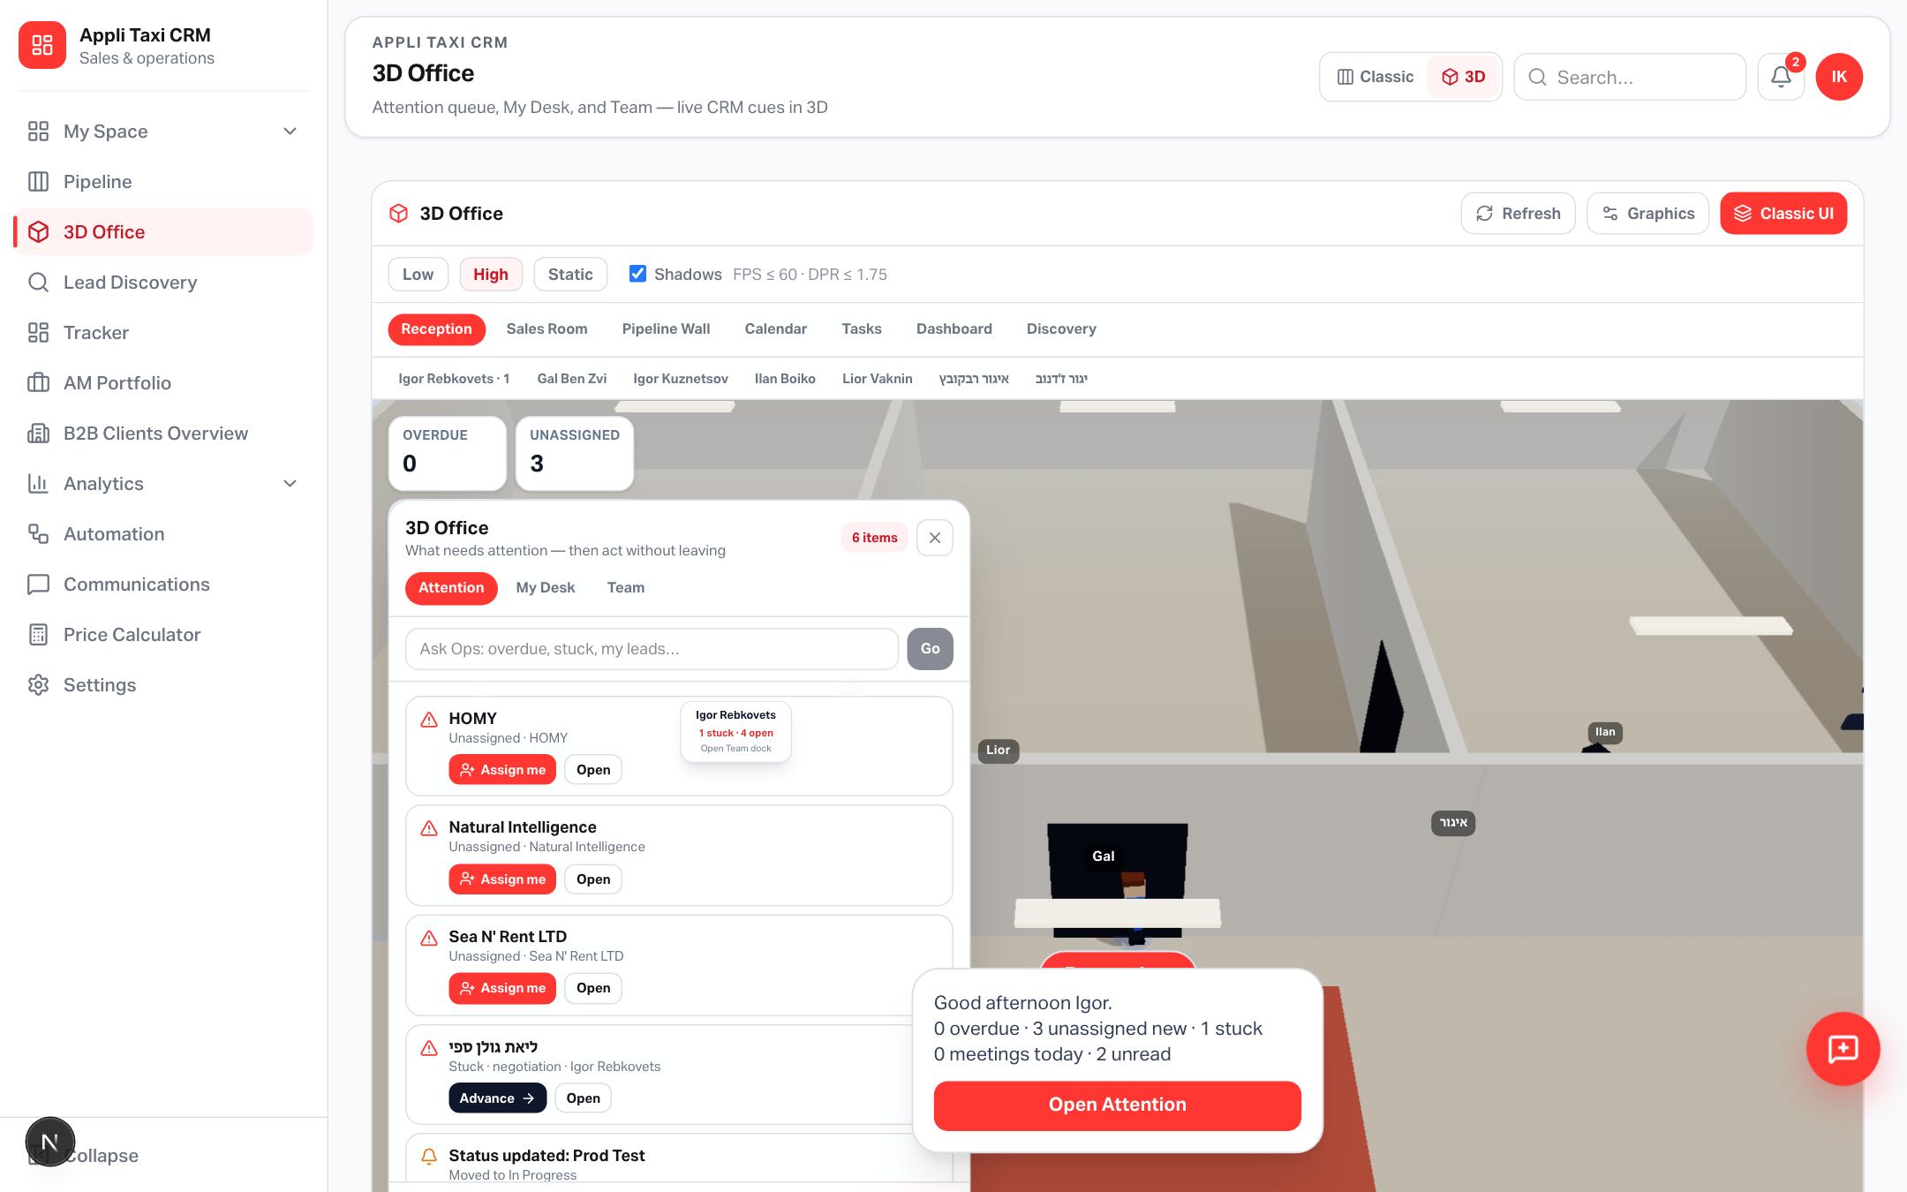
ATTENTION
What hurts right now
Dock opens on load — act without leaving 3D Office
Yango · Sales Operations · Release 0.2.51 · Confidential
4 / 10

Slide 5
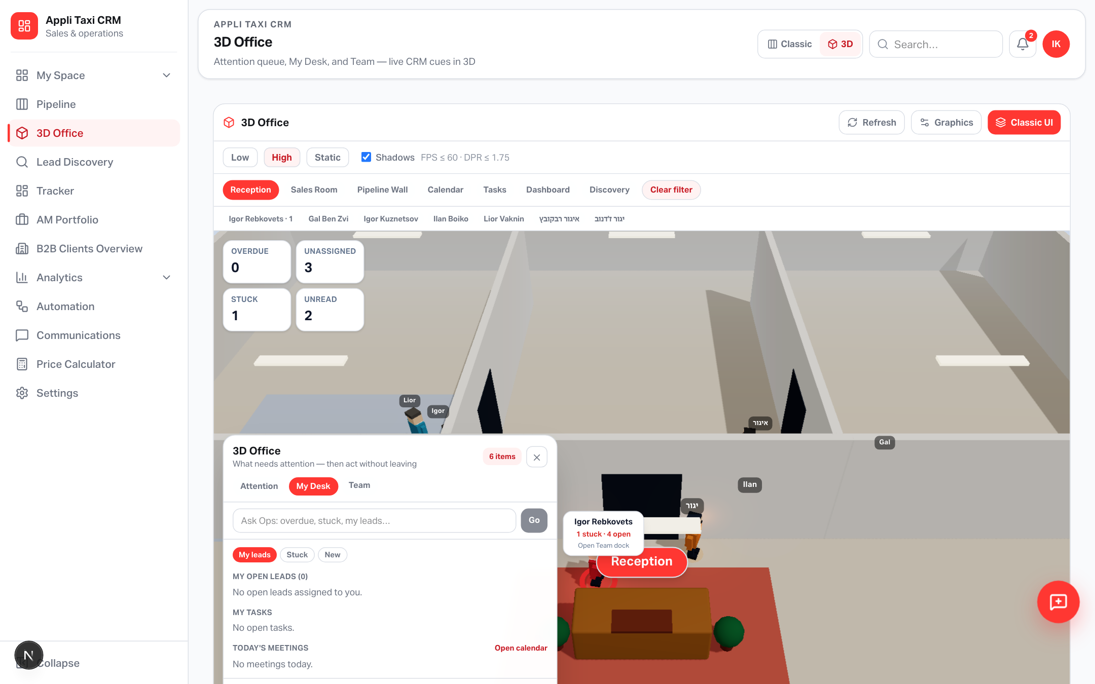
MY DESK
Your open leads & tasks
Filter by assignedManagerUserId — not name substring
Yango · Sales Operations · Release 0.2.51 · Confidential
5 / 10

Slide 6
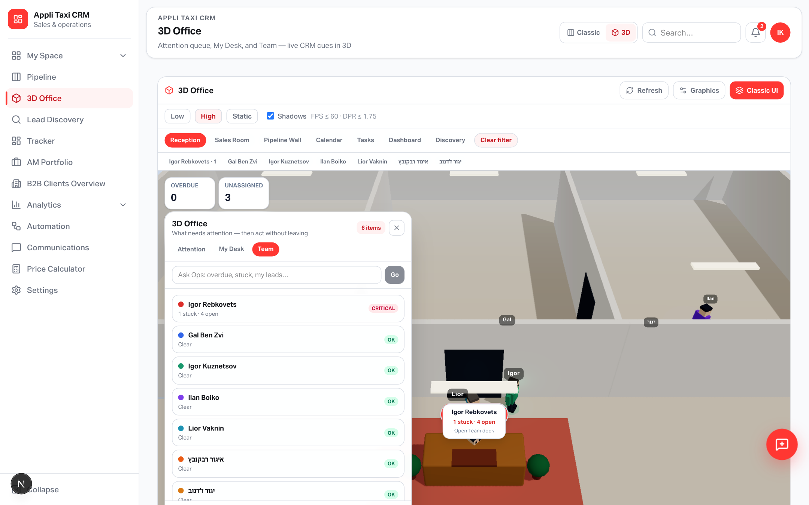
TEAM
Real CRM managers on the floor
Roster from /office/roster + lead owners · severity critical / warn / ok
Yango · Sales Operations · Release 0.2.51 · Confidential
6 / 10

Slide 7
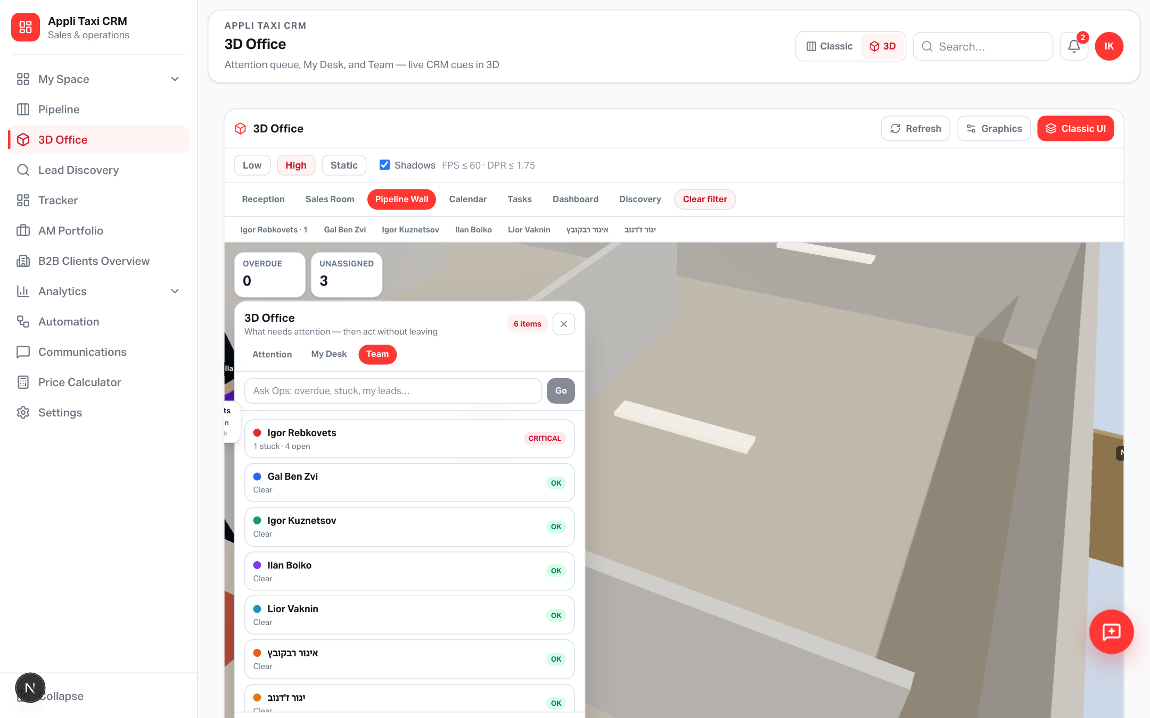
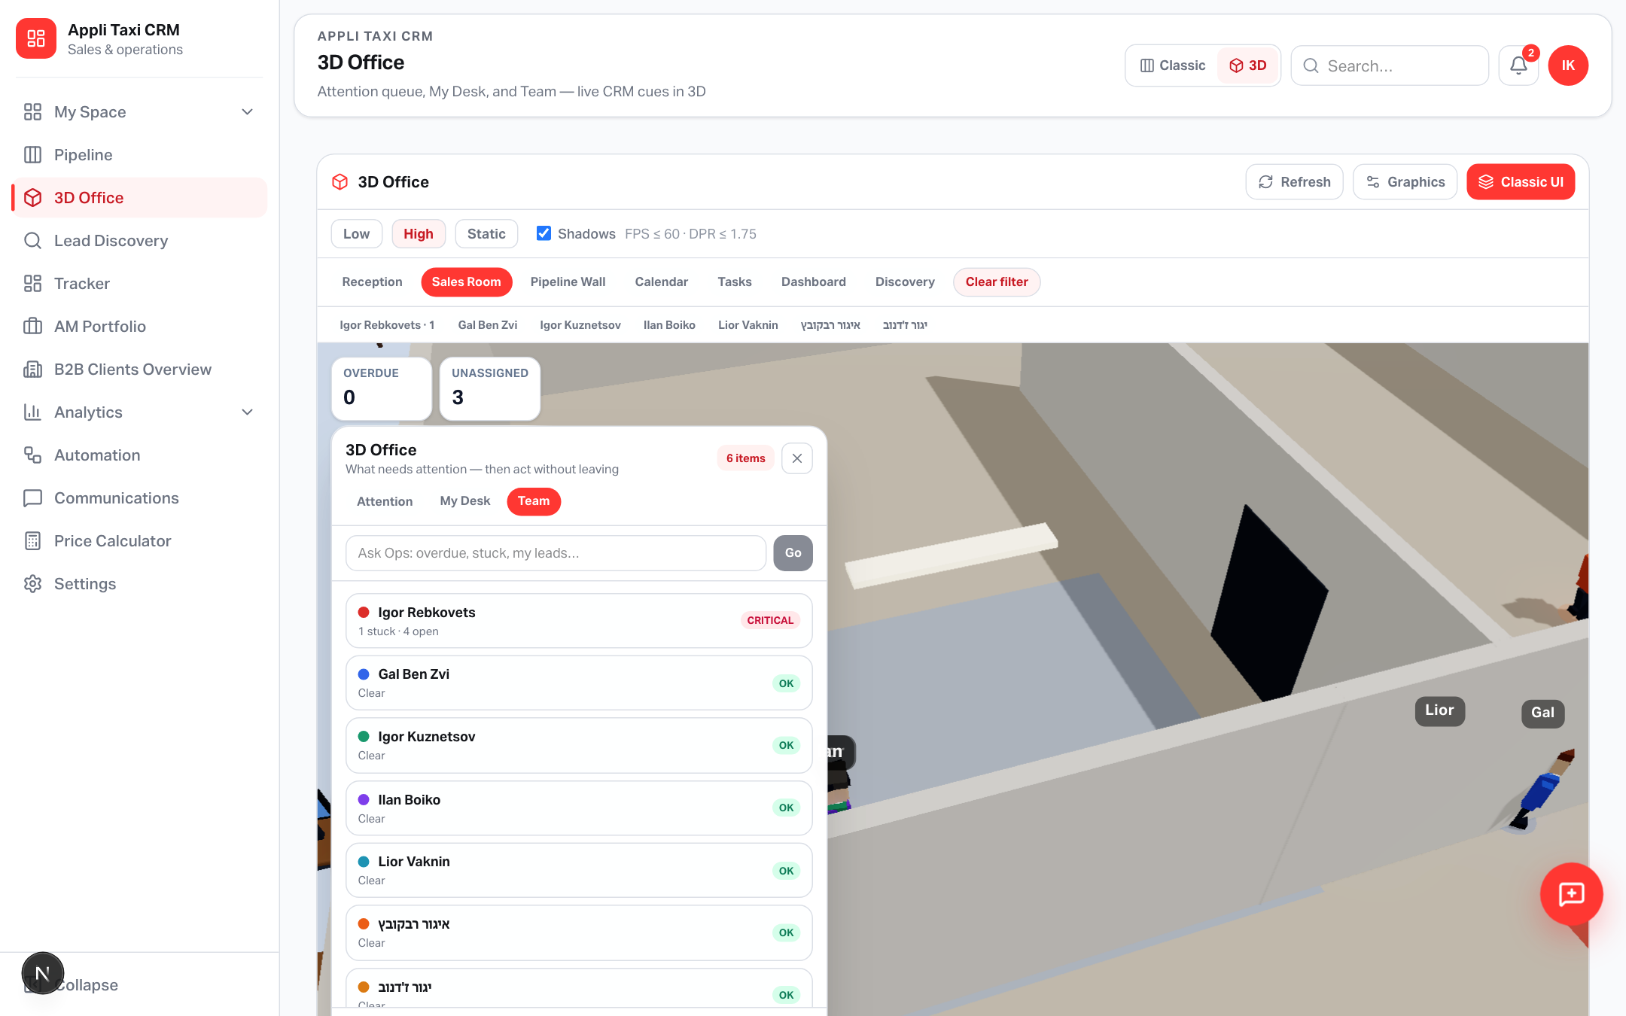
PIPELINE WALL
Spatial scan + stage-gate Advance
Stickers sync with dock filters (My / Stuck / Owner)
Yango · Sales Operations · Release 0.2.51 · Confidential
7 / 10

Slide 8
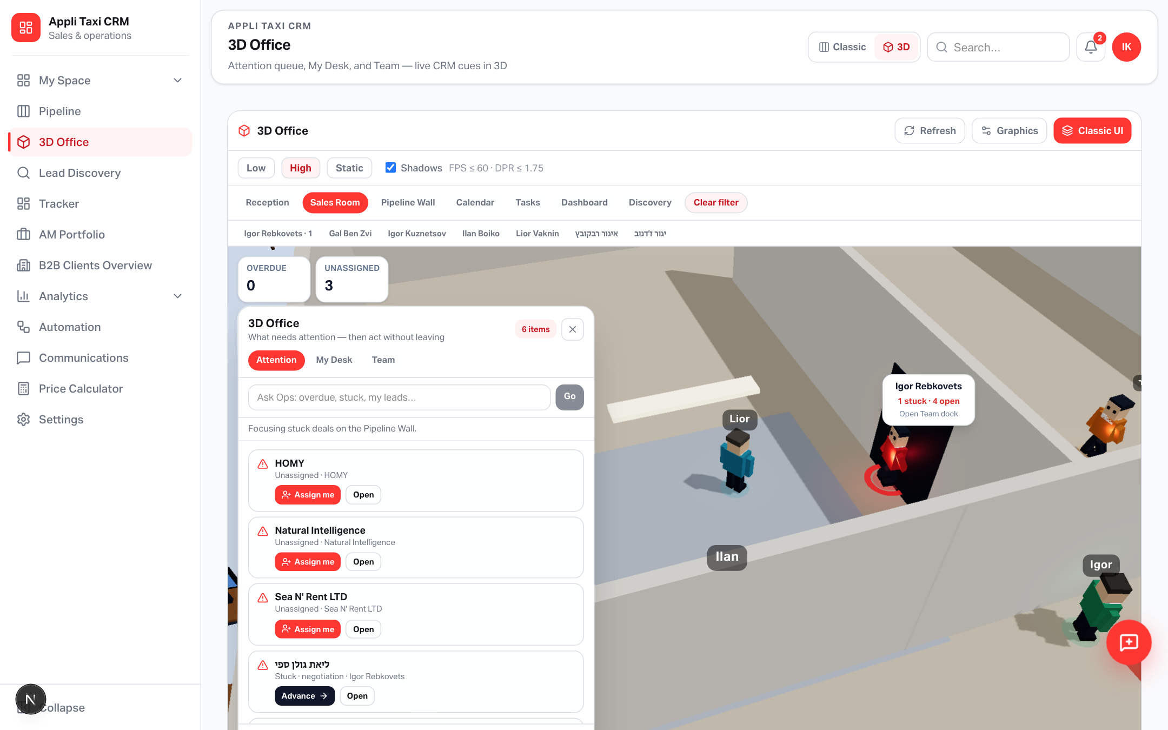
ASK OPS
Short commands → dock or classic
Try: overdue · stuck · my leads · team · pipeline · calendar
Yango · Sales Operations · Release 0.2.51 · Confidential
8 / 10

Slide 9
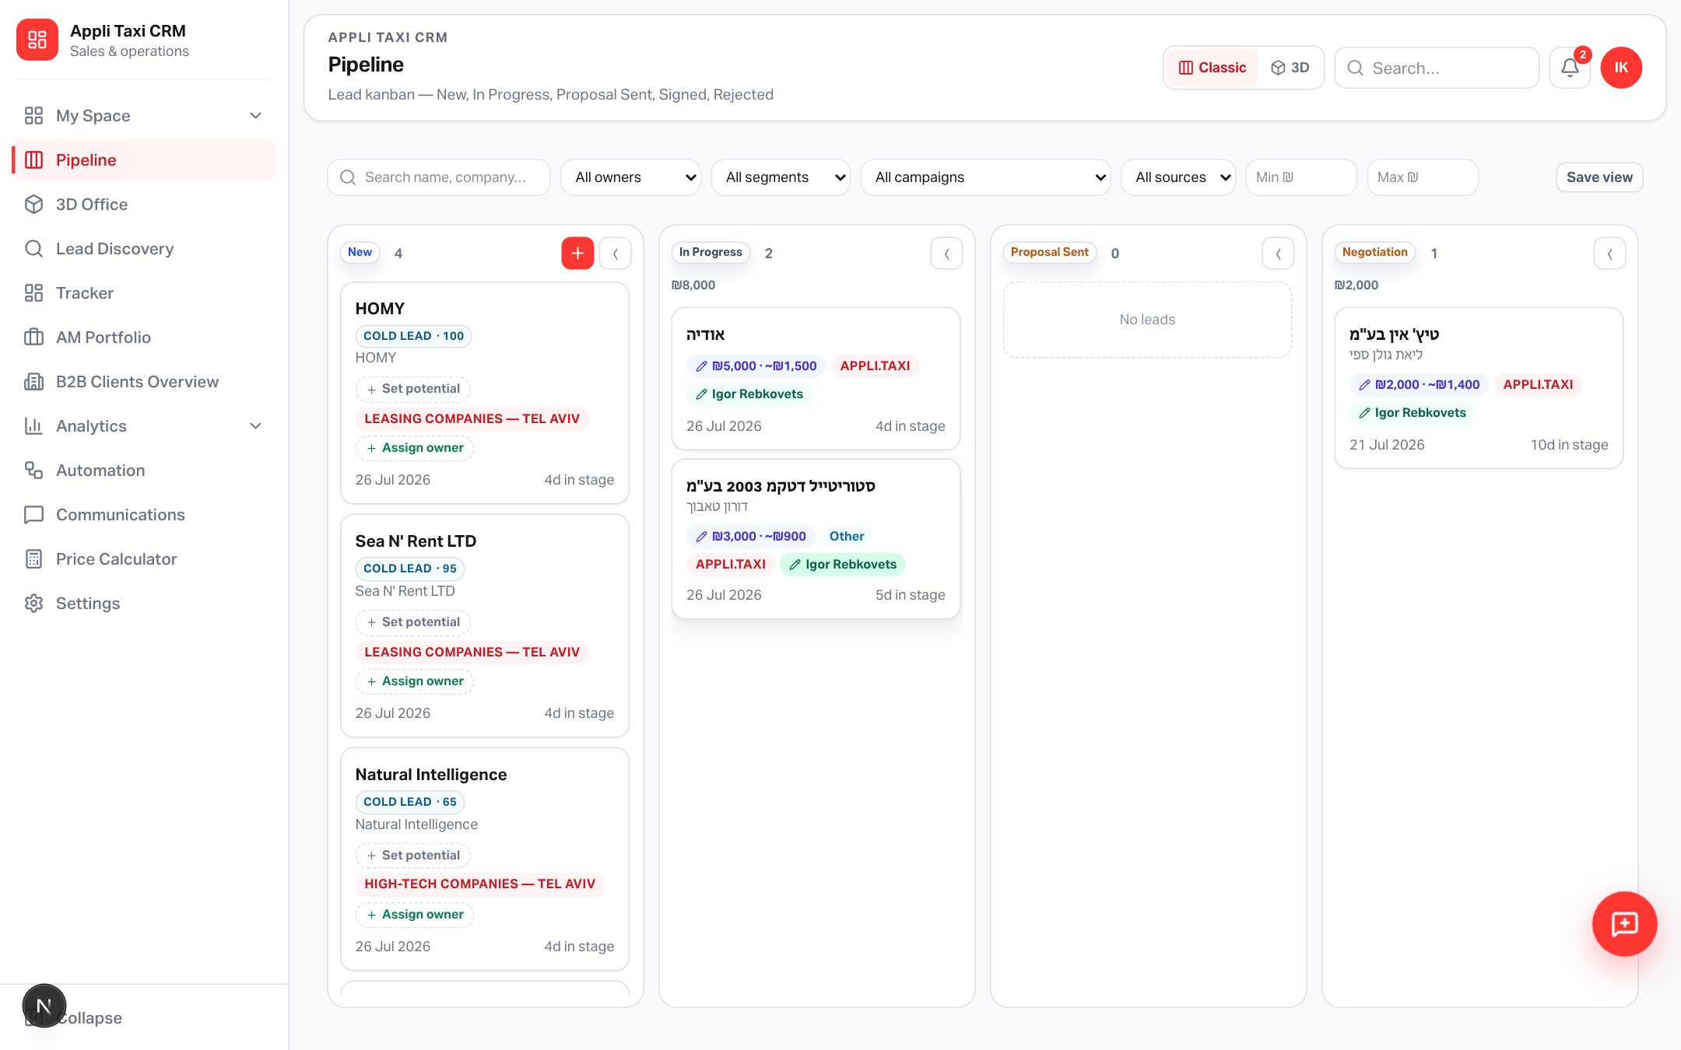
CLASSIC
3D for pulse · Classic for depth
Gates, email/SMS, Tracker, Discovery config, search stay in classic UI
Yango · Sales Operations · Release 0.2.51 · Confidential
9 / 10

Slide 10
Try it live
applitaxi.space/sales-operation/office
Close the dock anytime · reopen from the chip · managers walk with real load badges
Release 0.2.51 · Yango Sales Operations

