Slide 1

RELEASE 0.2.69
Call Center Bar Oz ready
3CX webhooks, screen-pop, Dial without FaceTime, dense Jerusalem call log + shell stage-1.
Yango · Sales Operations · Release 0.2.69 · Confidential
1 / 3

Slide 2
What's new
Bar Oz Lookup / Create / Call Report — Israel phones, fail-closed key, idempotent reports
Screen-pop drawer (~400px) with Dial + Open card; Answer is brand primary
Labeled Dial on drivers & customers — 3CX only, no tel:/FaceTime fallback
Dense call history in Asia/Jerusalem with filters
SO shell stage-1: Compact default, red rail active nav, outline toggles
Needs THREECX Call Control CLIENT_ID/SECRET for Dial; webhook secret already live
Yango · Sales Operations · Release 0.2.69 · Confidential
2 / 3

Slide 3
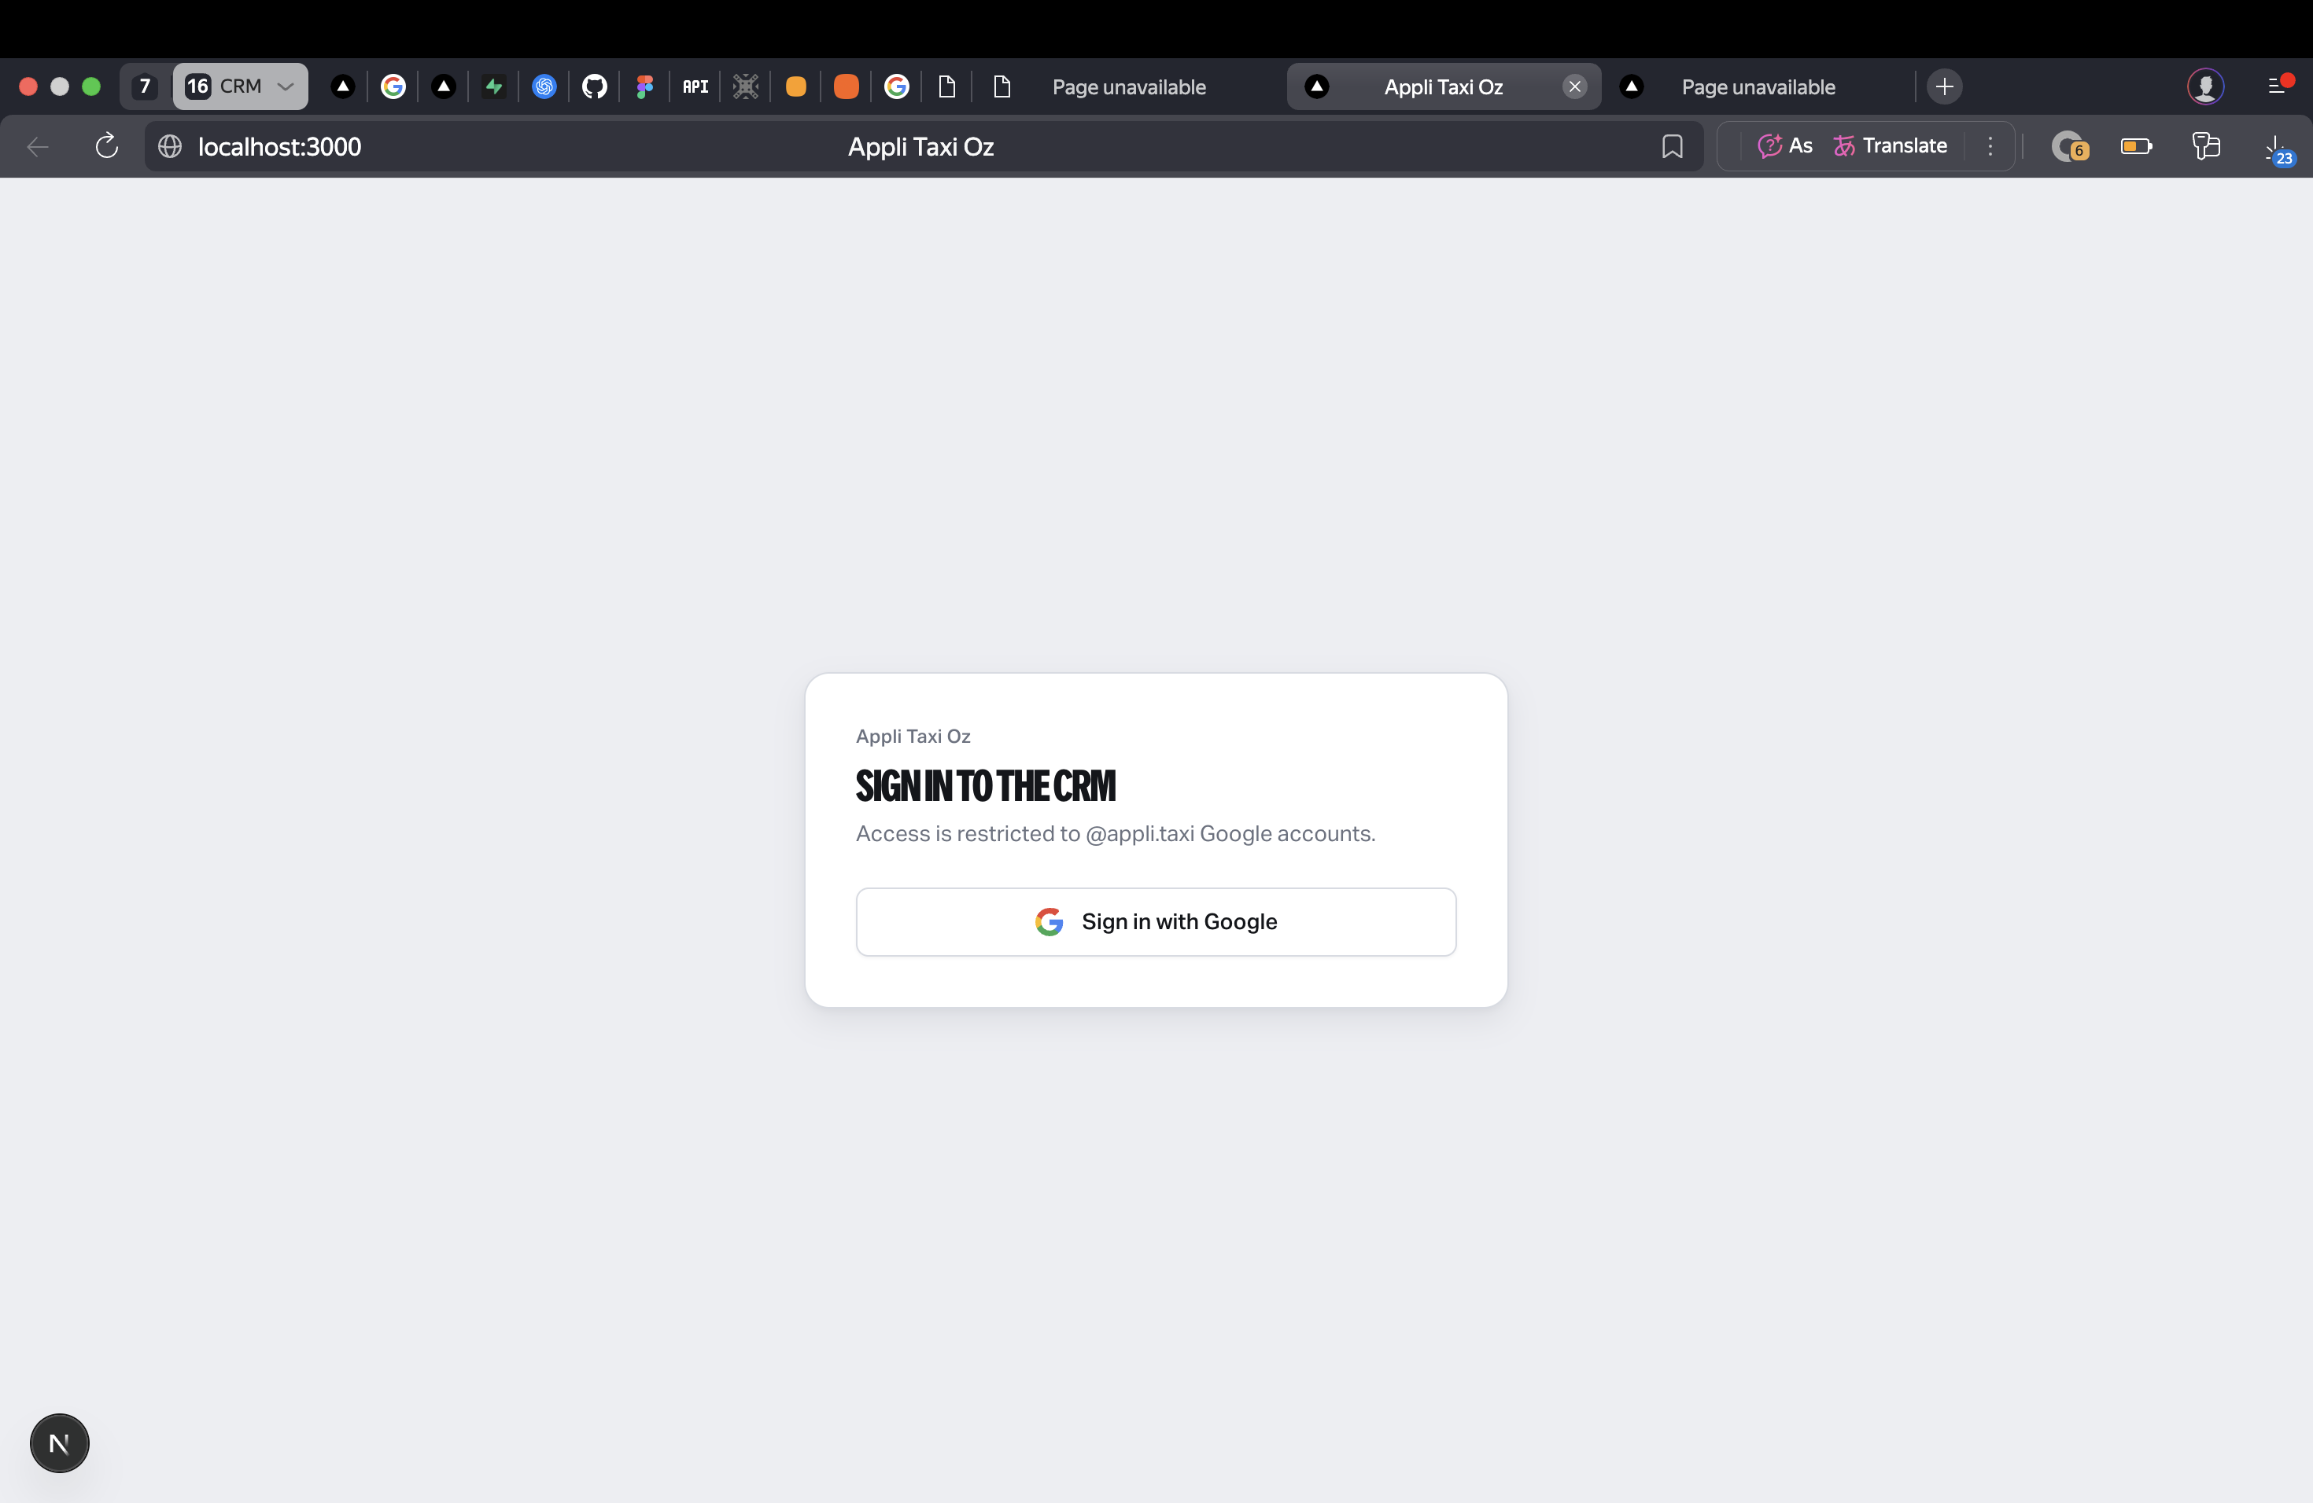
On the screen
Yango · Sales Operations · Release 0.2.69 · Confidential
3 / 3

