Slide 1
Analyzing Tackles using Oversampling and PCA against different ML Models in PySpark
Term Project by Natasya Liew U15913137
nliew@bu.edu
MET CS 777 O1 with Professor Trajanov

Slide 2
I want to analyze the different features for feature selections and compare the selected features with three different ML models to analyze the accuracy of predicting successful tackles. I intend to use k-means, logistic regression, and random forest as the models to classify successful tackles. If possible, I’d like to also explore the use of gradient boosting and/or regularization on the three models as well for parameter tuning. Based on the type of regularization model, feature removal/selection, and data cleaning, I would imagine that logistic regression will give us the best explainability in terms of correlation (or weights) of the features against prediction of successful tackles. However, random forest will probably provide the highest accuracy in terms of predicting successful tackles.
Proposed Project

Slide 3
Approach
Intended
Actual
Merge files into one dataset.
Create ‘Class’ target variable
Remove columns with more than 60% missing values, zero variance, collinearity, and non-related to the study.
Imputing missing values with missForest (then kNN).
Implementing SMOTE and PCA/Gradient Boosting
Train-Test Split and Cross Validation
Modeling using: Logistic Regression Gradient Boosting Tree, Random Forest, Decision Tree, Multilayer Perceptron Classifier, Linear SVC, NaiveBayes, kNN, and kMeans.
Calculating the metrics and analyze feature importance using correlation
Merge files into one dataset.
Create ‘Class’ target variable
Remove all rows with missing values and difficult computation.
Oversampling and PCA
Train-test Split
Modeling using: Logistic Regression, Random Forest, Decision Tree, and Linear SVC.
Calculate the metrics.

Slide 4



Research Question 1: Who are the Top 3 teams that are best at tackling?
Seattle Seahawks at first place with a total of 15,196 successful tackles within the first 9 weeks of the 2022 NFL Season.
Arizona Cardinals at second place with a total of 14,485 successful tackles within the first 9 weeks of the 2022 NFL Season.
Carolina Panthers at third place with a total of 14,360 successful tackles within the first 9 weeks of the 2022 NFL Season.

Slide 5

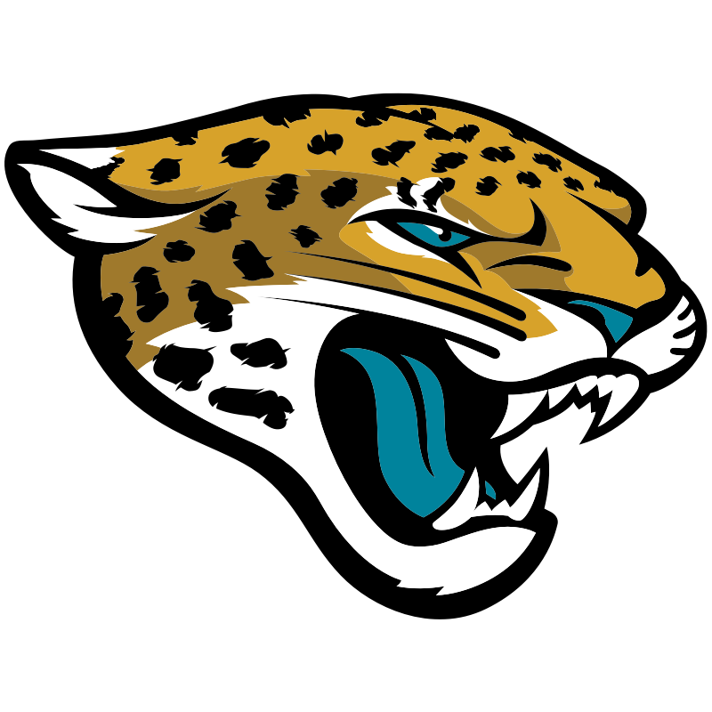
Research Question 2: Who are the Top 3 teams that are had the most missed tackles?
Houston Texans at first place with the total of 5,857 missed tackles for the first 9 weeks of the 2022 NFL Season.
Jacksonville Jaguars at second place with the total of 5,660 missed tackles for the first 9 weeks of the 2022 NFL Season.
Carolina Panthers at third place with a total of 4,872 missed tackles for the first 9 weeks of the 2022 NFL Season; telling us sometimes all you need to do is try and you might win third place in both the top successful tackles category and missed tackles category, earning yourself a valuation of USD 3.6B.

Slide 6
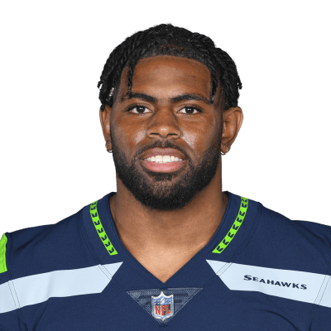
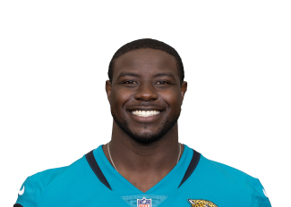
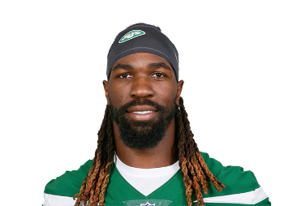
Research Question 3: Who are the Top 3 players that are best at tackling?
Jordyn Brooks from the Seattle Seahawks takes first place with 2,603 successful tackles for the first 9 weeks of the 2022 NFL Season, comprising more than 17 percent of the Seattle Seahawks total successful tackles count. When compared to the NFL statistics, it was surprising that he was not mentioned in any of the defensive player award from week 1 to 9. This tells us either that tackles are not highly rated as a contribution to the defensive player award, or that our dataset was altered.
Foyesade Oluokun from the Jacksonville Jaguars takes second place with 2,503 successful tackles for the first 9 weeks of the 2022 NFL Season, showing a promising career start after his transfer from the Atlanta Falcons to the Jacksonville Jaguars.
C.J. Mosley from New York Jets wins third place with 2,323 successful tackles for the first 9 weeks of the 2022 NFL Season. At this point, none of the three players were mentioned in the first 9 weeks defensive player award.

Slide 7
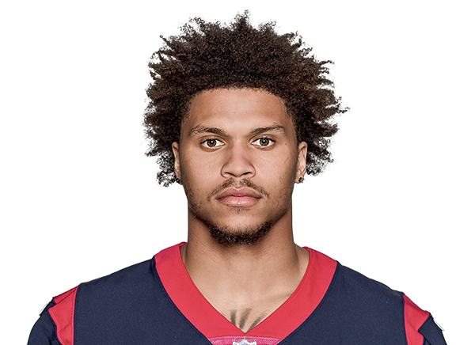
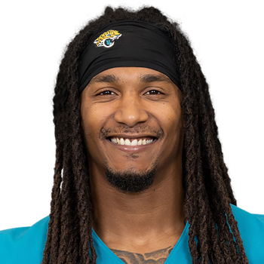
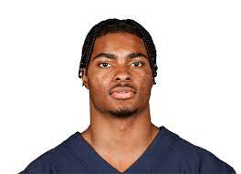
Research Question 4: Who are the Top 3 players that had the most missed tackles?
Jalen Pitre, this The Weekend lookalike wins first place with 1,280 missed tackles for the first 9 weeks of the 2022 NFL Season. Unlike his singer doppelganger, this defensive back is off to an unpromising start for Houston Texans on the 2022 NFL Season according to our dataset. Pitre taking responsibility a little below 22 percent of the Houston Texans’ missed tackles.
Rayshawn Jenkins, continuing our trend in matching lookalike, this Bob Marley Jacksonville Jaguar safety takes second place with 862 missed tackles for the first 9 weeks of the 2022 NFL Season. When comparing his statistics with the Season highlights, we saw that Jenkins did a comeback winning the title as Defensive Player of the Week on Week 15.
Jaquan Brisker, this Chris Rock lookalike, wins third place with 723 missed tackles for the first 9 weeks of the 2022 NFL Season. This Chicago Bears safety did not appear in the Players of the Week award.

Slide 8
Cleaned Dataset information
Rows: 166,324 rows
Columns: 18 columns
Target Variable Name: Class [Binary Outcome of 0 or 1]
‘0’ meaning missed tackled
‘1’ meaning successful tackle
Number of Features: 17 features

Slide 9
Cleaned Dataset Schema
root
|-- playDirection: integer (nullable = false)
|-- dis: double (nullable = true)
|-- o: float (nullable = true)
|-- dir: float (nullable = true)
|-- quarter: integer (nullable = true)
|-- down: integer (nullable = true)
|-- yardsToGo: integer (nullable = true)
|-- yardlineNumber: integer (nullable = true)
|-- preSnapHomeScore: integer (nullable = true)
|-- preSnapVisitorScore: integer (nullable = true)
|-- passLength: float (nullable = true)
|-- absoluteYardlineNumber: integer (nullable = true)
|-- defendersInTheBox: float (nullable = true)
|-- preSnapHomeTeamWinProbability: double (nullable = true)
|-- preSnapVisitorTeamWinProbability: double (nullable = true)
|-- assist: integer (nullable = true)
|-- forcedFumble: integer (nullable = true)
|-- Class: integer (nullable = true)

Slide 10
Predicted Result Schema
root
|-- pca_features: vector (nullable = true)
|-- Class: integer (nullable = true)
|-- rawPrediction: vector (nullable = true)
|-- probability: vector (nullable = true)
|-- prediction: integer (nullable = true)

Slide 11
What are the Top and Bottom 3 features to identify tackles?
Models | Best Performing Features | Worst Performing Features
Logistic Regression | preSnapHomeScore preSnapVisitorScore Down | yardsToGo playDirection distance (dis)
Random Forest | Down preSnapHomeScore orientation (o) | preSnapVisitorScore playDirection distance (dis)
Decision Tree | Down orientation (o) yardlineNumber | playDirection distance (dis) preSnapVisitorScore
Linear SVC | preSnapHomeScore preSnapVisitorScore Down | yardsToGo playDirection distance (dis)
Final Answer | Down preSnapHomeScore orientation (o) | playDirection yardToGo distance(dis)
Research Question 5 & 6:

Slide 12
Random Forest
Research Question 7: Which model is the best to predict a successful Tackle?

Slide 13
Use precision, confusion matrix, TPR, TNR, F1-Score, and Accuracy of each model using PCA.
 | Logistic Regression | Random Forest | Decision Tree | Linear SVC (SVM)
Precision | 57.715% | 66.563% | 68.901% | 59.087%
Accuracy | 57.195% | 63.949% | 61.392% | 57.095%
F1-Score | 55.844% | 61.109% | 51.977% | 52.463%
Recall/TPR | 54.091% | 56.481% | 41.727% | 47.175%
TNR | 60.305% | 71.461% | 81.113% | 67.089%
Rank of Performance | 3 | 1 Best | 2 | 4
Research Question 8

Slide 14
Key Findings
You imputing missing values have limited options if you’d like to you the PySpark packages
Same goes for Class balancing packages.
Other than PCA, the feature package from the PySpark ML library is quite decent.
It is very difficult to code with pure PySpark, it would be interesting to see how well the code can run or how bad the code can run while introducing other Python libraries to it.
Tackles is not the only contributor to how good/bad a club or a player is for the season.
There are still a lot of of biases within our study that we can fix.
Because we removed a lot features manually like birthdate, height, weight, and position, the dataset became more about identifying features that contribute to successful tackles for the team rather than the player. This might have been a good thing.

Slide 15
Video Links
https://www.loom.com/share/b5b5a08bb9904b8b9498b9c90c219fef

