Slide 1

CS-665 Final Project
RPG Character Creation System designed with Software Design Patterns
Created by Natasya Liew U15913137
Spring 2025
Notes:
Created by Natasya Liew U15913137

Slide 2
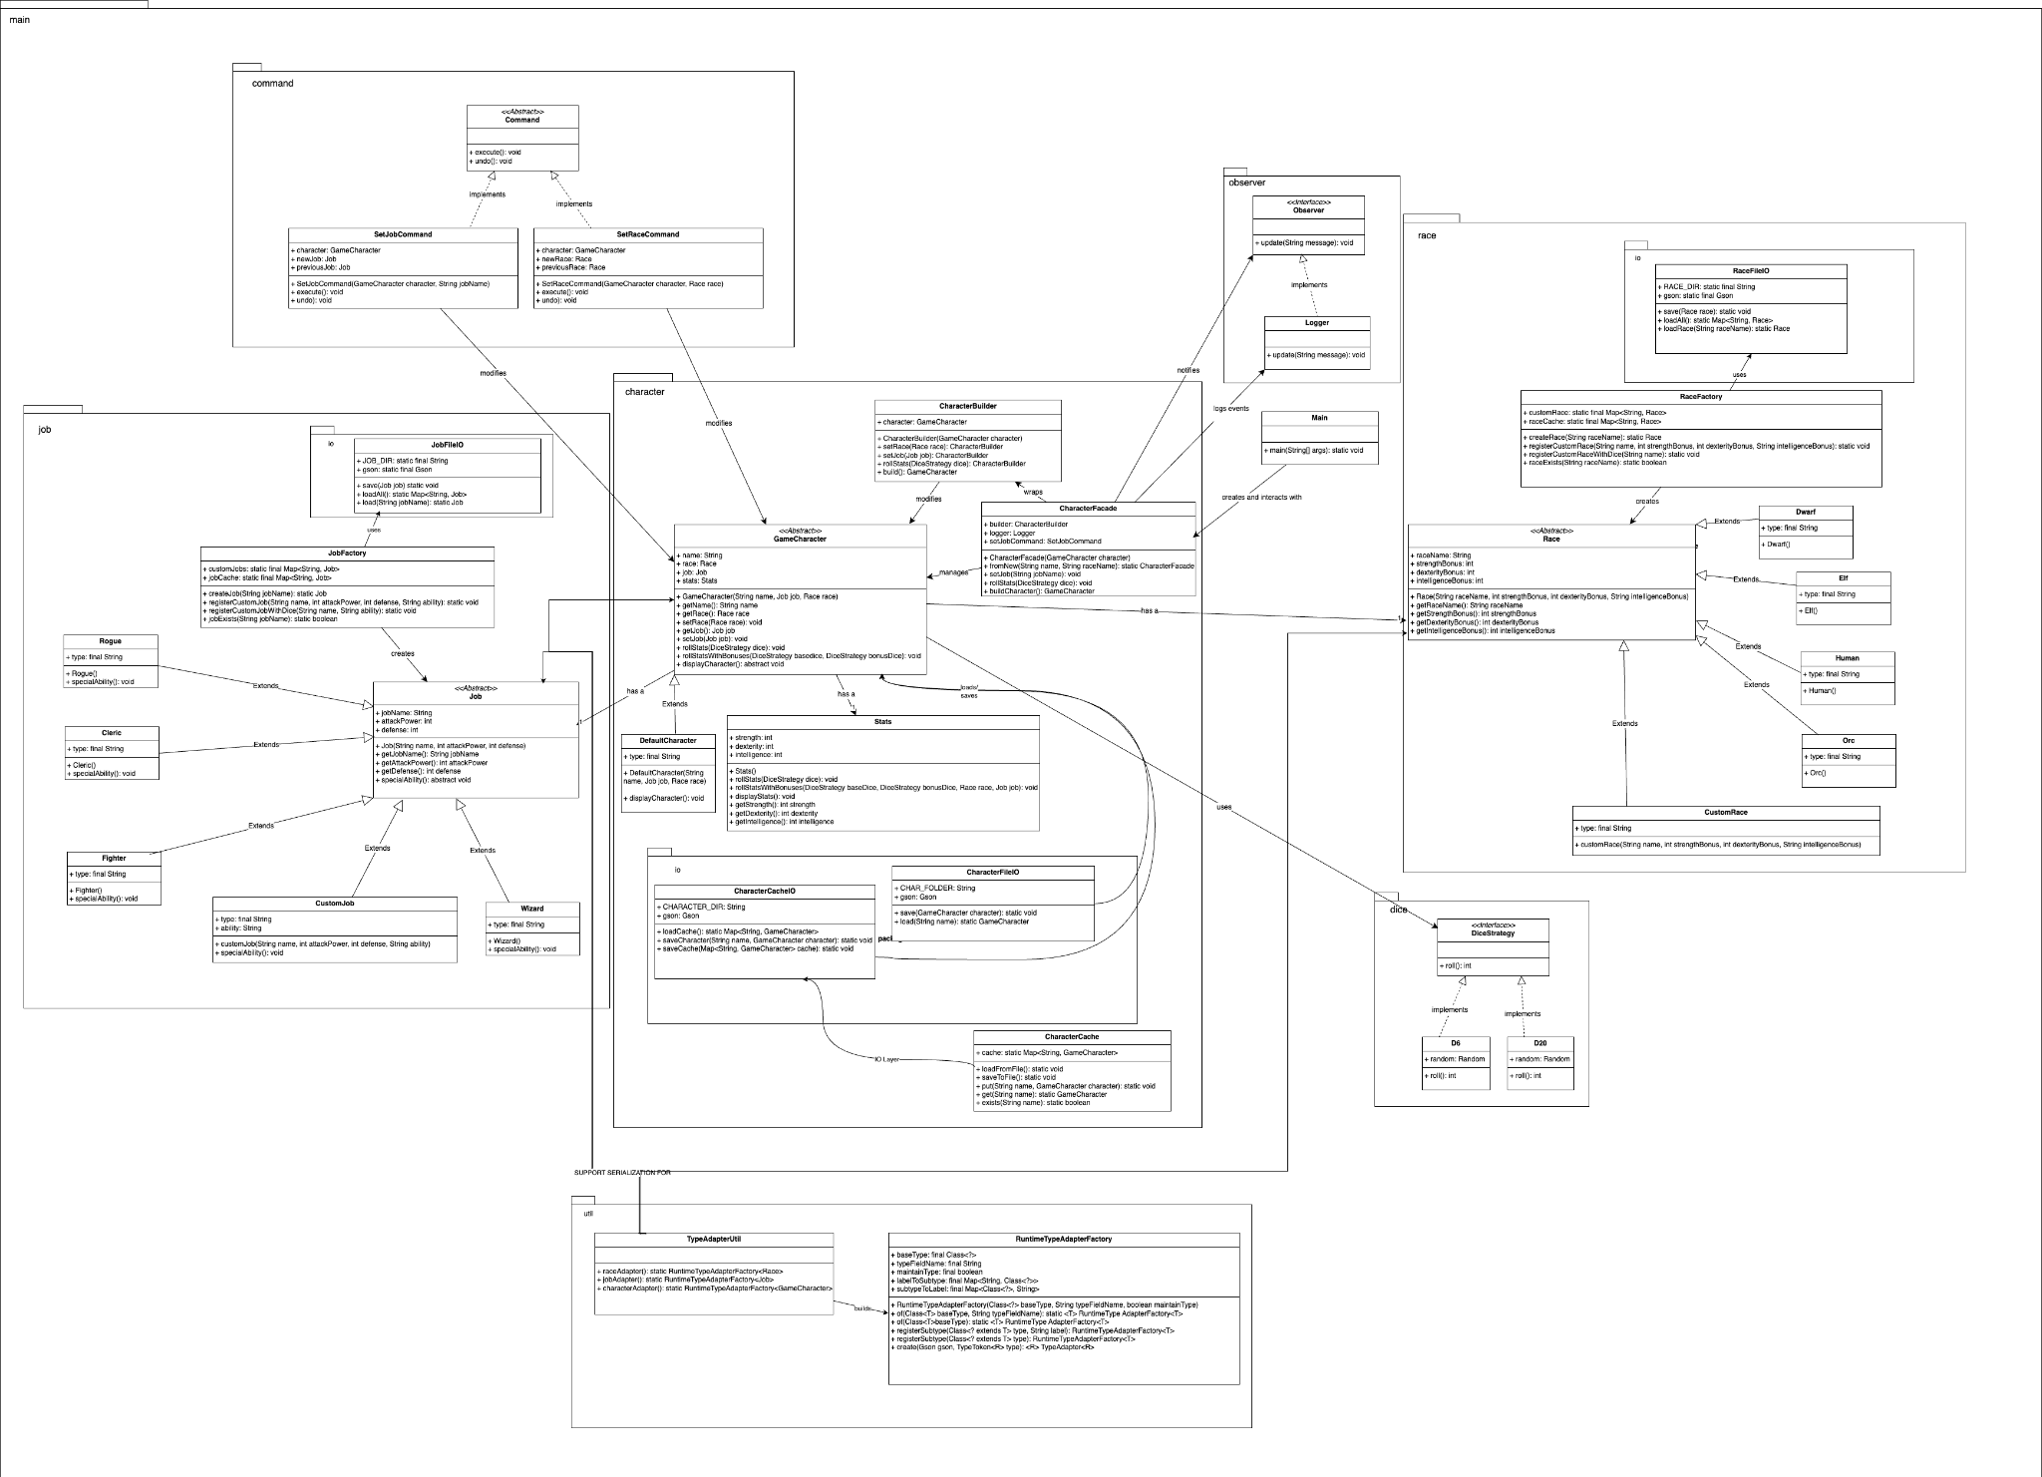
System Architecture
Notes:
The system is organized around OOP principles, with abstract base classes and polymorphism. We use Builder, Factory, and Facade to separate responsibilities cleanly.

Slide 3
Design Patterns Used
• Factory Pattern (RaceFactory, JobFactory)
• Builder Pattern (CharacterBuilder)
• Facade Pattern (CharacterFacade)
• Strategy Pattern (D6, D20)
• Command Pattern (SetJobCommand, SetRaceCommand)
• Observer Pattern (Logger)
• Adapter Pattern (RuntimeTypeAdapterFactory)
• Cache Pattern (CharacterCache)
Notes:
These design patterns were carefully selected to manage complexity, enable extensibility, and enforce best practices in software architecture.

Slide 4
Summary
Pattern | Used In | Why It Was Needed
Factory | JobFactory, RaceFactory | To create built-in and custom jobs/races without modifying existing logic. Supports open/closed principle.
Builder | CharacterBuilder | To construct GameCharacter objects step-by-step with clear control over attributes.
Facade | CharacterFacade | To simplify character creation by exposing a unified interface and hiding complexity.
Strategy | DiceStrategy, D6, D20 | To allow interchangeable dice logic for rolling stats. Promotes flexibility and reusability.
Command | SetJobCommand, SetRaceCommand | To encapsulate job/race changes and enable undo/redo functionality (extensible).
Observer | Logger | To decouple logging from character logic and track key updates in real time.
Adapter (Gson) | RuntimeTypeAdapterFactory + TypeAdapterUtil | To enable polymorphic serialization of abstract types (Race, Job, GameCharacter).
Cache | CharacterCache, CharacterCacheIO | To avoid reloading JSON files repeatedly and improve performance.

Slide 5
Factory Pattern Sample
public static Job createJob(String jobName) {
switch (jobName.toLowerCase()) {
case "fighter": return new Fighter();
case "wizard": return new Wizard();
...
default:
return customJobs.get(jobName.toLowerCase());
}
}
Centralizes object creation to avoid hardcoding job instantiation across the codebase.
Makes it easy to add new Job types without modifying external logic — just extend the class and update the factory.
Promotes Open/Closed Principle: code is open for extension, closed for modification.
Notes:
JobFactory.java, RaceFactory.java

Slide 6
Builder Pattern Sample
CharacterBuilder builder = new CharacterBuilder(character);
builder.setRace(race).setJob(job).rollStats(dice);
GameCharacter result = builder.build();
Used to gradually construct complex objects (GameCharacter) step-by-step.
Prevents constructor overloads by breaking down into logical, chainable actions.
Helps maintain clean and flexible character creation workflows.
Notes:
CharacterBuilder.java

Slide 7
Façade Pattern Sample
CharacterFacade facade = CharacterFacade.fromNew("hero", "elf");
facade.setJob("rogue");
facade.rollStats(new D20(), new D6());
GameCharacter character = facade.buildCharacter();
Hides internal complexity of multiple components (builder, job/race setting, stats) behind a single interface.
Simplifies usage of multiple patterns for the end user or main application.
Encourages separation of concerns and better encapsulation.
Notes:
CharacterFacade.java

Slide 8
Strategy Pattern Sample
public interface DiceStrategy {
int roll();
}
public class D20 implements DiceStrategy {
public int roll() { return new Random().nextInt(20) + 1; }
}
Allows switching between different dice-rolling algorithms (e.g., D6 vs D20) at runtime.
Enables testing and tuning of stat systems without changing underlying character code.
Encourages modularity and reuse of logic.
Notes:
DiceStrategy.java, D20.java, D6.java

Slide 9
Command Pattern Sample
Command setJob = new SetJobCommand(character, "wizard");
setJob.execute();
Encapsulates job change actions as objects, supporting undo/redo operations.
Useful for history tracking, debugging, and flexible game state management.
Promotes extensibility, as new commands can be added without touching the core logic.
Notes:
setJobCommand.java, setRaceCommand.java, Command.java

Slide 10
Observer Pattern Sample
Logger logger = new Logger();
logger.update("Job set to: wizard");
Separates logging/monitoring concerns from business logic.
Makes the system extensible for future observers (e.g., UI update, analytics).
Keeps core logic clean and decoupled from side effects.
Notes:
Logger.java, Observer.java

Slide 11
Polymorphic Serialization
(Gson Type Adapter Factory)
Gson gson = new GsonBuilder()
.registerTypeAdapterFactory(TypeAdapterUtil.characterAdapter())
.create();
It adapts the generic Gson deserializer to handle abstract or interface types (Race, Job, GameCharacter).
Without it, Gson cannot directly instantiate subclasses of abstract classes like Race or Job.
Crucial for saving custom job/race and characters to the assets folder (supplement cache)
Notes:
RuntimeTypeAdapterFactory.java, TypeAdapterUtil.java

Slide 12
Caching Pattern Sample
CharacterCache.put("natasya", character);
GameCharacter cached = CharacterCache.get("natasya");
CharacterCache.put("hero", character);
CharacterCache.get("hero");
Improves performance and reduces file I/O by reusing in-memory character data.
Supports quick lookups and preloading without repeatedly deserializing files.
Useful in games for fast access to previously used objects.
Notes:
CharacterCache.java

Slide 13
Best Practices & Quality
• JSON-based character persistence
• Modular and reusable codebase
• Javadoc-style documentation
• Defensive programming and exception handling
• Consistent checkstyle (Google Java)
• No SpotBugs issues
Notes:
We followed good software engineering principles, ensured documentation, static analysis compliance, and implemented modularity and reuse throughout the codebase.

Slide 14
Key Learning Points
Design patterns don't always simplify implementation upfront
  Initially, patterns like Facade, Command, and Factory introduced more boilerplate code.
  But they significantly reduced coupling, which made the code much easier to fix and extend when bugs appeared.
Adding features became more modular and intuitive
  New races and jobs could be added via JSON without touching core logic—thanks to Factory Pattern + RuntimeTypeAdapterFactory.
  Supporting undo/redo or multiple dice configurations was just a matter of adding new classes implementing existing interfaces.
Refactoring was painful but extremely rewarding
  Refactoring across patterns (like consolidating dice rolls or serializing objects) introduced a risk of bugs.
  But after refactoring, the system became cleaner, scalable, and much easier to reason about.
Pattern composition was powerful
  Builder + Facade helped manage the step-by-step creation of characters.
  Strategy + Factory enabled dynamic behaviors and new logic without modifying existing implementations.
Debugging and testing became focused
  Patterns enabled clear separation of concerns, making it easier to write unit tests per class.
  Bugs were often isolated to specific modules, reducing debugging scope.
Polymorphic serialization was non-trivial
  Implementing RuntimeTypeAdapterFactory required deep understanding of abstract types and Gson's limitations.
  Once working, it enabled seamless save/load for any Job, Race, or Character.
Observer pattern encouraged good side-effect management
  Logging was cleanly abstracted, allowing you to observe important changes without touching business logic.
Overall: Patterns enhanced maintainability and scalability
  The final codebase was ready for growth, allowing other devs to add new classes or features without risk.
  Design patterns made the system more testable, clean, and future-proof.

Slide 15
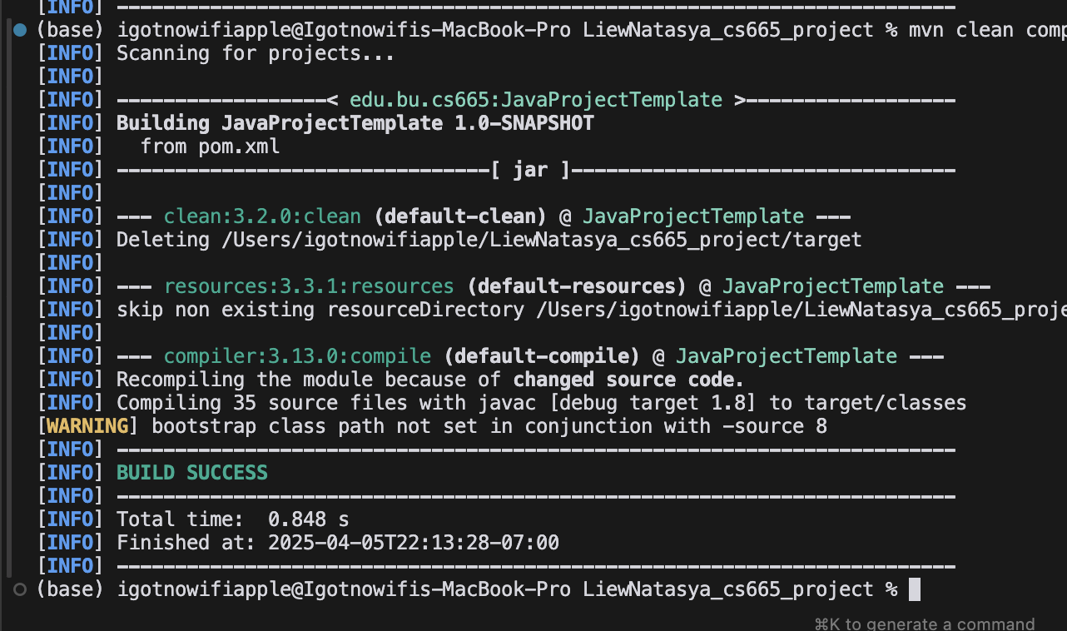
Compile & Build (Maven)
Notes:
Using Maven ensures reproducibility and dependency management. Compilation completes without warnings or errors.

Slide 16
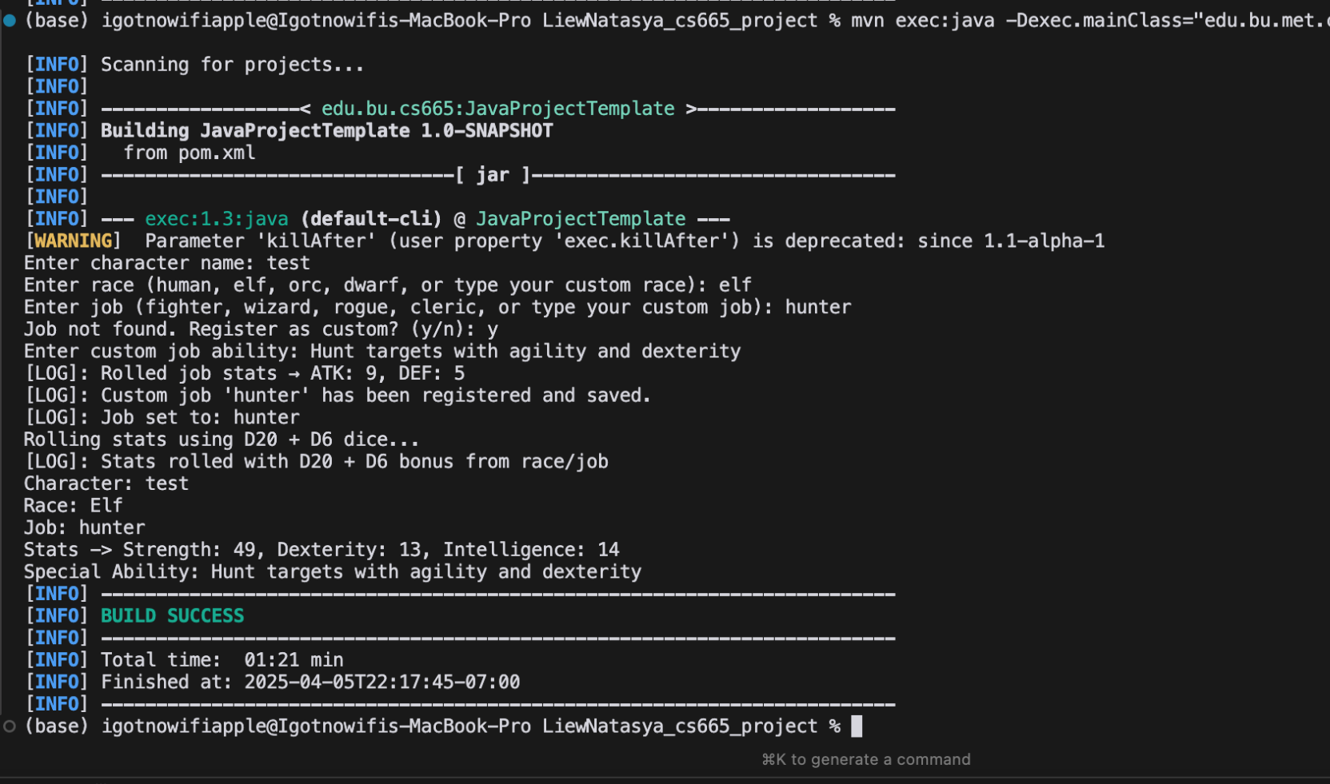
Run Output Demo
Notes:
This shows the user flow of inputting a race/job, dynamic creation, and character output including stats and abilities.

Slide 17
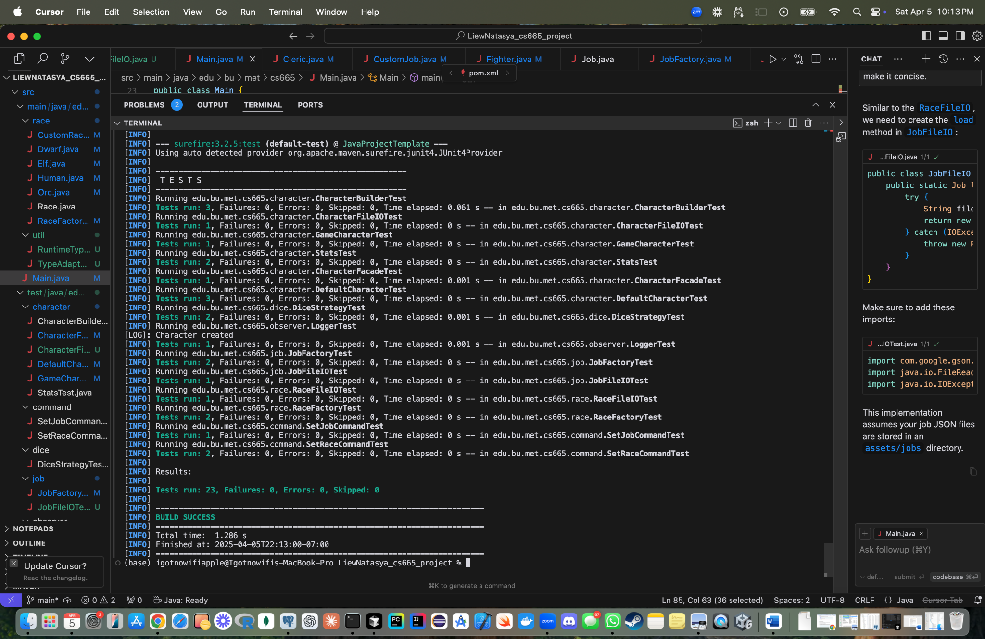
JUnit Testing
Notes:
All unit tests passed successfully. We covered factories, file IO, facade, commands, and race/job classes with over 20 test cases.

Slide 18
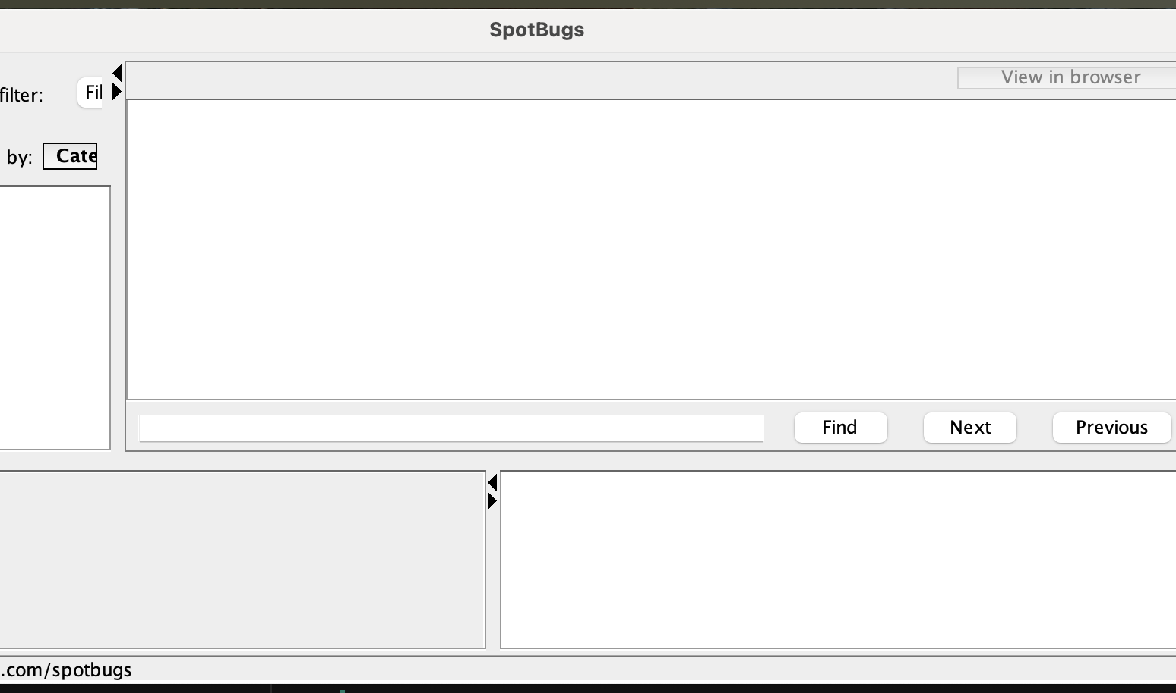
SpotBugs Scan
Notes:
Static analysis confirms zero critical or major issues. SpotBugs integration improves overall code safety.

Slide 19
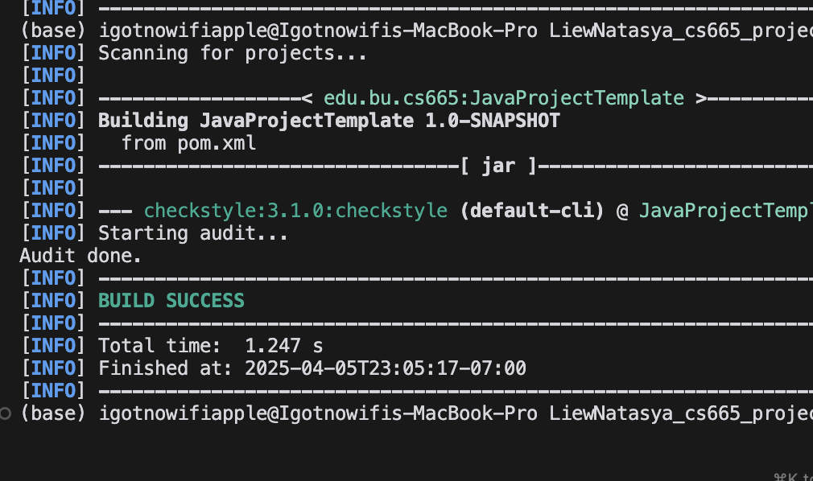
Checkstyle Validation
Notes:
The codebase is compliant with Google Java Style and customized rules. This improves code maintainability.

