Slide 1

Quality Management System (QMS) Workflow
Pharmaceutical Manufacturing
API Example: Paracetamol API · FDF Example: Paracetamol 500 mg Tablet
PREPARED BY PRIYANSHU NEGI
AIVOA.AI HIRING PRESENTATION

Slide 2
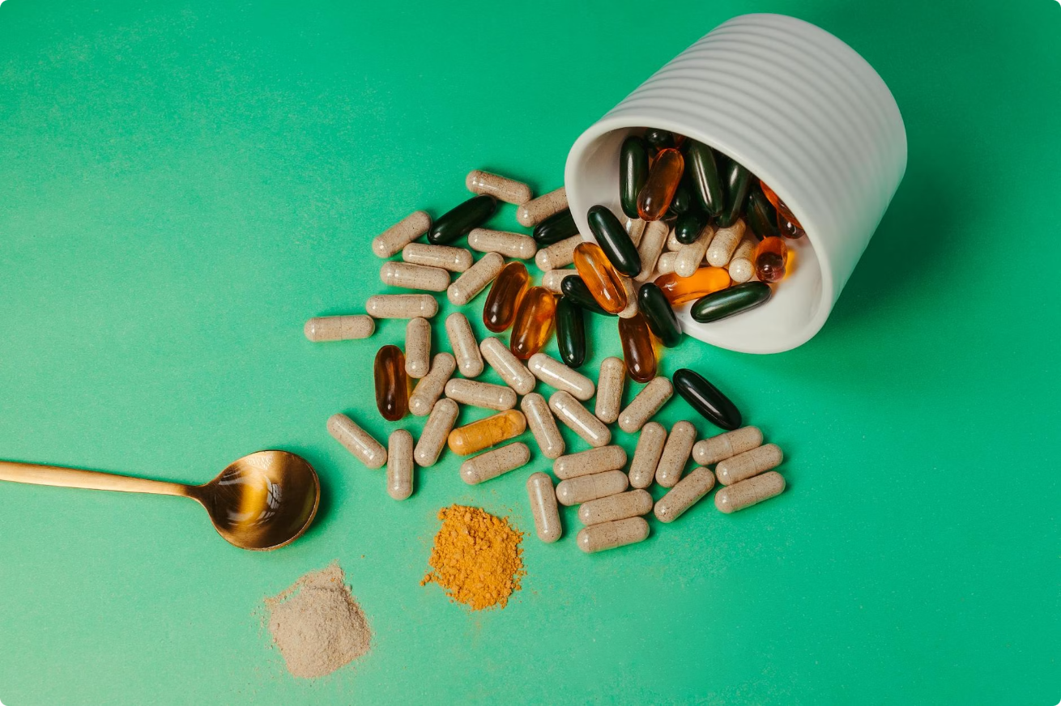



What are API and FDF?
API — Active Pharmaceutical Ingredient
The active substance responsible for the therapeutic effect of a medicine.
Example: Paracetamol API Powder
FDF — Finished Dosage Form
The final medicine consumed by patients.
Example: Paracetamol 500 mg Tablet
Manufacturing
Formulation and tablet production
Paracetamol API
Paracetamol Tablet
Powdered active ingredient
500 mg finished dosage form
The API undergoes controlled manufacturing to become the final finished dosage form consumed by patients.

Slide 3
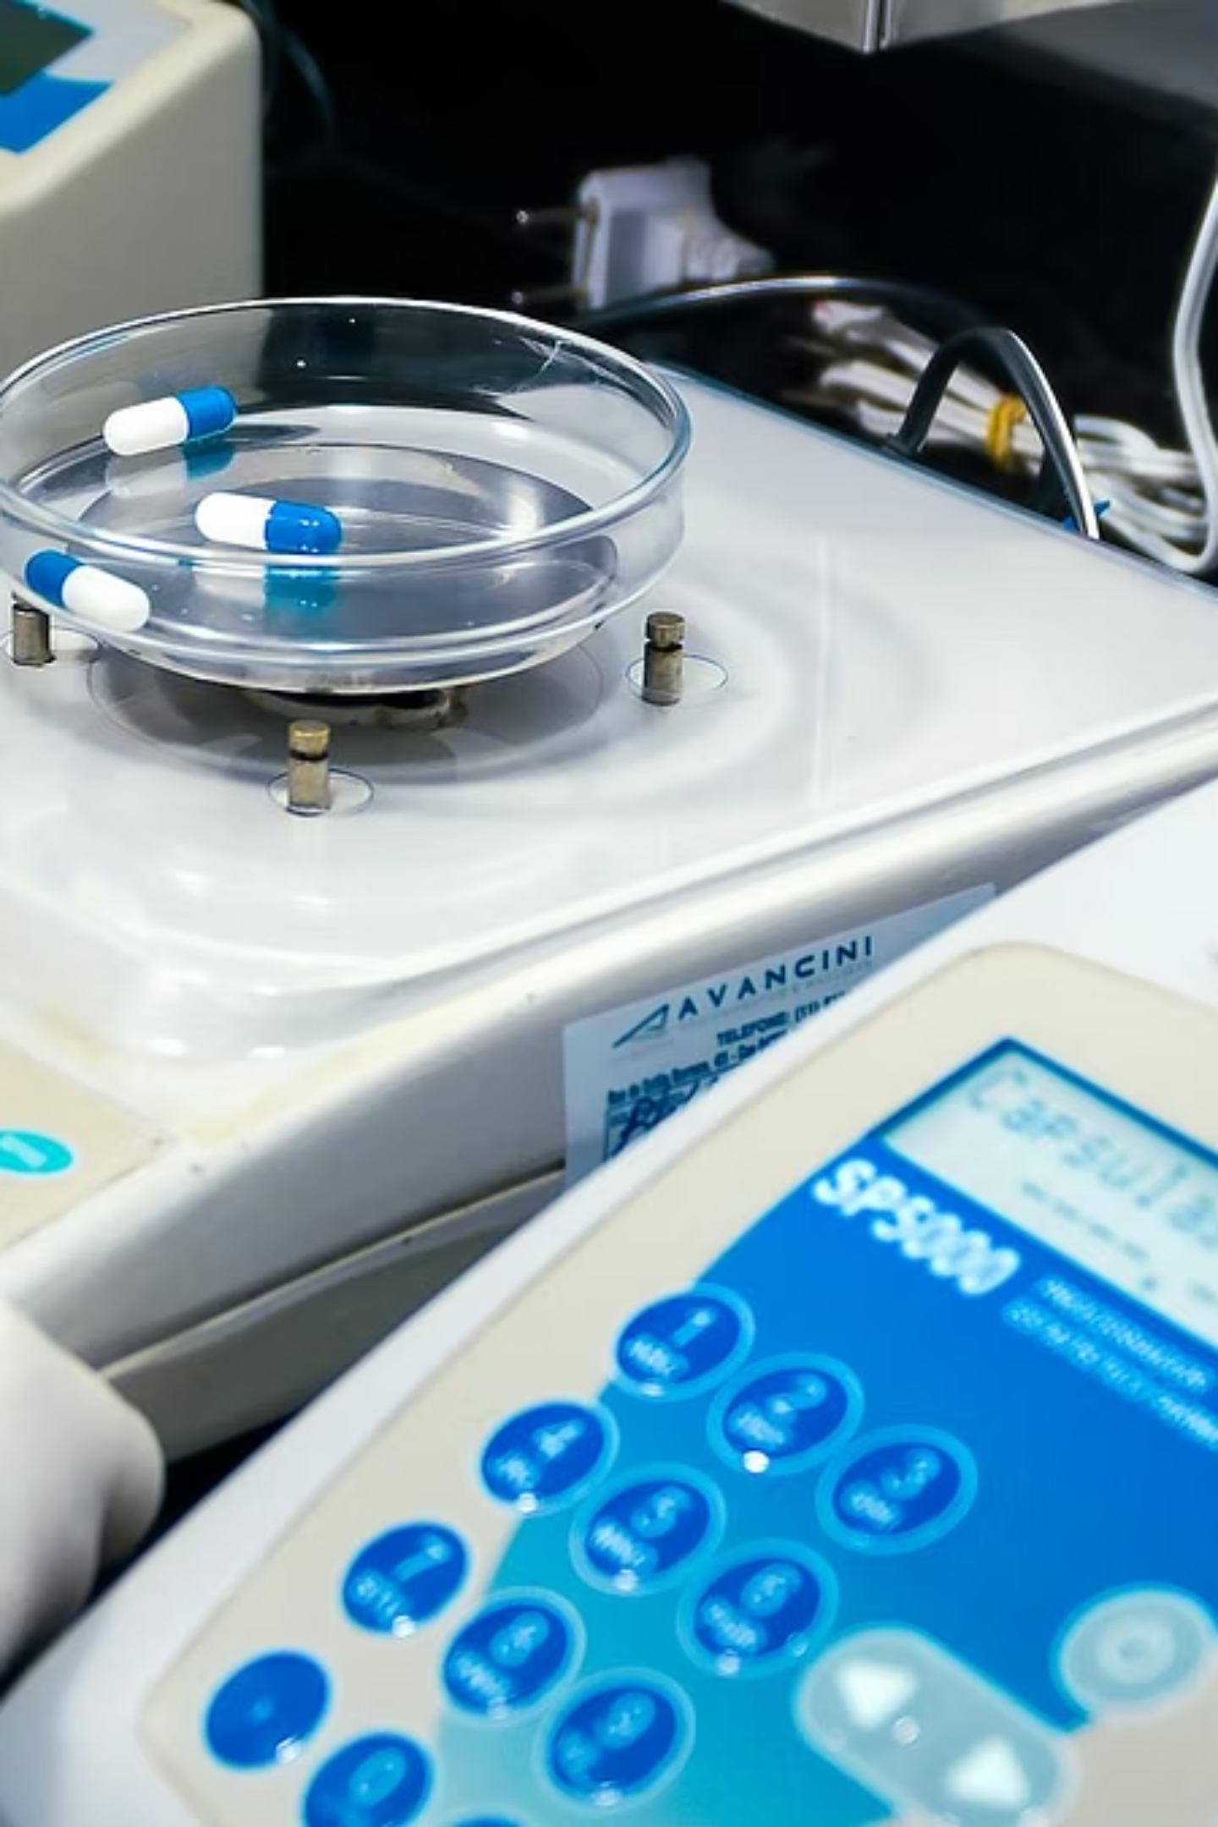


Manufacturing Process & Quality Checks
Step 1: Raw Material Inspection
Identity Testing
Purity Testing
Moisture Testing
QMS Module: Quality Control (QC)
Step 2: Tablet Manufacturing
Tablet Weight
Hardness
Dissolution
Appearance
QMS Module: In-Process Quality Checks

Slide 4


Deviation Management
⚠ Scenario
Expected: 500 mg ± 5%
Actual: 550 mg — exceeds acceptable limit.
QMS Actions
01
Raise Deviation Record
02
Investigate Root Cause
03
Document Findings
QMS Module: Deviation Management

Slide 5
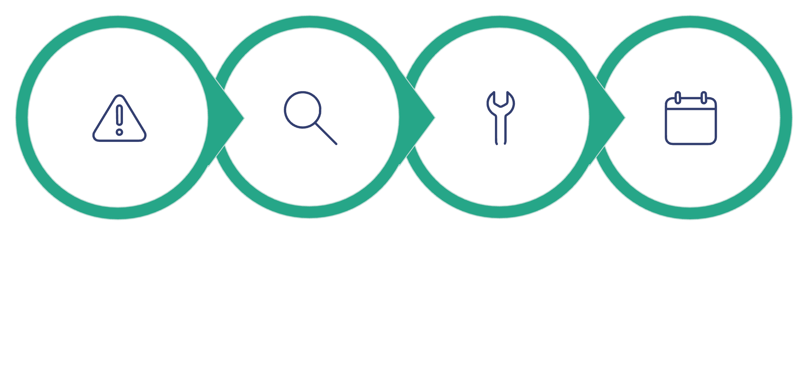
CAPA Process
Root Cause: Machine Calibration Issue
Issue Identified
Investigation
Corrective Action
Preventive Action
The CAPA process ensures issues are not only resolved but prevented from recurring.
Corrective Actions
Preventive Actions
Recalibrate Machine
Recheck Tablet Weight
Weekly Calibration Schedule
Additional Quality Reviews
QMS Module: CAPA Management

Slide 6
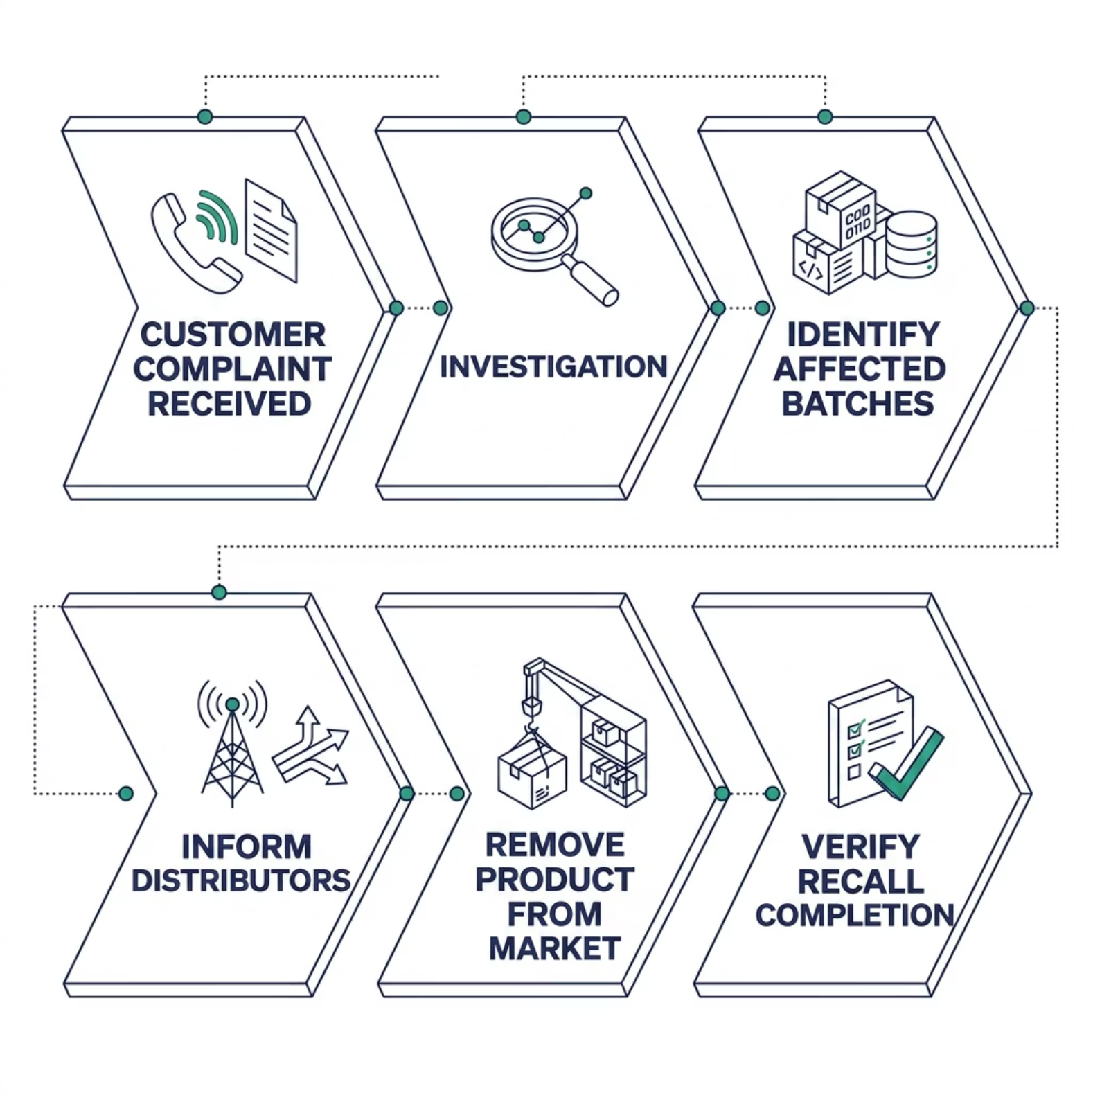
Recall Management Process
Patient Safety First
When a quality issue is identified post-distribution, the recall process ensures swift, coordinated action to protect patients.
Triggered by customer complaint or internal finding
Affected batches identified and isolated
Distributors notified and product removed
Recall completion verified and documented
QMS Module: Recall Management

Slide 7
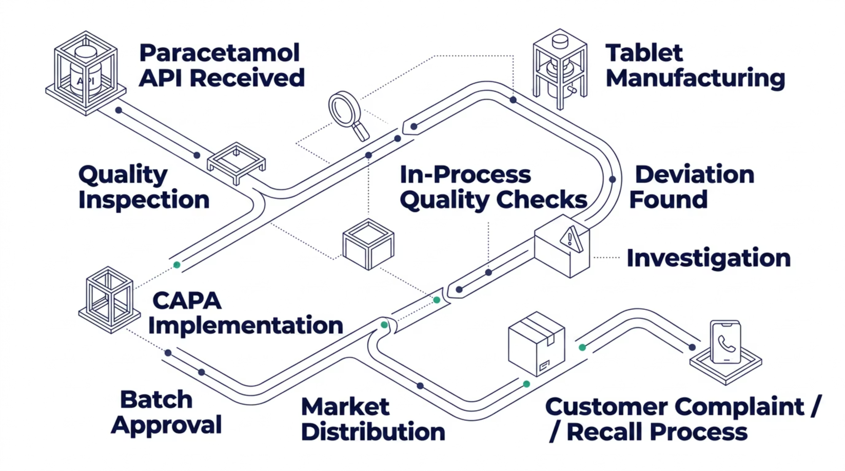
End-to-End QMS Workflow
Every stage is governed by a QMS module, ensuring traceability, compliance, and patient safety from raw material to market.

Slide 8





Key Learnings
Quality Control
Deviation Management
CAPA Management
Batch Approval
Recall Management
"This workflow demonstrates how pharmaceutical manufacturers use QMS processes to ensure safe and effective medicines reach patients."
QMS helps manufacturers maintain product quality, regulatory compliance, patient safety, and continuous process improvement throughout the product lifecycle.

