Slide 1
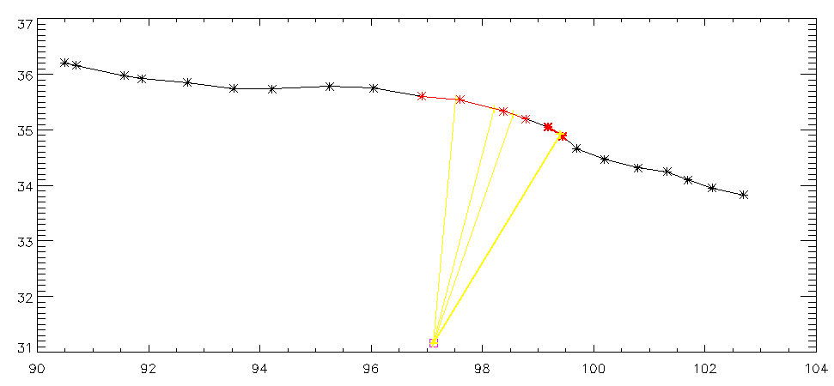
Special Case: Multiple results
Auto_strike=1 ;vary along strike (perpendicular to each fault segment)
Return the nearest one

Slide 2
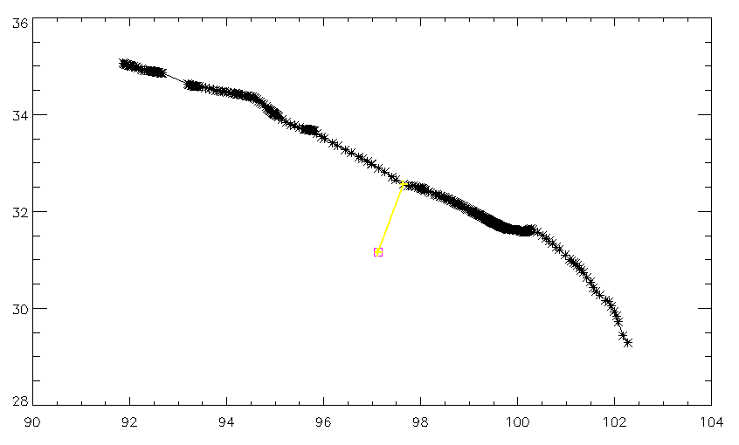
Special Case: NO matching results
Auto_strike=1
Return the nearest vertex

Slide 3
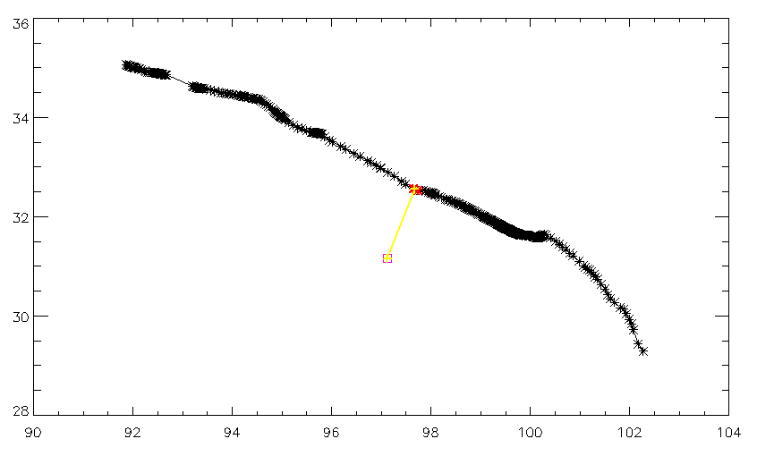
Special Case: NO matching results
Auto_strike=2
On the polyline

