Slide 1

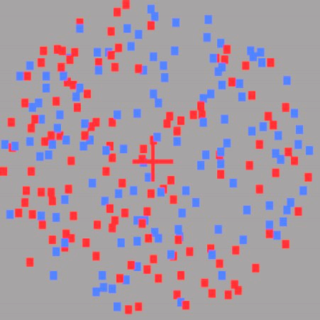
“Blue!”
3.25s

Slide 2
PRACTICE
€
5 Blocks of 40 trials
BASELINE
4 Blocks of 50 trials
TRAINING
4 Blocks of 50 trials
TEST
4 Blocks of 50 trials

Slide 3
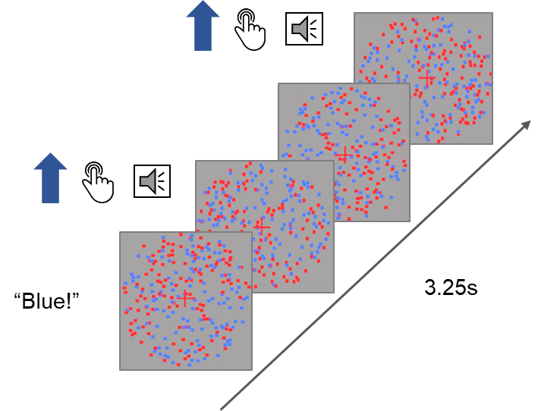
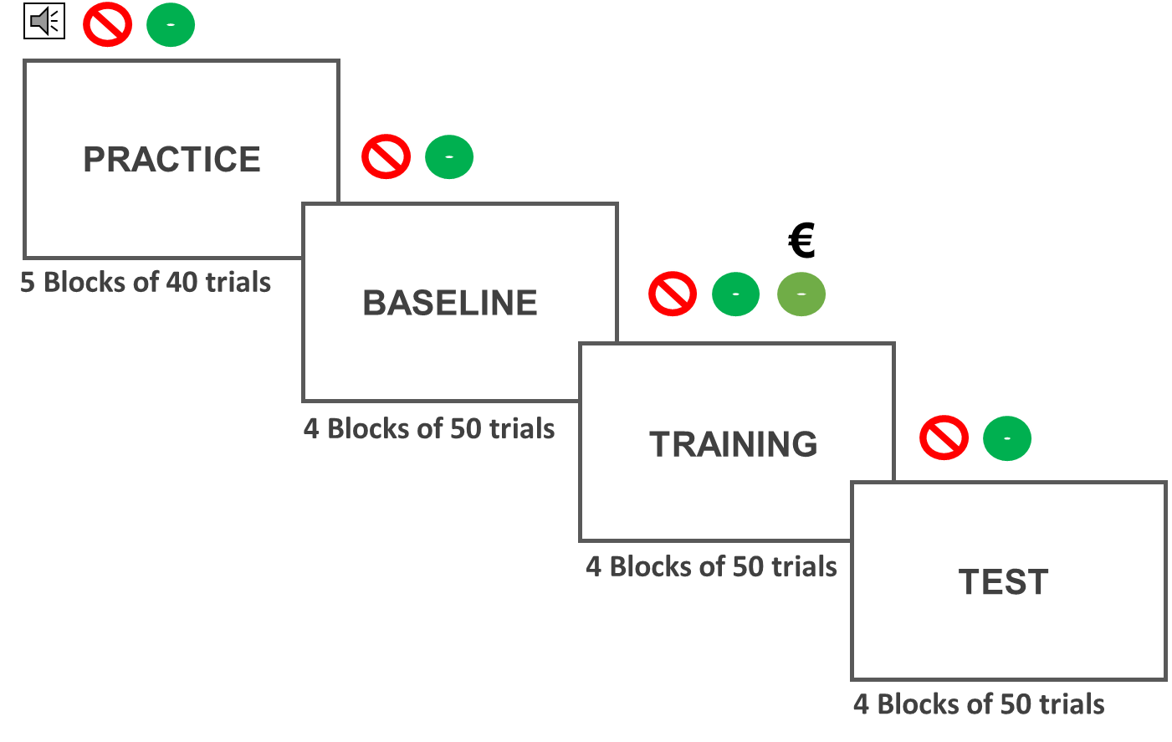
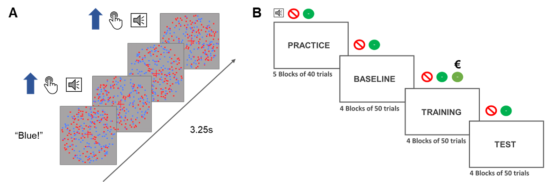
A
B

