Slide 1
Interview Scenario May 3rd, 2023
Isabelle Grenier

Slide 2
Agenda
Understanding any relation between 5-year survival and available covariates
Data overview
5-year survival logistic regression model
Accelerated failure time model (Weibull regression model)
Understanding the association between genes and patient survival
Data overview
Correlation exploration
Principal component analysis exploration

Slide 3
Part I
Understanding any relation between 5-year survival and available covariates

Slide 4
Data Overview
Available Covariates
Gender
Age at diagnosis
Ethnicity and race
Year of diagnosis
Disease stage

Slide 5
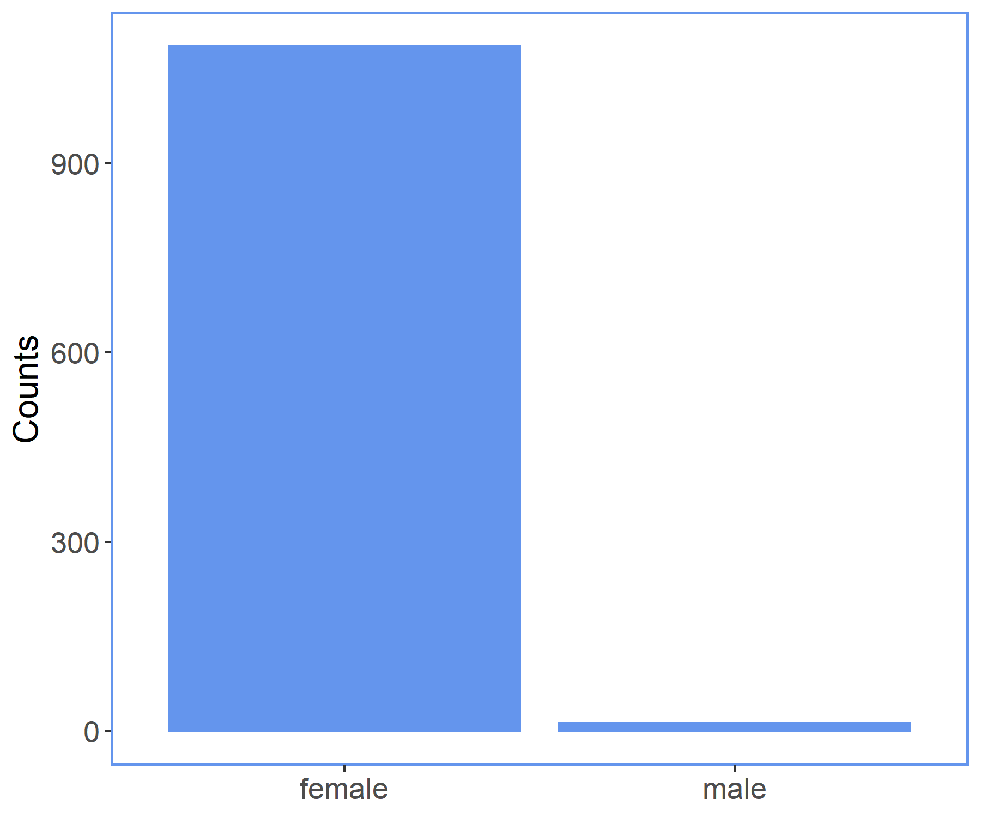
Data Overview
Gender
Type | Categorical (Nominal)
Range | Female, Male
Missing Values | Yes
Notes | Imbalance between categories is consistent with 1% of breast cancer cases being male No “events” in the male population: decided to remove male cases for the remaining of the analysis

Slide 6
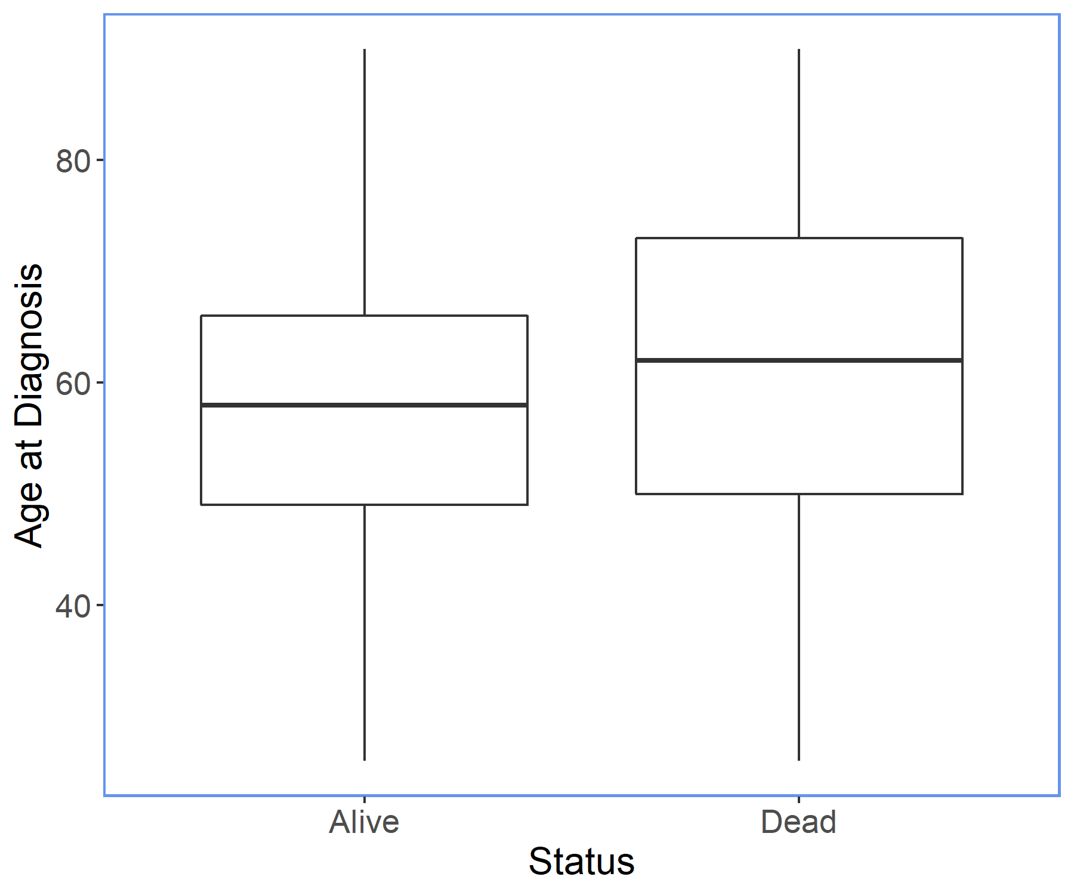
Data Overview
Age at Diagnosis
Type | Numeric (Continuous)
Range | 26 to 90
Missing Values | Yes
Notes | Available rounded to years (age at index) and available in days (days to birth, age at diagnosis) Could be treated as continuous or grouped
Notes:
Mention the median, and that the distribution is somewhat symmetric

Slide 7
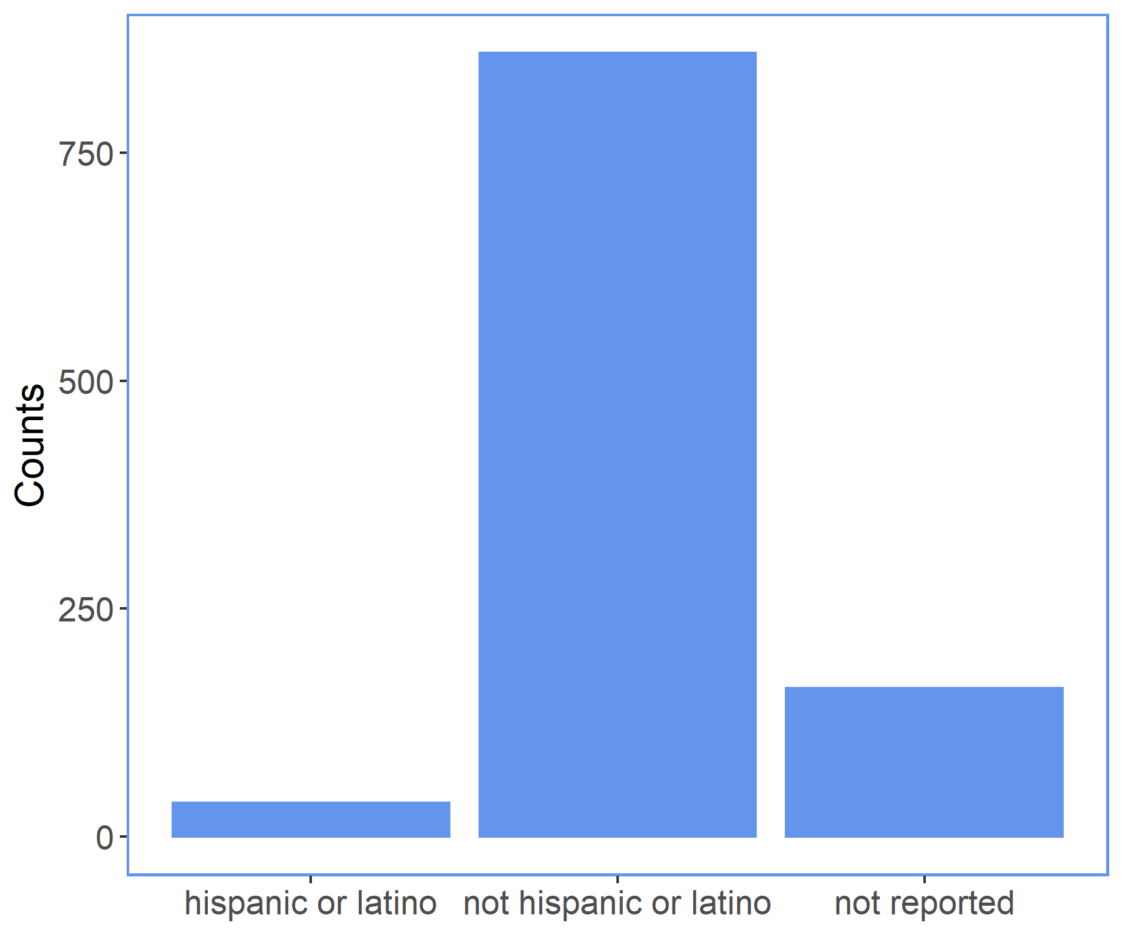
Data Overview
Ethnicity
Type | Categorical (Nominal)
Range | Hispanic or Latino, Not Hispanic or Latino, Not reported
Missing Values | No
Notes | No events in the subjects who reported being Hispanic or Latino

Slide 8
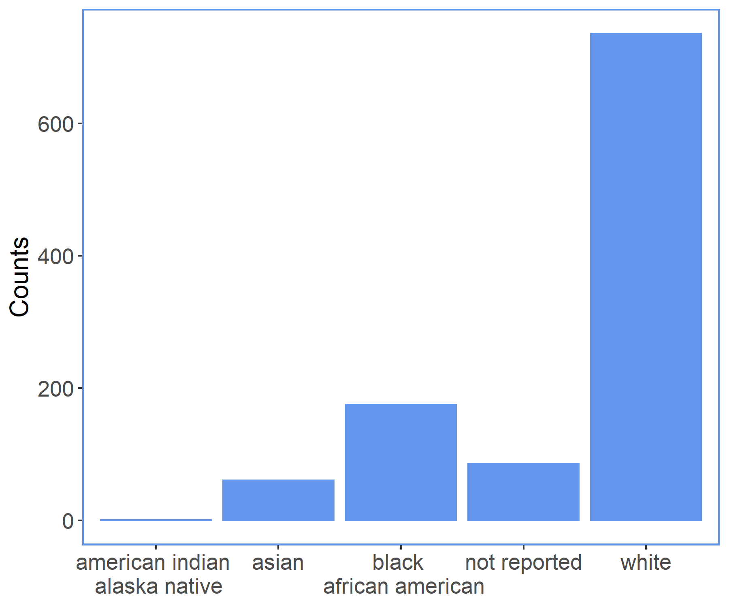
Data Overview
Race
Type | Categorical (Nominal)
Range | American Indian or Alaska native, Asian, Black or African American, White, Not reported
Missing Values | No
Notes | Some race categories contained too few cases and too few events, so we group them in a single category called “other”

Slide 9
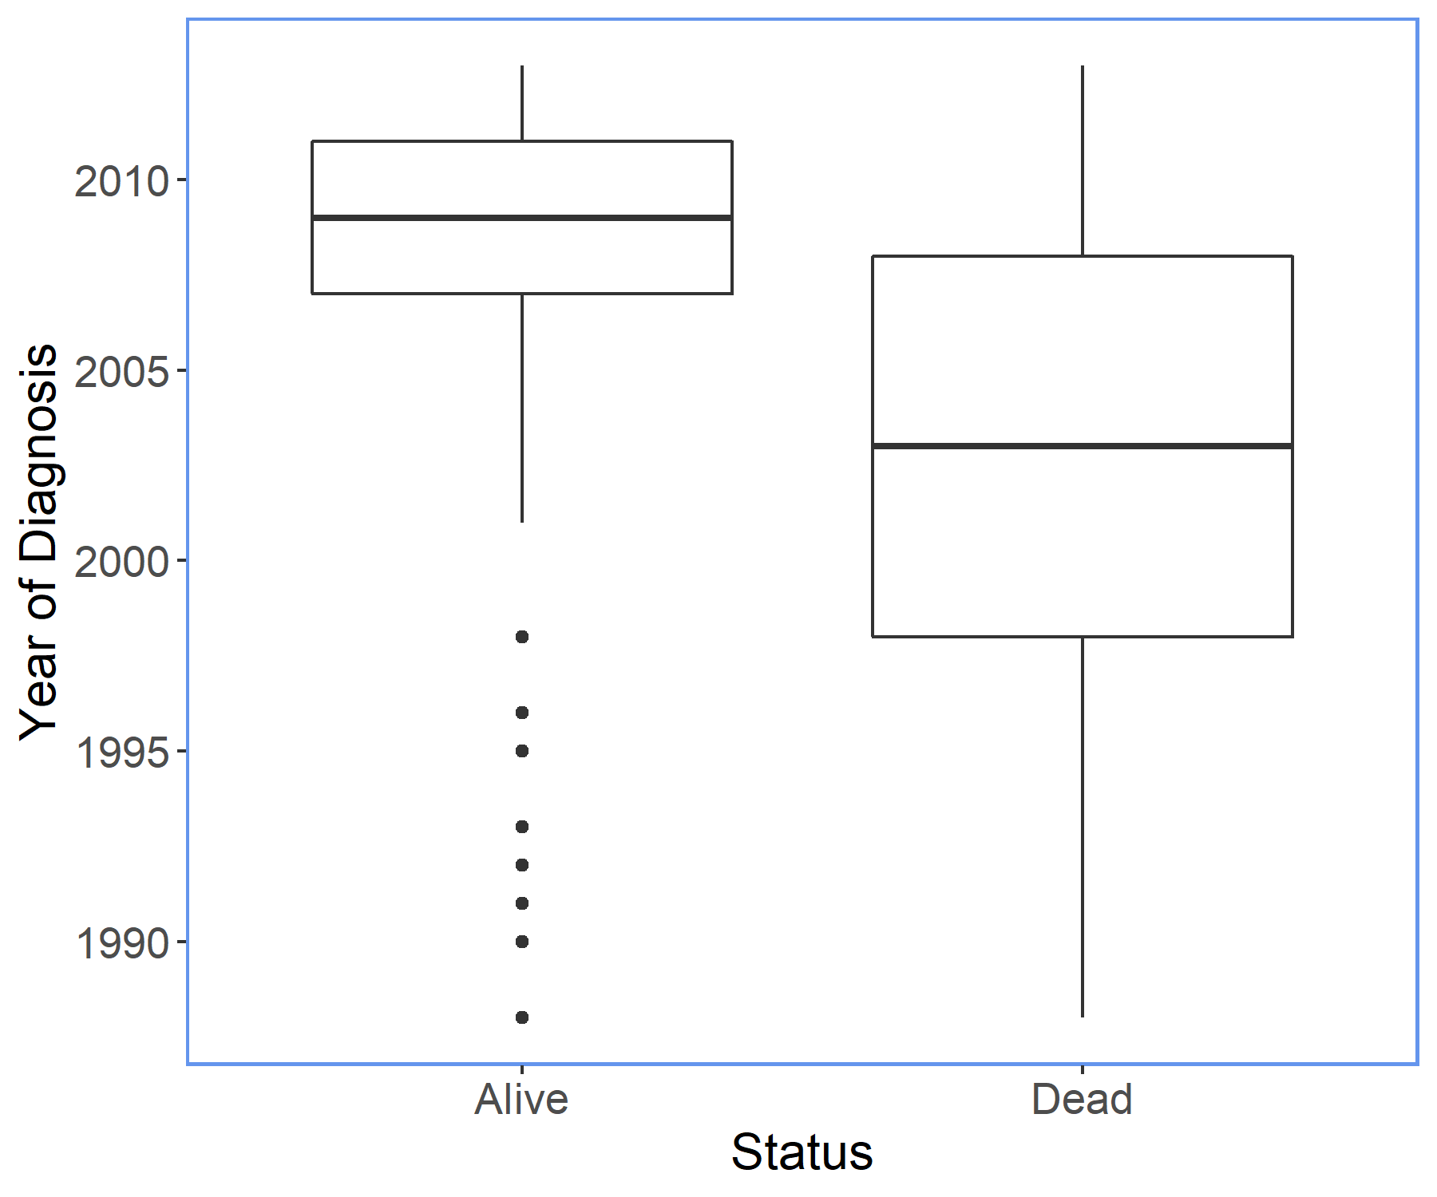
Data Overview
Year of Diagnosis
Type | Numeric (Continuous)
Range | 1988 to 2013
Missing Values | Yes
Notes | Small number of cases yearly until mid-2000s We could group the years into ranges, evenly or based on meaningful milestones We will treat the year as a continuous variable

Slide 10
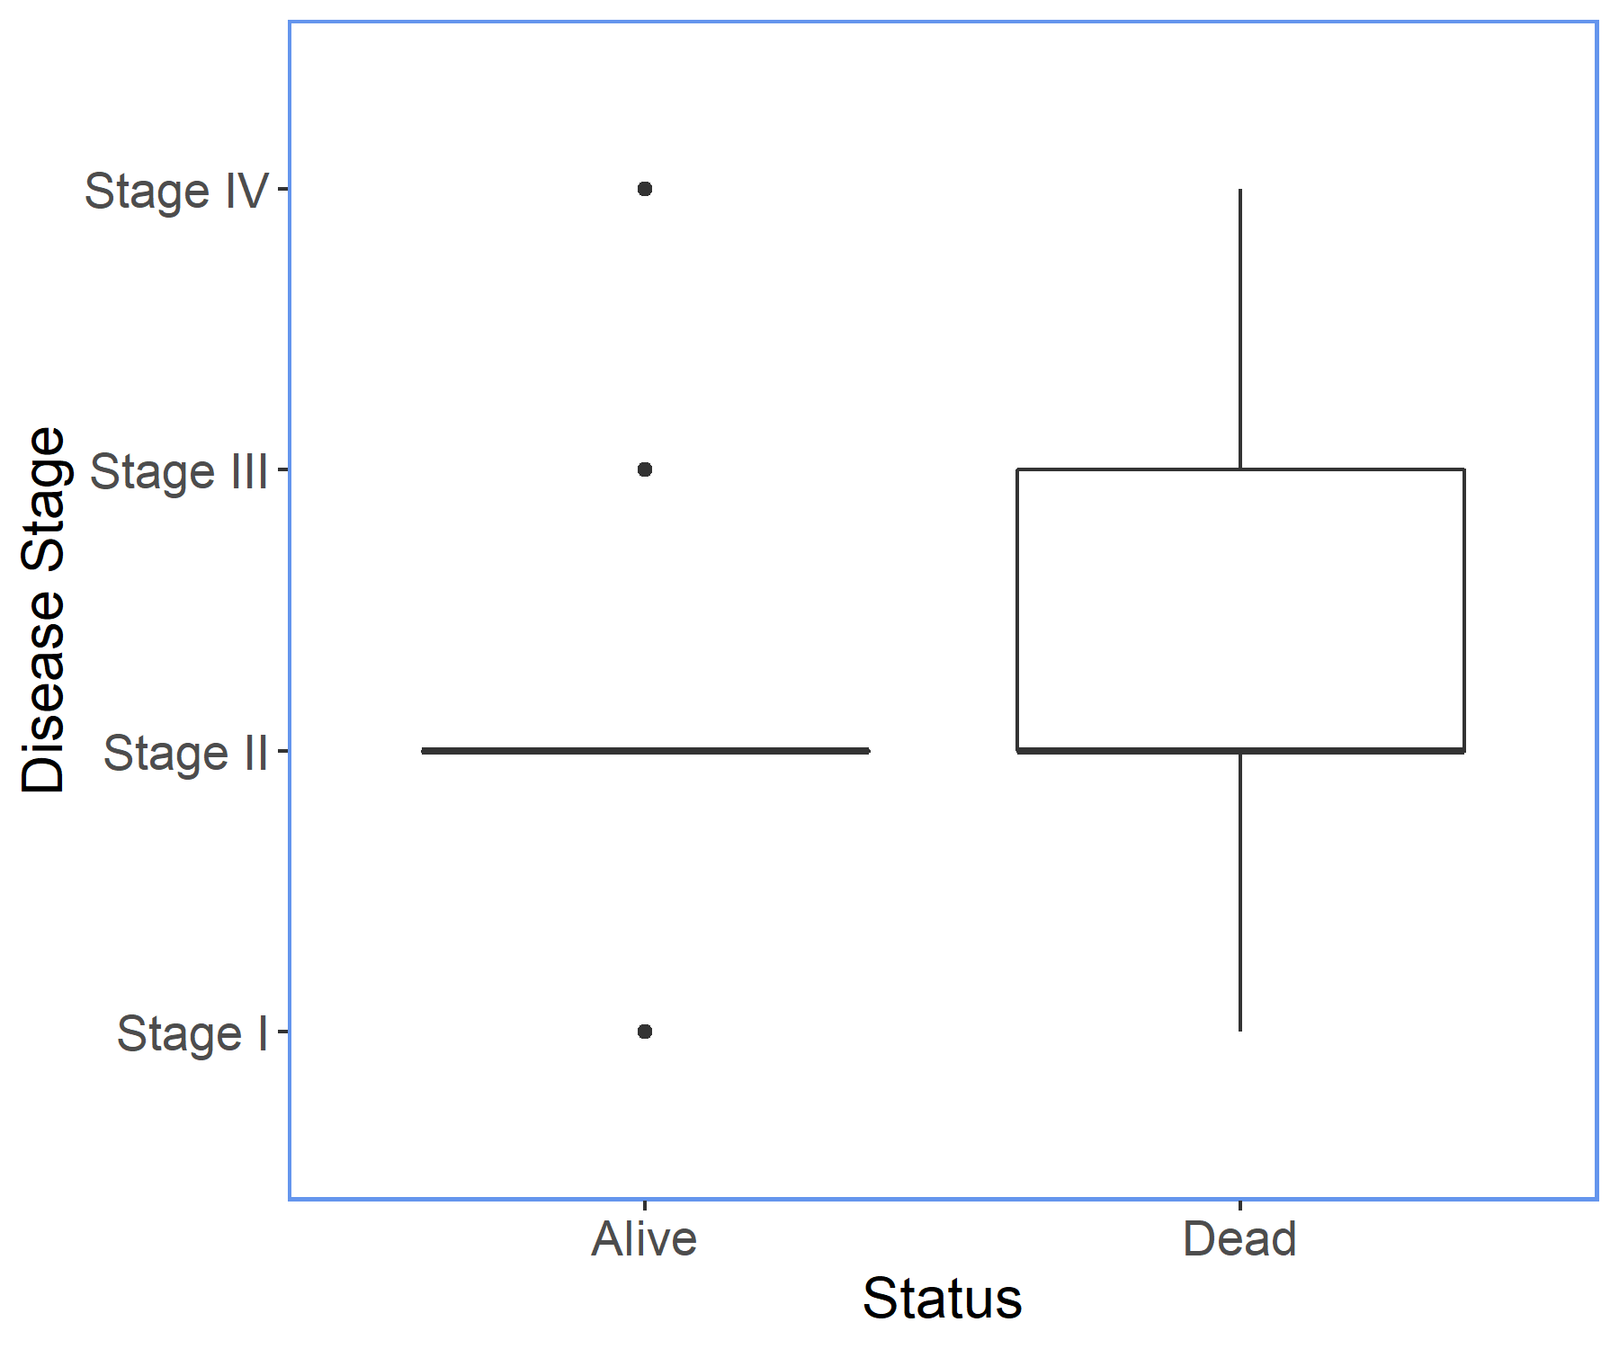
Data Overview
Disease Stage
Type | Categorical (Ordinal)
Range | Stage I, Stage II, Stage III, Stage IV
Missing Values | Yes
Notes | Pathologic Stage based on the T, M and N labeling. Available as stages 1 to 4 (Stage X for unable to assess) and further specified with level A, B and C. We group at the stage level to have events in all groups.

Slide 11
5-year survival logistic regression model
After filtering for cases where subjects survive 5 years, we are left with 300 cases:
64 dead before 5 years
236 alive after 5 years
Starting with the full model, we use backward feature selection to guide our choice of covariates
We use AIC and BIC to choose the final model

Slide 12
Inference
Survival rate decreases with age and disease stage
No significant difference in survival between Stage I and Stage II
Regression assumptions were verified
Variable | Coefficient | Std Error | P-value
Intercept | 2.235 | 0.406 | 3.84e-08
Age at diagnosis | -0.714 | 0.163 | 1.23e-05
Stage II | -0.439 | 0.454 | 3.34e-01
Stage III | -1.573 | 0.487 | 1.25e-03
Stage IV | -2.901 | 0.795 | 2.64e-04
Notes:
Update the coefficients to final values and write p-value in scientific notation

Slide 13
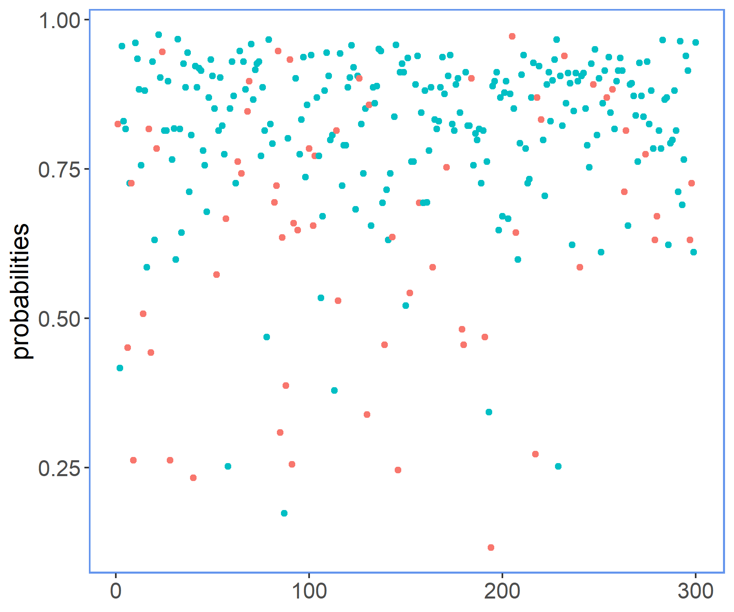
Prediction
Model precision: 0.83
Model recall: 0.97
True Positive: 229 | False Positive: 48
False Negative: 7 | True Negative: 16
Alive
Dead

Slide 14
Accelerated Failure Time Model
Pros:
Can use “all” the data: 1,039 cases
Accounts for right-censored data from the days to last follow-up
The fitted values provide us estimates of survival time
Cons:
Fully parametric model requires more assumptions than semi-parametric models (e.g. Cox Proportional Hazard Model)

Slide 15
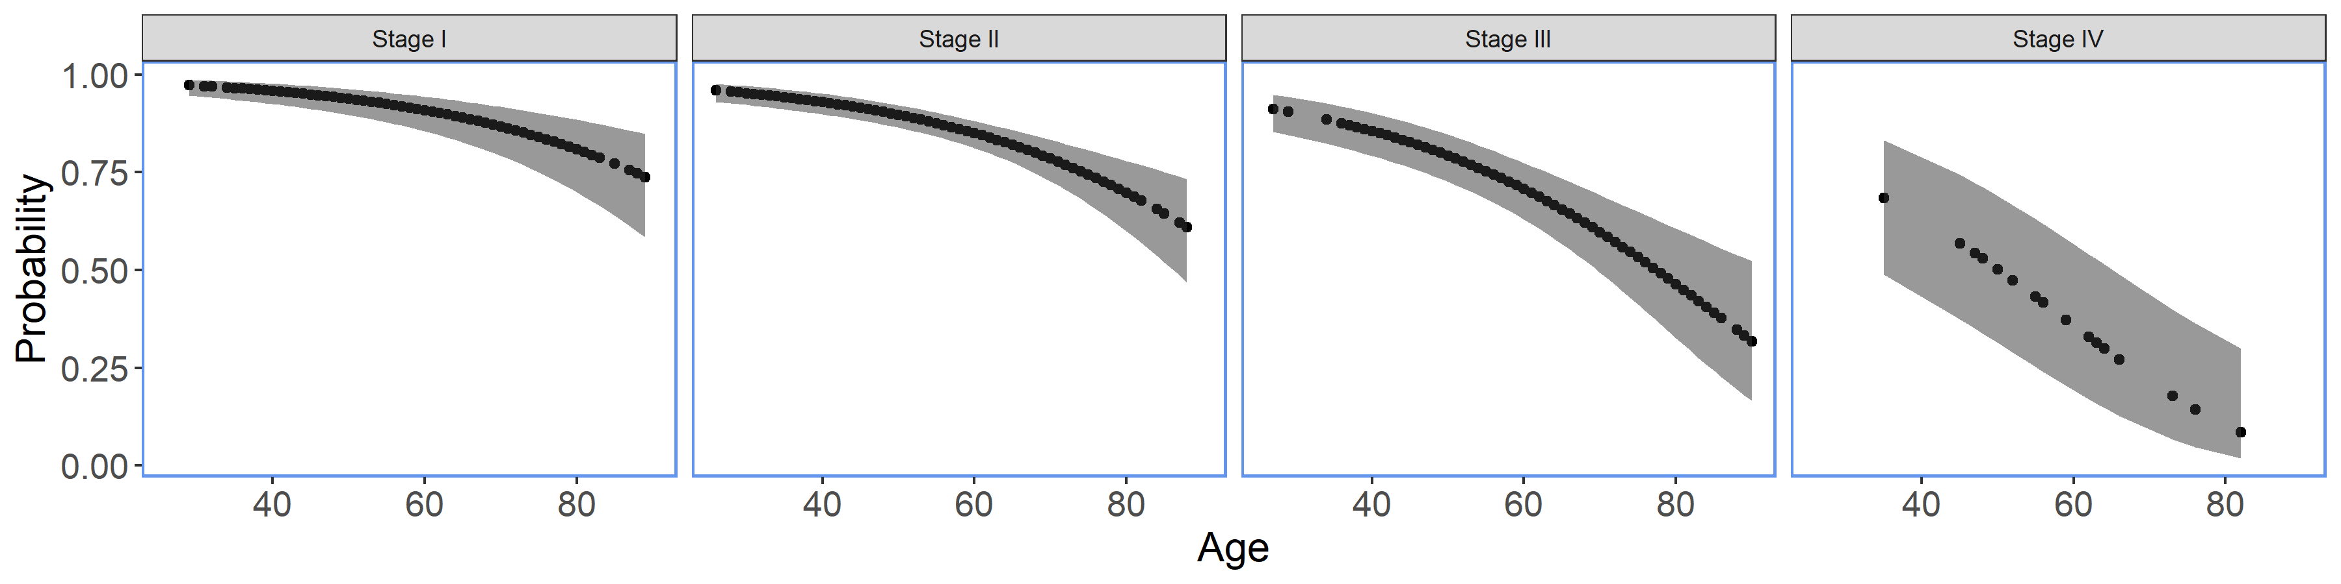
Probability estimate of the 5-year survival rate

Slide 16
Model Limitations
Extrapolation outside the covariate range
Accelerated Failure Time models are parametric which involve additional assumptions

Slide 17
Next steps…
Exploration of interactions between covariates
Exploration of additional covariates like therapy type
Bayesian extension of the Weibull Regression model to obtain full posterior distribution of coefficients

Slide 18
Part II
Understanding the association between genes and patient survival

Slide 19
Data Overview
Clinical Data
Filter on the cases with a minimum of 3-month history
Look at survival time and a subset containing 5-year survival rate information
Gene Data
Extract gene expression for the cases with 3-month history
Some Case IDs had multiple gene expression, we took the first instance
A few Case IDs were missing the gene expression file
We use tpm_unstranded as suggested

Slide 20
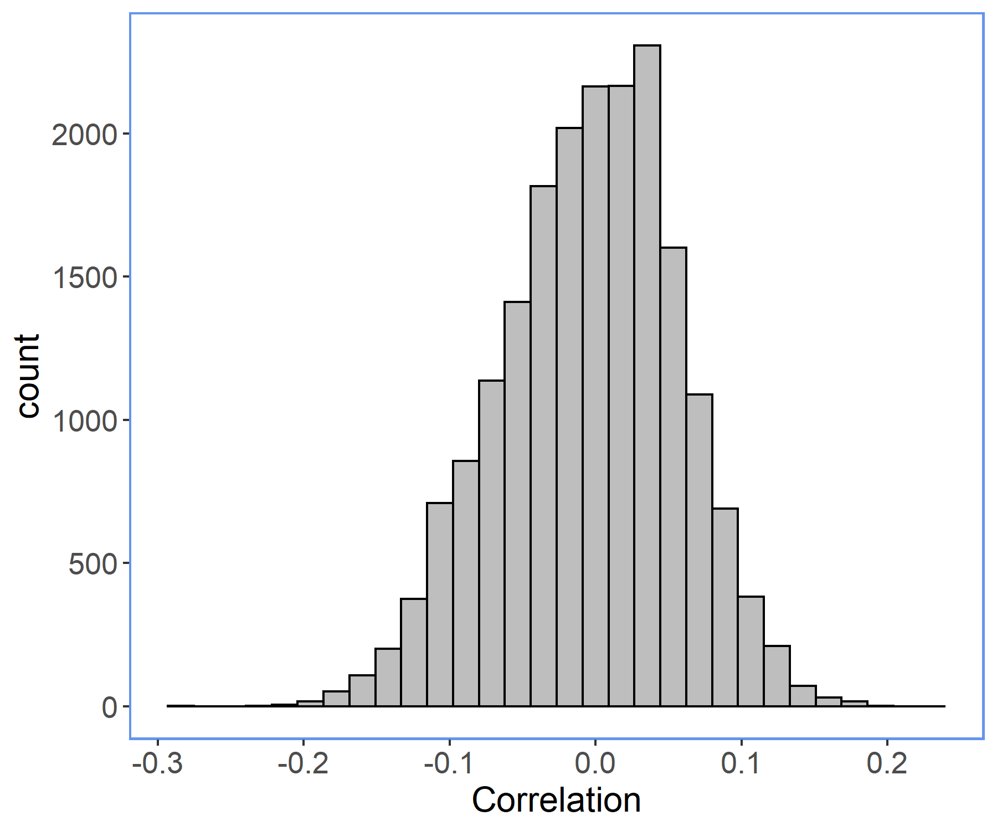
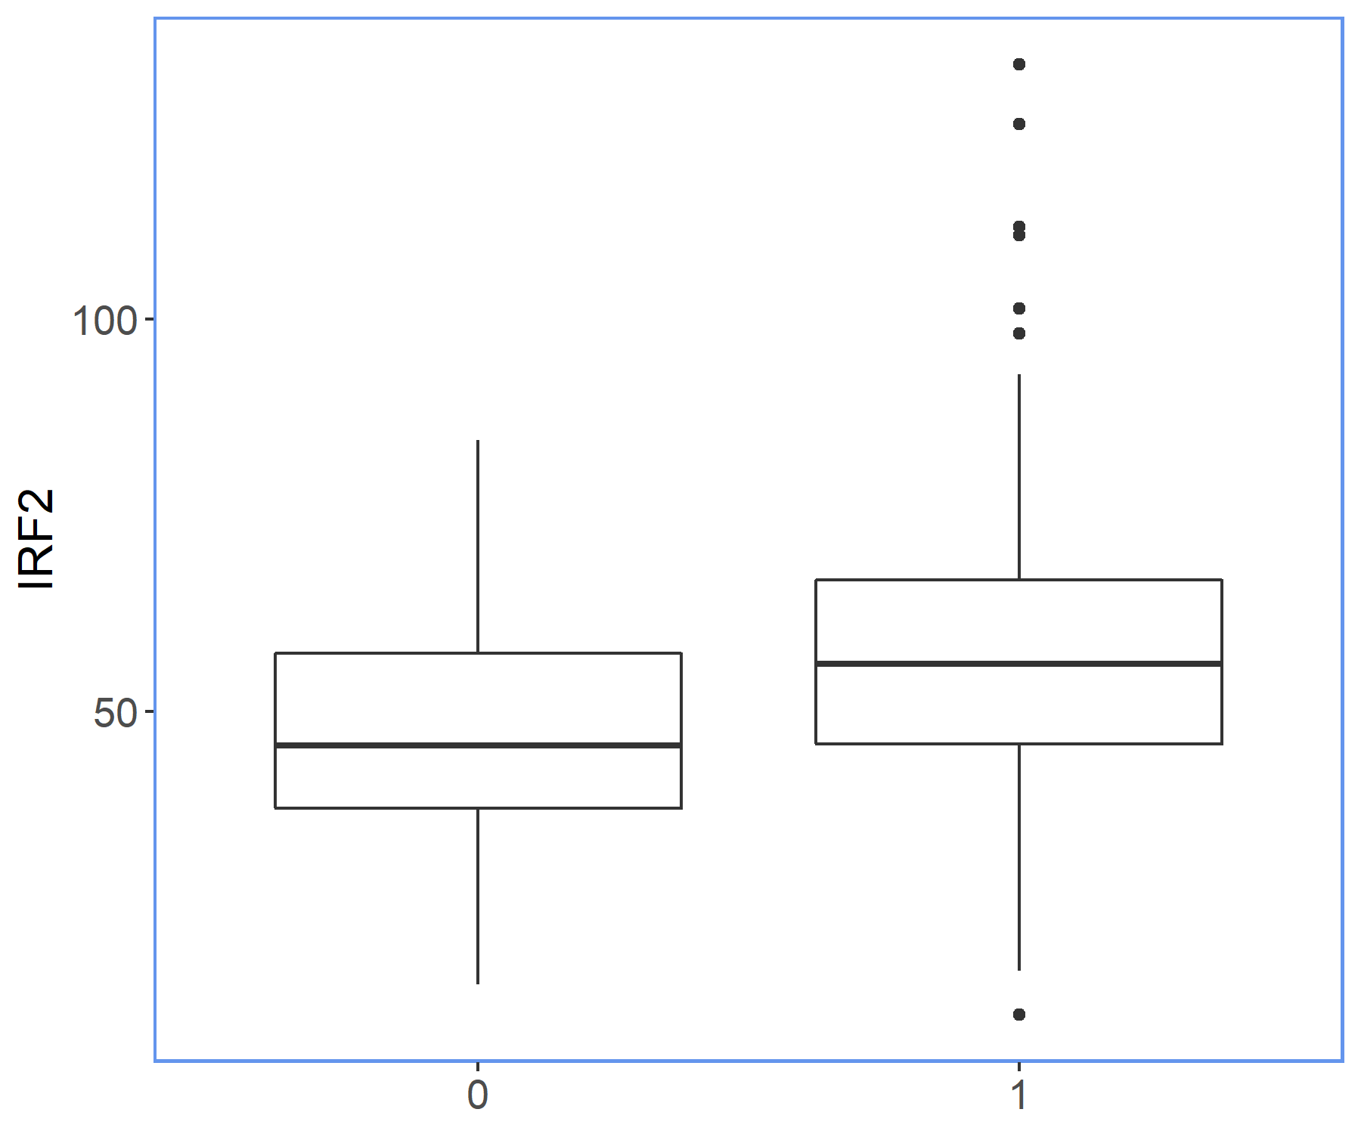
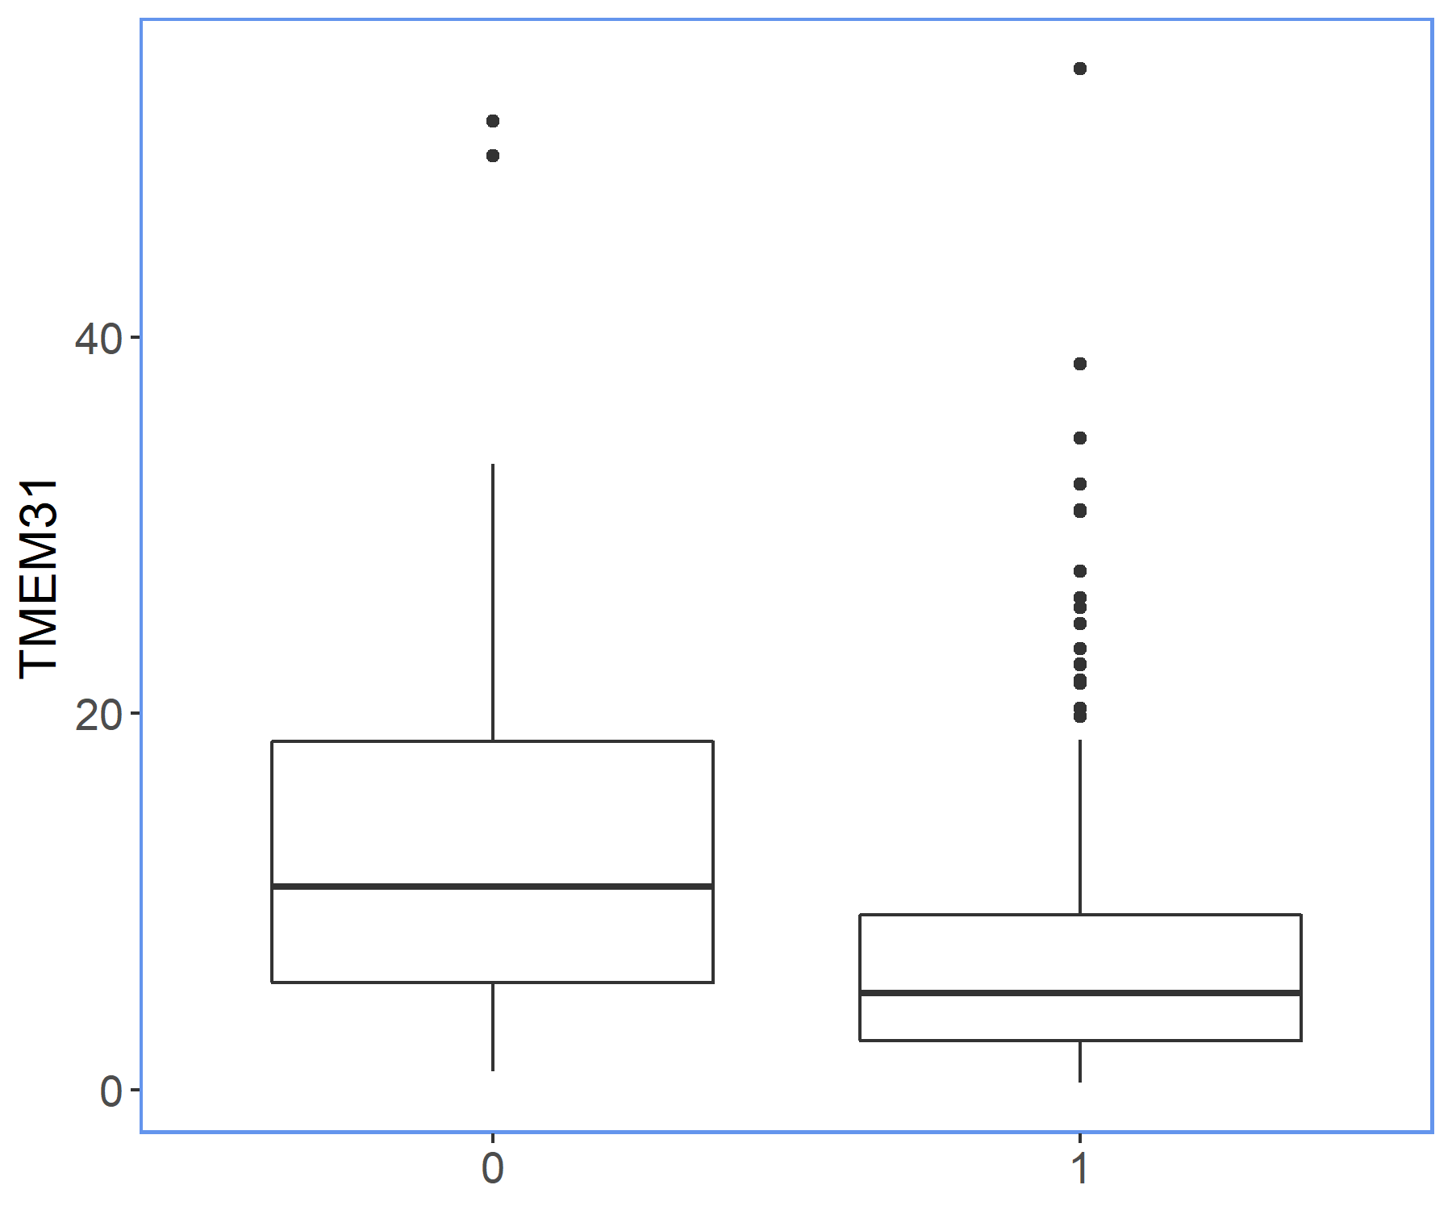
Correlation Analysis – 5-year Survival Rate
We compute the correlation between each available gene and the survival status

Slide 21
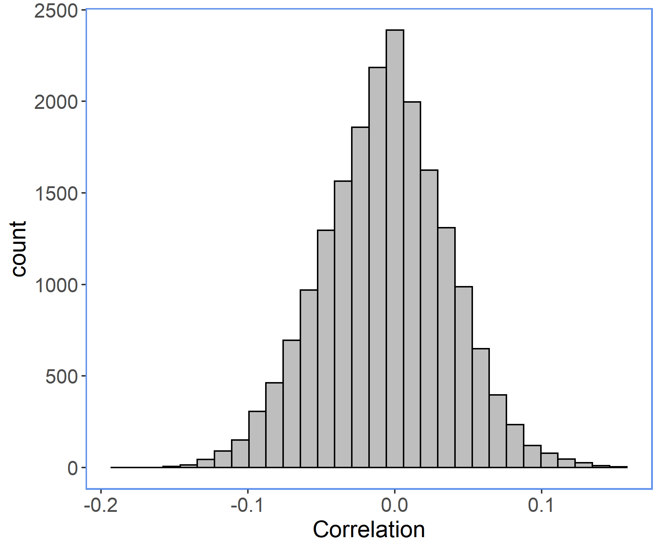
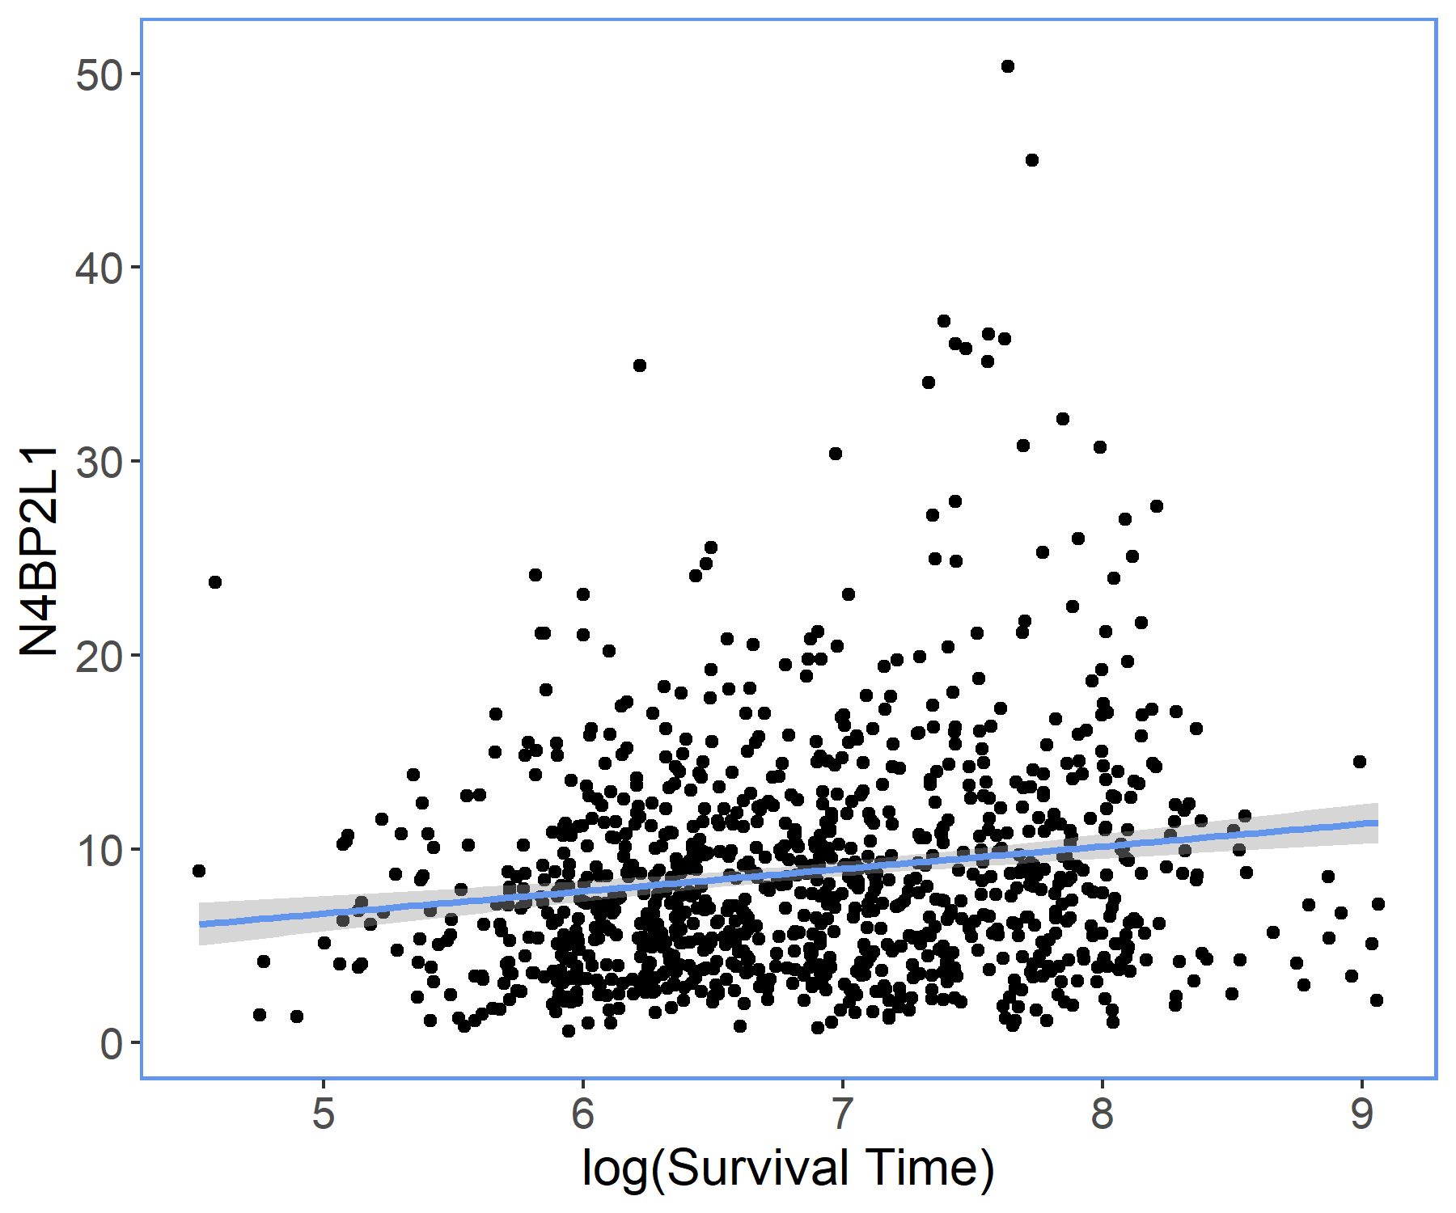
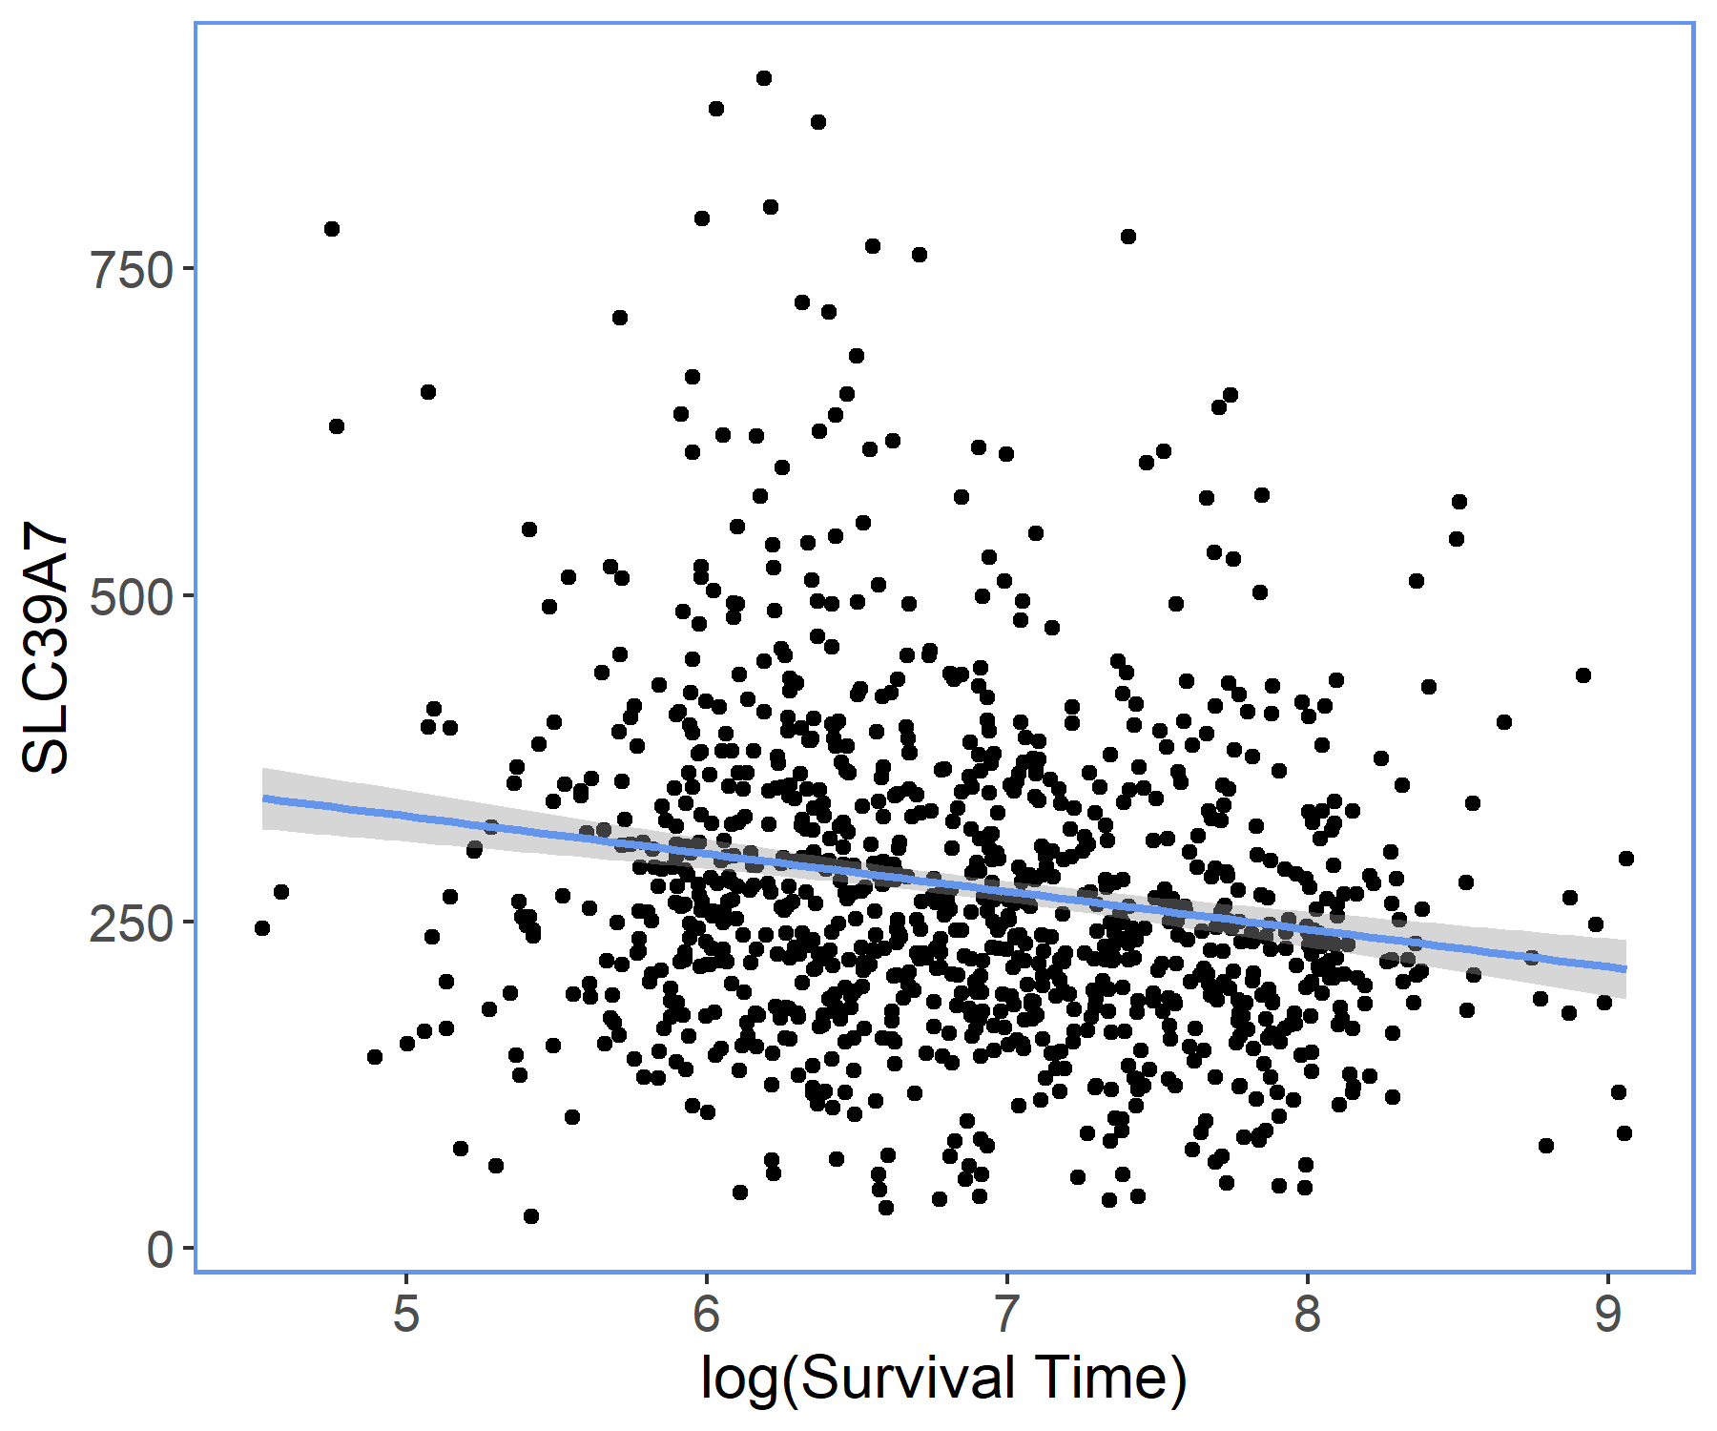
Correlation Analysis – Survival Time
We compute the correlation between each available gene and the survival time

Slide 22
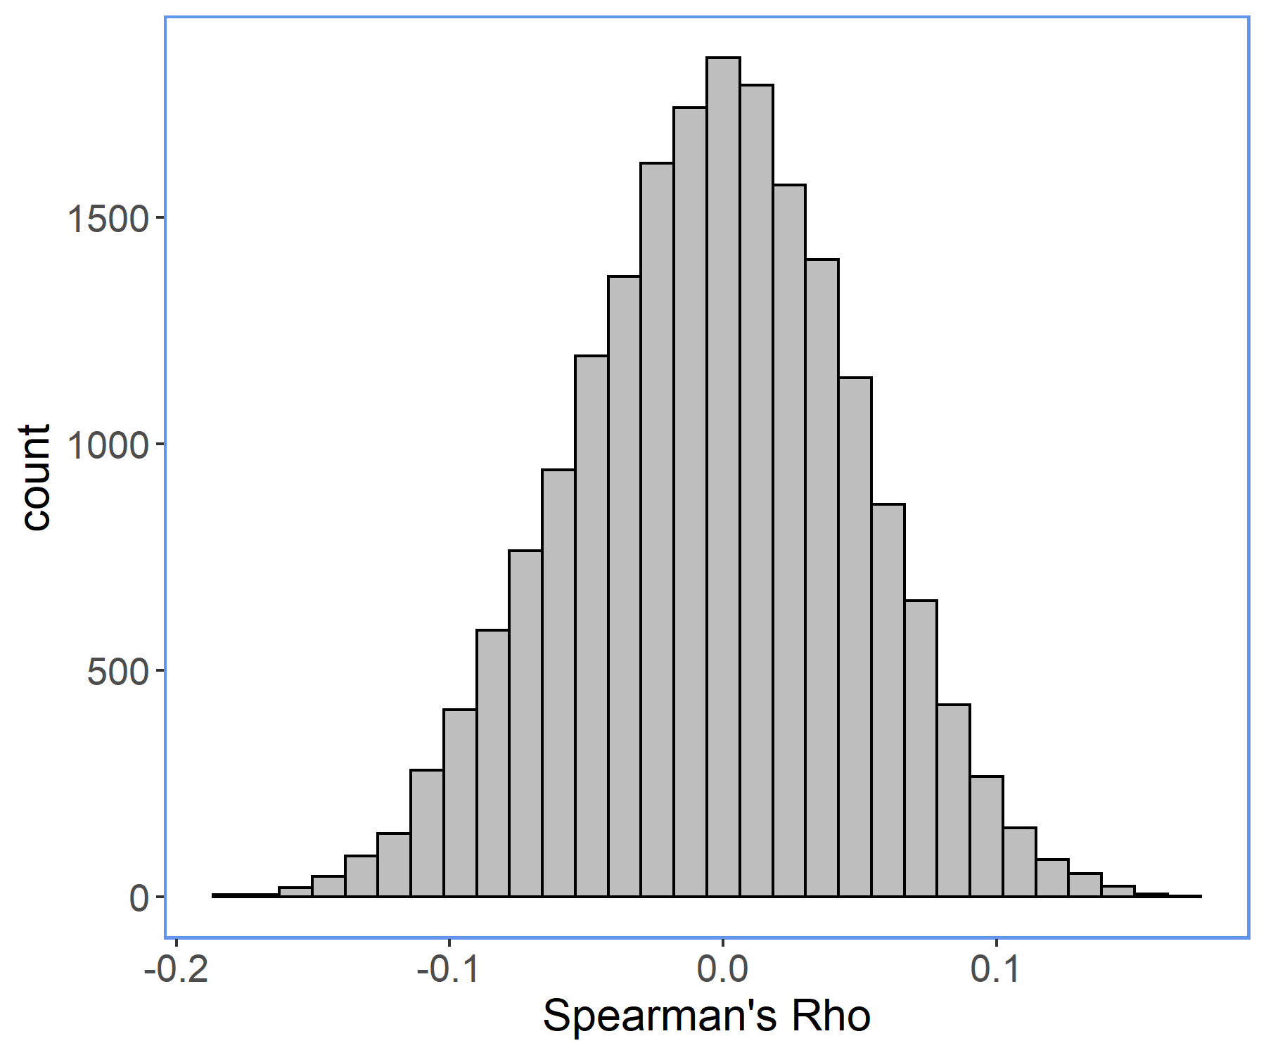
Rank Correlation Analysis – Survival Time
We compute Spearman’s rho rank correlation and compare the results with the linear correlation
Gene | Pearson | Spearman
SLC39A7 | -0.182 | -0.186
TMED9 | -0.155 | -0.177
ATG101 | -0.154 | -0.177
LRPAP1 | -0.150 | -0.173
AKIP1 | -0.149 | -0.179
CARS1 | -0.146 | -0.168
Gene | Pearson | Spearman
N4BP2L1 | 0.157 | 0.152
RPL11 | 0.151 | 0.163

Slide 23
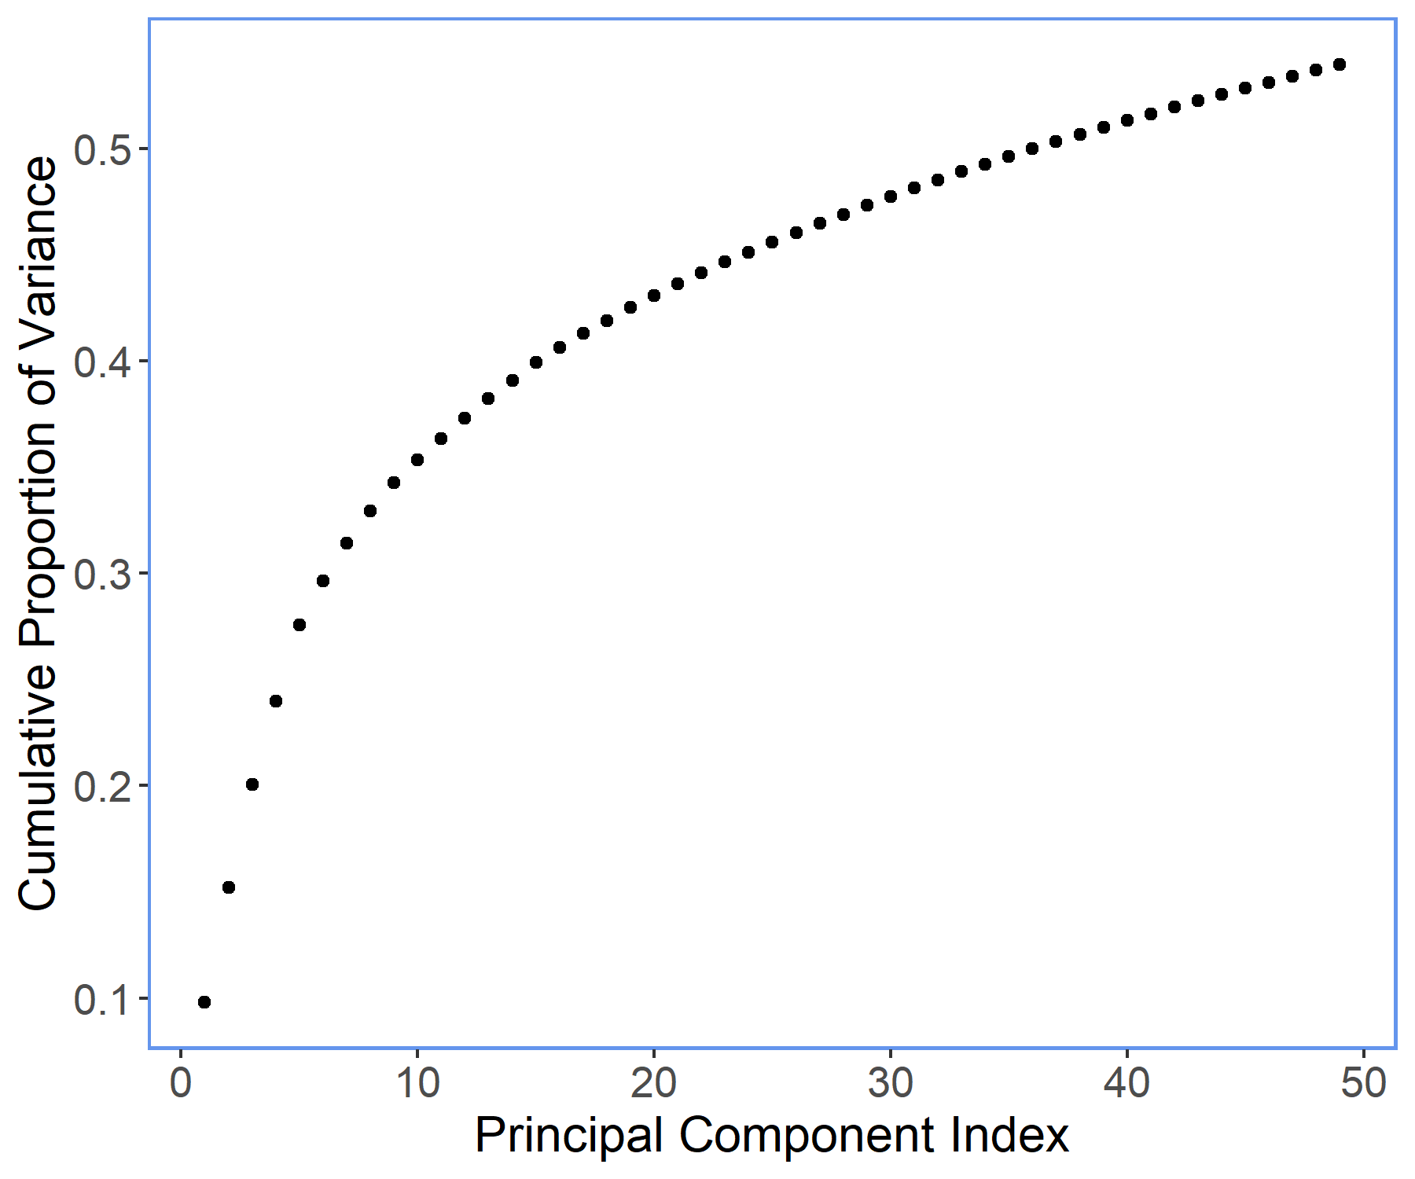
Principal Component Analysis (PCA)
Looking at the cumulative proportion of variance from PCA for dimensionality reduction
No plateau signifies the absence of a cluster of genes responsible for survival time

Slide 24
Next steps…
Further develop nonlinear correlation analysis
Formally include the information we gained to our survival regression model

Slide 25
Thank you
Isabelle Grenier
igrenier.stats@gmail.com
https://github.com/igrenier/TCGA_BRCA

Slide 26
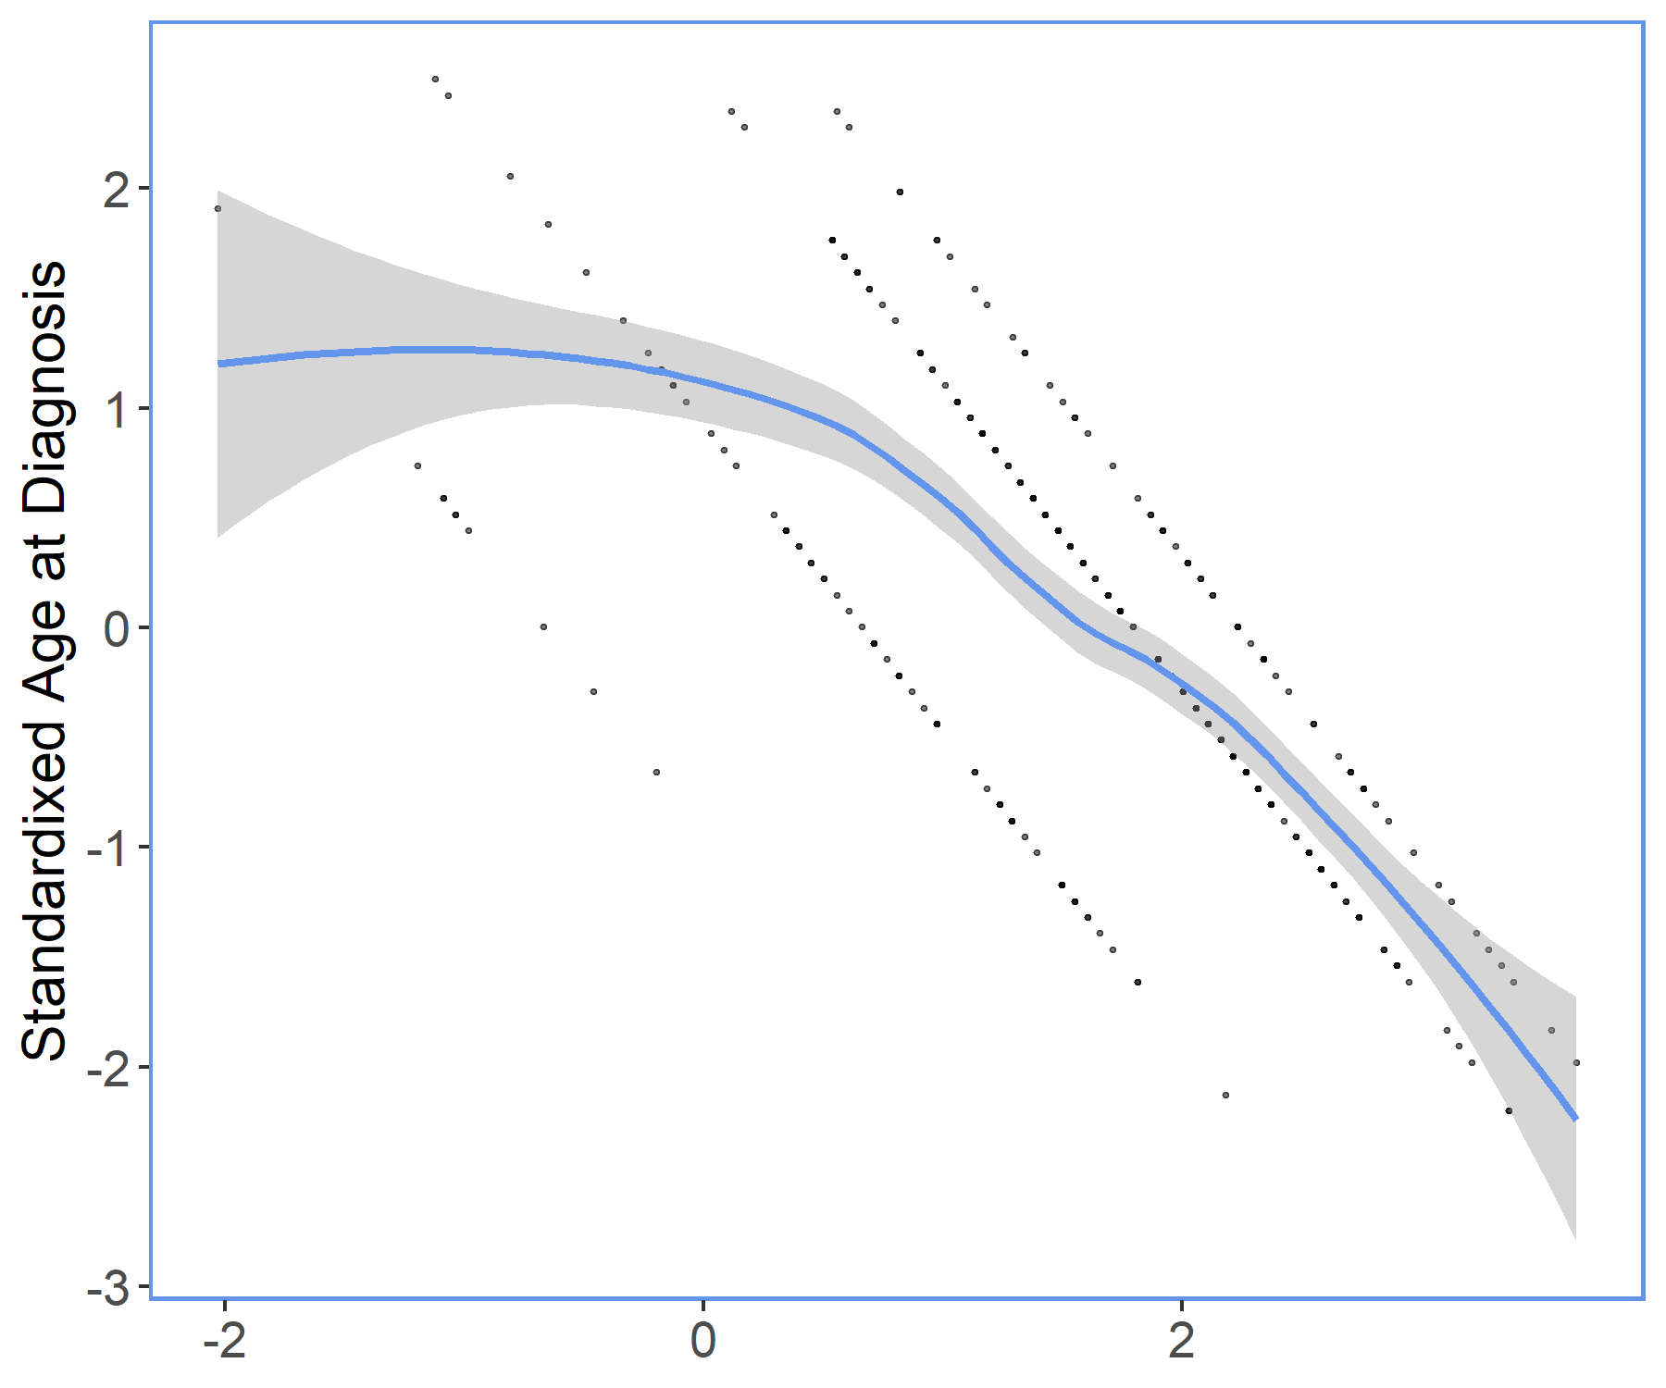
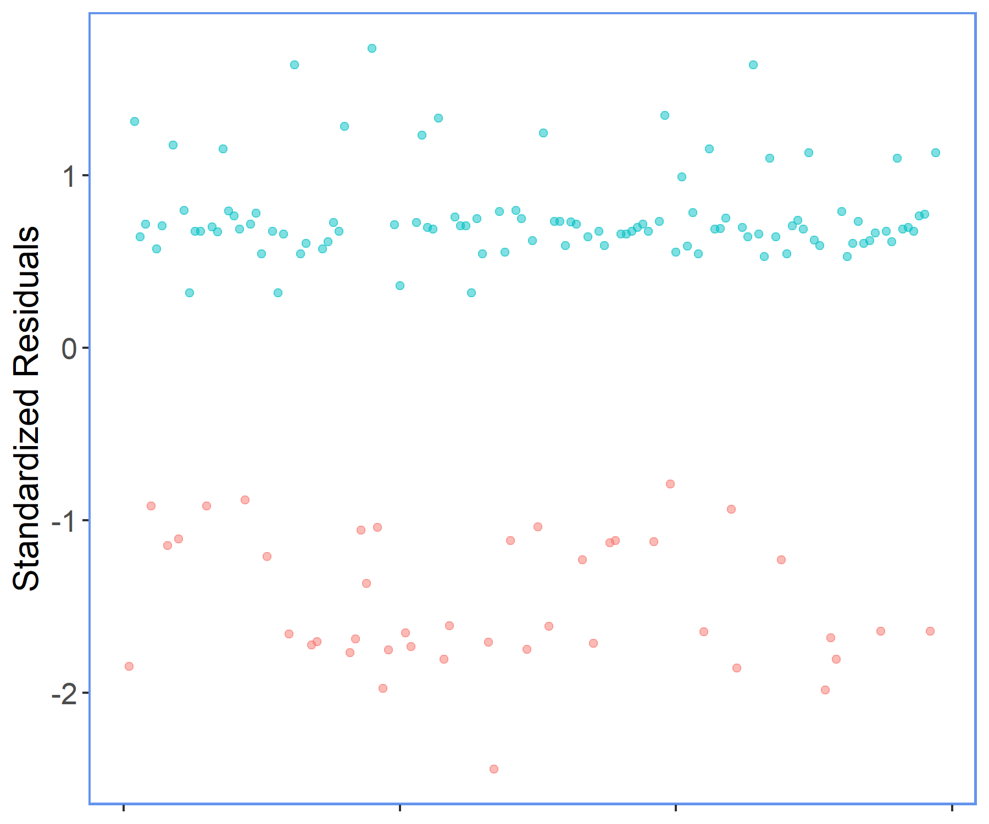
Regression Assumptions
Linearity of Continuous Covariate
Influential Points
Alive
Dead

