Slide 1

Ignacio Giadach - Portfolio
Website and decision-making process

Slide 2

How did I decide what to do?

Slide 3
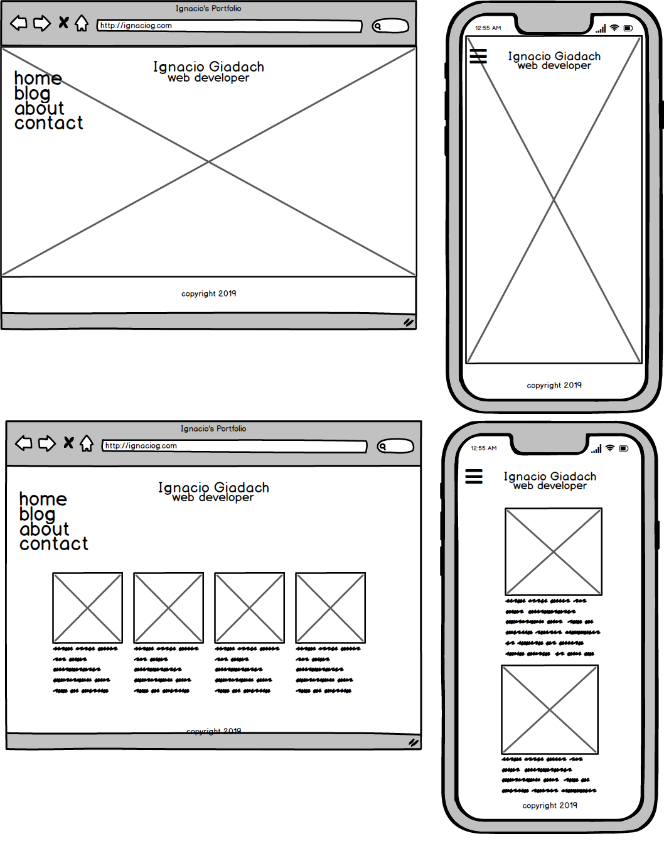
the mockups

Slide 4
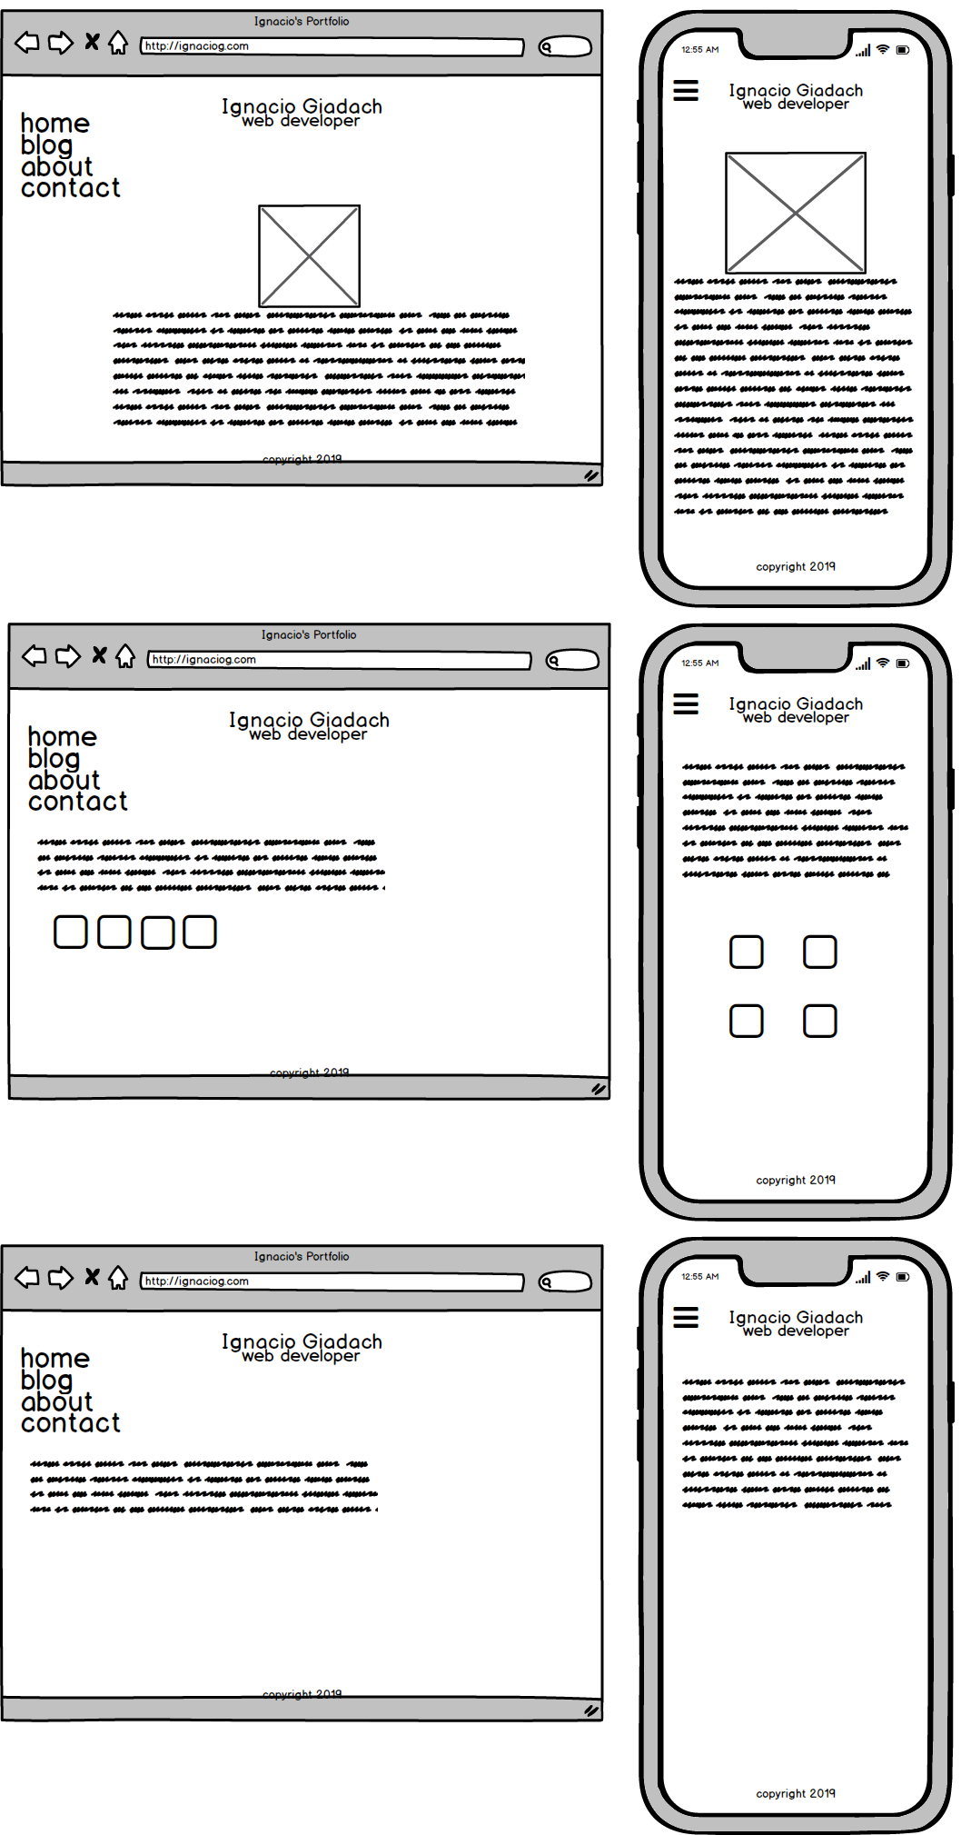
the mockups

Slide 5
What will be used?

Slide 6
What will be used?
- HTML5
- CSS
Animations!
- Social icons from Font Awesome
- Make it responsive, make it clean and simple
Media queries
flexbox

Slide 7
The result…

Slide 8

home

Slide 9
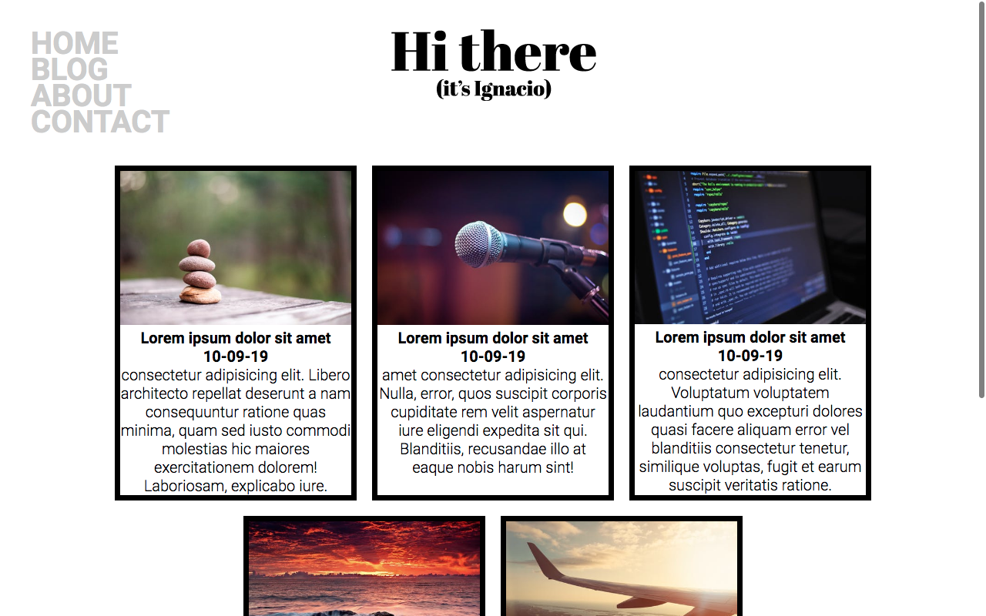
blog

Slide 10
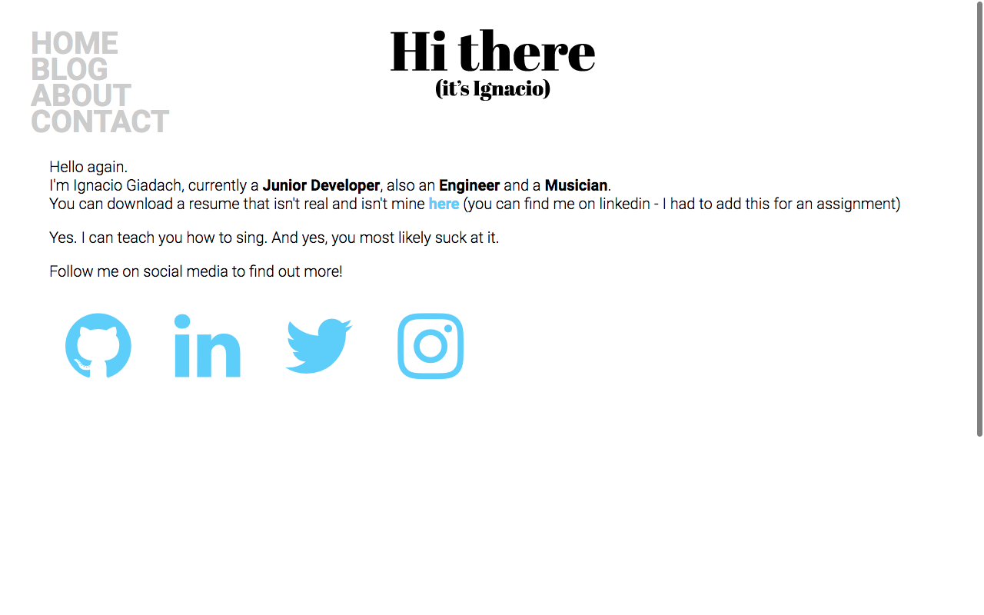
about

Slide 11
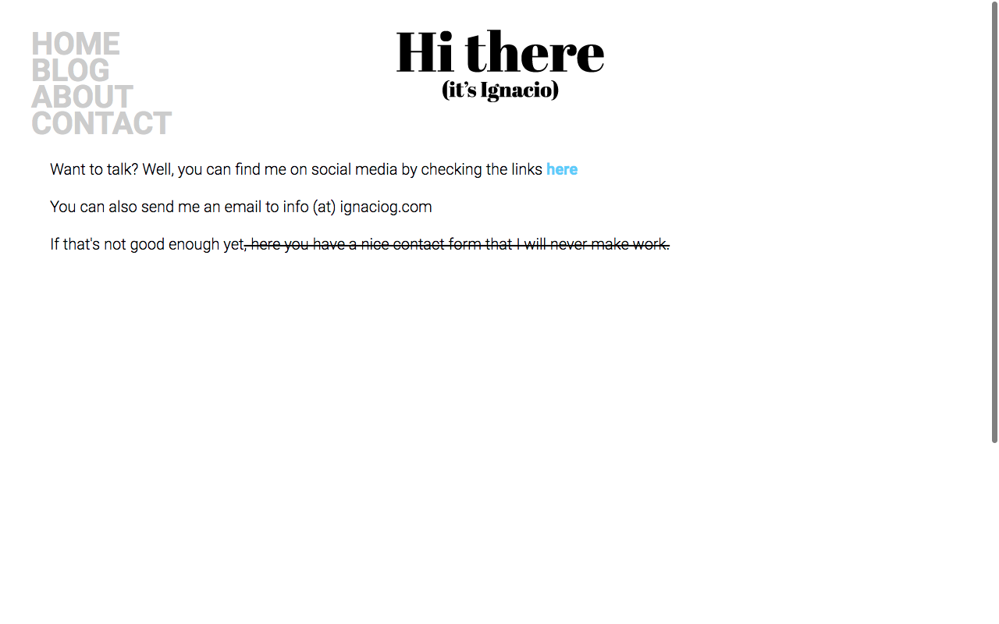
contact

Slide 12
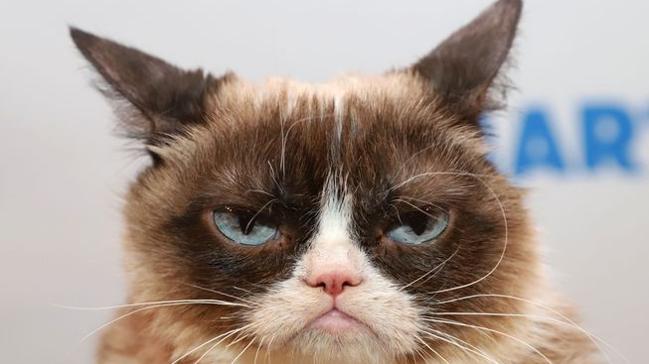

Slide 13
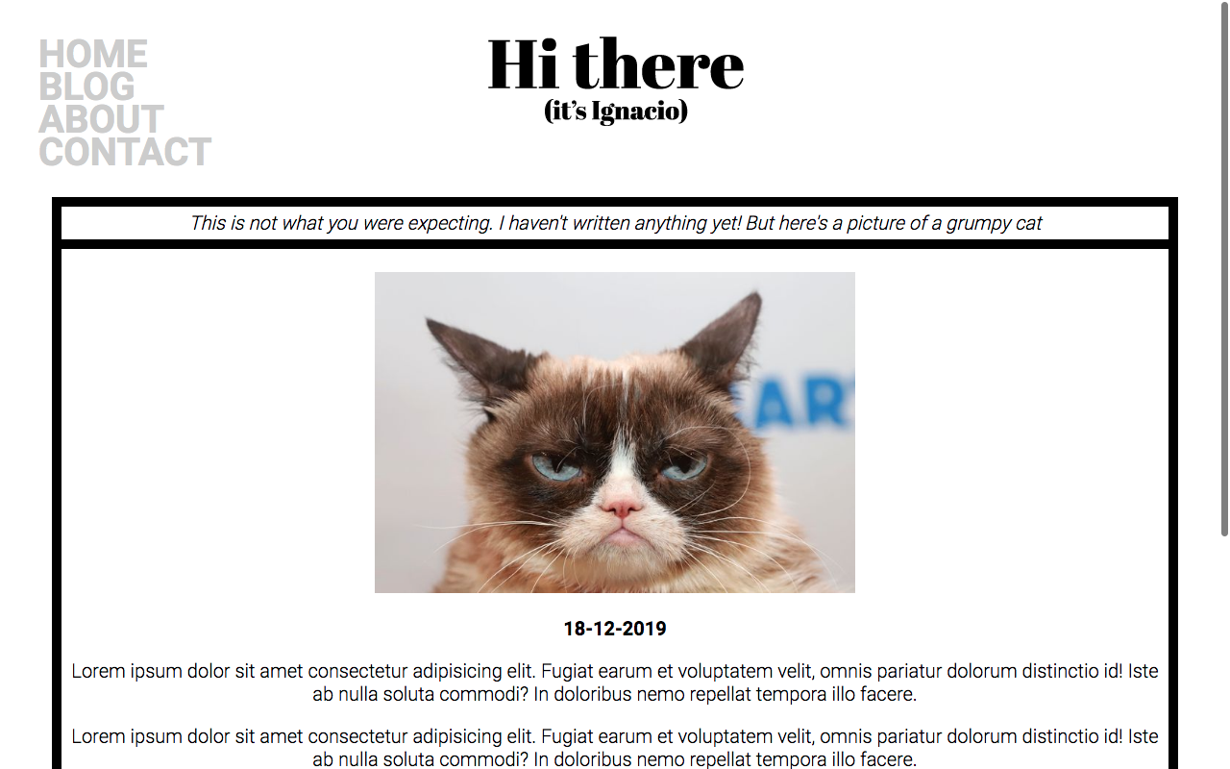
blog entry

