Slide 1

Ignacio Giadach - Portfolio
Website and decision-making process

Slide 2

How did I decide what to do?

Slide 3
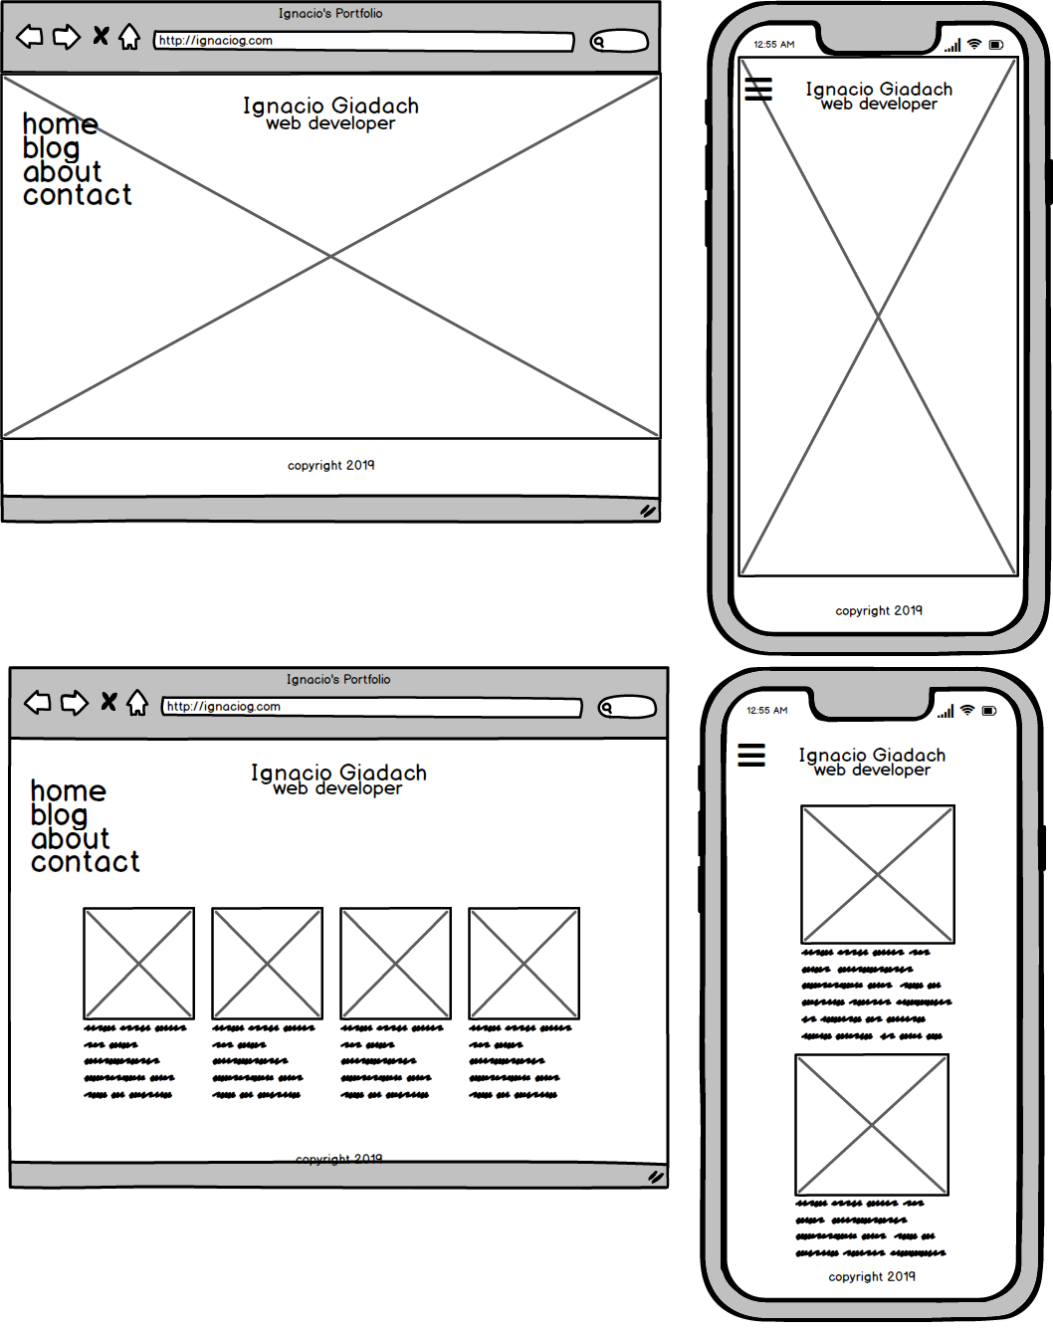
the mockups

Slide 4
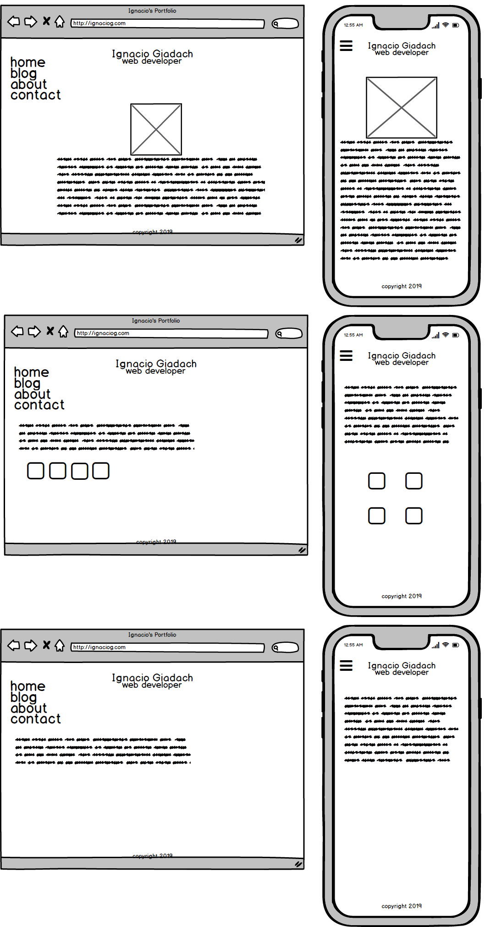
the mockups

Slide 5
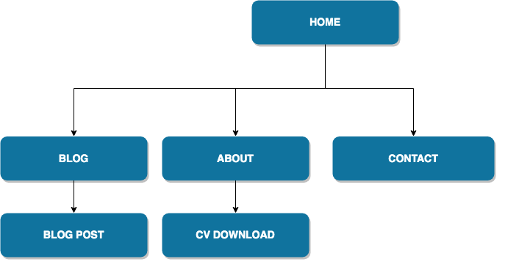
sitemap

Slide 6
What did I use?

Slide 7
What did I use?
- HTML5
- SCSS
Animations!
- Social icons from Font Awesome
- Make it responsive, make it clean and simple
Media queries
flexbox

Slide 8
What did I learn
- You can do it!
- Nothing too serious
- While I was creating, I kept coming up with new ideas
My creative process was different
- Ethics of using other’s work

Slide 9
The result…

Slide 10

home

Slide 11
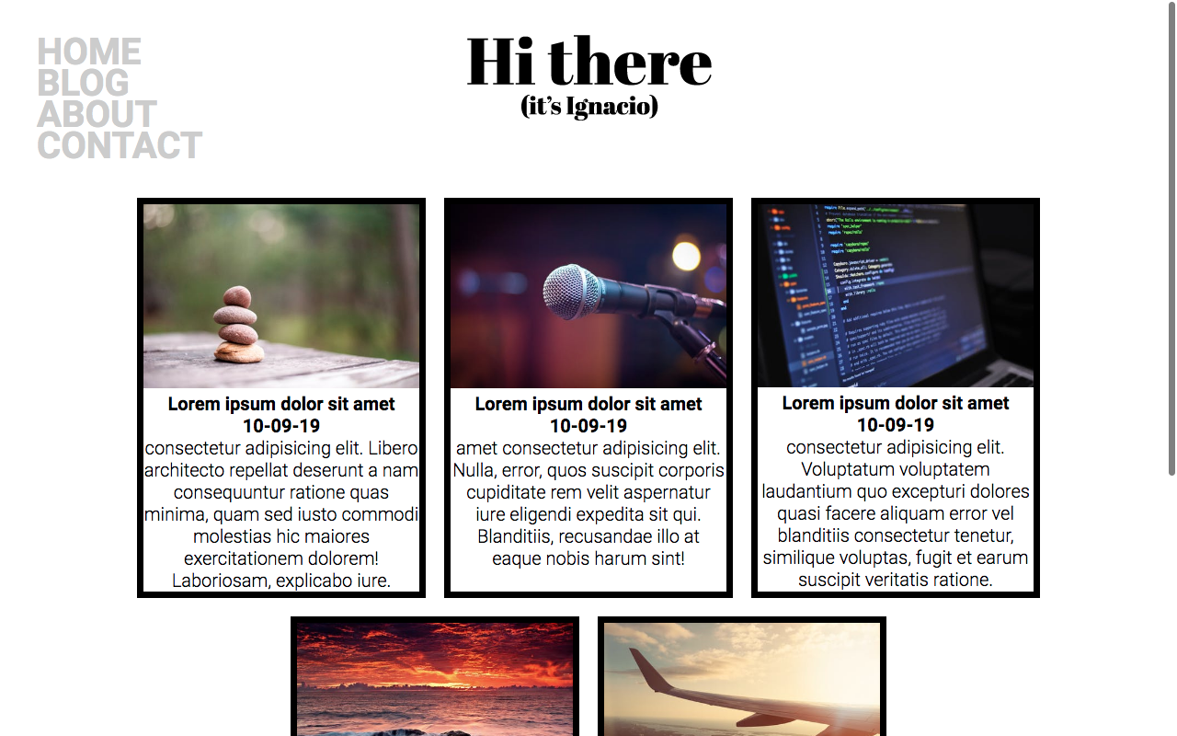
blog

Slide 12
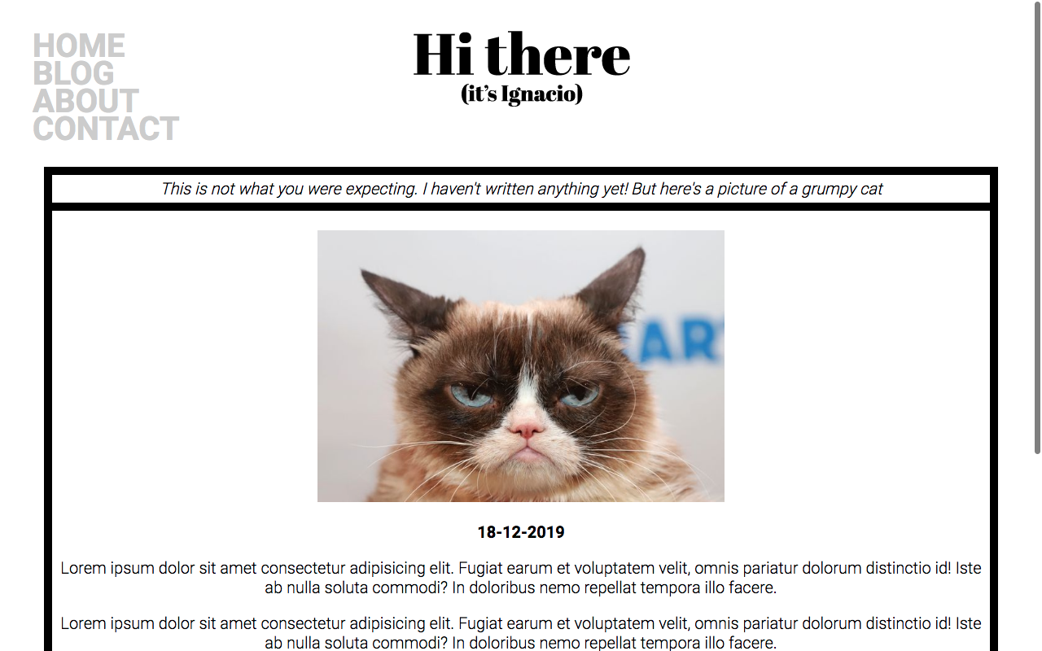
blog entry

Slide 13
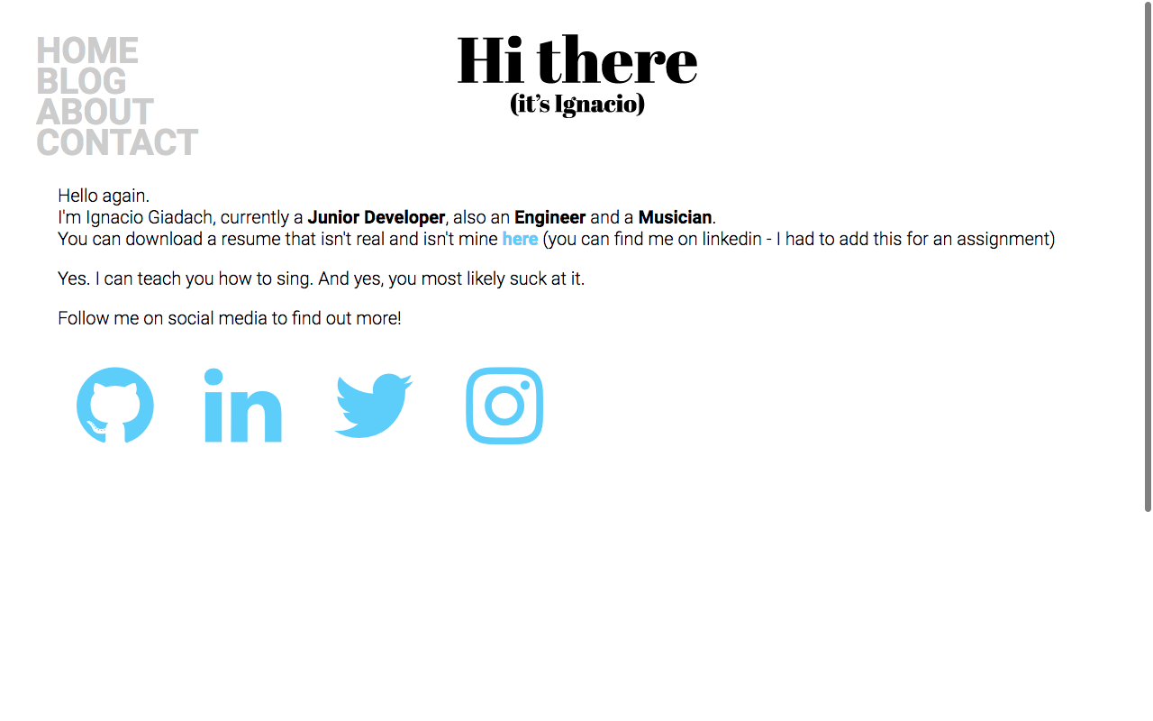
about

Slide 14
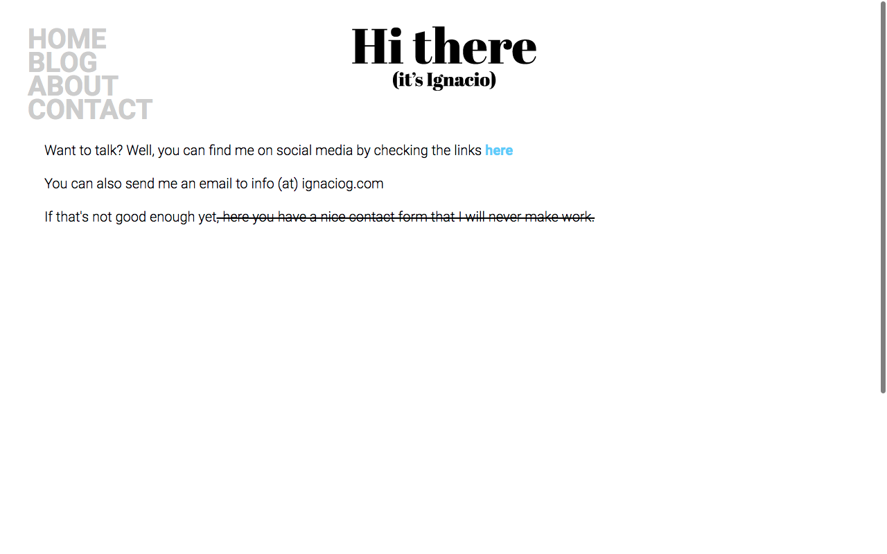
contact

Slide 15


