Slide 1



eCam
Fleet manager
Robot brain
Factory setup
Notes:
Basia
Affordable software solution for robot navigation and control
Targetted at small factories and hobbyists
It features
a fleet manager server,
Robot brain controller,
And concepts of factory setups

Slide 2

API
Notes:
Igor, then Igor shows website
API
Assign factory layout
Management of robots inside the factory
Reliable data logging
Fast pathfinding
API AND DOCUMENTATION!!!

Slide 3


Website
Navigation
Notes:
Igor gives intro (reads off the slide), then Tommi swiftly shows the robot is following the QR code
Website
Robot control and programming
Data logging display
Tutorials and documentation for service and developers of third-party software
Navigation
Real-time navigation tracking
Advanced speed optimization algorithms
Server controlled solution

Slide 4

Image processing
Notes:
Igor gives intro (reads off the slide), Freyr quickly presents the RAW image on the computer.
Customizable exposure control
Advanced motion blur reduction
Performance optimization for image calculations in navigation and obstacle detection

Slide 5

Obstacle detection
Notes:
Igor gives intro (reads off the slide), Pither/Olger display the principle on a table
Lightweight and fast machine learning model
High accuracy
Security measures for robots

Slide 6

Device case
Notes:
Sergiusz shows the case

Slide 7
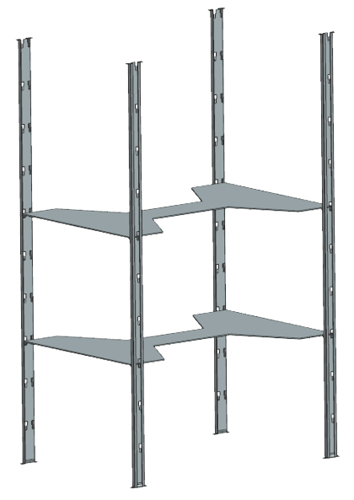
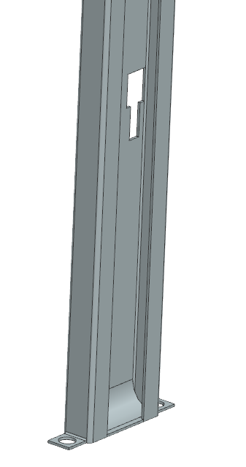
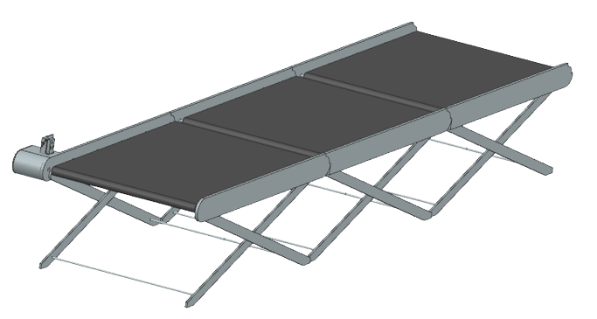
Belt mover
Mounting rack
Shelf
Notes:
Modular and easy-to-setup factory
Suitable for future eFactory
Sustainable and affordable parts

