Slide 1
DUMBWAYS BOOTCAMP
I Gusti Bagus Dharma Putra

Slide 2
Automation
01
02
03
04
Deploy PHP Application in cPanel
Setup Server with Ansible
Setup Monitoring Server
Connect Multiple Server to Prometheus

Slide 3
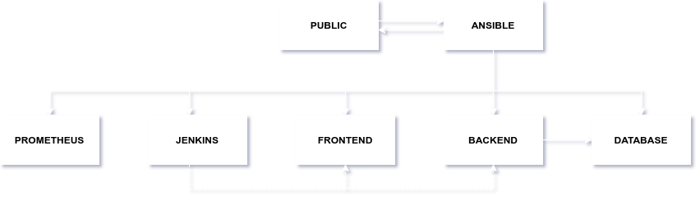

Slide 4
Deploy PHP Application in cPanel
01

Slide 5
Deploy PHP Application in cPanel
Project Laravel
Transfer File
Add SSL
Daftar cPanel
Install Project Laravel

Slide 6
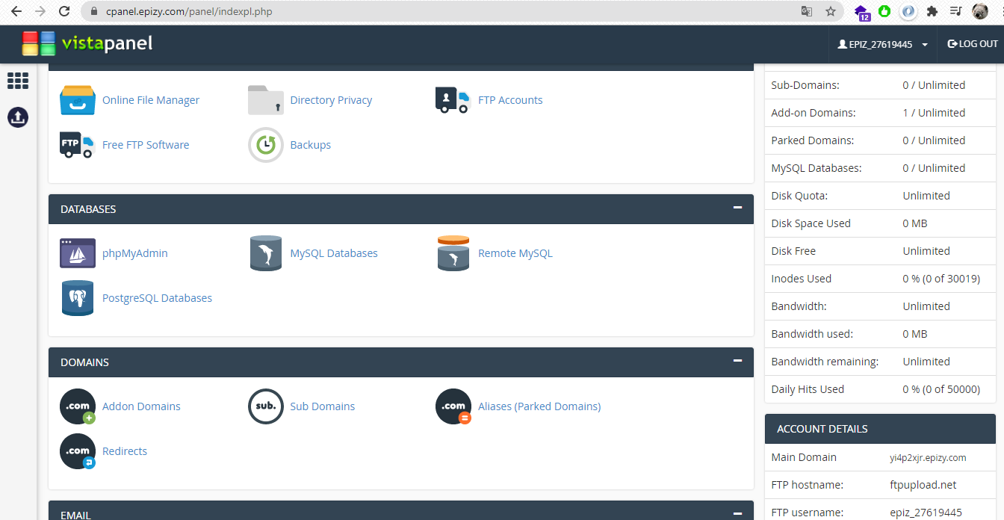
Deploy PHP Application in cPanel

Slide 7
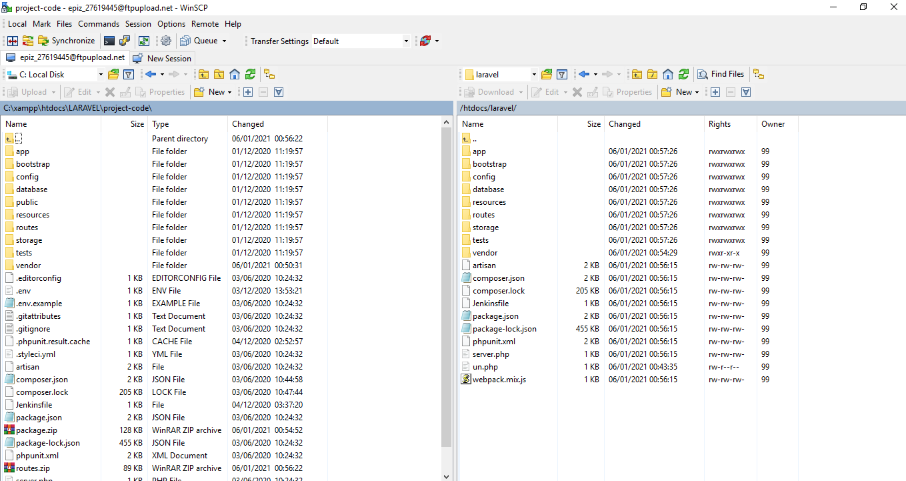
Deploy PHP Application in cPanel

Slide 8
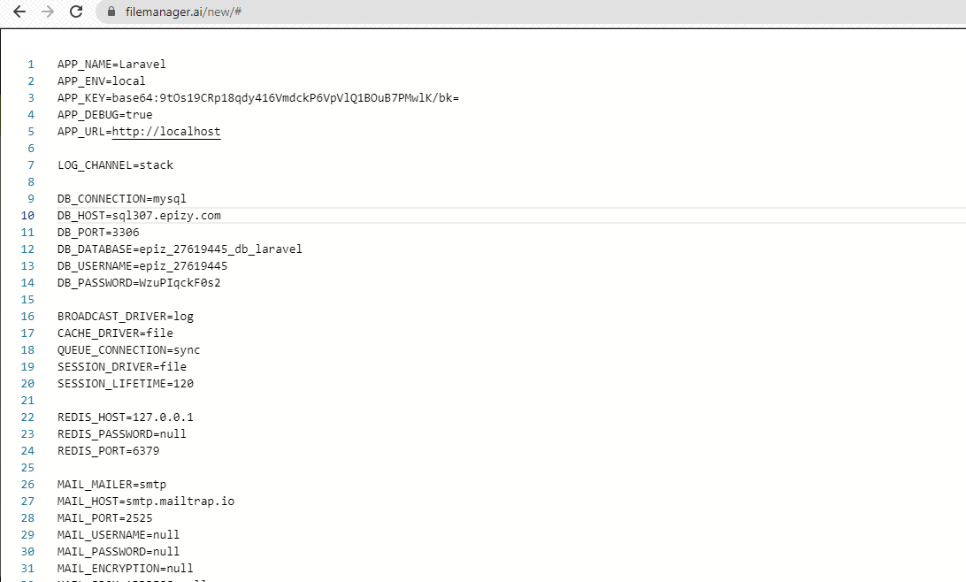
Deploy PHP Application in cPanel

Slide 9
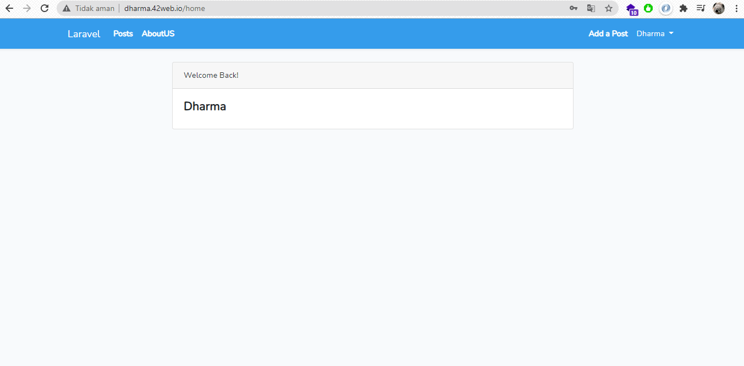
Deploy PHP Application in cPanel

Slide 10
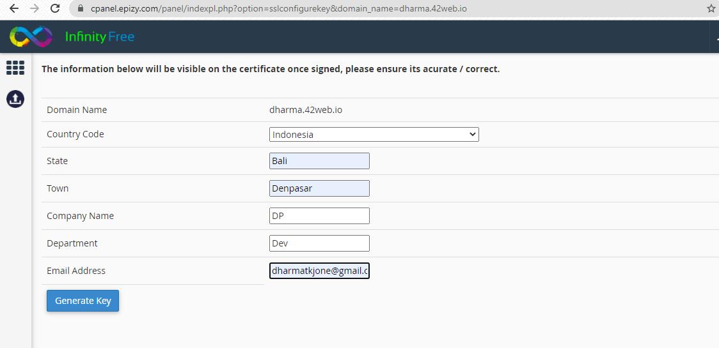
Deploy PHP Application in cPanel

Slide 11
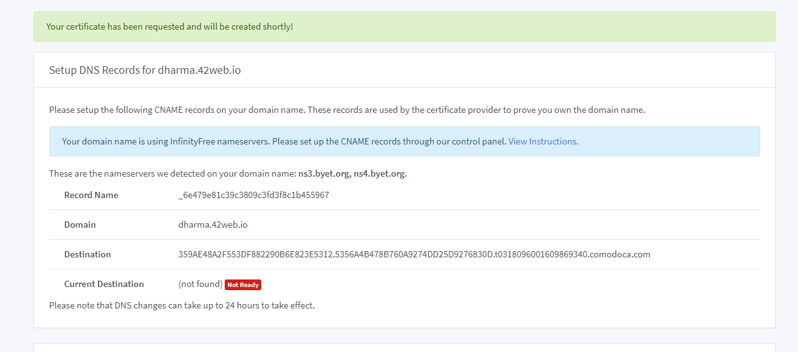
Deploy PHP Application in cPanel

Slide 12
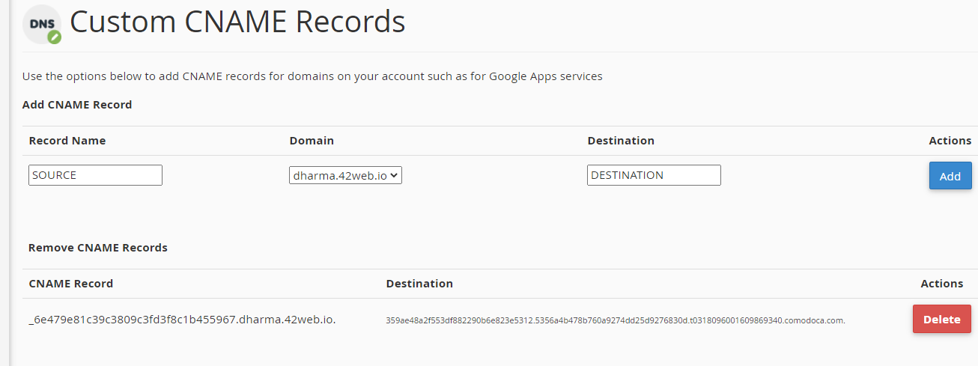
Deploy PHP Application in cPanel

Slide 13
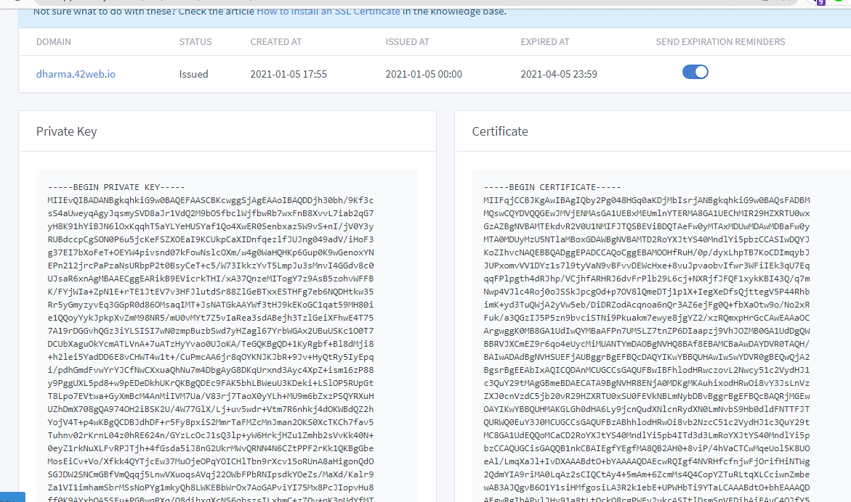
Deploy PHP Application in cPanel

Slide 14
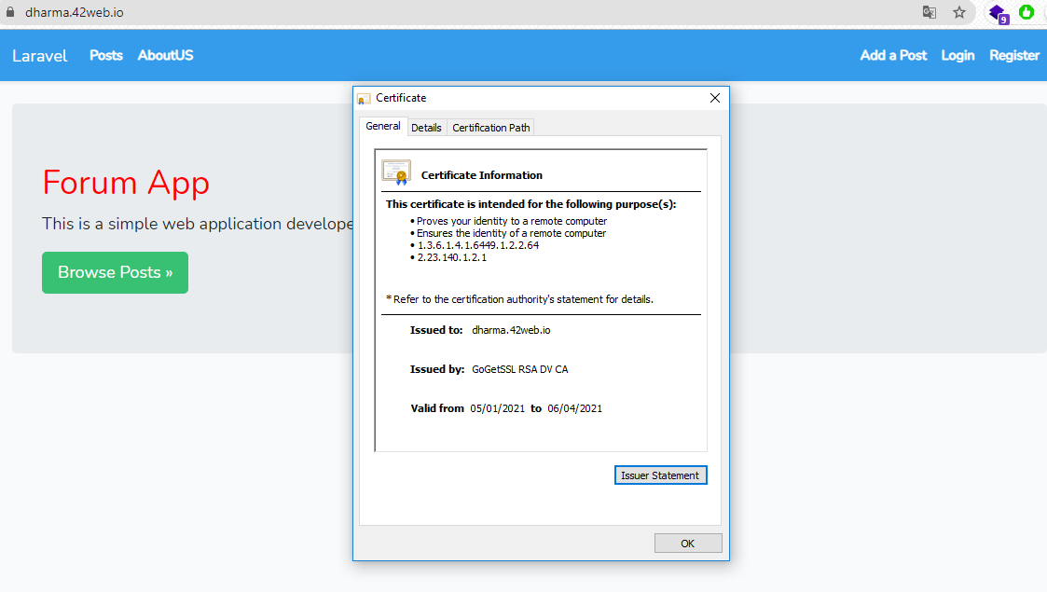
Deploy PHP Application in cPanel

Slide 15
Setup Server with Ansible
02

Slide 16
Setup Server with Ansible
Install Python
apt install python
Add Ansible repository
sudo apt-add-repository ppa:ansible/ansible
Update cache
apt update
Install Ansible
apt install ansible

Slide 17
Setup Server with Ansible
Create Inventory
Membuat inventory berisi host remote
Create User and Group
Buat user dan group pada server remote
Aplikasi Pendukung
Install Modul
Nginx
Mysql
Docker
- Node exporter
- Grafana
- Jenkins
- housy
Install aplikasi pendukung
Try and error
Percobaan

Slide 18
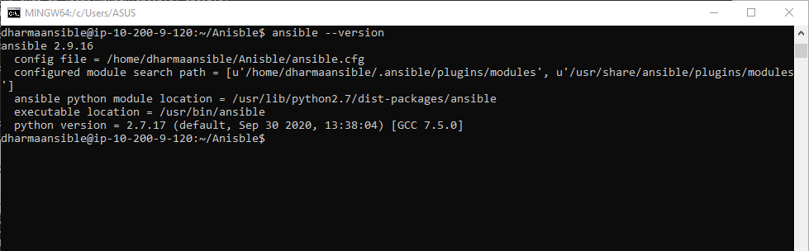
Setup Server with Ansible

Slide 19
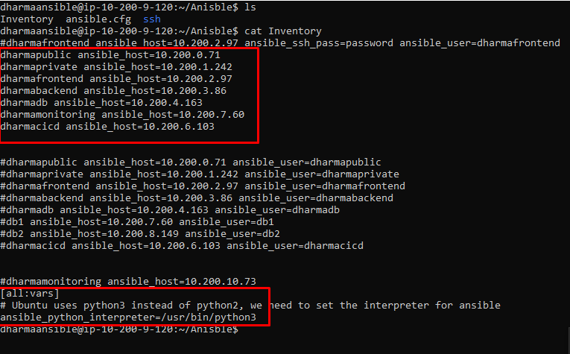
Setup Server with Ansible

Slide 20
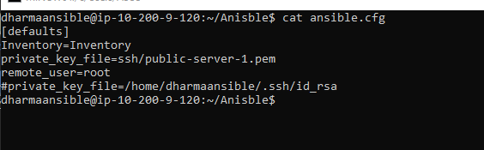
Setup Server with Ansible

Slide 21
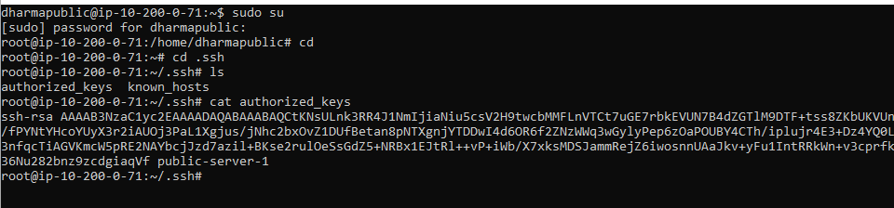
Setup Server with Ansible

Slide 22
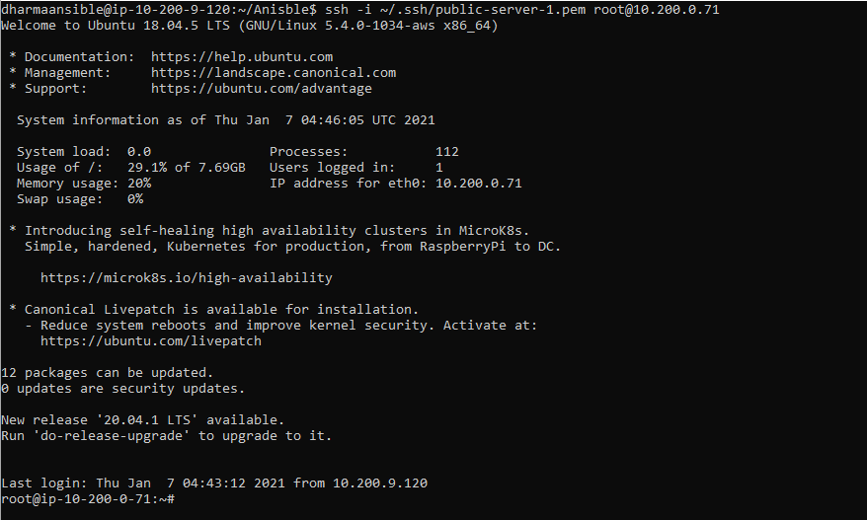
Setup Server with Ansible

Slide 23
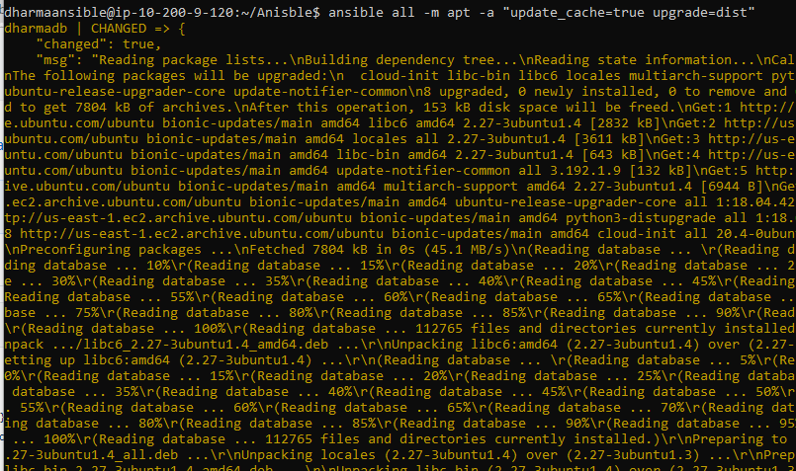
Setup Server with Ansible

Slide 24
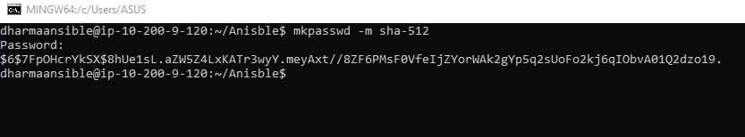
Setup Server with Ansible

Slide 25
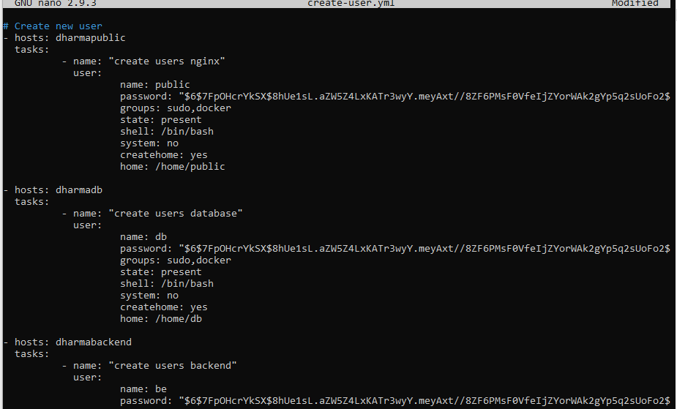
Setup Server with Ansible

Slide 26
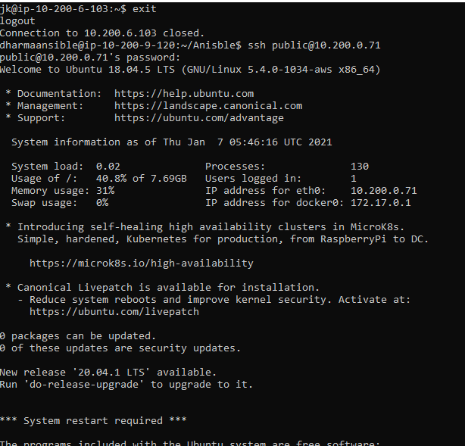
Setup Server with Ansible

Slide 27
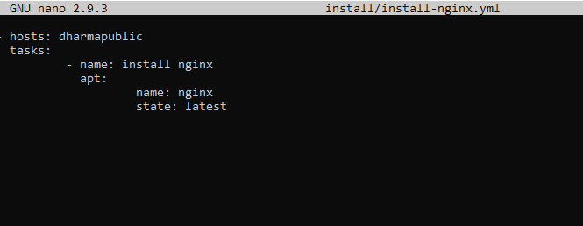
Setup Server with Ansible

Slide 28
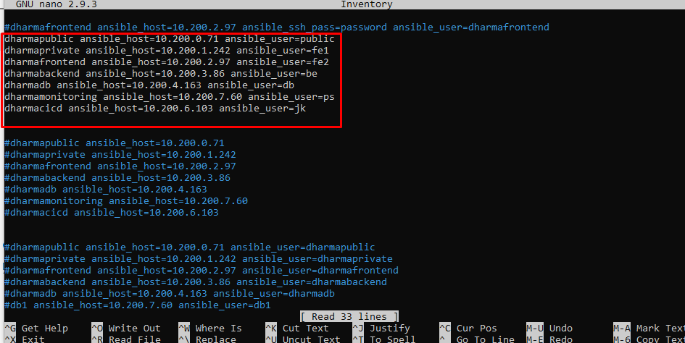
Setup Server with Ansible

Slide 29
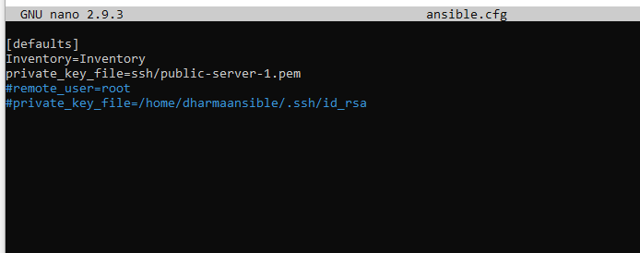
Setup Server with Ansible

Slide 30
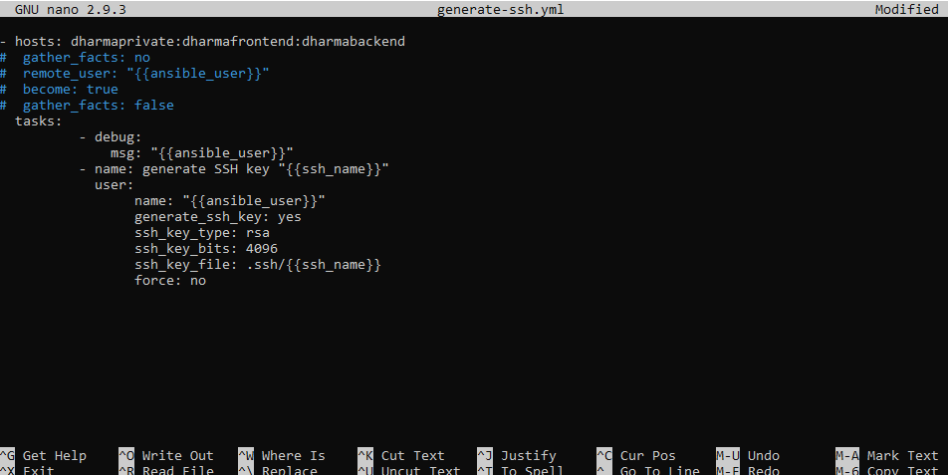
Setup Server with Ansible

Slide 31
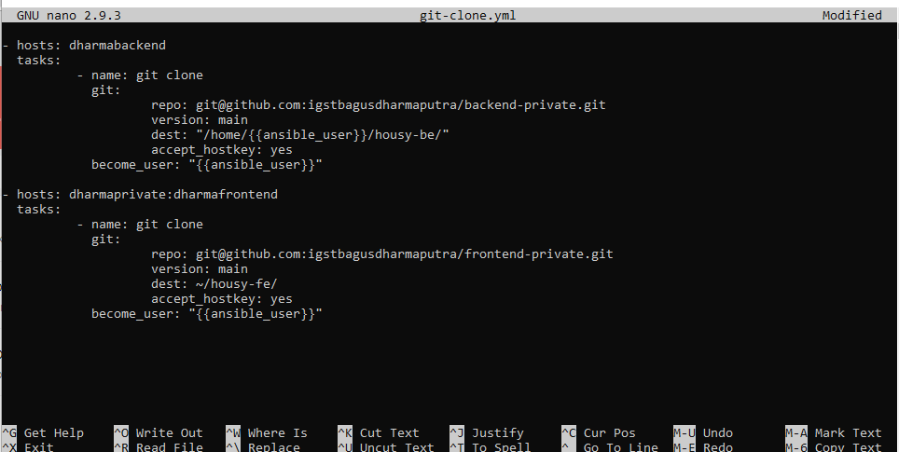
Setup Server with Ansible

Slide 32
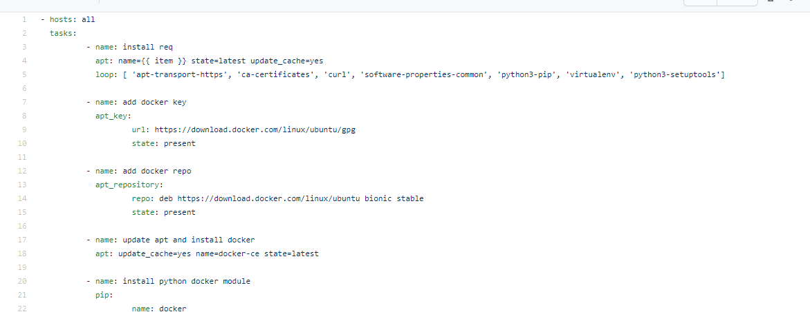
Setup Server with Ansible

Slide 33
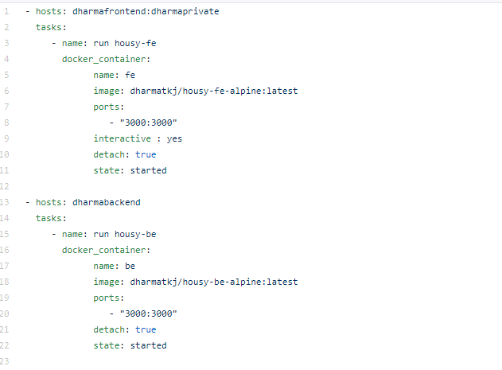
Setup Server with Ansible

Slide 34
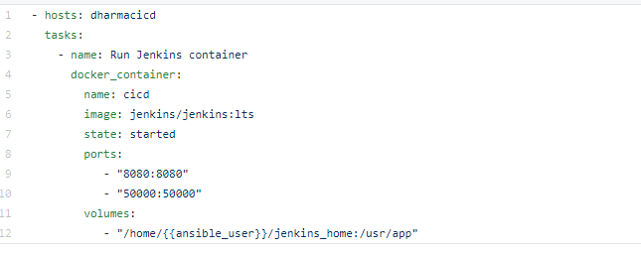
Setup Server with Ansible

Slide 35
Setup Monitoring Server
03

Slide 36
Setup Monitoring Server
Docker
Cepat dan Mudah
Manual
Paham Konsep

Slide 37
Setup Monitoring Server
Download & Extract
Bisa menggunakan wget / curl
Docker Run
Get Image and run with volume
Copy & Chown
Promtool & prometheus /usr/local/bin/
consoles & console_library
/etc/prometheus
Config
/etc/prometheus/prometheus.yml
Config Promethes
/etc/systemd/system/prometheus.service
/etc/prometheus/prometheus.yml
Start service
daemon-reload
start prometheus

Slide 38
Setup Monitoring Server
Create Ansible-playbook config
Add credentials
SSL Let’s Encrypt
Copy to Public Server
Reverse Proxy
Create Reverse Proxy File
Copy to Public Server

Slide 39
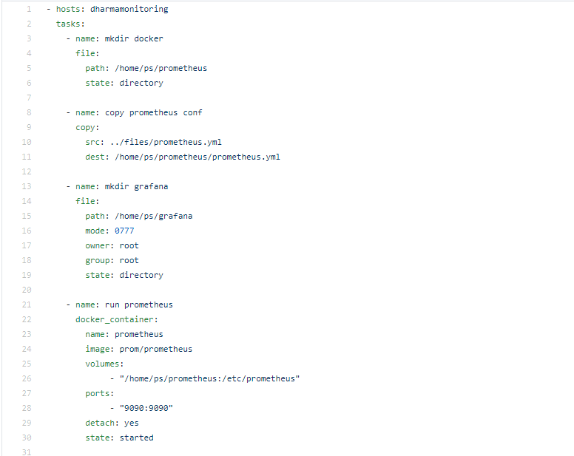
Setup Monitoring Server

Slide 40
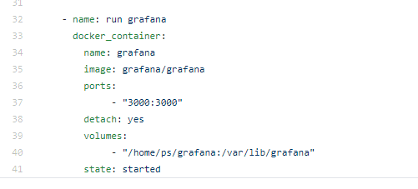
Setup Monitoring Server

Slide 41
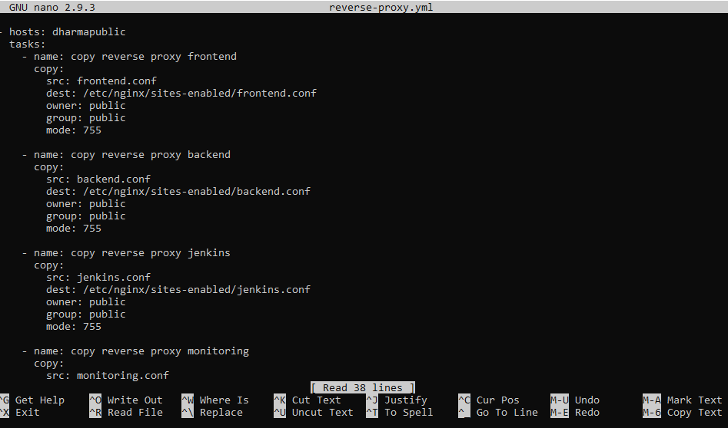
Setup Monitoring Server

Slide 42
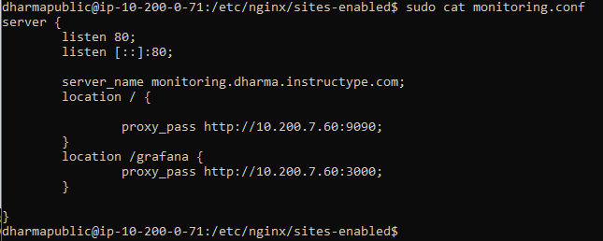
Setup Monitoring Server

Slide 43
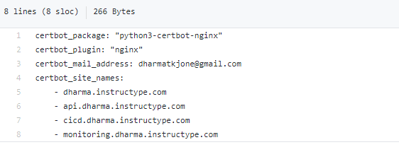
Setup Monitoring Server

Slide 44
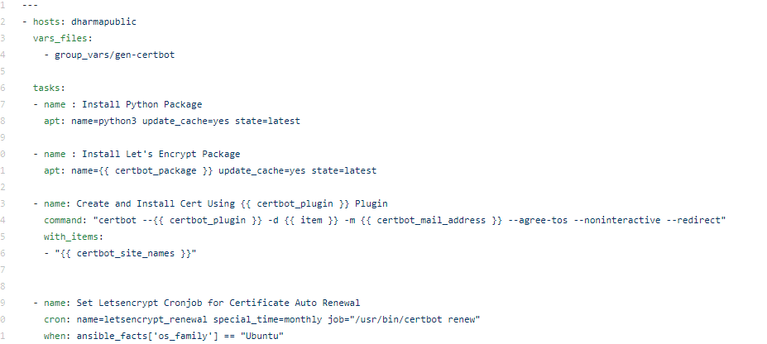
Setup Monitoring Server

Slide 45
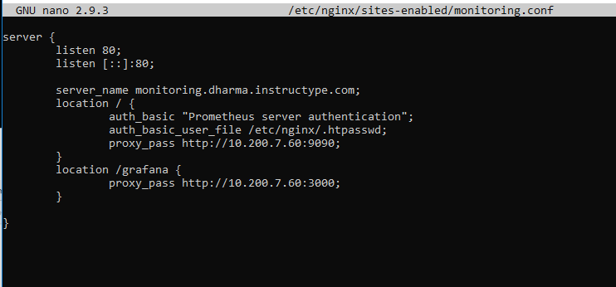
Setup Monitoring Server

Slide 46
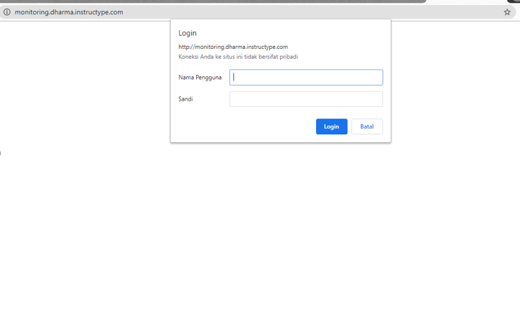
Setup Monitoring Server

Slide 47
Connect Multiple Server to Prometheus
04

Slide 48
Connect Multiple Server to Prometheus
01
02
03
Install node exporter
Config Prometheus
Check Target Prometheus
Install node exporter with docker
Add host target with port 9100 open
Check endpoint state, make sure it’s up
06
04
Customize Grafana
Import Data to Grafana
Dashboard theme
Copy all prometheus target into grafana

Slide 49
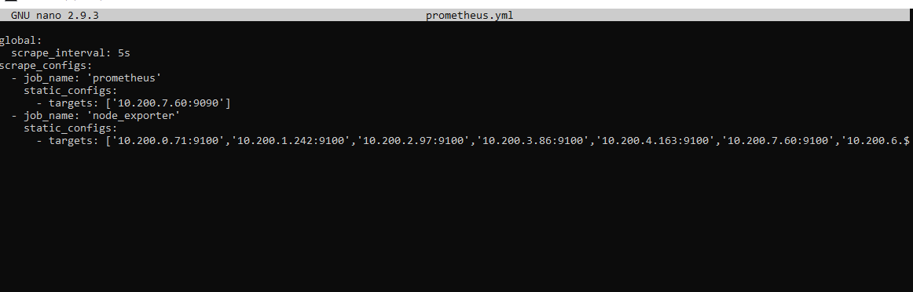
Setup Monitoring Server

Slide 50
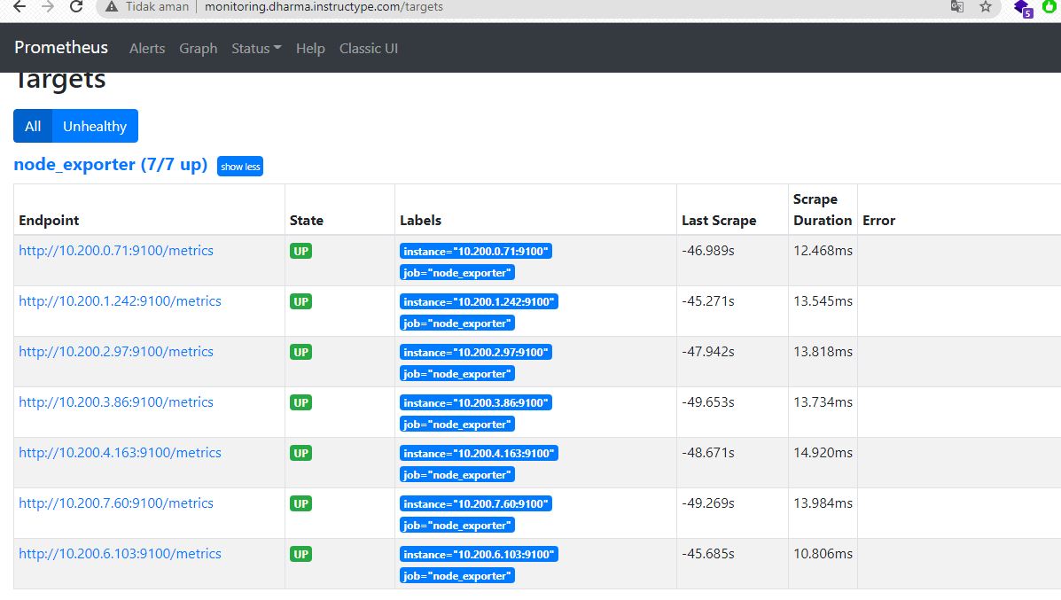
Setup Monitoring Server

Slide 51
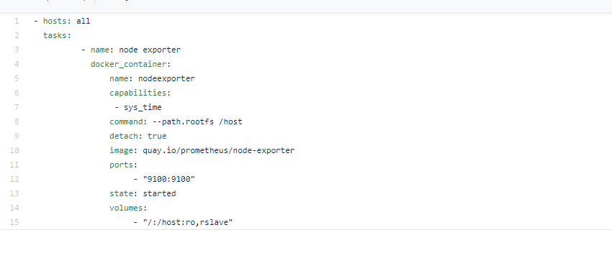
Setup Monitoring Server

Slide 52
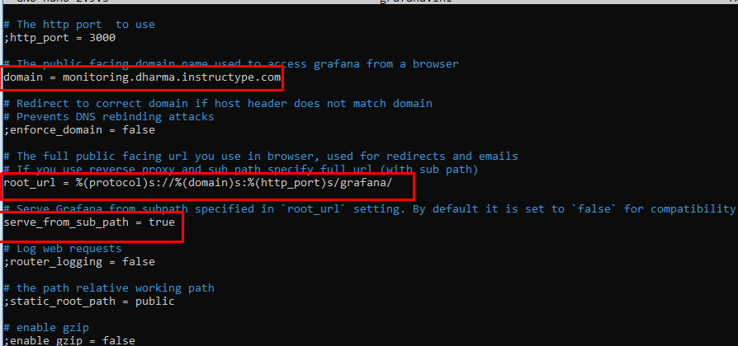
Setup Monitoring Server

Slide 53
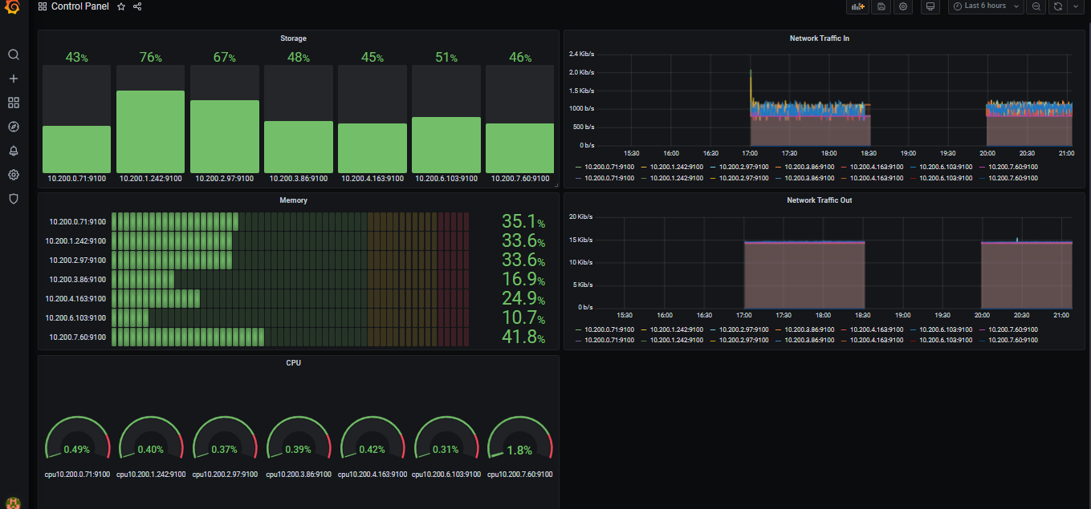
Setup Monitoring Server

Slide 54
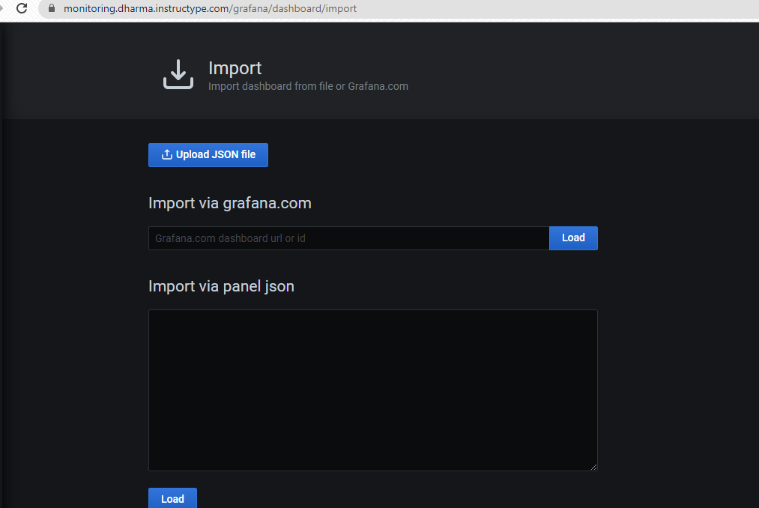
Setup Monitoring Server

Slide 55
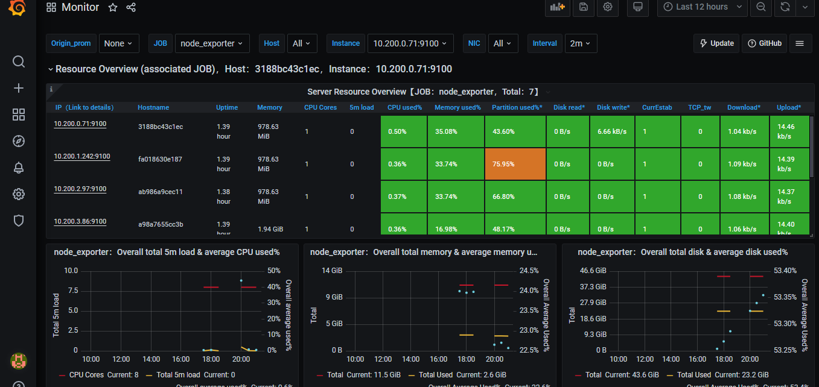
Setup Monitoring Server

Slide 56
DEMO

Slide 57
EXPLORE KUBERNETES

Slide 58
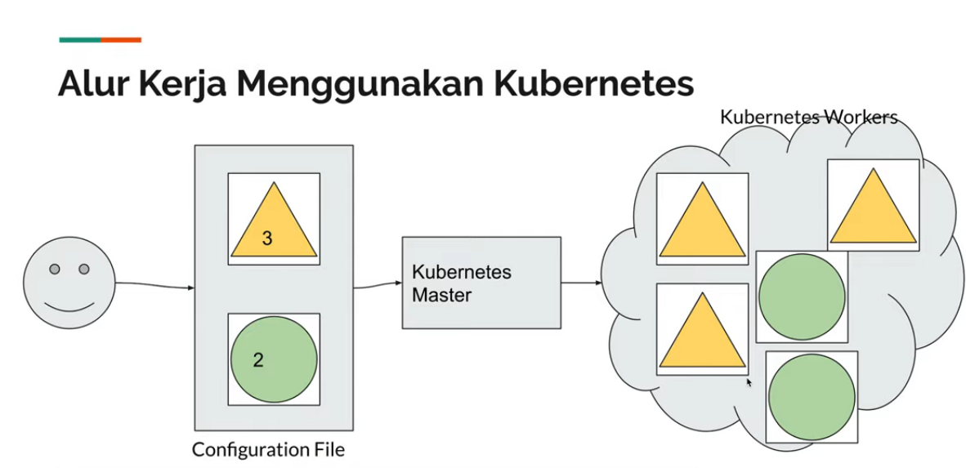
https://www.youtube.com/c/ProgrammerZamanNow

Slide 59
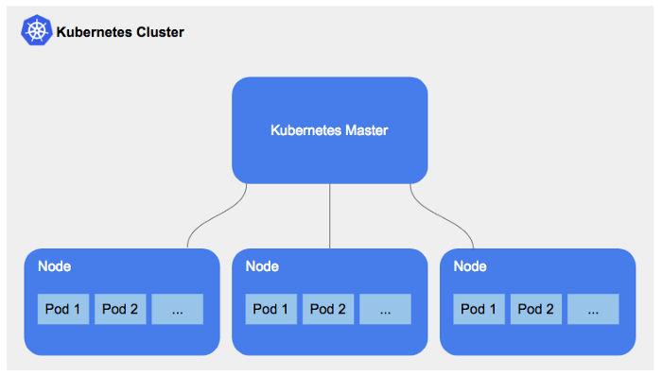
Notes:
https://medium.com/@tomerf/so-you-want-to-configure-the-perfect-db-cluster-inside-a-kubernetes-cluster-a4d2c26aca7a

Slide 60
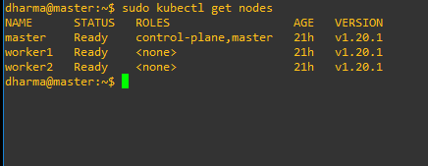

Slide 61
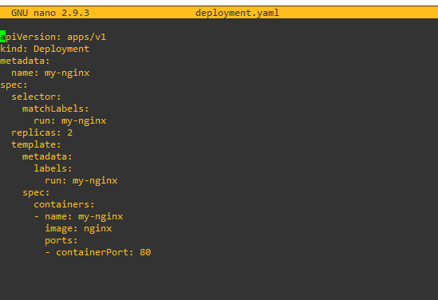

Slide 62
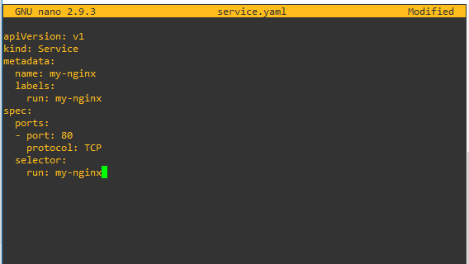

Slide 63
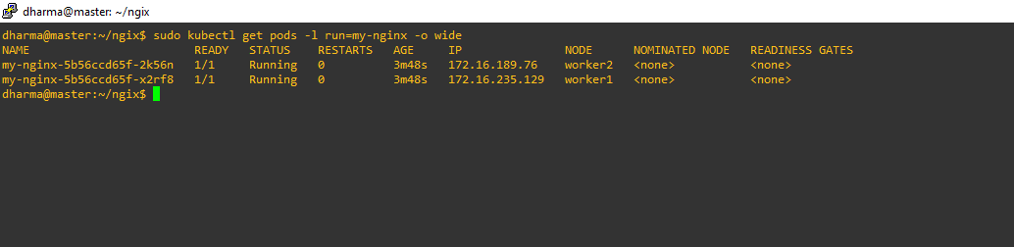

Slide 64
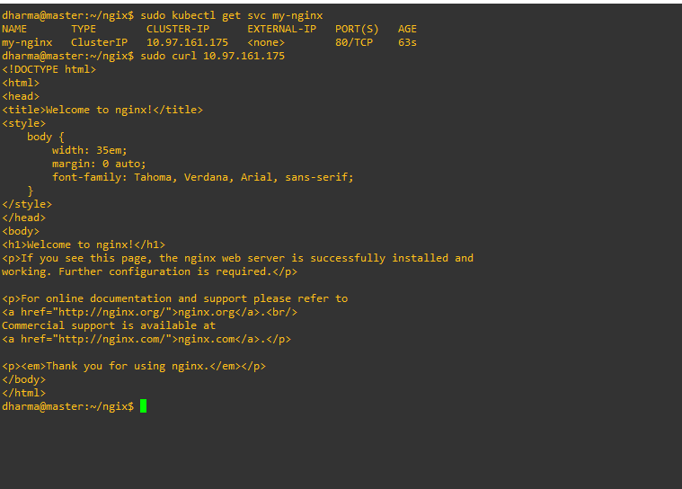

Slide 65
THANK
YOU

