Slide 1
DUMBWAYS BOOTCAMP 2ND WEEK
I Gusti Bagus Dharma Putra

Slide 2
MANAGE CODE AND DATABASE

Slide 3
01
03
05
Install Git & SSH Key
Deploy Backend
Custom Domain
02
04
Setup Database
Reverse Proxy
06
Config SSL

Slide 4
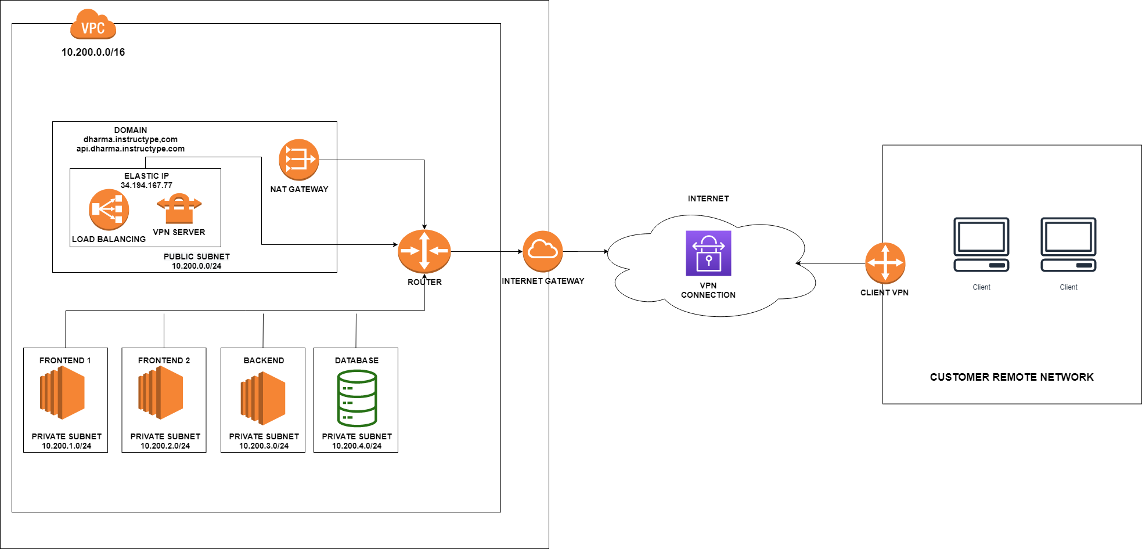
AWS Architecture for Application

Slide 5
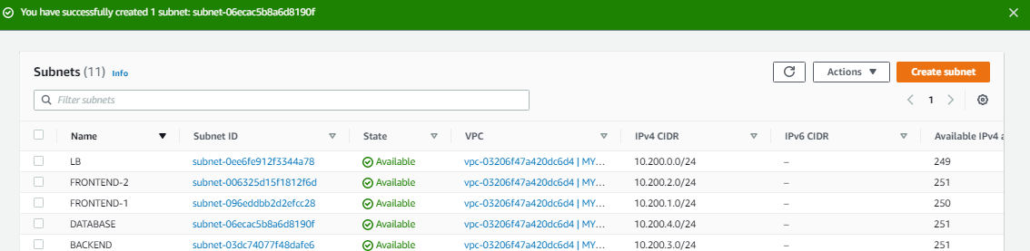
Setup Instance and Network

Slide 6
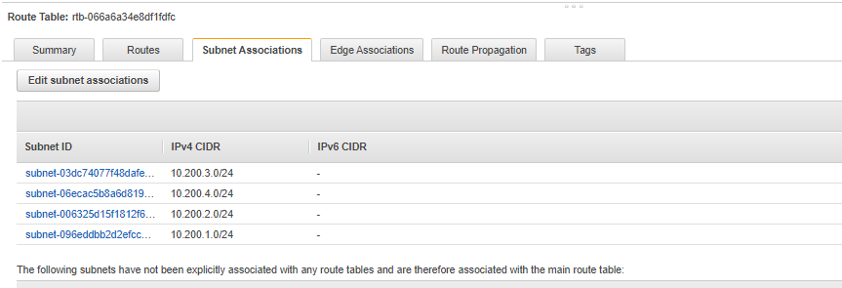
Setup Instance and Network

Slide 7
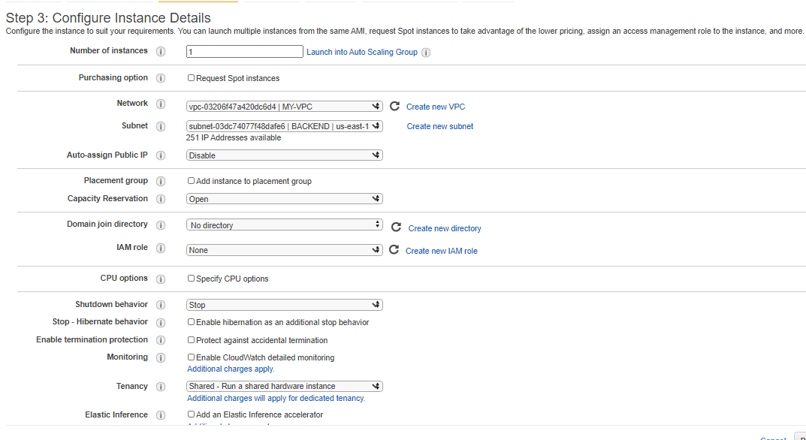
Setup Instance and Network

Slide 8
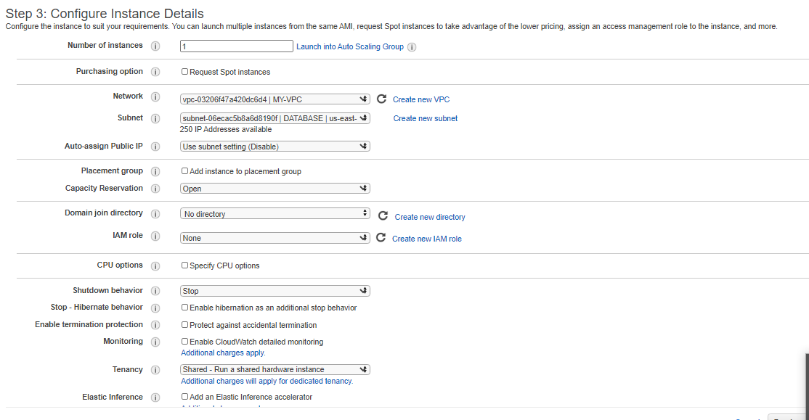
Setup Instance and Network

Slide 9
01
Install Git & SSH Key

Slide 10
Install Git & SSH Key
1. Fork & Make Private
2. Create & Initiate SSH Keys
3. Connect and Clone
Fork repository sgnd/housy-backend dan buat private repository agar hanya bisa diakses melalui server dengan SSH keys.
Menghubungkan server dengan github melalui SSH dan clone repository.
4. Test and Push
Buat SSH Keys dan masukkan ke dalam akun github.
Mencoba melakukan beberapa perubahan pada source code dan push ke repository github.

Slide 11
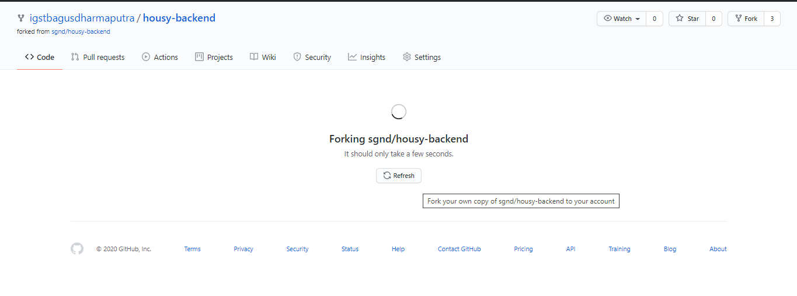
Install Git & SSH Key
FORK REPOSITORY

Slide 12
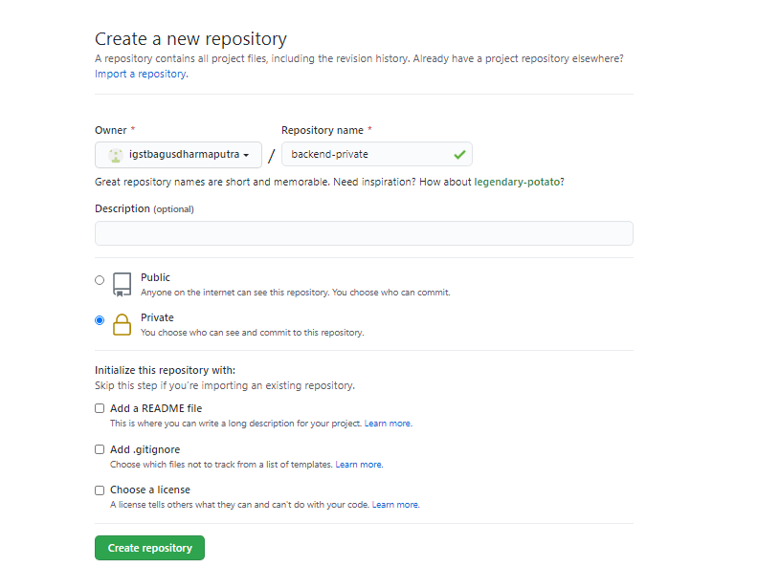
Install Git & SSH Key
PRIVATE REPOSITORY

Slide 13
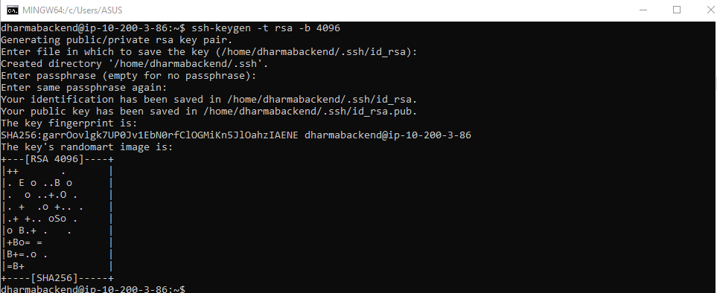
Install Git & SSH Key
GENERATE SSH KEY

Slide 14
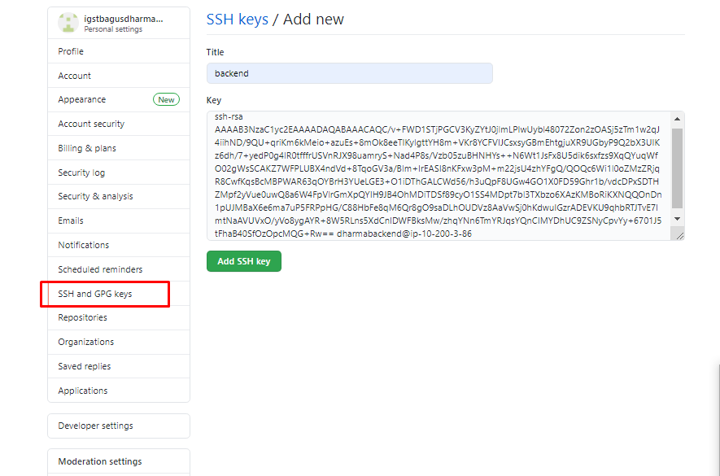
Install Git & SSH Key
DEPLOY SSH KEY PUBLIC TO GITHUB

Slide 15
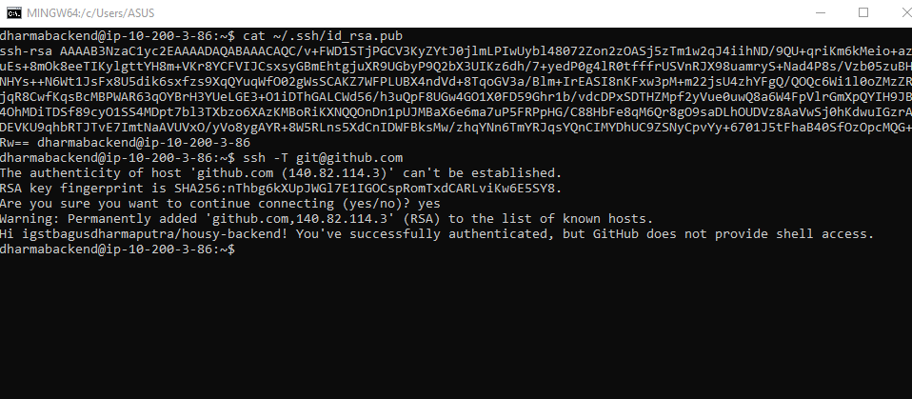
Install Git & SSH Key
CONNECT SERVER FROM SSH

Slide 16
Install Git & SSH Key
CLONE REPOSITORY

Slide 17
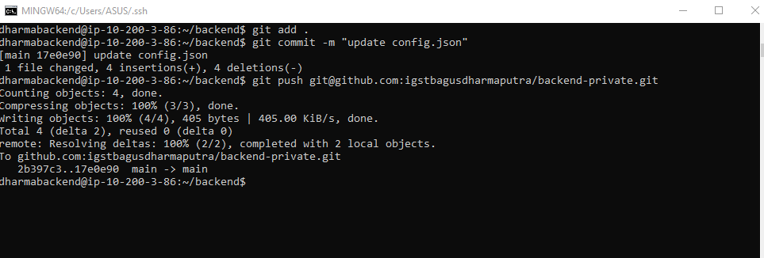
Install Git & SSH Key
EDIT SOURCE CODE AND PUSH GITHUB REPOSITORY

Slide 18
02
Setup Database

Slide 19
SETUP DATABASE
1. INSTALL MYSQL SERVER 5.7
2. Tambah User
3. Test Koneksi
Instal MySQL server versi 5.7 melalui apt install, ganti bind-address dan buat database db_housy
Melakukan koneksi ke database server melalui server backend yang sudah terinstall mysql client.
Menambahkan user yang memiliki semua akses ke database melalui server backend

Slide 20
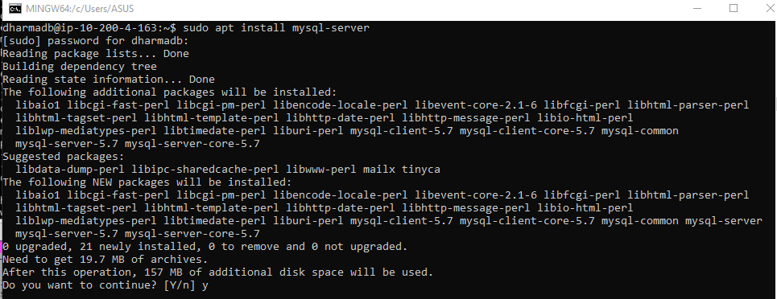
Setup Database
INSTALL MYSQL SERVER 5.7

Slide 21
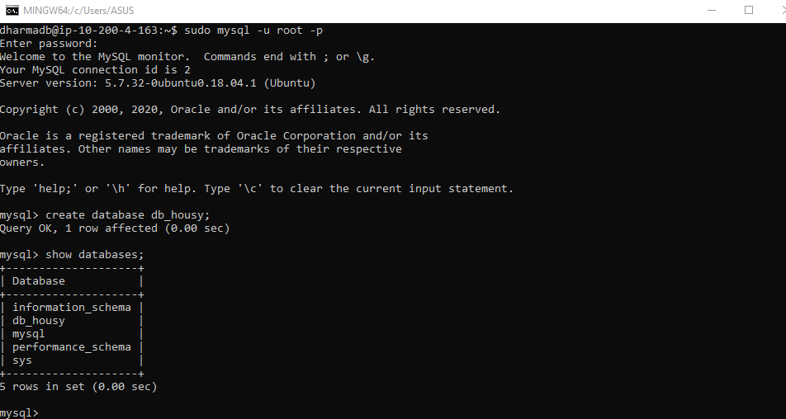
Setup Database
CREATE DATABASE

Slide 22
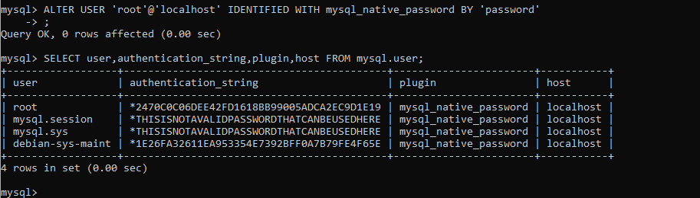
Setup Database
EDIT PASSWORD USER ROOT

Slide 23
Setup Database
EDIT PASSWORD USER ROOT

Slide 24
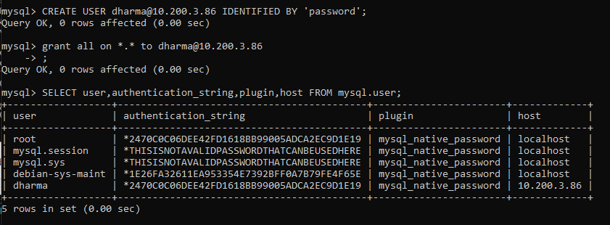
Setup Database
CREATE USER FOR BACKEND SERVER

Slide 25
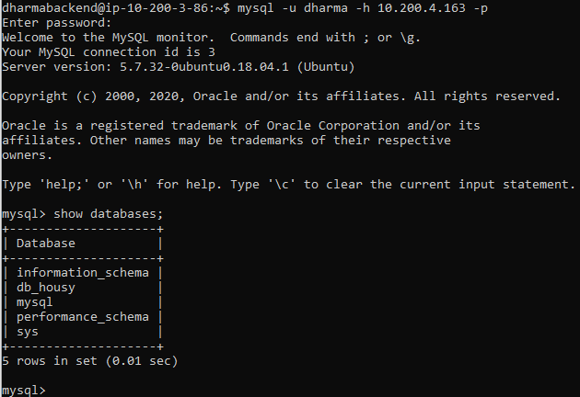
Setup Database
TEST CONNECTION

Slide 26
03
Deploy Backend

Slide 27
Deploy Backend
1. Install Node JS
2. Install dependency package atau module
3. Connect Database
4. Migrate
5. Start pm2

Slide 28
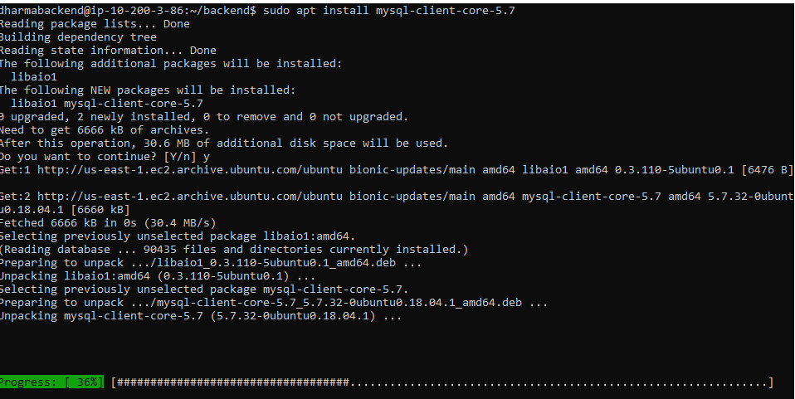
Deploy Backend
INSTALL MYSQL CLIENT

Slide 29
Deploy Backend
TEST CONNECTION

Slide 30
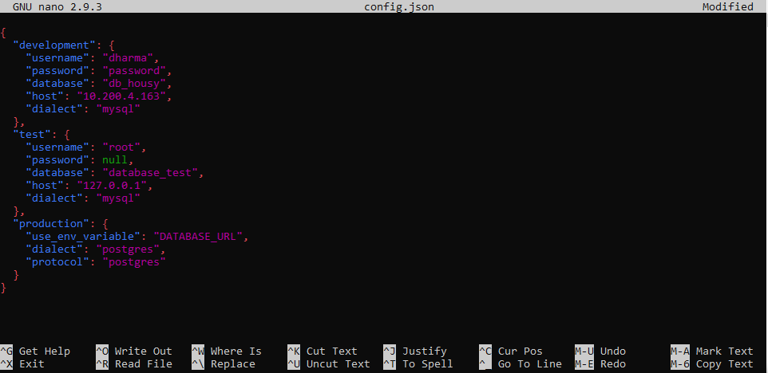
Deploy Backend
EDIT CONFIG.JSON

Slide 31
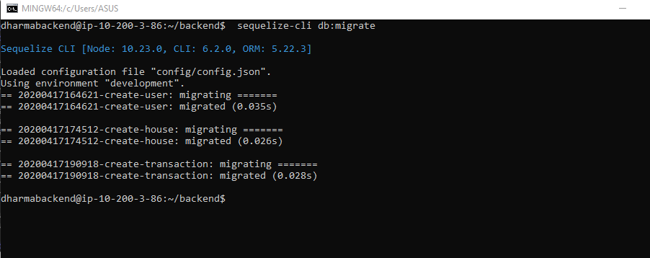
Deploy Backend
MIGRATE

Slide 32
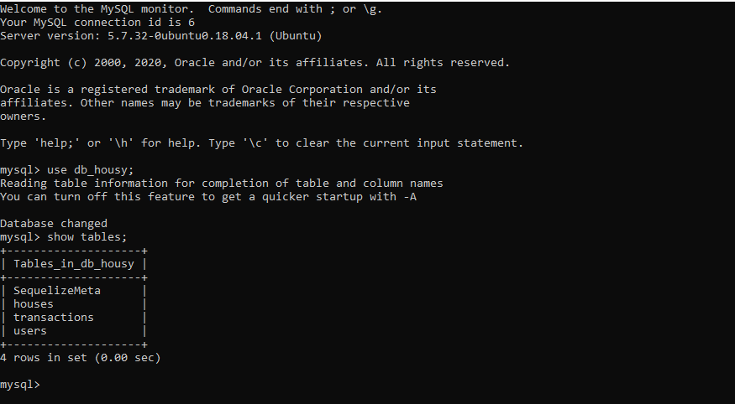
Deploy Backend
SHOW TABLE

Slide 33
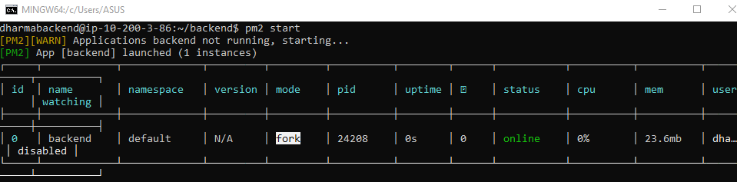
Deploy Backend
RUN APPLICATION

Slide 34
04
REVERSE PROXY

Slide 35
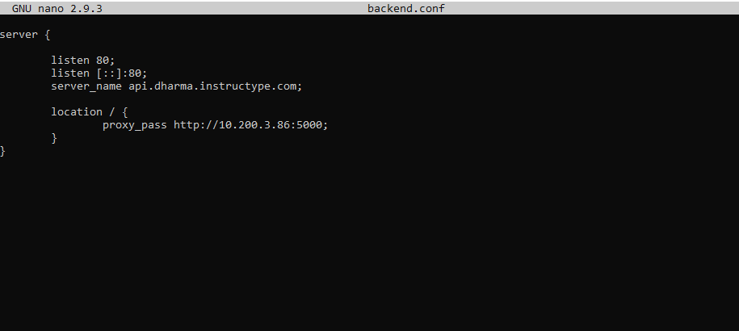
REVERSE PROXY
REVERSE PROXY FOR BACKEND

Slide 36
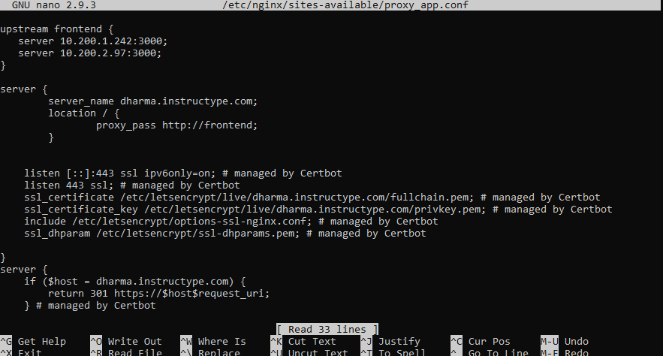
LOAD BALANCING
LOAD BALANCING FOR FRONTEND

Slide 37
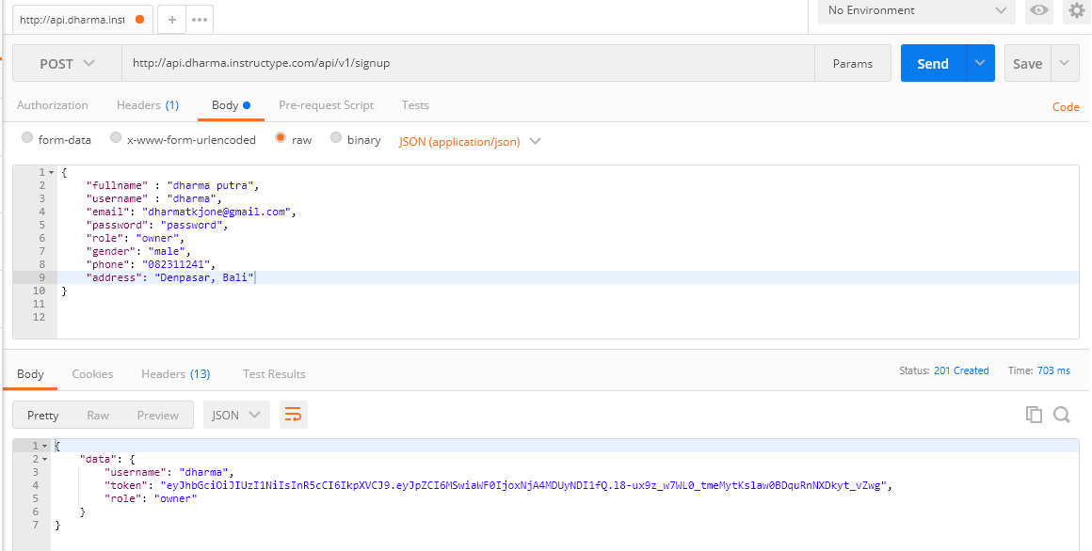
REVERSE PROXY
CREATE USER FROM API POSTMAN

Slide 38
05
CUSTOM DOMAIN

Slide 39
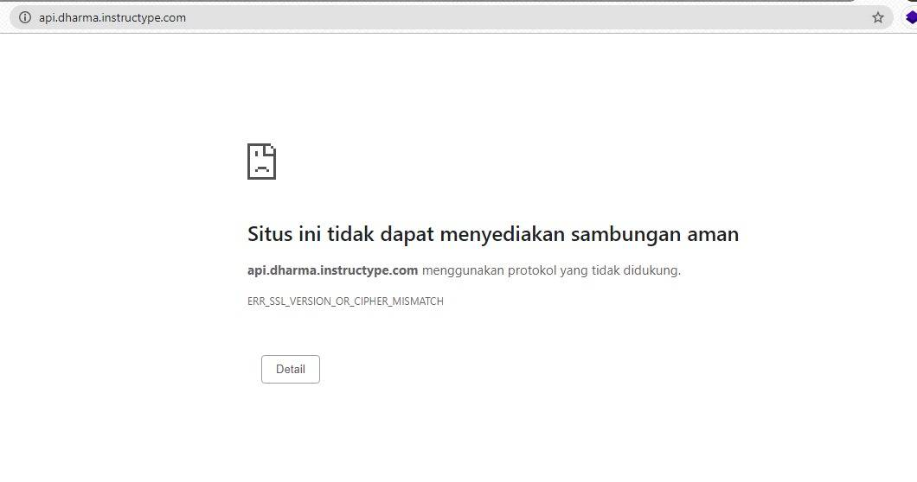
CUSTOM DOMAIN
ERROR SSL

Slide 40
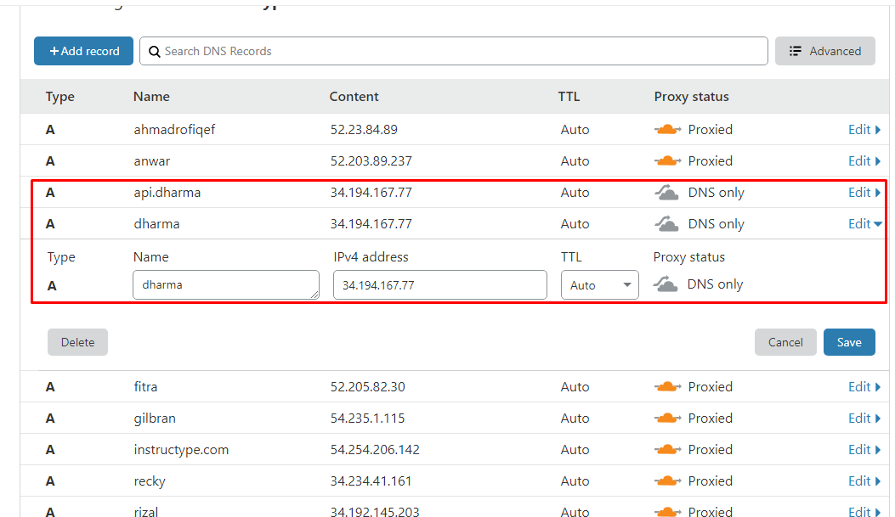
CUSTOM DOMAIN
ADD DOMAIN

Slide 41
06
SSL CONFIG

Slide 42
Config & Certificate
Certbot
Periksa konfigurasi reverse proxy untuk api dan cek https
Tambahkan Let’s Encrypt SSL dengan bantuan Certbot
Add API
Login
Tes login ke website utama dengan akun yang sudah dibuat
Tambahkan website api ke pengaturan frontend

Slide 43
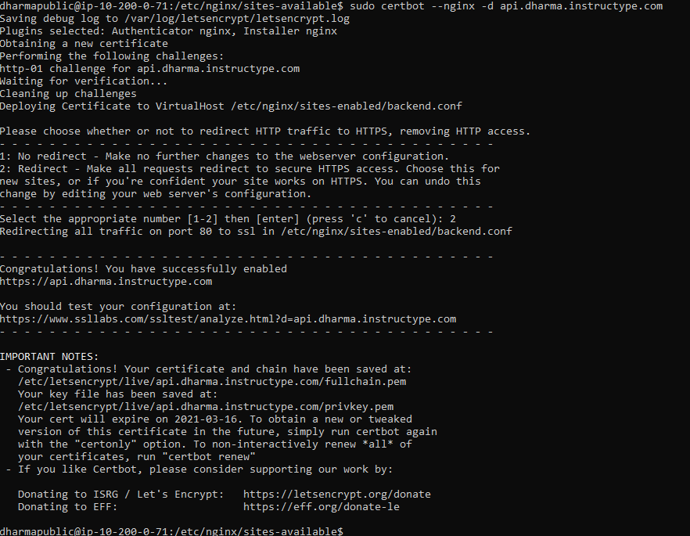
SSL CONFIG
CERTBOT

Slide 44
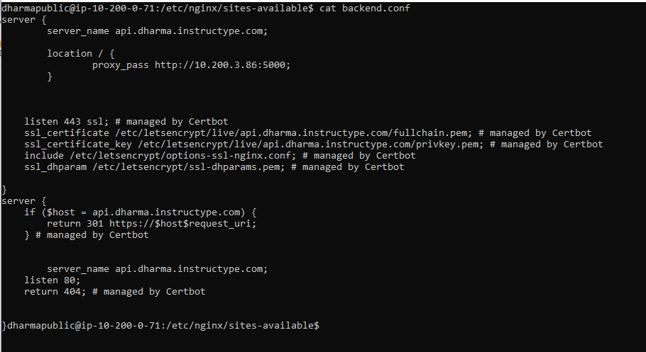
SSL CONFIG
VIRTUALHOST BACKEND

Slide 45
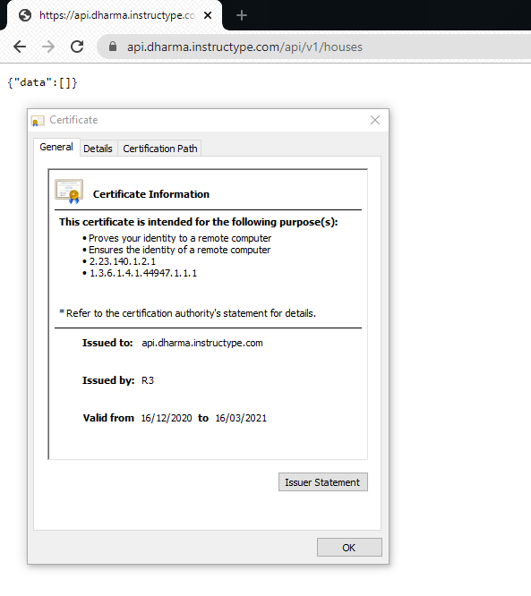
SSL CONFIG
CERTIFICATE SSL

Slide 46
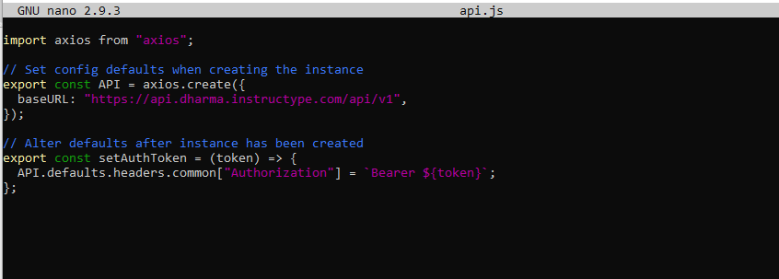
SSL CONFIG
EDIT FILE api.js FRONTEND

Slide 47
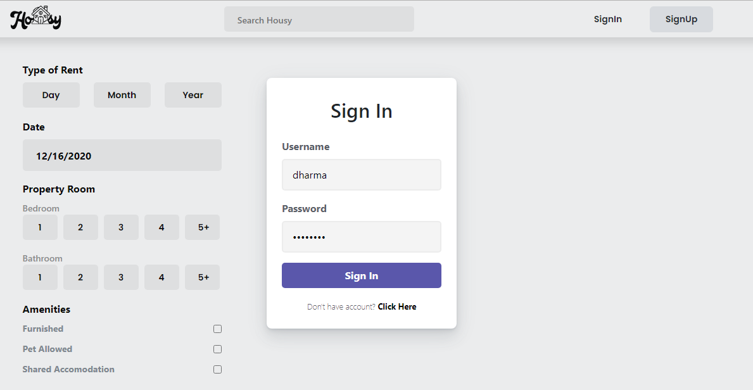
SSL CONFIG
TEST LOGIN

Slide 48
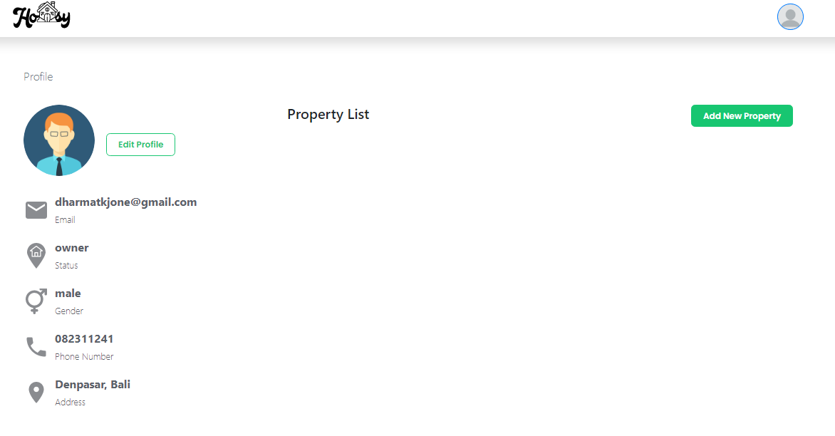
SSL CONFIG

Slide 49
07
ACCESS IP PRIVATE FROM EXTERNAL NETWORK

Slide 50
ACCESS IP PRIVATE FROM EXTERNAL NETWORK
1. VPN SERVER
2. IPTABLE (FIREWALL)
3. VPN CLIENT

Slide 51
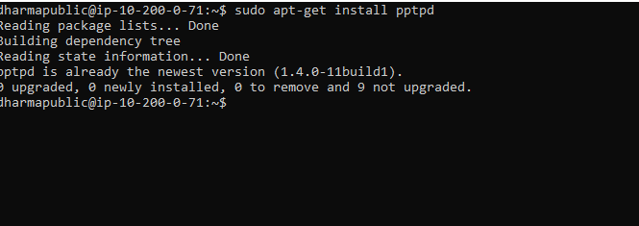
VPN SERVER
INSTALL PPTPD FOR VPN SERVER

Slide 52
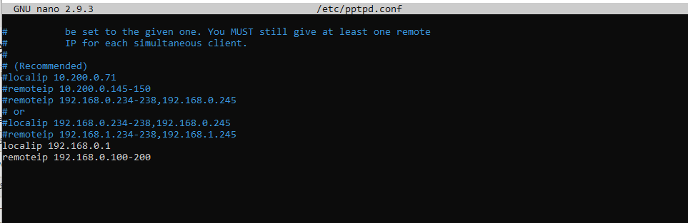
VPN SERVER
EDIT PPTPD.CONF

Slide 53
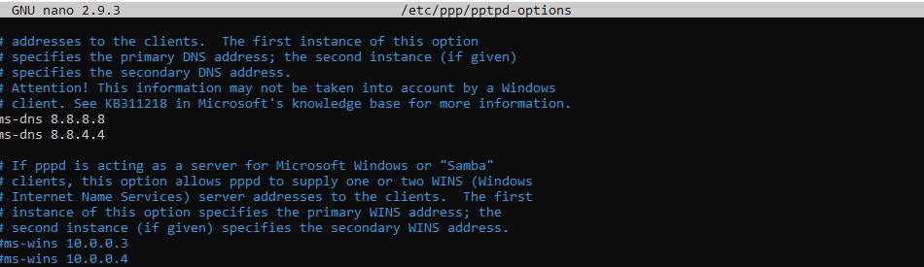
VPN SERVER
EDIT PPTPD-OPTIONS

Slide 54
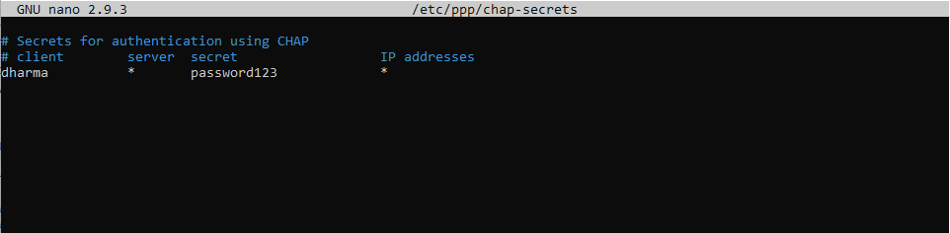
VPN SERVER
CREATE USER VPN

Slide 55
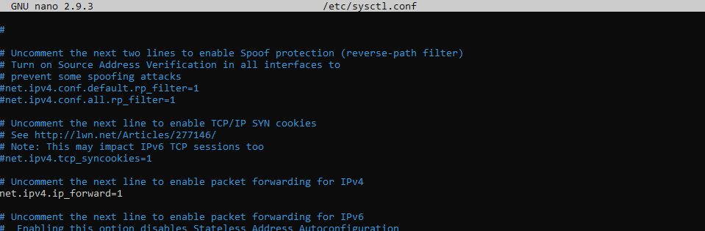
IPTABLES (FIREWALL)
FORWARDING

Slide 56
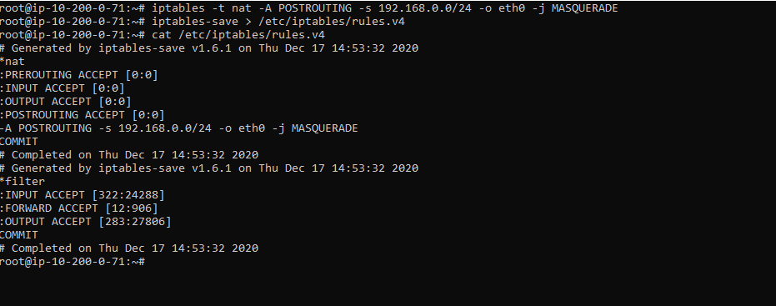
IPTABLES (FIREWALL)
NAT

Slide 57
IPTABLES (FIREWALL)
NAT

Slide 58
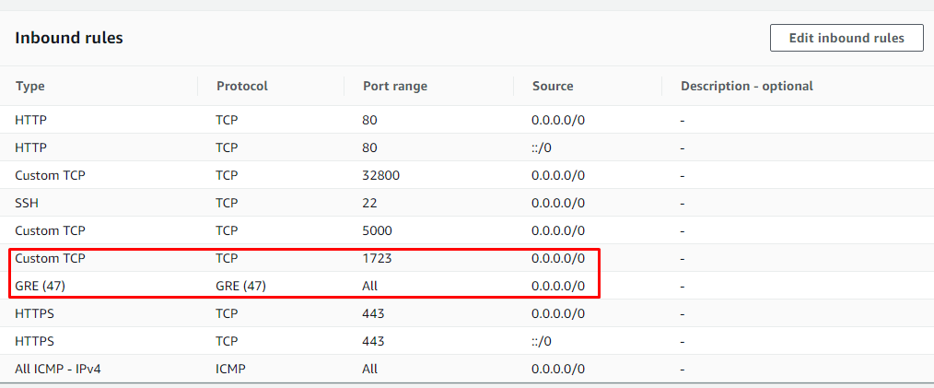
VPN CLIENT
SECURITY GROUP

Slide 59
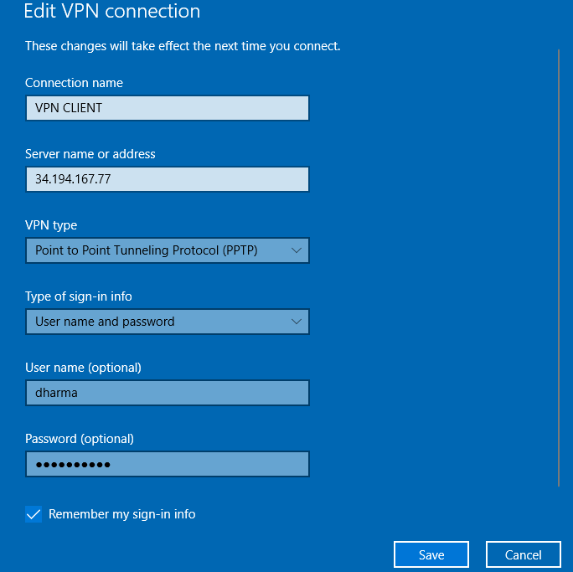
VPN CLIENT
ADD VPN CLIENT

Slide 60
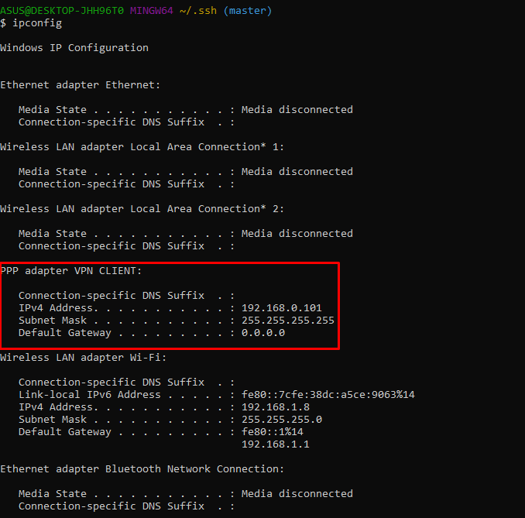
VPN CLIENT
IPCONFIG

Slide 61
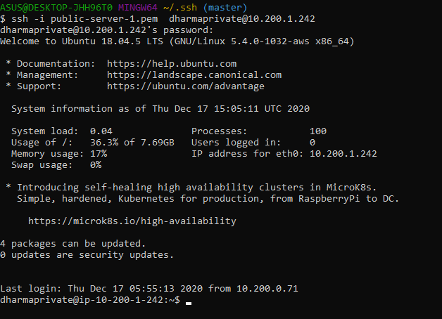
VPN CLIENT
TESTING

Slide 62
08
NGINX VS HAPROXY

Slide 63
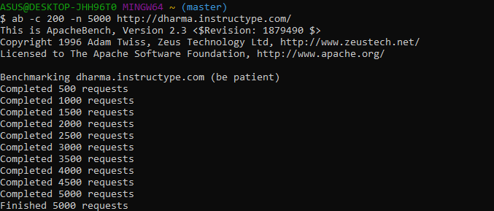
NGINX VS HAPROXY
TEST BENCHMARK

Slide 64
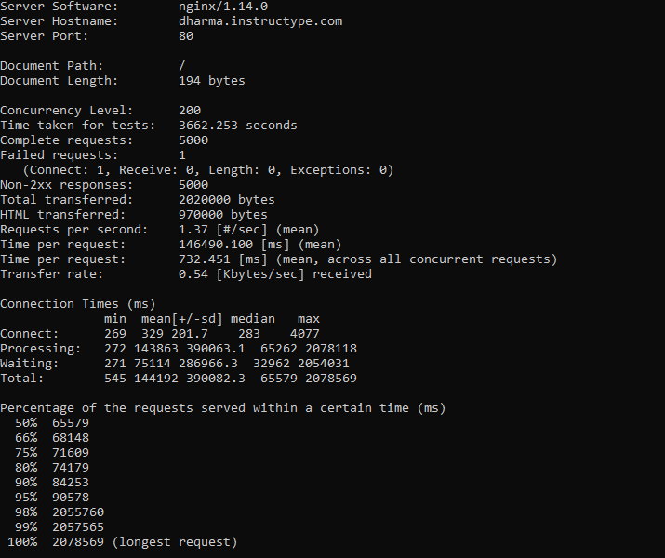
NGINX VS HAPROXY
NGINX

Slide 65
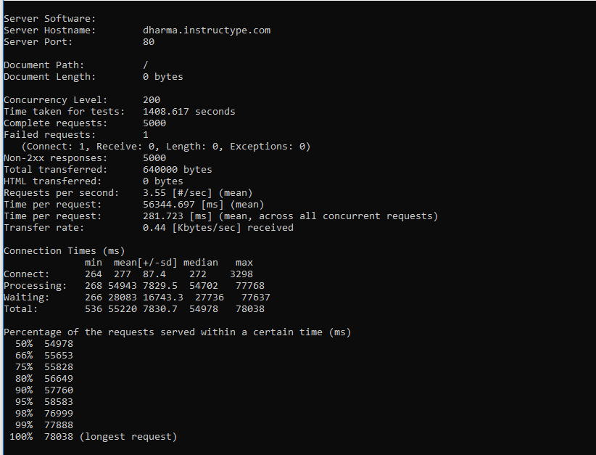
NGINX VS HAPROXY
HAPROXY

Slide 66
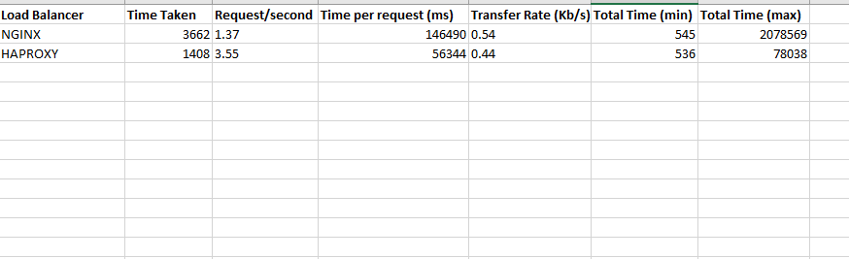
NGINX VS HAPROXY
RESULT

Slide 67


TERIMA KASIH

