Slide 1

An introduction to Vanilla and Graph Neural Networks (with metaphors)
*The art of learning the right questions-being a good journalist
Citrix
John Tzolas
11/03/2021

Slide 2
Goals of the presentation
A way to reason and think about neural networks in simple terms.
Build metaphors that capture the operations performed by vanilla and graph neural networks
Concrete steps to code a GNN with pytorch. It is not HARD ! Anyone with a basic python background can follow !

Slide 3
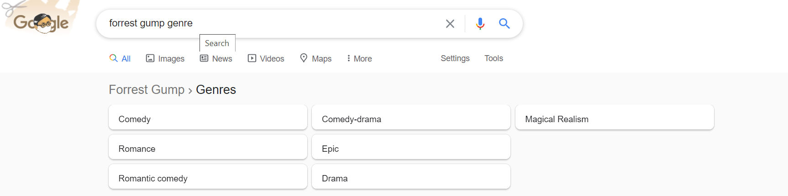
“Forrest Gump” is a movie that contains a bit of comedy, a fare amount of romance and drama, a lot of magical realism.
“Forrest Gump” = [ 0.2 0.4 0.6 0.9 ]
The movie can be represented as a vector.
This is the EMBEDDING for the movie “Forrest Gump”, which is nothing more than a VECTOR whose values represent semantic features

Slide 4

…suppose someone had not seen the movie but was provided with the embedding of the movie
What should the person do if he wanted to ask :
HOW similar is “Forrest Gump” to romantic and dramatic movies ?
comedy romance drama magical realism
“Forrest Gump” = [ 0.2 0.4 0.6 0.9 ]
A possible QUESTION could be :

Slide 5

Dot Product = Question
- If the Dot Product is a question what is a matrix multiplication ?
- We can think of matrix multiplication with a vector as asking many questions. The questions are laid in the rows of the matrix.
Matrix Vector Multiplication = Questionnaire

Slide 6
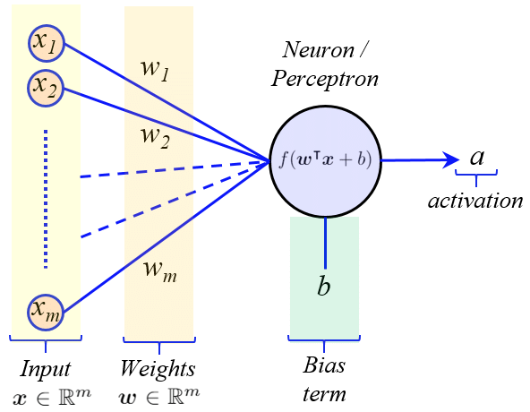
Single Neuron asks a single Question

Slide 7
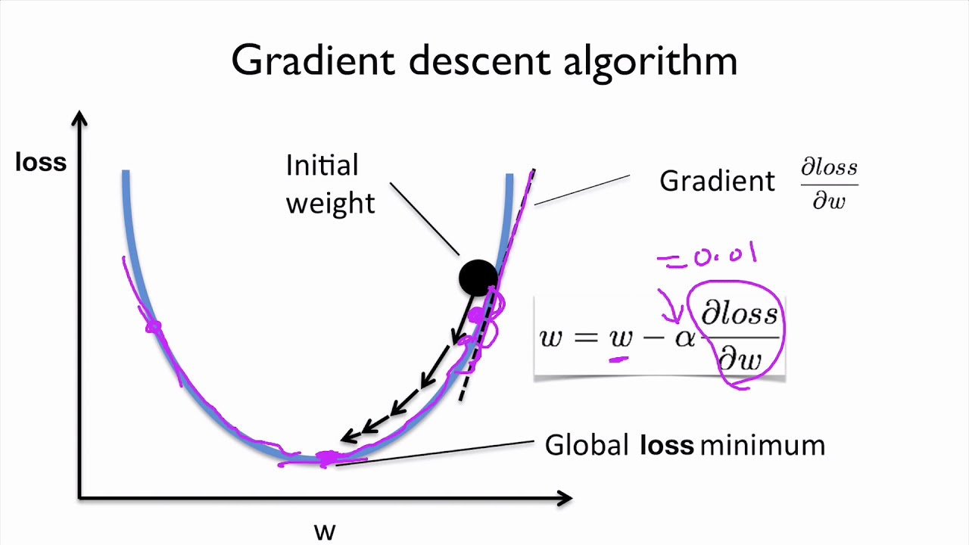
Gradient descent – How training happens
The gradient of the loss function is taken with respect to all parameters.
The weights are updated by going towards the direction of the negative gradient.

Slide 8
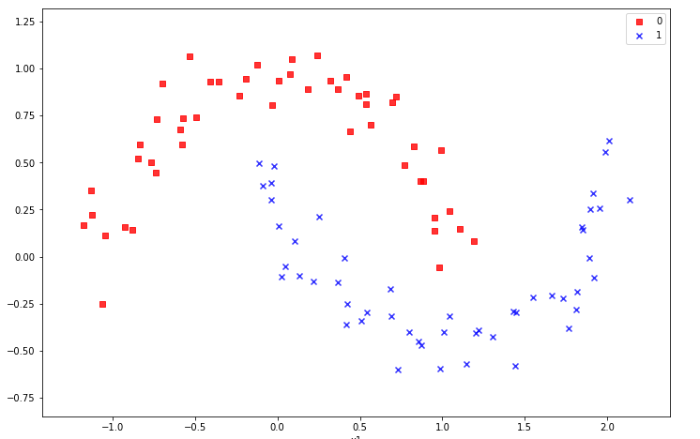
Takeaways …..
In the fixated example a single question was sufficient to separate the 2 classes of data because the data were linearly separable
There can be cases in which this is not the case

Slide 9
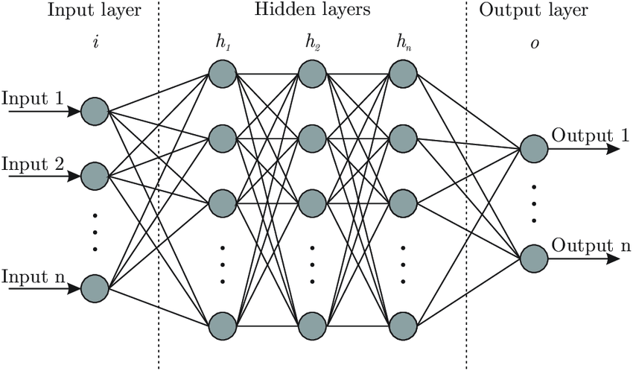
Deep Neural Networks to the rescue
So we need to ask more questions whose answers map to other spaces (perhaps more high dimensional spaces) in which the data points will eventually be linearly separable. The final question can thus operate on a linearly separable space.

Slide 10
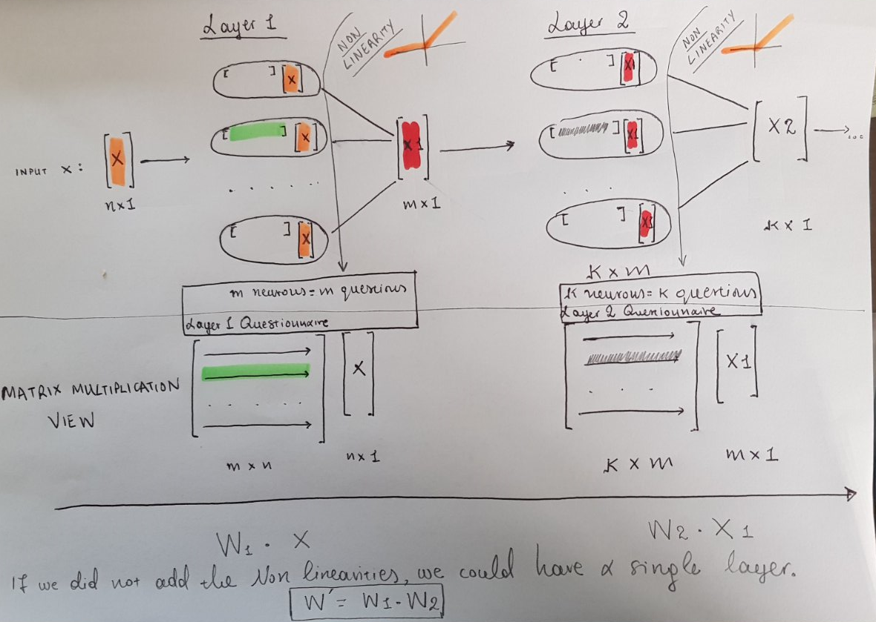
- Layers of processing, each later layer is asking questions on the answers of previous layers
- Structured flow of information driven by the loss function.
- The final representation should lie in a space whereby the initial representations can be easily separated. This leads to meaningful hidden representations

Slide 11
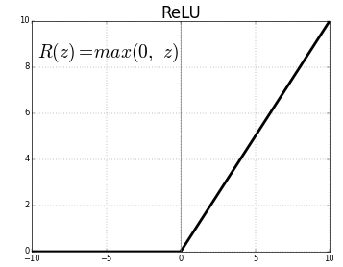
Non Linearities added after the questions
A simple non linearity is ReLU :
Our original questions are of the form ‘How similar’?
( The non linearity adds some if logic in the above case)
if how similar < 0:
return 0
else:
return how_similar

Slide 12
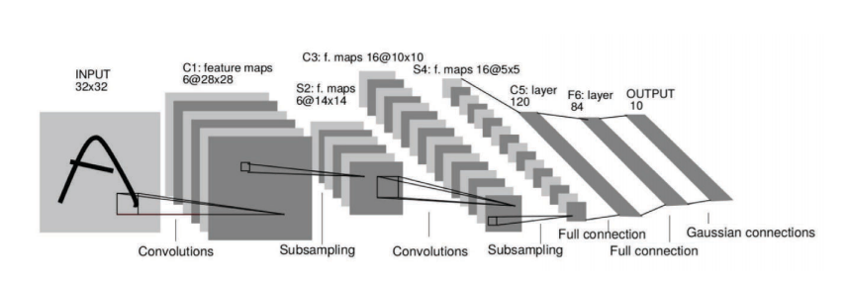
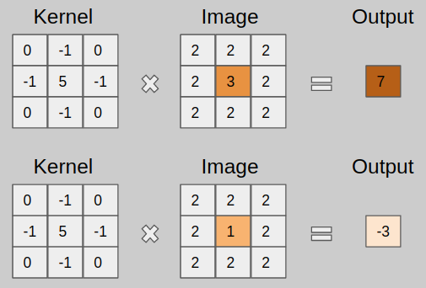
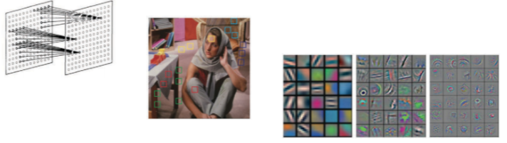
Convolutional Neural Networks (CNNs)
The questions being asked by CNNs is how similar are parts of the input image to stencils/sketch templates. Deeper layers question on similarity with more elaborate shapes.

Slide 13
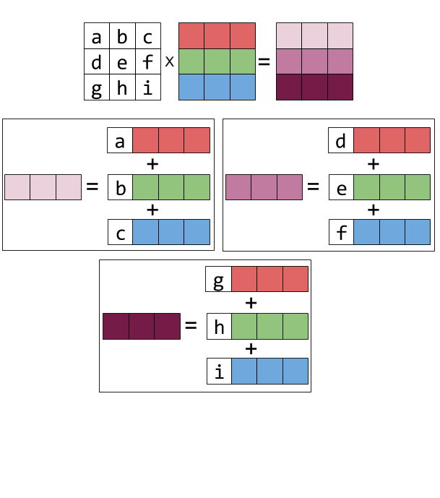
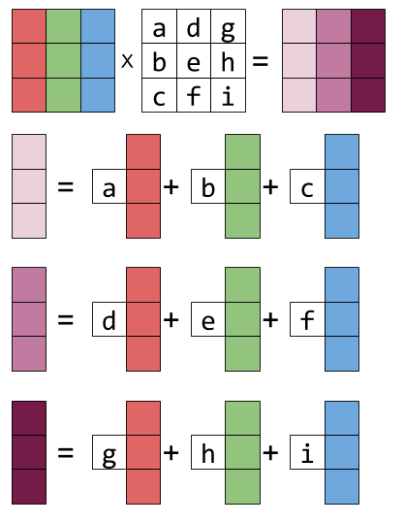
Linear Algebra – Matrix-Matrix Multiplication
When we multiply 2 arrays A and B ( ) we are performing :
Linear combination
of the rows of B
Linear combination
of the columns of A

Slide 14
Matrix Matrix Multiplication-Combining opinions
- Interviewer Mary asks some questions :
M ∙ v = [AnswerMary1 AnswerMary2 …. AnswerMaryN]
- Interviewer Rahul asks some questions :
R ∙ v = [ AnswerRahul1 AnswerRahul2 …. AnswerRahulN]
- How could we combine the answers to both of them (left multiply with [1 1 … 1] – linear combination of the rows) :
[1 1 …. 1] ∙ [AnswerMary1 AnswerMary2 …. AnswerMaryN
AnswerToRahul1 AnswerToRahul2 …. AnswerToRahulN] =
Result = [ (AnswerMary1+AnswerRahul1) (AnswerMary2+AnswerRahul2) …. (AnswerMaryN+AnswerRahulN) ]

Slide 15
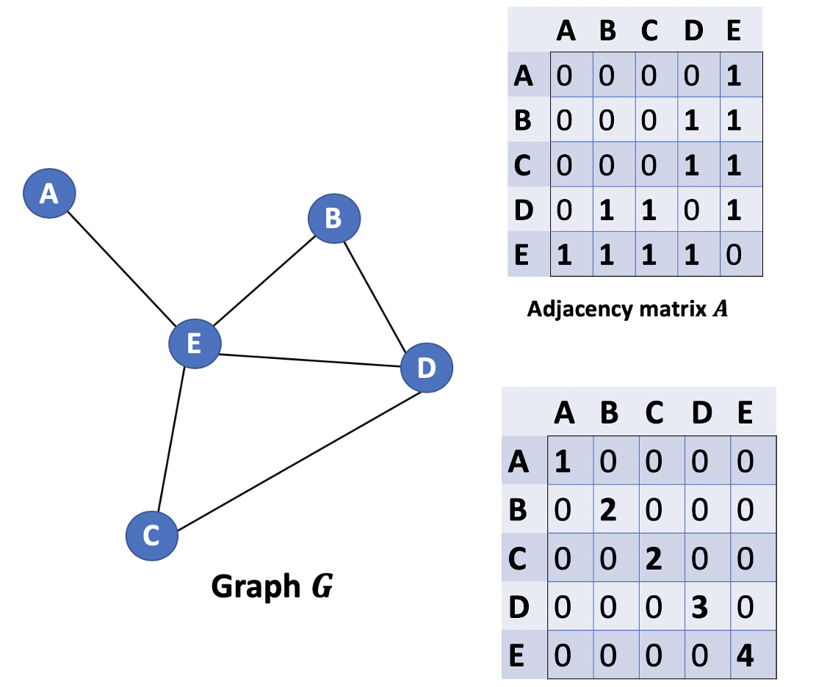
Adjacency (A) and Degree (D) matrix of a Graph

Slide 16
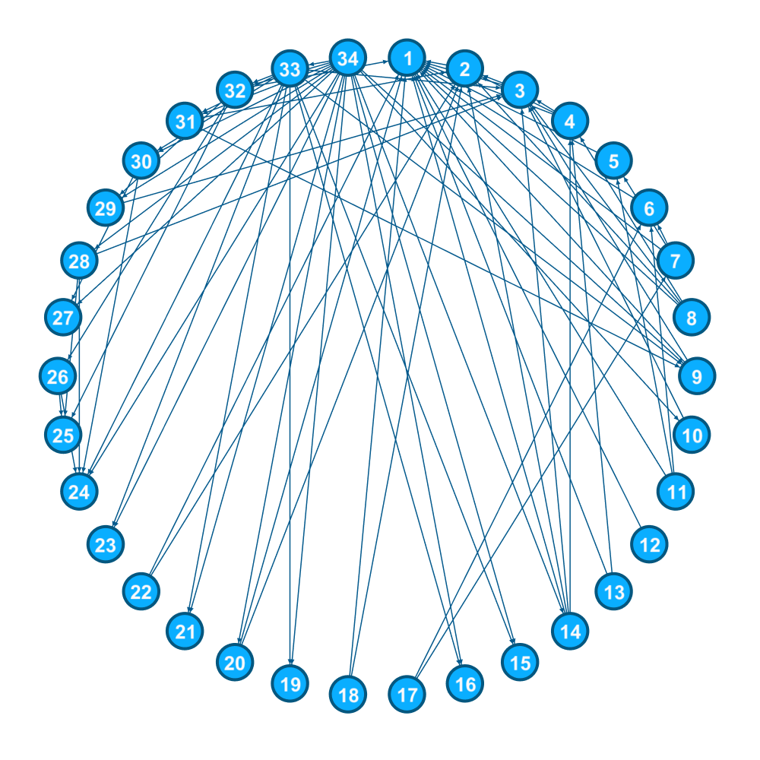
Graph Convolutional Neural Networks (GCNs)
Zachary Karate Club
During the period from 1970-1972, Wayne W. Zachary observed the people belonging to a local karate club. He represented these people as nodes in a graph and added an edge between a pair of people if they interacted with each other. The result was the graph shown below.
During the study, an interesting event happened. A conflict arose between the administrator “John A” and instructor “Mr. Hi” (pseudonyms), which led to the split of the club into two. Half of the members formed a new club around Mr. Hi; members from the other part found a new instructor or gave up karate.
Can we use GNNs to predict what members will do?

Slide 17
Let’s think about the strategy !
1 ) Let’s give each node a questionnaire to learn something from them
The questionnaire is the same across nodes.
Greek Proverb : ‘Tell me your friends and I will tell you who you are.’
2) Once each node has answered, each node sends its opinions to its direct neighbors – Message Passing step.
3) Each node gathers and summarizes the information received from its neighbors – Aggregation step.
4) It uses this summarized/aggregated information along with its own beliefs to update its state – Update step.
*What does repetition of this process provide?
Building on previous answers
Propagating at distances greater than 1 (or radius n : n = number of times we repeat the steps)

Slide 18
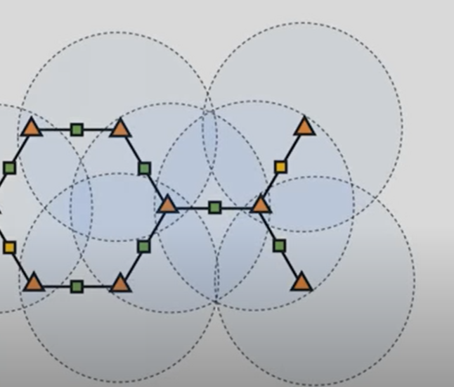
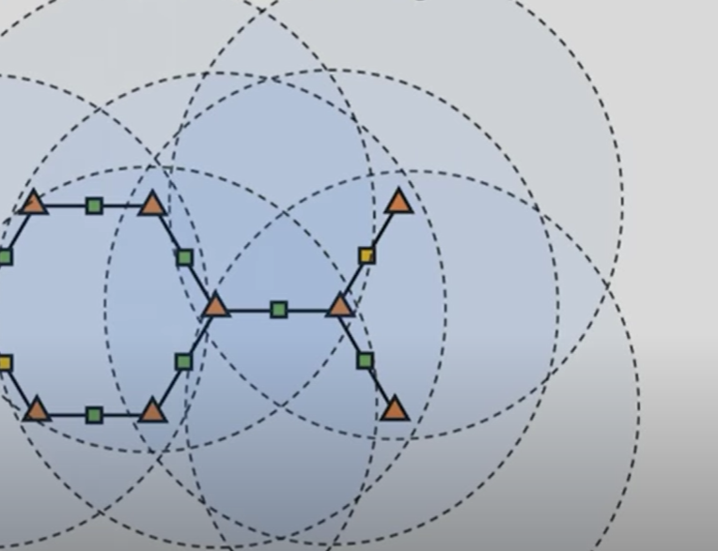
Propagation of information (n = 1 and n =2)

Slide 19
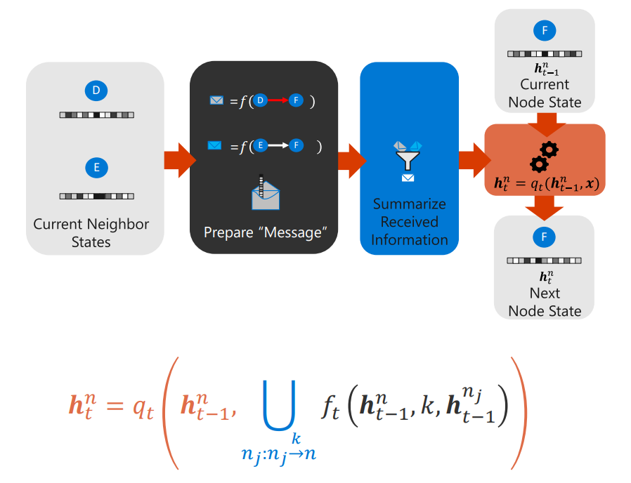
Strategy Visualized

Slide 20
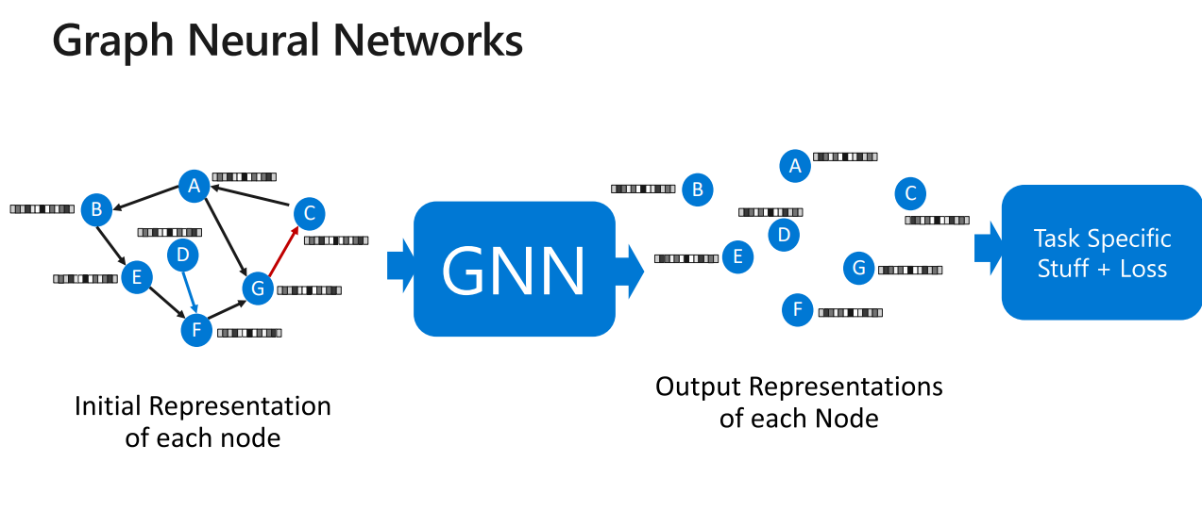
Reminder: What we are shooting for

Slide 21
Graph Convolution Neural Networks (GCNs)
The formula for the GCNs is the following :
1 ) Let’s give each node a questionnaire to learn something from them
The questionnaire is the same across nodes.
W is the set of questions.
Greek Proverb : ‘Tell me your friends and I will tell you who you are.’
2) Once each node has answered, each node sends its opinions to its direct neighbors – Message Passing step.
3) Each node gathers and summarizes the information received from its neighbors – Aggregation step.
4) It uses this summarized/aggregated information along with its own beliefs to update its state – Update step.
By multiplying with the adjacency matrix augmented by the identity matrix each row will be a combination of its own answers + the answers of its neighbors.
We also multiply by the inverse of the inverse degree matrix because we want the mean opinions !
If a node has 100 neighbors and another 2 the feature scales between them will not be the same if we do not take the mean.

Slide 22
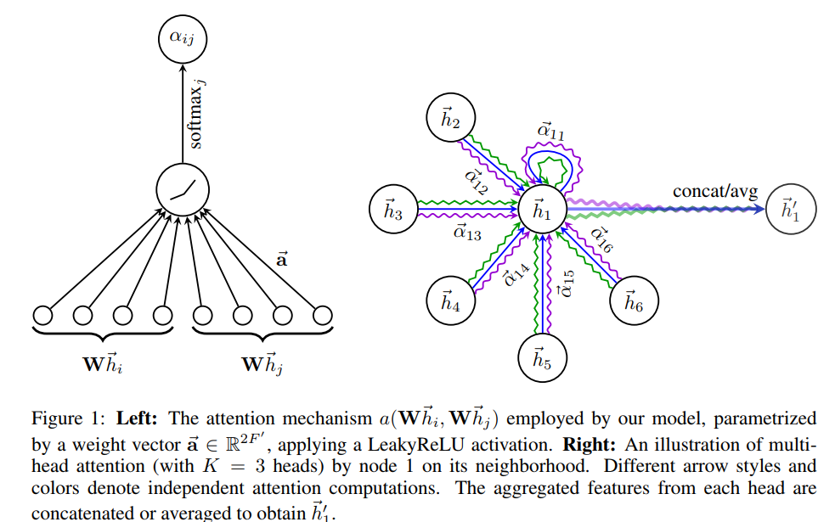
Disadvantage of GCN – Introducing Attention
During the aggregation of the information from the node neighbors, the same weight is given to all the neighbors.
To circumvent this issue, the nodes learn where to attend, to which nodes to pay more attention and take into account upon updating its own state.
This leads to GATs (Graph Attention Neural Networks)

Slide 23


