Slide 1
End to End Project
Utilizing Azure and Databricks for to analyze Yelp Reviews
Ivan Gonzalez

Slide 2
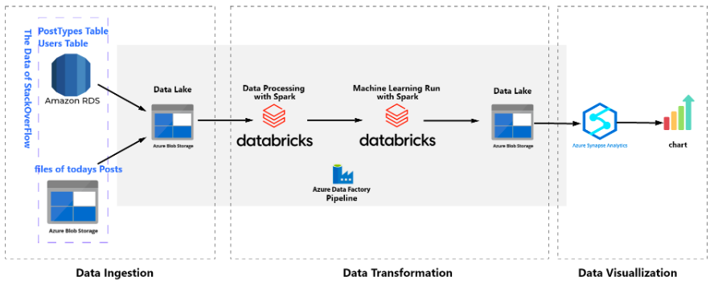
PROJECT OVERVIEW
Data Sources:
Amazon RDS: Used for storing structured data, such as business, user, and review information.
Azure Blob Storage: Used for storing unstructured data, including reviews in Parquet format.
Data Lake Storage:
Created two storage accounts:
bdprojectb11: Stores structured datasets like business, users, tips, and check-ins.
projectb11: Stores reviews data and the machine learning model.
Databricks:
Data processing using Spark for efficient handling of large datasets.
Trained machine learning models to predict customer sentiment based on reviews.
Saved the trained model and other results in the data lake.
Azure Data Factory:
Created two automated pipelines:
Weekly pipeline: Ingests data from Amazon RDS.
Daily pipeline: Transfers new review data to the destination and keeps it updated.
Azure Synapse Analytics:
Analyzed data and created visualizations to present insights from reviews, ratings, and user behavior

Slide 3
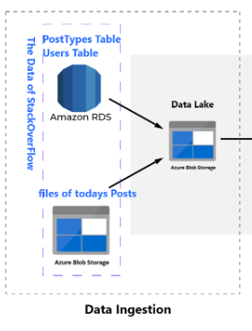
Data Ingestion
Data Source 1: Amazon RDS
Description: A managed relational database service that stores structured data.
Tables Used:
Business: Information about businesses (names, locations, ratings).
Users: User details (IDs, names, contact information).
Tips: User-generated tips/reviews about businesses.
Checkin: Records of user check-ins at businesses.
Data Source 2: Azure Blob Storage
Description: Cloud storage for unstructured data.
Functionality:
Stores the reviews file in Parquet format, which is optimized for read performance and efficient storage.
Facilitates ingestion into the data pipeline for further processing.

Slide 4
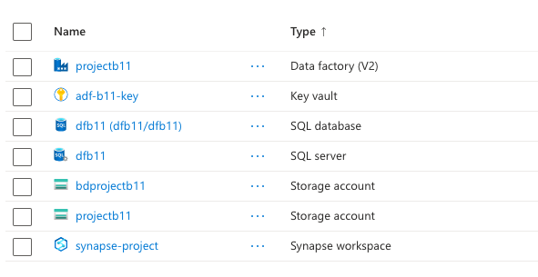
Data Lake Storage
Overview: A centralized repository for storing raw and processed data at scale for our project.
Storage Account Creation:
Two storage accounts have been created:
bdprojectb11: Used for organizing specific datasets and data management. This storage account was created to store the Business, Users, Tips, and Checkin tables.
projectb11:Designed to store additional data sources, ensuring organized and scalable management. This storage account is used to store our reviews data. Additionally, this container is used to house our advanced machine learning model and the StringIndexer, which are essential for transforming and preparing our data for insightful predictions and analyses.

Slide 5
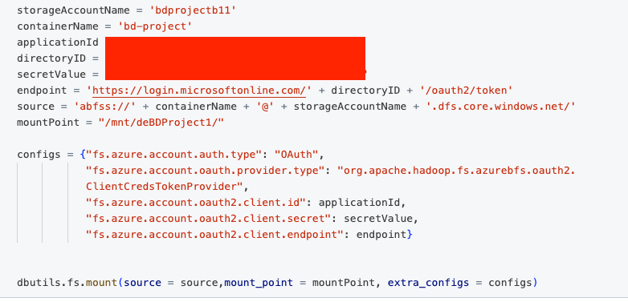
Databricks/Mounting Our Storage
Overview of Databricks:
A cloud-based collaborative platform built on Apache Spark, designed for big data processing and machine learning.
Facilitates real-time collaboration among data teams, allowing multiple users to work on notebooks simultaneously.
Key Features:
Integrated Environment: Supports various languages (Python, R, SQL, Scala) for flexible data analysis and model development.
Scalability: Automatically scales resources to handle large datasets, making it ideal for projects with extensive data like the Yelp reviews.
MLflow Integration: Manages the machine learning lifecycle, enabling tracking of experiments, versioning of models, and seamless deployment.
Mounting Azure Storage:
Seamless Data Access: Azure Data Lake Storage is mounted to Databricks for easy reading and writing of data using standard file paths.
Performance Optimization: Enhances performance with optimized read and write operations for large datasets.
Simplified Workflows: Enables a smoother user experience by reducing the need for repeated connection setups.
Collaboration: Ensures consistent access to the same data for all team members, fostering collaboration.

Slide 6
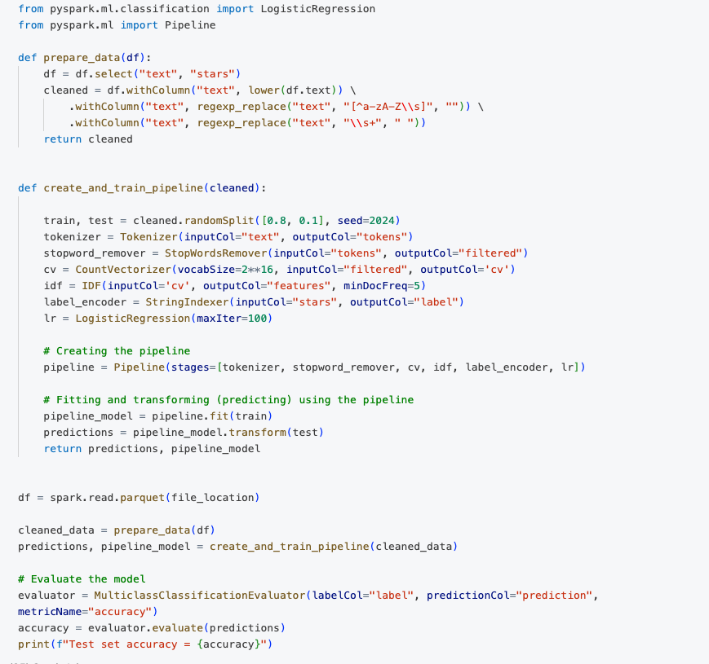
Databricks in the Yelp Project
Data Source for Analysis:
Provides user-generated reviews, offering insights into customer experiences and business performance.
Data Exploration:
Perform exploratory data analysis (EDA) to understand the structure and characteristics of the data.
Data Preprocessing:
Tokenization: Split the text of the reviews into tokens (words or phrases) to facilitate analysis.
Normalization: Apply various normalization techniques, such as converting to lowercase, removing punctuation, and stemming or lemmatization.
Training Machine Learning Models:
Used to predict user ratings based on the textual content of reviews, leveraging historical data.
Improving Business Insights:
Analyzes sentiment and common themes in reviews to inform business strategies and enhance customer satisfaction.
Evaluating Model Performance:
Serves as a benchmark for testing and validating machine learning models against actual ratings.

Slide 7
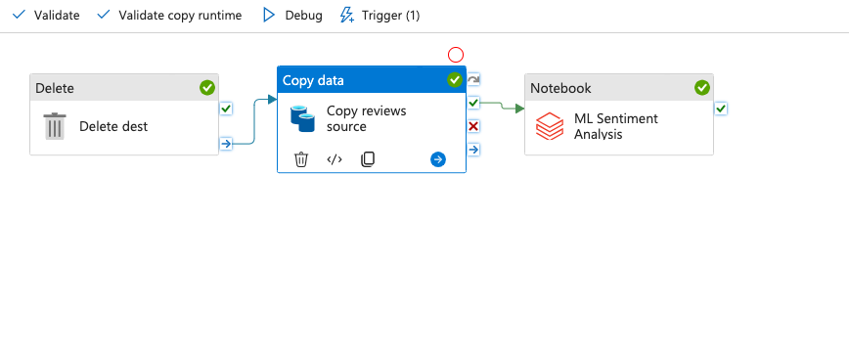
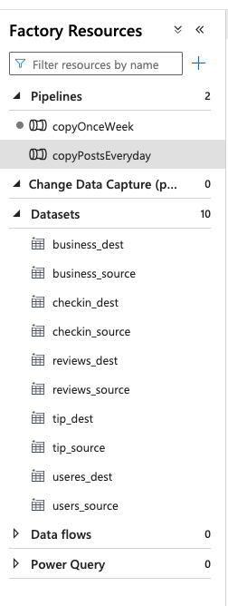
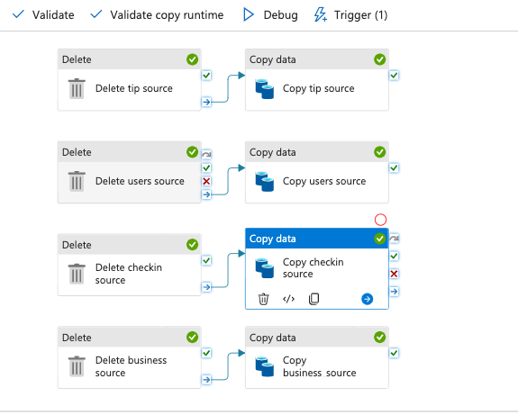
Azure Data Factory
Pipeline Creation:
Weekly Pipeline:
Ingests data from Amazon RDS on a weekly schedule, ensuring regular updates to the data warehouse for timely insight.
Daily Pipeline:
Transfers data from the reviews_source to the destination.
Includes a delete operation for cleaning the destination before data transfer.
ML Sentiment Analysis:
Executes a notebook to perform sentiment analysis on the ingested reviews data.
This step enhances insights by analyzing user sentiments in the reviews.
Automation:
Pipelines are triggered automatically based on schedules or events.
Streamlines the data ingestion process, reducing the need for manual intervention.

Slide 8
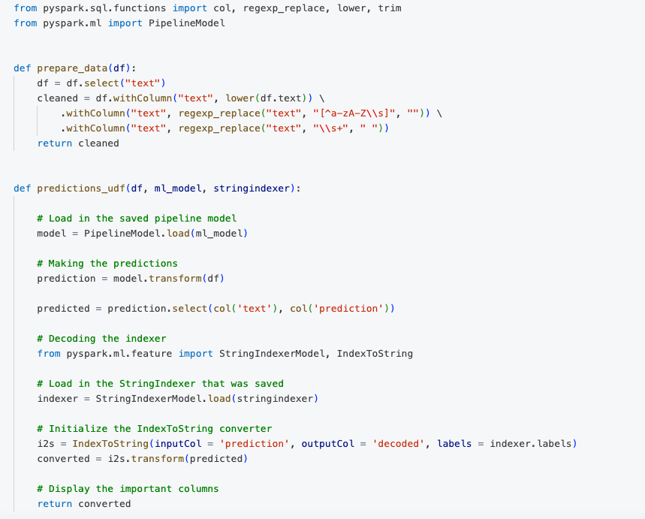
Model Inference in Databricks
Data Loading:
The notebook imports the necessary libraries and loads the refined datasets (e.g., users, tips, check-ins) from Azure Data Lake Storage or Azure Blob Storage.
Model Inference:
The notebook applies a pre-trained machine learning model to make predictions on the dataset.
This step may involve loading the model from a specified location and using it to predict user ratings or sentiments based on the content of the reviews.
Evaluation of Results:
Predictions are assessed to determine accuracy, precision, and other relevant metrics, providing insights into model performance.
Visualizations may be generated to illustrate the predictions and their implications, such as trends in user behavior or sentiment analysis.

Slide 9
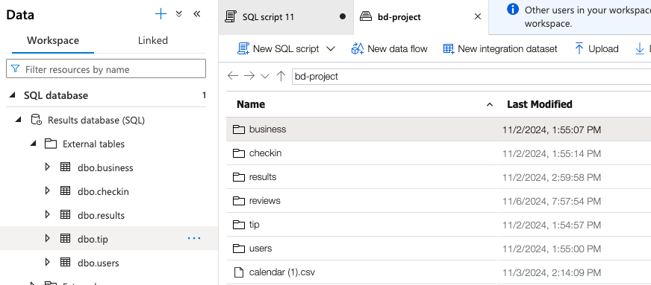
Azure Synapse Analytics
Connection to Azure Data Lake Storage:
Established a connection to Azure Data Lake Storage for direct access to datasets.
Facilitates real-time analytics and querying capabilities without data duplication.
External Tables Created:
Created external tables for key datasets to enable efficient analysis:
Business: Contains details about businesses listed on Yelp.
Check-in: Tracks check-in activity at various businesses.
Results: Stores aggregated results from analysis or model predictions.
Reviews: Contains user reviews associated with businesses.
Tips: Includes tips provided by users regarding businesses.
Users: Information about users who interact with the Yelp platform.
Benefits of Using External Tables:
Allows for querying large datasets directly from the data lake without moving data.
Supports various data formats such as Parquet and CSV, for flexibility in data storage and retrieval.

Slide 10
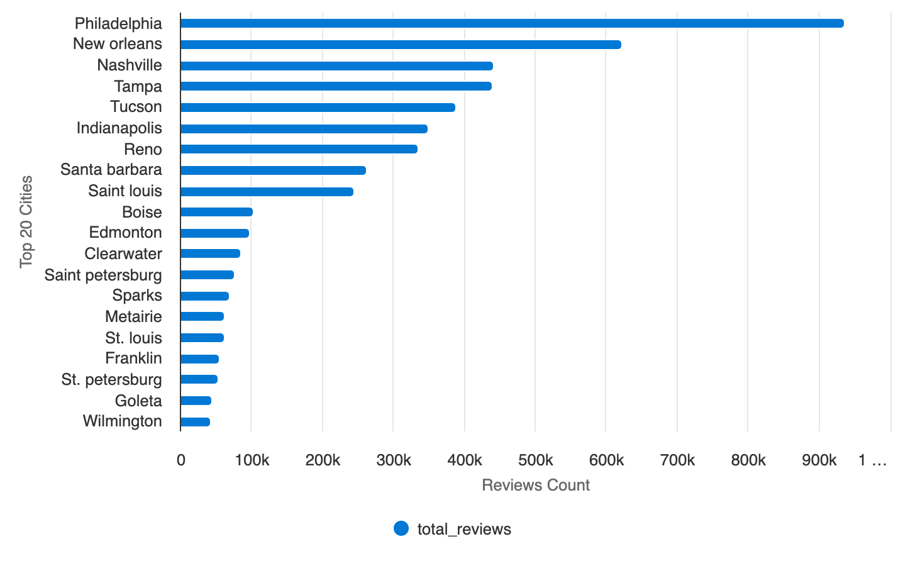
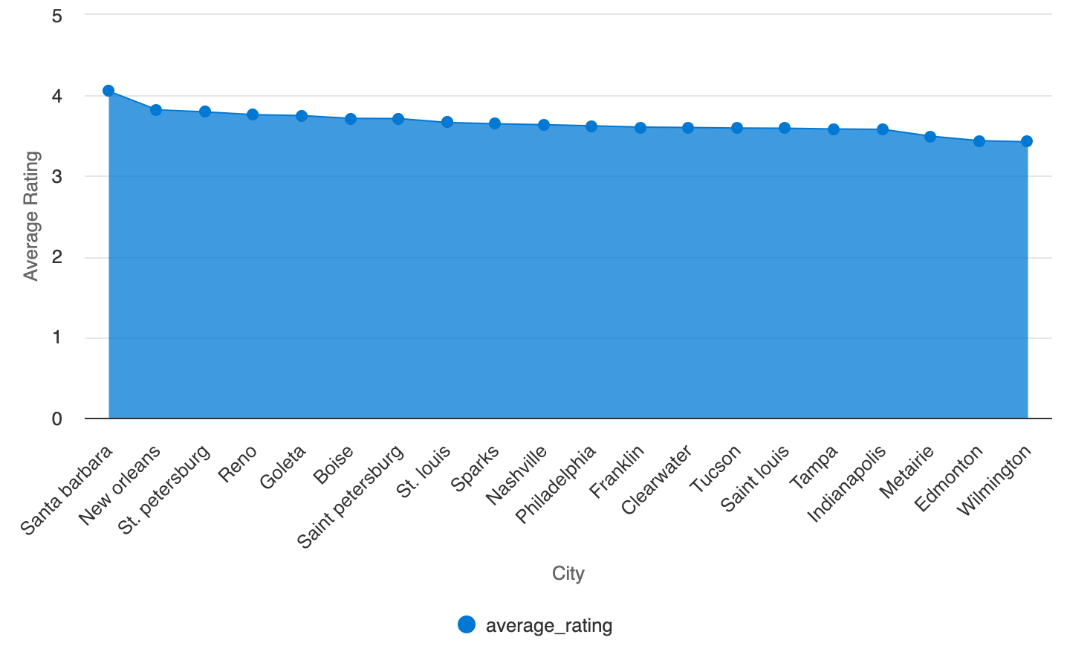
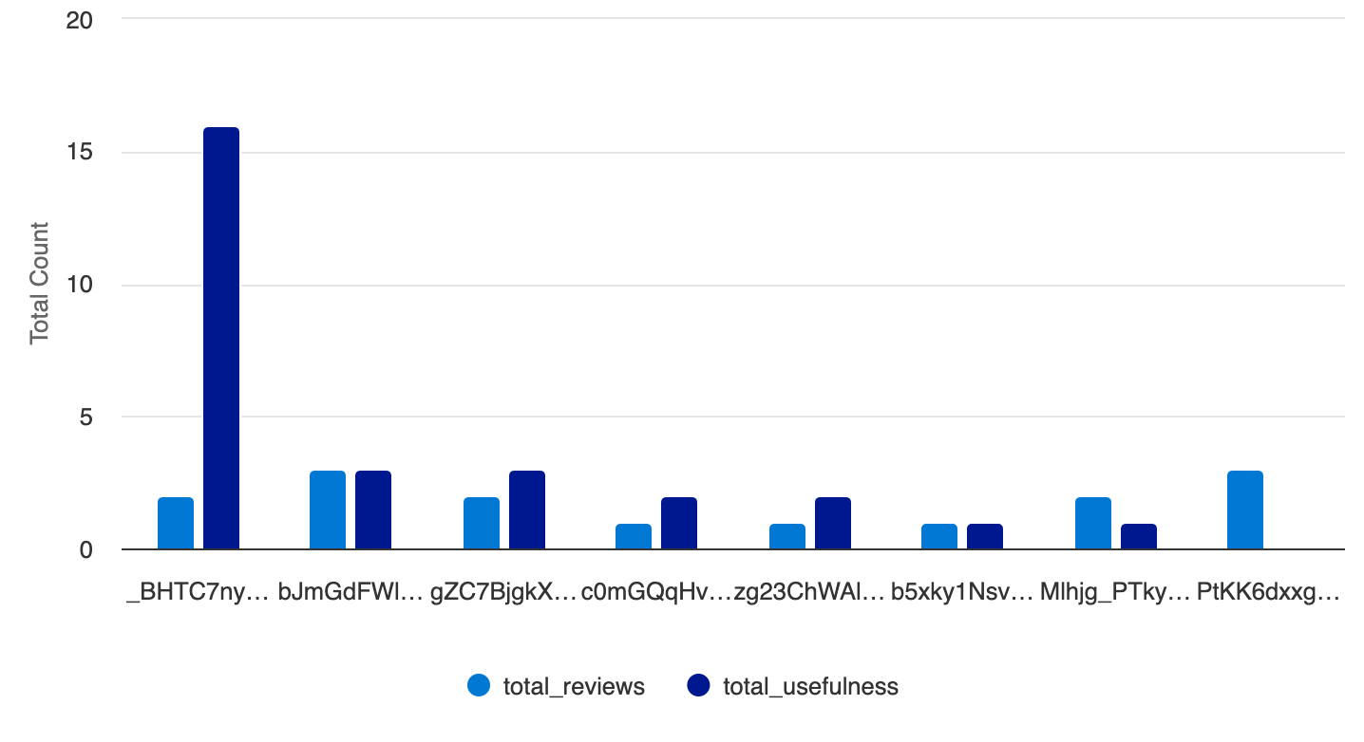
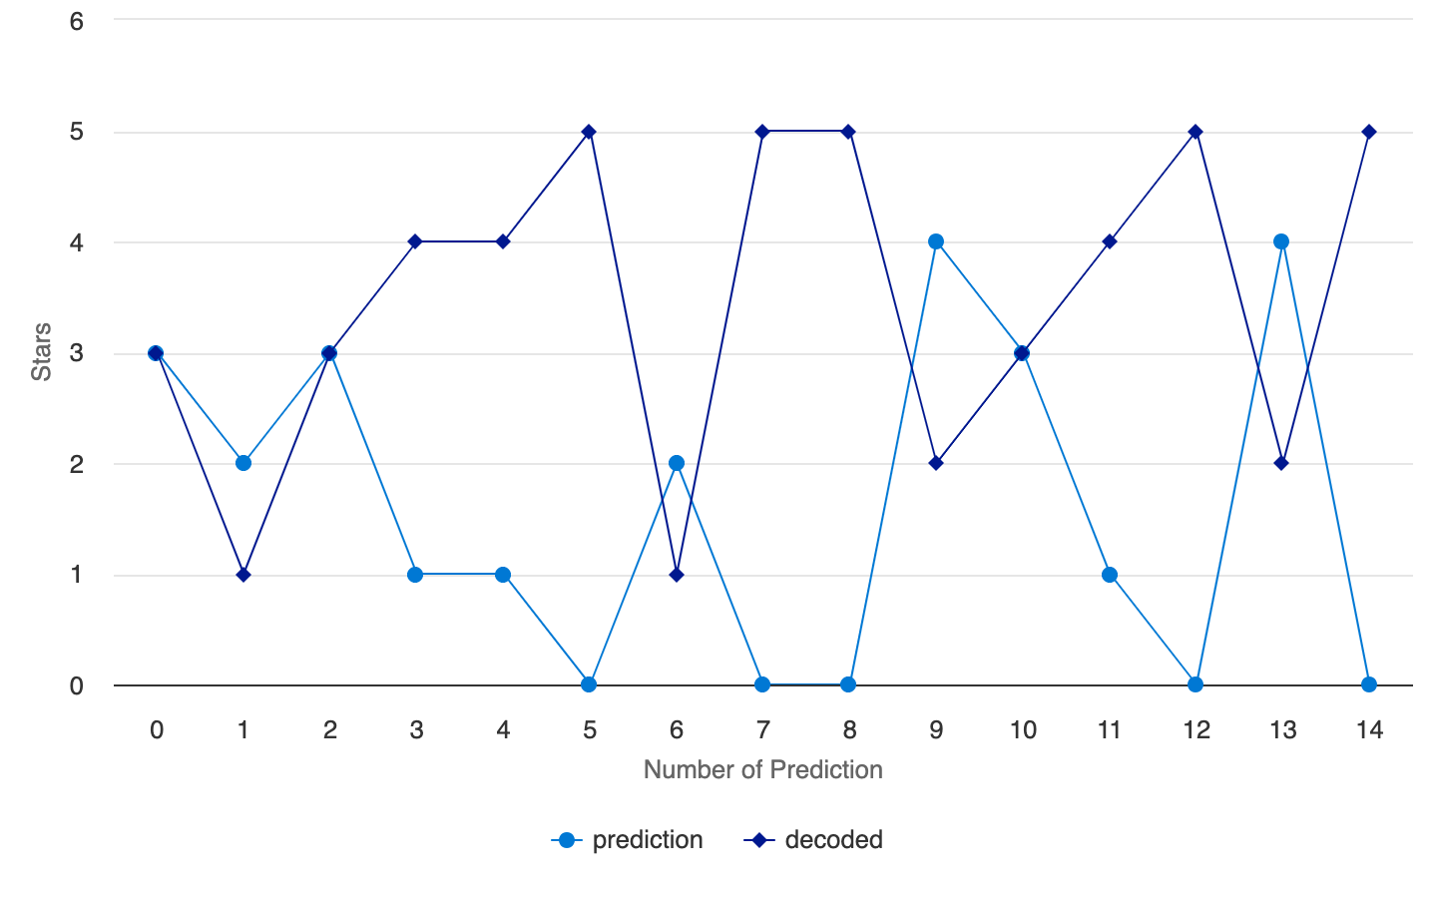
2.
1.
3.
4.
Data Analysis
1.User Engagement by City
3. Review Quality by User
2. Average Ratings Across Top Cities
4. Prediction Accuracy Comparison

Slide 11
Key Challenges and Improvements
Data Quality Issues:
Initial challenges with data format compatibility affected our ability to create external tables in Azure Synapse.
File Reading Problems:
Encountered issues when trying to read the original files, leading to delays in the analysis process.
Solution Implemented:
Switched to Parquet format, which provided enhanced compatibility and performance.
Created 4 new datasets in ADF
Dataset Creation:
Utilized Azure Data Factory (ADF) to format the source files and save them as Parquet, ensuring smooth integration with Azure Synapse.
Future Considerations:
Need to implement more thorough data validation processes to prevent similar issues in future projects.
Implement a scheduled ADF pipeline to retrieve the latest reviews daily for the data lake.

