Slide 1
Automated ETL Pipeline for Sales and Inventory Insights
Ivan Gonzalez

Slide 2
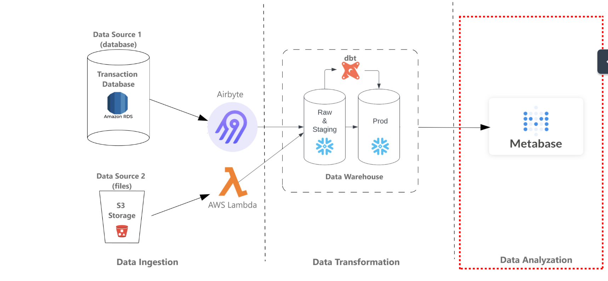
Project Overview

Slide 3
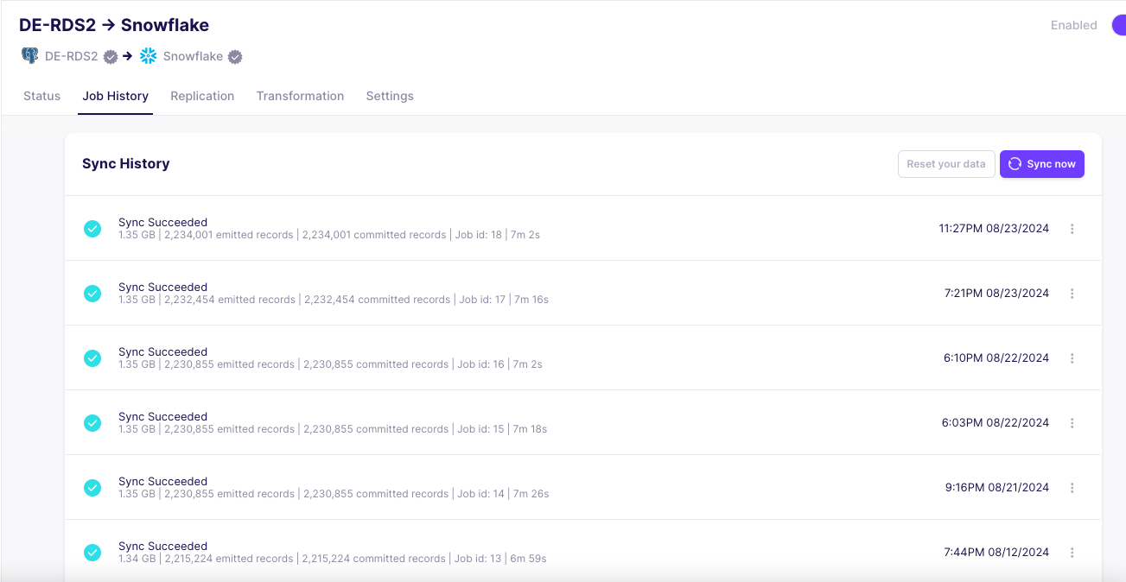
Data Source 1: Amazon RDS
Dataset: TPCDS
Extracted sales and customer data from RDS and load into snowflake using Airbyte

Slide 4
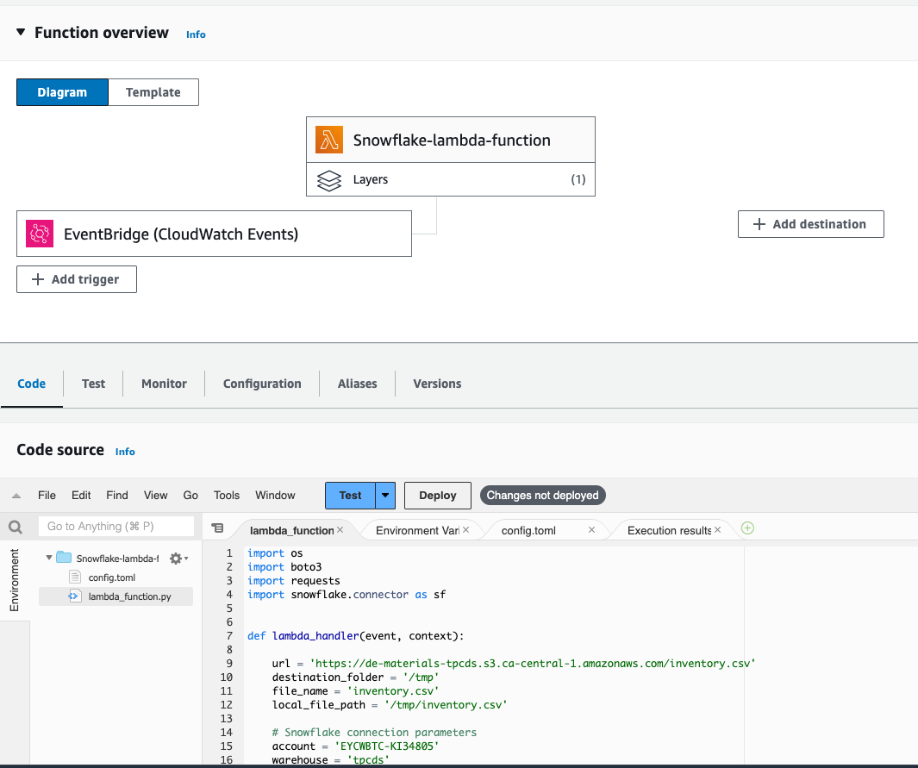
Data Source 2: Lambda Function
Create Lambda function to load the inventory.csv file from public S3 bucket into Snowflake
Add EventBridge to trigger at 6AM UTC
Add lambda layer to include .zip file with all the packages needed to run lambda function code.

Slide 5
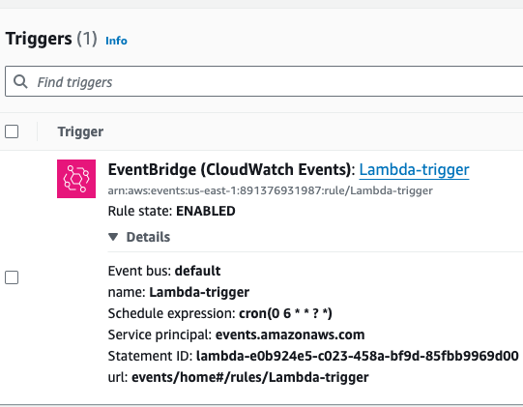
Lambda Trigger
The Lambda trigger, scheduled via EventBridge, automates daily data ingestion by running the Lambda function at 6 AM UTC to load inventory data into Snowflake.
Triggered by EventBridge events, the Lambda function reads packages through the Lambda layer, processes data via the Snowflake layer, and ensures seamless integration and real-time updates within the system.

Slide 6
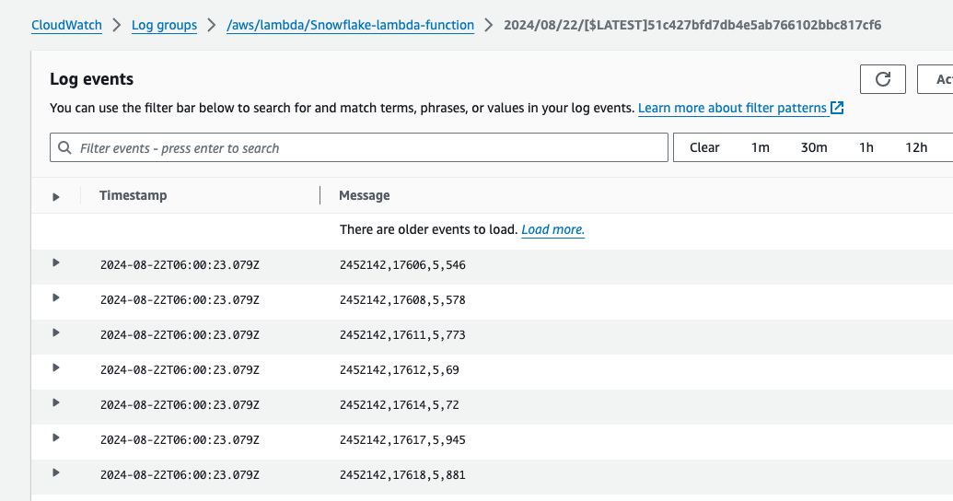
Lambda Function Cloudwatch log
Daily loading at 6 AM UTC

Slide 7
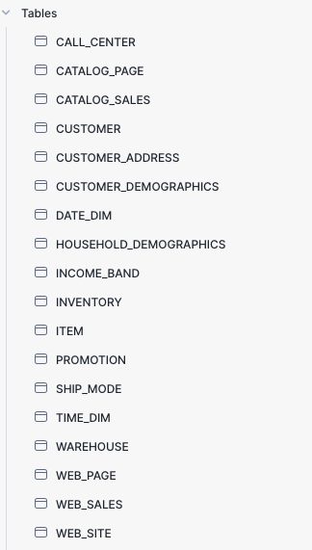
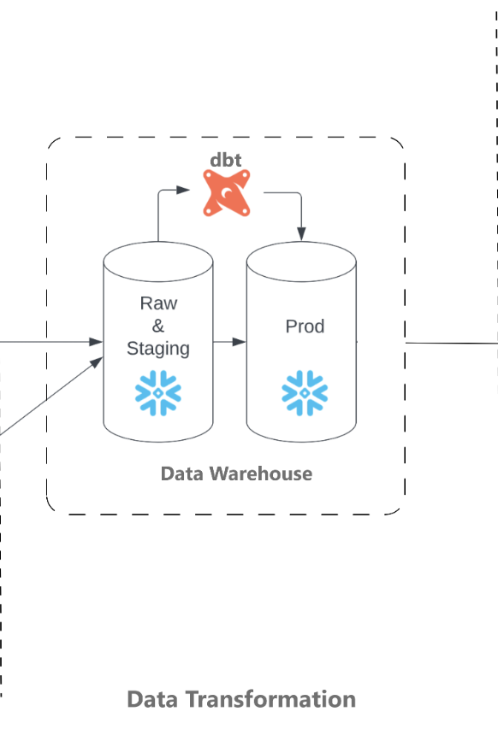
Data Transformation - Snowflake/dbt
Data Modelling:
Collect business requirements
Customer dimensions
Fact Sales
Notes:
Get the requirements we need from OLAP

Slide 8
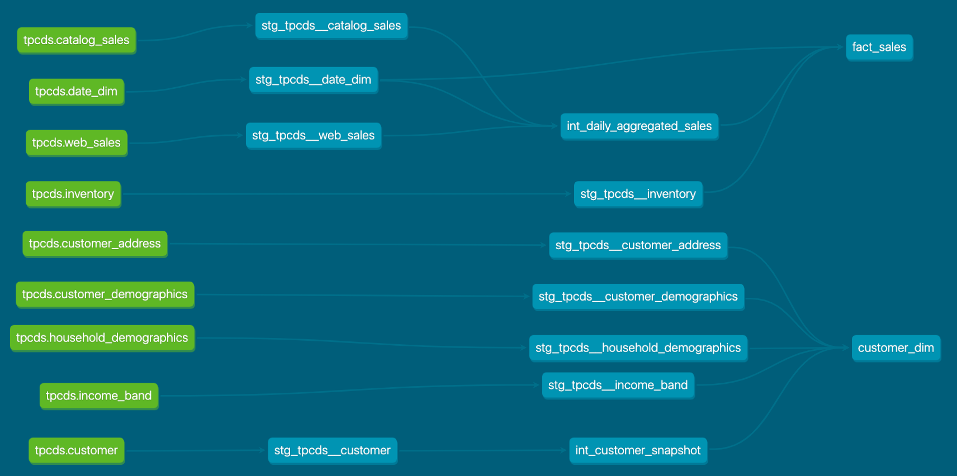
Streamlining Data Models with dbt

Slide 9
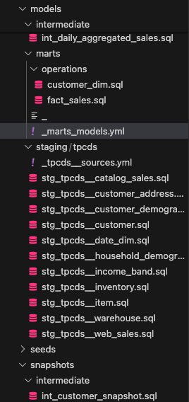
Dbt transformation
Staging Models: Clean and standardize raw data for consistent downstream transformations.
Intermediate Models: Apply business logic and prepare data for specific analytics needs.
Snapshot Models: Track historical changes over time, using Type 2 Slowly Changing Dimensions (SCDs).
Marts Models: Deliver final aggregated datasets for reporting and visualization.
Process: Built and managed these models in dbt using Visual Studio Code and executed transformations with the dbt build command.
Notes:
Snapshots for type 2 SCD models

Slide 10
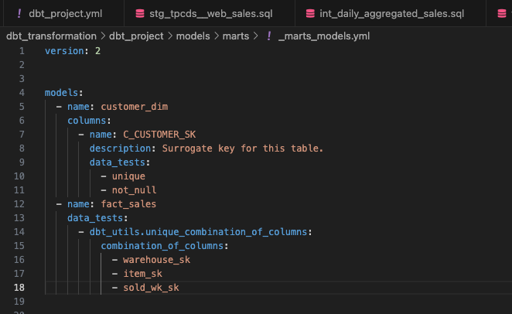
Test
Ensures data accuracy and reliability through comprehensive dbt testing, including schema validation and data quality checks.

Slide 11
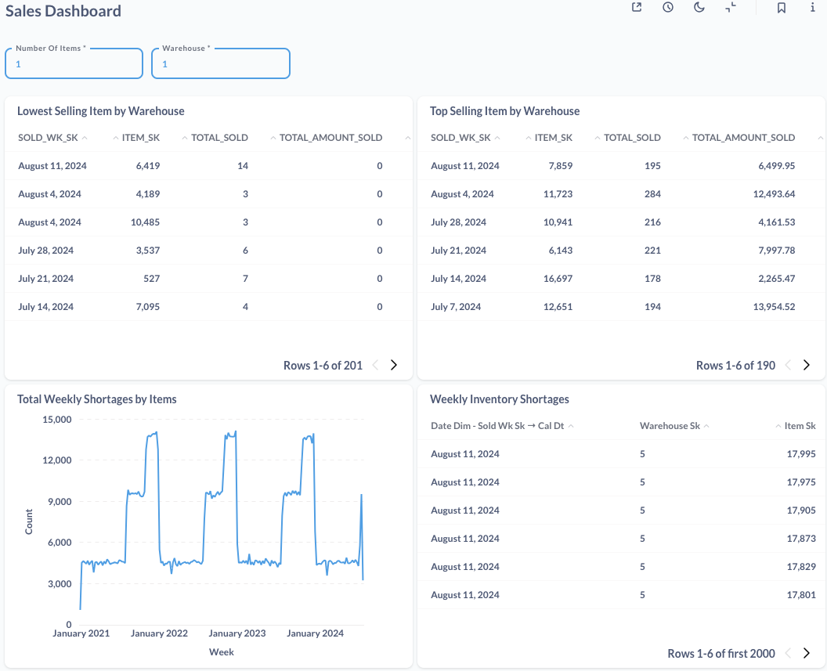
Metabase
Sales Performance Dashboard: Visualizes sales trends over time, including revenue growth, top-performing products, and seasonal patterns.
Customer Behavior Dashboard: Highlights customer demographics, purchase frequency, and retention rates to identify behavioral trends.
Inventory Levels Dashboard: Tracks stock levels, turnover rates, and restocking schedules to ensure supply chain efficiency.
Regional Insights Dashboard: Displays sales and inventory metrics segmented by region to identify high-performing markets and areas for improvement.

