Slide 1
LOCAL SERMON TRANSLATION
Neo Sermon
Real-time sermon interpretation into 25 languages — running
entirely offline, on a single laptop.
25
0
0
LANGUAGES
CLOUD CALLS
ACCOUNTS NEEDED

Slide 2
PART ONE
How It Works
From the spoken word to a translated voice, in under a second.

Slide 3
HOW IT WORKS
From Voice to Translation
1
2
3
4
5
Capture
Recognize
Translate
Speak
Share
Microphone, system audio,
or a mixer line-in
What was just said,
turned into text
Into every language
the room needs, at once
A natural voice, in each
listener's own language
Sent straight to every
phone in the room
All of it happens right there on the laptop — nothing is sent to the internet.
NEO SERMON
3

Slide 4
PART TWO
Running a Service
What the operator sees and controls from the laptop.

Slide 5
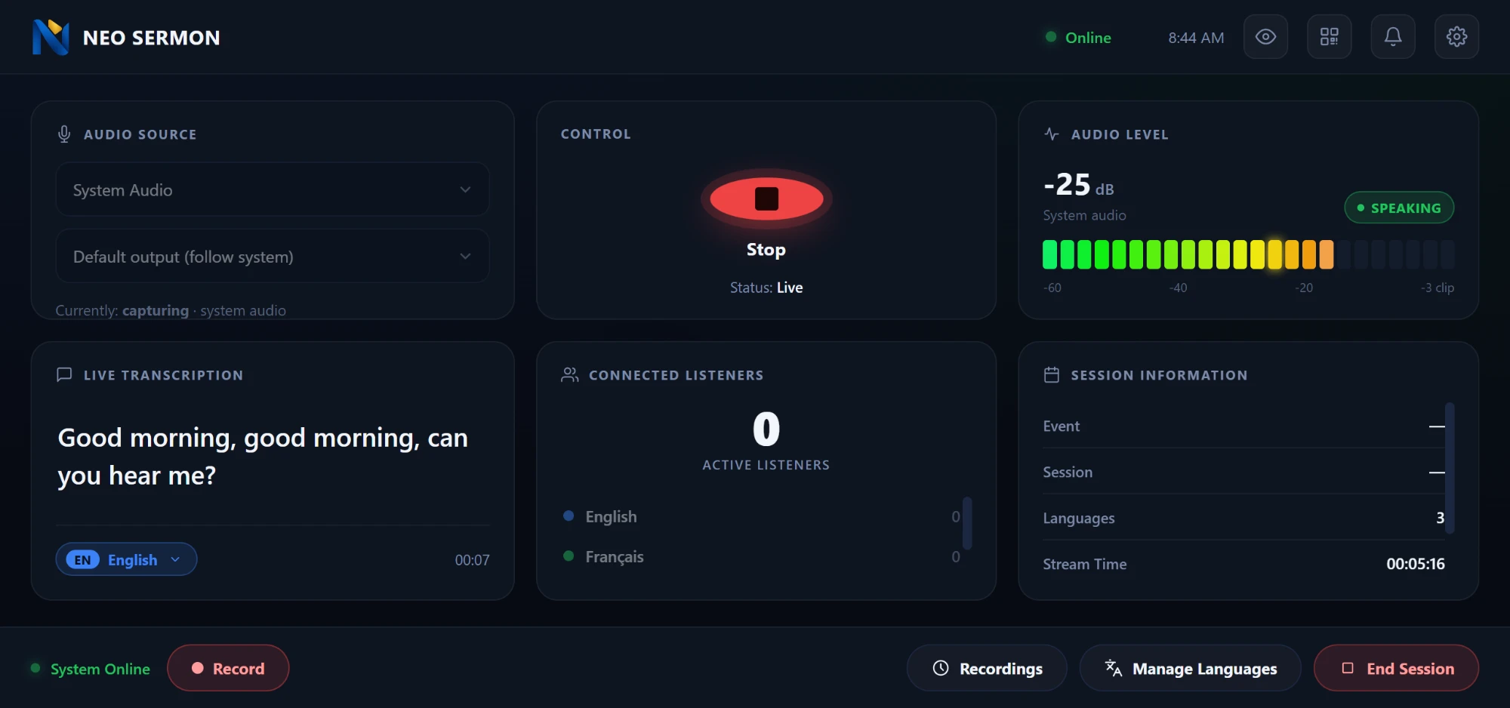
OPERATOR EXPERIENCE
The Control Panel
Audio source, start/stop, a live level meter, the transcript as it's recognized, every language's listener count, and the session details — one screen.
NEO SERMON
5

Slide 6
OPERATOR EXPERIENCE
Recording
● PRIORITY FEATURE
WHAT GETS SAVED
Every language, or just the ones that matter, recorded to its own file — without ever interrupting the live broadcast.
One audio file per language, named
and timestamped automatically
A short summary of the session —
event, duration, every file saved
1
Start
All languages, or pick a subset
The source (English) recorded
alongside every translation
2
Pause / Resume
Hold without losing the session
3
Stop
Each language saved as its own file
NEO SERMON
6

Slide 7
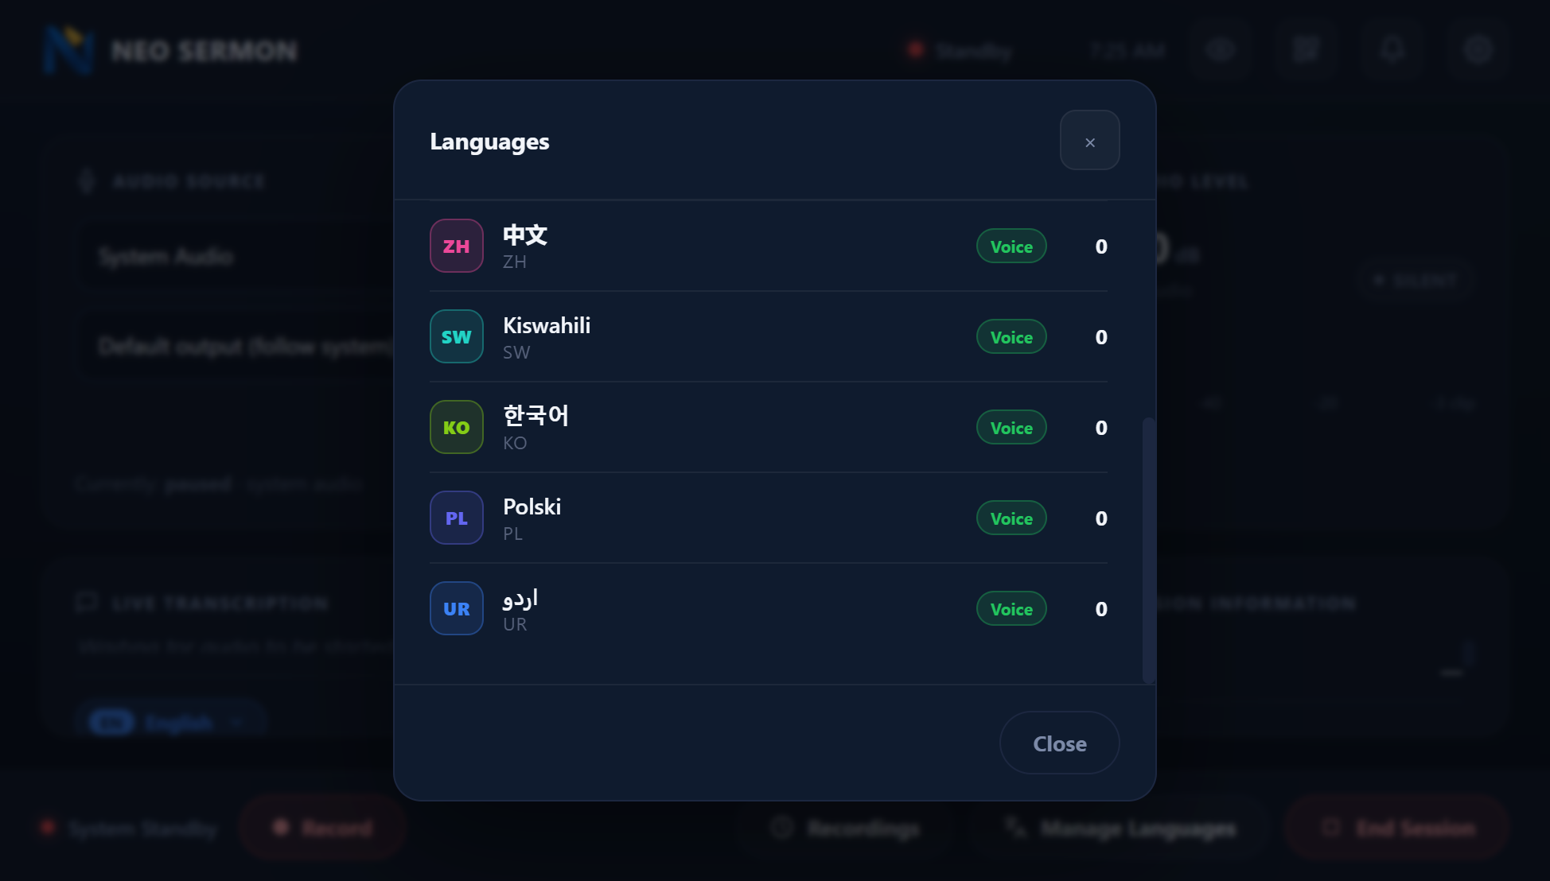
OPERATOR EXPERIENCE
Reports & Language Control
RPT
Listener Reports
LNG
Manage Languages
One tap, no form to fill in — a listener flags a problem
the moment it happens.
Every configured language, with its live listener count.
Wrong translation
No / bad audio
Technical issue
Something else
Visible to the operator the moment it's sent.
NEO SERMON
7

Slide 8
PART THREE
The Listener Experience
What the congregation sees on their own phone — no app install.

Slide 9
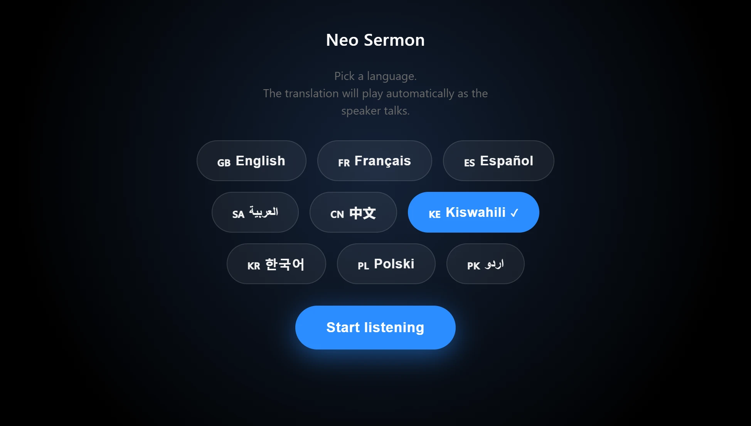
LISTENER EXPERIENCE
Scan, Pick, Listen
1
Scan
Point the phone's camera at the QR code on screen
2
Pick a language
A scrollable list, each shown in its own script
3
Listen
Live captions and a translated voice, automatically
The language list scrolls on its own — 25 languages never push the Start button off a small screen.
NEO SERMON
9

Slide 10
LISTENER EXPERIENCE
Customizable Access
Give the listener link a name that means something to your audience — set once in Settings.
ON THE SCREEN
/listeners/sunday-service
Updates the QR code automatically
https://192.168.1.20:8096/listeners/
sunday-service
Easy to read aloud or print on a bulletin
Works in any phone's own browser
All phones must be on the same
Wi-Fi as the laptop.
NEO SERMON
10

Slide 11
PRIVATE BY DESIGN
Fully Offline, By Design
Nothing is sent to the internet, and nothing needs to be. Once it's installed, the whole service can run without a connection.
25
0
1
LANGUAGES
CLOUD
LAPTOP
Thank you.
NEO SERMON
11

