Slide 1
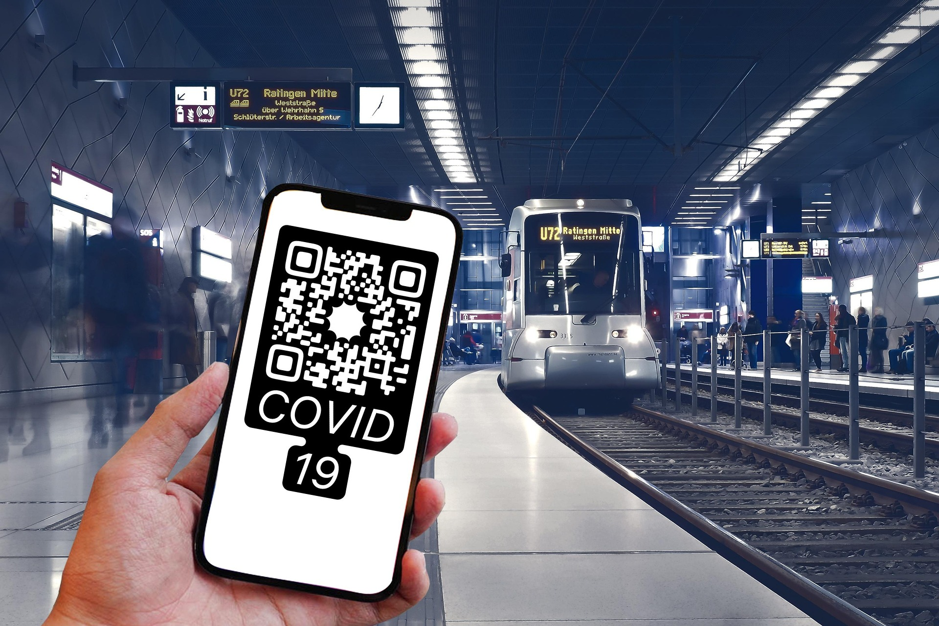
Secure Transport QR Code Authentication System (STQAS)
Student: Chijioke Igwe Supervisor: Cathryn Peoples Programme: Msc. Cyber Security

Slide 2

AGENDA
Introduction
Problem Statement
Research motivation
Artefact Overview
System Architecture (Three-Tier Model) UML Design Summary Core Components
Key Algorithm
Security Features
Testing and Deployment Plan
Performance Targets
Conclusion

Slide 3
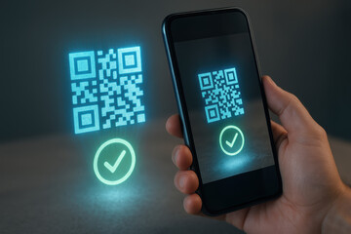
Introduction
The proposed Secure Transport QR Code Authentication System (STQAS) is a secure framework to mitigate the security risks of quishing within the UK transport industry.
Quishing is asocial engineering technique that utilizes QR codes to deceive unsuspecting users into revealing sensitive information or becoming victims of cyber attack.
Purpose of the STQAS
Address rising quishing attacks in the UK transport industry. There were 100 incidents recorded in 2019. However as of 2024, it has increased to 1,386.
Provide cryptographically secure QR code authentication.
Protect operators, passengers, and local authorities.

Slide 4

Problem Statement
Escalating Threat Landscape
Quishing Incidents: 100 -> 1,386 (2019 – 2024).
Financial Losses: £150k -> £3.5m
QR phishing share: 0.8% -> 10.8%
Behavioural Gaps
Only 33% of users check URLs before they scan.
Only 19% of staff within the UK businesses receive cybersecurity training.
Only 15% of transport operators and authorities conduct daily infrastructural checks.

Slide 5

Research motivation
QR codes widely deployed across transport hubs.
Attackers exploit physical accessibility.
Inadequate cryptographic signing in current deployments.
Need for sector-wide, standardised, and verifiable solution.

Slide 6
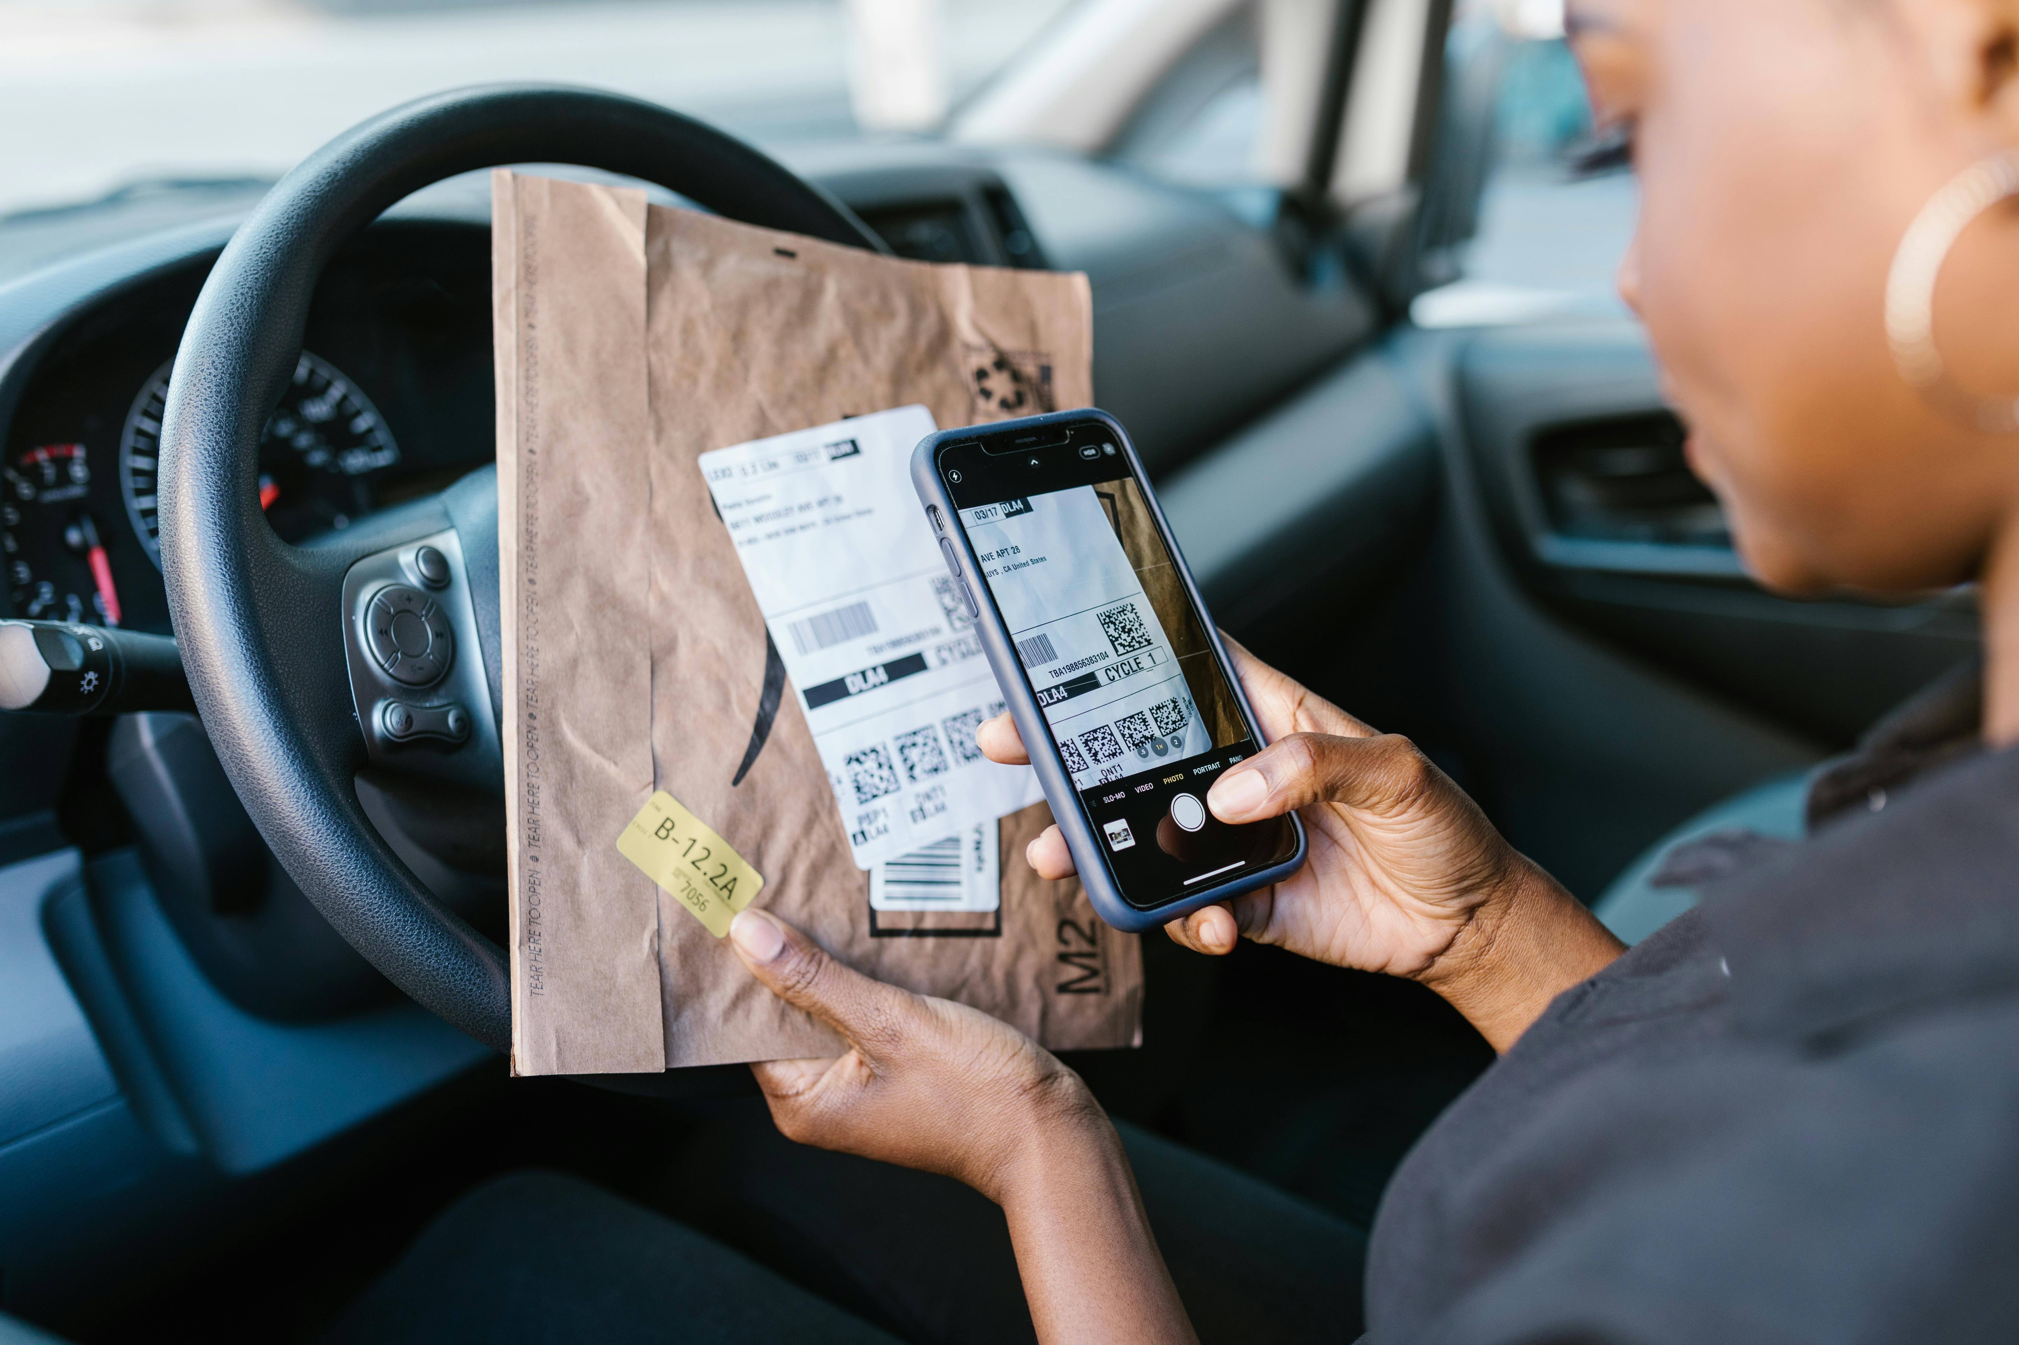
Artefact overview
User groups
Transport operators: These are users of the system who generate secure QR codes, registers domains and configures security settings. Could be rail operators (LNER, Great Western Railway, Northern Trains), bus and coach operators (Stagecoach, National Express, Flixbus), logistics, haulage and postal operators (Royal Mail, Evri, DPD), air and Maritime operators (British Airways, EasyJet, Heathrow Airport Holdings, P&O Ferries).
End users: These users Scan QR codes, view security status and report suspicious activities/codes.
Transport Authorities: The local authority monitor infrastructure, review incident reports and issue security alerts such as local councils, the Transport for London, the Transport for Greater Manchester.
STQAS Provides
Cryptographically signed QR codes. Using the Elliptic Curve Digital Signature Algorithm (ECDSA) in combination with hash algorithm SHA-256.
Real-time verification.
Threat intelligence integration
Automated fraud detection
User-friendly risk indicators.

Slide 7
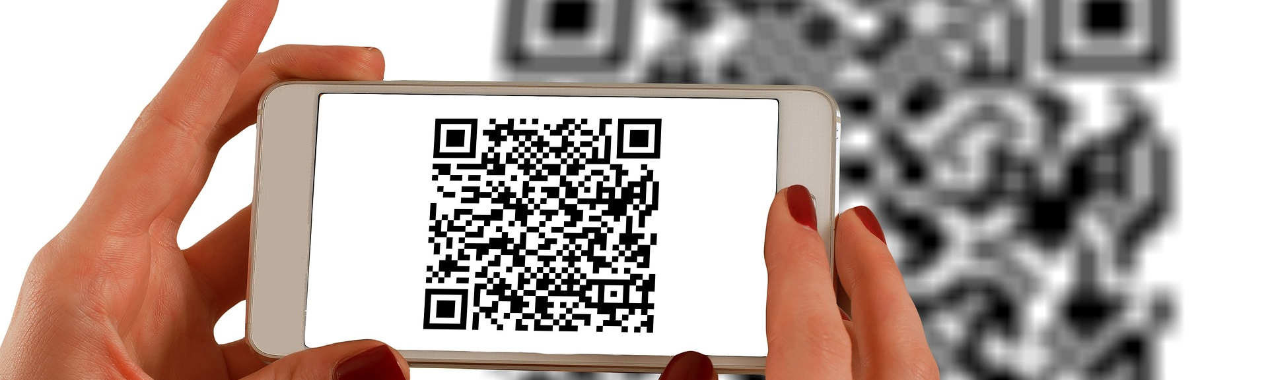
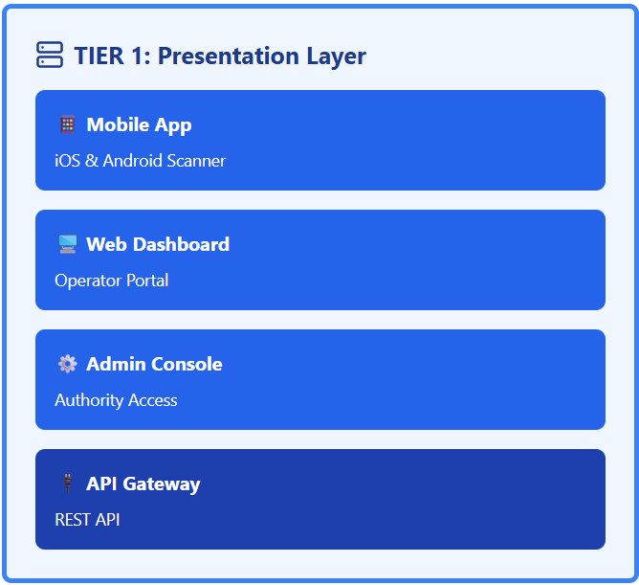
System architecture
Presentation Layer
Mobile App
Web Dashboard
Admin Console

Slide 8
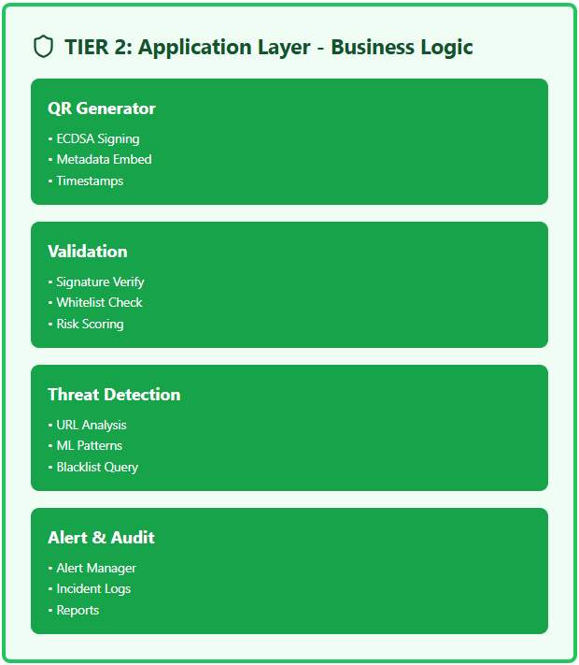
System architecture
Application Layer
QR Generator
Validator
Threat Engine
Alerts and Audit

Slide 9
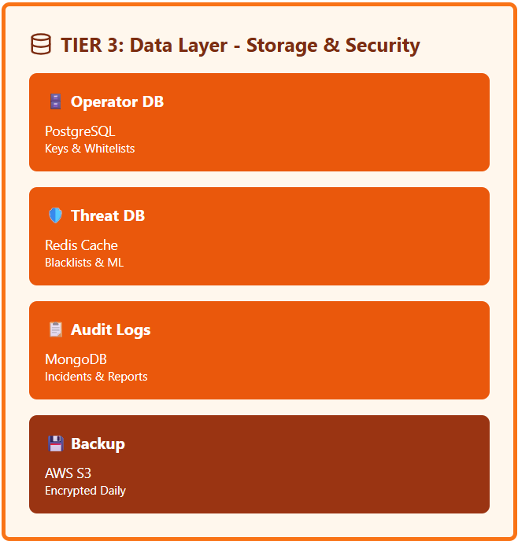
System architecture
Data Layer
Operator database
Threat database
Logs
Backups

Slide 10
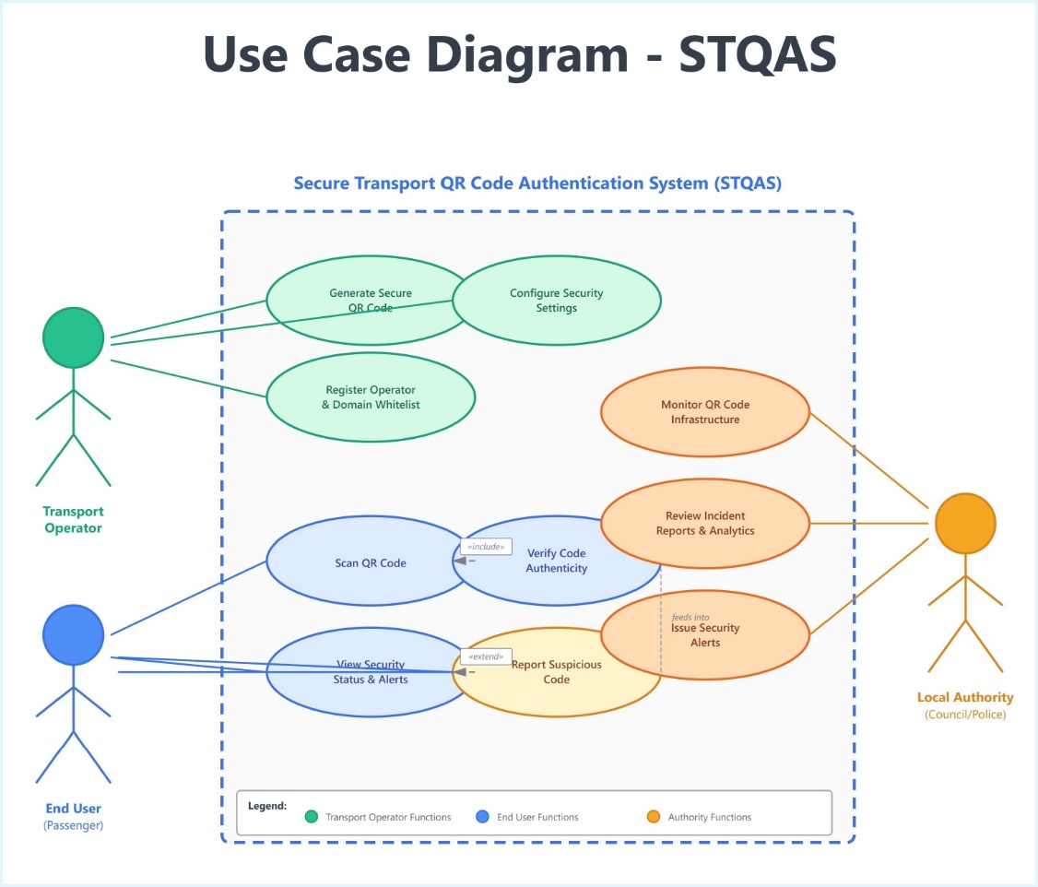
UML Design summary
Notes:
The STQAS ecosystem recognises three main actors as identified in the use case diagram, and their interactions with the system.

Slide 11
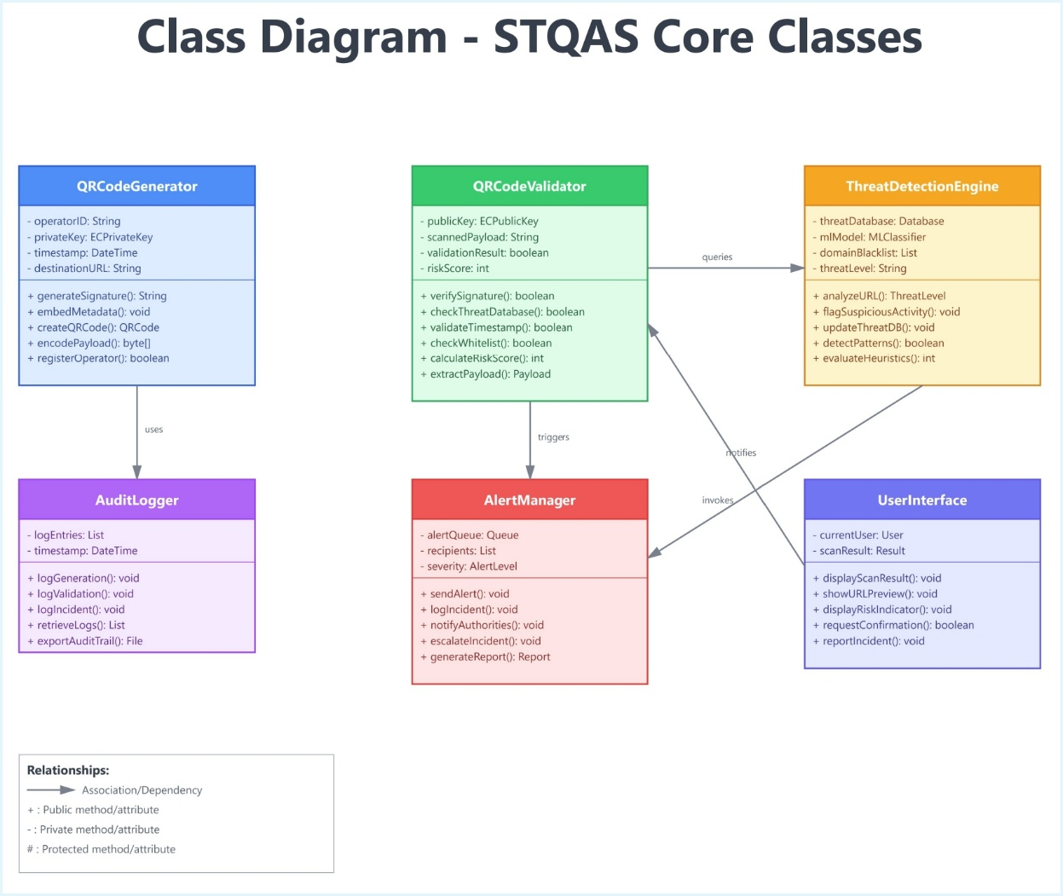
UML Design summary
Notes:
The STQAS ecosystem recognises three main actors as identified in the use case diagram, and their interactions with the system.

Slide 12
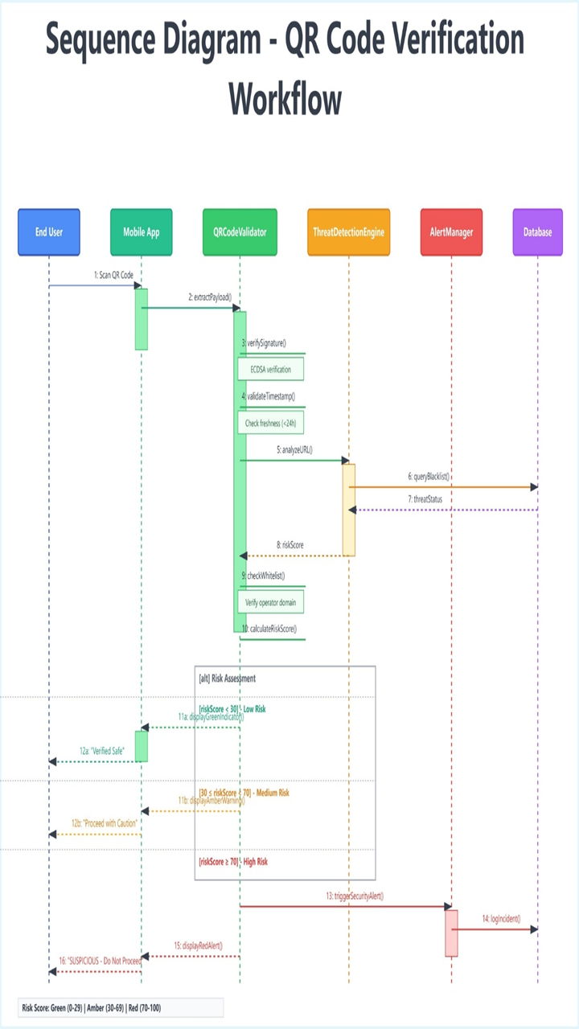
Sequence
Steps 1-5: First scan, extraction of payload, and verification of signature based on ECDSA with the use of public key infrastructure.
Steps 6-8: Checking of timestamps, checking of threat databases, and blacklist.
Steps 9-10 Whitelist verification and calculation of the overall risk score.
Processing steps 11-16: Three outcomes of the risk-based response:
- lowest risk ( 0-29): green signal, Verified Safe message.
- Medium Risk (30-69): Amber alert, have caution, message.
- High risk (70-100): Red alert, security incident registered, message "SUSPICIOUS - Do Not Proceed"
Notes:
The whole process is to be accomplished within less than 2 seconds and still, it should retain in-depth security inspections.

Slide 13
Technical Core components
Enhanced QR Code Generation
ECDSA signatures
SHA-256 hashing
Embedded metadata
Verification Layer
PKI-based signature checks.
Timestamp freshness (<24 hours)
Whitelist and threat database checks.
Threat Detection Engine
Machine Learning (ML) – based URL pattern analysis.
Heuristic anomaly detection.
Real-time intelligence feeds.

Slide 14
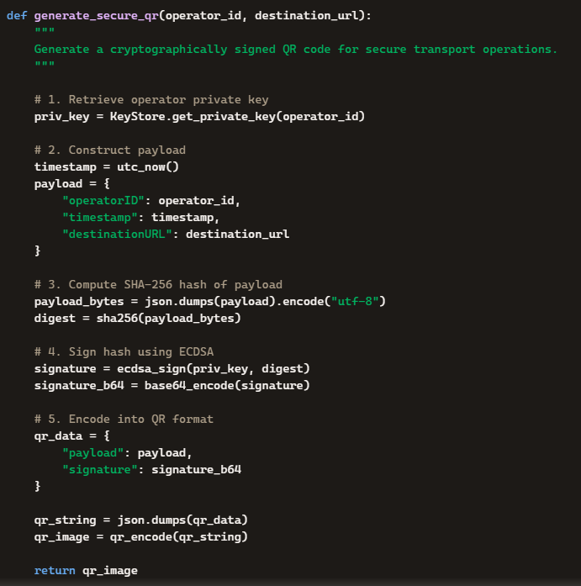
Key algorithm
Generation Algorithm
Retrieve private key
Construct payload
SHA-256 hash
ECDSA signature
Encode QR

Slide 15
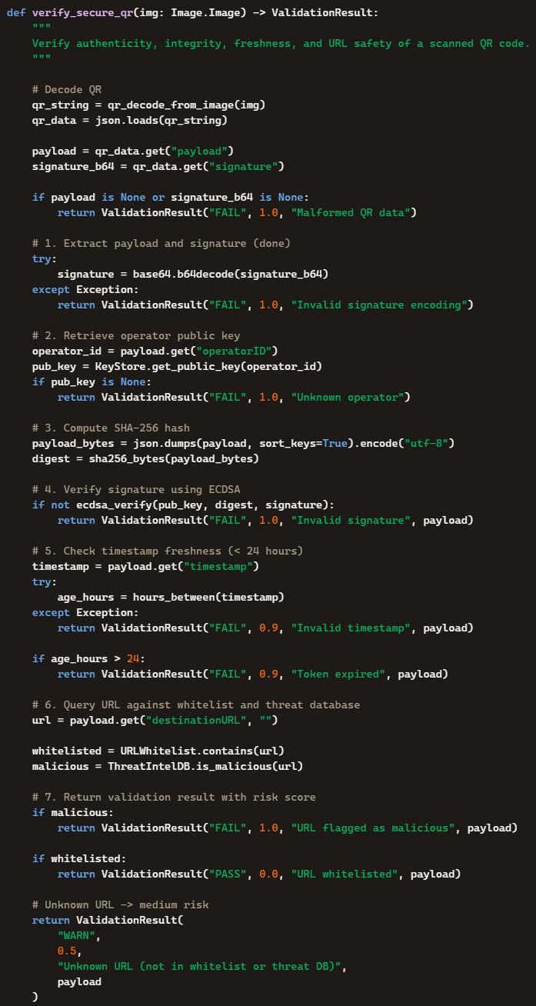
Key algorithm
Verification Algorithm
Extract payload.
Retrieve public key.
Verify signature.
Check timestamp.
Query whitelist and threat database.
Produce risk score

Slide 16

Security features
The security features of the STQAS system are:
URL preview with colour-coded indicators.
Domain whitelisting.
Real-time threat intelligence.
User confirmation and one-click reporting.
Multi-factor authentication for operators.

Slide 17

Testing and deployment plan
Phase 1: Piloted on a single transport hub with extensive monitoring.
Phase 2: Expanded to the network of one operator.
Phase 3: City-wide implementation with multiple operators.

Slide 18

Performance targets
Verification: Verification time should be less than 2 seconds.
False positives: This should be less than 1%
User Adoption: High

Slide 19
Conclusion
STQAS delivers:
Strong cryptographic assurance.
Real-time verification
Intelligent threat detection.
Policy-aligned deployment
Measurable uplift in public safety.

Slide 20

Thank you
Chijioke Igwe
2026
​

