Slide 1

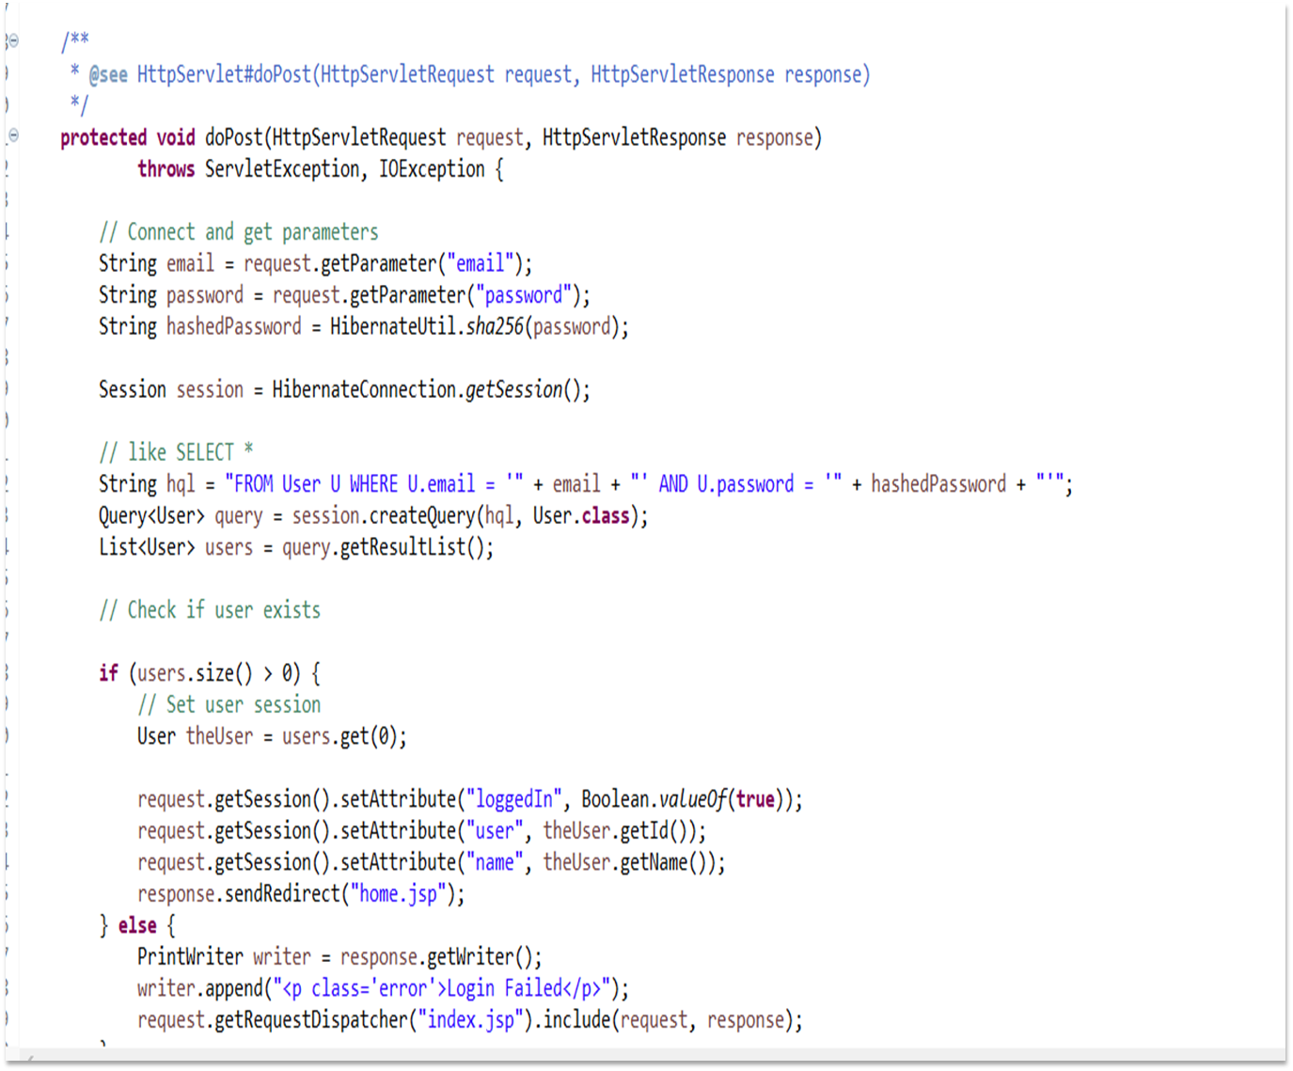
Login
First, we develop a login module that authenticate user based on email and password. To make it simple, index.jsp is our login page.
Whenever user enters the email and password and clicks the submit button, we call Login.java module to authenticate the user.
If users email and password is correct it will take the user to the home/ upload page.

Slide 2
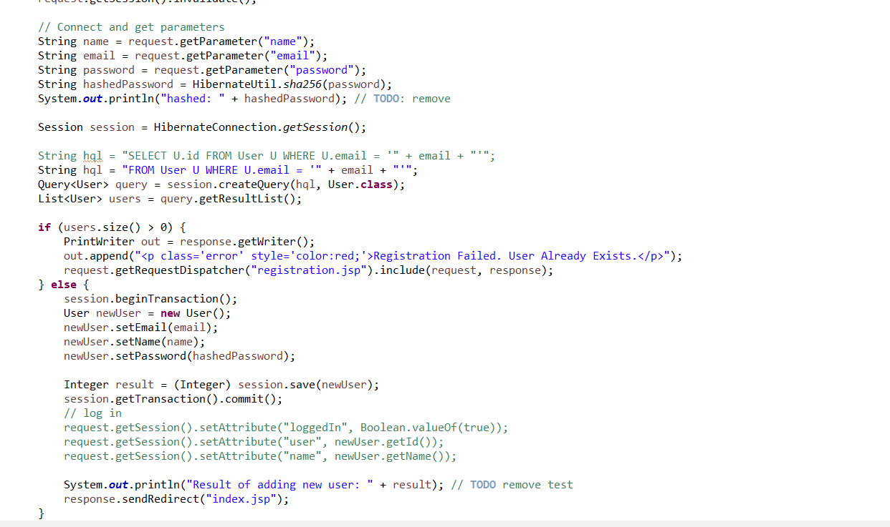
Register
First, we start on the Login page for User who are already Registered.
If the user doesn’t have an account already, user is going to click on the “Don't have an account yet? Make one here”
Once on the Register.jsp page the user enters their name, email, and create a password.
Then we connect and get parameters in Register.java file.
Then it checks to see if the new user has been set, works, and saved into the database.
When that is done it will take you back to the login page.
The passwords are not stored in the database as plain text.
They are hashed with SHA256 before being stored into the database.

Slide 3
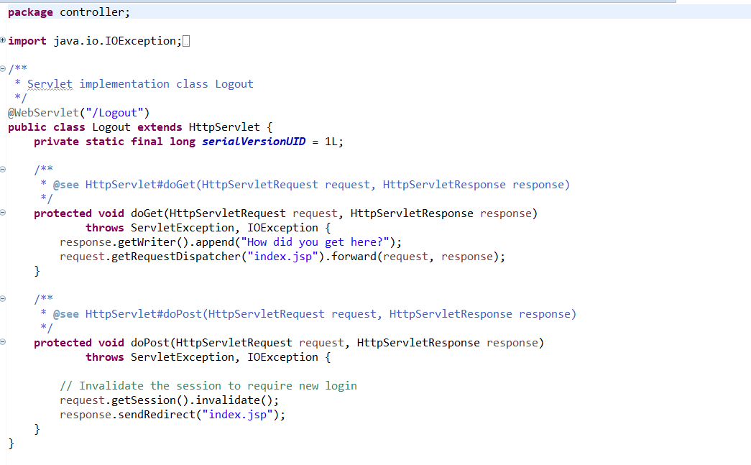
Logout
Once you’ve created an account and login there will be an option at the top to logout when you want to exit out of the home/ upload page.
When you click it you will be taken back to the login page.
So you have invalidated the session to require new login which is why user has been taken back to the login page.

