Slide 1

Team ALLIT 12/02/2014

Slide 2
Go Fish! Goals
Goal
To create a functional fishing game which will attract casual gamers.
Objectives
Will be a game where players can fish on a 2d map.
Will have play time divided into in-game fishing-days.
Will track player progress between sessions.
Will be easy and enjoyable to play.

Slide 3
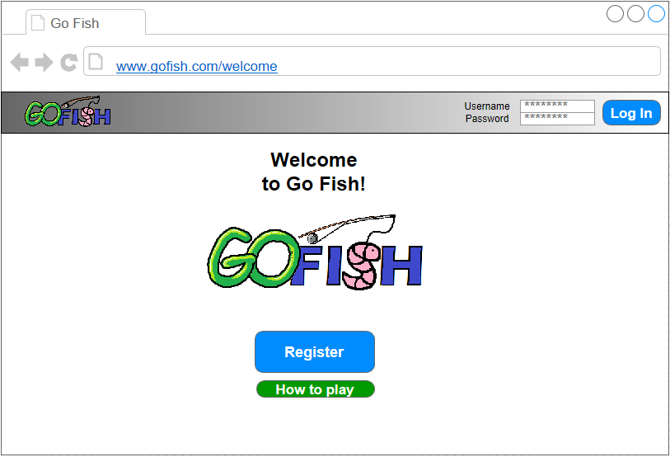
Go Fish! Welcome Screen
Log In Area
User will enter their log in details here, and use the button to log on to a game.
Register button
Allows users to register for a new account.
How to Play button
Takes user to instructions for the game
Red text indicates Inessential Features
Means partially Implemented
Means Implemented
Means not implemented

Slide 4
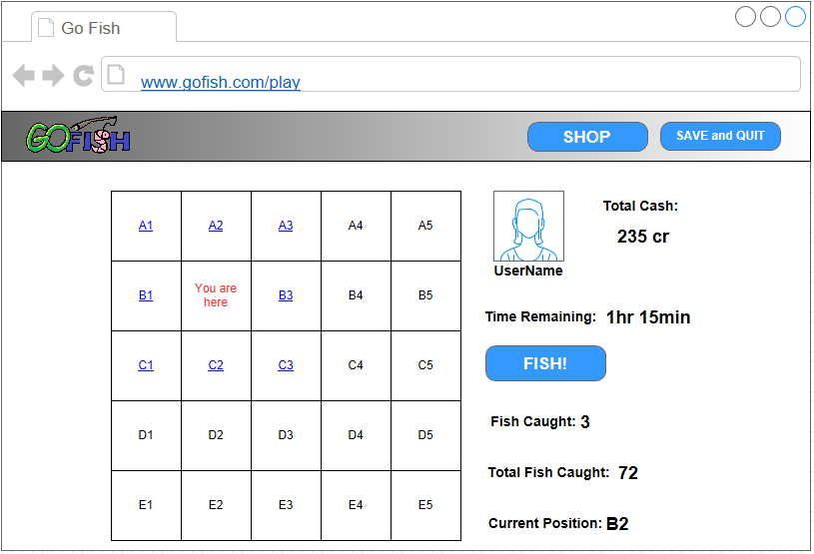
Go Fish! Game Screen
Save/Quit button
Allows user to quit the game, saving their progress
Profile info
Users profile picture, username and balance
Time remaining
Round is over when this runs out
Fish button
Allows a user to fish in current square
Round info
Number of fish caught, total fish and current location
Game map
Allows navigation to new fishing location.
Shop button
Allows access to shop for upgrades

Slide 5
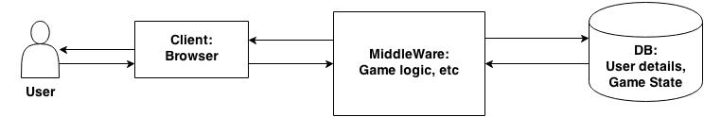
Go Fish! Architecture
User will interact with the game via their browser.
Middleware handles the game logic (django, python).
Database will store the users session information, game state, profile, etc (SQLite).

Slide 6
Go Fish! ER Diagram
User
1:1
has
N:1
Rod
1:1
1:1
has
N:1
Boat
1:N
1:1
has
N:1
Bait
plays
has
N:1
Trophy Fish
1:1
Game
1:N
consists of
Achievements
1:1

Slide 7
Go Fish! ER Diagram
User | Game | Items (Rod, Boat, Bait) | Trophy Fish | Achievements
User ID VARCHAR (15) Login VARCHAR (30) Avatar BINARY FIELD Achievements VARCHAR(30) Inventory VARCHAR (2) Money NUM (15) Amount of fish NUM (12) Login dates SMALLDATETIME(multi-valued) Rank NUM (3) (multivalued) Boat VARCHAR (30) Means of fishing VARCHAR (30) Bait VARCHAR (30) | Distribution of fish NUM (1) (multivalued) Fish caught NUM (1) (multivalued Current time NUM (2) Location NUM (1) Map VARCHAR (10) (multivalued) | Name VARCHAR (30) Category VARCHAR (30) Cost NUM (7) Multiplier Value FLOAT (5) Level NUM(2) | Name VARCHAR (30) Value NUM (4) | Name VARCHAR (30) Trophy Fish 1 VARCHAR (30) Trophy Fish 2 VARCHAR (30) Trophy Fish 3 VARCHAR (30) Trophy Fish 4 VARCHAR (30) Trophy Fish 5 VARCHAR (30)

Slide 8
Go Fish! Standout Features
Player movement on 2d grid – seek the fish, seek your destiny…
Unpredictable placement of fish – new adventure every time!
Sell fish to buy incredible items and master the waves!
Win fame and honour by earning achievements.
Multiple maps – fish where you want!
Save on exit – fish when you want!
Probably the best game
… In the World!

Slide 9
Go Fish!
Any Questions?

Slide 10
Go Fish! MoS
Must | Should
2-dimensional fishing grid Randomised fish count per square Linearly, with each click, depleting fish Minimal player equipment: default rod, boat, bait 5-hour fishing day Default fishing time – 15 minutes Moving on the grid takes 30 minutes per square Fish stored between sessions | Graphical map instead of grid Automatic fish sale by the end of the day Shop: different baits, rods, nets, boats (small selection) can be purchased with player money Fishing time/results depending on equipment used: “the more you spend the more you get“ Player can upload avatar Player can access shop during the day for the total movement time cost Ranking based on total fish count Player register Player login screen Player money stored between sessions Player equipment stored between sessions

Slide 11
Go Fish! CoW
Could | Won‘t
Several maps Shop: different baits, rods, nets, boats (big selection, e.g. dynamite, sonar) Implementation of dynamite & sonar (minimal): basic functionality Complex “battleship“ spawn algorithm Ultra-rare, not-for-sale trophy fish different for each map Trophy fish collections/achievements Achievements completeness player ranking Ranking based on best fish count per time played Collections stored between sessions | Treasure: boots, chests Player trade of trophy fish Pirating at risk of notoriety (coast guard fees) Implementation of dynamite & sonar (extensive): e.g. players who use dynamite have to move away quickly or boat will explode, environmentalist try to sabotage players who use dynamite, sonar shows previously hidden, random yielding spots Catching and selling dolphins and whales makes player rich, but increases risk of sabotage Message in a bottle: instant messaging between players Player info pages accessible with registered account

Slide 12

Persona 1: Keyleigh Casualgamer
Personal | Age: 23 Gender: Female Education: Standard grades
Professional | Occupation: Call centre agent Job experience: 4 years Needs, interests, and goals: Astrology, shopping, stress management Environment: During breaks at work, after work
Technical | Devices owned: Smartphone, desktop computer Regularly used software/apps: Yahoo, Facebook, FarmVille, Sims Time spent online per day: 3 hours
K. is single and dreams of romance with the people she has to call during office hours. The continuous demand to converse is very draining, and she tends to be so worked up by the time she arrives back home that she wants nothing more than a no frills, relaxing game with guaranteed rewards.

Slide 13
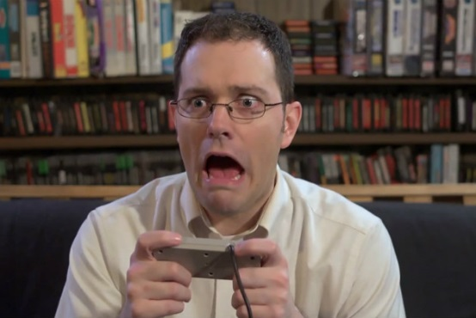
Persona 2: Percy Powergamer
Personal | Age: 35 Gender: Male Education: Bachelor
Professional | Occupation: Insurance salesman Job experience: 11 years Needs, interests, and goals: Precision, achievements, control, regularity Environment: Weekend, at home
Technical | Devices owned: Smartphone, Xbox, laptop, tablet, desktop computer Regularly used software/apps: Excel, SPSS, Minesweeper, Eve Online, StarCraft, XCOM Time spent online per day: 4 hours
P. loves games, but sadly his job and family (his wife & two children) keep him from playing during the week. He is a strategically minded person who delves into theorycraft before he starts playing. He enjoys getting the most out of a game - which to him means the best possible performance.

Slide 14
Go Fish! User Needs Matrix
 |  | USER GROUP
TASK | PRIORITY | CASUAL | PRO
Convenient access to game | 5 | High | High
Challenging game play | 3 | Low | High
Satisfying game play | 5 | High | High
Achievements (such as trophies) | 3 | Low | High
Analysis of scores | 2 | Low | High

Slide 15
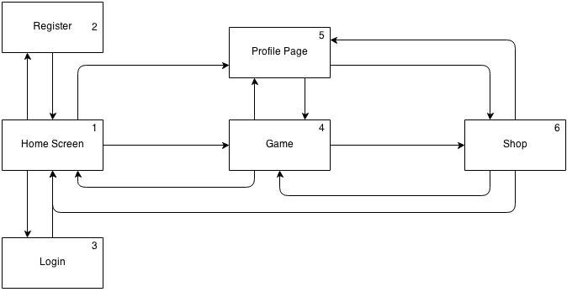
Go Fish! Site Map/URL’s
www.gofish.com/ 5. www.gofish.com/profile
www.gofish.com/register 6. www.gofish.com/shop
www.gofish.com/login
www.gofish.com/play

